Slide 1
CPSC 535: Advanced Algorithms
Instructor: Dr. Doina Bein

Slide 2
Importance of Sorting
https://users.cs.duke.edu/~reif/courses/alglectures/skiena.lectures/lecture4.1.pdf

Slide 3
Sorting problem
The sorting problem’s lower bound is 𝜴(n log n), which means that every algorithm that solves the sorting problem has time complexity O(n log n) or slower.
Theorem: The sorting problem has a lower bound of 𝜴(n log n) that applies to all comparison-based sorting algorithms.
But there are sorting algorithms with O(n) time complexity. How?
If we sort without comparisons, i.e. without comparing entire elements with each other, but maybe parts of it, for example digits of it
Counting sort, radix sort, and bucket sort, all have O(n)
(Chapter 8 of CLRS)

Slide 4
Counting Sort (https://users.cs.duke.edu/~reif/courses/alglectures/demleis.lectures/lec5.pdf)
No comparisons between elements
Input: A[1..n], an array with n elements to be sorted such that the elements are drawn from A[j] ∈ {1, 2, …, k} Output: B[1..b] (which is the sorted A) Auxiliary storage: C[1..k]
Algorithm:
for i=1 to k do C[i] = 0
for j=1 to n do
C[A[j]] = C[A[j]] + 1 // C[i] = |{ key == i }|
for i=2 to k do
C[i]=C[i] + C[i-1] // C[i] = |{ key ≤ i }|
for j=n downto 1 do
B[C[A[j]]] = A[j]
C[A[j]] = C[A[j]] - 1

Slide 5
More on Counting Sort
See the slides 13 through 27 at https://users.cs.duke.edu/~reif/courses/alglectures/demleis.lectures/lec5.pdf
Time complexity: O(n+k); if k = O(n) then counting sort takes O(n). Why?
Because counting sort is not a comparison-based sort. No comparison takes place between elements.
Counting sort is a stable sort: it preserves the input order among equal elements. What other sorting algorithm is stable? Answer: mergesort.

Slide 6
Radix Sort
Origin: Herman Hollerith’s card sorting machine for US census in 1890.
It is a digit by digit sort, sorting on least significant digit first using some auxiliary stable sort; Hollerith’s idea was to sort starting with the most significant digit which is bad.
Two elements are not compared by their whole value, but by their digits
Read the slides 32 through 35 at https://users.cs.duke.edu/~reif/courses/alglectures/demleis.lectures/lec5.pdf
Radix sort has O(d⋅n) time where the values to be sorted are in the range 0..n^{d}-1 (i.e. at most d digits)

Slide 7
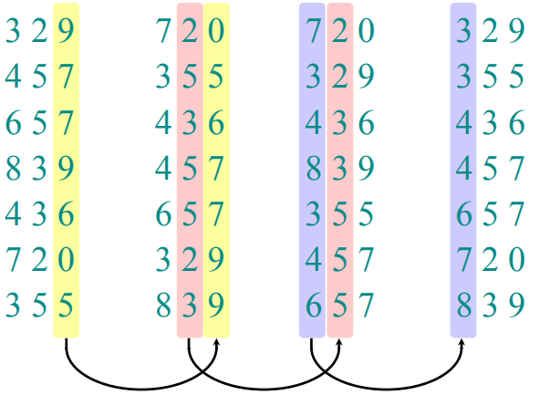
Example

Slide 8
Bucket Sort
Assumes that the input is drawn from a uniform distribution over the interval [0,1), i.e. the input is generated by a random process that distributes elements uniformly and independently over the interval [0,1)
Input: n numbers from the interval [0,1), uniformly distributed
Output: sorted n values
Bucket sort steps:
Divide the interval [0,1) into n equal-sized subintervals (or buckets)
Distribute each input value into the corresponding bucket
Simply sort the numbers in each bucket
Go through the buckets in order, listing the elements in each

Slide 9
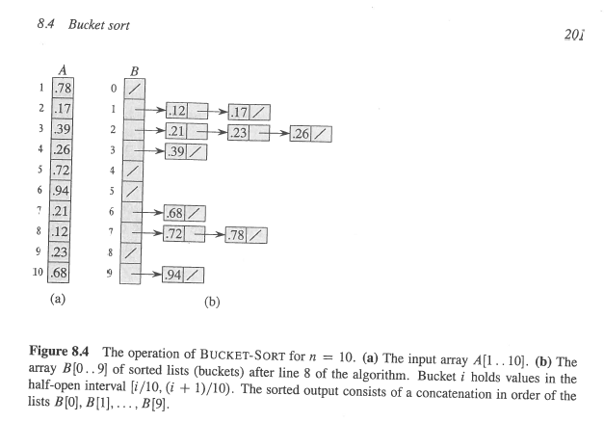
Example

Slide 10
Bucket Sort (contd.)
We expect few numbers (i.e. a constant number) in each subinterval
We use insertion sort to sort the elements in each subinterval, which is O(1) expected
Average-case is Θ(n) as long as the sum of the squares of the bucket sizes is linear in the total number of elements

