Slide 1
CPSC 535: Advanced Algorithms
Instructor: Dr. Doina Bein

Slide 2
Fundamental Data Structures
Short review of them
The open content book available at http://opendatastructures.org/ covers them in detail
PDF version: http://opendatastructures.org/ods-python.pdf
HTML version: http://opendatastructures.org/ods-python/
The book is geared towards a Python implementation of these data structures, but the fundamentals are the same, independent of the implementation
Other websites about teaching introductory computer science algorithms, including searching, sorting, recursion, and graph theory:
https://www.khanacademy.org/computing/computer-science/algorithms

Slide 3
Abstract Data Types (ADT)
An abstract data type (ADT) is a set of objects that are related to each other together with a set of operations:
Description of the objects that compose the data type
Description of the relationships between the individual objects
Description of the operations to be performed on the objects
An ADT is a mathematical abstraction: nowhere in its definition is any mention of how the operations are implemented
Familiar examples of data types: integers, reals, booleans, arrays.
Examples of ADT: lists, sets, graphs, trees, along with their operations

Slide 4
ADT versus Its Implementation
The familiar examples of data types are built-in in programming language (you do not need to worry about their implementation; it is already done)
An ADT is language-independent and must be implemented in an appropriate computer language
Difference between an abstract data type (ADT) and the implementation: how each ADT functions and not how is implemented
An ADT may be implemented in several ways using the same programming language
If an implementation is done correctly, the program that use them does not necessarily need to know which implementation was used => information hiding

Slide 5
Operations on Data Types
Data type Integers: addition (+), subtraction (-), multiplication (*), integer division (/), comparisons (<, <=, >, >=, ==, !=) etc.
Data type Reals: addition (+), subtraction (-), multiplication (*), division (/), comparisons (<, <=, >, >=, ==, !=) etc.
Data Type Booleans: and (&&), or (||), not (!).
Data Type Array: fetch and store using []

Slide 6
Array ADT
An array is a sequence indexed by a system of integer coordinates
The system of indexes is used to access elements and to permit alteration of individual elements.
The elements can be accessed directly in Θ(1) time (constant time)
The type array is built in any high level programming language, but we can still define our own type array and implement it in a different way
Two integers m and n, m:n denotes all integers in the range m..n
In a k–dimensional array A, the index i_{j} in the dimension j ranges between m_{j}:n_{j}: A[i₁,i₂,…i_{k}] is the element of array A with index (i₁,i₂,…i_{k})
To store a k-dimensional array A[m₁:n₁, m₂:n₂,…, m_{k}:n_{k}] in memory the obvious way is to store it using consecutive memory cells
Notes:
taken from Thomas A. Standish, Data Structure Techniques, 1990, pages 348-350

Slide 7
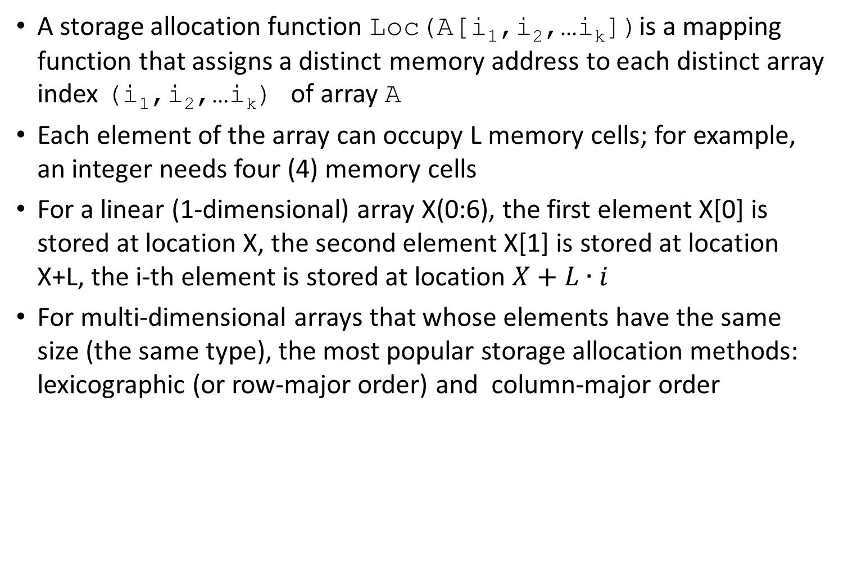
Notes:
taken from Thomas A. Standish, Data Structure Techniques, 1990, pages 348-350

Slide 8
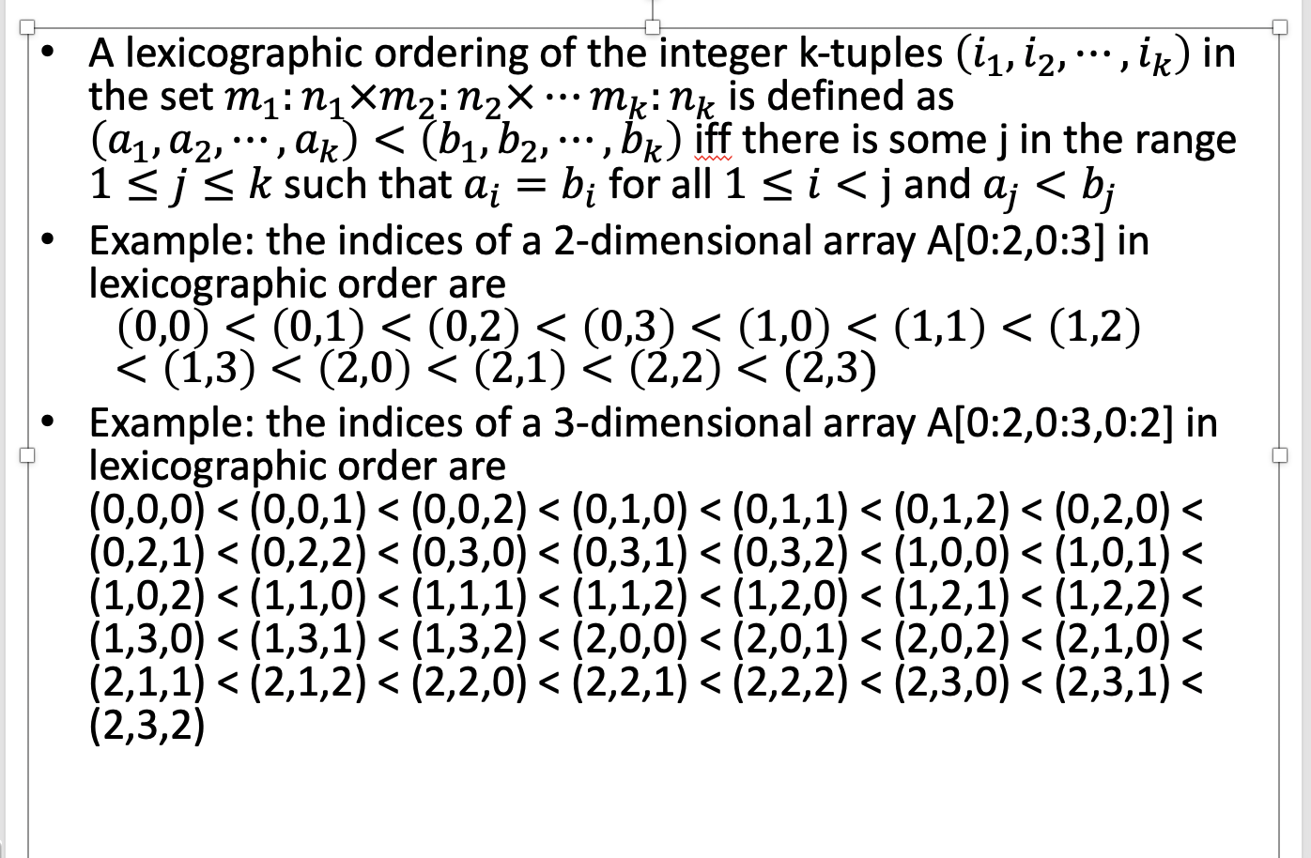
Lexicographic (Row-Major) Storage Allocation
Notes:
taken from Thomas A. Standish, Data Structure Techniques, 1990, pages 351-

Slide 9
If we display the elements of A[0:2,0:3] as a rectangular array (see below) then lexicographic storage (see right) means that first row 0 of A is stored in locations 0:3, then row 1 of A is stored in locations 4:7, and finally row 2 of A is stored in locations 8:11. Thus the name row-major order.
Location | Array element
0 | A[0,0]
1 | A[0,1]
2 | A[0,2]
3 | A[0,3]
4 | A[1,0]
5 | A[1,1]
6 | A[1,2]
7 | A[1,3]
8 | A[2,0]
9 | A[2,1]
10 | A[2,2]
11 | A[2,3]
A[0,0] | A[0,1] | A[0,2] | A[0,3]
A[1,0] | A[1,1] | A[1,2] | A[1,3]
A[2,0] | A[2,1] | A[2,2] | A[2,3]

Slide 10
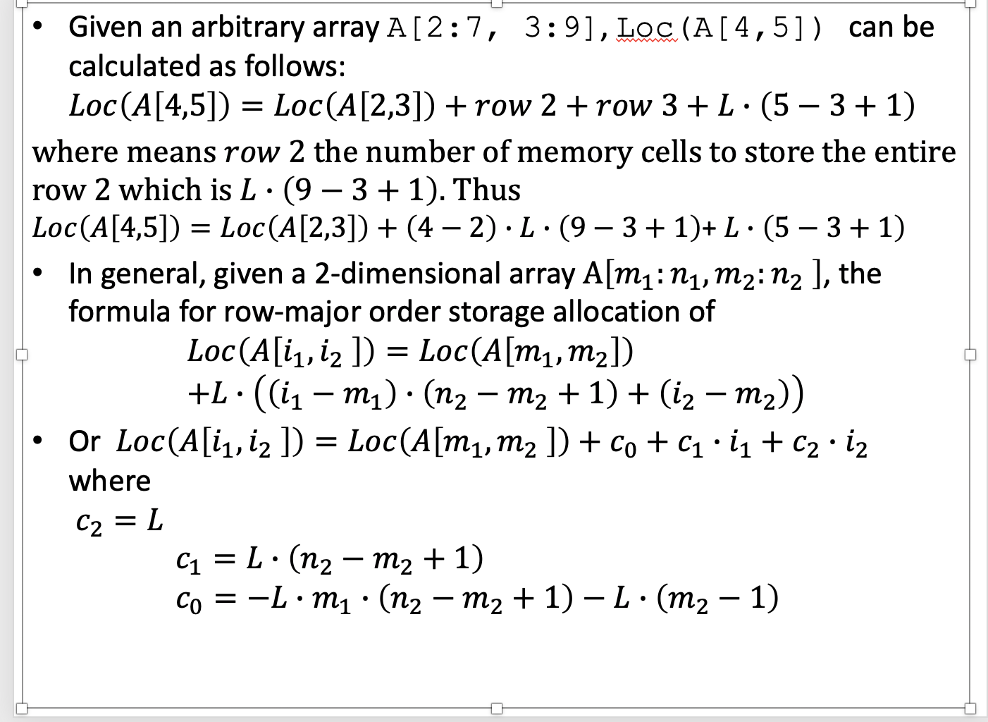

Slide 11
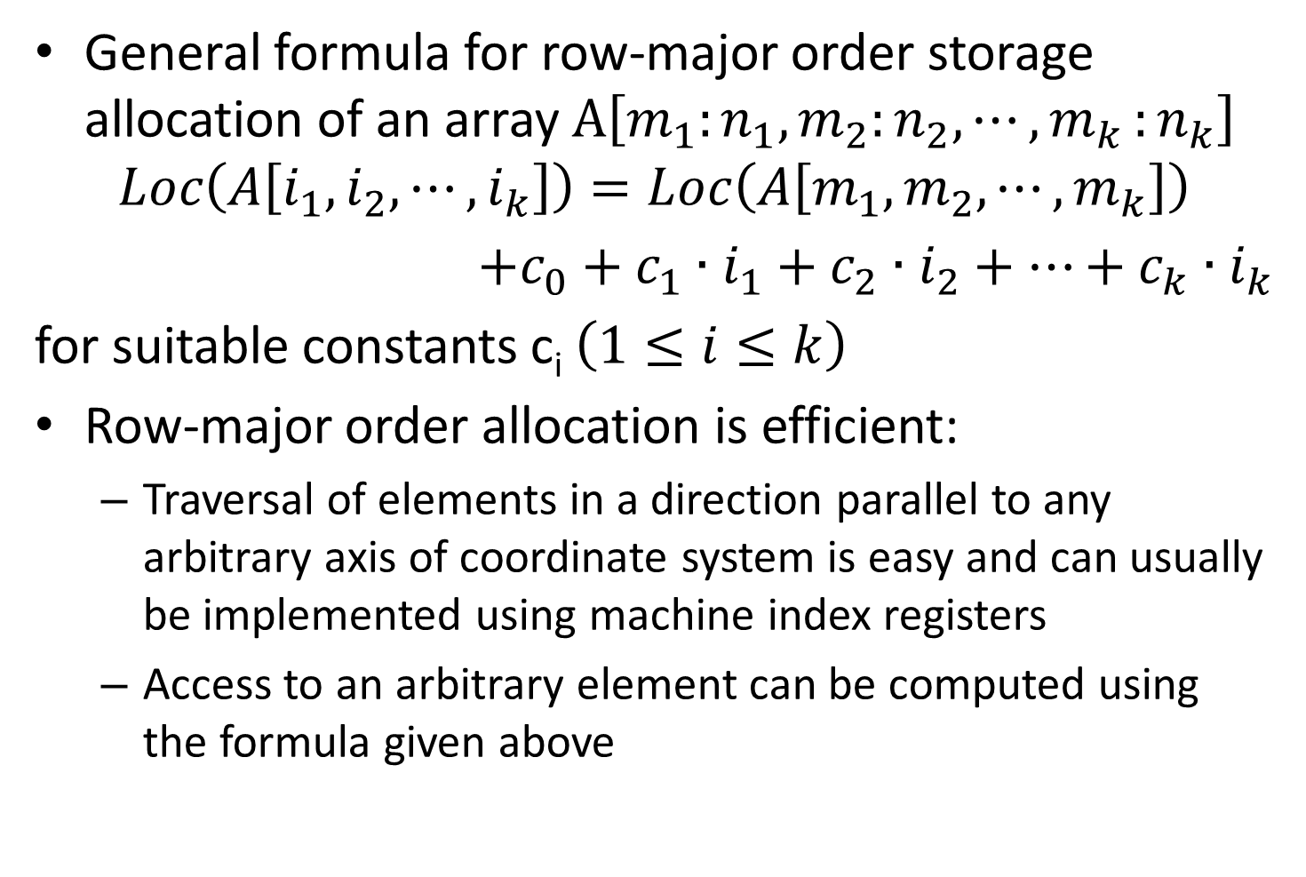

Slide 12
Column-major Storage Allocation
If we display the elements of A[0:2,0:3] as a rectangular array (see below) then column-major order storage (see right) means that first column 0 of A is stored in locations 0:2, then column 1 of A is stored in locations 3:5, then column 2 of A is stored in locations 6:8, and finally column 3 of A is stored in locations 9:11.
Location | Array element
0 | A[0,0]
1 | A[1,0]
2 | A[2,0]
3 | A[0,1]
4 | A[1,1]
5 | A[2,1]
6 | A[0,2]
7 | A[1,2]
8 | A[2,2]
9 | A[0,3]
10 | A[1,3]
11 | A[2,3]
A[0,0] | A[0,1] | A[0,2] | A[0,3]
A[1,0] | A[1,1] | A[1,2] | A[1,3]
A[2,0] | A[2,1] | A[2,2] | A[2,3]

Slide 13
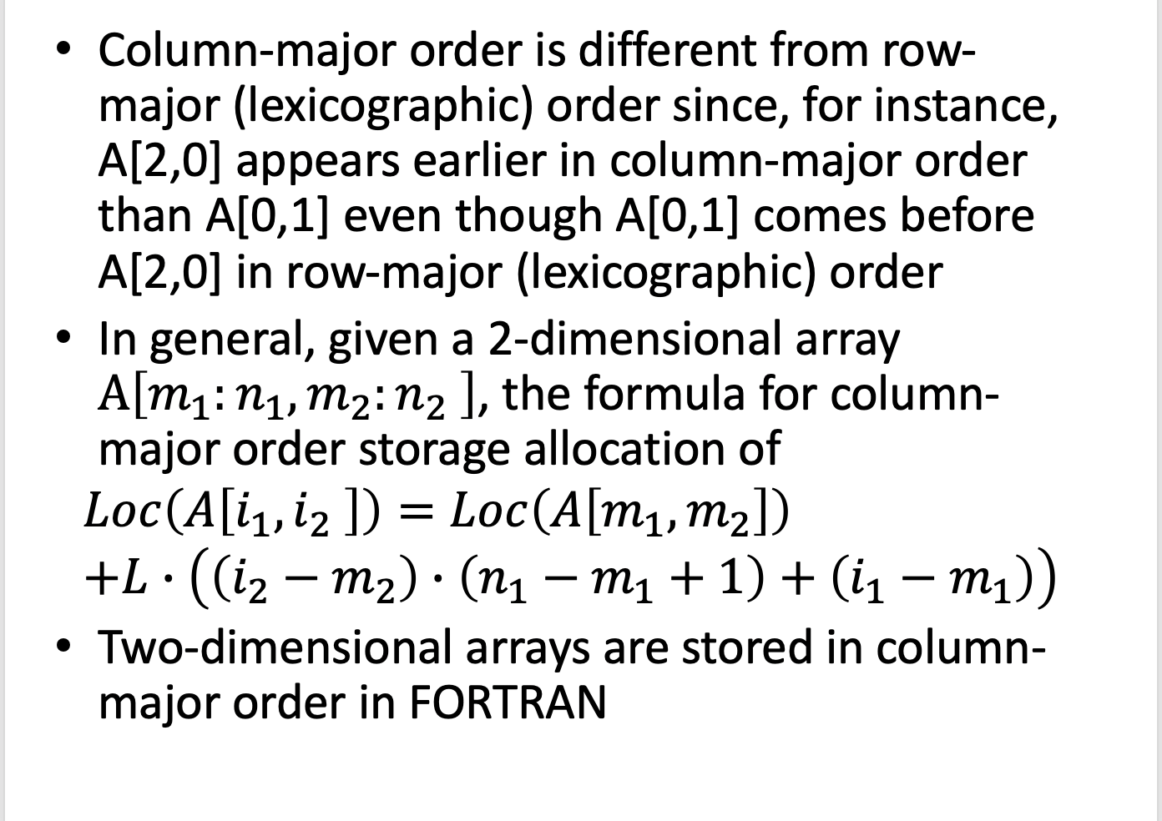

Slide 14
Sparse Array ADT
A sparse array is simply an array most of whose entries are nil (or 0 or some other default value)
Example: Suppose you wanted a 2-dimensional array of course grades, whose rows are CSUF students and whose columns are courses
There are about 45,000 students (a fact)
There are about 3,000 courses (assumption, I could not find the number of courses)
This array would have about 135,000,000 entries
Since most students take fewer than 3000 courses, there will be a lot of empty spaces in this array
This is a big array, even by modern standards
There are ways to represent sparse arrays efficiently
Notes:
taken from http://www.cis.upenn.edu/.../45-sparse-arrays.ppt

Slide 15
We will start with sparse one-dimensional arrays, which are simpler
0
1
2
3
4
5
6
7
8
9
10
11
ary
0
0
0
0
17
0
0
23
14
0
0
0
We could represent it as a linked list
ary
4
17
7
23
8
14
We need to get values from the array by operation fetch <element type> fetch(int index)
which searches a linked list for a given index
And to store values in the array by operation store void store(int index, <element type> value)
which searches a linked list for a given index and inserts the element in the list

Slide 16
Implement the Sparse Array ADT in Java
class List {
int index; // the index number Object value; // the actual data List next; // the "pointer"
public Object fetch(int index) { List current = this; // first "List" (node) in the list do { if (index == current.index) { return current.value; // found correct location } current = current.next; } while (index < current.index && next != null); return null; // if we get here, it wasn't in the list }
}
The store operation is basically the same, with the extra complication that we may need to insert a node into the list

Slide 17
Although “stepping through an array” is not a fundamental operation on an array, it is one we do frequently
for (int i = 0; i < array.length; i++) {...}
We have a list, and all we need to do is step through it.
Expand the ADT by adding operations
An interface, in Java, is like a class, but
It contains only public methods (and maybe some final values)
It only declares methods; it doesn’t define them
Example: public interface Iterator { // Notice: no method bodies public boolean hasNext( ); public Object next( ); public void remove( ); }
This is an interface that is defined for you, in java.util

Slide 18
Example:
public class SparseArrayIterator implements Iterator {
private List current; // pointer to current cell in the list
SparseArrayIterator(List first) { // the constructor current = first; }
public boolean hasNext() { return current != null; }
public Object next() { Object value = current.value; current = current.next return value; };
public void remove() { // We don't want to implement this, so... throw new UnsupportedOperationException(); }
}

Slide 19
Data Structures
Data Structure: method for storing, organizing data
Data members e.g. head pointer, tail pointer
Invariant(s) defining how the structure must be organized to remain valid, e.g. head points to first node, tail points to last node
Defined operations, each operation is an algorithm that operates on the structure.

Slide 20
Dynamic Sets
Sets that can change over time are called dynamic
A dictionary is a dynamic set that supports the following operations: insert elements into, delete elements from, test membership in a set.
Other operations can be supported
Each element in a set is represented by an object whose fields can be examined and manipulated
Some types of dynamic sets assume that one of the object’s field is an identifying key field (aka key)
Some types of dynamic sets assumes that the keys are drawn from a totally ordered set (e.g. real numbers, all words in a dictionary under the usually alphabetic ordering)

Slide 21
Operations on Dynamic Sets
The operations can be grouped into two types:
Queries: return info about the set, an element in the set, or a group of elements in the set
Modifying operations: change the set
Typical operations for a set S:
Search(S, k): given S and a key value k, return a pointer x to an element in S whose key is k (key[x]=k) or NIL, if S does not contain such an element (query)
Insert(S,x): augment S with the element pointed by x, assuming that all the fields in x have been initialized (modifying op.)
Delete(S,x): given a pointer x to an element of S, remove x from S (modifying op.). Note: x is a pointer and not a key value. (modifying op.)
Minimum(S,x): given a totally ordered set S, return the element of S with the smallest key value (query)

Slide 22
Operations on Dynamic Sets
Maximum(S,x): given a totally ordered set S, return the element of S with the largest key value (query)
Successor(S,x): given an element x whose key is from a totally ordered set S, return the next larger element in S, or NIL if x is the maximum element (query)
Predecessor(S,x): given an element x whose key is from a totally ordered set S, return the next smaller element in S, or NIL if x is the minimum element (query)
Successor and Predecessor can be extended to sets with non-distinct keys

Slide 23
Priority Queue
A priority queue is a list (an ADT) that maintains S elements, each with an associated value called a key
A max-priority queue supports the following operations:
Init(S):Initialize the priority queue to be empty.
Is_empty(S):Test to see whether the priority queue is empty.
Insert(S,x): inserts the elements x into the set S. It can be written 𝑆=𝑆∪{𝑥}
Maximum(S): returns the element of S with the largest key
Extract-max(S): removes and returns the element of S with the largest key
Increase-key(S,x,k): increases the value of element x’s key to the new value k, which is assumed to be at least as large as x’s current key value

Slide 24
Priority Queue
Stacks, queue, heaps (min heap and max heap) are examples of a priority queue:
In a stack, the priority item is the most recently inserted item (called the top).
In a queue, the priority item is the least recently inserted item (insert at front; peek and delete from rear)
In a heap, the priority item is the item with the minimum (or maximum) key. The key could be anything.

Slide 25
Example: The items of a PQ are unfulfilled obligations.
The Bill Payer problem: You get bills in the mail from time to time, and you have to pay them. But you don't pay bills the moment you receive them: instead, you place them on your desk, where they are unfulfilled obligations. When you decide to pay a bill, you take one from your desk and pay it.
The stack strategy: When you get a bill, you place it on the top of your pile of bills. When you decide to pay a bill, you pay the one on top, i.e., the one you got most recently.
The queue strategy: The bill you pay is the one that's been on your desk the longest. One way to do this is to insert every new bill at the bottom (rear) of the pile, and take from the top (front) of the pile.
The heap strategy: Every bill has a due date. When you decide to pay, you pay the bill that has the earliest due date. How would you implement this in practice?

Slide 26
Stack (aka LIFO queue) operation | Worst Case
Create an empty stack | O(1)
Push an element into the stack | O(1)
Return the top element of the stack | O(1)
Pop and return the top of the stack | O(1)
Test whether the stack is empty | O(1)
Can I do the following operations?
Return the bottom of the stack. Answer: NO
Test whether an element is in the stack. Answer:
YES: I can only test the top element
NO: I cannot check the entire stack

Slide 27
Queue (FIFO queue) operation | Worst Case
Create an empty queue | O(1)
Push an element into the queue | O(1)
Return the rear of the queue | O(1)
Pop the queue | O(1)
Pop and return the rear of the queue | O(1)
Test whether the queue is empty | O(1)
Can I do the following operations?
Return the front of the queue. Answer: NO. (Technically, I can do it since I have access to the front of the queue, but it violates the property of a queue ADT, when only the element at the rear of the queue can be returned.)
Test whether an element is in the queue. Answer:
YES: I can only test the rear element
NO: I cannot check the entire queue

Slide 28
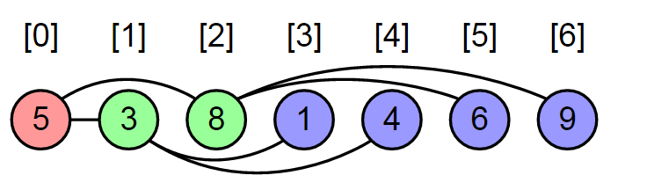
Heaps
A (binary) heap is a complete binary tree and the nodes in the tree follow a heap-order property.
A complete binary tree is completely filled except maybe the lowest level, which is filled from left to right.
A complete binary tree can be represented as an array : array A has length[A] elements but only the indices 0.. heapsize[A] are used for the heap.
The root of the tree is stored at A[0]
Given the index i of a node:
A[(i-1)/2] stores the parent of i, Parent(i)
A[2*i+1] stores i’s left child Left(i) and
A[2*i+2] stores i’s right child Right(i)

Slide 29
Heap-order property:
A tree follows the heap-order property if it follows either the max-heap or the min-heap property.
A tree follows the max-heap order property if the value stored at every node x is ≤ the value stored at the parent of x, except the root which has no parent: A[Parent(i)] ≥ A[i] or A[(i-1)/2] ≥ A[i]
A tree follows the min-heap property if the value stored at every node x is ≥ the value stored at the parent of x, except the root which has no parent: A[Parent(i)] ≤ A[i] or A[(i-1)/2] ≤ A[i]

Slide 30
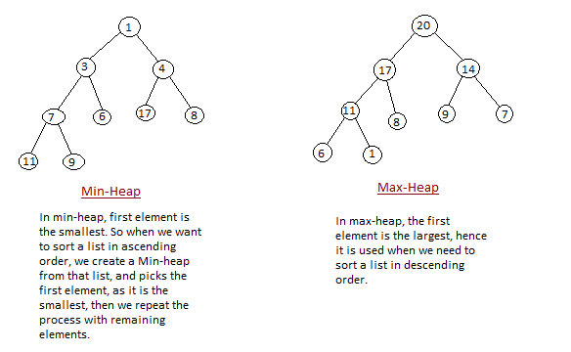
Figures taken from
http://www.studytonight.com/data-structures/heap-sort

Slide 31
Maintaining the Heap Property for max-heaps:
If an element A[i] violates the max-heap property w.r.t. its left child i.e. A[i] < A[2*i+1] and/or w.r.t its right child A[i] < A[2*i+2] but the subtrees rooted at Left(i) and Right(i) are max-heaps, then A[i]needs to be push down the tree

Slide 32
Min-heap operation | Worst Case
Create an empty heap | O(1)
Convert an unsorted list into a heap in-place | O(n)
Push an element into the heap | O(log n)
Find the minimum element into the heap | O(1)
Pop the minimum element out of the heap & restructure heap | O(log n)
Return the top of the heap (aka the minimum element) | O(1)
Pop, return the top of the heap & restructure heap | O(log n)
Test whether the heap is empty | O(1)

Slide 33
Linked Lists
A list is a finite sequence of items drawn from some set
The simple linked lists are singly or doubly:
A singly linked list is a list in which each element points to its successor; a list item stores an element and a pointer to its successor
FIRST
Item 1
Item 2
Item 3
Item 4
In a doubly linked list, each element points to its successor and to its predecessor; a list item stores an element and two pointers, one to its successor and one to its predecessor
Item 1
Item 2
Item 3
Item 4
FIRST

Slide 34
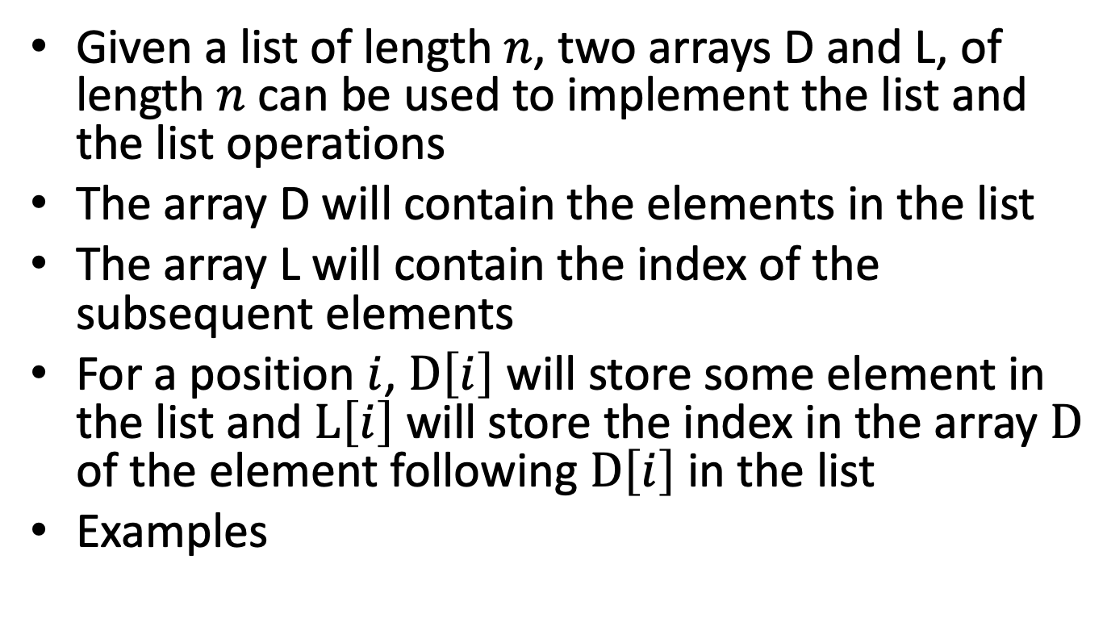
Implementing the list using arrays

Slide 35
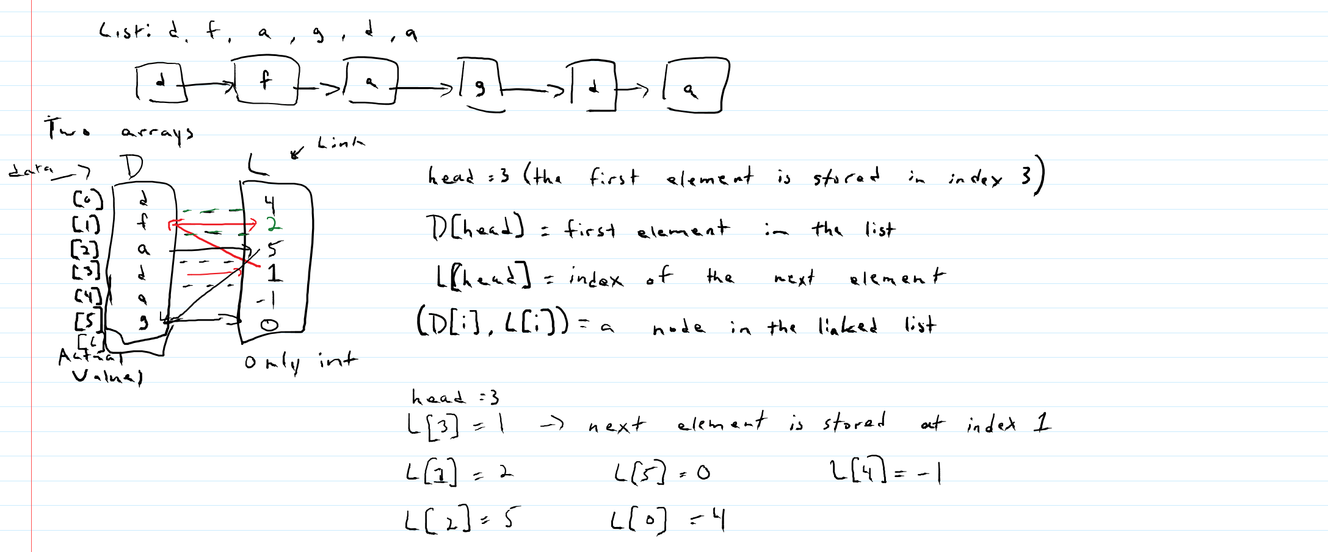

Slide 36
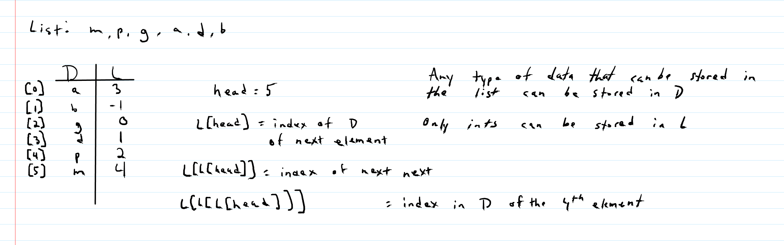

Slide 37
List operation | Worst Case
Create an empty list | O(1)
Test whether the list is empty | O(1)
Insert an element in the list at the head | O(1)
Insert an element anywhere besides the head | O(n)
Insert an element at the end when the tail is maintained
Insert an element at the end when the tail is not maintained | O(n)
Search for an element based on its value (key) | O(n)
Delete an element in the list based on its value (key) | O(n)
The delete operation is based on which operation? (Answer: search)

Slide 38
Skips Lists (taken from http://u.cs.biu.ac.il/~amir/DS/w3_skip_lists_biu.ppt and https://users.cs.duke.edu/~reif/courses/alglectures/demleis.lectures/lec12.pdf )
A skip list is a data structure for dictionaries that uses a randomized insertion algorithm
Invented by William Pugh in 1989
In a skip list with n entries
The expected space used is O(n)
The expected search, insertion and deletion time is O(log n)
Skip lists are fast and simple to implement in practice

Slide 39
From list to skip list
Start from simplest data structure: (sorted) linked list
Search takes Θ(n) time in worst case
How can we speed up searches?
Suppose we had two sorted linked lists (on subsets of the elements)
Each element can appear in one or both lists • How can we speed up searches?
12
23
26
31
34
44
56
64
78
23
31
34
64
12
23
26
31
34
44
56
64
78

Slide 40
Linked lists as subway lines
IDEA: Express and local subway lines (à la New York City 7th Avenue Line)
Express line connects a few of the stations
Local line connects all stations
Links between lines at common stations
S1
S0
23
31
34
64
12
23
26
31
34
44
56
64
78

Slide 41
Searching in two linked lists
SEARCH(x):
Start with topmost list (S1) and walk right until until going right would go too far
Walk down to lower linked list (S0) and walk right in S0 until element found (or not)

Slide 42
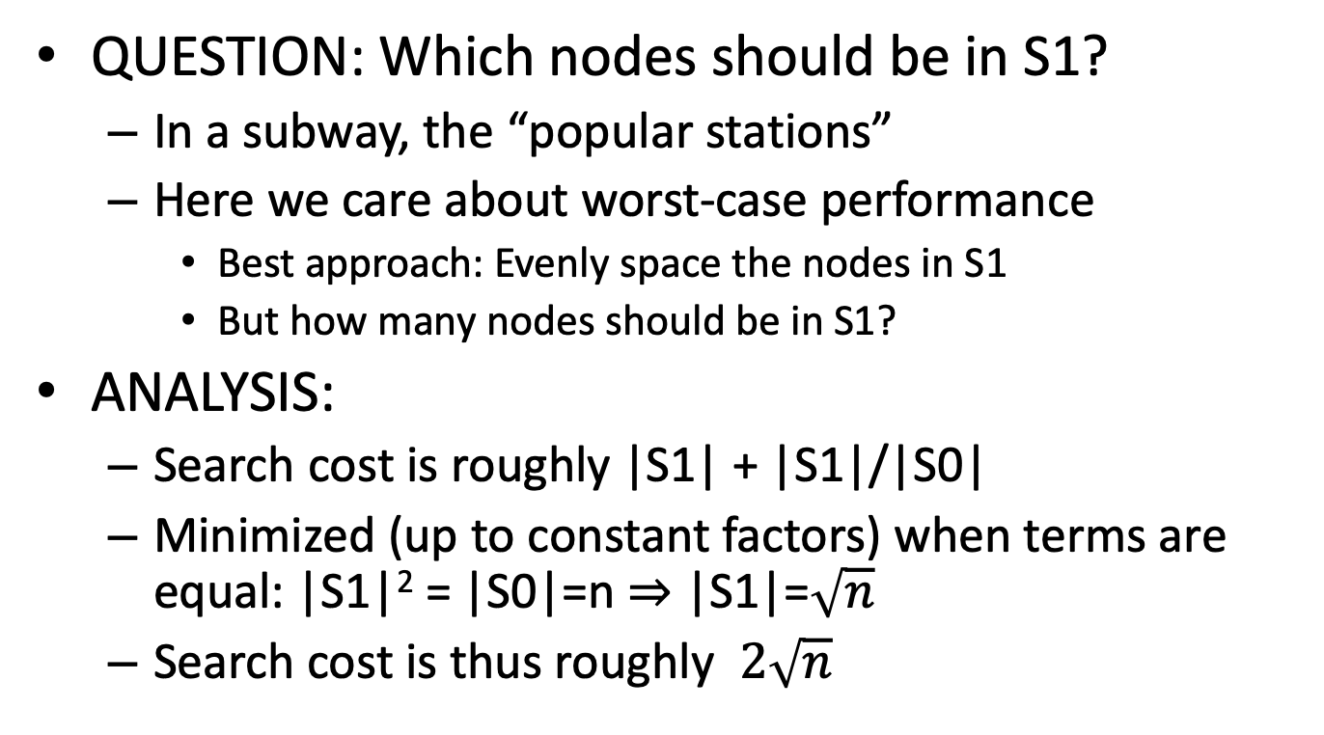
Choosing what nodes go to S1

Slide 43
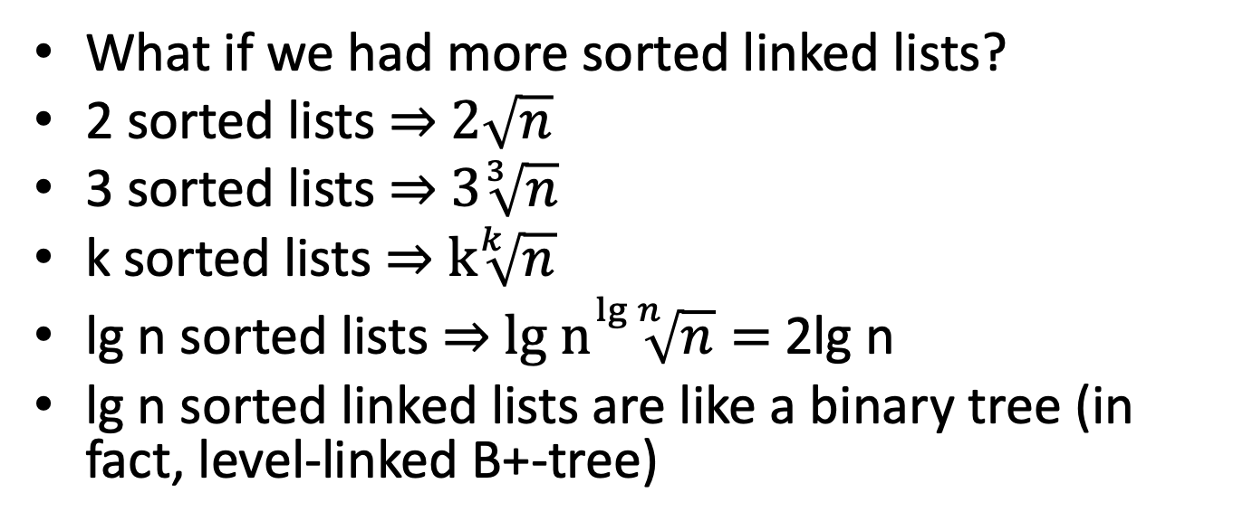
More linked lists?
S₃
−∞
+∞
S₂
−∞
31
+∞
S₁
−∞
23
31
34
64
+∞
S₀
−∞
12
23
26
31
34
44
56
64
78
+∞

Slide 44
Skip Lists
A skip list for a set S of distinct (key, element) items is a series of lists S₀, S₁ , … , S_{h} such that
Each list S_{i} contains the special keys +∞ and −∞
List S₀ contains the keys of S in nondecreasing order
Each list is a subsequence of the previous one, i.e., S₀ ⊇ S₁ ⊇ … ⊇ S_{h}
List S_{h} contains only the two special keys
We show how to use a skip list to implement the dictionary ADT

Slide 45
Search
We search for a key x in a a skip list as follows:
We start at the first position of the top list
At the current position p, we compare x with y ← key(next(p))
x == y: we return element(next(p))
x > y: we “scan forward”
x < y: we “drop down”
If we try to drop down past the bottom list, we return null
Example: search for 78
S₃
−∞
+∞
S₂
−∞
31
+∞
S₁
−∞
23
31
34
64
+∞
S₀
−∞
12
23
26
31
34
44
56
64
78
+∞
© 2004 Goodrich Tamassia

Slide 46
Randomized Algorithms
A randomized algorithm performs coin tosses (i.e., uses random bits) to control its execution
It contains statements of the type
b ← random()
if b = 0
do A …
else { b = 1}
do B …
Its running time depends on the outcomes of the coin tosses
We analyze the expected running time of a randomized algorithm under the following assumptions
the coins are unbiased, and
the coin tosses are independent
The worst-case running time of a randomized algorithm is often large but has very low probability (e.g., it occurs when all the coin tosses give “heads”)
We use a randomized algorithm to insert items into a skip list
© 2004 Goodrich Tamassia

Slide 47
Insert(x)
QUESTION: To which other lists should we add x?
IDEA:
Flip a (fair) coin; if HEADS, promote x to next level up and flip again to see if x will be inserted in upper lists
Let i be the number of consecutive HEADS
When inserting x in a skip list, we search for x in the skip list and find the positions p₀, p₁ , …, p_{i} of the items with largest key less than x in each list S₀, S₁, … , S_{i}
For j ← 0, …, i, we insert item (x, o) into list S_{j} after position p_{j}
Probability of promotion to next level = 1/2
On average:
1/2 of the elements promoted 0 levels
1/4 of the elements promoted 1 level
1/8 of the elements promoted 2 levels
etc.

Slide 48
Example
Example: insert key 15, with HEADS, HEADS, HEADS, i.e. i = 2
S₃
−∞
+∞
p₂
S₂
−∞
+∞
S₂
−∞
15
+∞
p₁
S₁
−∞
23
+∞
S₁
−∞
15
23
+∞
p₀
S₀
−∞
10
23
36
+∞
S₀
−∞
10
15
23
36
+∞
© 2004 Goodrich Tamassia

Slide 49
Delete(x)
To remove an entry with key x from a skip list, we proceed as follows:
We search for x in the skip list and find the positions p₀, p₁ , …, p_{i} of the items with key x, where position p_{j} is in list S_{j}
We remove positions p₀, p₁ , …, p_{i} from the lists S₀, S₁, … , S_{i}
We remove all but one list containing only the two special keys
Example: remove key 34
S₃
−∞
+∞
p₂
S₂
−∞
34
+∞
S₂
−∞
+∞
p₁
S₁
−∞
23
34
+∞
S₁
−∞
23
+∞
p₀
S₀
−∞
12
23
34
45
+∞
S₀
−∞
12
23
45
+∞
© 2004 Goodrich Tamassia

Slide 50
Summary
A skip list is the result of insertions (and deletions) from an initially empty structure (containing just +∞ and −∞)
INSERT(x) uses random coin flips to decide promotion level
DELETE(x) removes x from all lists containing it
THEOREM: With high probability, every search in an n-element skip list costs O(lg n)

Slide 51
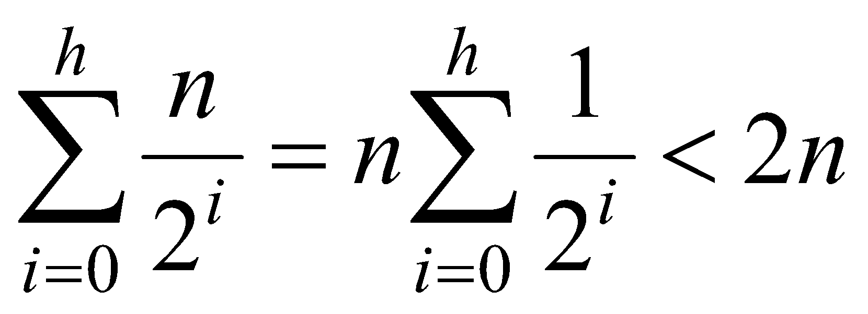
Space Usage
Consider a skip list with n entries
By Fact 1, we insert an entry in list S_{i} with probability 1/2^{i}
By Fact 2, the expected size of list S_{i} is n/2^{i}
The expected number of nodes used by the skip list is
The space used by a skip list depends on the random bits used by each invocation of the insertion algorithm
We use the following two basic probabilistic facts:
Fact 1: The probability of getting i consecutive heads when flipping a coin is 1/2^{i}
Fact 2: If each of n entries is present in a set with probability p, the expected size of the set is np
Thus, the expected space usage of a skip list with n items is O(n)
© 2004 Goodrich Tamassia

Slide 52
Read more
Read more at https://courses.csail.mit.edu/6.046/spring04/handouts/skiplists.pdf

Slide 53
Array ADT & Matrices
An array is a sequence indexed by a system of integer coordinates
The system of indexes is used to access elements and to permit alteration of individual elements.
The elements can be accessed directly in O(1) time (constant time)
The type array is built in any high level programming language, but we can still define our own type array and implement it in a different way
Two integers m and n, m:n denotes all integers in the range m..n
A matrix is a two-dimensional array but it can be extended to an arbitrary dimension
In a k–dimensional array A, the index i_{j} in the dimension j ranges between m_{j}:n_{j}: A[i₁,i₂,…i_{k}] is the element of array A with index (i₁,i₂,…i_{k})
Notes:
taken from Thomas A. Standish, Data Structure Techniques, 1990, pages 348-350

Slide 54
