Slide 1
CPSC 535: Advanced Algorithms
Instructor: Dr. Doina Bein

Slide 2
Graphs
Directed versus undirected versus weighted graphs
Representation of a graph using an adjacency matrix or adjacency lists

Slide 3
Undirected Graph
A undirected graph is a pair G = (V, E) where V is a set whose elements are called vertices, and E is a set of unordered pairs of distinct elements of V.
Vertices are often also called nodes.
Elements of E are called edges, or undirected edges.
Each edge may be considered as a subset of V containing two elements,
{v, w} denotes an undirected edge
In diagrams this edge is the line v---w.
In text we simply write vw, or wv
vw is said to be incident upon the vertices v and w

Slide 4
Directed Graph
A directed graph (or digraph) is a pair G = (V, E) where V is a set whose elements are called vertices, and E is a set of ordered pairs of elements of V.
Vertices are often also called nodes.
Elements of E are called directed edges, or arcs.
For directed edge (v, w) in E, v is its tail and w its head;
(v, w) is represented in the diagrams as the arrow, v -> w.
In text we simply write vw.

Slide 5
A weighted graph is a triple (V, E, W) where (V, E) is a graph (directed or undirected) and W is a function from E into R, the reals (integers or rationals). For an edge e, W(e) is called the weight of e.
SAC
48
SF
48
STK
OAK
128
120
48
60
100
100
100
FRES
80
LA
48
120
SD

Slide 6
1
2
0 | 1 | 1 | 0 | 0 | 0 | 0
1 | 0 | 1 | 1 | 0 | 0 | 0
1 | 1 | 0 | 1 | 0 | 1 | 0
0 | 1 | 1 | 0 | 0 | 1 | 0
0 | 0 | 0 | 0 | 0 | 1 | 0
0 | 0 | 1 | 1 | 1 | 0 | 1
0 | 0 | 0 | 0 | 0 | 1 | 0
3
4
5
6
7
(a) An undirected graph
(b) Its adjacency matrix

Slide 7
25
1
2
0 | 25 | ∞ | ∞ | ∞ | ∞ | ∞
∞ | 0 | 10 | 14 | ∞ | ∞ | ∞
5 | ∞ | 0 | ∞ | ∞ | 16 | ∞
∞ | 6 | 18 | 0 | ∞ | ∞ | ∞
∞ | ∞ | ∞ | ∞ | 0 | ∞ | ∞
∞ | ∞ | ∞ | 32 | 42 | 0 | 14
∞ | ∞ | ∞ | ∞ | ∞ | 11 | 0
5
10
14
6
18
4
3
16
32
42
11
5
6
7
14
An weighted directed graph
(b) Its weight matrix

Slide 8
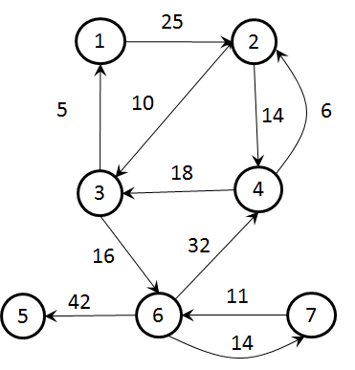
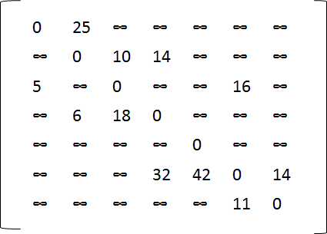
An weighted directed graph
(b) Its weight matrix
2
25
nil
3
10
4
14
nil
1
5
6
16
nil
2
6
3
18
nil
nil
4
32
5
42
7
14
nil
6
11
nil
(b) Its adjacency lists

Slide 9
State-space graph (taken from Levitin, page 246-248)
Many puzzles and games can be solved by a reduction to one of the standard graph problems.
vertices of a graph typically represent possible states of the problem in question, and
edges indicate permitted transitions among such states: one of the graph’s vertices represents an initial state and another represents a goal state of the problem
The problem reduces to finding a path from the initial-state vertex to a goal-state vertex.
Applications: state-space graphs are very important to AI
Example: A peasant finds himself on a river bank with a wolf, a goat, and a head of cabbage. He needs to transport all three to the other side of the river in his boat. However, the boat has room only for the peasant himself and one other item (either the wolf, the goat, or the cabbage). In his absence, the wolf would eat the goat, and the goat would eat the cabbage. Find a way for the peasant to solve his problem or prove that it has no solution.

Slide 10
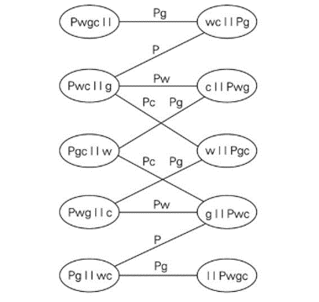
River crossing example
Fig. 6.18: P, w, g, c stand for the peasant, the wolf, the goat, and the cabbage, respectively; the two bars || denote the river; we label the edges by indicating the boat’s occupants for each crossing.
In terms of this graph, we are interested in finding a path from the initial-state vertex labeled Pwgc| | to the final-state vertex labeled | |Pwgc.
Use BFS to find the shortest such paths; in this case, two distinct paths, each with 7 edges. i.e. river crossings

Slide 11
Trees
A tree is a connected graph without cycles
A graph is a pair of nodes and edges
Examples
Nodes are dots; an edge is a line connecting two nodes
A connected graph is a graph in which between any two nodes there is a way of reaching one node from another
Examples

Slide 12
A cycle: there is a pair of nodes that has two disjoint ways of reaching one another
Examples
A tree that has a special node, called root, is called a rooted tree.
In a rooted tree, each node except the root, has a parent
Examples
Each node may have child(ren)
An external node (leaf) is a node without children
An internal node is a node with at least one child; sometimes the root is not considered an internal node
The size of a tree is the number of nodes in it

Slide 13
Depth
Depth of a node: number of ancestors (between the node and the root)
Root has depth 0
Depth of p’s node is recursively defined:
if (p.isRoot()) return 0; // root has depth 0
else return 1 + depth(p.parent()); // 1 + (depth of parent)
5
What is the depth at each node?
15
11
25

Slide 14
Height
Height of a node p in a tree T is defined recursively:
If p is the external node, then the height of p is 0
Otherwise, the height of p is 1 + the maximum height of children of p
Height of a tree == maximum depth of its external nodes
Height of a tree T is the height of the root of T
5
What is the height at each node?
15
11
25

Slide 15
Topological Sorting (application of DFS) (slides taken from www.cs.toronto.edu/~tabrown/csc263/week9)
A Directed Acyclic Graph (DAG) is a directed graph G = (V,E) without cycles.
We use Depth First Search (DFS) traversal of a DAG starting at the first node in V
We have a counter that is initialized to 0 and gets increments each time a node is visited
For each node, we keep track of two timestamps, the discovery timestamp and the finishing timestamp
Edges in a DFS traversal can be classified based on the discovery and finishing timestamps
d
c
a
g
f
b
e

Slide 16
DFS (Pages 603-610 of CLRS)
We have a global counter called time=0 (initially)
Each vertex v
has a color v.color: WHITE (initially), GREY (after discovered first time) or BLACK (all neighbors have been explored) and changes color WHITE→GREY→BLACK during DFS traversal
Has two timestamps: v.d records when v was discovered (and greyed) and v.f records when v was finished exploring (and blackened); always v.d<v.f

Slide 17
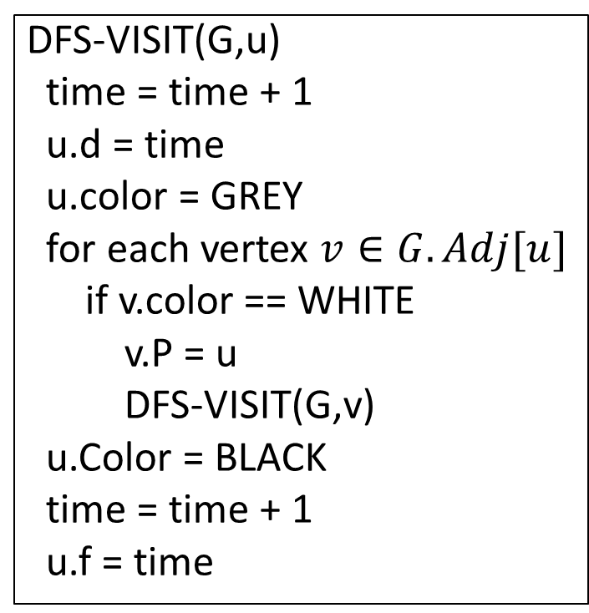
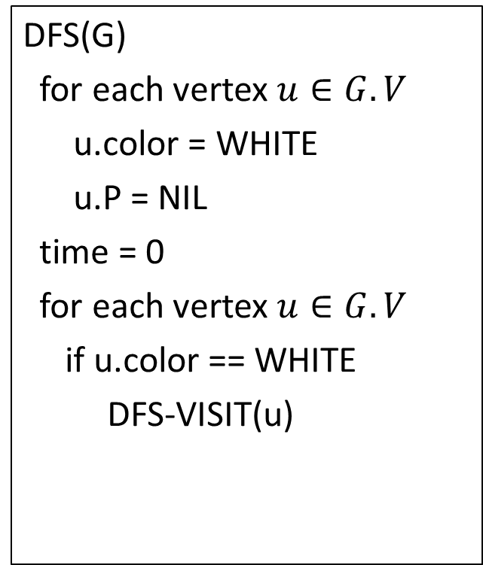
DFS Pseudocode (page 604)
DFS(G)
for each vertex $u∈G.V$
u.color = WHITE
u.P = NIL
time = 0
for each vertex $u∈G.V$
if u.color == WHITE
DFS-VISIT(u)
DFS-VISIT(G,u)
time = time + 1
u.d = time
u.color = GREY
for each vertex $v∈G.Adj[u]$
if v.color == WHITE
v.P = u
DFS-VISIT(G,v)
u.Color = BLACK
time = time + 1
u.f = time

Slide 18
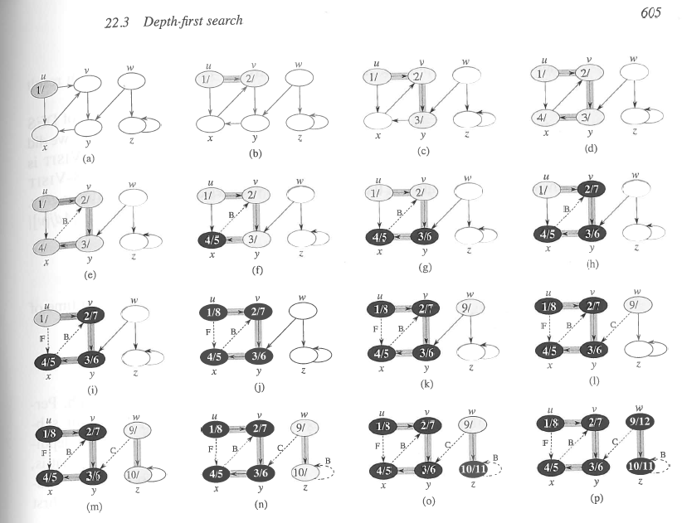
Example (pg 605 CLRS) tree edges are shaded, the rest are dotted

Slide 19
Edge classification by DFS
The edges in E will be partitioned into 4 types:
Edge (u,v) is a:
Tree edge iff u discovers v during the DFS so u becomes parent of v, v.P = u
Forward edge iff u is an ancestor of v in the DFS tree
Back edge iff u is a descendant of v in the DFS tree
Cross edge iff u is neither an ancestor nor a descendant of v

Slide 20
Edge classification by DFS
Tree edges
Forward edges
Back edges
Cross edges
a
b
c
c
The edge classification depends on the particular DFS tree!

Slide 21
Edge classification by DFS
Tree edges
Forward edges
Back edges
Cross edges
Both are valid
a
a
b
b
c
c
The edge classification depends on the particular DFS tree!

Slide 22
DAGs and back edges
Can there be a back edge in a DFS on a DAG?
NO! Back edges close a cycle!
A graph G is a DAG <=> there is no back edge classified by DFS(G)

Slide 23
Topological Sort
A topological sort of a DAG G=(V,E) is a linear ordering of all its vertices (aka a permutation of V) such that if G contains an edge (u,v), then u appears before v in its ordering.
Typically topological sort renames each vertex with IDs from 1..n
Applications:
We have a set of tasks and a set of dependencies (precedence constraints) of form “task A must be done before task B”. We need an ordering of the tasks that conforms with the given dependencies such that each edge (u, v)∊E means that task u must be done before task v.
When scheduling task graphs in distributed systems, usually we first need to sort the tasks topologically and then assign them to resources (the most efficient scheduling is an NP-complete problem).
During compilation to order modules/libraries. For example, command apt-get uses topological sorting to obtain the admissible sequence in which a set of Debian packages can be installed/removed.

Slide 24
Algorithm for TS (page 613 of CLRS)
TOPOLOGICAL-SORT(G):
call DFS(G) to compute finishing times f[v] for each vertex v
as each vertex is finished, insert it onto the front of a linked list
return the linked list of vertices
Note that the result is just a list of vertices in order of decreasing finish times f[]

Slide 25
Topological sort
Call DFS(G) to compute the finishing times f[v]
Time = 1
Time = 2
d = ∞
f = ∞
Let’s say we start the DFS from the vertex c
a
d = ∞
f = ∞
Next we discover the vertex d
d = ∞
f = ∞
d = 1
f = ∞
b
c
c
d = ∞
f = ∞
d = ∞
f = ∞
d
e
d = ∞
f = ∞
f

Slide 26
Topological sort
Call DFS(G) to compute the finishing times f[v]
Time = 2
Time = 3
d = ∞
f = ∞
Let’s say we start the DFS from the vertex c
a
d = 1
f = ∞
Next we discover the vertex d
d = ∞
f = ∞
b
c
c
d = ∞
f = ∞
d = ∞
f = ∞
d = 2
f = ∞
d
d
e
d = ∞
f = ∞
f

Slide 27
Topological sort
Call DFS(G) to compute the finishing times f[v]
Time = 3
Time = 4
as each vertex is finished, insert it onto the front of a linked list
d = ∞
f = ∞
Let’s say we start the DFS from the vertex c
a
d = 1
f = ∞
Next we discover the vertex d
d = ∞
f = ∞
b
c
c
Next we discover the vertex f
d = 2
f = ∞
d = ∞
f = ∞
f is done, move back to d
d
d
e
d = 3
f = ∞
d = 3
f = 4
f
f
f

Slide 28
Topological sort
Call DFS(G) to compute the finishing times f[v]
Time = 4
Time = 5
d = ∞
f = ∞
Let’s say we start the DFS from the vertex c
a
d = 1
f = ∞
Next we discover the vertex d
d = ∞
f = ∞
b
c
c
Next we discover the vertex f
d = 2
f = 5
d = ∞
f = ∞
f is done, move back to d
d
d
e
d is done, move back to c
d = 3
f = 4
f
f
d
f

Slide 29
Topological sort
Call DFS(G) to compute the finishing times f[v]
Time = 5
Time = 6
d = ∞
f = ∞
Let’s say we start the DFS from the vertex c
a
d = 1
f = ∞
Next we discover the vertex d
d = ∞
f = ∞
b
c
c
Next we discover the vertex f
d = 2
f = 5
d = ∞
f = ∞
f is done, move back to d
d
d
e
d is done, move back to c
d = 3
f = 4
f
Next we discover the vertex e
f
d
f

Slide 30
Topological sort
Call DFS(G) to compute the finishing times f[v]
Time = 6
Time = 7
d = ∞
f = ∞
Let’s say we start the DFS from the vertex c
a
d = 1
f = ∞
Next we discover the vertex d
d = ∞
f = ∞
b
c
Next we discover the vertex f
Both edges from e are cross edges
d = 2
f = 5
d = 6
f = ∞
f is done, move back to d
d
d
e
e
d is done, move back to c
d = 3
f = 4
f
Next we discover the vertex e
f
e is done, move back to c
e
d
f

Slide 31
Topological sort
Call DFS(G) to compute the finishing times f[v]
Time = 7
Time = 8
d = ∞
f = ∞
Let’s say we start the DFS from the vertex c
a
Just a note: If there was (c,f) edge in the graph, it would be classified as a forward edge
(in this particular DFS run)
d = 1
f = ∞
Next we discover the vertex d
d = ∞
f = ∞
b
c
Next we discover the vertex f
d = 2
f = 5
d = 6
f = 7
f is done, move back to d
d
d
e
e
d is done, move back to c
d = 3
f = 4
f
Next we discover the vertex e
f
e is done, move back to c
c
e
d
f
c is done as well

Slide 32
Topological sort
Call DFS(G) to compute the finishing times f[v]
Time = 9
Time = 10
d = ∞
f = ∞
Let’s now call DFS visit from the vertex a
d = 9
f = ∞
a
a
d = 1
f = 8
Next we discover the vertex c,
but c was already processed => (a,c) is a cross edge
d = ∞
f = ∞
b
c
d = 2
f = 5
d = 6
f = 7
Next we discover the vertex b
d
d
e
e
d = 3
f = 4
f
f
c
e
d
f

Slide 33
Topological sort
Call DFS(G) to compute the finishing times f[v]
Time = 10
Time = 11
d = 9
f = ∞
Let’s now call DFS visit from the vertex a
a
a
d = 1
f = 8
Next we discover the vertex c,
but c was already processed => (a,c) is a cross edge
d = 10
f = ∞
d = 10
f = 11
b
b
c
d = 2
f = 5
d = 6
f = 7
Next we discover the vertex b
d
d
e
e
b is done as (b,d) is a cross edge => now move back to c
d = 3
f = 4
f
f
b
c
e
d
f

Slide 34
Topological sort
Call DFS(G) to compute the finishing times f[v]
Time = 11
Time = 12
d = 9
f = ∞
Let’s now call DFS visit from the vertex a
a
a
d = 1
f = 8
Next we discover the vertex c,
but c was already processed => (a,c) is a cross edge
d = 10
f = 11
b
b
c
d = 2
f = 5
d = 6
f = 7
Next we discover the vertex b
d
d
e
e
b is done as (b,d) is a cross edge => now move back to c
d = 3
f = 4
f
f
a is done as well
b
c
e
d
f

Slide 35
Topological sort
Call DFS(G) to compute the finishing times f[v]
Time = 11
Time = 13
d = 9
f = 12
Let’s now call DFS visit from the vertex a
WE HAVE THE RESULT!
return the linked list of vertices
a
a
d = 1
f = 8
Next we discover the vertex c,
but c was already processed => (a,c) is a cross edge
d = 10
f = 11
b
b
c
d = 2
f = 5
d = 6
f = 7
Next we discover the vertex b
d
d
e
e
b is done as (b,d) is a cross edge => now move back to c
d = 3
f = 4
f
f
a is done as well
a
b
c
e
d
f

Slide 36
Topological sort
Time = 11
Time = 13
The linked list is sorted in decreasing order of finishing times f[]
d = 9
f = 12
a
a
d = 10
f = 11
d = 1
f = 8
b
Try yourself with different vertex order for DFS visit
b
c
d = 2
f = 5
d = 6
f = 7
d
d
e
e
Note: If you redraw the graph so that all vertices are in a line ordered by a valid topological sort, then all edges point „from left to right“
d = 3
f = 4
f
f
a
b
c
e
d
f

Slide 37
Time complexity of TS(G)
Running time of topological sort:
Θ(n + m) where n=|V| and m=|E|
Why? Depth first search takes Θ(n + m) time in the worst case, and inserting into the front of a linked list takes Θ(1) time

Slide 38
Proof of correctness
Theorem: TOPOLOGICAL-SORT(G) produces a topological sort of a DAG G
The TOPOLOGICAL-SORT(G) algorithm does a DFS on the DAG G, and it lists the nodes of G in order of decreasing finish times f[]
We must show that this list satisfies the topological sort property, namely, that for every edge (u,v) of G, u appears before v in the list
Claim: For every edge (u,v) of G: f[v] < f[u] in DFS

Slide 39
Proof of correctness
“For every edge (u,v) of G, f[v] < f[u] in this DFS”
The DFS classifies (u,v) as a tree edge, a forward edge or a cross-edge (it cannot be a back-edge since G has no cycles):
If (u,v) is a tree or a forward edge ⇒ v is a descendant of u ⇒ f[v] < f[u]
If (u,v) is a cross-edge

Slide 40
Proof of correctness
“For every edge (u,v) of G: f[v] < f[u] in this DFS”
If (u,v) is a cross-edge:
as (u,v) is a cross-edge, by definition, neither u is a descendant of v nor v is a descendant of u:
d[u] < f[u] < d[v] < f[v]
or
d[v] < f[v] < d[u] < f[u]
Q.E.D. of Claim
since (u,v) is an edge, v is surely discovered before u's exploration completes
f[v] < f[u]

Slide 41
Proof of correctness
TOPOLOGICAL-SORT(G) lists the nodes of G from highest to lowest finishing times
By the Claim, for every edge (u,v) of G: f[v] < f[u]
⇒ u will be before v in the algorithm's list
Q.E.D of Theorem

Slide 42
Binary Trees
A binary tree is a rooted, oriented tree in which each node has at most two children
A child is a left child or a right child
In the tree’s traversal, left children precede right children
There are left subtrees and right subtrees
In a full binary tree (also called proper binary tree or 2-tree), every node has either 0 or 2 children
In a complete tree, every level is complete except maybe the last level where nodes are missing from right to left

Slide 43
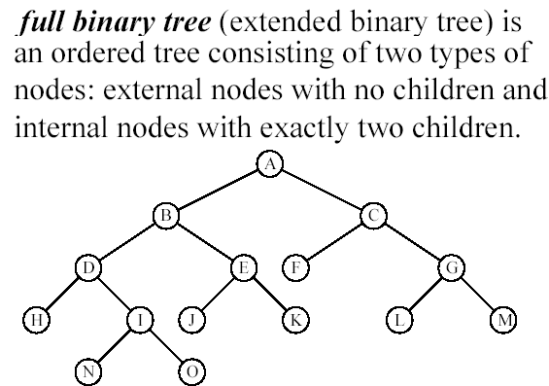


Slide 44
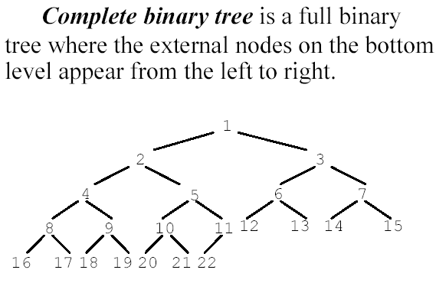


Slide 45
Binary Tree Traversal
Is a procedure that systematically visits every vertex of an ordered rooted tree
Tree traversals are naturally recursive
Since a binary tree has three “parts,” there are six possible ways to traverse the binary tree:
root, left, right left, root, right
left, right, root root, right, left
right, root, left right, left, root
Three most used algorithms
Preorder traversal.
Inorder traversal.
Postorder traversal.

Slide 46
Preorder traversal
In preorder, the root is visited first
The code for preorder traversal to print out all the elements in the binary tree:
void preorderPrint(const Tree& T) { cout << T.element; // print element
if (T.leftChild != NULL)
preorderPrint (T.leftChild); if (T.rightChild != NULL)
preorderPrint(T.rightChild);
}

Slide 47
Inorder traversal
In preorder, the left child is visited first, then the root, then the right child
The code for inorder traversal to print out all the elements in the binary tree:
void inorderPrint(const Tree& T) { if (T.leftChild != NULL)
inorderPrint (T.leftChild);
cout << T.element; // print element if (T.rightChild != NULL)
inorderPrint(T.rightChild);
}

Slide 48
Postorder traversal
In preorder, the root is visited last, after the left child, then the right child
The code for postorder traversal to print out all the elements in the binary tree:
void postorderPrint(const Tree& T) { if (T.leftChild != NULL)
postorderPrint (T.leftChild);
if (T.rightChild != NULL)
postorderPrint(T.rightChild);
cout << T.element; // print element
}

Slide 49
Binary Search Tree
BST = a tree in which each node is an object
In addition a node contains fields left, right and p that point to the left child, right child and parent, respectively; if a node is missing, then the field contains NIL
The root is the only node for which p is NIL
The keys satisfy the binary-search-tree property:
Let x be a node in the BST. If y is a node in the left subtree of x then key[y] < key[x]. If y is a node in the right subtree of x then key[x] < key[y].
Query operations supported by binary search trees: Search(x, k), Minimum(x), Maximum(x), Successor(x), Predecessor(x) where x is a node and k is a key value
They run in O(h) time where h is the height of the tree

Slide 50
Binary Search Trees (BST)
v
u
w
An inorder traversal of a binary search trees visits the keys in increasing order
A binary search tree is a binary tree storing keys (or key-value entries) at its internal nodes and satisfying the following property:
Let u, v, and w be three nodes such that u is in the left subtree of v and w is in the right subtree of v. We have key(u) ≤ key(v) ≤ key(w)
6
2
9
1
4
8

Slide 51
Operations
Search: locate a node with a specific key
Insert: add a node
Remove: remove a node

Slide 52
Search in a BST
To find/search for a key k, we trace a downward path starting at the root
Navigate left and right down the tree
At each node, compare node key to search key
If they match, search terminates successfully
If search key is less, go down to left subtree
If search key is greater, go down to right subtree
If no match has been found when bottom of tree is reached (no left or right subtree to descend to), search terminates unsuccessfully.
<
6
2
>
9
1
4
=
8

Slide 53
BST Search
Example: search(4):
Call BSTSearch(4)
BSTSearch(key) {
cur = root
while (cur is not null)
if (key == cur->key)
return cur // Found
else if (key < cur->key)
cur = cur->left
else
cur = cur->right
return null // Not found
}
<
6
2
>
9
1
4
=
8

Slide 54
Insert in a BST
To perform operation insert(k, val), we search for key k
Assume k is not already in the tree, and let w be the null pointer reached by the search
Create a new node with key k and attach it to pointer w
Example: BSTInsert (5)
<
6
2
>
9
1
4
>
8
w
6
2
9
1
4
8
w
5

Slide 55
Delete from a BST
Most difficult operation
If the node to be removed is not a leaf, one should keep its child(ren)
Three cases for the node to be deleted: the node has
no children (aka a leaf)
1 child
2 children
<
6
2
>
9
1
4
8
v
5

Slide 56
BST Remove – 0 children
<
6
To perform operation erase(k), we search for key k
Assume key k is in the tree, and let let v be the node storing k
If node v has NO internal children, just remove v
Example: remove 5
2
>
9
1
4
8
v
5
6
2
9
1
4
8

Slide 57
BST Remove – 1 internal child
<
6
If node v has one child w, we remove v and attach w as the child of v’s parent
“Ask grandparent to take care of single child”
Example: remove (4)
2
>
9
1
4
v
8
5
w
6
2
9
1
5
8

Slide 58
BST Remove – 2 internal children
Consider the case where the key k to be removed is stored at a node v whose children are both internal
Find the internal node w that follows v in an inorder traversal
Copy key(w) into node v
Remove node w – this node will have at most one child
Example: remove (3)
1
v
3
2
8
6
9
w
5
1
v
5
2
8
6
9

Slide 59
BST Remove – 2 internal children (contd.)
How to find the internal node w that follows v in an inorder traversal?
Find v’s successor by going right, then left, left,…
Examples:
Successor of 3 is
Successor of 8 is
1
v
3
2
8
6
9
5
w
5
9

Slide 60
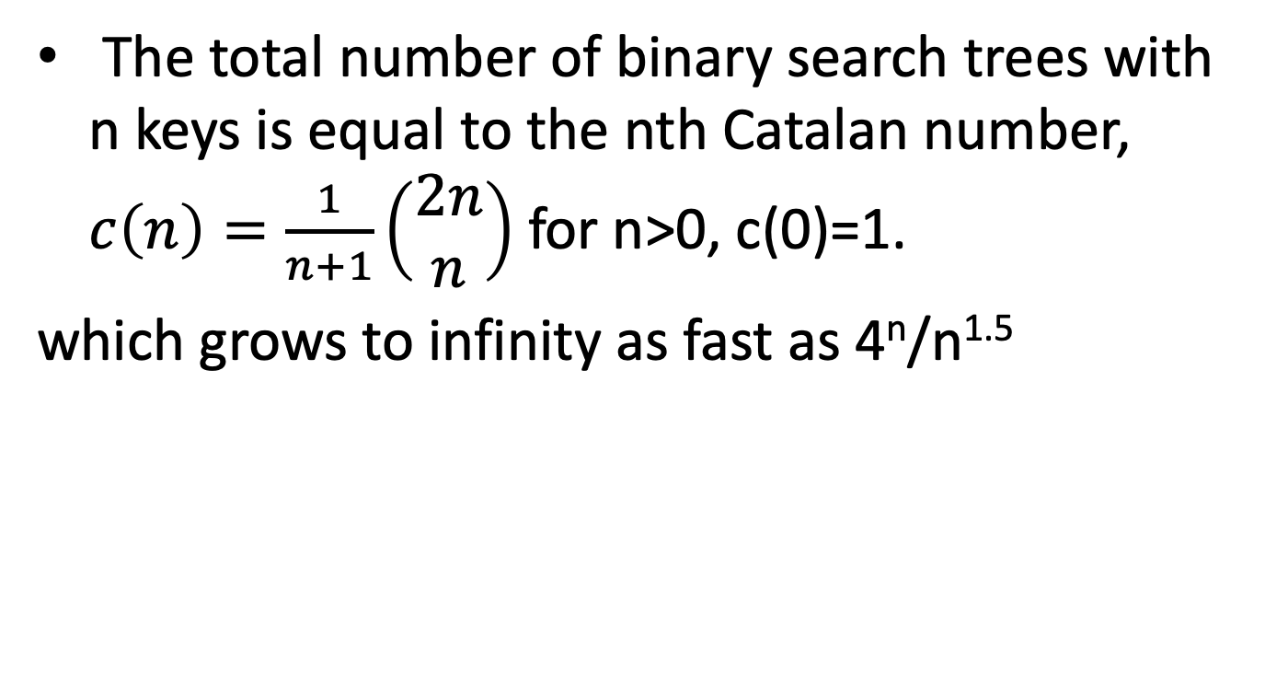
Number of BST trees
The total number of binary search trees with n keys is equal to the nth Catalan number, $c\left(n\right)=\frac{1}{n+1}\left(\begin{aligned}2n \\ n\end{aligned}\right)$ for n>0, c(0)=1.
which grows to infinity as fast as 4^{n}/n^{1.5}

