Slide 1
CPSC 535: Advanced Algorithms
Instructor: Dr. Doina Bein

Slide 2
Dynamic Programming
Applicable to only a narrow range of problems, but offers impressive efficiency gains
The pattern is suited to problems with a divide-and-conquer structure (e.g. decrease-by-one or decrease-by-half) where there is “overlap” between the sub-instances
Instead of re-computing each sub-instance, keep the result in an array called the cache and access it when needed
An array (list) T is used as a cache for sub-instance solutions
The first time a particular sub-instance is solved, its solution is stored in T
Later, when needed, directly access the solution by a fast array lookup rather than re-compute it from scratch

Slide 3
A dynamic programming algorithm is analyzed by its dimension = the number of nested for loops needed to fully initialize the cache T and solve the full-sized problem

Slide 4
The 1D (one-dimensional) dynamic programming pattern
def dynamic_programming_1D(instance):
T = one dimensional empty array
<INITIALIZE BASE CASE ELEMENTS OF T>
for i =<LEAST NON-BASE CASE> to <GREATEST INSTANCE> do
<INITIALIZE T[i] USING ONLY ELEMENTS OF T THAT HAVE ALREADY BEEN INITIALIZED>
return T[<SOLUTION INDEX>]

Slide 5
All-pairs Shortest Paths
Shortest path problems involve computing minimal-weight paths between vertices in weighted graphs.
In a weighted graph, each edge may have a numeric weight: < 0, zero or > 0.
Numeric weights may be unconstrained or be required to be non-negative.
All-pairs shortest path problems involve computing paths between all pairs of distinct vertices.

Slide 6
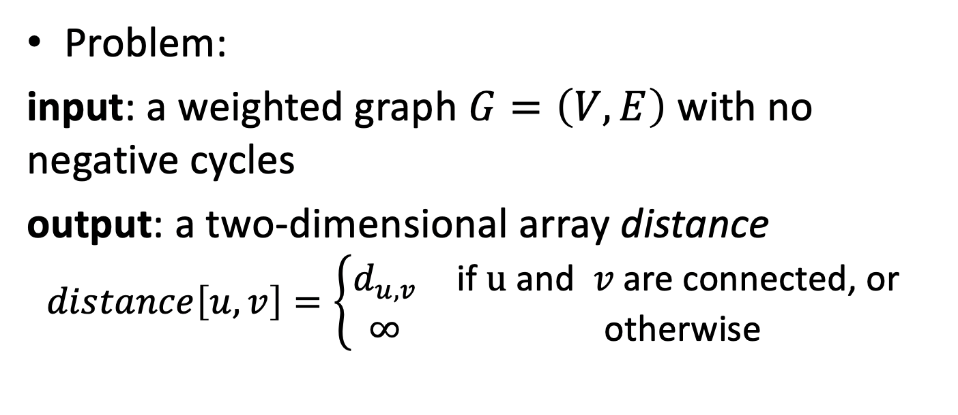
All-pairs Shortest Paths

Slide 7
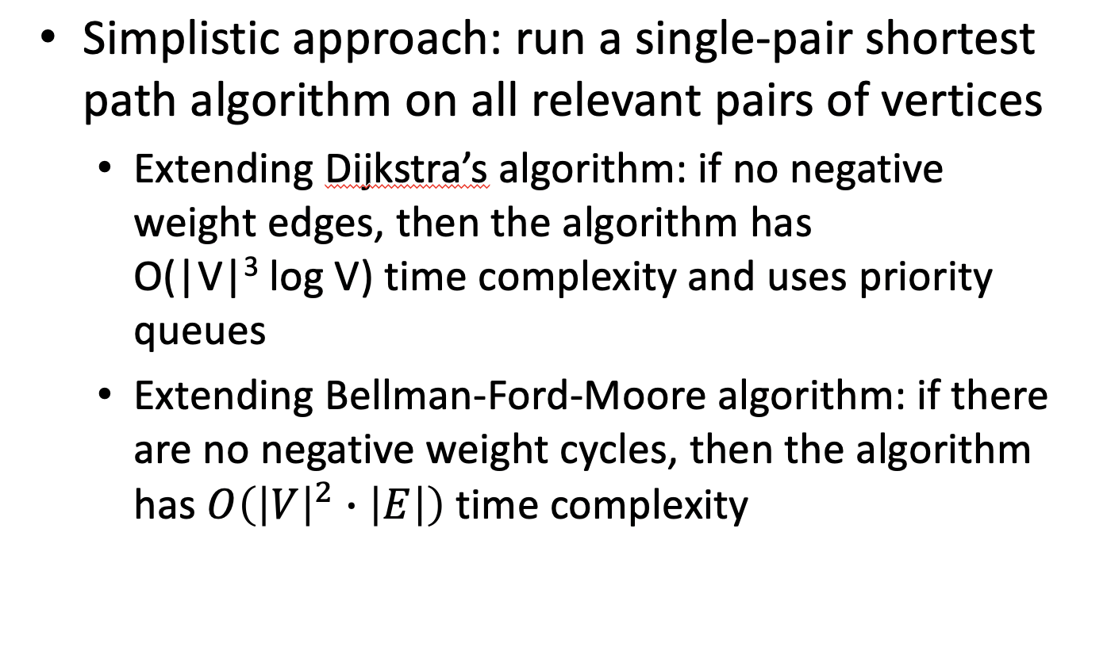

Slide 8
Floyd-Warshall Algorithm
Also known as Floyd's algorithm, the Roy-Warshall algorithm, the Roy-Floyd algorithm, or the WFI algorithm.
Finds the shortest paths between all pairs of nodes in a weighted graph with no negative weight cycles
It does not return details of the paths themselves
It is similar to Bellman-Ford-Moore algorithm: incrementally improves an estimate on the shortest path between two vertices until the estimate is optimal.

Slide 9
Transitive closure of a graph
The transitive closure of a directed graph with n vertices can be defined as the n × n boolean matrix T = {t_{ij} }, in which the element in the i th row and the jth column is 1 if there exists a nontrivial path (i.e., directed path of a positive length) from the ith vertex to the jth vertex; otherwise, t_{ij} is 0.
An example of a digraph, its adjacency matrix, and its transitive closure is given in Figure 8.11.

Slide 10
Optimal Substructure Property: given a shortest path, any subpath is also a shortest path between corresponding nodes
Let V={1,2,…,N} be the set of nodes in the graph G
Let function shortestPath(i,j,k) return the shortest path from i to j using vertices only from the set {1,2,...,k} as intermediate points along the way
Our goal: shortest path in G between i and j is the return of function shortestPath(i,j,N)
Dynamic programming: calculate shortestPath(i,j,k+1) using the previous calculated shortest paths; it could be either
(1) a path that only uses vertices in the set {1, ..., k} => shortestPath(i,j,k)
(2) a path that goes from i to k + 1 and then from k + 1 to j => shortestPath(i,k+1,k)+shortestPath(k+1,j,k)

Slide 11
Compute shortestPath(i, j, k) for all (i, j) pairs starting with k = 1, then k = 2, … until k=N.
Floyd-Warshall algorithm:
for i = 1 to |V| do
for j = 1 to |V| do
dist[ i, j ] = ∞
for i = 1 to |V| do
dist[ i, i ] = 0
for each edge (u,v) do
dist[ u, v ] = w(u,v) // the weight of the edge (u,v)
for k = 1 to |V| do
for i = 1 to |V| do
for j = 1 to |V| do
if dist[ i, j ] > dist[ i, k ] + dist[ k, j ] then
dist[ i, j ] = dist[ i, k ] + dist[ k, j ]

Slide 12
Take the example from Wikipedia:
https://en.wikipedia.org/wiki/Floyd%E2%80%93Warshall_algorithm
If there are negative cycles in the graph, the Floyd–Warshall algorithm can be used to detect them
The path between a node and itself dist[i,i] should remain 0
Initially, dist[i,i]=0
F-W algorithm tried to improve any path, including the one between a node and itself
The value of dist[i,i]=0 will be negative if there exists a negative-length path from i back to i
One can inspect the diagonal of the matrix dist, and the presence of a negative number indicates that the graph contains at least one negative cycle

Slide 13
Other algorithms:
Johnson's algorithm solves all pairs shortest paths and may be faster than Floyd–Warshall on sparse graphs
Viterbi algorithm solves the shortest stochastic path problem with an additional probabilistic weight on each node

Slide 14
Johnson’s Algorithm
It allows some of the edge weights to be negative numbers, but no negative-weight cycles may exist
Steps:
A new node q is added to the graph, connected by zero-weight edges to all other nodes.
The Bellman–Ford algorithm is used: the starting vertex q, find for each vertex v the minimum weight h(v) of a path from q to v; if a negative cycle is detected, the algorithm is terminated.
The edges of the original graph are reweighted using the values computed by the Bellman–Ford algorithm: an edge from u to v, having length w(u,v), is given the new length w(u,v) + h(u) − h(v).
Node q is removed and Dijkstra's algorithm is used to find the shortest paths from each node s to every other vertex in the reweighted graph.

Slide 15
The time complexity is O(V²log V + VE) which is faster than F-W’s time complexity of O(V³) for sparse graphs ( E = O(V) )
A similar reweighting technique is also used in Suurballe's algorithm for finding two disjoint paths of minimum total length between the same two vertices in a graph with non-negative edge weights

Slide 16
Longest path in a graph
The longest path problem is NP-hard and the decision version of the problem, which asks whether a path exists of at least some given length, is NP-complete.
However, the longest path problem has a linear time solution for directed acyclic graphs.
The idea is similar to the linear time solution for shortest path in a directed acyclic graph by using Topological Sorting.

Slide 17
Pseudocode
Longest-path-DAG(G)
Input: Unweighted DAG G = (V, E)
Output: Longest path in G
1: Topologically sort G
2: Initialize array dist[] = {MIN_INT, ….MIN_INT} // size N
3: dist[0] = 0
4: for each vertex u ∈ V in linearized order do
// compute dist(u) = max_{(v,u)∈E} {dist(v) + 1}
5: for every v ∈ V do
6: if ( A[u][v] == 1 && dist[v] < dist[u] + 1 )
7: then dist[v] = dist[u] + 1
8: endif
9: enddo
10: endfor
11: return max_{v∈V} {dist(v)}

Slide 18
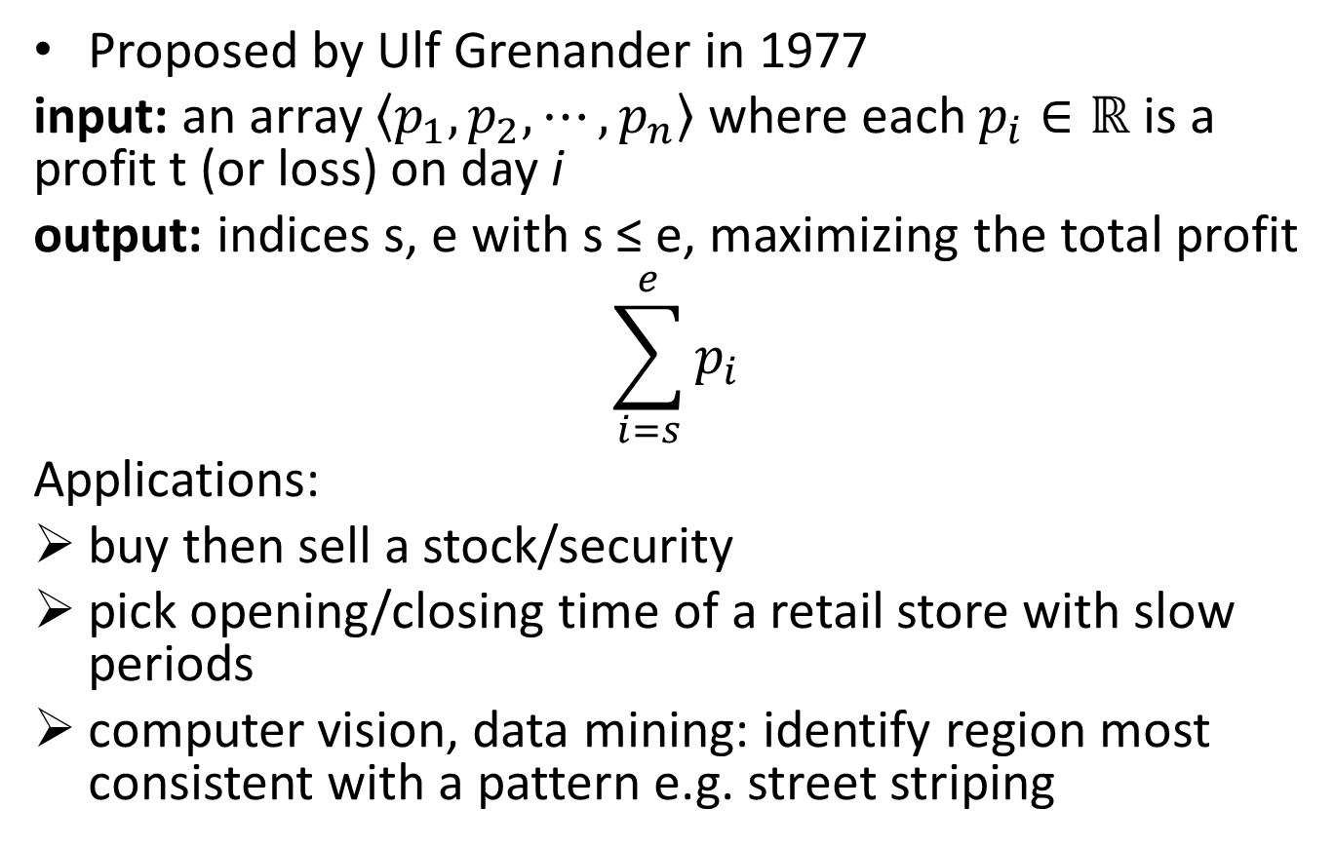
Maximum subarray problem

Slide 19
Greedy fails
Straightforward greedy algorithm would be:
buy at the lowest price or sell at the highest price
incorrect; best "run" could be elsewhere
example: -3, -2, 4, -1, -2, 1, 5, 4, -3
Greedy suggests: -3, -2, 4, -1, -2, 1, 5, 4, -3
But optimal is -3, -2, 4, -1, -2, 1, 5, 4, -3

Slide 20
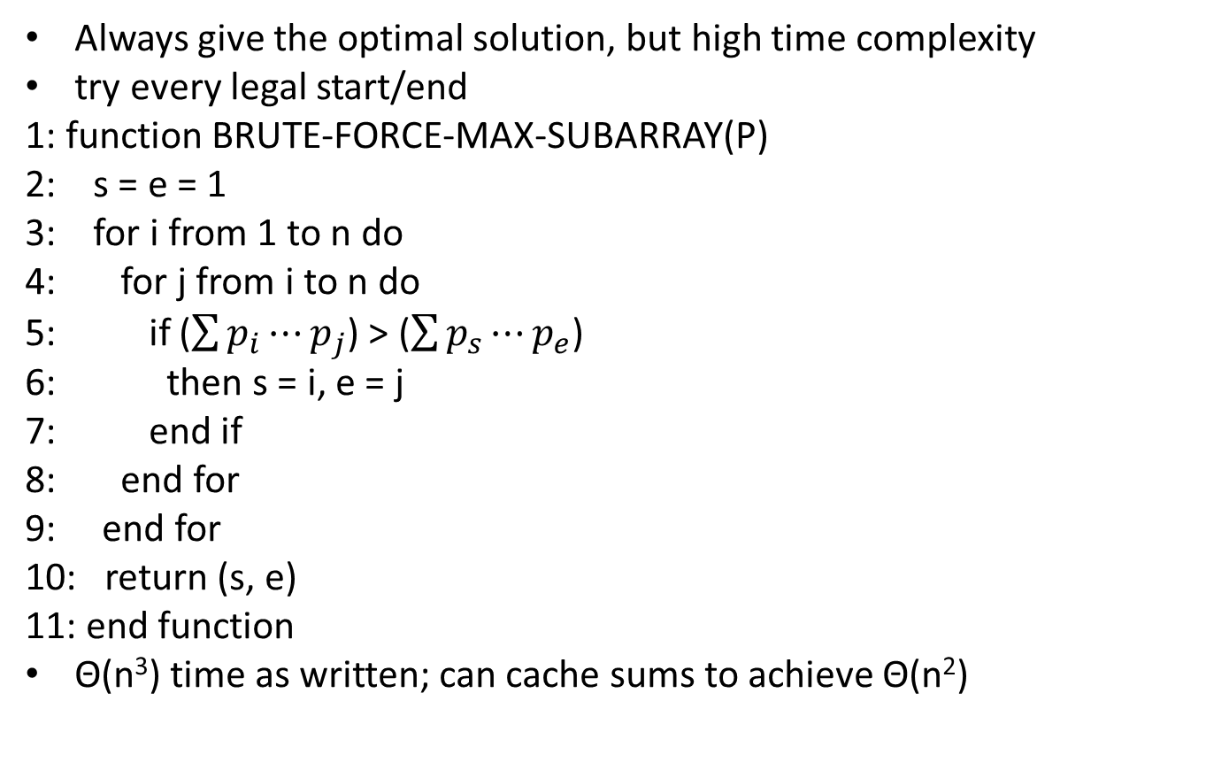
Exhaustive optimization, aka brute force

Slide 21
Divide-and-conquer (D&C) - brainstorm
Divide: chop array in half into two smaller arrays L and R
Conquer: recursively compute maximum subarray in L and in R
Combine: choose a subarray of entire P that offers the maximum sum; the subarray P could be
1. subarray entirely in L;
2. subarray entirely in R; or
3. crossing subarray that starts in L and ends in R
For Combine, options 1 and 2 are easy, option 3 is tricky

Slide 22
Identify crossing subarray - try 1
Suppose the two pieces of P are P[low … mid] and P[mid + 1 … high]
Tempting to try all pairs of s є {low … mid} and e є {mid + 1, …., high} would work, but
time becomes T(n) = 2T(n/2) + Θ(n²) which is Θ(n²) by master theorem
same time as brute force, but more complicated → not a win

Slide 23
Identify crossing subarray - try 2
Not using the fact that a crossing subarray must cross mid: s is how far before mid; separately, e is how far after mid?
two separate 1D searches → two linear loops: Θ (n) + Θ (n) = Θ (2n) = Θ (n) time
versus s is where, and e is how much later? → 2D search → two nested loops → Θ(n²) time

Slide 24
Identify crossing subarray - try 2
1: function MAX-CROSSING-SUBARRAY(P, low, mid, high)
2: leftsum = rightsum = - infinity
3: sum = 0
4: for i from mid down to low do
5: sum = sum + P[i ]
6: if sum > leftsum then
7: leftsum = sum
8: maxleft = i
9: end if
10: end for
11: sum = 0
12: for i from mid + 1 to high do
13: sum = sum + P[i ]
14: if sum > rightsum then
15: rightsum = sum
16: maxright = i
17: end if
18: end for
19: return (maxleft; maxright; leftsum + rightsum)
20: end function

Slide 25
Maximum subarray algorithm – D&C solution
1: function MAX-SUBARRAY(P, low, high)
2: if low == high then
3: return (low, high, P[low])
4: else
5: mid = floor((low + high)/2)
6: (leftlow, lefthigh, leftsum) = MAX-SUBARRAY(P, low, mid)
7: (rightlow, righthigh, rightsum) = MAX-SUBARRAY(P, mid + 1, high)
8: (crosslow, crosshigh, crosssum) = MAX-CROSSING-SUBARRAY(A, low, mid, high)
9: if leftsum >= rightsum and leftsum >= crosssum then
10: return (leftlow, lefthigh, leftsum) // entirely-left subarray
11: else if rightsum >= leftsum and rightsum >= crosssum then
12: return (rightlow, righthigh, rightsum) // entirely-right subarray
13: else
14: return (crosslow, crosshigh, crosssum) // mid-crossing subarray
15: end if
16: end if
17: end function

Slide 26
Time complexity of D&C solution
D&C runtime is T(n) = 2T(n/2) + Θ(n)
Solves to Θ(n log n), by master theorem, same as merge sort.
D&C is much faster than brute force
D&C benefits from observation that subarrays are contiguous, so extend in two directions from a middle, while brute force is oblivious to this

Slide 27
Best algorithm – Dynamic Programming
Best algorithm is Kadane’s algorithm and uses Dynamic Programming
Read https://www.geeksforgeeks.org/largest-sum-contiguous-subarray/
IDEA:
look for all positive contiguous segments of the array (max_ending_here is used for this)
and keep track of maximum sum contiguous segment among all positive segments (max_so_far is used for this)
each time we get a positive sum compare it with max_so_far and update max_so_far if it is greater than max_so_far

Slide 28
Kadane’s alg (taken from https://www.geeksforgeeks.org/largest-sum-contiguous-subarray/ )
1: function DYN-PROG-MAX-SUBARRAY(P)
2: max_so_far = INT_MIN
3: max_ending_here = 0
4: start = end = s = 0;
5: for i from 1 to n do
6: max_ending_here = max_ending_here + P[i]
7: if (max_so_far < max_ending_here) then
8: max_so_far = max_ending_here
9: start = s;
10: end = i;
11: endif
12: if (max_ending_here < 0) then
13: max_ending_here = 0
14: s = i + 1;
15: endif
16: endfor
17: return (max_so_far, start, end)
18: end function

Slide 29
More resources on Dynamic Programming
https://www.geeksforgeeks.org/top-20-dynamic-programming-interview-questions/
https://www.geeksforgeeks.org/top-50-dynamic-programming-coding-problems-for-interviews/
https://medium.com/techie-delight/top-10-dynamic-programming-problems-5da486eeb360
https://igotanoffer.com/blogs/tech/dynamic-programming-interview-questions

