Slide 1
CPSC 535: Advanced Algorithms
Instructor: Dr. Doina Bein

Slide 2
Decrease-by-half or Divide and Conquer (taken from https://github.com/kevinwortman/advanced-algorithms-slides/blob/master/03-divide-and-conquer.pdf )
One of the big ideas of computer science problem solving:
1. Divide a problem into smaller parts
2. Conquer the smaller problems recursively
3. Combine the smaller solutions into one solution for the original problem
(Ancient Roman politicians: divide your enemies (by getting them to distrust each other) and then conquer them one after another.)
Divide-and-conquer, outside of algorithm design
Software design; breaking features into classes, functions
Networking; OSI seven layer model
Parallel processing; MapReduce
Software process; agile methods; sprints

Slide 3
Divide-and-conquer pattern
1: function DIVIDE-AND-CONQUER(INPUT)
2: if INPUT is base case then
3: return trivial base case solution
4: else
5: x1, x2, …, xk = divide INPUT into k pieces (often 2)
6: s1 = DIVIDE-AND-CONQUER(x1)
7: ⁞
8: sk = DIVIDE-AND-CONQUER(xk )
9: S = combine s1, …, sk into one solution
10: return S
11: end if
12: end function

Slide 4
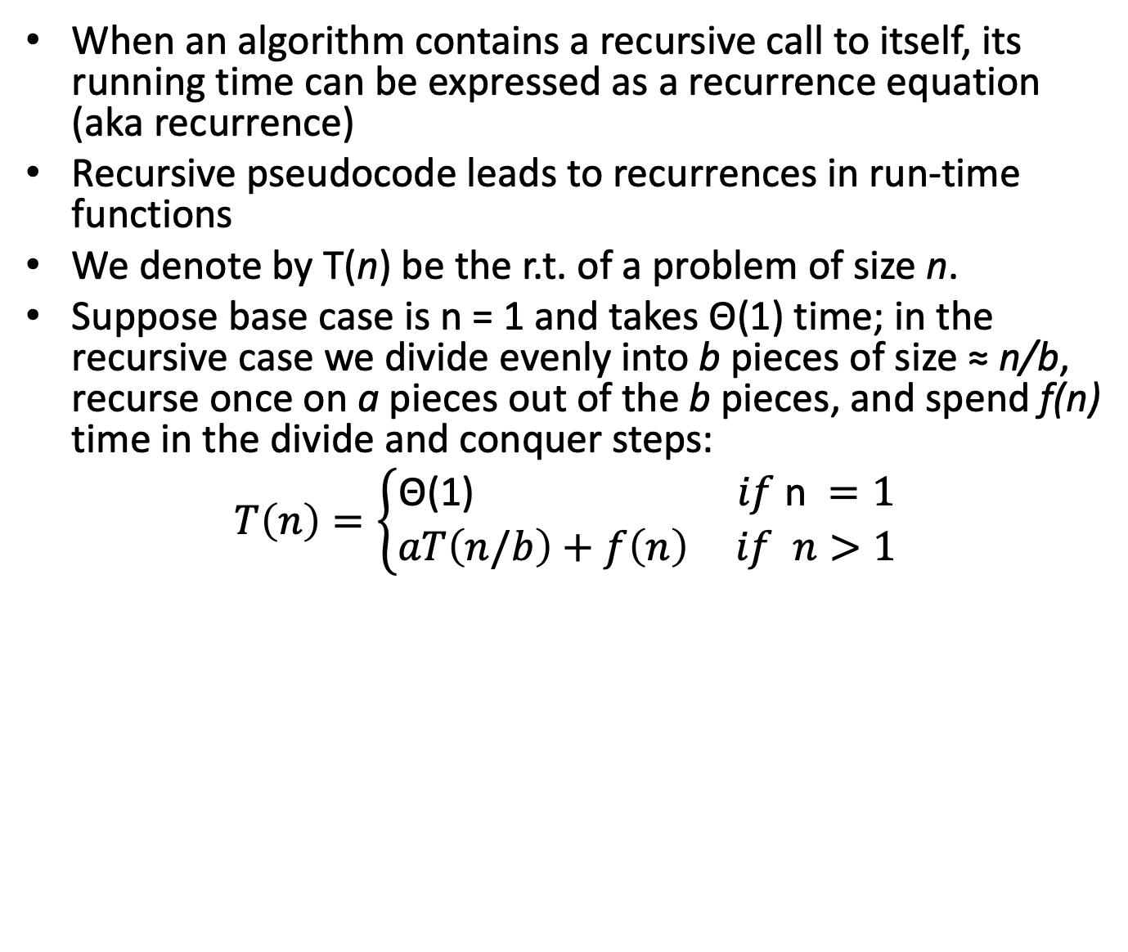
Time complexity

Slide 5
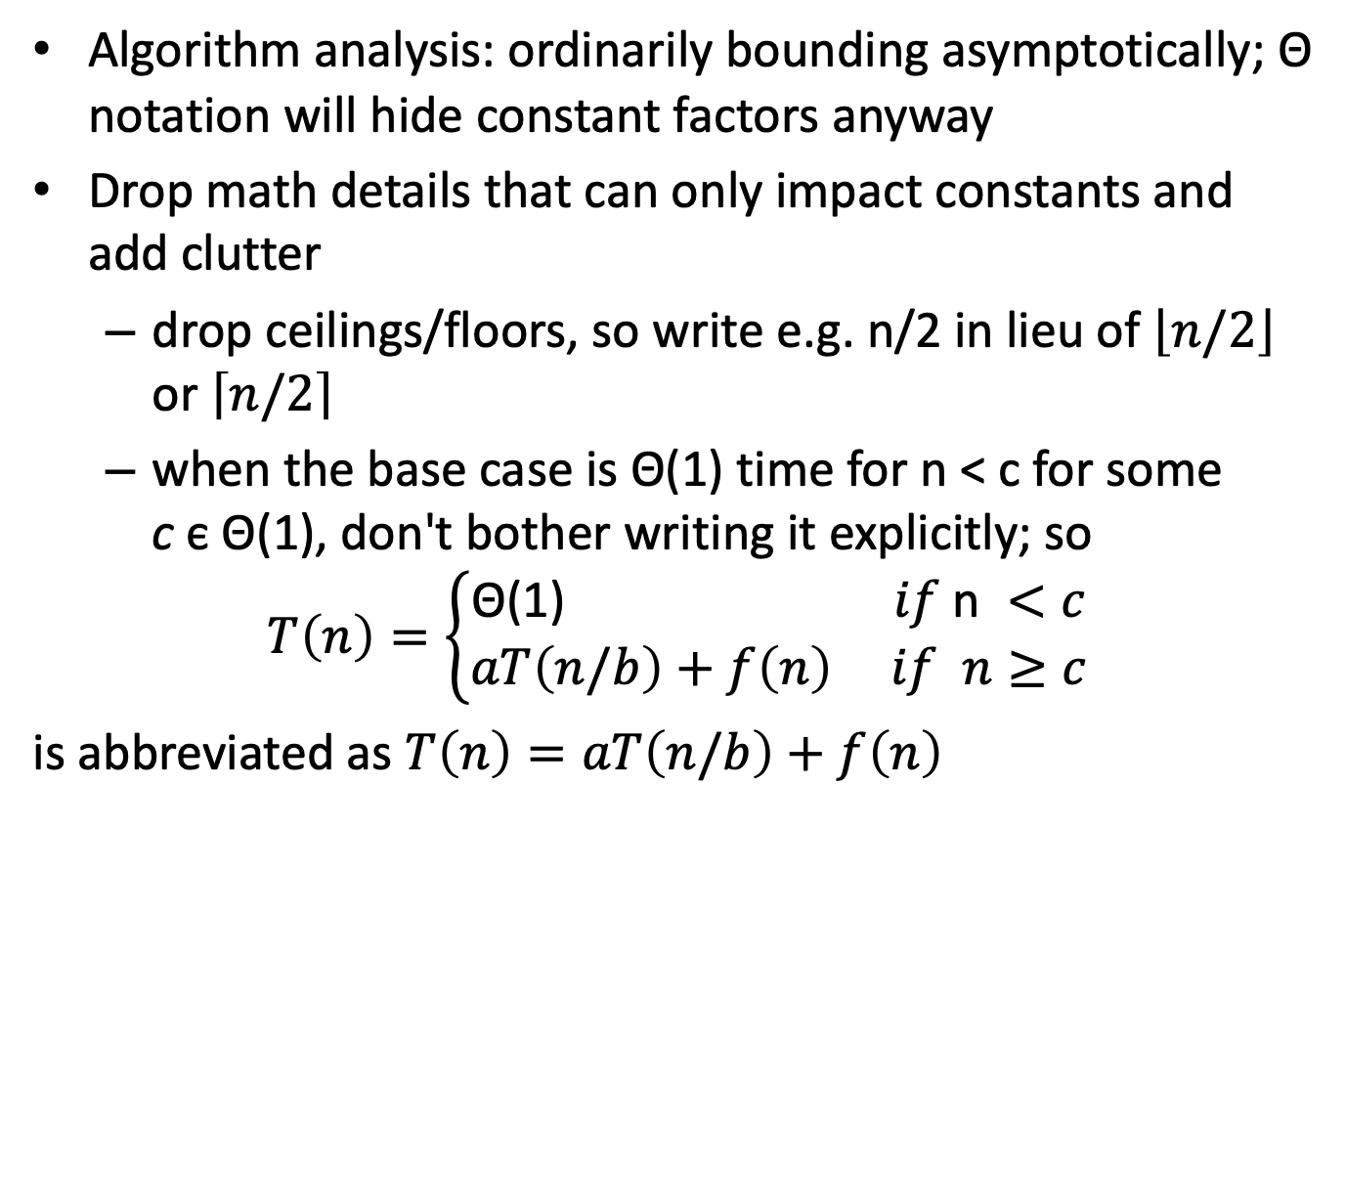
Taking liberties with recurrence functions

Slide 6
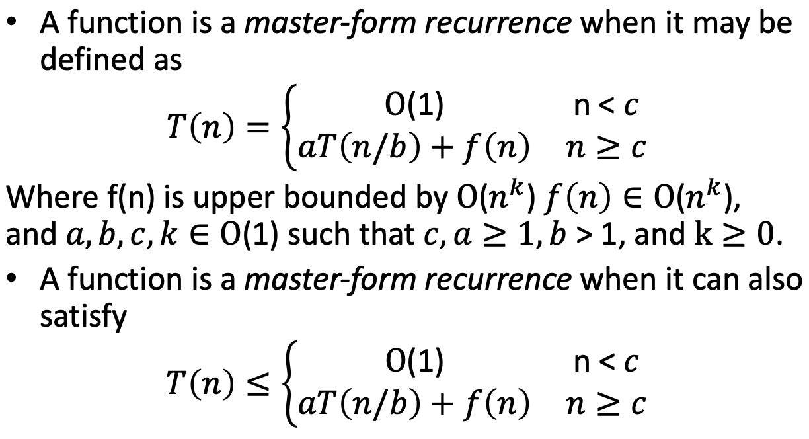
Master Theorem

Slide 7
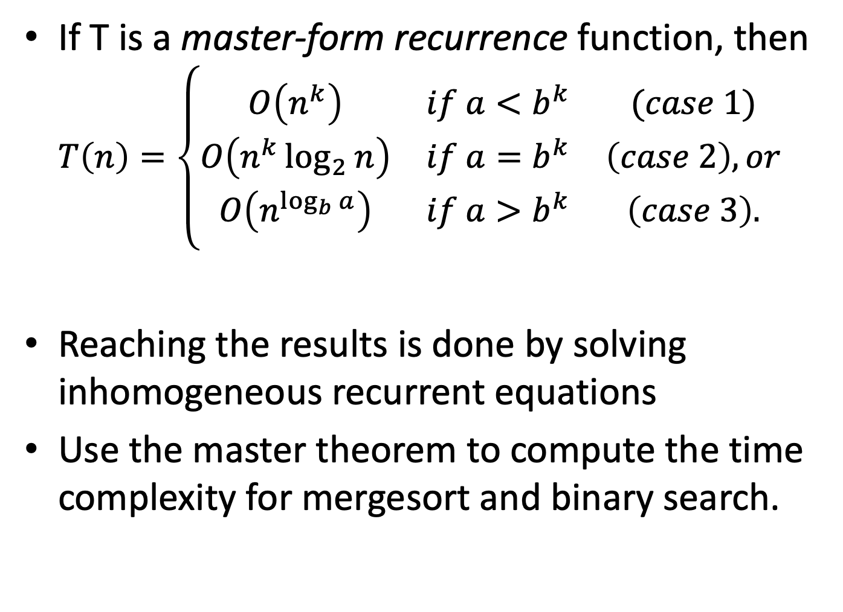

Slide 8
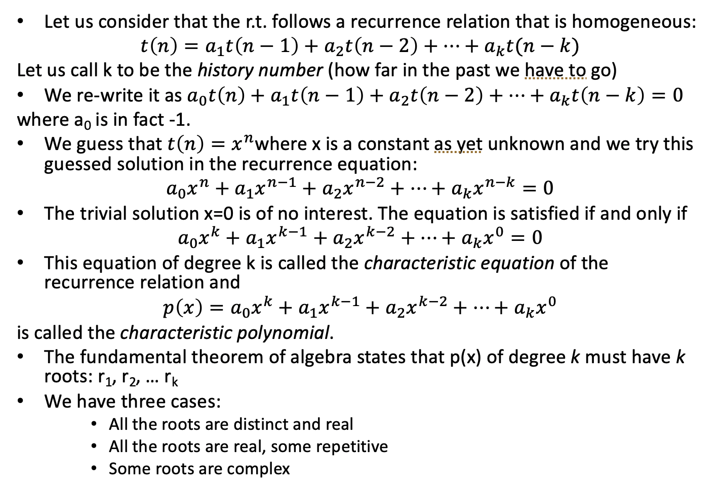
Homogeneous Recurrences

Slide 9
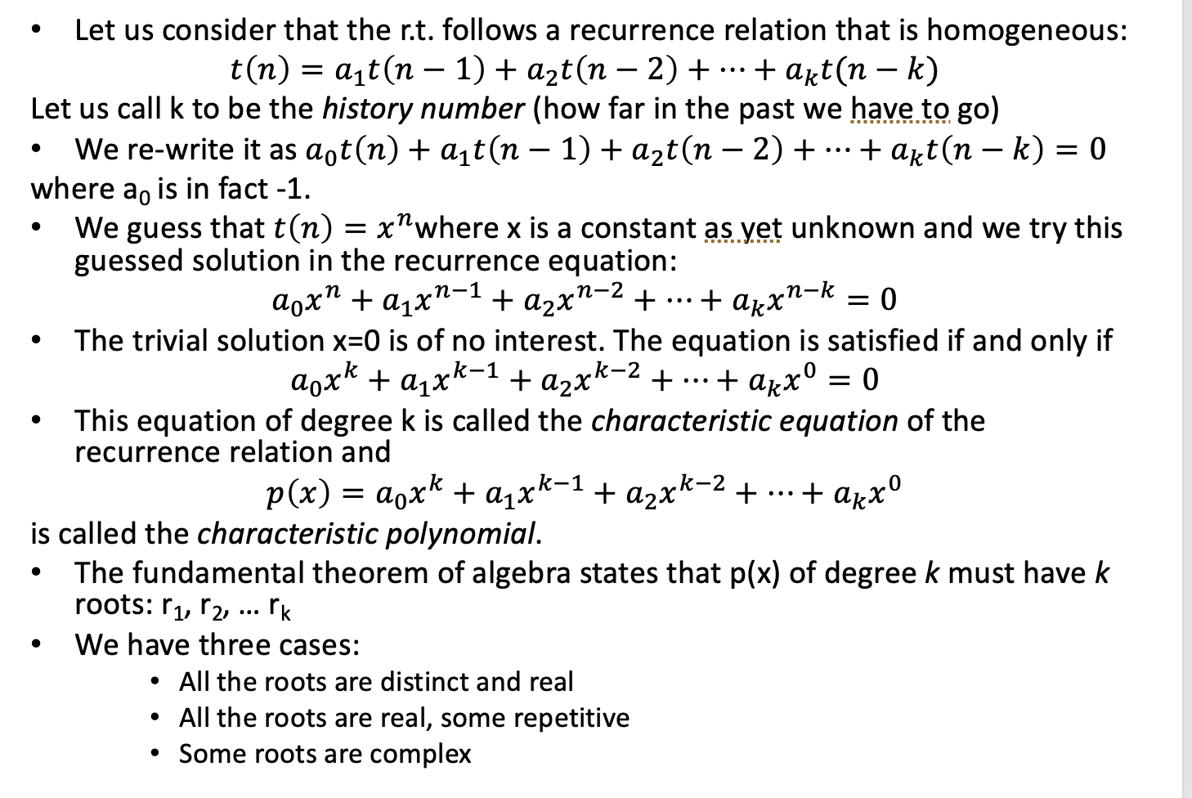
Case 1: All roots are real and distinct

Slide 10
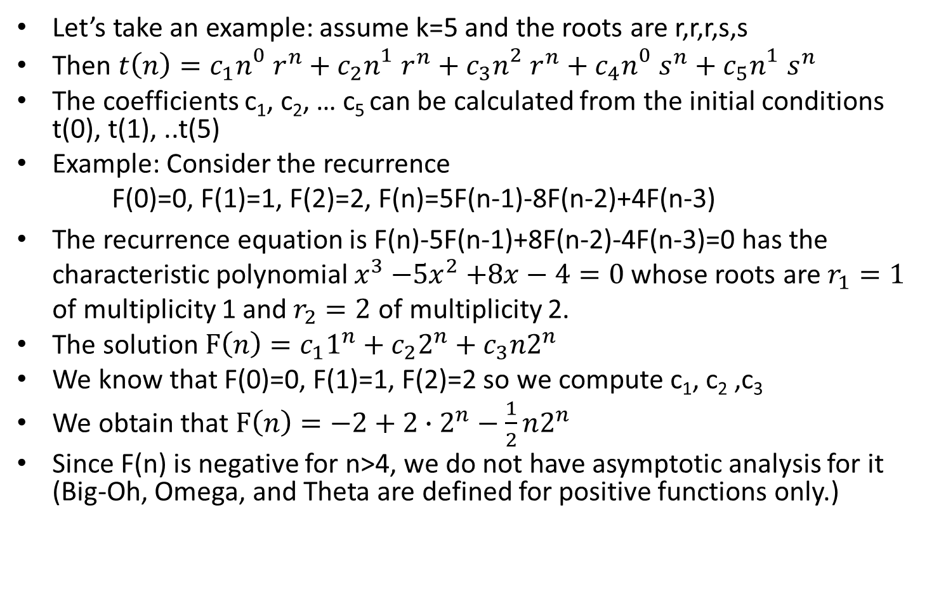
Case 2: All roots are real, some repeat

Slide 11
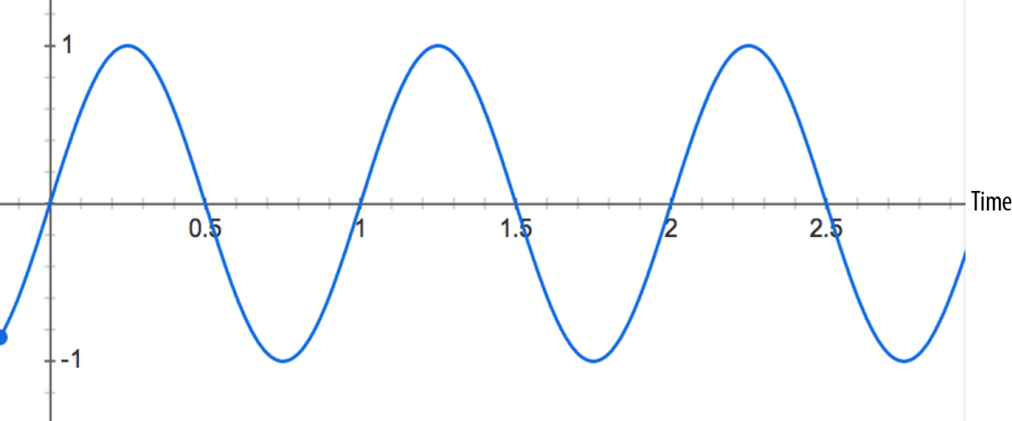
Case 3: Some roots are complex
When n grows asymptotically, a complex root makes for oscillating values for t(n) (like sine or cosine)
This makes no sense in the analysis of the r.t., so please check the correctness of your recurrence.

Slide 12
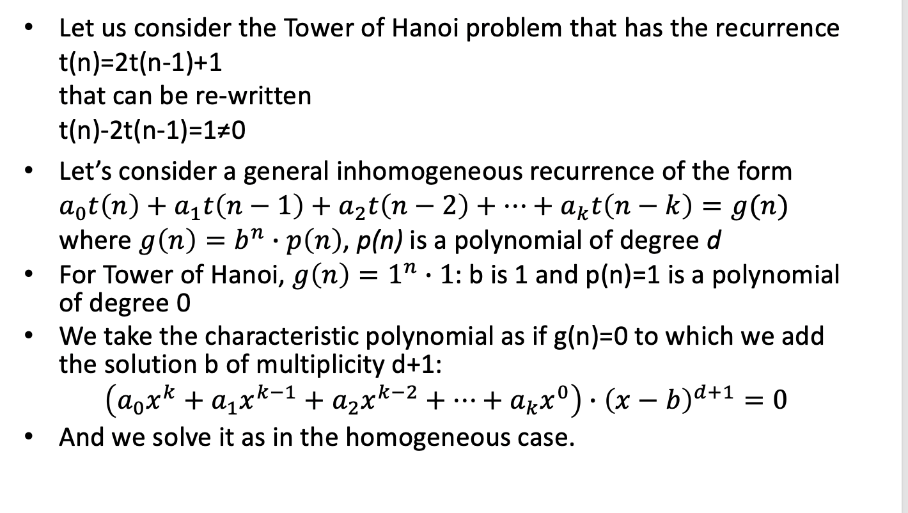
Inhomogeneous Recurrences

Slide 13
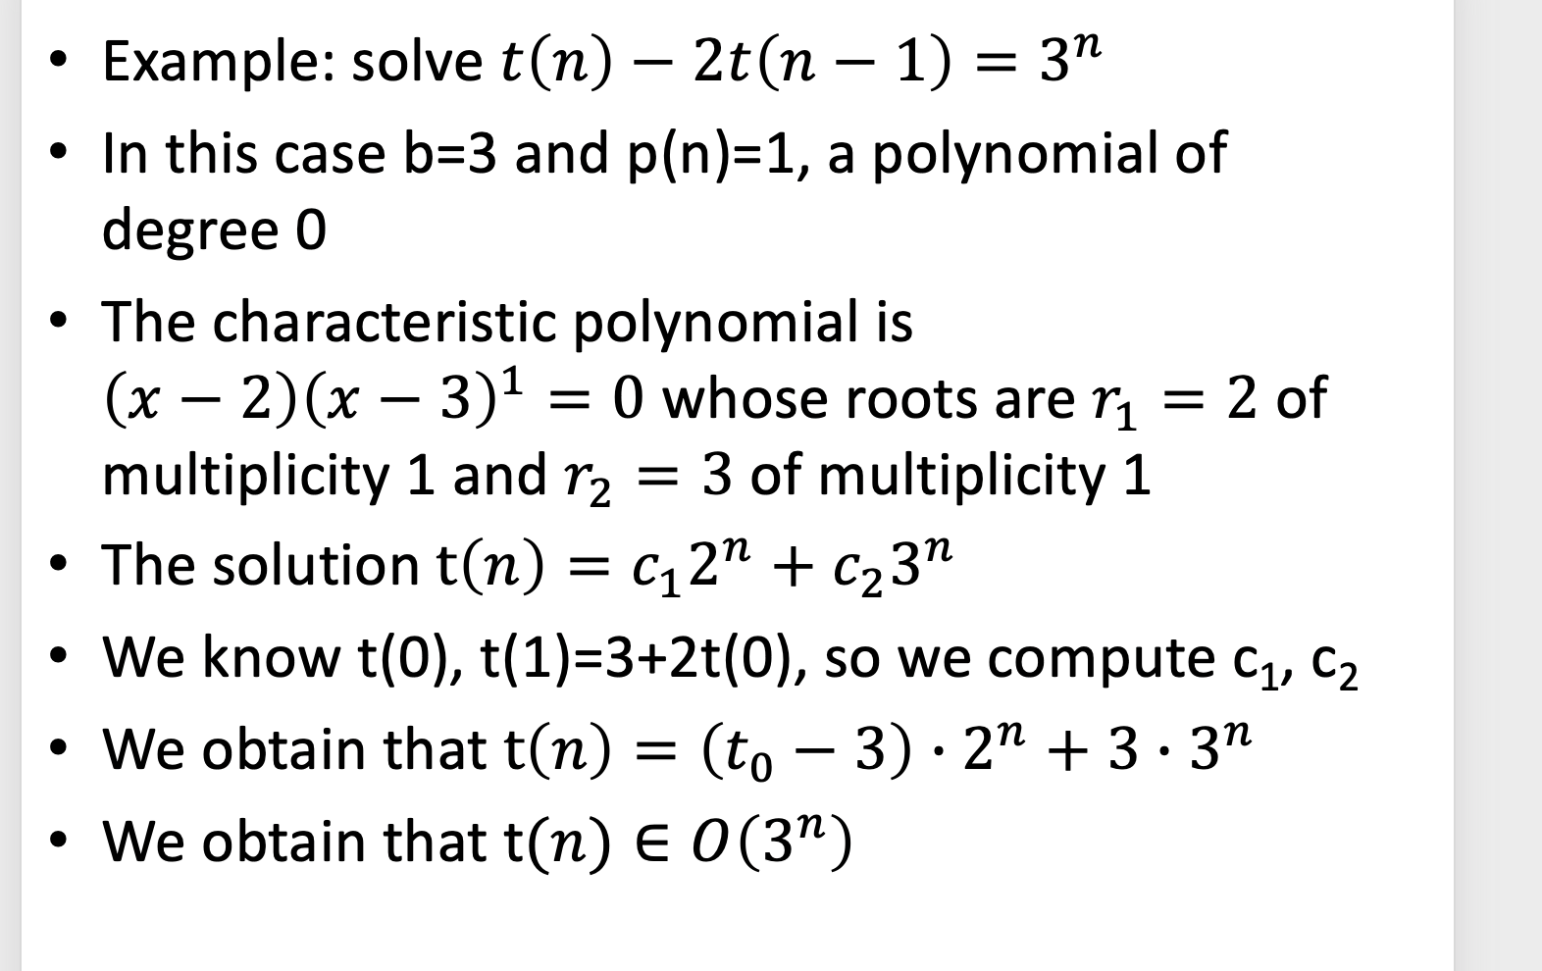

Slide 14
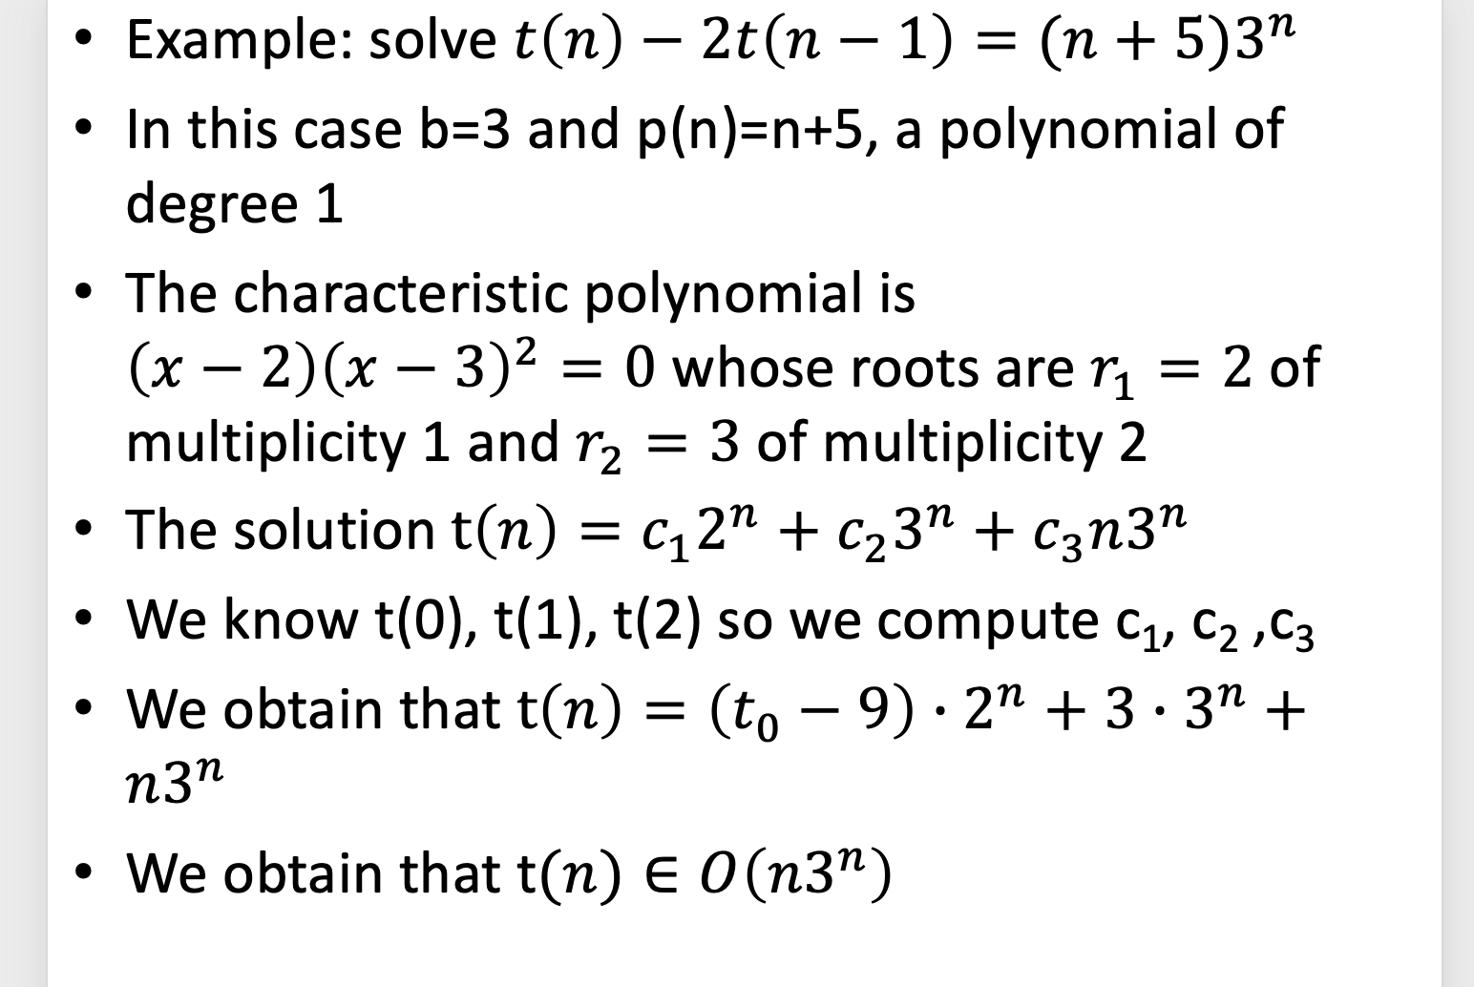

Slide 15
Change of Variables

Slide 16
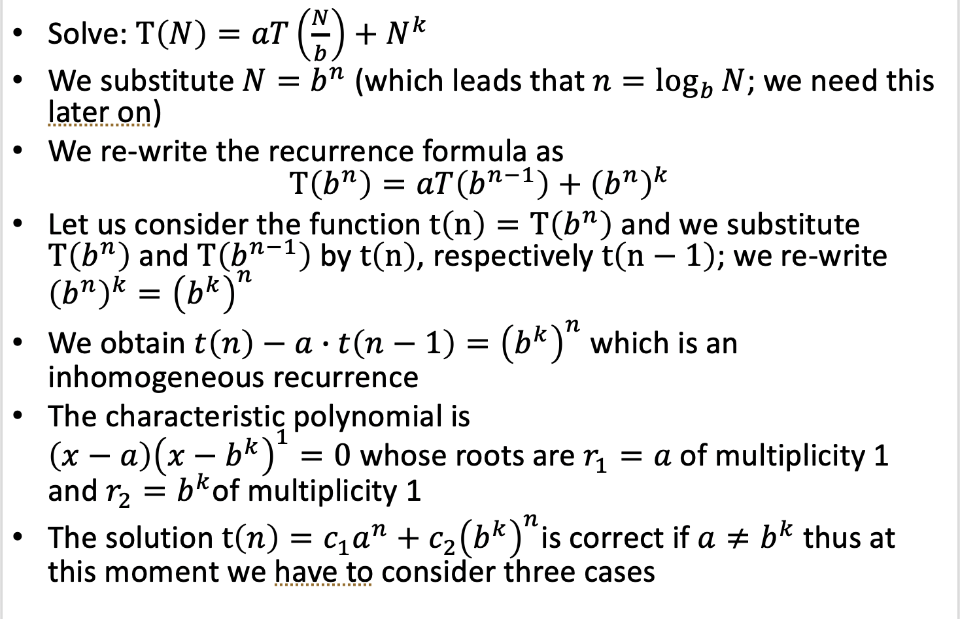
Master Theorem

Slide 17
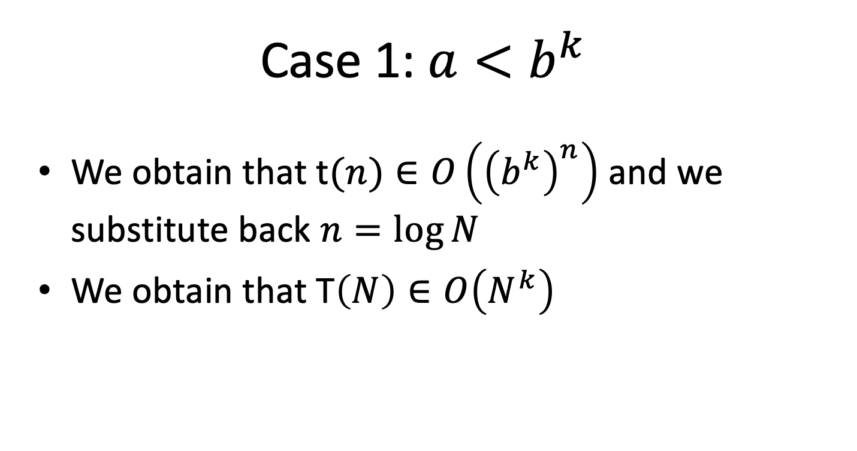

Slide 18
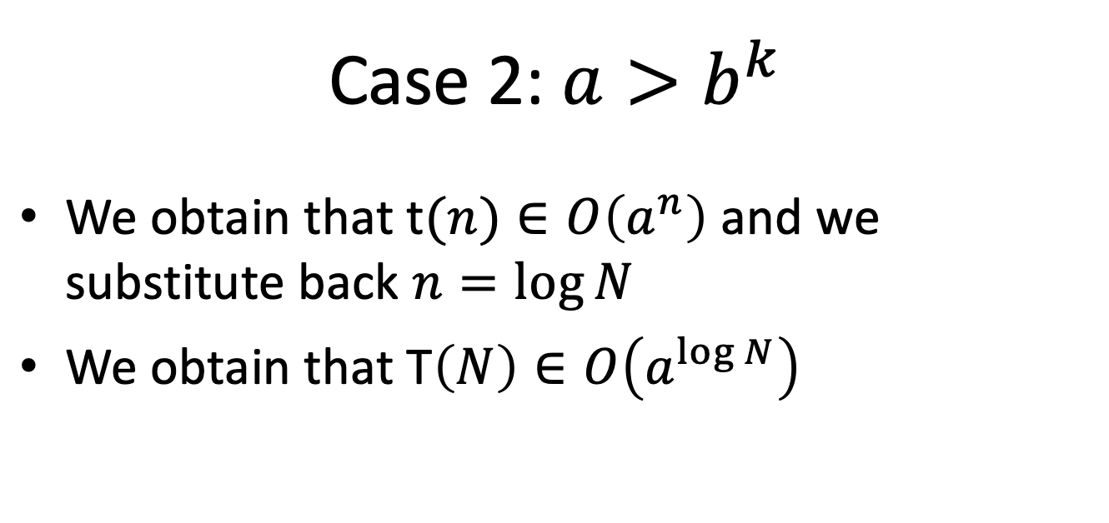

Slide 19
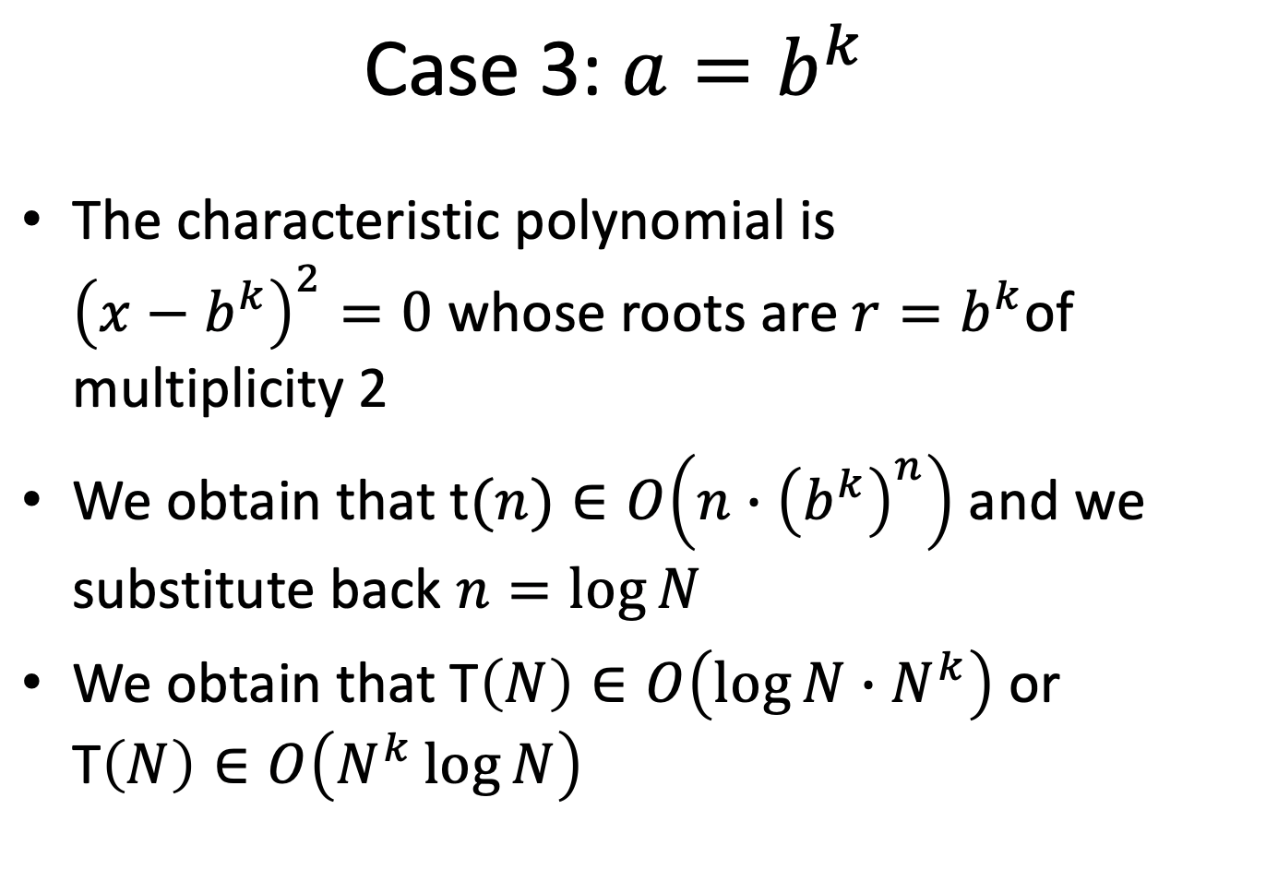

Slide 20
Merge Sort
Merge sort is a divide-and-conquer algorithm that was invented by John von Neumann in 1945
Given a vector of n comparable elements V, stored in an array V[1 ...n], sort the sequence in non-descending order; Objective: the sorted sequence S is a permutation S of V
Follow the divide-and-conquer paradigm for sorting:
Divide: Split V down the middle into two subsequences, each of size roughly n/2.
Conquer: Sort each subsequence (by calling merge_sort recursively on each).
Combine: Merge the two sorted subsequences into a single sorted list (by calling merge).
Merge-Sort(A,i,j)
if (i<j) then
m = (i+j)/2
Merge-Sort(A,i,m)
Merge-Sort(A,m+1,j)
merge(A,i,m,j)

Slide 21
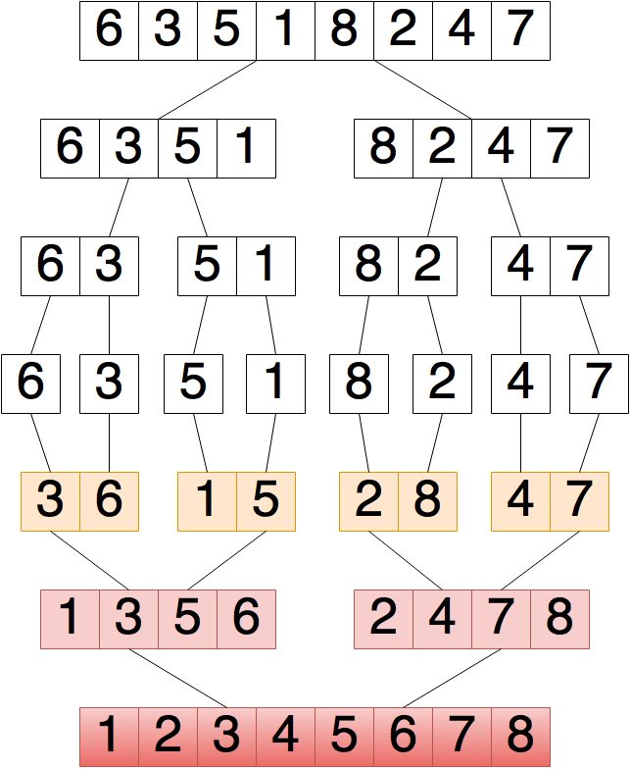

Slide 23
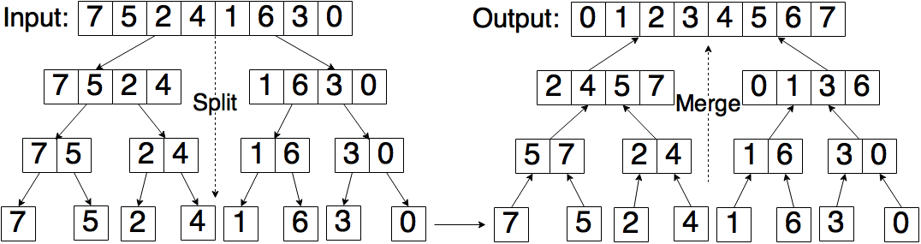
Pseudocode:
MergeSort(array V, int p, int r) {
if (p == r) then // do nothing
else {
// we have at least 2 items
q = (p + r)/2
MergeSort(V, p, q) // sort V[p..q]
MergeSort(V, q+1, r) // sort V[q+1..r]
Merge(V, p, q, r) // merge everything together
}
}
Procedure Merge is described on the next slide.

Slide 24
Merge(array V, int p, int q, int r) {
// merges V[p..q] with V[q+1..r]
// declare a temporary array S to store the sorted sequence
array S[p..r]
i = k = p // initialize pointers
j = q+1
while (i <= q and j <= r) {
// while both subarrays are nonempty
if (V[i] <= V[j]) then
// copy from left subarray
S[k++] = V[i++]
else
// copy from right subarray
S[k++] = V[j++]
}
// copy any leftover to B from the left subarray
while (i <= q) do
S[k++] = V[i++]
// copy any leftover to B from the right subarray
while (j <= r) do
S[k++] = V[j++]
// copy B back to A
for i = p to r do V[i] = S[i]
}
Observe that of the last two while-loops in the Merge procedure, only one will be executed. Why?

Slide 25
MergeSort(array V, int p, int r) {
if (p == r) then // do nothing
else {
// we have at least 2 items
q = (p + r)/2
MergeSort(V, p, q) // sort V[p..q]
MergeSort(V, q+1, r) // sort V[q+1..r]
Merge(V, p, q, r) // merge everything together
}
}
Merge(array V, int p, int q, int r) {
// merges V[p..q] with V[q+1..r]
// declare a temporary array S to store // the sorted sequence
array S[p..r]
i = k = p // initialize pointers
j = q+1
while (i <= q and j <= r) {
// while both subarrays are nonempty
if (V[i] <= V[j]) then
// copy from left subarray
S[k++] = V[i++]
else
// copy from right subarray
S[k++] = V[j++]
}
// copy any leftover to B from the left subarray
while (i <= q) do
S[k++] = V[i++]
// copy any leftover to B from the right subarray
while (j <= r) do
S[k++] = V[j++]
// copy B back to A
for i = p to r do V[i] = S[i]
}

Slide 26
Merge Sort is a Stable Sorting Algorithm
Suppose that instead of the if-statement “if (V[i] <= V[j])”, we have the if-statement “if (V[i] < V[j])” .
In this case, if (V[i]==V[j]) we would copy from the right subvector.
It wouldn’t have mattered for equal elements, if instead of copying from the left subvector we had copied from the right subvector; since the elements are equal, they can appear in either order in the final subvector.
The reason to prefer this particular choice:
Many times we are sorting data that does not have a single attribute, but has many attributes (name, SSN, grade, etc.) Often the list may already have been sorted on one attribute (say, name). If we sort on a second attribute (say, grade), then it would be nice if people with same grade are still sorted by name.
A sorting algorithm that has the property that equal items will appear in the final sorted list in the same relative order that they appeared in the initial input is called a stable sorting algorithm.
By favoring elements from the left sublist over the right, we preserve the relative order of elements.
It can be shown by induction that Merge Sort is a stable sorting algorithm.

Slide 27
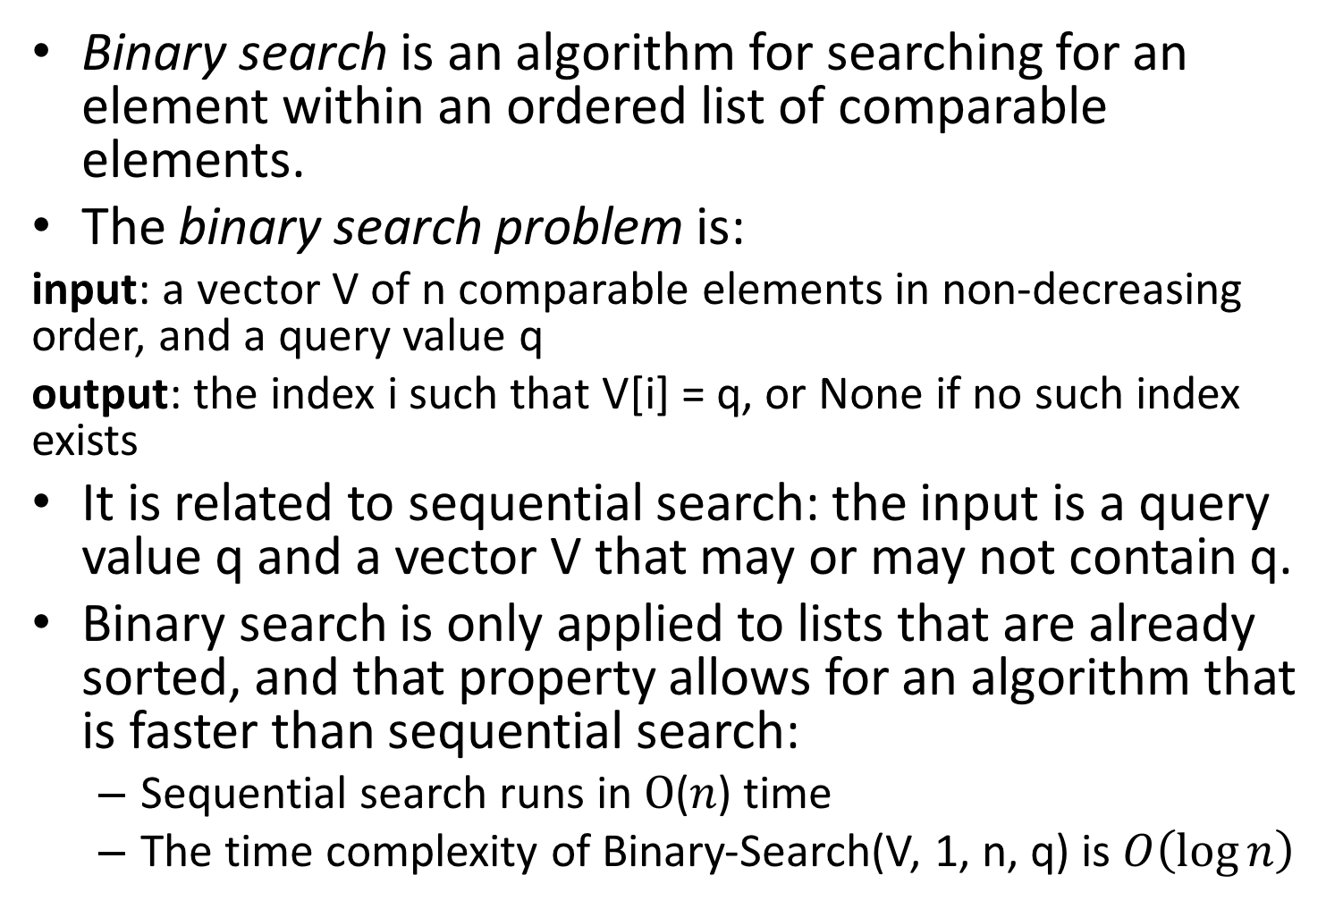
Binary Search

Slide 28
Follows the divide-and-conquer paradigm
Divide: the n-element vector V[i..j], i=1 and j=n, into two subsequence of n/2 length, V[i..m] and V[m+1..j] where m=(i+j)/2
Conquer: compare the middle element of the sequence with q and search the correct subsequence out of the two using binary-search
Combine: nothing

Slide 29
Binary-Search(V, i, j, q)
if (i == j) then
return (V[i] == q)
else
m = (i+j)/2
if ( V[m] == q ) then
return True
else
if ( q < V[m] ) then
return Binary-Search(V,i,m-1,q)
else
// ( q > V[m] )
return Binary-Search(V,m+1,j,q)

Slide 30
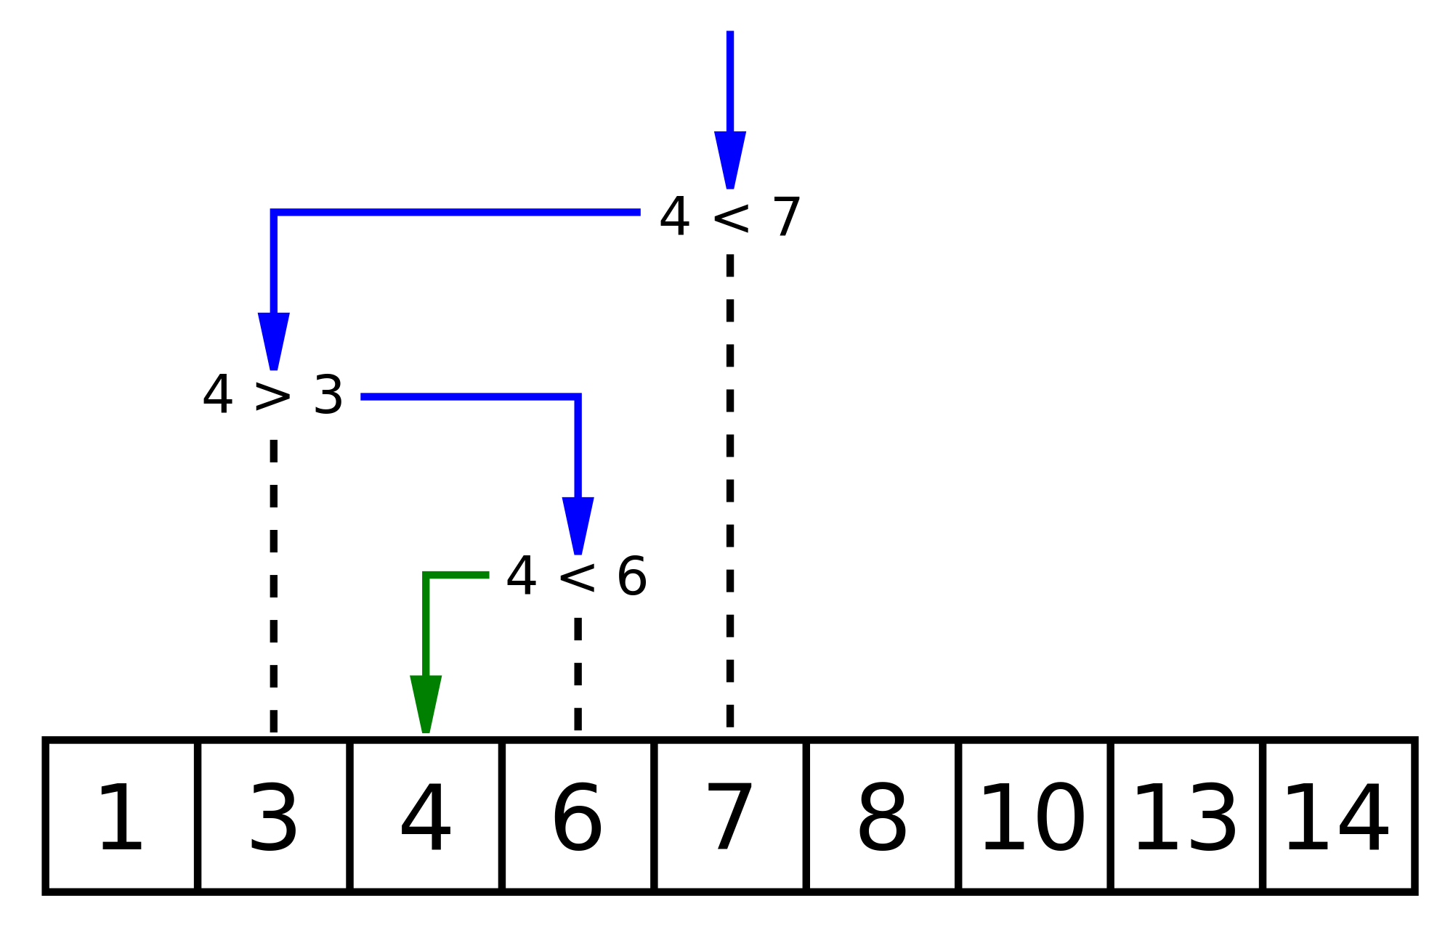
Image taken from wikipedia

Slide 31
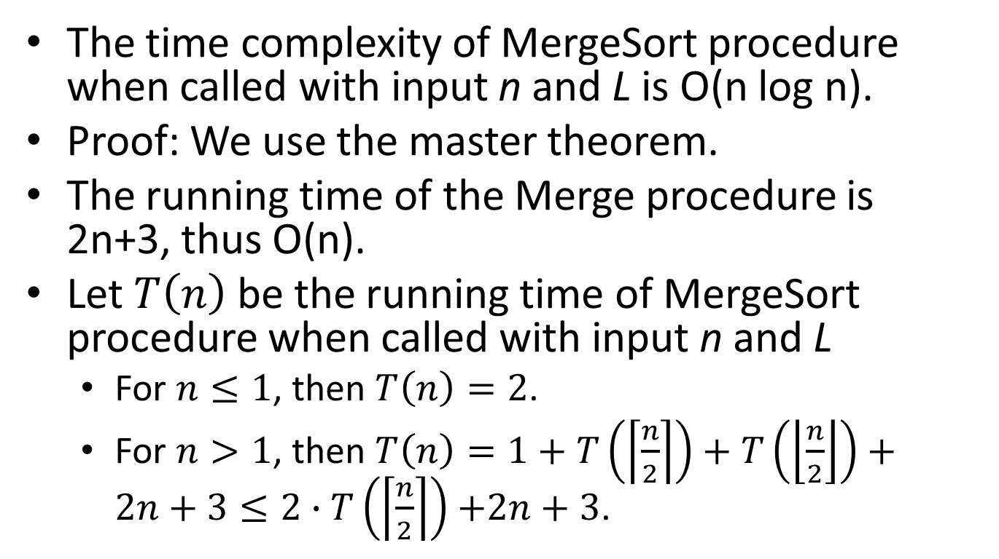
Time Complexity of Mergesort

Slide 32
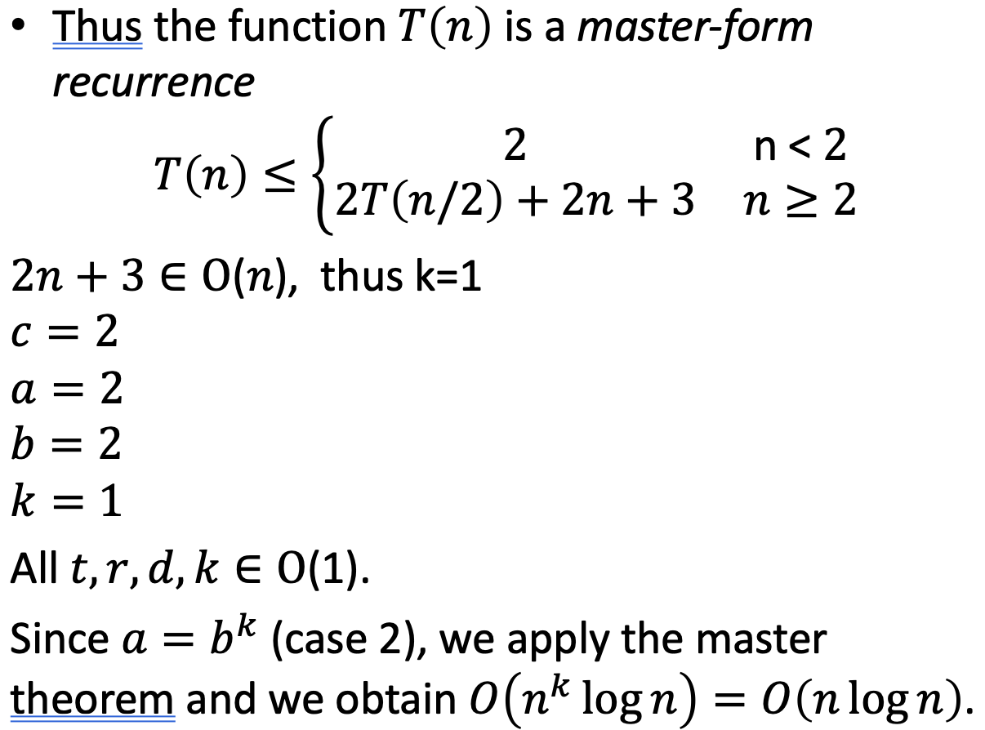

Slide 33
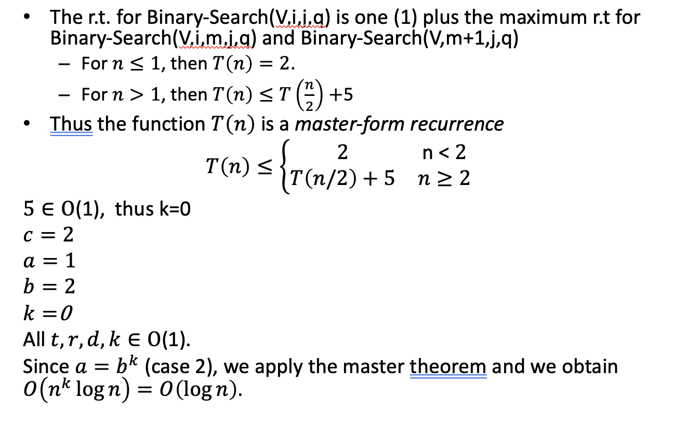
Time Complexity of Binary Search

Slide 34
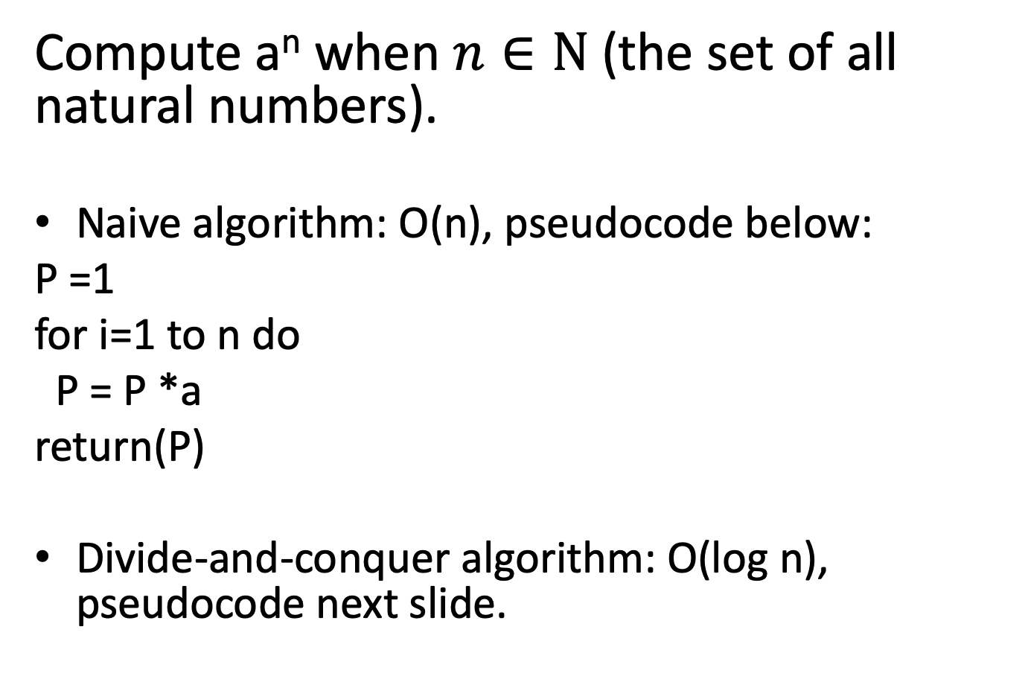
Powering a number (https://users.cs.duke.edu/~reif/courses/alglectures/demleis.lectures/lec3.pdf)

Slide 35
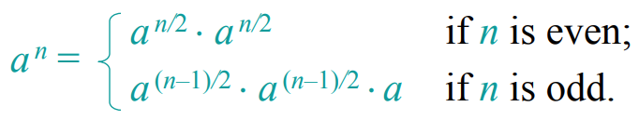
Powering a number (contd.)
We use the following relation
By the master theorem: T(n) = T(n/2) + O(1) => T(n) = O(log n).
DaC(a,n)
if n ==0) return(1)
elsif (n==1) return(a)
elsif (n%2 == 0) // even number
B = DaC(a,n/2)
return(B*B)
else // odd number
B = DaC(a,(n-1)/2)
return(B*B*a)

Slide 36
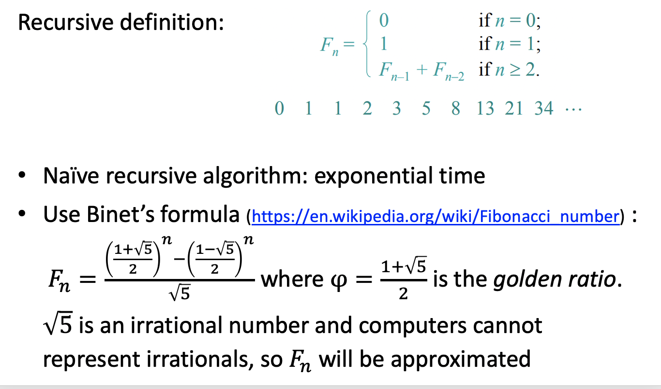
Computing Fibonacci numbers (https://users.cs.duke.edu/~reif/courses/alglectures/demleis.lectures/lec3.pdf)

Slide 37
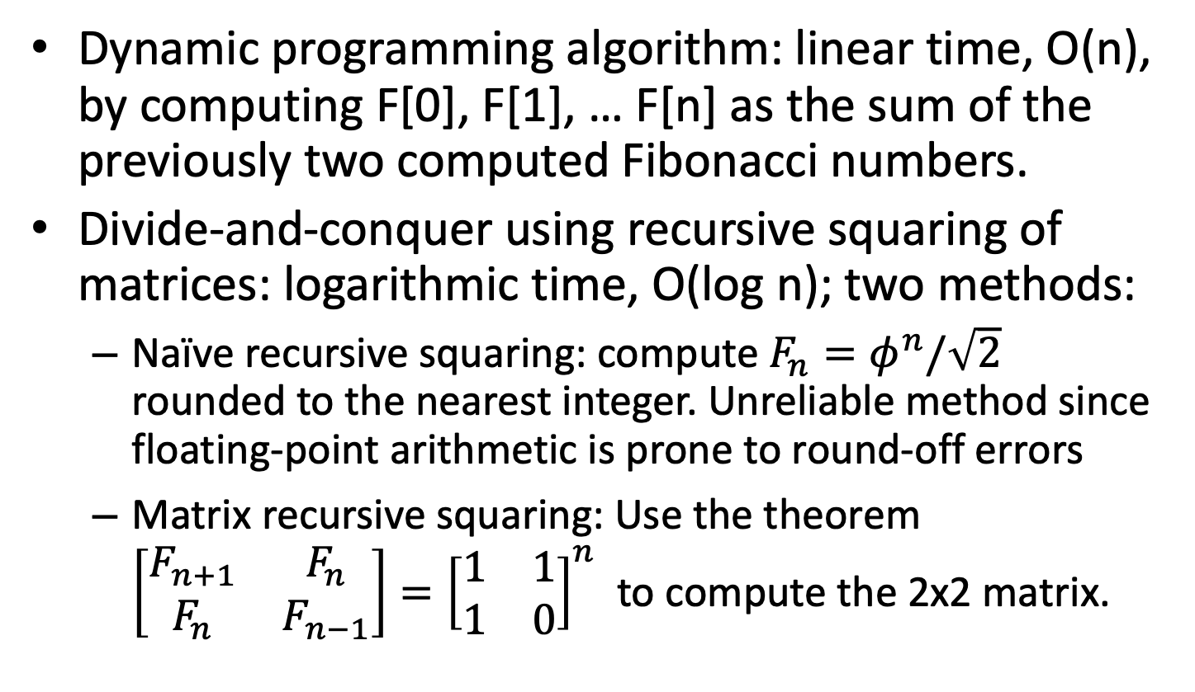
Computing Fibonacci numbers (contd.) (https://users.cs.duke.edu/~reif/courses/alglectures/demleis.lectures/lec3.pdf)

Slide 38
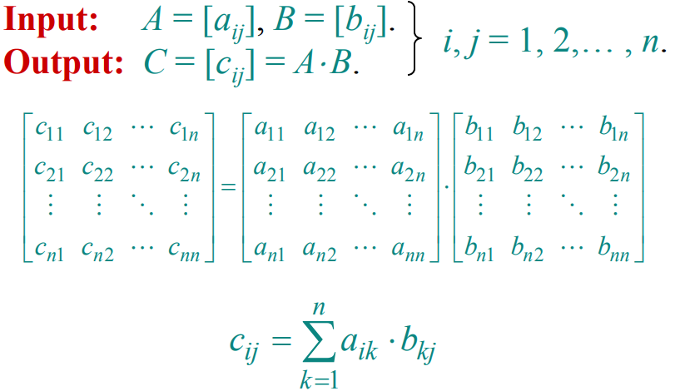
Matrix Multiplication
Given two matrices A=[a_{ij}] and B=[b_{ij}] , compute C= [c_{ij}] =A⋅B, with i,j=1,..n.

Slide 39
Matrix Multiplication (contd.)
Algorithm learnt in school:
for i=1 to n do
for j = 1 to n do
c[i][j] = 0
for k=1 to n do
c[i][j] = c[i][j] + a[i][k] * b[k][j]
Time complexity: O(n³)

Slide 40
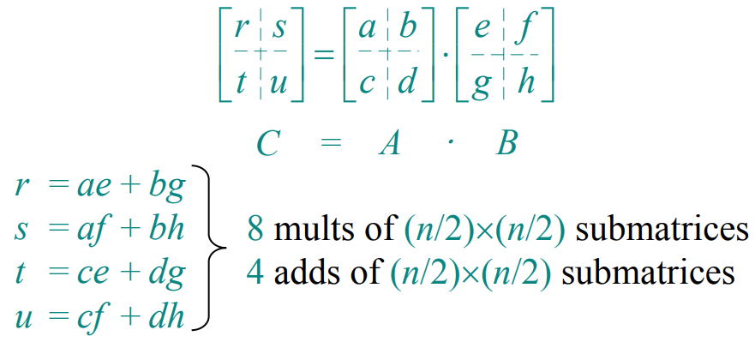
Matrix Multiplication (contd.)
Divide-and-conquer: the n×n matrix is equivalent to a 2×2 matrix, each element being an (n/2)×(n/2) submatrix
mults = multiplications
adds = additions

Slide 41
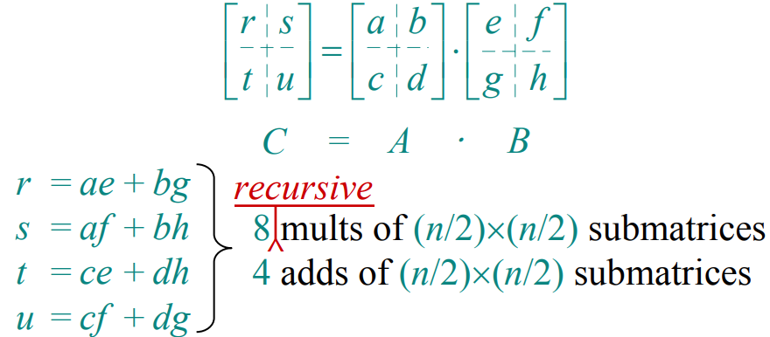
Matrix Multiplication (contd.)
Divide-and-conquer: the n×n matrix is equivalent to a 2×2 matrix, each element being an (n/2)×(n/2) submatrix

Slide 42
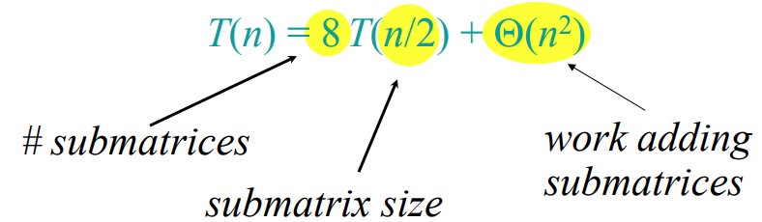
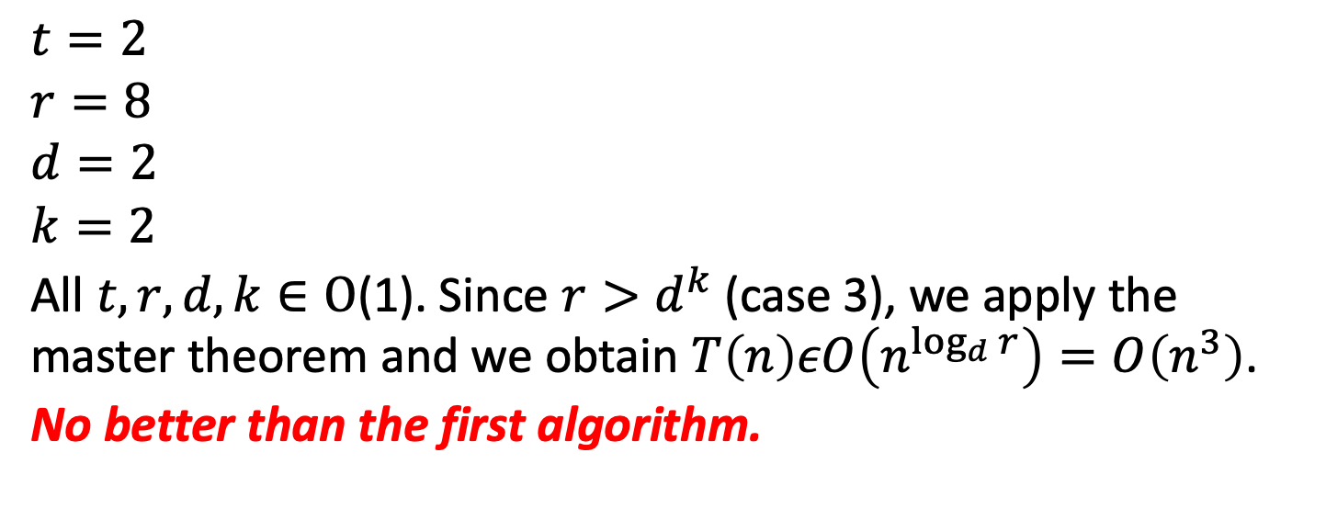
Matrix Multiplication (contd.)

Slide 43
Matrix multiplication: Strassen idea
Strassen idea: Multiply 2×2 matrices using only 7 recursive mults.
Let A and B be the two input matrices, 2x2
Let C = A⋅B, so we would have to have
r = a⋅e + b⋅g
s = a⋅f + b⋅h
t = c⋅e+d⋅g
u = c⋅f+d⋅h which is the standard matrix multiplication.
Instead, we consider 7 new terms:
P1 = a ⋅ (f-h) and we now have r = P5 + P4 - P2 + P6
P2 = (a+b) ⋅ h s = P1 + P2
P3 = (c+d) ⋅ e t = P3 + P4
P4 = d ⋅ (g-e) u = P5 + P1 - P3 - P7
P5 = (a+d) ⋅ (e+h) with a total of 7 mults and 18 adds/subs
P6 = (b-d) ⋅ (g+h)
P7 = (a-e) ⋅ (e+f)

Slide 44
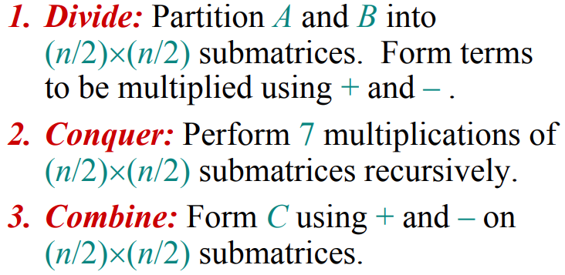
Strassen’s algorithm for any matrices
It can be generalized to any pair of n×n matrices A and B
Time complexity: T(n) = 7T(n/2) + O(n²)

Slide 45
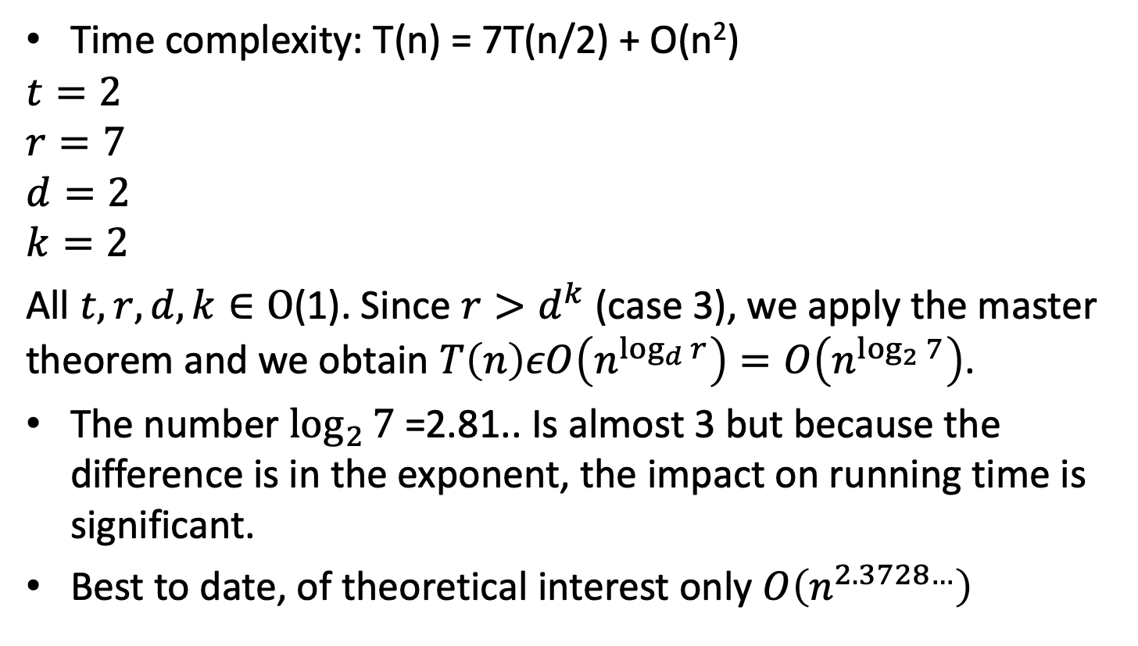
Strassen’s algorithm for any matrices (contd.)

Slide 46
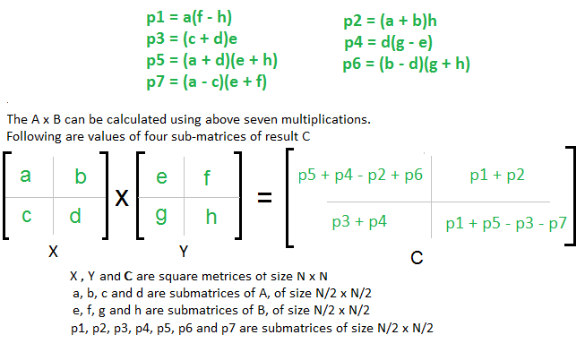
Easy way to remember Strassen (taken from https://www.geeksforgeeks.org/easy-way-remember-strassens-matrix-equation/)
You just need to remember 4 Rules :
AHED (Learn it as ‘Ahead’)
Diagonal
Last CR
First CR
Also, consider X as (Row +) and Y as (Column -) matrixraw

Slide 47
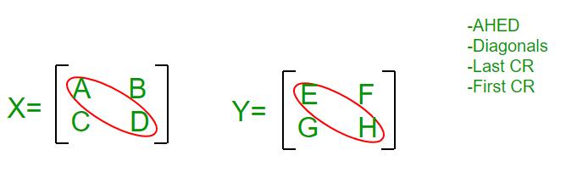
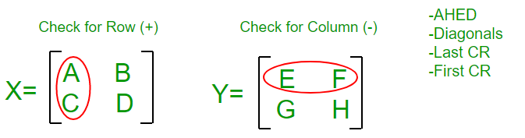
Follow the Steps :
Write P1 = A; P2 = H; P3 = E; P4 = D
For P5 we will use Diagonal Rule i.e. (Sum the Diagonal Elements Of Matrix X ) * (Sum the Diagonal Elements Of Matrix Y ), we get P5 = (A + D)* (E + H)
P1 = A
P2= H
P3= E
P4= D
P5= ( A + D ) * ( E + H )
For P6 we will use Last CR Rule i.e. Last Column of X and Last Row of Y and remember that Row+ and Column- so i.e. (B – D) * (G + H), we get
P6 = (B – D) * (G + H)
For P7 we will use First CR Rule i.e. First Column of X and First Row of Y and remember that Row+ and Column- so i.e. (A – C) * (E + F), we get
P6 = (A – C) * (E + F)

Slide 48
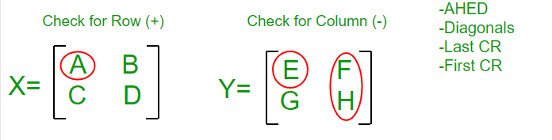
P1 = A
P2= H
P3= E
P4= D
P5= ( A + D ) * ( E + H )
P6= ( B – D ) * ( G + H)
P7= ( A – C ) * ( E + F)
Come Back to P1 : we have A there and it’s adjacent element in Y Matrix is E, since Y is Column Matrix so we select a column in Y such that E won’t come, we find F H Column, so multiply A with (F – H)
So, finally P1 = A * (F – H)

Slide 49
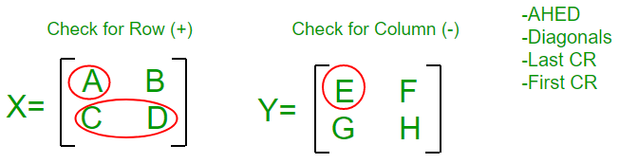
P1 = A * ( F – H)
P2= H
P3= E
P4= D
P5= ( A + D ) * ( E + H )
P6= ( B – D ) * ( G + H)
P7= ( A – C ) * ( E + F)
Come Back to P2 : we have H there and it’s adjacent element in X Matrix is D, since X is Row Matrix so we select a Row in X such that D won’t come, we find A B Column, so multiply H with (A + B)
So, finally P2 = H * (A + B)
Come Back to P3 : we have E there and it’s adjacent element in X Matrix is A, since X is Row Matrix so we select a Row in X such that A won’t come, we find C D Column, so multiply E with (C + D)
So, finally P3 = E * (C + D)

Slide 50
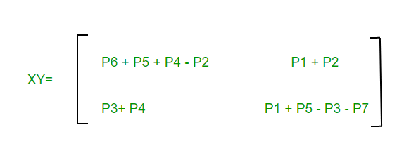
P1= A * ( F – H )
P2= H * ( A + B )
P3= E * ( C + D )
P4= D
P5= ( A + D ) * ( E + H )
P6= ( B – D ) * ( G + H)
P7= ( A – C ) * ( E + F)
Come Back to P4 : we have D there and it’s adjacent element in Y Matrix is H, since Y is Column Matrix so we select a column in Y such that H won’t come, we find G E Column, so multiply D with (G – E)
So, finally P4 = D * (G – E)
We are done with P1 – P7 equations, so now we move to C1 – C4 equations in Final Matrix C :
Remember Counting : Write P1 + P2 at C2
Write P3 + P4 at its diagonal Position i.e. at C3
Write P4 + P5 + P6 at 1st position and subtract P2 i.e. C1 = P4 + P5 + P6 – P2
Write odd values at last Position with alternating – and + sign i.e. P1 P3 P5 P7 becomes
C4 = P1 – P3 + P5 – P7

Slide 51
Counting paths between two vertices in a graph (taken from Levitin, page 242)
It is not difficult to prove by mathematical induction that the number of different paths of length k > 0 from the ith vertex to the jth vertex of a graph (undirected or directed) equals the (i, j)th element of A^{k} where A is the adjacency matrix of the graph.
Therefore, the problem of counting a graph’s paths can be solved with an algorithm for computing an appropriate power of its adjacency matrix.
Note that the exponentiation algorithms we discussed before for computing powers of numbers are applicable to matrices as well.

Slide 52
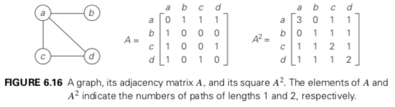
Example (taken from Levitin, page 242)
Consider the graph of Figure 6.16.
Its adjacency matrix A and its square A² indicate the numbers of paths of length 1 and 2, respectively, between the corresponding vertices of the graph.
There are three paths of length 2 that start and end at vertex a, (a − b − a, a − c − a, and a − d − a), but there is only one path of length 2 from a to c, (a − d − c).

Slide 53
Indivisible Problems
The decrease-by-a-fraction pattern cannot be used to solve all problems.
The viability of the pattern depends on two properties of the problem at hand:
It must always be possible to divide any instance into two sub-instances of roughly equal size; and
It must always be possible to combine the solutions to those sub-instances into a correct output for the entire original instance.

Slide 54
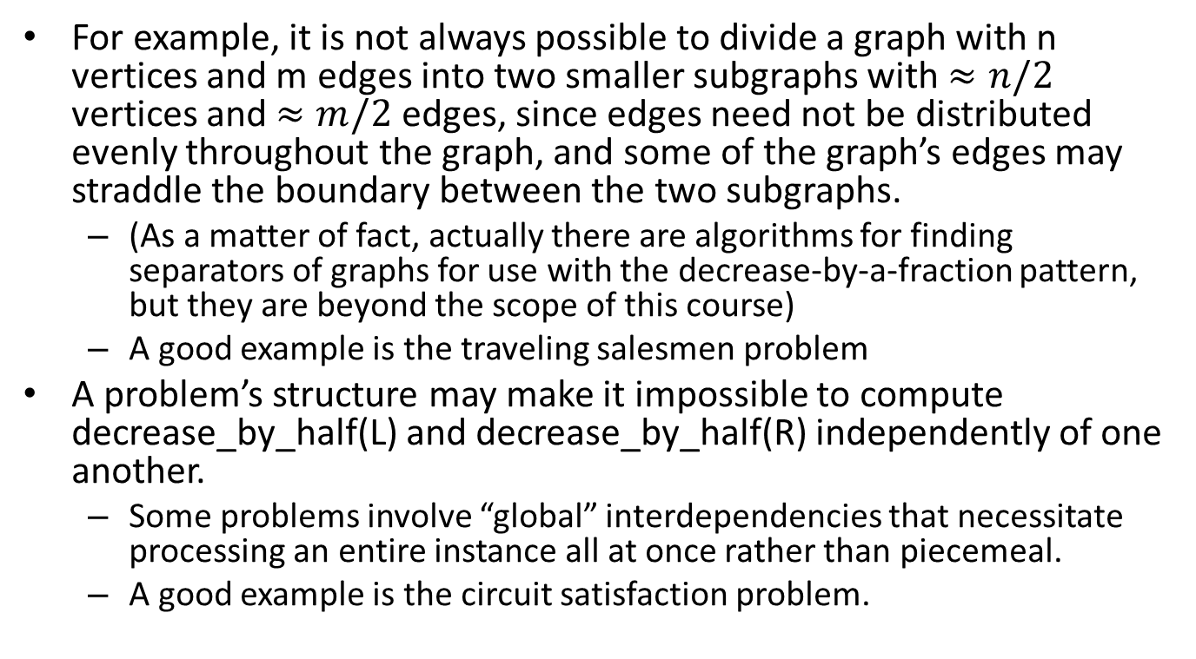
Example of indivisible problems

