Slide 1

Project Title: Final Cybersecurity Virtual Lab – Multi-Service Deployment & Hardening
Submitted By: Hetal Antala
Submission Date:
16/12/2025

Slide 2
Introduction
The purpose of this project is to:
Build a fully functional multi-service network environment using VirtualBox.
Deploy essential services such as the Web Server, DNS Server, Mail Server, and FTP Server.
Understand how these services work at the network and system level.
Apply security best practices including firewall rules, port management, SSH modification, user restrictions, and fail2ban.
Analyze server behavior using tools like Nmap, nslookup, dig, and system logs.
The following services were installed, configured, tested, and secured:
Web Server (Apache2 + HTTPS/SSL) Used for hosting web content and securing communication with SSL certificates.
DNS Server (Bind9) Configured for domain name resolution and zone management.
Mail Server (Postfix) Set up to send and receive local mails within the network.
FTP Server (vsftpd) Deployed for secure file transfer with disabled anonymous login and user isolation.
Each service was assigned a specific IP address inside the virtual network:
Web Server: 192.168.56.102
DNS Server: 192.168.56.105
Mail Server: 192.168.56.107
FTP Server: 192.168.56.101

Slide 3
Importance of Cybersecurity & Hardening:
Security hardening helps:
Protect services from unauthorized access
Prevent brute-force attacks
Limit network exposure
Strengthen server configurations
Improve overall resilience against cyber-attacks
In this project, several key hardening techniques were implemented:
UFW firewall configuration
Fail2Ban to prevent repeated login attacks
SSH hardening (disable root login, change port, allow specific users)
FTP security (disable anonymous login, enable user isolation)
SSL encryption for secure website communication

Slide 4
Lab Setup Overview
Virtualization Platform
VirtualBox Version: Oracle VM VirtualBox 7.x
Host Operating System: Windows 10 / 11 (64-bit)
Network Mode Used: Internal Network (intnet) for communication between servers
Optional NAT adapter added for updates
VM Hardware Configuration
Each Ubuntu server machine was provisioned with:
2 GB RAM
2 CPU Cores
20–25 GB Storage
Internal Network Adapter
Optional NAT Adapter for updates

Slide 5
Guest Operating Systems (VMs Used)
VM Role | OS | IP Address | Purpose
Web Server | Kali Linux | 192.168.56.102 | Host Apache2 and HTTPS
DNS Server | Kali Linux | 192.168.56.105 | Host Bind9 and zone resolution
Mail Server | Kali Linux | 192.168.56.107 | Host Postfix for local mail transfer
FTP Server | Ubuntu | 192.168.56.101 | Host vsftpd for file transfer
Attacker / Test Machine | Kali Linux | DHCP / Manual | Used for Nmap & penetration testing

Slide 6
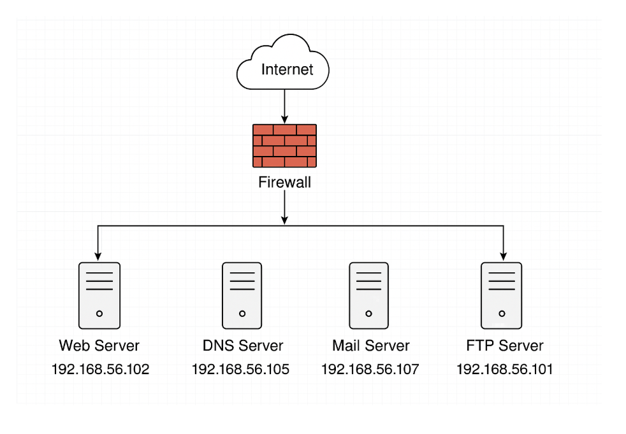
Network Topology Diagram

Slide 7
Web Server (Apache2 + HTTPS)
1.1 Installation Steps
sudo apt update
sudo apt install apache2
1.2 Enable Firewall Rules
sudo ufw allow 80/tcp
sudo ufw allow 443/tcp
1.3 Create Self-Signed SSL Certificate
sudo openssl req -x509 -nodes -days 365 -newkey rsa:2048 \
-keyout /etc/ssl/private/apache.key \
-out /etc/ssl/certs/apache.crt
1.4 Configure Virtual Host
Edit the SSL config file:
sudo nano /etc/apache2/sites-available/default-ssl.conf
Set:
SSLEngine on
SSLCertificateFile /etc/ssl/certs/apache.crt
SSLCertificateKeyFile /etc/ssl/private/apache.key

Slide 8
Enable SSL Module:
sudo a2enmod ssl
sudo a2ensite default-ssl.conf
sudo systemctl restart apache2
1.5 HTTPS Testing
Using browser or: curl -k https://192.168.56.102
Hardening Applied
✔ Disable directory listing ✔ Enable firewall rules ✔ Disable default Apache pages ✔ Restrict access logs
Nmap Scan
nmap -sV 192.168.56.102

Slide 9
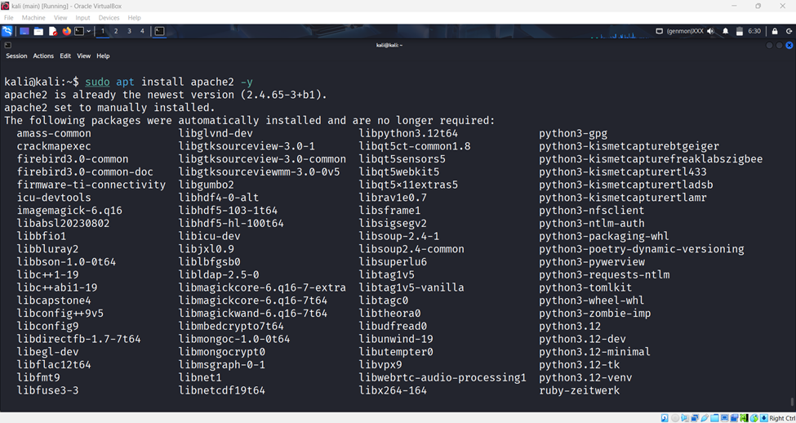
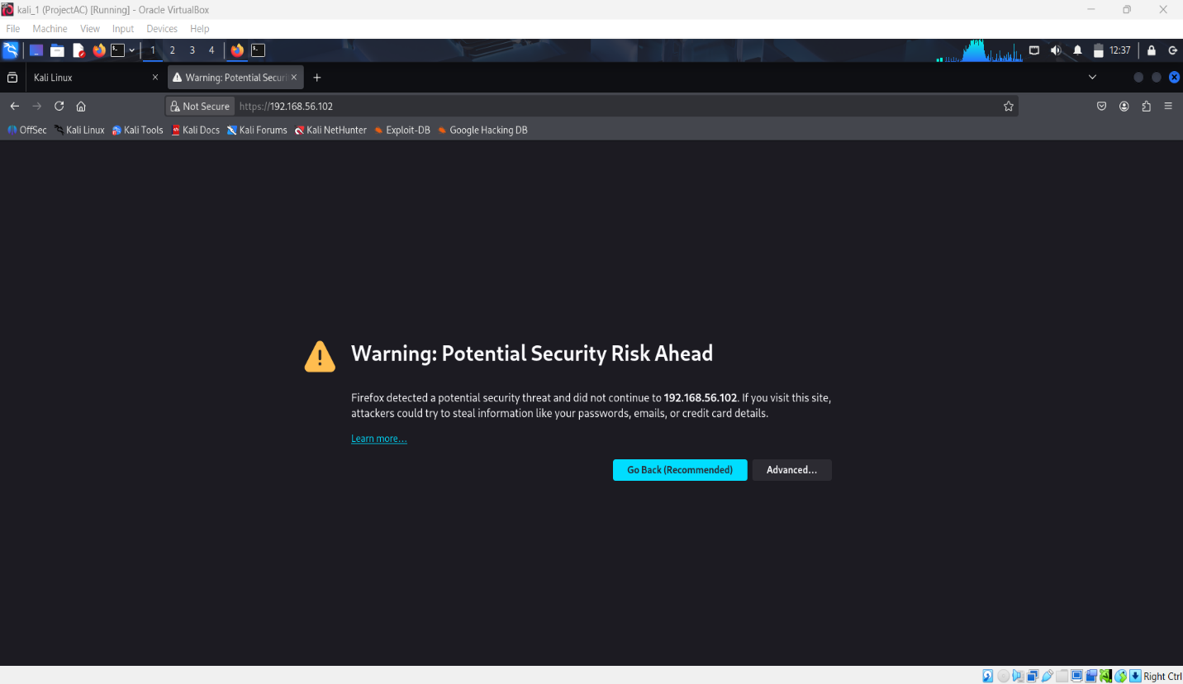
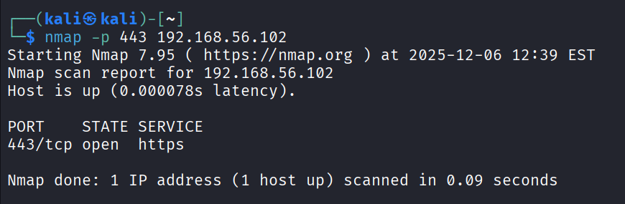
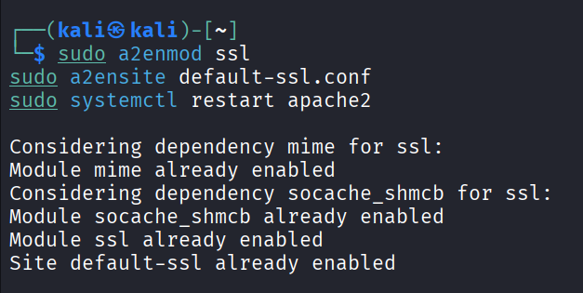
Screenshots:

Slide 10
DNS Server (Bind9)
2.1 Install Bind9
sudo apt install bind9 bind9utils bind9-doc
2.2 Configure named.conf.local
Add zone:
zone "mydomain.local" {
type master;
file "/etc/bind/db.mydomain.local";
};
2.3 Create Zone File
Path:
/etc/bind/db.mydomain.local

Slide 11
Example zone:
@ IN SOA ns1.mydomain.local. admin.mydomain.local. (
2 ; Serial
604800 ; Refresh
86400 ; Retry
2419200 ; Expire
604800 ) ; Negative Cache TTL
;
@ IN NS ns1
ns1 IN A 192.168.56.105
www IN A 192.168.56.102
2.4 DNS Resolution Testing
nslookup www.mydomain.local
dig ftp.mydomain.local

Slide 12
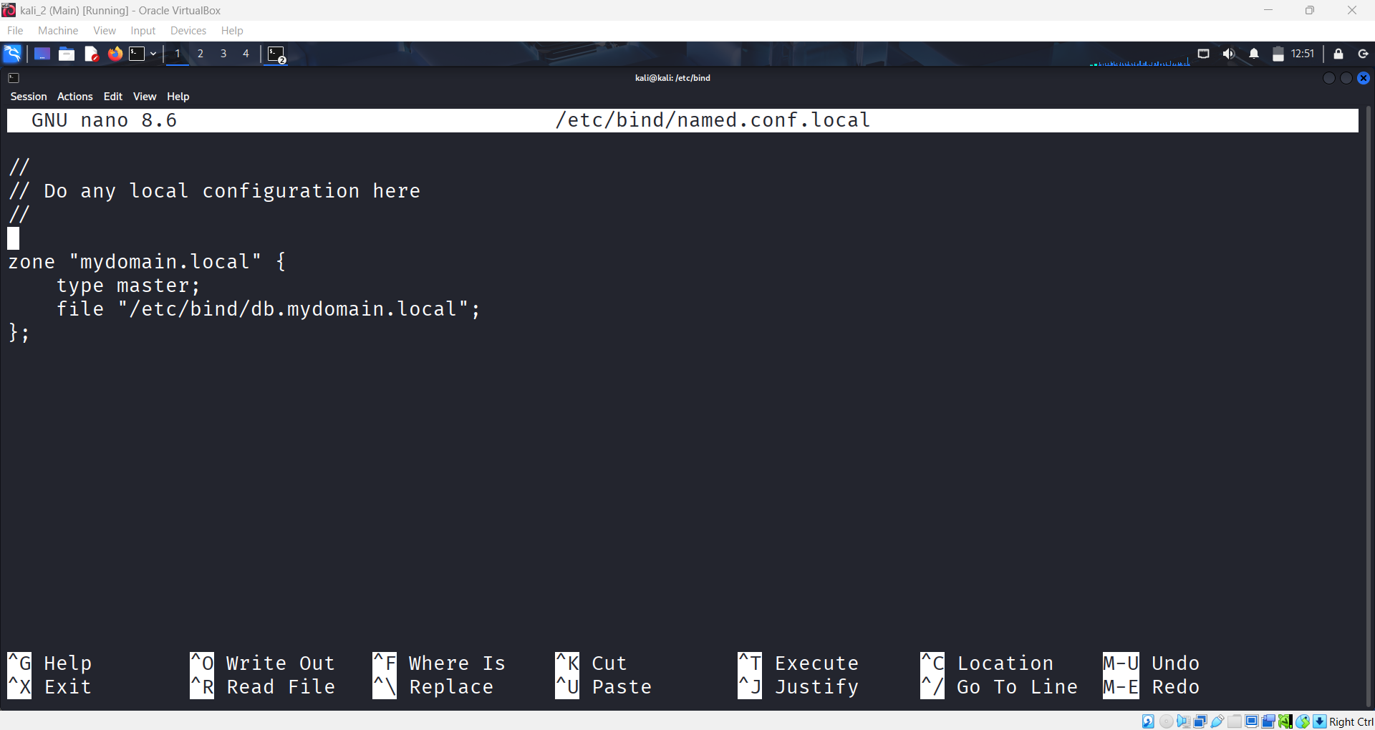
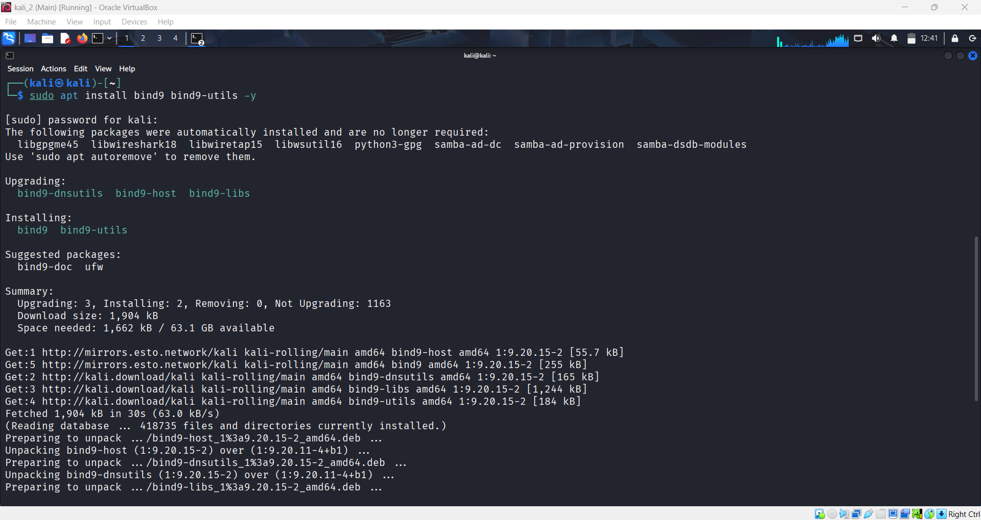
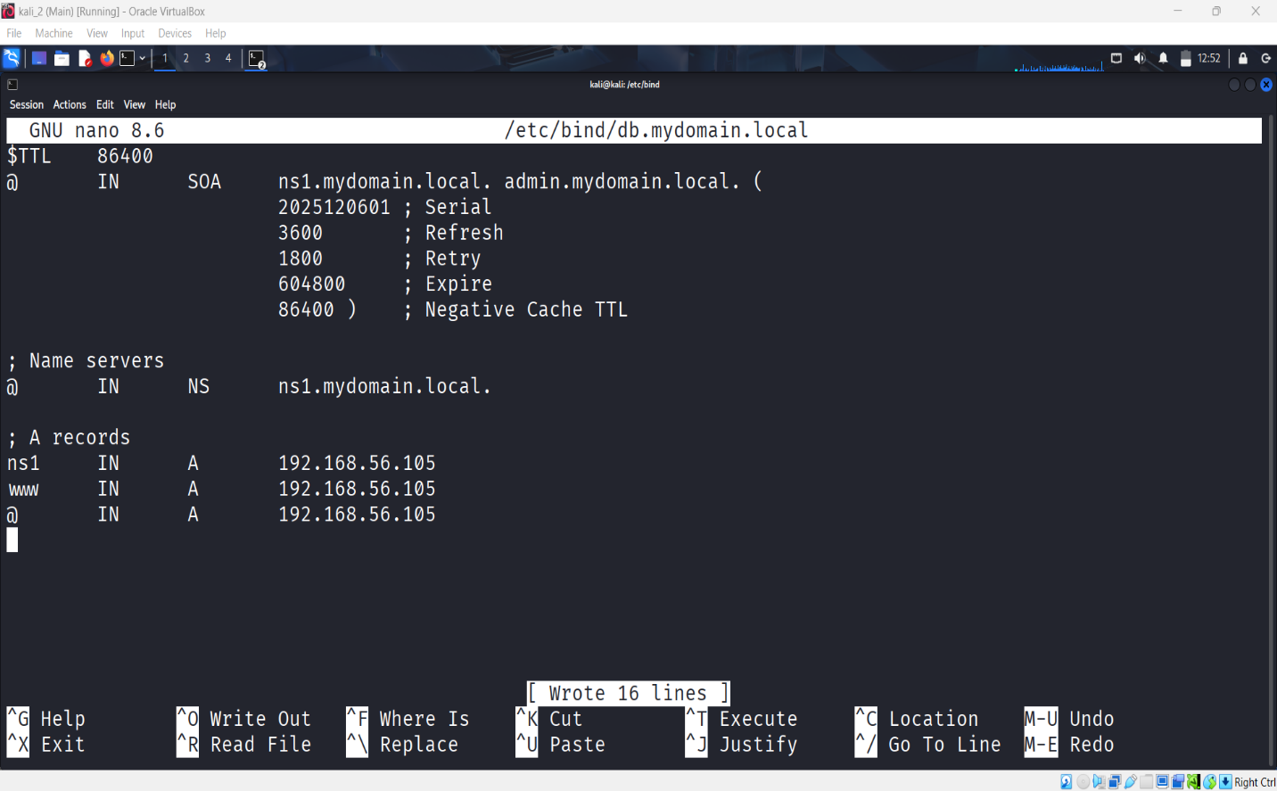
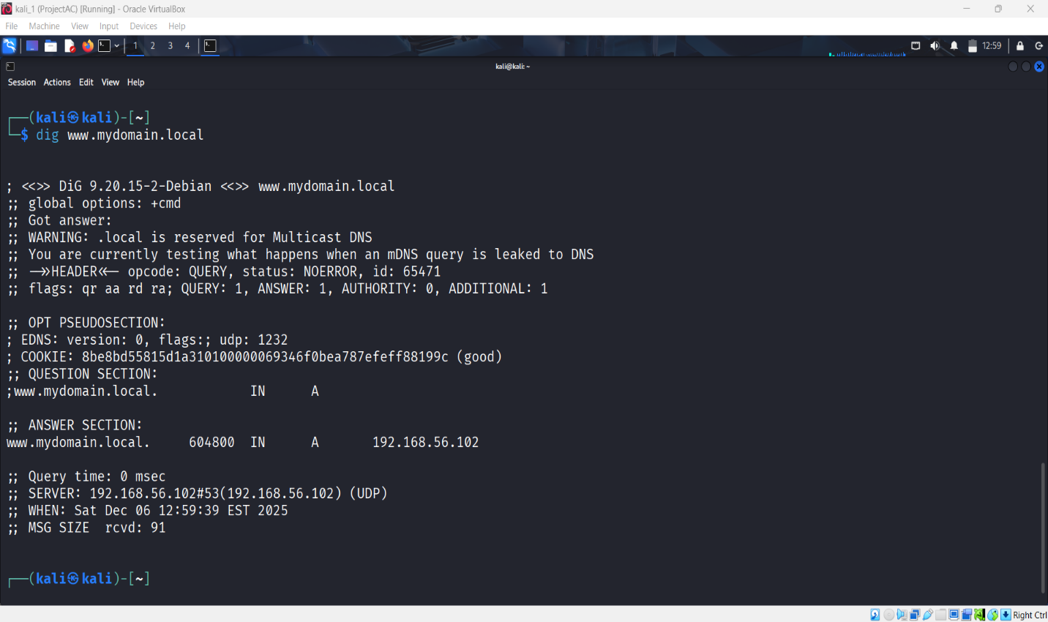
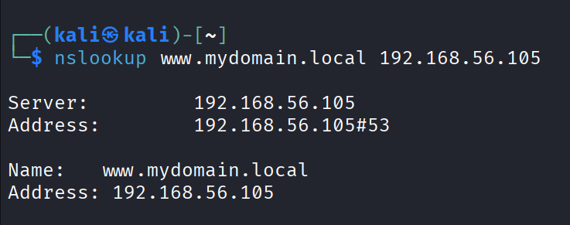
Screenshots:

Slide 13
Mail Server (Postfix)
3.1 Installation
sudo apt install postfix mailutils
Select: Local Only
3.2 Configuration File
/etc/postfix/main.cf
Set:
myhostname = mail.mydomain.local
mydestination = $myhostname, localhost.localdomain, localhost
3.3 Send Test Mail
echo "Hello Maildir" | mail -s "Test Mail"user1@mydomain.local
3.4 Logs
sudo tail -f /var/log/mail.log

Slide 14
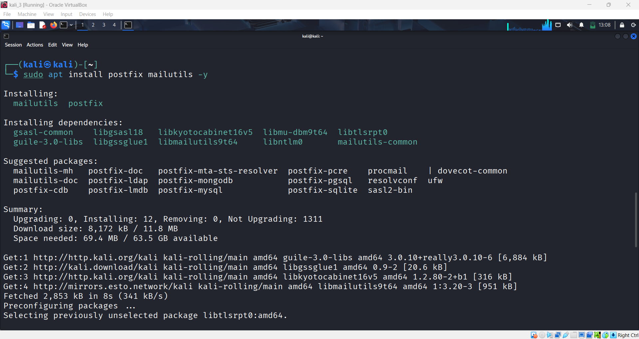
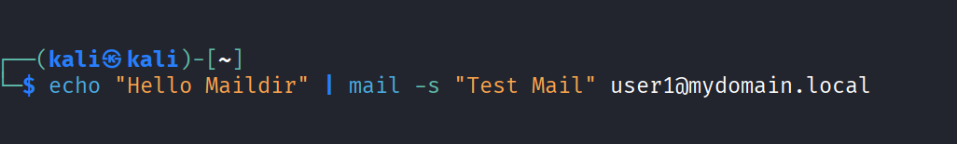
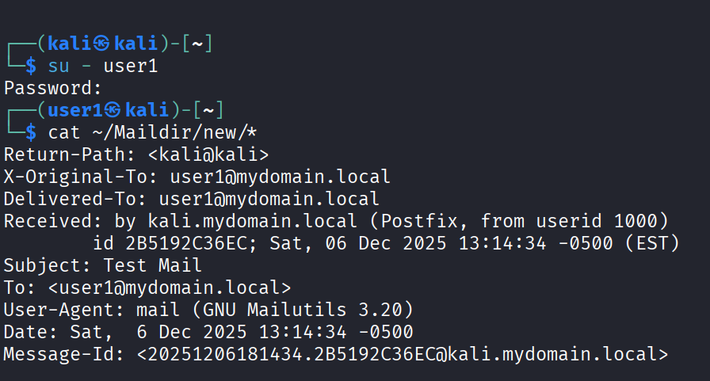
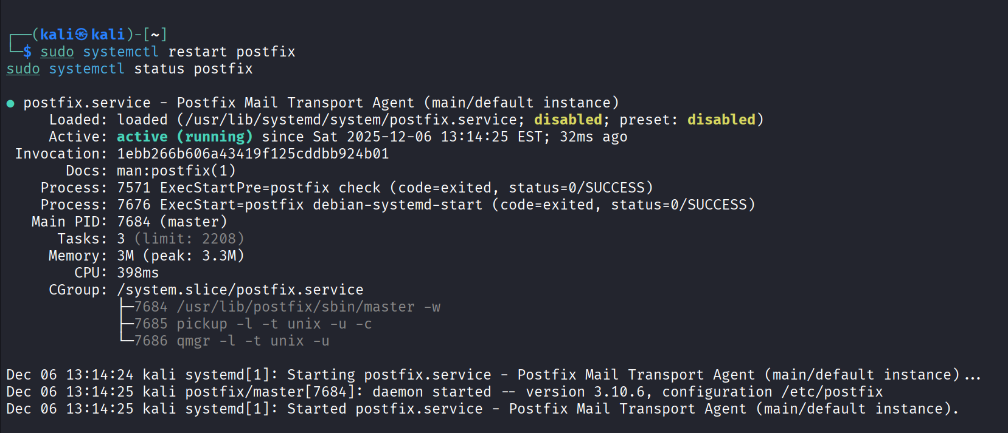
Screenshots:

Slide 15
FTP Server (vsftpd)
4.1 Installation
sudo apt install vsftpd
4.2 Important Configurations
Edit:
/etc/vsftpd.conf
Set:
anonymous_enable=NO
local_enable=YES
write_enable=YES
chroot_local_user=YES
Restart:
sudo systemctl restart vsftpd
4.3 FTP Login Test
ftp 192.168.56.101
4.4 Upload / Download Test
Commands:
put file.txt
get file.txt

Slide 16
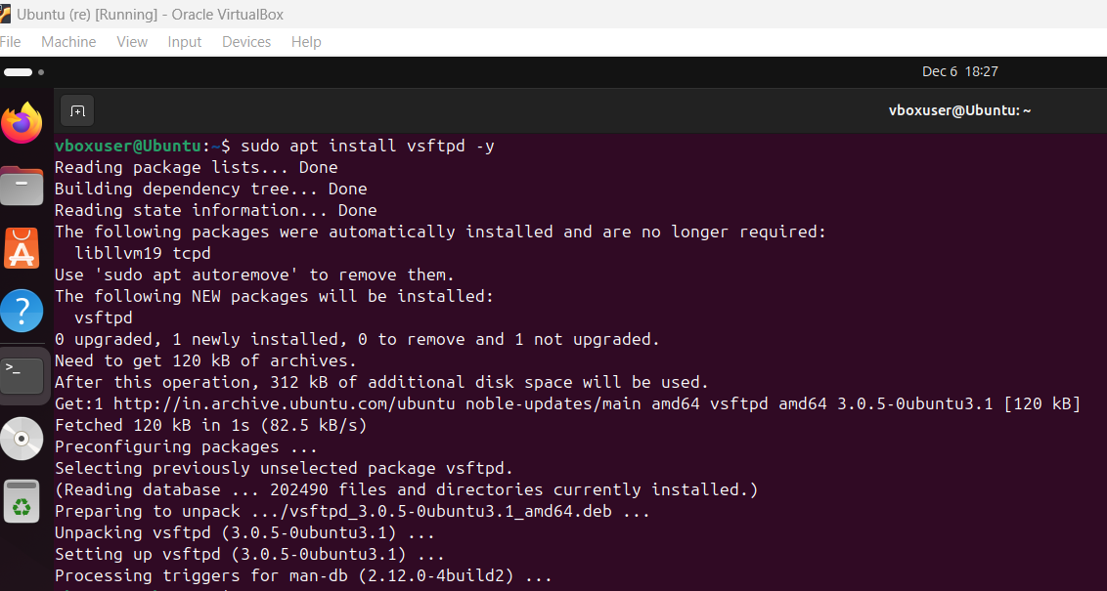
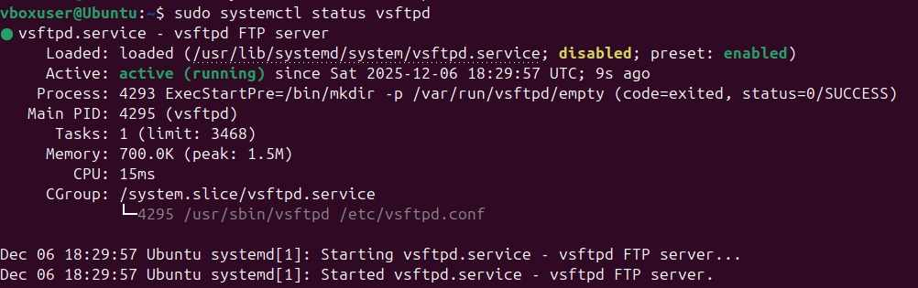
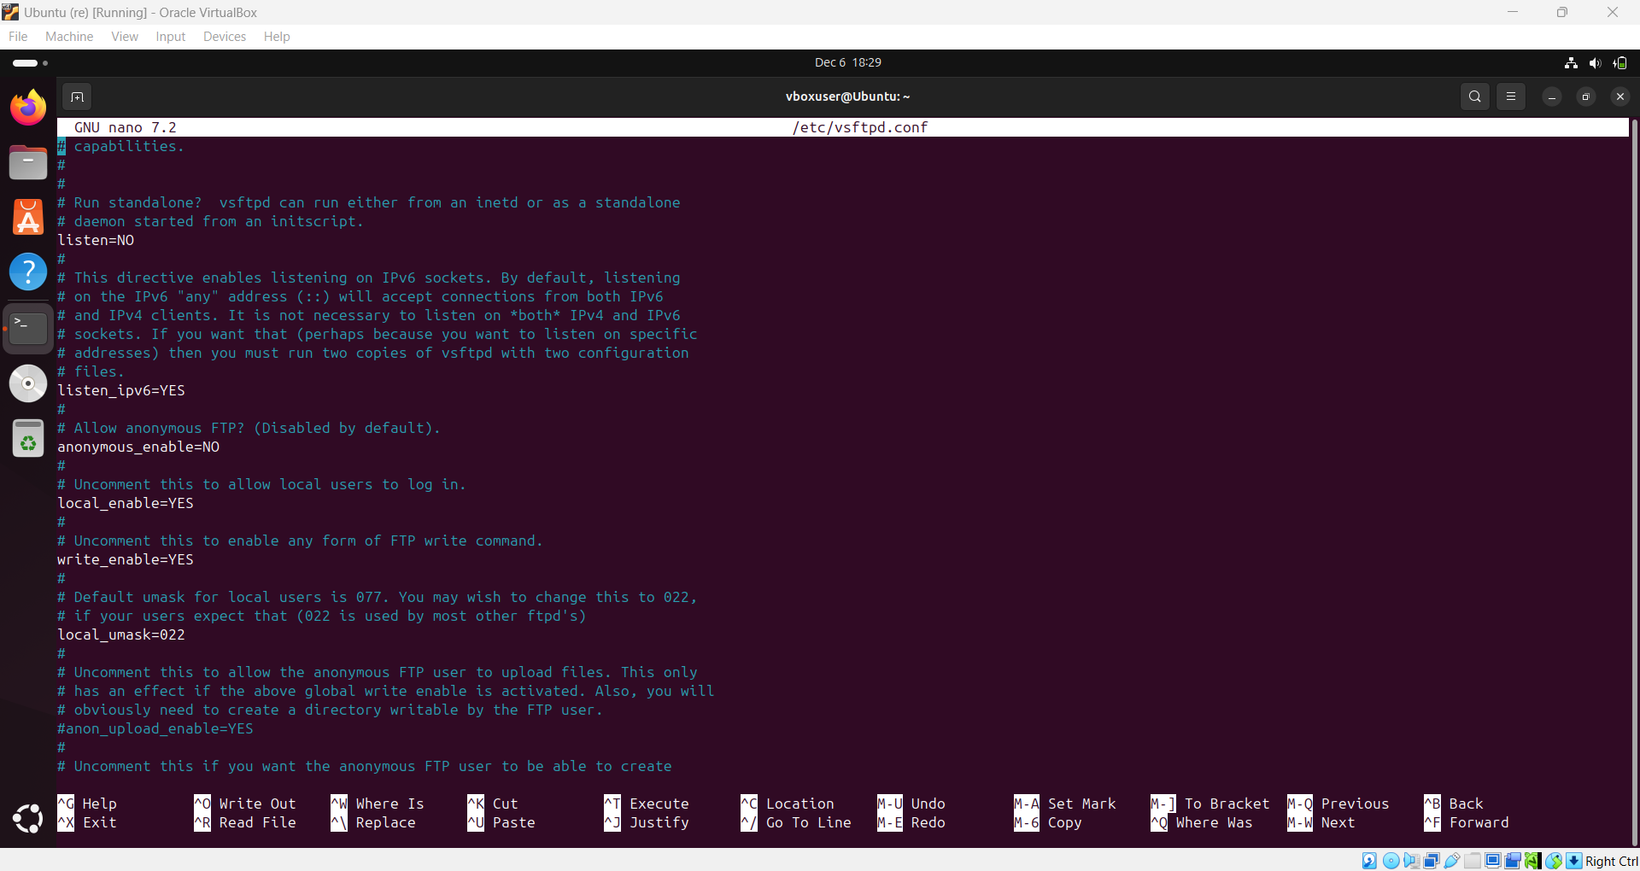
Screenshots:

Slide 17
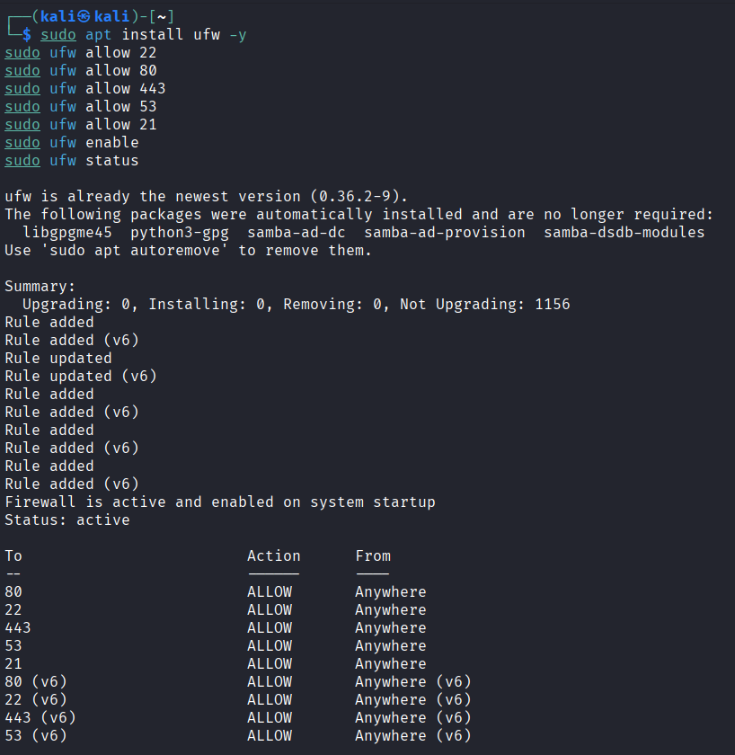
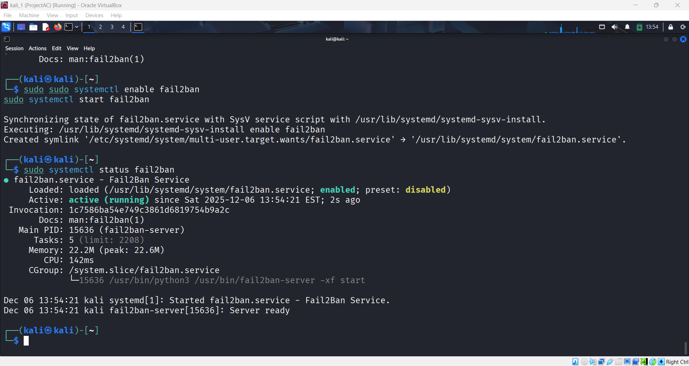
Security Hardening
1)UFW Firewall
Allowed required ports: 22, 80, 443, 53, 25, 21
Denied everything else:
sudo ufw default deny incoming
sudo ufw default allow outgoing
2)Fail2ban
Installation:
sudo apt install fail2ban
Configured jail:
/etc/fail2ban/jail.local
Enabled:
sudo systemctl enable --now fail2ban

Slide 18
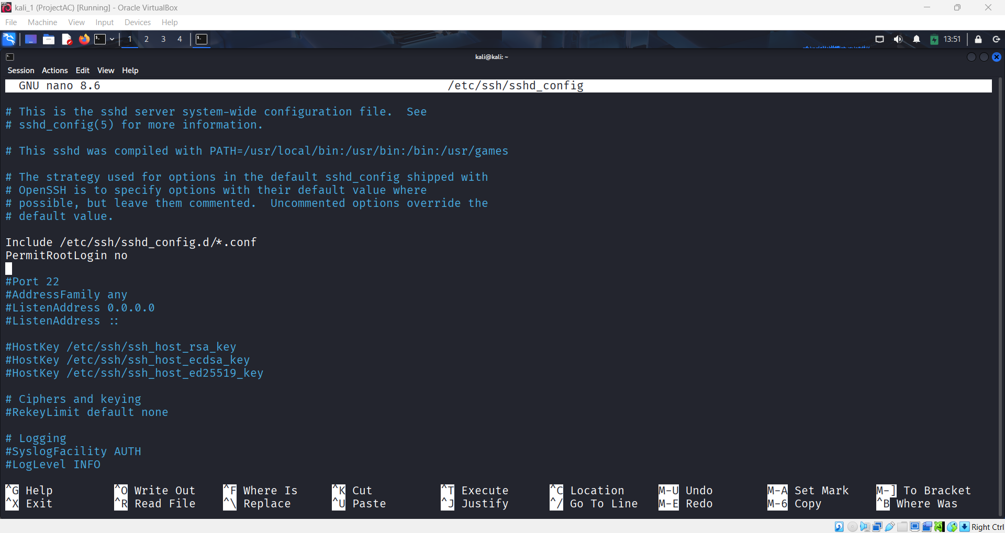
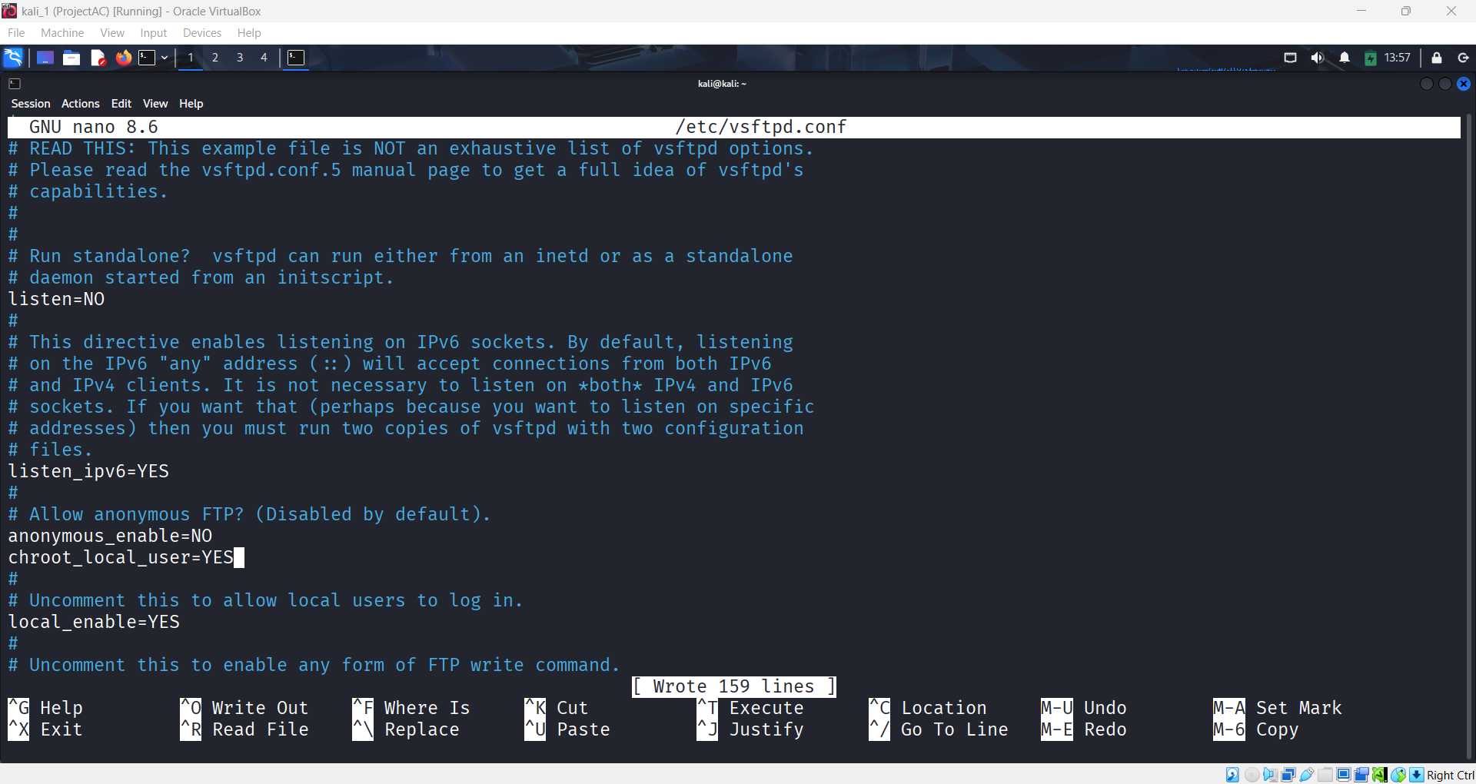
3) SSH Hardening
File:
/etc/ssh/sshd_config
Set:
PermitRootLogin no
PasswordAuthentication yes/no
AllowUsers youruser
Restart SSH:
sudo systemctl restart ssh
4) FTP Hardening
Disabled Anonymous Login
chroot jail enabled
Strong password rules
UFW firewall restricted

Slide 19
Challenges & Solutions
1. DNS resolution not working
Reason: Misconfigured zone file Fix: Corrected A records and SOA entry
2. UFW blocked SSH accidentally
Fix: Logged in through VirtualBox console and allowed SSH manually
3. FTP permission issues
Fix: Set correct ownership and enabled write permissions
4. Postfix mail stuck in queue
Fix: Started postfix service and fixed hostname configuration

Slide 20
Conclusion
This project provided hands-on experience in deploying and securing multiple network services in a virtualized environment. I learned how servers communicate, how DNS and mail routing work, how to secure communication with SSL, and how to protect services using firewall and intrusion prevention tools. The lab reflects real-world system administration practices and strengthened my understanding of cybersecurity fundamentals.
In the future, this project can be enhanced by adding:
Intrusion Detection Systems (Snort/Suricata)
Web Application Firewall (ModSecurity)
Load Balancing
Cloud deployment (AWS/Azure)

Slide 21
References
Apache Documentation: https://httpd.apache.org/
Bind9 DNS Docs: https://bind9.readthedocs.io/
Postfix Docs: http://www.postfix.org/documentation.html
vsftpd Docs: https://security.appspot.com/vsftpd.html

Slide 22
Thank You

