Slide 1

Data 1203 Business Analysis Assessment Assignment 3 – Data Visualization Coffee Shop Case Study (2018) Professor : Carrie Pajotte
Submitted By
Name: Hetal Parmar
Student Id: 100992608

Slide 2
Index
Audience Analysis
Data Analysis
5 Key Performance Questions
5 Additional Questions and Missing Data Attributes
Sketched mockup of your executive dashboard design executive dashboard design
Instructions for your Executive Dashboard
Identify the design techniques utilized

Slide 3
Audience Analysis
Audience: Senior Management Team of The Coffee Cup Store.
What Do They Want to Know?
Franchise performance and revenue trends.
Top-performing products and regions.
Opportunities for improvement in sales and operations.
How Does This Analysis Help?
Provides visualized data insights on performance metrics.
Enables better decision-making with an interactive executive dashboard.

Slide 4
Data Analysis
Errors Identified:
Duplicate Rows:There were duplicate rows in the dataset.
Steps Taken to Correct Errors:
Missing Values:Several columns had missing values.
Negative Values:Some numerical columns had negative values where they shouldn't be (e.g., sales, inventory).
Handling Missing Values:Missing values were filled using forward fill (ffill), which propagates the last valid observation forward.
Removing Duplicate Rows:Duplicate rows were removed from the dataset.
Correcting Negative Values:Negative values in columns where they shouldn't be were identified and corrected.

Slide 5
5 Key Performance Questions
Which regions generate the most revenue?
What is the average sales performance across different product categories?
How do dine-in and takeout sales compare across franchises?
What are the peak sales hours in a day?
Which products contribute the most to total revenue?

Slide 6
5 Additional Questions and Missing Data Attributes
1. What are the seasonal trends in sales for different products?
Missing Data Attributes:
Detailed monthly or weekly sales data for each product.
Weather data or seasonal indicators (e.g., holidays, events).
2. How does customer demographic information impact sales and profit?
Missing Data Attributes:
Customer demographic data (e.g., age, gender, income level).
Customer purchase history and preferences.

Slide 7
5 Additional Questions and Missing Data Attributes Cont.
3. What is the impact of marketing campaigns on sales and profit?
Missing Data Attributes:
Data on marketing campaigns (e.g., type of campaign, duration, budget).
Sales data before, during, and after marketing campaigns.
4. Which stores have the highest and lowest inventory turnover rates?
Missing Data Attributes:
Detailed inventory data (e.g., beginning and ending inventory levels).
Sales data for each store.

Slide 8
5 Additional Questions and Missing Data Attributes
5. What are the most and least profitable products across different regions?
Missing Data Attributes:
Detailed profit data for each product by region.
Sales volume and cost data for each product by region.

Slide 9
5 Additional Questions and Missing Data Attributes
5. What are the most and least profitable products across different regions?
Missing Data Attributes:
Detailed profit data for each product by region.
Sales volume and cost data for each product by region.

Slide 10
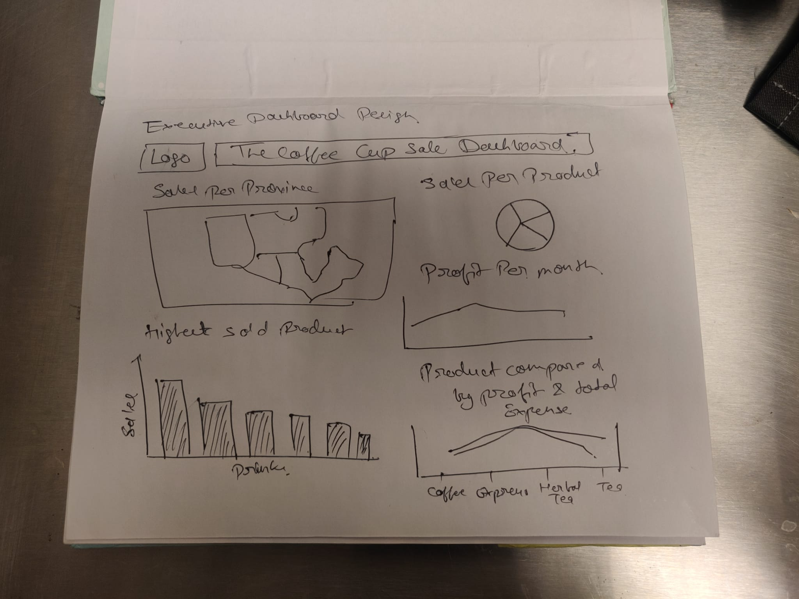
Sketched mockup of your executive dashboard design

Slide 11
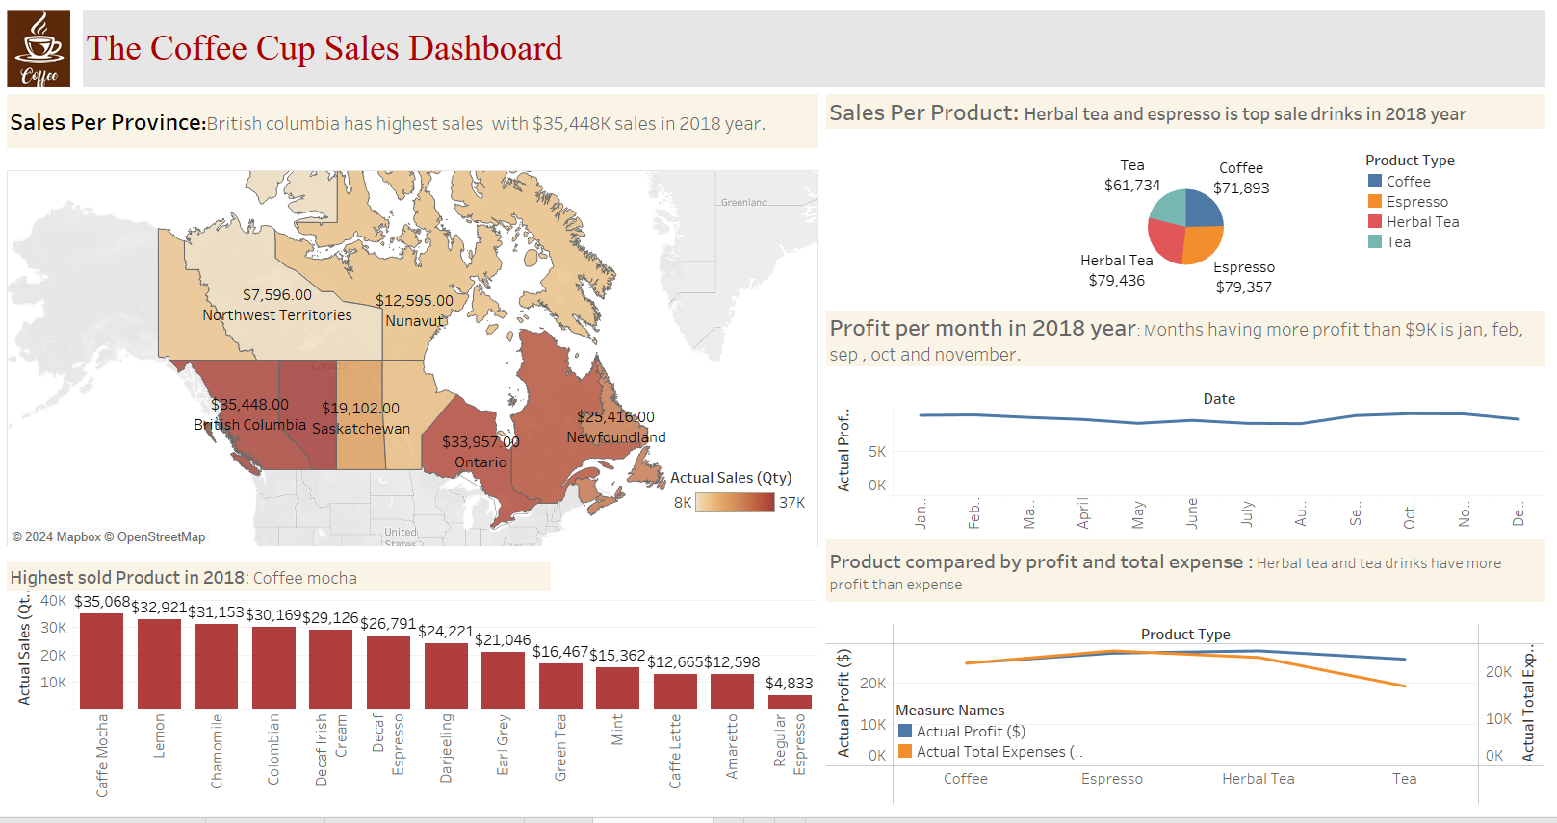
executive dashboard design

Slide 12
Instructions for your Executive Dashboard
The Sales Per Province (Map): British Columbia has the highest sales ($35,448), followed by Ontario ($33,957). The Northwest Territories and Nunavut have the lowest sales.
Sales Per Product (Pie Chart):Herbal Tea ($79,436) and Espresso ($79,357) are the best-selling product types. Coffee ($71,893) follows, while Tea has the lowest sales.
Profit Per Month (Line Chart): Profit is consistent across the year, with months like January, February, and March yielding profits above $9,000.
Highest Sold Product in 2018 (Bar Chart): Caffe Mocha is the best-selling product with 35,068 units sold, followed by Lemon and Chamomile. Earl Grey and Regular Espresso are the least sold.
Product Comparison by Profit vs. Expense (Line Chart): Herbal Tea and Tea show higher profits relative to their expenses. Espresso and Coffee have slightly higher expenses relative to profits.

Slide 13
identify the design techniques utilized
Color Coding: Used gradients and distinct colors to highlight sales differences and product categories.
Logical Layout: Organized from top-level insights (e.g., map) to detailed metrics (e.g., bar chart).
Visualization Variety: Used maps, pie charts, bar charts, and line charts for tailored data representation.
Annotations: Highlighted key findings directly on the dashboard for clarity.
Minimalistic Design: Maintained clean layout with sufficient white space for better readability.

Slide 14
Thank you

