Slide 1

Customer Shopping Behavior Analysis
Hetal Parmar
Data Analysis Project | Python · SQL · Power BI

Slide 2

Dataset at a Glance
3,900
18
Transactions
Columns
37
Missing Values
Review Rating only
Key features: demographics, purchase details, shopping behavior

Slide 3

Data Preparation in Python
Load & Explore
Clean Missing Data
Standardize
Imported 3,900 transaction records using pandas
Used df.info() to identify data types and missing values
Applied df.describe() for statistical summary (mean, median, std dev, quartiles)
Identified 37 missing values in Review Rating column only
Applied median imputation strategy grouped by product category
Preserved category-specific rating patterns during imputation
Validated imputation quality with before/after distribution analysis
Converted all column names to snake_case for consistency
Removed redundant promo_code_used column (duplicate information)
Ensured data type consistency across all features
Final dataset: 3,900 rows × 18 columns, ready for analysis

Slide 4




Feature Engineering
Age Group
Binned customer ages into 4 segments using pd.cut() for equal-width binning:
Young Adult (18–35)
Middle-aged (36–50)
Adult (51–65)
Senior (65+)
Purchase Frequency
Calculated days between consecutive purchases per customer to derive behavioral metrics:
Average purchase interval & frequency score
Identified repeat buyers (5+ purchases) vs. one-time buyers
PostgreSQL Load
Exported cleaned DataFrame to a production-ready PostgreSQL database:
Created indexed tables for optimized query performance
Enabled real-time SQL analysis & dashboard connectivity

Slide 5

SQL Analysis: Revenue & Discounts
Revenue by Gender
Subscribers vs. Non-Subscribers
Discount-Dependent Products
Compared total revenue: male vs. female customers
Female: $75,191 | Male: $157,890
Comparison of customer count, average spend, and total revenue by subscription status
Subscribers (Yes): 1,053 customers | Avg. Spend: $59.49 | Total Revenue: $62,645.00
Non-Subscribers (No): 2,847 customers | Avg. Spend: $59.87 | Total Revenue: $170,436.00
Top 5 products with highest % of discounted purchases
Hat — 50.00%
Sneakers — 49.66%
Coat — 49.07%
Sweater — 48.17%
Pants — 47.37%

Slide 6

SQL Analysis: Products & Shipping
Top 5 Products by Rating
Shipping Comparison
Top 3 per Category
Highest average review ratings:
Average spend by shipping type:
Standard: $58.46 | Express: $60.48
Most purchased products by category:
Accessories:
Gloves — 3.86
Sandals — 3.84
Boots — 3.82
Hat — 3.80
Skirt — 3.78
Jewelry — 171 orders
Sunglasses — 161 orders
Belt — 161 orders
Clothing:
Blouse — 171 orders
Pants — 171 orders
Shirt — 169 orders
Footwear:
Sandals — 160 orders
Shoes — 150 orders
Sneakers — 145 orders
Outerwear:
Jacket — 163 orders
Coat — 161 orders

Slide 7
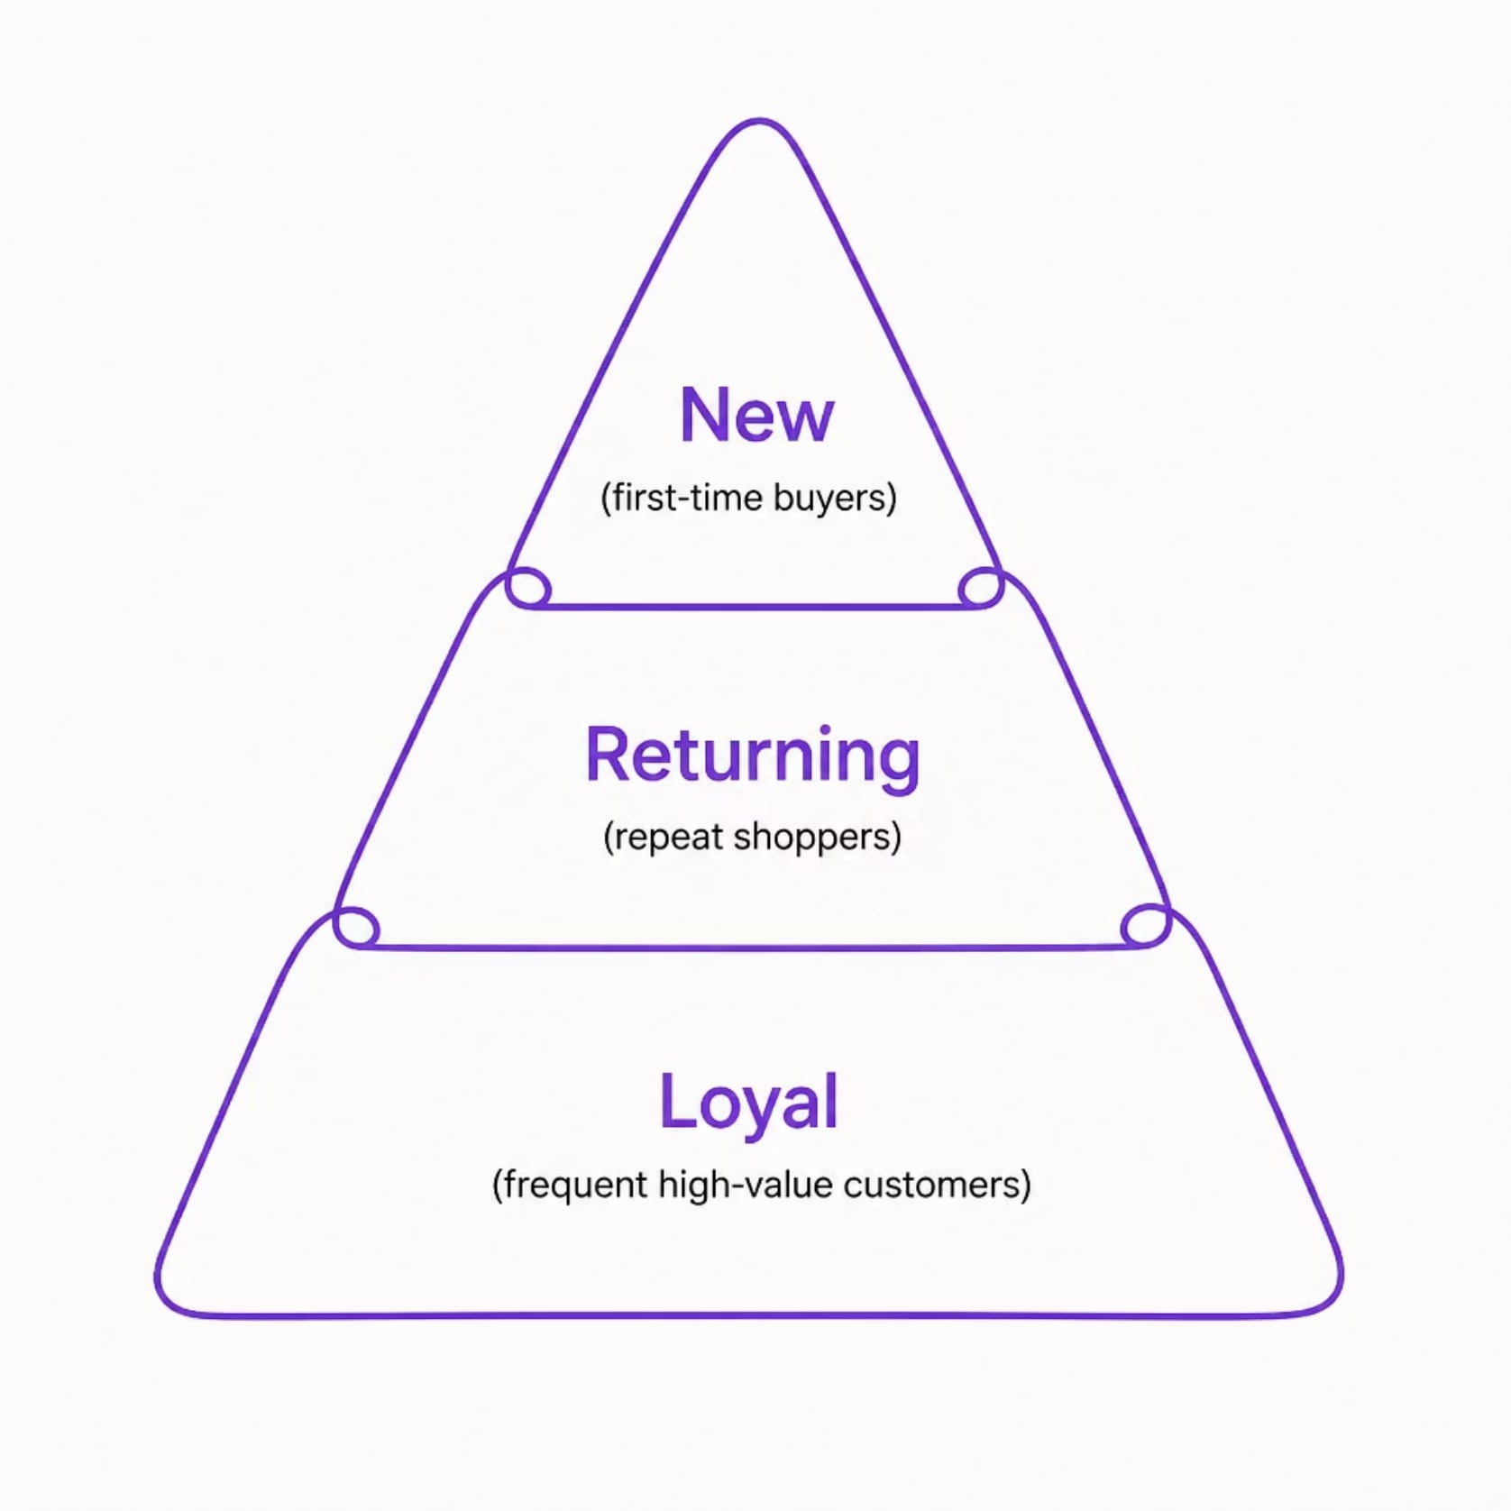
Customer Segmentation
Segments Defined by Purchase History
New — first-time buyers
Returning — repeat shoppers
Loyal — frequent, high-value customers
Also analyzed: subscribers vs. non-subscribers spend & revenue

Slide 8



Age Groups & Subscription Behavior
Revenue by Age Group
Young Adult: $62,143
Middle-aged: $59,197
Adult: $55,978
Senior: $55,763
Young Adults generate the highest total revenue
Repeat Buyers → Subscriptions
Of customers with 5+ purchases:
Non-Subscribers: 2,518 repeat buyers (73%)
Subscribers: 958 repeat buyers (27%)
Majority of repeat buyers remain non-subscribers

Slide 9

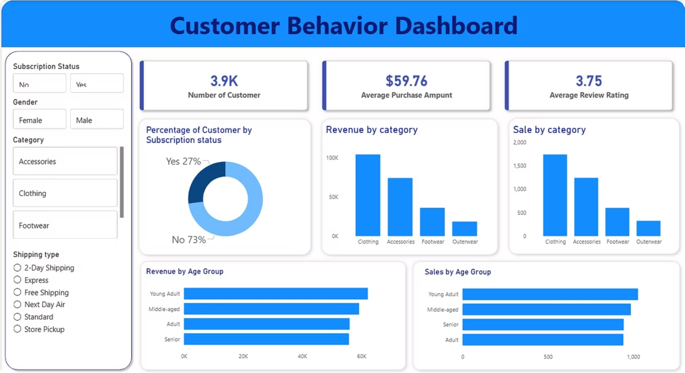
Power BI Dashboard
Interactive visual summary of all insights — revenue, segments, products, and behavior patterns in one view.

Slide 10

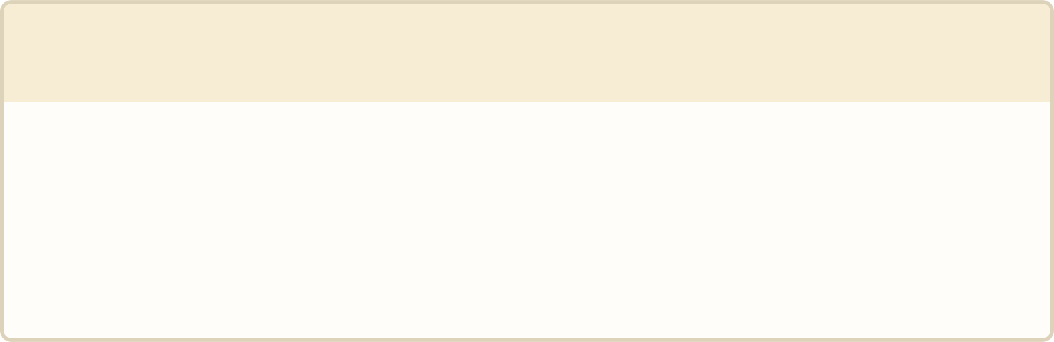
Dashboard Features & Capabilities
This comprehensive Power BI dashboard consolidates all analytical insights into a single, dynamic view, enabling real-time exploration of revenue, customer behavior, and product performance.
1
2
Revenue & KPI Cards
Product Performance
Total revenue, transaction count, and customer segment totals at a glance
Real-time tracking by gender, age group, and subscription status
Ratings, order volumes, and discount rates per product
Category-level breakdown of top and underperforming items
3
4
Customer Segmentation
Interactive Filters
Visual breakdown of New, Returning, and Loyal segments
Shipping method analysis and its impact on average spend
Drill down by category, age group, and customer type
Slicers enable cross-filtering across all visuals simultaneously

Slide 11

Key Insights from Dashboard Analysis
Three critical findings that drive business strategy:
Subscription Opportunity
Clothing Category Dominance
Young Adult Revenue Leadership
73% of customers shop without subscription — representing a massive untapped revenue stream. Converting even a portion of these 2,847 non-subscribers could significantly boost recurring revenue and customer lifetime value.
The Clothing category leads in both revenue and sales volume, with Blouse and Pants each generating 171 orders. This category should be prioritized for inventory, marketing, and product development investments.
Young Adults generate the highest revenue at $62,143 — outpacing Middle-aged ($59,197), Adult ($55,978), and Senior ($55,763) segments. This demographic should be the primary target for marketing campaigns and product positioning strategies.

Slide 12





Business Recommendations
Boost Subscriptions
Loyalty Programs
Review Discounts
Promote exclusive subscriber benefits. Only 27% of customers are subscribers — target the 2,518 non-subscriber repeat buyers with dedicated conversion campaigns.
Reward repeat buyers in top segments. Young Adults ($62K) and Middle-aged ($59K) lead in revenue — reward frequent purchasers to increase lifetime value.
Balance sales lift with margin control. Hats (50%), Sneakers (49.7%), and Coats (49%) show high discount dependency — closely monitor margin impact.
Targeted Marketing
Product Positioning
Focus on high-value segments. Young Adults generate the highest revenue; Express shipping users spend $2 more per order on average — prioritize these audiences.
Highlight top-rated & best-selling items. Gloves (3.86★), Sandals (3.84★), and Boots (3.82★) top ratings; Jewelry & Blouse lead in order volume.

