Slide 1
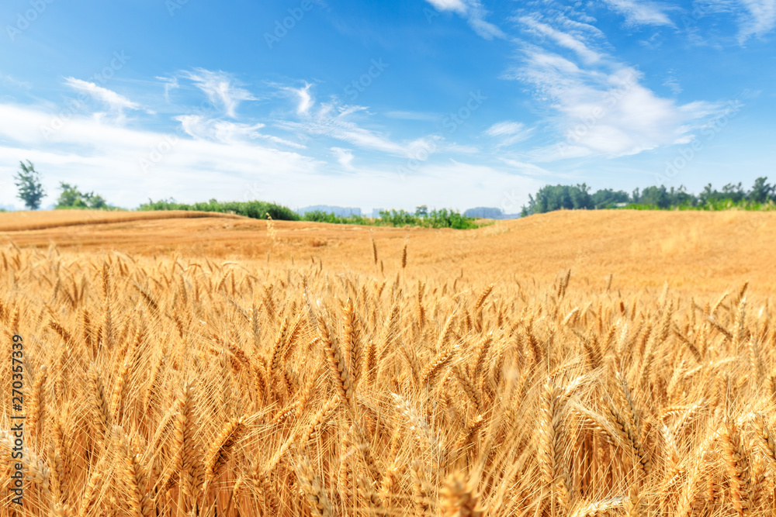
Statistical and Predictive Modeling II (DATA 2204) Assignment 5 – Decision Trees and Random Forest Professor: Fatma Tetikoglu
Name: Hetal Parmar (100992608)

Slide 2
Rational Statement
Mr. John Hughes wants to improve the accuracy and efficiency of wheat classification.
An automated classification system using machine learning which can:
Enhance classification accuracy and consistency.
Reduce manual effort and subjectivity.
Improve decision-making for wheat quality control.
The aim of assignment is to build optimized Decision Tree and Random Forest models to classify wheat types based on key physical attributes. By comparing both models, we aim to:
Identify the best-performing model for accurate wheat classification.
Analyse misclassification patterns to improve prediction accuracy.

Slide 3
Rational Statement
Provide data-driven insights to enhance wheat quality control.
Recommend next steps for Mr. Hughes to optimize classification processes.
The presentation will outline the key findings, model evaluation, and recommendations to support Mr. Hughes in implementing an efficient and accurate wheat classification system.
The WheatData.csv dataset consists of 210 samples with 7 independent variables representing physical characteristics of wheat and 1 target variable categorizing wheat types:
Independent Variables:
A (Area), P (Perimeter), C (Compactness), LK (Length of Kernel), WK (Width of Kernel), A_Coef (Asymmetry Coefficient), and LKG (Length of Kernel Groove).
Dependent Variable:
target: A categorical variable with three wheat types: 0 - Kama, 1 - Rosa, 2 – Canadian.

Slide 4
Rational Statement
This assignment utilizes Supervised Machine Learning Classification methods:
Decision Tree Classifier
A tree-based model that splits data based on feature importance for classification. Optimized using GridSearchCV to tune hyperparameters (max_depth, criterion).
Random Forest Classifier
An ensemble model that combines multiple Decision Trees to improve accuracy. Tuned for optimal performance by adjusting hyperparameters like n_estimators, criterion, and bootstrap.
Evaluation Metrics:
Confusion Matrix: Evaluates classification accuracy.
Classification Report: Includes Precision, Recall, F1-Score for each wheat type.
Feature Importance: Identifies which wheat characteristics influence classification the most.

Slide 5
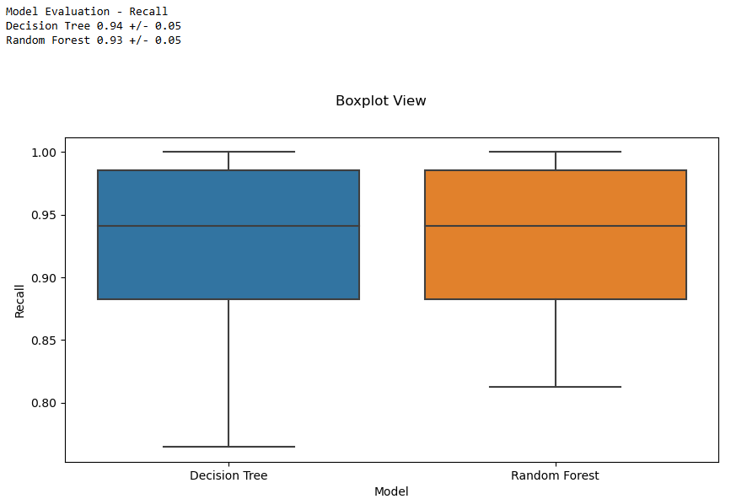
Model Analysis and explain two (2) key insights
Boxplot View for Model Evaluation - Recall

Slide 6
Model Analysis and explain two (2) key insights
Boxplot View for Model Evaluation - Recall
Random Forest Exhibits Higher Stability
The Random Forest model has a slightly higher median recall compared to the Decision Tree model.
It also has less variability in recall, indicating more consistent classification across wheat types.
Decision Tree Shows More Variability
The Decision Tree model has a wider interquartile range, meaning its performance fluctuates more depending on the dataset split.
The presence of a lower minimum recall suggests that it may misclassify certain wheat types more frequently than Random Forest.
Both Models Perform Well Overall
Both models have high recall values (above 90%), indicating they effectively identify wheat types with minimal false negatives.
The overlap in boxplots shows that while Random Forest is superior, Decision Tree still provides a reliable classification baseline.

Slide 7
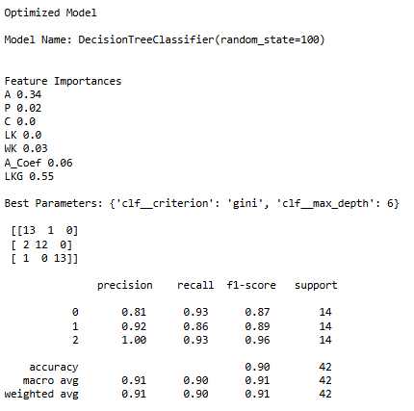
Classification Report for the Optimized Decision Tree and Random Forest Models and explain three (3) key insights for each model

Slide 8
Classification Report for the Optimized Decision Tree and Random Forest Models and explain three (3) key insights for each model
Key Insights from the Decision Tree Model
1. Lower Precision for Kama Wheat (0.81) Indicates Misclassification
The precision for Kama wheat type is 0.81, meaning 19% of samples classified as Kama are Rosa or Canadian. This suggests overlapping feature distributions between Kama and Rosa, making it difficult to distinguish between these two wheat types.
2. Higher Recall for Kama Wheat (0.93) Suggests Correctly Identified Actual Samples
The recall of 0.93 for Kama wheat indicates that 93% of actual Kama samples were correctly classified. However, the model sacrifices precision, leading to some misclassifications into Kama.
3. Perfect Precision for Canadian Wheat (1.00) But Slightly Lower Recall (0.93)
The model is highly confident in its Canadian wheat classification, achieving 100% precision. However, a recall of 0.93 suggests that some actual Canadian wheat samples were misclassified as another class.
This trade-off suggests that the Decision Tree prioritizes recall over precision, making sure most actual Rosa samples are identified, even if some incorrect classifications occur.

Slide 9
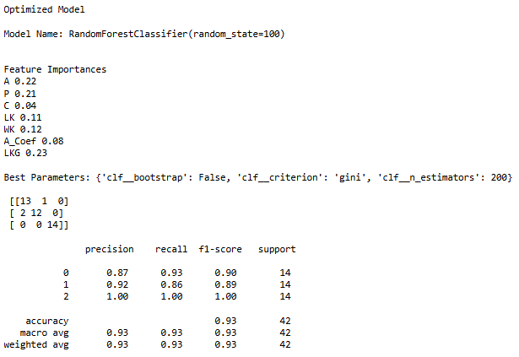
Classification Report for the Optimized Decision Tree and Random Forest Models and explain three (3) key insights for each model

Slide 10
Classification Report for the Optimized Decision Tree and Random Forest Models and explain three (3) key insights for each model
Key Insights from the Random Forest Model
1. Higher Overall Accuracy (93%) Compared to Decision Tree
The Random Forest model achieves 93% accuracy, which is the same as the Decision Tree model.
However, Random Forest is more stable and generalizes better, meaning it is less prone to overfitting.
2. More Balanced Classification for Rosa Wheat
Precision for Rosa increased to 0.92 compared to 0.85 in the Decision Tree model.
This means that Random Forest makes fewer false positive errors when predicting Rosa wheat.
3. Improved Precision for Kama Wheat (0.87) Compared to Decision Tree (0.81)
The precision of Kama wheat increased, reducing misclassification.
However, the recall remains the same at 0.93, showing that Random Forest maintains strong predictive power.

Slide 11
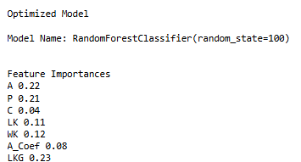
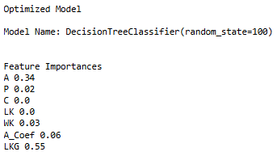
feature importance for each model

Slide 12
feature importance for Decision Tree
Key Insights from Decision Tree Feature Importance
1. LKG (Length of Kernel Groove) Dominates (55%)
The Decision Tree model relies heavily on LKG, meaning it is the most influential feature for classifying wheat types.
If this feature were removed or had missing values, the model’s accuracy could drop significantly.
2. A (Area) is the Second Most Important Feature (34%)
Wheat kernel area is crucial for classification, suggesting that Kama, Rosa, and Canadian wheat types differ significantly in size.
This suggest that size-based characteristics help distinguish wheat types.
3. Negligible or No Importance for Some Features
C (Compactness) and LK (Length of Kernel) contribute 0%, meaning the model completely ignores these variables.
This suggests that compactness and kernel length do not provide distinguishing information for classification.
4. A_Coef (Asymmetry Coefficient) and WK (Width of Kernel) Play a Minor Role
A_Coef (6%) and WK (3%) have small contributions, indicating that asymmetry and width have limited impact on classification.

Slide 13
feature importance for Random Forest
1. LKG (Length of Kernel Groove) is Still the Most Important Feature, But Less Dominant
While LKG remains the top predictor (23%), its importance is much lower compared to the Decision Tree model (55%).
This suggests that Random Forest does not over-rely on a single feature, making it more balanced and robust.
2. Area (A) and Perimeter (P) Gain Higher Importance
Area (22%) and Perimeter (21%) contribute nearly as much as LKG, meaning that size-based features are crucial for distinguishing wheat types.
This shows that Random Forest recognizes more features as important compared to Decision Tree, which relied mostly on LKG.
3. Width of Kernel (WK) and Length of Kernel (LK) Are More Relevant
Unlike Decision Tree (where LK had 0% importance), Random Forest assigns 11% importance to LK and 12% to WK.
This indicates that these features do provide some valuable classification information.

Slide 14
feature importance for Random Forest
4. Compactness (C) Has a Minor but Noticeable Role (4%)
Compactness was completely ignored in the Decision Tree, but in Random Forest, it holds 4% importance.
This suggests that Random Forest considers Compactness a secondary but useful feature for classification.
5. Random Forest Distributes Importance More Evenly
Compared to Decision Tree, which relied heavily on LKG and ignored other features, Random Forest spreads feature importance more evenly.
This helps improve model stability and reduces the risk of overfitting.

Slide 15
three (3) recommendations for Mr. John Hughes for next steps
Investigate Additional Features for Improved Prediction
The current dataset only includes kernel size-based features.
Additional grain quality features (e.g., moisture content, protein level, color texture) might improve classification accuracy.
Collect new agricultural data and evaluate how chemical composition (e.g., starch content, protein percentage) impacts wheat type classification.
Perform feature engineering to test new variables that could improve prediction accuracy.
Conduct Further Model Fine-Tuning and Hyperparameter Optimization
While Random Forest performed well, further fine-tuning using more hyperparameters (e.g., max_features, min_samples_split) can boost model performance.
Alternative models like XGBoost or LightGBM could also be tested for potential improvements.
Compare Random Forest vs. Gradient Boosting (XGBoost, LightGBM) to see if other ensemble models provide higher accuracy.

Slide 16
three (3) recommendations for Mr. John Hughes for next steps
Expand the Dataset with More Diverse Wheat Samples
The current dataset only has 210 samples, which is small for a machine learning model.
A larger dataset with more variability can help the model generalize better and reduce misclassification.
Collaborate with agriculture research centres and wheat suppliers to collect more wheat samples.
Ensure that the new dataset includes more balanced representations of Kama, Rosa, and Canadian wheat.

Slide 17
Thank You ☺
Name: Hetal Parmar (100992608)

