Slide 1
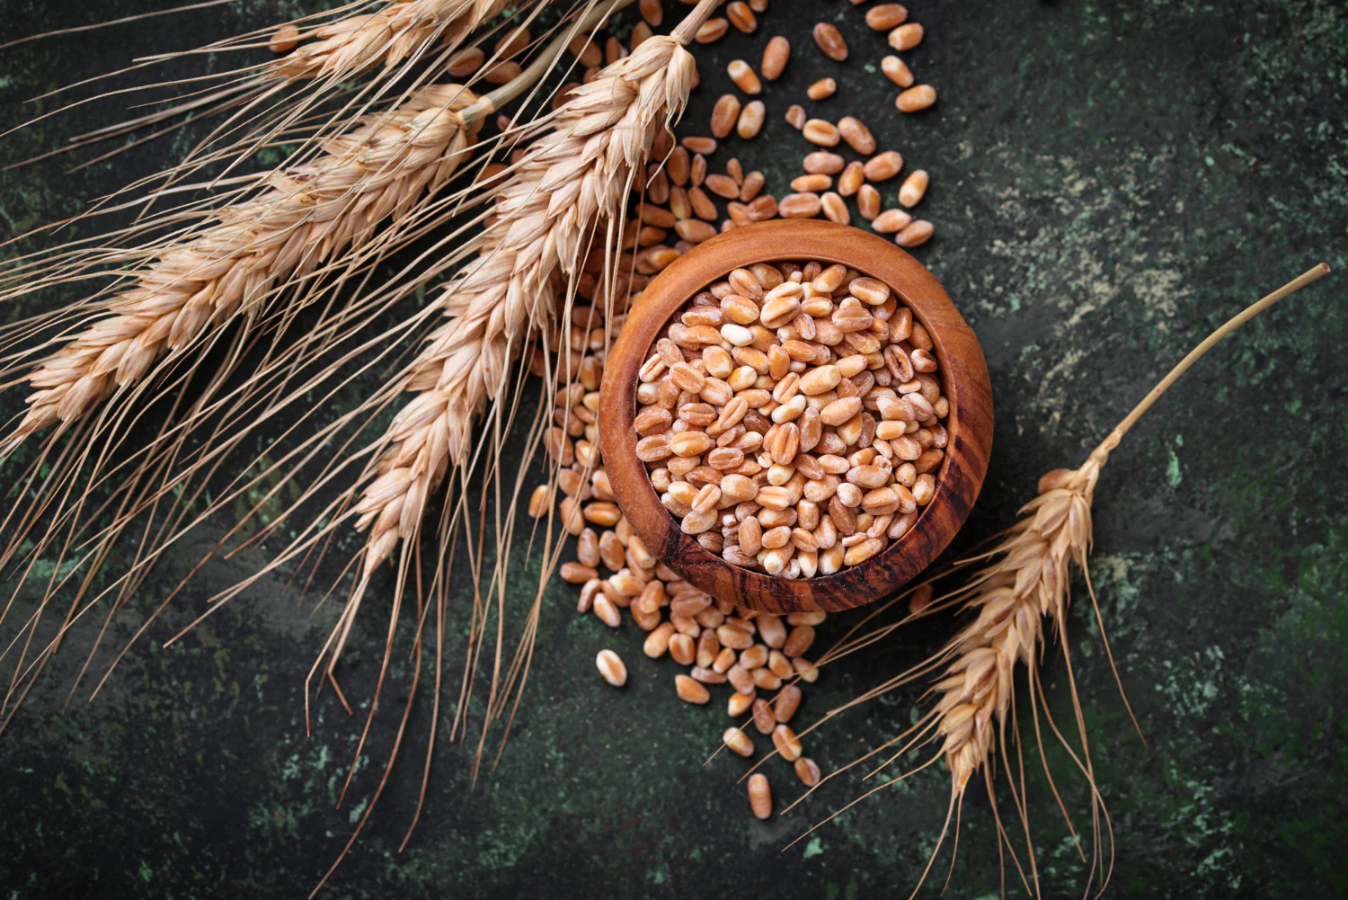
DATA 2204 statistical and Predictive Modeling II Assignment 3 – Discriminant Analysis PROFESSOR: FATIMA TETIKOGLU
STUDENT NAME: HETAL PARMAR (100992608)

Slide 2
Rational Statement
Objective:
Developing predictive models using discriminant analysis (LDA & QDA) to classify wheat types. For aid in decision-making for wheat quality control, breeding programs, and production optimization.
Model Selection:
LDA (Linear Discriminant Analysis):
It is used when a linear boundary is required between classifiers. It assumes the covariances are equal.
Assumes equal covariance among classes.
Provides linear decision boundaries.
LDA Assumptions for dataset:
a. That your data is Gaussian, that each variable is shaped like a bell curve when plotted.
b. Input variables are numeric and have the same variance (spread). Each of the classes has identical covariance matrices.
c. The decision boundaries are linear equations, obtained by finding linear combinations of the independent variables

Slide 3
Rational Statement
QDA (Quadratic Discriminant Analysis):
It is used to find a non-linear boundary between classifiers. No assumption regarding covariances.
LDA Assumptions for dataset:
a. That your data is Gaussian, that each variable is shaped like a bell curve when plotted.
b. Input variables are numeric and don’t need to have the same variance (spread). Each of the classes don’t need to have the same covariance matrices.
c. The decision boundaries are quadratic equations, obtained by finding quadratic combinations of the independent variables
Data-Driven Insights from EDA:
Pandas Profile Report was used to evaluate data quality, distribution, and inter-variable relationships.
Levene’s Test was used to check covariance equality, confirming that the assumption of equal variance holds, thus justifying LDA.
Addressing Data Challenges:
Class Imbalance: SMOTE (Synthetic Minority Oversampling Technique) was applied to balance the dataset, ensuring equal representation of each wheat type.
Dataset Description
Source & Size:The dataset, named WheatData.csv, contains 210 observations.

Slide 4
Rational Statement
Variables:
Independent Variables:
A (Area): The area measurement of the wheat kernel.
P (Perimeter): The perimeter measurement of the wheat kernel.
C (Compactness): Calculated as 4π×AreaPerimeter2\frac{4\pi \times \text{Area}}{\text{Perimeter}^2}Perimeter24π×Area​, indicating how compact the kernel is.
LK (Length of Kernel): A measure of the kernel's length.
WK (Width of Kernel): A measure of the kernel's width.
A_Coef (Asymmetry Coefficient): A measure of the asymmetry in the kernel shape.
LKG (Length of Kernel Groove): The length of the groove on the kernel.
Dependent Variable: target Categorical variable representing the wheat type: 0(Kama),1(Rosa) and 2(Canadian)
Data Quality & Structure:
The Pandas Profile Report shows that the dataset is clean (no missing values) with reasonable ranges and distributions for each variable.
Descriptive statistics (mean, standard deviation, quartiles) suggest that the data is well-suited for predictive modelling after proper scaling and balancing.

Slide 5
Rational Statement
Problem Statement
Client Requirement:
Mr. John Hughes needs a reliable tool to classify wheat types accurately (Kama, Rosa, and Canadian) based on physical and geometric measurements.
Key Questions:
Model Effectiveness:
Can LDA and QDA provide high precision, recall, and overall accuracy in classifying wheat types?
Assumptions Verification:
Do the features satisfy LDA’s assumption of equal covariance? If not, is QDA a better alternative?
Impact of Preprocessing:
How do techniques like SMOTE and feature scaling improve the performance of the predictive models?
Expected Outcomes:
Optimized LDA and QDA models using grid search and cross-validation.
Detailed performance metrics (confusion matrices, classification reports) to guide further improvements.
Actionable recommendations for refining the modelling process.

Slide 6
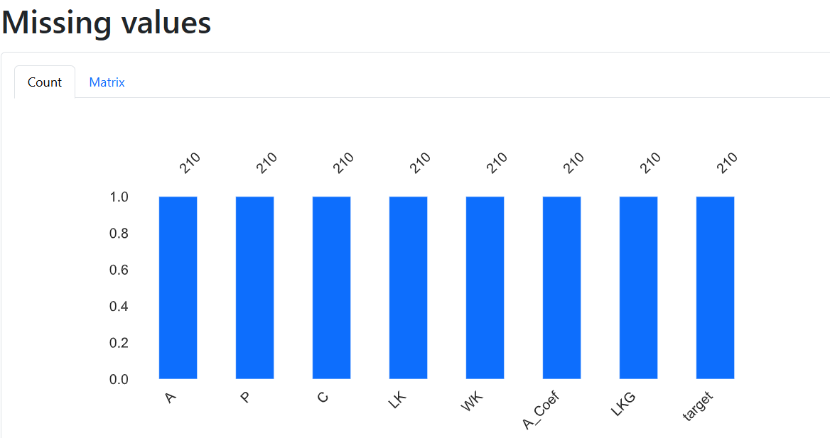
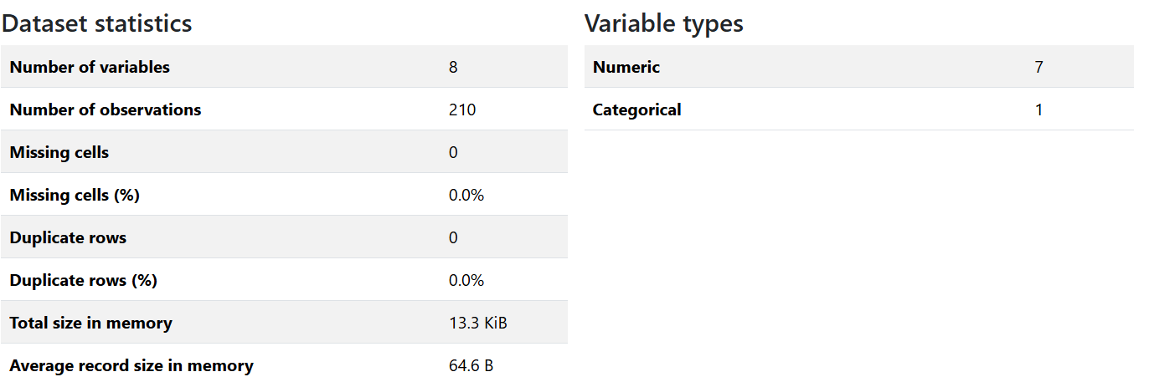
Create, Identify and explain two (2) key insights from the Pandas Profile Report
The Pandas Profile Report shows that the dataset is complete with no missing values. This is critical because it means that every observation can be used for modelling without the need for imputation, reducing the risk of introducing bias or noise.
Well-Behaved Distributions:
Descriptive Statistics: The report shows that the variables (e.g., Area, Perimeter, Compactness, Length of Kernel, etc.) have reasonable ranges and standard deviations. For example, the variable A (Area) has a mean of approximately 14.85 and a standard deviation of 2.91, indicating that the data are clustered around the mean with moderate variability.

Slide 7
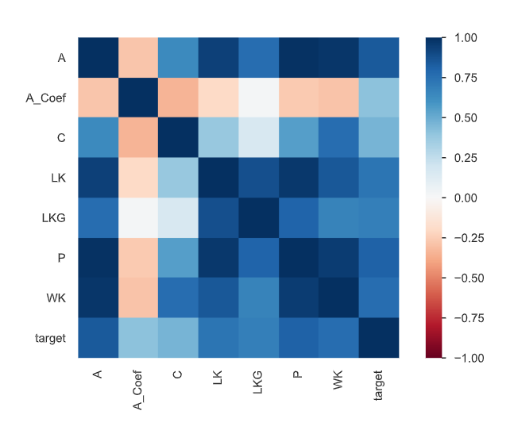
Create, Identify and explain two (2) key insights from the Pandas Profile Report
Strong Relationships Between Key Features: The correlation matrix provided in the report highlights strong correlations between variables such as Area (A) and Perimeter (P), which is expected because as the area of an object increases, its perimeter tends to increase as well. Similarly, features like Length of Kernel (LK) and Width of Kernel (WK) show positive correlation, indicating that larger kernels are generally wider.
Strong correlations exist among features (e.g., Area with Perimeter, Kernel Length with Kernel Width).
While these correlations indicate some redundancy, they can also enhance class separation if the relationship patterns differ among wheat types.

Slide 8
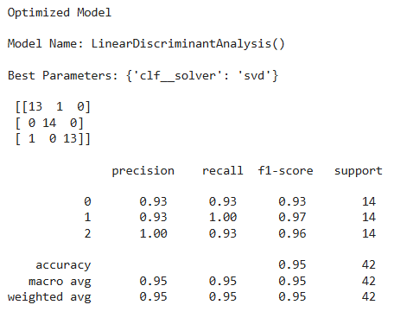
Confusion Matrix/Classification Report for the Optimized LDA and QDA Model
Classification Report of LDA
Class 0: Precision = 0.93, Recall = 0.93, F1-Score = 0.93, Support = 14
Class 1: Precision = 0.93, Recall = 1.00, F1-Score = 0.97, Support = 14
Class 2: Precision = 1.00, Recall = 0.93, F1-Score = 0.96, Support = 14
Overall Accuracy: 95% (Macro Avg: Precision, Recall, F1 = 0.95)

Slide 9
Confusion Matrix/Classification Report for the Optimized LDA and QDA Model
Key Insights for LDA:
High Overall Accuracy & Balanced Predictions:
The overall accuracy of model 95% shows that LDA is highly effective. With equal support 14 each, the predictions are balanced across all wheat types.
Strong Precision and Recall: Precision values (0.93–1.00) indicate that when the model predicts a class, it is very reliable. Further, High recall (0.93–1.00) ensures that most actual cases are correctly identified, minimizing false negatives.
Robust F1-Scores: F1-scores ranging from 0.93 to 0.97 represent a good balance between precision and recall, meaning the model performs consistently well in handling both false positives and false negatives.

Slide 10
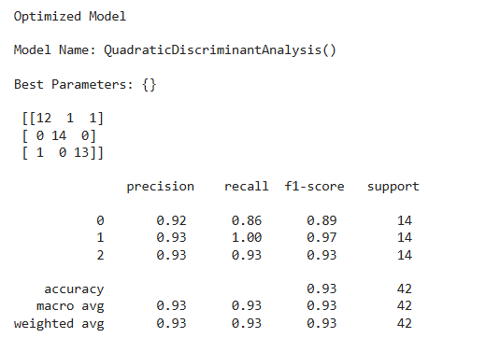
Confusion Matrix/Classification Report for the Optimized LDA and QDA Model
QDA model is base model as optimized is not possible in QDA.
Classification Report:
Class 0: Precision = 0.92, Recall = 0.86, F1-Score = 0.89, Support = 14
Class 1: Precision = 0.93, Recall = 1.00, F1-Score = 0.97, Support = 14
Class 2: Precision = 0.93, Recall = 0.93, F1-Score = 0.93, Support = 14
Overall Accuracy: 93% (Macro Avg: Precision, Recall, F1 = 0.93)

Slide 11
Confusion Matrix/Classification Report for the Optimized LDA and QDA Model
Key Insights for QDA:
Slightly Lower Overall Performance: Overall accuracy of model is 93%, QDA performs well but slightly underperforms compared to LDA. Notably, Class 0 has a lower recall (0.86), suggesting that some true instances of this class are being missed.
Variable Performance Across Classes: While Classes 1 and 2 show strong precision and recall, Class 0’s lower recall and F1-score (0.89) indicate variability in model performance. This indicates that QDA's flexible covariance assumptions may not benefit all classes equally.
Good but Inconsistent F1-Scores: F1-scores for Class 1 and Class 2 are high (0.97 and 0.93, respectively), but the lower F1-score for Class 0 (0.89) highlights a slight imbalance in model effectiveness across classes.This inconsistency calls for further refinement or potential feature engineering to boost Class 0’s performance.

Slide 12
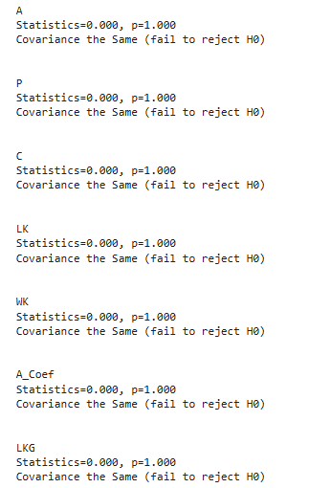
Covariance Test – Levene’s Test
Purpose of Levene’s Test:
To check if the variances across groups (wheat types) are statistically equal.
Results in Your Analysis: For every feature, the p-value was 1.000 (> 0.05).
Interpretation: Fail to reject the null hypothesis – indicating that variances (and hence covariances) are similar across the wheat classes.

Slide 13
Covariance Test – Levene’s Test
Purpose of Levene’s Test:
To check if the variances across groups (wheat types) are statistically equal.
Results in Your Analysis: For every feature, the p-value was 1.000 (> 0.05).
Interpretation: Fail to reject the null hypothesis – indicating that variances (and hence covariances) are similar across the wheat classes.

Slide 14

SMOTE
Balancing Classes with SMOTE:
SMOTE (Synthetic Minority Oversampling Technique) is applied to the training set to generate synthetic samples for underrepresented classes, ensuring equal representation (56 samples per class).
Class are balanced for dataset.

Slide 15
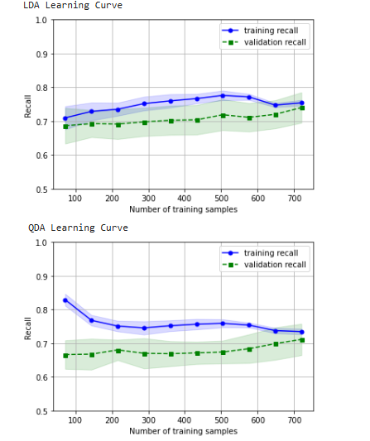
Learning Curves & Cross-Validation
LDA training recall starts high and gradually decreases and meet validation recall at a point 0.75 while validation recall improves steadily. This pattern suggests that LDA generalizes with more data.
QDA represent a higher initial training recall but a lower validation recall, indicating a bigger gap early on. Though QDA’s training recall decreases over time, its validation recall doesn’t rise as much, hinting at higher variance or sensitivity.
Overall, LDA’s learning curve converges more smoothly than QDA’s, indicating that LDA is more stable and consistent performance as sample size increases.

Slide 16
Compare the Optimized LDA to the Optimized QDA identifying three (3) key insights
1 Overall Accuracy & Macro Metrics for LDA and QDA
LDA: Overall accuracy: 95% and Macro average metrics (Precision, Recall, F1): 0.95
QDA: Overall accuracy: 93% and Macro average metrics: ~0.93
Interpretation: LDA outperforms QDA slightly on overall accuracy and macro metrics, indicating that, on average, LDA consistently classifies all classes with higher reliability.
2 Specific Performance Differences
Class 0:
LDA: the Precision value is 0.93, Recall value is 0.93 and F1 value is 0.93
QDA: the Precision value is 0.92, Recall value is 0.86 and F1 value is 0.89
Interpretation:
For Class 0, LDA shows higher recall and F1, indicating it captures true instances of Class 0 more effectively than QDA. QDA misses more Class 0 instances indicating lower recall, reducing its overall F1-score for this class.

Slide 17
Compare the Optimized LDA to the Optimized QDA identifying three (3) key insights
Classes 1 & 2:
Both models achieve high metrics Class 1 with LDA have Precision value as 0.93, Recall value as 1.00 and F1 score as 0.97 and for QDA, the Precision value is 0.93, Recall value is 1.00, F1 score is 0.97 ;Class 2 is also having similar values.
Interpretation:
The performance for Classes 1 and 2 is robust in both models, showing that the primary performance difference is driven by the results on Class 0.
3 Consistency and Model Robustness Across Classes
LDA: the model shows consistent performance with equal support 14 and similar metrics across classes. Its assumption of equal covariance appears to suit the dataset well, leading to uniform predictions.
QDA: the model performing well overall, it shows variability for Class 0. This inconsistency indicates that QDA's flexibility (allowing different covariance structures) might make it more sensitive to slight deviations in the data, leading to less stable performance on one of the classes.
Interpretation: The consistency in LDA’s performance across all classes indicates that it is a more robust model for this dataset, whereas QDA’s sensitivity for Class 0 could warrant further tuning or additional feature engineering.

Slide 18
two recommendations for Mr. John Hughes for next steps
1 Improve Features and Reduce Unnecessary Data
The current models perform well but adding new features or changing existing ones could make the predictions even better.
For example, combining features like kernel length and width might give new insights. Another option is to reduce the number of features by removing less important ones. This can make the model simpler and faster, helping it perform better.
2 Try Other Models for Better Results
Even though the current models (LDA and QDA) are good, trying different models may give better accuracy. We might want to experiment with models like Random Forests, which work by combining many models to make better predictions. If more data becomes available or if patterns get more complicated, testing new models like Support Vector Machines (SVM) or neural networks could help.
These recommendations suggest ways to improve the current prediction system, making it more reliable and accurate for Mr. Hughes's wheat classification.

Slide 19
Conclusion
Analysis in assignment present that both LDA and QDA model are effective in classifying wheat types based on the given features. LDA slightly outperforms QDA, achieving higher overall accuracy and more consistent performance across all classes.
Further, key preprocessing step such as using SMOTE to balance the classes and scaling the feature were important in enhancing model performance. The clean data and clear relationships between features confirmed by the Pandas Profile Report provided a solid foundation for the modelling. Moreover, further improvements could be achieved through advanced feature engineering and exploring alternative or ensemble modelling techniques, which may lead to even better prediction accuracy for Mr. Hughes.
References :
Week 5 – Discriminate Analysis (DA) course notes
Wee5a - LDAQAD-lib python file

