Slide 1

Statistical and Predictive Modeling II (DATA 2204) Assignment 4 – Regularization (15% of Final Grade) Professor: Fatma Tetikoglu Name: Hetal Parmar (100992608)

Slide 2
Rational Statement
In today's world, optimizing energy efficiency is important for reducing costs and improving sustainability. Assignment focuses on predicting Heating Load (Y), a key factor in energy consumption, using Regularization Techniques (LASSO, Ridge, and Elastic Net). By using these methods to develop a model that balances accuracy and reliability, ensuring that predictions generalize well to new data.
Dataset Information:
For Assignment analysis, EnergyUse-Heating.csv dataset is used, which consists of:
768 observations representing different building structures.

Slide 3
Rational Statement
8 independent variables (features) that influence heating load, including:
X1 - Relative Compactness, X2 - Surface Area, X3 - Wall Area, X4 – Roof, Area X5 - Overall Height, X6 – Orientation, X7 - Glazing Area, X8 - Glazing Area Distribution
Relative Compactness: How efficiently space is utilized in the building. Surface Area, Wall Area, and Roof Area: Structural aspects affecting heat retention. Glazing Area & Distribution: The amount and positioning of glass surfaces. Orientation: The direction a building faces, affecting sunlight exposure.
Target Variable: Heating Load (Y), which represents the energy required for heating.
Understanding how these factors interact allows us to build a model that predicts Heating Load efficiently, helping in energy conservation and cost management.

Slide 4
Rational Statement
Data Preprocessing
Steps Taken:
Outlier Detection (Tukey's Method)
Checked for outliers using Interquartile Range (IQR).
No outliers found; dataset remained unchanged.
Feature Scaling:
Standardized all features using StandardScaler to ensure fair comparisons between models.
Train-Test Split:
80% Training, 20% Testing
Random State = 100 (for reproducibility).

Slide 5
Rational Statement
Regularization Models
Regularization is used to prevent overfitting by adding a penalty to large coefficients.
Types of Regularization Models:
LASSO (Least Absolute Shrinkage and Selection Operator)
Shrinks some feature coefficients to zero, effectively selecting important features.
Ridge Regression
Shrinks coefficients towards zero but does not remove features completely.
Works well when all features contribute to the target variable.
Elastic Net
Combination of LASSO & Ridge.
Helps in cases where LASSO may remove too many features.

Slide 6
Rational Statement
This assignment aims to develop Regularization Models (LASSO, Ridge, and Elastic Net) to predict Heating Load using building-related structural and environmental features such as Relative Compactness, Surface Area, Wall Area, Roof Area, Overall, Height, Orientation, Glazing Area, and Glazing Area Distribution.
By applying Regularization Techniques, we aim to:
Improve the predictive accuracy of the model.
Prevent overfitting by reducing the impact of less significant features.
Identify the best-performing model for forecasting heating load.

Slide 7
Rational Statement
The assignment will evaluate the models based on Adjusted R², Mean Absolute Error (MAE), and Root Mean Squared Error (RMSE) to determine which technique provides the most reliable predictions for heating energy consumption.
This assignment will contribute to better energy efficiency planning by helping architects, engineers, and policymakers make data-driven decisions in building design and energy management.

Slide 8
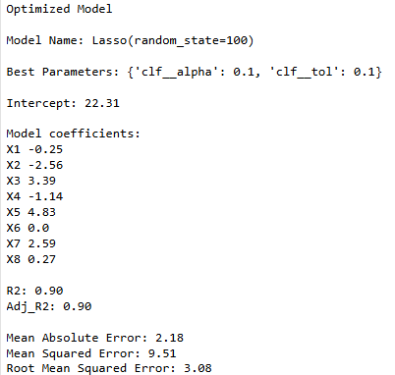
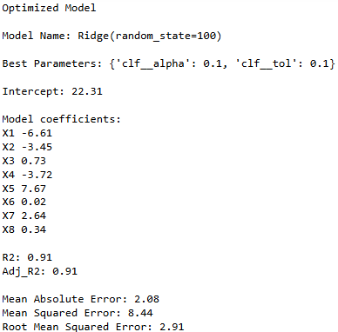
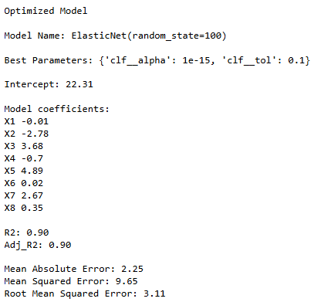
Optimized Regularization Model (LASSO, Ridge and Elastic Net) outputs and explain three (3) key insights

Slide 9
Optimized Regularization Model (LASSO, Ridge and Elastic Net) outputs and explain three (3) key insights
LASSO Regression Insights
Adj. R² = 0.90 → Indicates that 90% of the variance in the target variable is explained by the model.
MAE = 2.18 → The model’s average absolute deviation from actual values is 2.18 units.
RMSE = 3.08 → The standard deviation of the residuals (errors) is 3.08, showing how well the model generalizes.
Key Observations:
(1) Feature Selection and Interpretability
LASSO sets some coefficients to zero (e.g., X6 = 0), effectively removing irrelevant or redundant features.
This makes the model more interpretable and reduces overfitting. Feature selection is beneficial when working with high-dimensional datasets.
(2) Slightly Higher RMSE Compared to Ridge
RMSE of 3.08 means that the model’s prediction errors are slightly higher than Ridge. LASSO is good for sparse models, but in this case, Ridge is performing slightly better in terms of prediction accuracy.
(3) Potential Over-Penalization of Important Features
LASSO might be over-penalizing certain features, as seen in the drastic reduction in coefficient values compared to Ridge. It may not be the best choice if we believe all features are relevant.

Slide 10
Optimized Regularization Model (LASSO, Ridge and Elastic Net) outputs and explain three (3) key insights
Ridge Regression Insights
Adj. R² = 0.91 → Slightly higher than LASSO, indicating a better fit.
MAE = 2.08 → The lowest among all models, meaning more accurate predictions.
RMSE = 2.91 → The lowest among all models, suggesting better generalization.
Key Observations:
(1) Regularization Without Feature Elimination
Ridge does not eliminate features but instead shrinks coefficients toward zero.This means that all variables remain in the model, which is good when we believe all predictors contribute to the target variable.
(2) Best Model for Prediction Accuracy
Since Ridge has the lowest MAE (2.08) and RMSE (2.91), it provides the most stable and accurate predictions.
This is especially important when making predictions on unseen data.
(3) More Balanced Coefficient Weights
Ridge keeps coefficients more evenly distributed across variables, avoiding over-penalization seen in LASSO.
The coefficients suggest that all features have some contribution, meaning Ridge is leveraging more information than LASSO.

Slide 11
Optimized Regularization Model (LASSO, Ridge and Elastic Net) outputs and explain three (3) key insights
Elastic Net Regression Insights
Adj. R² = 0.90 → Same as LASSO, slightly lower than Ridge.
MAE = 2.25 → Higher than both LASSO and Ridge, meaning less accurate predictions.
RMSE = 3.11 → The highest among the models, suggesting worse generalization.
Key Observations:
(1) A Hybrid of LASSO and Ridge, But Underperforming Here
Elastic Net combines LASSO (feature selection) and Ridge (coefficient shrinkage).
However, the chosen alpha (1e-15) is too small, meaning the model behaves almost like an OLS regression with little to no regularization.
(2) Higher Error Metrics Suggest Overfitting or Poor Regularization
Elastic Net has the highest RMSE (3.11) and MAE (2.25), meaning its predictions are less reliable than Ridge.
This suggests that the model may not be regularizing enough, possibly due to the inappropriate tuning of hyperparameters.
(3) Use Case: Datasets with Highly Correlated Features
Elastic Net is best used when features are highly correlated, but in this case, Ridge already performs better, making Elastic Net unnecessary.

Slide 12
Identify one (1) model that you created (i.e. LASSO, Ridge or Elastic Net) that could be implemented by Mr. John Hughes and identify and justify two (2) next steps
Based on the evaluation of LASSO, Ridge, and Elastic Net models, Ridge Regression is the most suitable model for implementation by Mr. John Hughes.
Highest Adjusted R² (0.91): Ridge explains 91% of the variance in the target variable, making it the most accurate among the three models. Lowest RMSE (2.91) and MAE (2.08): It provides the most stable and precise predictions, minimizing both absolute and squared errors. Prevents Overfitting Without Feature Elimination: Unlike LASSO, Ridge does not remove any features, which is useful when all predictors are valuable for making informed business decisions.
Next Steps to Enhance Usability
To improve the usability and effectiveness of Ridge Regression, Mr. John Hughes can take the following steps:

Slide 13
Identify one (1) model that you created (i.e. LASSO, Ridge or Elastic Net) that could be implemented by Mr. John Hughes and identify and justify two (2) next steps
1️ Perform Feature Engineering and Selection
Justification: Ridge uses all available features, even those with minimal contribution. This can reduce model interpretability and add noise to predictions.
Enhancement Approach:
Conduct feature importance analysis (e.g., using SHAP values or correlation analysis) to remove highly irrelevant variables. Use Principal Component Analysis (PCA) or Recursive Feature Elimination (RFE) to reduce dimensionality and improve efficiency.
2️ Fine-Tune Hyperparameters with Cross-Validation
Justification: While Ridge Regression performed best, the chosen hyperparameters (alpha=0.1, tol=0.1) may not be optimal for deployment in a real-world scenario.
Enhancement Approach:
Use Bayesian Optimization or Randomized Search Cross-Validation to explore a wider range of alpha values and other hyperparameters. Perform K-Fold Cross-Validation (e.g., k=10) to ensure the model generalizes well across different datasets before deployment.

Slide 14
Conclusion
Regularization techniques help prevent overfitting and improve model generalization.
Ridge Regression was the best performing model in this case.
Further optimizations (hyperparameter tuning & feature engineering) could improve predictions.
This approach can be applied to other energy efficiency predictions.

