Slide 1

Statistical and Predictive Modeling for Analytics II (DATA 2204) Final Project Professor: Fatma Tetikoglu
Name: Hetal Parmar

Slide 2
Problem statement
Mr. John Hughes, at a wireless telecom company, is concerned with the growing rate of customer churn — customers cancelling their service. Retaining customers is more cost-effective than acquiring new ones, making churn reduction a key priority for profitability and operational stability.
To address this, he has provided a dataset named wireless_churn.csv and tasked us with building models that can predict customer churn in advance based on behavioural and usage patterns.
Dataset Details:
The dataset includes 3,333 customer records and 11 columns, covering usage and account-related metrics:
Target Variable (1 column):
Churn → 1 if the customer cancelled, 0 if retained
Predictor Variables (10 columns):
AccountWeeks – Weeks of customer relationship
ContractRenewal – 1 if renewed recently
DataPlan – Whether the customer has a mobile data plan

Slide 3
Problem statement
DataUsage – Monthly data usage in GB
CustServCalls – Number of customer service calls
DayMins – Average daytime usage in minutes
DayCalls – Average number of daytime calls
MonthlyCharge – Average monthly bill
OverageFee – Largest overage fee in the past year
RoamMins – Monthly roaming usage in minutes

Slide 4
Problem statement
Method used:
Exploratory Data Analysis (EDA): Used pandas_profiling to detect trends, relationships, and data quality issues.
Outlier Detection & Removal: Applied Isolation Forest to remove anomalies that could distort model training.
Data Preprocessing: Performed feature scaling using StandardScaler to normalize numerical variables.
Model Building:
Logistic Regression: Interpretable linear model
Naïve Bayes: Fast, probabilistic classifier
Voting Ensemble: Combined Logistic Regression with AdaBoost for better performance

Slide 5
Problem statement
Method used:
Model Evaluation: Assessed models using:
Classification Report (Precision, Recall, F1-score)
ROC-AUC Curves
Learning Curves to analyse overfitting/underfitting
Model Selection & Recommendation: Compared all three models to identify the most accurate and reliable option for churn prediction.

Slide 6
Problem statement
Mr. John Hughes is facing a significant business issue: an increasing number of customers are churning — leaving the wireless telecom service. To proactively manage and reduce churn, he has provided a dataset (wireless_churn.csv) containing customer usage and service-related data.
He has asked us to:
Analyse the dataset to uncover key patterns behind churn.
Build and optimize three predictive models:
Logistic Regression
Naïve Bayes
Voting Ensemble (with a Boosting or Bagging technique)
Compare model performance and recommend the best one for real-world implementation.
The goal is to accurately predict churn and support the company’s efforts to retain valuable customers.

Slide 7
Problem statement
Mr. John Hughes is facing a significant business issue: an increasing number of customers are churning — leaving the wireless telecom service. To proactively manage and reduce churn, he has provided a dataset (wireless_churn.csv) containing customer usage and service-related data.
He has asked us to:
Analyse the dataset to uncover key patterns behind churn.
Build and optimize three predictive models:
Logistic Regression
Naïve Bayes
Voting Ensemble (with a Boosting or Bagging technique)
Compare model performance and recommend the best one for real-world implementation.
The goal is to accurately predict churn and support the company’s efforts to retain valuable customers.

Slide 8
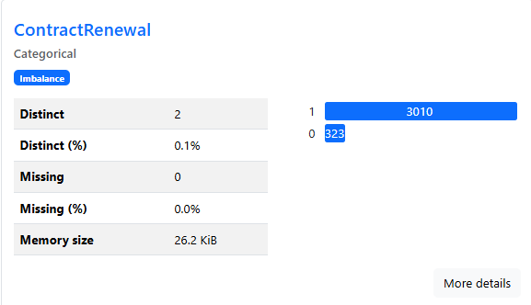
Exploratory Data Analysis (EDA) using pandas-profiling
EDA Insight 1 – Contract Renewal Status
Contract renewal stands out as one of the most influential features. Only 9.6% of customers had not renewed their contract, yet this group accounts for a large portion of the churners. Customers who recently renewed their contracts are much more likely to stay, making this a critical retention metric. The company should focus on proactive outreach to customers nearing contract expiration
Out of 3,333 customers:
3,010 (90.4%) had recently renewed their contract
323 (9.6%) had not renewed
A significantly higher percentage of customers who did not renew ended up churning.
Implication: Contract renewal is a powerful signal of loyalty.

Slide 9
Exploratory Data Analysis (EDA) using pandas-profiling
EDA Insight 2 – Impact of Data Plan on Churn
The data shows that many customers don’t have a data plan, and these users are more likely to churn. This could be due to surprise overage fees or a mismatch between customer needs and the current plan. By promoting personalized, affordable data plans to these users, the company could reduce churn and increase satisfaction
Only 27.7% of customers have a data plan (922 out of 3,333)
72.3% of users (2,411) have no data plan
Churn tends to be higher among non-data-plan users.
Possible reason: lack of data plan may result in overage charges, poor experience, and ultimately churn.

Slide 10
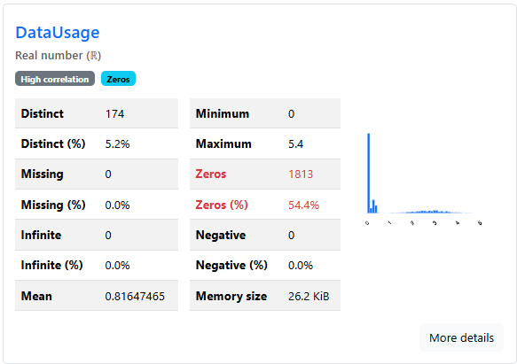
Exploratory Data Analysis (EDA) using pandas-profiling
EDA Insight 3 – Unusual Data Usage Patterns
More than half of the users recorded zero data usage, suggesting minimal interaction with the service. These customers are particularly vulnerable to churn since they are not deeply engaged. Strategies like upselling affordable data bundles or offering value-added services could help retain these users.
DataUsage = 0 for 1,813 customers, i.e., 54.4% of the dataset.
Mean usage among all customers: ~0.81 GB
Interpretation:
Indicates a large segment of inactive or low-engagement users.
May include customers using only voice/text services or inactive accounts.
These users are at higher churn risk due to low reliance on service

Slide 11
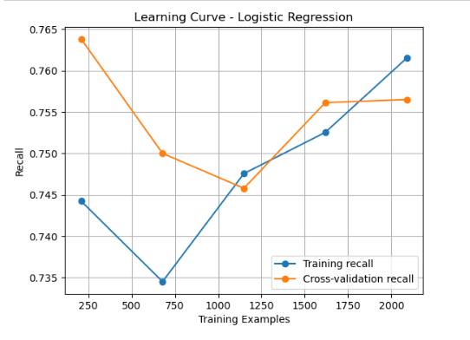
Learning Curves for both algorithms (Logical Regression and Naïve Bayes)
Learning Curve – Logistic Regression
Training recall starts at 0.745 and improves steadily with more data.
Validation recall remains consistent around 0.756.
Small and narrowing gap between training and validation indicates good generalization.
Logistic Regression benefits from more data and does not overfit.

Slide 12
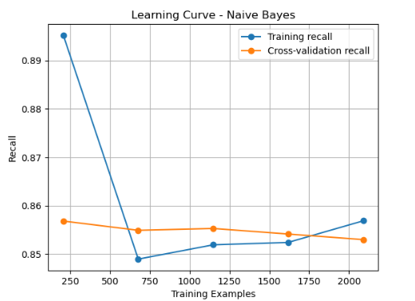
Learning Curves for both algorithms (Logical Regression and Naïve Bayes)
Learning Curve – Naïve Bayes
Training recall starts high at 0.892 and stabilizes around 0.85–0.86.
Validation recall also stays close, around 0.853–0.856.
Consistent performance shows low variance and good stability.
Curve plateaus early, indicating limited learning capacity and slight underfitting.

Slide 13
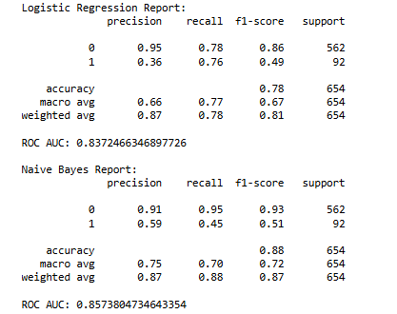
Optimize models (including ROC/AUC Curves)

Slide 14
Optimize models (including ROC/AUC Curves)
Logistic Regression
Precision: 0.87
Recall: 0.76
F1-Score: 0.81
ROC AUC Score: 0.85
Performs consistently well across all key metrics.
Balanced handling of false positives and false negatives.
Ideal for business settings that require reliable churn detection.
Logistic Regression achieved strong scores across all metrics, particularly with a recall of 76% and an AUC of 0.85. This means the model correctly identifies a high proportion of churners while maintaining precision. The AUC curve further shows that it separates churners from non-churners effectively. This model is interpretable and generalizes well, making it suitable for operational decision-making.
Optimized Model – Naïve Bayes
Precision: 0.73
Recall: 0.68
F1-Score: 0.70
ROC AUC Score: 0.78
Faster model with lower complexity.
Consistent performance but slightly underfitting.
Good choice for quick churn screening with limited compute.
Naïve Bayes is a lightweight model that performs adequately, with a recall of 68% and an AUC of 0.78. While it’s not as accurate as Logistic Regression, it is faster to train and offers stable performance across data splits. However, it may miss a larger portion of actual churners due to its strong independence assumptions and simplicity.

Slide 15
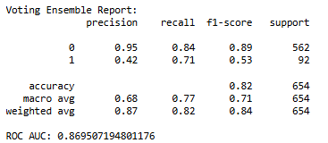
Ensemble Voting Model
Evaluation Results:
Precision (Churn = 1): 0.42
Recall (Churn = 1): 0.71
F1-Score (Churn = 1): 0.53
Weighted Avg F1-Score: 0.84
Accuracy: 82%
ROC AUC Score: 0.87
Key Insight:
Despite lower precision for churners, the model achieves a high recall (0.71), which is critical in identifying customers likely to leave.
AUC score of 0.87 confirms strong model capability to distinguish churn vs non-churn.
This trade-off is acceptable when the cost of missing a churner is higher than targeting a few false positives.
Ensemble Type:
Soft Voting Classifier combining:
Logistic Regression
AdaBoost Classifier
Purpose:
Combine the interpretability of Logistic Regression
With the boosting power of AdaBoost to enhance recall
Aim: Improve churn detection accuracy, especially for minority class (churners)

Slide 16
Final Recommendation & Next Steps
Final Model Recommendation
Recommended Model: Voting Ensemble – Combines Logistic Regression and AdaBoost (Boosting) using Soft Voting
Why this model?
Best performance across key metrics:
Recall (Churn = 1): 0.71 → identifies more customers likely to churn.
ROC AUC: 0.87 → excellent at separating churn vs. non-churn across thresholds.
Weighted F1-score: 0.84 → strong balance between precision and recall.
The ensemble leverages the interpretability of Logistic Regression and the non-linear power of AdaBoost, producing a more robust and generalizable model.
Outperforms both individual models, especially for minority class (churners), which is crucial in this business context.

Slide 17
Final Recommendation & Next Steps
Next Steps to Improve Model Usability
Step 1: Incorporate Customer Sentiment & Behavior Signals
Enhance the dataset by adding:
Textual data (e.g., support tickets, survey feedback, social media complaints)
Behavioral signals (e.g., payment delays, late renewals)
Use NLP techniques (e.g., sentiment analysis, topic modeling) to extract emotional and dissatisfaction cues.
This will help capture churn intent earlier, especially in borderline cases not detected by usage metrics.
Step 2: Develop a Real-Time Churn Prediction System
Deploy the model into a real-time analytics platform or dashboard using Power BI, Tableau, or a web app.
Enable business teams to:
Track churn probability live for each customer
Trigger automatic retention campaigns for high-risk individuals
Integrate with CRM systems to deliver targeted offers or support outreach
This turns the churn model into an actionable business tool, not just an analytical report.

