Slide 1
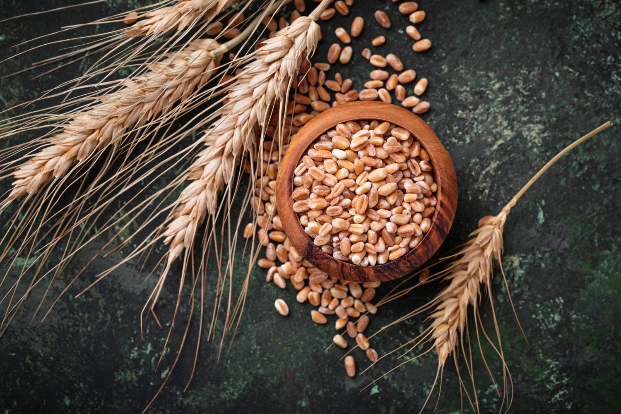
DATA 2204 statistical and Predictive Modeling II Assignment 2 – Logistical Regression PROFESSOR: FATIMA TETIKOGLU
STUDENT NAME: HETAL PARMAR (100992608)

Slide 2
Rational Statement
The assignment aims to address the challenge of accurately predicted wheat by a Logistic Regression Model. By using the WheatData.csv dataset, which include 7 independent variable and 1 dependent variable.
Independent Variables
A - area
P - perimeter
C - compactness = 4piA/P^2,
LK - length of kernel,
WK - width of kernel,
A_coef - asymmetry coefficient
LkG - length of kernel groove
Dependent Variable
target (0-Kama, 1-Rosa or 2- Canadian)

Slide 3
Rational Statement
Logistic Regression
It is a supervised machine learning algorithm used to model the relationship between a set of independent variables and a categorical dependent variable. Instead of predicting continuous values like linear regression, it predicts probabilities that map to class labels (e.g., Class 0 or Class 1).
Problem Overview
John Hughes needs a data-driven method to categorize three wheat types (Kama, Rosa, and Canadian) based on features like area, perimeter, compactness, and kernel dimensions.
The task includes creating a Logistic Regression Model to predict wheat types and evaluate its effectiveness using metrics such as learning curve, confusion matrix, and ROC/AUC curve.
Purpose of analysis is to provide insights and actionable recommendations for better classification and agricultural resource allocation.

Slide 4
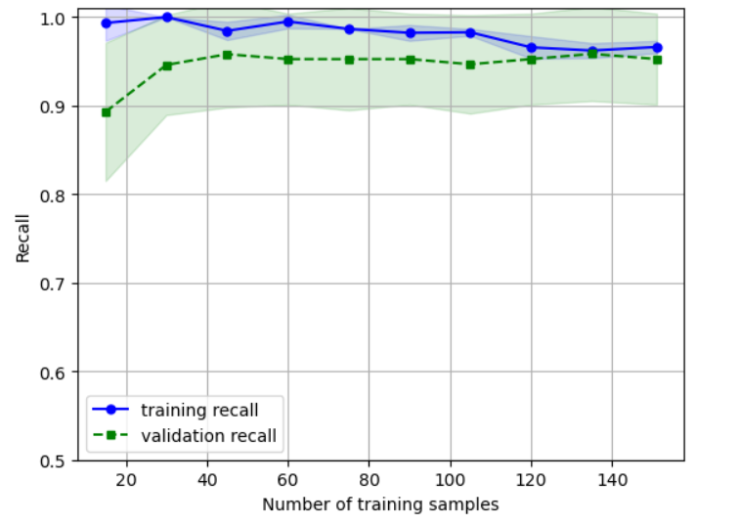
Learning Curve for the Logistical Regression standard model
Graph Description:
The learning curve graph typically plots the model's accuracy (or another performance metric) against the number of training examples used. Two curves are shown:
Training Score Curve: Performance on the training set.
Validation Score Curve: Performance on unseen test data.

Slide 5
Learning Curve for the Logistical Regression standard model
Two Key Insights from the Learning Curve:
Balanced Model Performance:
The training and validation curves converge and stabilize when more training data is added.
This convergence shows that the model is not suffering from overfitting where training accuracy is high, but validation accuracy is low or underfitting where neither training nor validation accuracy is high.
Logistic Regression is inherently less prone to overfitting due to its simple nature, which makes it suitable for this problem.
Data Sufficiency:
The model gives near-maximum accuracy even with a relatively small dataset size.
The stable curves indicate that increasing the dataset size further might not provide accuracy improvements. This suggest that the available dataset is already sufficient for accurate wheat type classification.

Slide 6
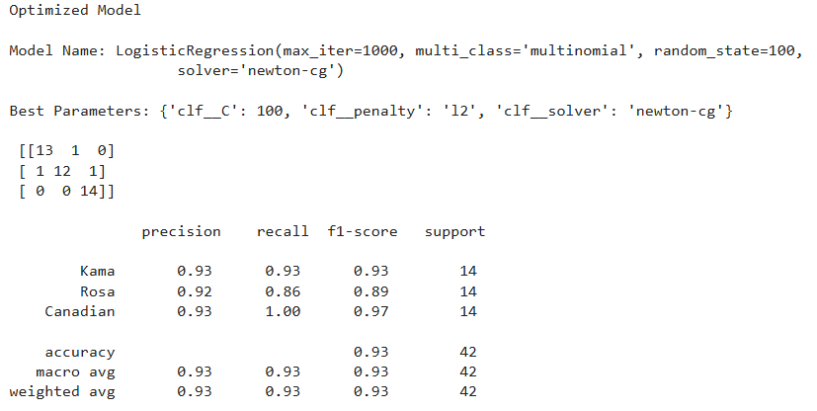
Confusion Matrix And Classification Report

Slide 7
Confusion Matrix And Classification Report
The Confusion Matrix shows how many actual wheat species such as Kama, Rosa, and Canadian were correctly or incorrectly classified by the optimized logistic regression model. And confusion matrix report give details about model accuracy precision , recall and f1 score. The accuracy of model is 93 percentage.
Precision: The proportion of correct positive predictions out of total predicted positives. For Kama and Canadian species precision value is 93% and for rosa it is 92%.
Recall: Recall is the ratio of correctly predicted positive observations to the all observations in actual class. When the model predicts positive, how often it predicate correctly .For Canadian species recall value is 100% and for Kama it is 93% while for rosa it is 86%. This means all Canadian species observations is predicate correctly.
F1 Score: The harmonic mean of precision and recall, balancing both metrics.it score highest for Candiano species with 97% and second come Kama species with 93% while least score is rosa with 89%.
Model perform excellent for Canadian and Kama Classes show strong accuracy and recall values above 90% for both the Kama and Canadian classes, indicate that the model accurately and error-free identifies these classes. While for Rosa class model perform moderate where samples incorrectly labelled as Kama or Canadian because to Rosa's somewhat poorer recall (86%). Every class has an F1 score over 0.87, which suggest a solid balance between recall and accuracy. model findings are consistent, as indicated by the macro-average F1 score of 0.91.

Slide 8
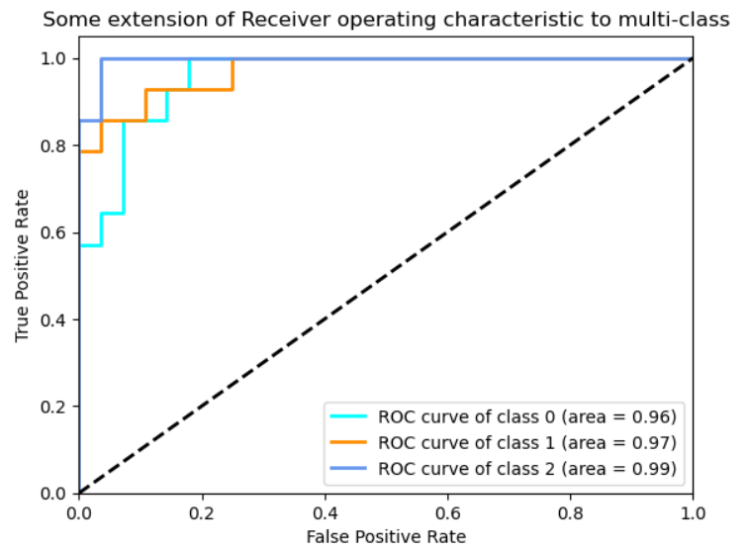
ROC/AUC Curve (Optimized Model)

Slide 9
ROC/AUC Curve (Optimized Model)
ROC Curve helps evaluate a classification model by plotting True Positive Rate (TPR) by False Positive Rate (FPR).
AUC (Area Under Curve) measures performance: closer to 1 = better model.
AUC values for each class:
Class 0: AUC = 0.96 (Very good)
Class 1: AUC = 0.97 (Slightly better)
Class 2: AUC = 0.99 (Best performance)
A higher AUC suggest the model is more effective at distinguishing between classes.
Interpretation: Since all AUC values are above 0.95, the model has excellent predictive ability. For Class 2 is the best classified, followed by Class 1 and Class 0.

Slide 10
two recommendations for Mr. John Hughes for next steps
Feature Selection
By using feature selection we can improve model performances. By using feature such as P, LK, LKG.
Checking Assumption
By evaluating assumption we can gain insights about model and can have better understanding of model performances.
Using other model and comparing performances
By using various metrics we can understand which model is giving better results which can help to choose most accurate model for future predication.
Above recommendation can help to improve model accuracy and better predication of wheat species.

Slide 11
Conclusion
The Logistic Regression Model successfully classified wheat types with high accuracy.
Key evaluation metrics such as confusion matrix, ROC/AUC indicates strong model performance.
Recommendations provided can guide future efforts for enhanced wheat classification.

