Slide 1
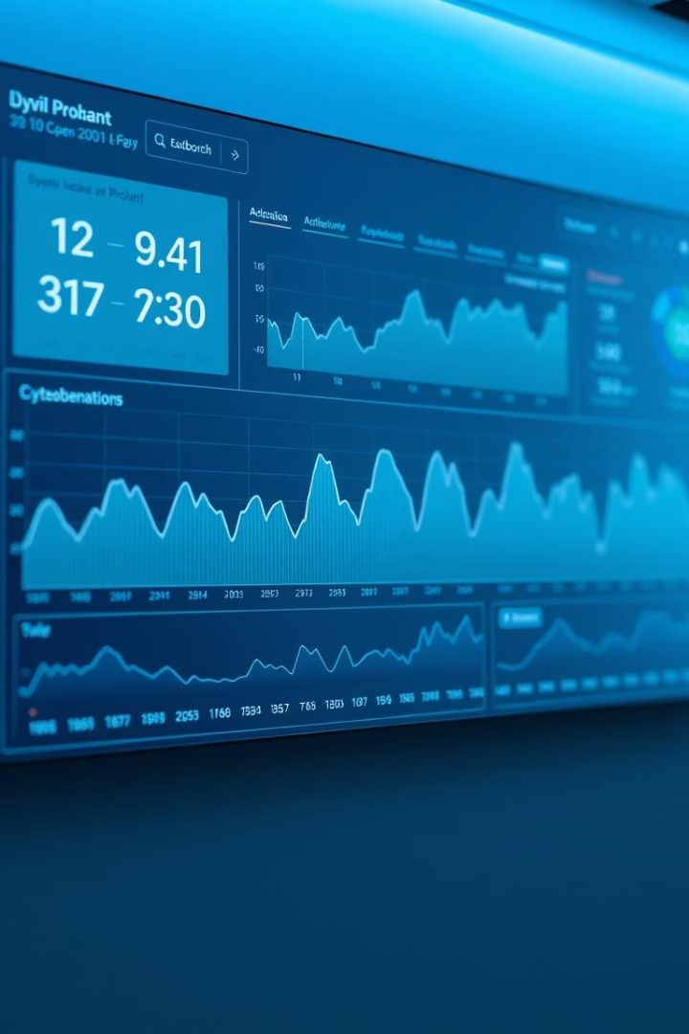
Cryptocurrency Market Dashboard
Presented by Hetavi Patel, this dashboard provides insights into crypto market trends.

Slide 2

Project Overview
Objective
Key Questions
Create an interactive dashboard analyzing crypto market data trends.
Market cap changes, price trends, and total volume traded over years.

Slide 3




Tools and Technologies
Power BI
Microsoft Excel
GitHub
Used for data modeling and creating interactive visual dashboards.
Manages and stores raw historical cryptocurrency data.
Handles version control and hosts the project repository.

Slide 4
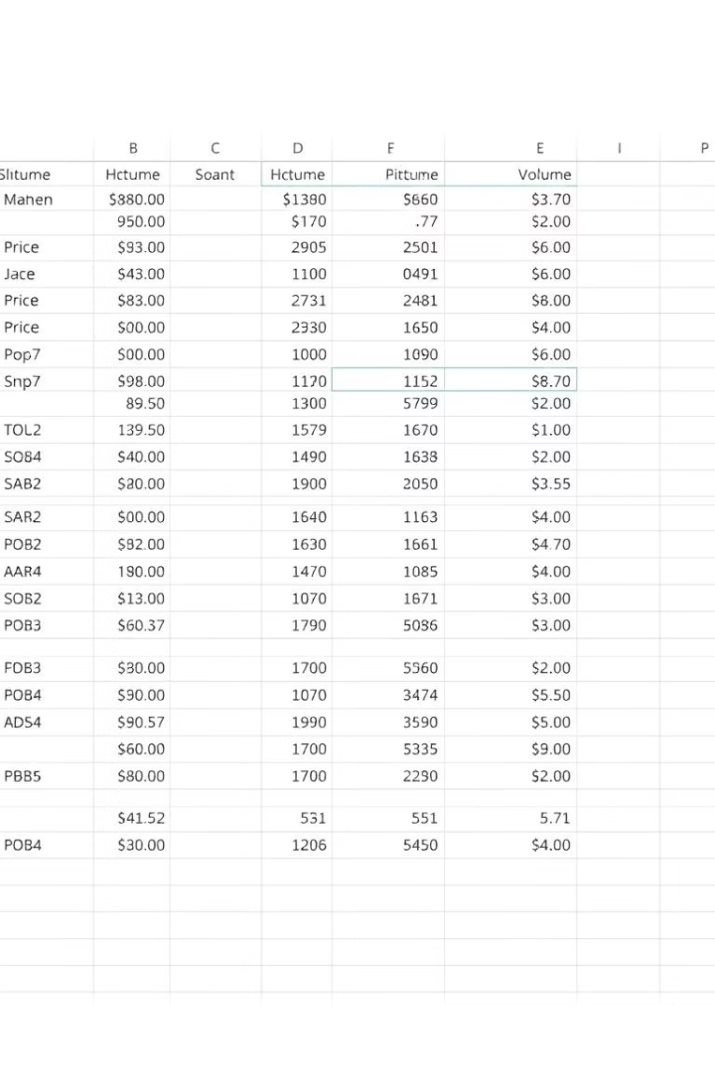
Data Source
Dataset
Daily historical data of multiple cryptocurrencies from 2017 to 2021.
Key Fields
Name, Symbol, Date
High, Low, Open, Close Prices
Volume, Market Cap

Slide 5
Dashboard Features
Interactive Controls
Key Metrics Displayed
Coin Selector functionality (Bitcoin, Ethereum, Binance Coin, etc.)
Market Cap
High, Low, Average Prices
Time Filter spanning 2017 to 2021
Volume traded
Market Cap trends via line chart by date

Slide 6
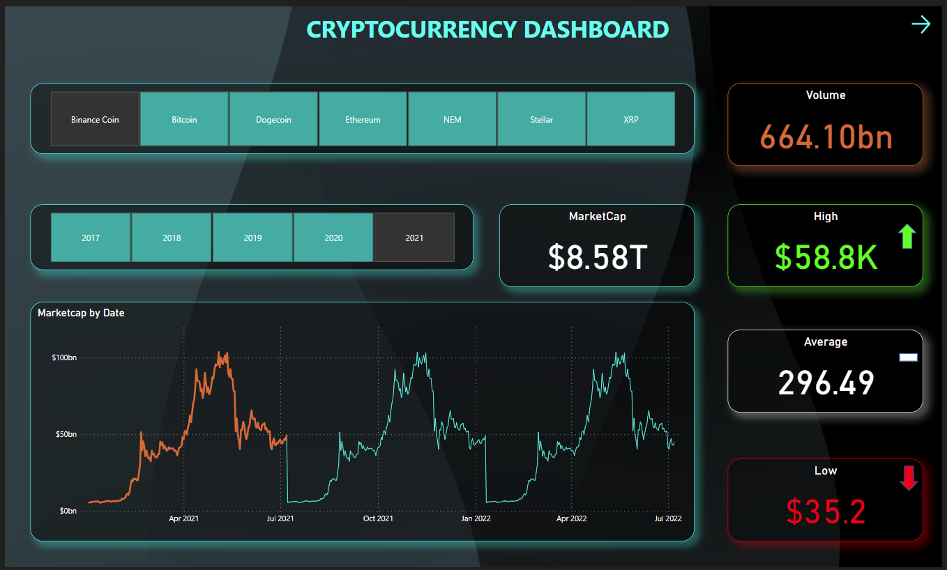
Dashboard Snapshot

Slide 7

How to Use
Clone or download
Obtain the project repo from GitHub.
Open dashboard
Load CryptoCurrency_Dashboard.pbix in Power BI Desktop.
Connect data
Link to CryptoData.xlsx if data updates are needed.
Explore visuals
Use filters and interact with charts to analyze trends.

Slide 8

Thank You
Explore the dashboard freely. Contact me for further questions or collaboration.

