Slide 1

UT Mart Sales Analytics
A Tableau-powered project revealing sales insights for UT Mart through rich data visualization and analysis.

Slide 2

About Tableau
Powerful Visualization
No Coding Needed
Business Intelligence
Supports exploring data with dynamic visuals and intuitive controls.
Allows users of varying skill levels to create insights quickly.
Widely adopted for data-driven decision making.

Slide 3
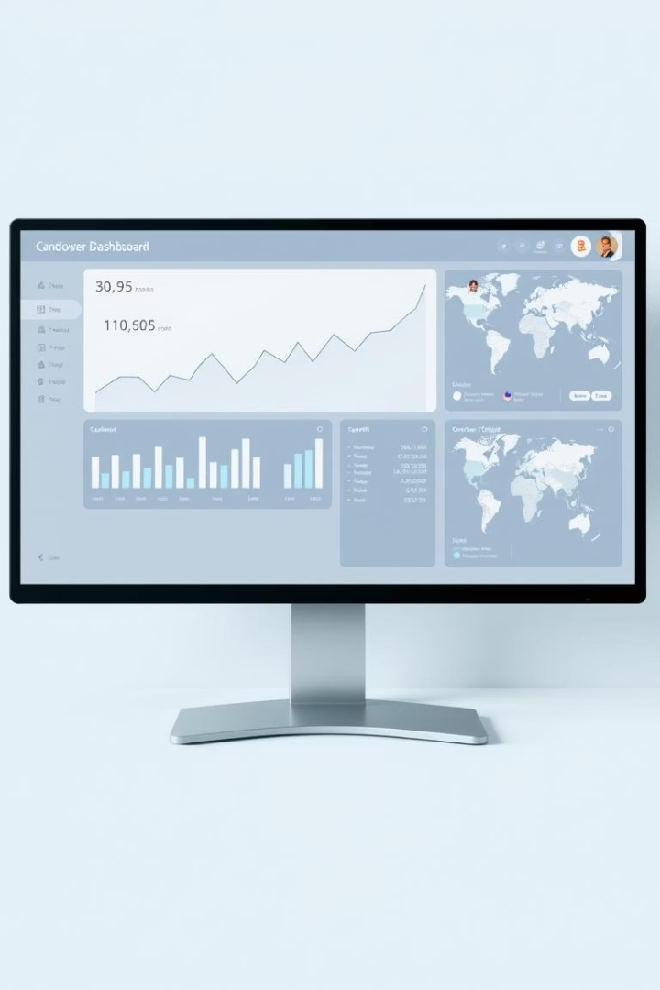
Key Uses of Tableau
Interactive Dashboards
Drill down into data for detailed analysis on demand.
Visual Storytelling
Transforms raw data into compelling narratives for stakeholders.
Multi-Source Support
Integrates diverse data efficiently to enrich analysis.
Fast Decision-Making
Accelerates insights to drive timely strategic actions.

Slide 4
Project Objectives
Monitor Metrics
Analyze Performance
Explore Trends
Sales
By Product Category
Monthly Sales Cycles
Profit
By Region
Yearly Growth Patterns
Quantity Sold

Slide 5

Business Goals
Understand Behavior
Deeply analyze customer purchasing preferences.
Identify Winners
Spot high-performing products and regions effectively.
Validate Patterns
Confirm common purchasing trends like multiple item orders.

Slide 6




Project Approach
Clean & Prepare Data
Processed CSVs to ensure accuracy and usability.
Analyze Trends
Identified meaningful sales patterns and behaviors.
Build Dashboard
Created dynamic, interactive visual tools in Tableau.

Slide 7

Outcome
The resulting dashboard enables real-time retail insights, enhancing daily decisions for UT Mart.
It simplifies complex data into actionable visual narratives for stakeholders.

Slide 8
Created By
Hetavi
Thank you for exploring the UT Mart sales analytics journey.

