Slide 1
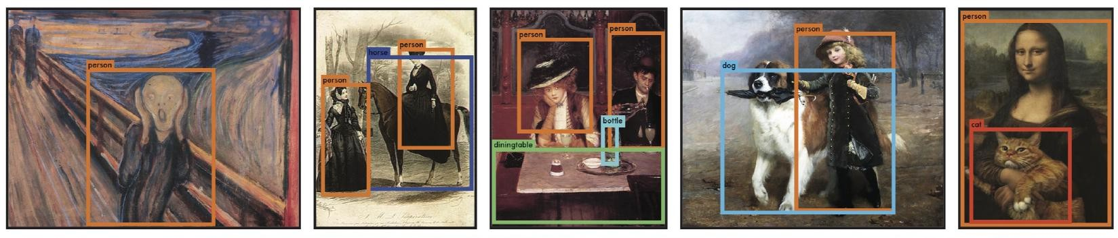
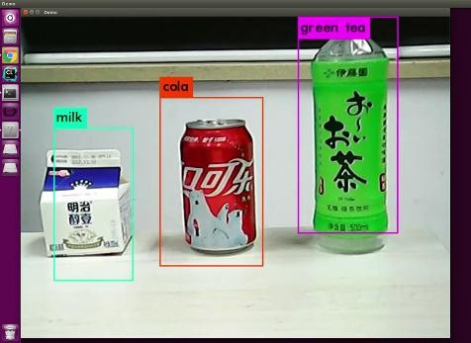
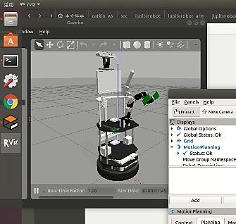
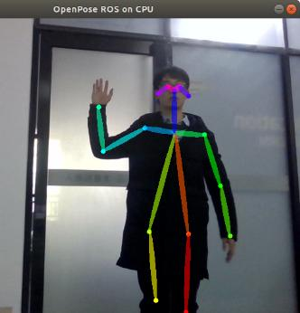
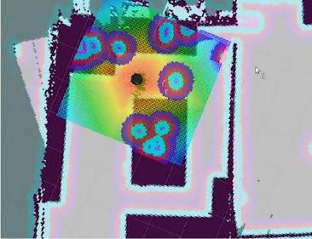
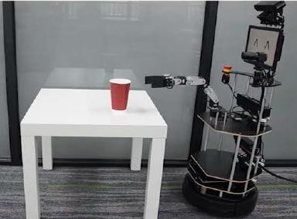

Machine Learning
PRACTICAL APPLICATIONS
08 – 10 Nov 2026 | Jeffrey Tan

Slide 2
Contents
Practical Application Development
  Jupiter AI Robotics System
  ROS Introduction
  Basic ROS Development
Natural Speech Interaction with ML
  Speech Synthesis
  Speech Recognition
  Chatbot Application
Computer Vision with ML
  RGB-D Sensing
  OpenCV Applications
  Deep Learning based Image Processing
  Model Training with YOLO
Mini Projects
  Project Presentations

Slide 3
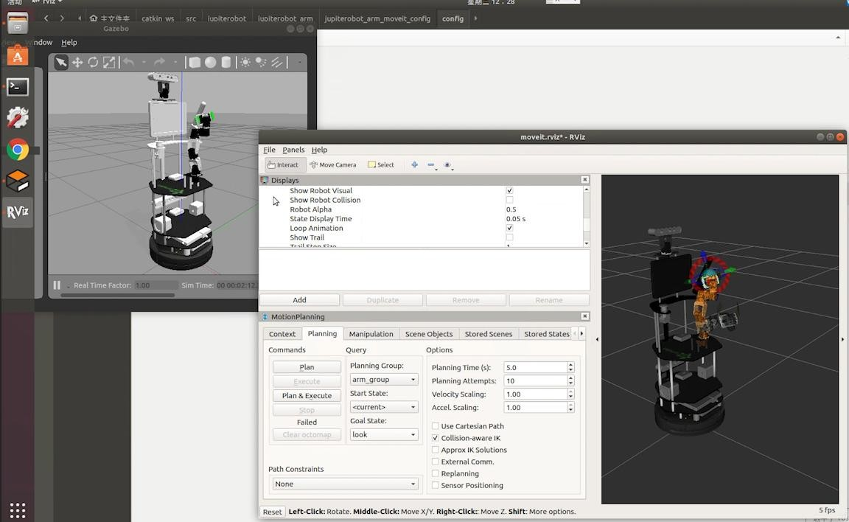
PRACTICAL APPLICATION DEVELOPMENT

Slide 4
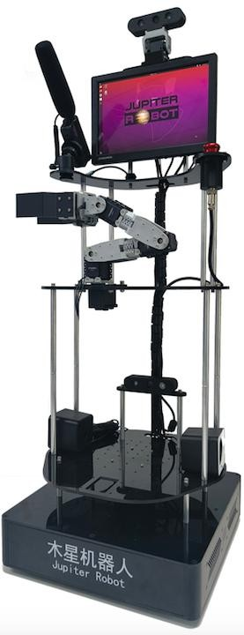

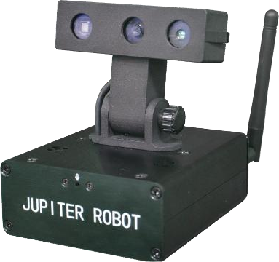
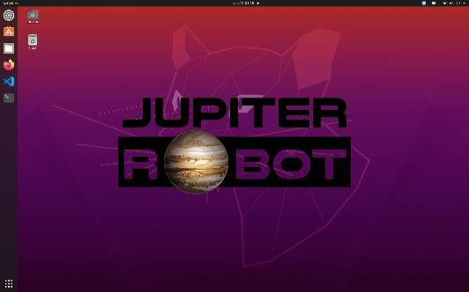
Jupiter AI Robotics System
Jupiter 2
Juno 2
JupiterOS 20

Slide 5



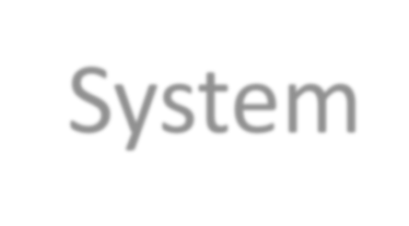
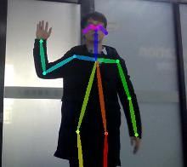
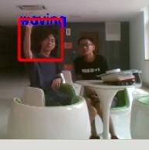

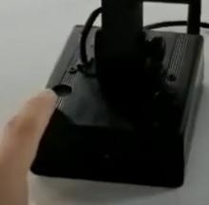
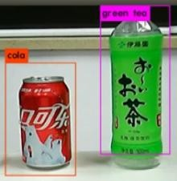
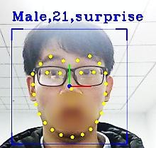
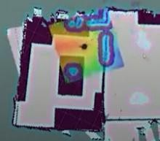
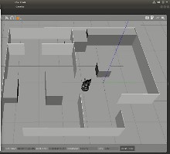

Jupiter
AI Robotics
http://www.jupiterobot.com/
JupiterOS 20
System
Robot Intelligence
AI, Machine Learning, Cloud Computing
Natural Interaction
Speech Interaction
Computer Vision
Visual Perception, Object Recognition
Mobile Platform
SLAM, Navigation
Juno 2
Jupiter 2
Robot Arm
Object Manipulation

Slide 6

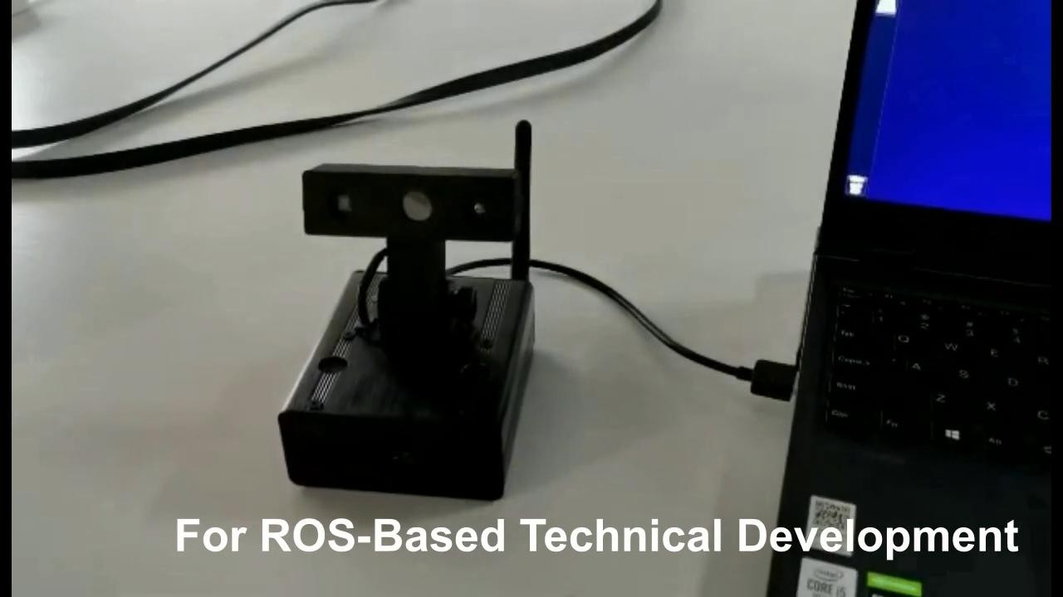
Jupiter AI Robotics System
Juno
https://youtu.be/ECugi4e165k
6

Slide 7

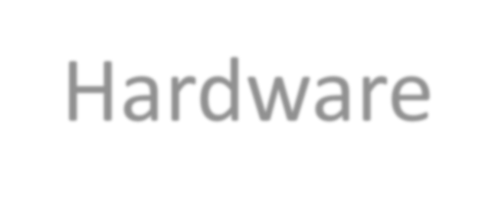

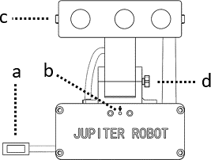
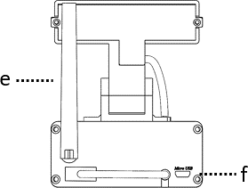


Juno – Hardware

Slide 8

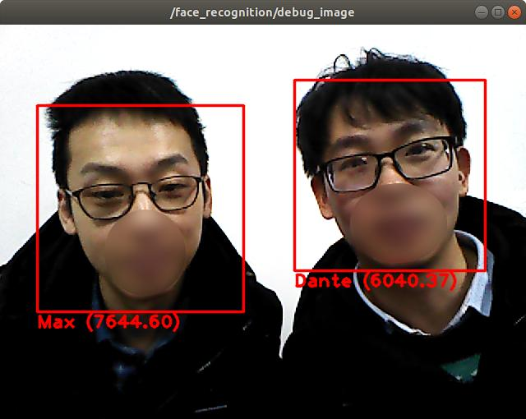
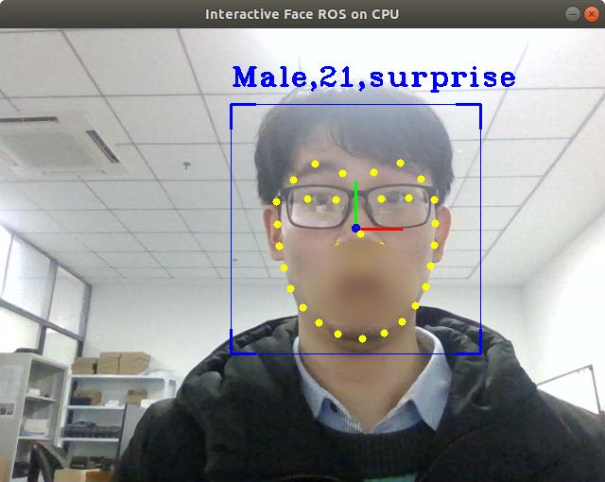
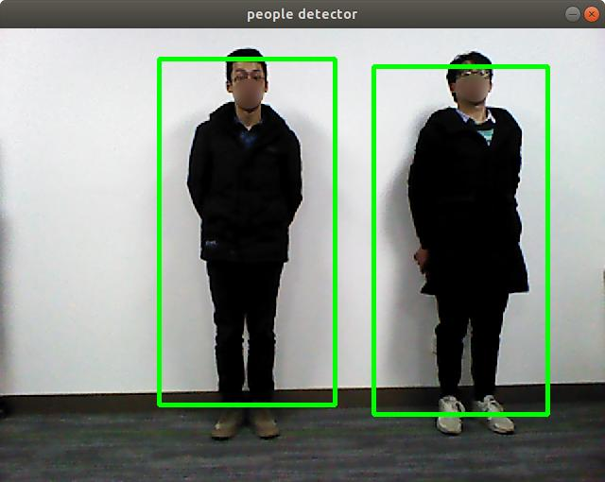
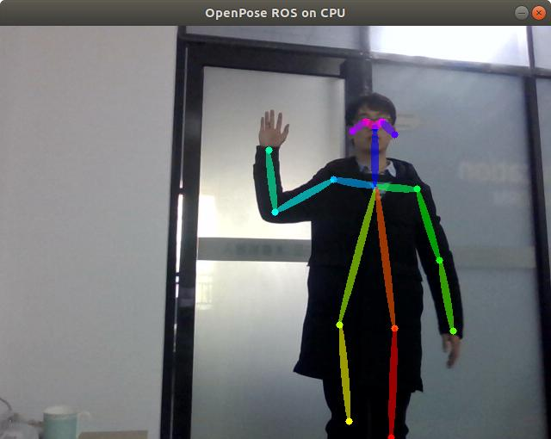
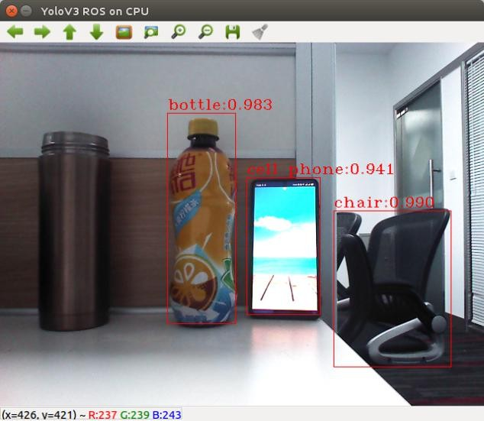
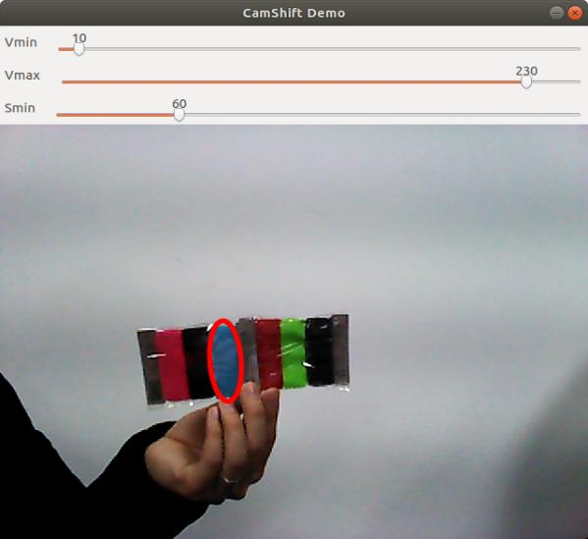
Juno
Computer Vision
Jupiter AI Robotics System

Slide 9


Jupiter AI Robotics System
JupiterOS
Dev. Environment (Software)
Ubuntu OS
ROS 1 and ROS 2
Jupiter Robot System
Robot Model in Gazebo
OpenCV
YOLO
MediaPipe
PocketSphinx
Etc.

Slide 10

Jupiter Robot Software Environment
JupiterOS 20
Ubuntu 20.04.6 LTS (Focal Fossa)
  https://releases.ubuntu.com/20.04/
ROS Noetic Ninjemys [ROS 1]
  http://wiki.ros.org/noetic
  Tutorials: http://wiki.ros.org/ROS/Tutorials
  Workspace: ~/catkin_ws
ROS Foxy Fitzroy [ROS 2]
  https://docs.ros.org/en/foxy/
  Tutorials: https://docs.ros.org/en/foxy/Tutorials.html
  Workspace: ~/colcon_ws
Jupiter Robot System
  https://github.com/jupiterobot/jupiterobot2
RoboCup@Home Education OpenCourseWare
  https://www.robocupathomeedu.org/learn
  https://github.com/robocupathomeedu

Slide 11



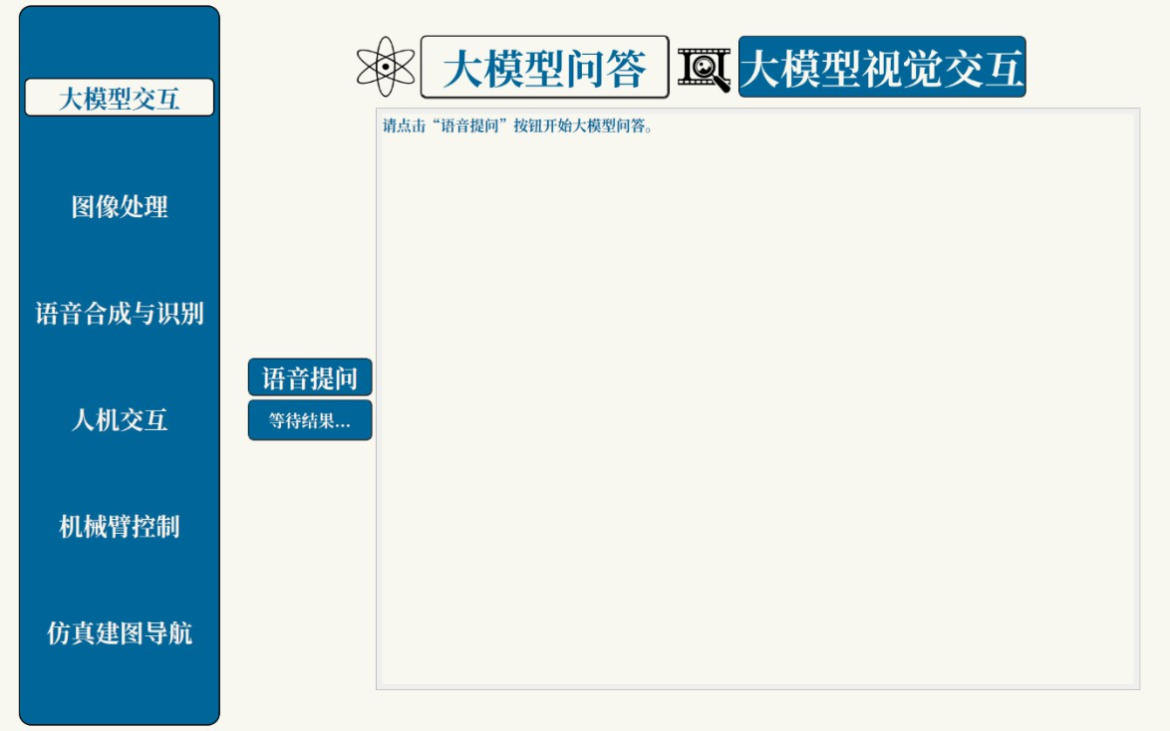
Jupiter Robot – Demo GUI
Setup
$ cd ~/catkin_ws/src
$ git clone https://github.com/jupiterobot/jupiterobot2_qt.git
$ cd ~/catkin_ws
$ catkin_make
Execution
$ roslaunch jupiterobot2_qt jupiterobot2_qt.launch

Slide 12
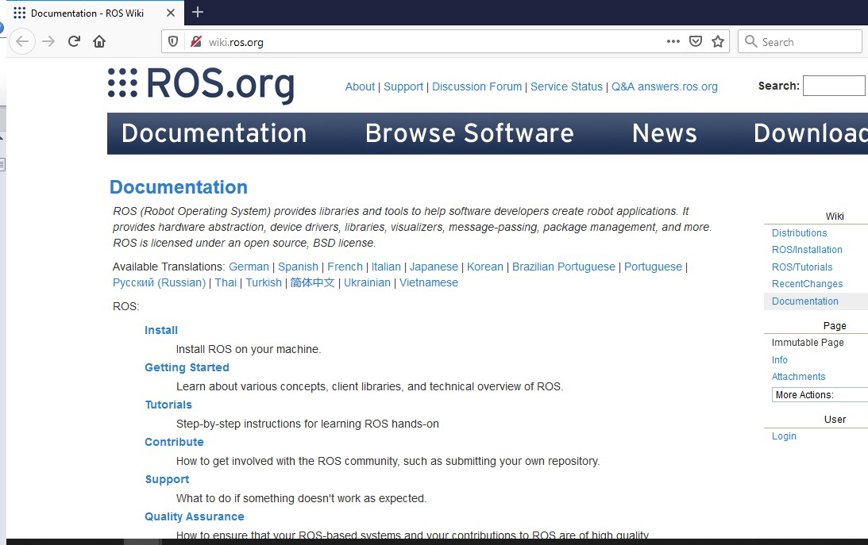
ROS INTRODUCTION

Slide 13

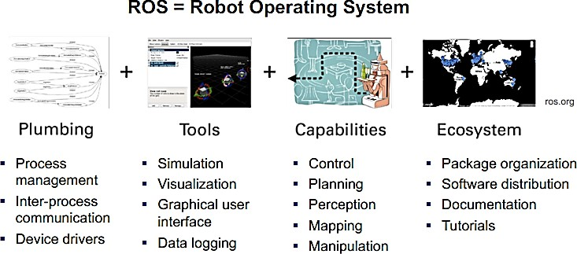
What is ROS?

Slide 14



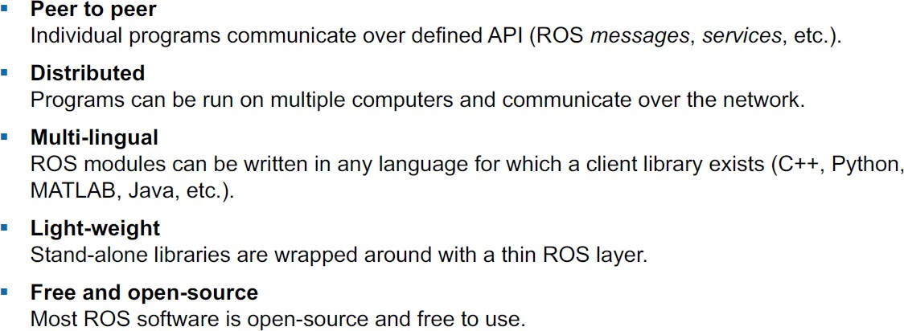
ROS Architecture & Philosophy

Slide 15

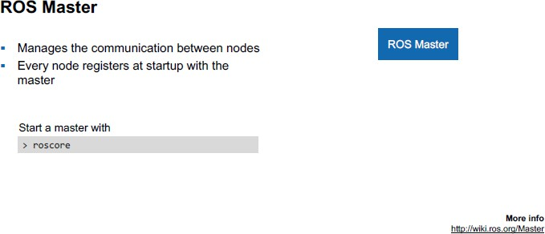
ROS Master

Slide 16

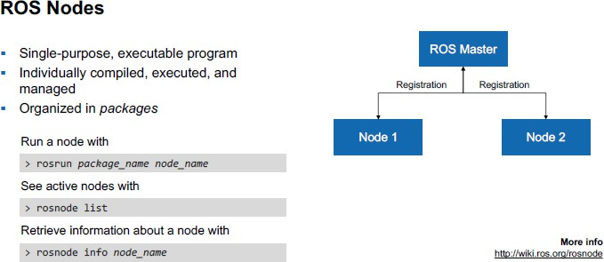
ROS Nodes

Slide 17

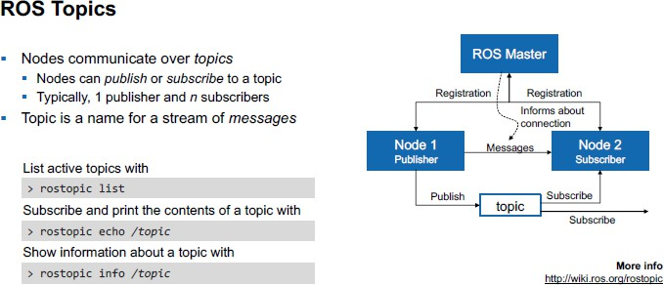
ROS Topics

Slide 18

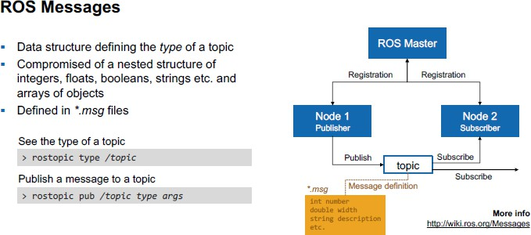
ROS Messages

Slide 19
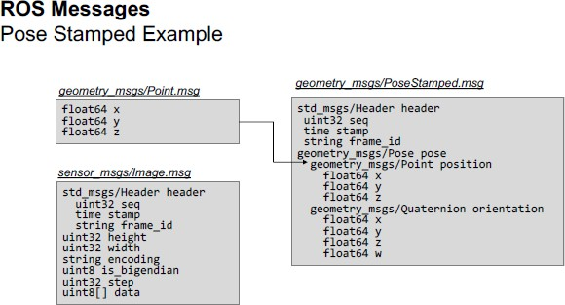
ROS Messages

Slide 20

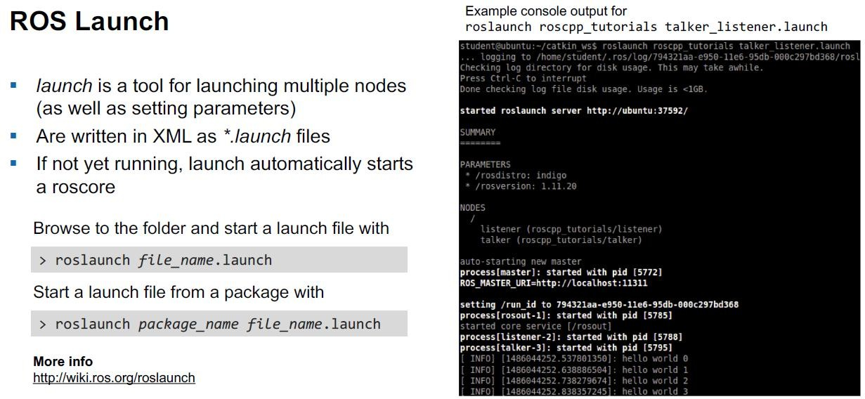
ROS Launch

Slide 21
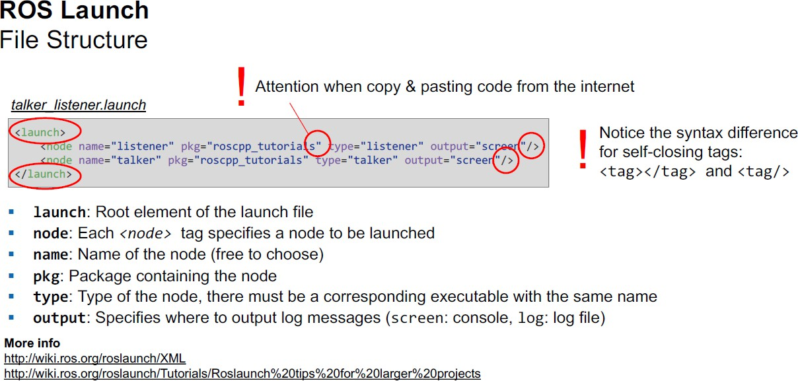
ROS Launch

Slide 22

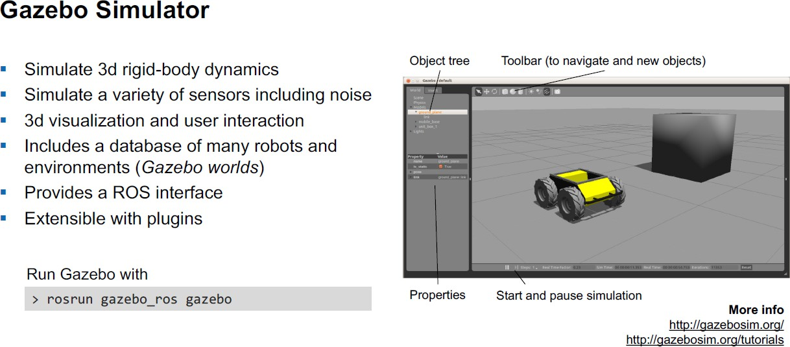
Gazebo Simulator

Slide 23
Other Important ROS Features
ROS package structure
ROS C++ client library (roscpp)
RViz visualization
TF Transformation System
rqt User Interface
Robot models (URDF)
Simulation descriptions (SDF)
ROS time
ROS bags

Slide 24
Other Important ROS Features
ROS publishers and subscribers
ROS parameter server
ROS services
ROS actions (actionlib)

Slide 25
BASIC ROS DEVELOPMENT

Slide 26

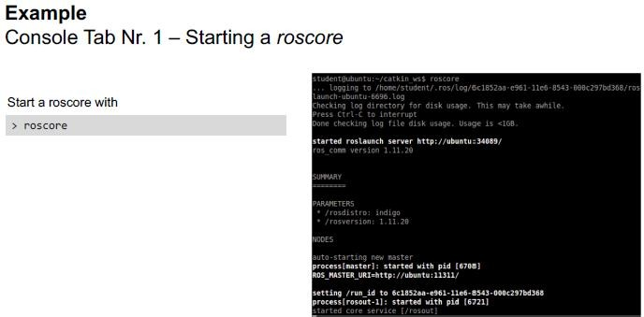
Roscore

Slide 27

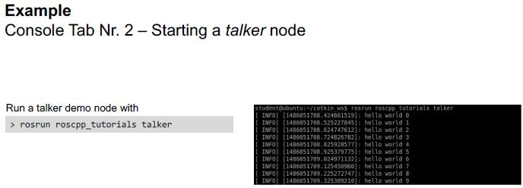
Talker Node

Slide 28

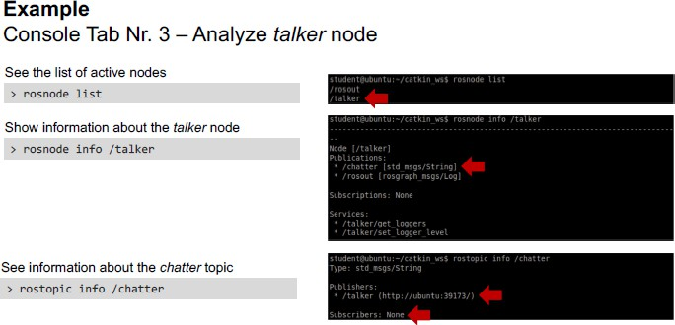
Analyze Talker Node

Slide 29

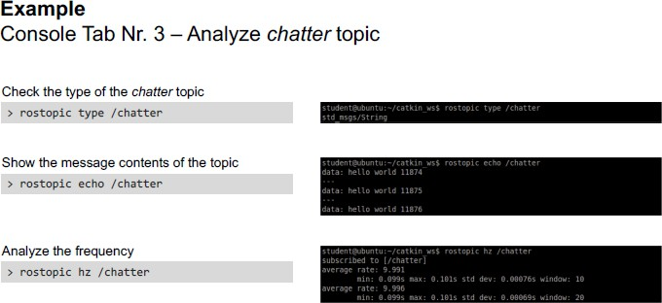
Analyze Chatter Topic

Slide 30

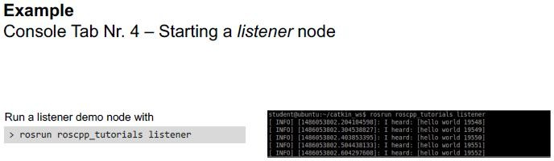
Listener Node

Slide 31
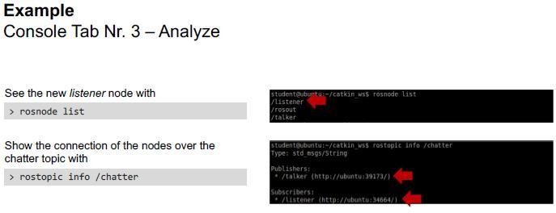
Analyze Chatter Topic Again
Try: $ rqt_graph

Slide 32
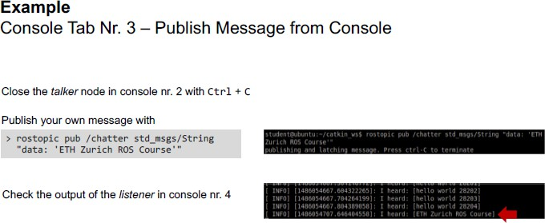
Publish Message from Terminal
Insert Own Text
Display Own Text

Slide 33
Exercise: Publisher and Subscriber
Creating a ROS Package
  http://wiki.ros.org/ROS/Tutorials/CreatingPackage
Writing a Simple Publisher and Subscriber (Python)
  http://wiki.ros.org/ROS/Tutorials/WritingPublisherSu bscriber%28python%29

Slide 34
Natural Speech Interaction with ML
Speech Synthesis Speech Recognition
Text Analysis (Front-End)
Acoustic Modeling
Vocoder (Waveform Generation)
Acoustic Modeling
Language Modeling
Feature Extraction
End-to-End Deep Learning

Slide 35


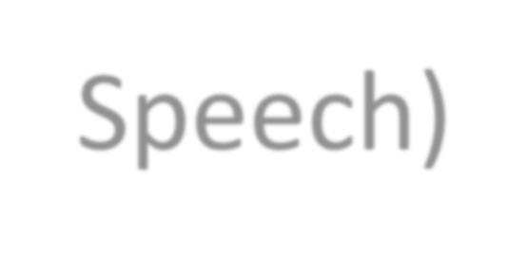

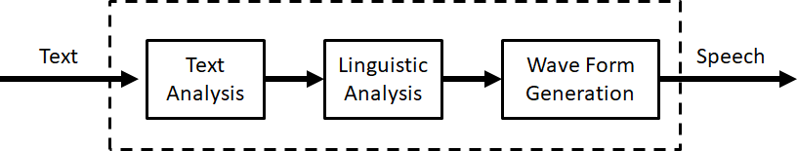
Speech Synthesis (Text-to-Speech)
Speech synthesis is the production of artificial human speech by a computer or other machines.
Also known as a text-to-speech (TTS) system, where normal language text is converted into speech.

Slide 36

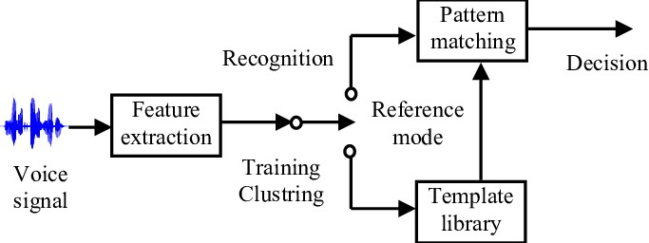
Speech Recognition
Speech recognition is a process to extract speech contents from human’s voice.
An automatic speech recognition (ASR) system converts spoken words into text.
[Hamidia, Mahfoud, et al. "Voice interaction using Gaussian mixture models for augmented reality applications." 2015 4th International Conference on Electrical Engineering (ICEE). IEEE, 2015.]

Slide 37



iFlytek Open Platform
https://www.xfyun.cn/

Slide 38








Speech Recognition
Speech recognition function block diagram:
Topic (/voiceWakeup)
voiceRecognition
(iat_publish.cpp)
Topic
(/voiceWords)

Slide 39

Speech Recognition
Speech recognition code:
  subscriber: Receives the wakeup signal and sets the wakeupFlag variable;
  publisher: In the main loop, calls the SDK's speech recognition function, sets the resultFlag variable after successful recognition, and publishes the
recognized string.
jupiterobot2_voice_xf/src/iat_publish.cpp

Slide 40

Speech Recognition
Speech recognition example:
$ roscore
$ rosrun jupiterobot2_voice_xf iat_publish
$ rostopic pub /voiceWakeup std_msgs/String "data: 'any string'"

Slide 41






Speech Synthesis
Speech synthesis function block diagram:
Topic (/voiceWords)
TextToSpeech
(tts_subscribe.cpp)

Slide 42

Speech Synthesis
Speech synthesis code:
subscriber: Subscribes to the voiceWords topic and receives input strings.
voiceWordsCallback: Uses the SDK interface to convert strings into speech.
jupiterobot2_voice_xf/src/tts_subscribe.cpp

Slide 43

Speech Synthesis
Speech synthesis example:
$ roscore
$ rosrun jupiterobot2_voice_xf tts_subscribe
$ rostopic pub /voiceWords std_msgs/String "data: '你好，我是机器人'"

Slide 44









Speech Recognition and Speech Synthesis
Speech recognition and speech synthesis block diagram:
Topic
(/voiceWakeup)
TextToSpeech
(tts_subscribe.cpp)
voiceRecognition (iat_publish.cpp)
Topic (/voiceWords)

Slide 45

Speech Recognition and Speech Synthesis
Speech recognition and output example:
$ roslaunch jupiterobot2_voice_xf
repeat_voice.launch
$ rostopic pub /voiceWakeup std_msgs/String "data: 'any string'"

Slide 46








Robot Speech Interaction
Speech interaction function block diagram:
Topic (/voiceWakeup)
voiceRecognition
(iat_publish.cpp)
Topic
(/voiceWords)
VoiceAssistant (voice_assistant.cpp)

Slide 47

Robot Speech Interaction
Speech interaction code:
  subscriber: Subscribes to the voiceWords topic and receives input strings.
  voiceWordsCallback: Uses an if statement to determine keywords and provides a voice response.
jupiterobot_voice_xf/src/voice_assistant.cpp

Slide 48



Robot Speech Interaction
Speech interaction example:
$ roslaunch jupiterobot2_voice_xf voice_assistant.launch
$ rostopic pub /voiceWakeup std_msgs/String "data: 'any string'"

Slide 49




Jupiter Robot – Speech Demo GUI
Execution
$ roslaunch jupiterobot2_qt jupiterobot2_qt.launch

Slide 50

CHATBOT APPLICATION

Slide 51


Chatbot System
Sound Detection and Localization
Speech Understanding and Dialogue Manager
Dialog System
LLM

Slide 52
Exercise: Chatbot Application
1. Combine the TTS and SR nodes to create a simple Q&A chatbot.

Slide 53


Jupiter Robot – LLM Demo GUI
Execution
$ roslaunch jupiterobot2_qt jupiterobot2_qt.launch

Slide 54

Chatbot with LLM
OpenAI API – https://platform.openai.com/docs/overview
Setup
Git clone RobotForAll Speech sample code into workspace
  $ git clone https://github.com/robotforall/rfa-speech.git
  $ pip install openai
  deepseek.yaml, qwen.yaml: OPENAI_API_KEY: "Insert your
API Key here"
Sample code execution
  $ roslaunch rfa_gpt deepseek.launch OR qwen.launch
  $ rostopic pub -1 /gpt_in std_msgs/String “data: ‘hello’”

Slide 55

RGB-D SENSING

Slide 56






Robot Vision Sensors
Optical and camera based systems
Laser range finder, ultrasonic distance sensor, 3 dimensional range image camera using modulated infrared light, etc.
2D laser range finder
3D laser range finder
Color camera
[https://msdn.microsoft.com/en-us/library/jj131033.aspx]

Slide 57




RGB-D Sensor
Sensor
3D MS Kinect sensor
  RGB Color VGA Video camera
  Depth sensor
    Infrared projector
    Monochrome CMOS
sensor
Resolution 640 x 480 pixel
30 FPS
Sensor

Slide 58

Distance Sensing
The distance to the object is measured using the time (Time of Flight, TOF) of the laser beam emitted from the transmitter hits the object and returns to the receiver.
𝑙 = 𝑣∆𝑡 / 2
Transmitter
Receiver

Slide 59




Color Sensing
Light
How camera sensor works
Imaging element
Light intensity → Electric signal
CCD(Charge Coupled Device)
CMOS(Complementary Metal Oxide Semiconductor)
Photodiode
Color filter: R(red), G(green), B(blue)
Pixel value: 256 levels (0 – 255)
[https://www.cambridgeincolour.com/tutorials/camera-sensors.htm]

Slide 60

Visual Perception
OpenNI2 - http://structure.io/openni
OpenKinect - https://github.com/OpenKinect
PCL - http://pointclouds.org/
OpenCV - http://opencv.org/
ROS opencv_apps - http://wiki.ros.org/opencv_apps
Bring up
  [Jupiter2] $ roslaunch jupiterobot2_bringup multi_camera.launch
  [Juno2] $ roslaunch astra_camera astra.launch
Display RGB and Depth images
  $ rqt
  $ rosrun image_view image_view image:=/camera/color/image_raw
  $ rosrun image_view image_view image:=/camera/depth/image_raw
* [Jupiter2 bottom camera] Replace “camera” with “camera_bot”

Slide 61

Take Photo
Bring up camera
[Jupiter2] $ roslaunch jupiterobot2_bringup multi_camera.launch
[Juno2] $ roslaunch astra_camera astra.launch
Take photo
$ rosrun rchomeedu_vision take_photo.py OR
$ rosrun rchomeedu_vision take_photo_sub.py
$ rostopic pub -1 /take_photo std_msgs/String “take photo”
Image topic = “/camera/color/image_raw” (edit code according to the camera used)
Photo taken is saved in the current folder

Slide 62
Exercise: Take Photo by Voice Command
1. Combine the Take Photo example with speech module to create a photo taking application by voice command.

Slide 63
OPENCV APPLICATIONS

Slide 64
CamShift Object Tracking
Bring up
[Jupiter2] $ roslaunch jupiterobot2_bringup multi_camera.launch
[Juno2] $ roslaunch astra_camera astra.launch
Image topic argument
image:=/camera/color/image_raw
OpenCV CamShift
$ roslaunch opencv_apps camshift.launch image:=/camera/color/image_raw
* Select an area of similar color to track

Slide 65
Face/People Detection and Recognition
Bring up
  [Jupiter2] $ roslaunch jupiterobot2_bringup multi_camera.launch
  [Juno2] $ roslaunch astra_camera astra.launch
Image topic argument
  image:=/camera/color/image_raw
Face Detection using Haar feature-based cascade classifiers
  $ roslaunch opencv_apps face_detection.launch <img topic arg>
Face Recognition
  $ roslaunch opencv_apps face_recognition.launch <img topic arg>
People Detection using Histogram of Oriented Gradients (HOG)
  $ roslaunch opencv_apps people_detect.launch <img topic arg>

Slide 66
DEEP LEARNING BASED IMAGE PROCESSING

Slide 67
Deep Learning based Image Processing
Bring up
  [Jupiter2] $ roslaunch jupiterobot2_bringup multi_camera.launch
  [Juno2] $ roslaunch astra_camera astra.launch
Yolo Object Detection
  $ roslaunch jupiterobot2_vision_yolov5 object_detection.launch
Body Pose Landmark Detection
  $ roslaunch jupiterobot2_vision_mediapipe mediapipe_pose.launch
Face Detection
  $ roslaunch jupiterobot2_vision_mediapipe mediapipe_faceDetect.launch
Face Landmark Detection
  $ roslaunch jupiterobot2_vision_mediapipe mediapipe_faceMesh.launch
Hand Landmark Detection
  $ roslaunch jupiterobot2_vision_mediapipe mediapipe_hand.launch

Slide 68

Computer Vision Demo GUI
Execution
$ roslaunch jupiterobot2_qt jupiterobot2_qt.launch

Slide 69

Exercise: Say Hello
1. Extend the Face Detection/Recognition example for the system to say greetings when someone comes in front of the system.

Slide 70

Visual Interaction Demo GUI
Execution
$ roslaunch jupiterobot2_qt jupiterobot2_qt.launch

Slide 71

AI based Vision (VLM)
OpenAI API – https://platform.openai.com/docs/guides/images-vision
Setup
Git clone RobotForAll Vision sample code into workspace
  $ git clone https://github.com/robotforall/rfa-vision.git
  api_key = "Insert your API Key here“,
  $ pip install openai
Sample code execution
Bring up camera
  [Jupiter2] $ roslaunch jupiterobot2_bringup multi_camera.launch
  [Juno2] $ roslaunch astra_camera astra.launch
Image Recognition
  $ rosrun rfa_vlm image_recognition_qwen.py Object Detection
  $ rosrun rfa_vlm object_detection_qwen.py
www.LattelRobotics.com

Slide 72


Jupiter Robot – VLM Demo GUI
Execution
$ roslaunch jupiterobot2_qt jupiterobot2_qt.launch

Slide 73

Computer Vision with ML
Image Classification
Object Detection
Object Classification
Object Localization
Image Segmentation

Slide 74



Object Detection: Machine Learning vs. Deep Learning
Object detection based on machine learning
Typically, traditional machine learning algorithms such as Support Vector Machines, AdaBoost, and Random Forests are used.
The basic concept of these methods is to extract image features, classify those features using a classifier, and then use an object detector to detect objects.
These algorithms require manual selection and extraction of image
features, thus necessitating the knowledge and experience of
domain experts.
74

Slide 75

Object Detection: Machine Learning vs. Deep Learning
Object detection based on deep learning
Deep neural networks are typically used to automatically learn features and perform object detection.
Currently popular methods fall into two categories: Two-stage detection methods and single-stage detection methods.

Slide 76
Object Detection: Machine Learning vs. Deep Learning
Machine learning-based object detection
Deep learning-based object detection

Slide 77


Face Detection based on Machine Learning
Haar Cascade is a machine learning-based algorithm used to detect
objects in images or videos.
The algorithm uses a set of Haar-like features (rectangular patterns of pixel values) to distinguish objects from the background.
The algorithm uses these features to train a classifier, which can
then be used to detect objects in new images or videos.

Slide 78

Face Detection System
Launch camera
$ roslaunch astra_camera astra.launch
Launch Face Detection
system
$ roslaunch opencv_apps face_detection.launch image:=/camera/color/im age_raw
Code: https://github.com/ros-perception/opencv_apps

Slide 79





Two-Stage Detection Methods: DPM, R-CNN
Two-stage process: first, candidate regions are extracted, then classification and regression are performed.
Sliding window technique
DPM (Deformable Parts Model)
R-CNN (Region-based Convolutional Neural Network)

Slide 80




One-Stage Detection Methods: SSD, YOLO
Single-stage, direct prediction of bounding boxes and categories.
YOLO (You Only Look Once) is a real-time object detection algorithm.
Proposed by Joseph Redmon et al. in 2015.
The YOLO algorithm uses a single CNN model to achieve end-to-end object detection.
The input image is fed into the CNN network, and the network's predictions are processed to obtain the detected objects.

Slide 81


Advances and Comparisons of Object Detection Algorithms

Slide 82
Basic Principles of YOLO
Step 1: Image Segmentation
  Divide the input image into an S×S grid.
Step 2: Bounding Box Prediction
  Predict B bounding boxes (center coordinates, width, height, and confidence score) for each grid cell.
Step 3: Class Prediction
  Predict the probability of C classes for each grid cell.
Step 4: Non-Maximum Suppression (NMS)
  Remove overlapping bounding boxes and retain the most likely detections.

Slide 83

Basic Principles of YOLO
The image is divided into an S×S grid.
Each grid cell is responsible for predicting B bounding boxes and class probabilities.
Redundant boxes are removed using non-maximum suppression (NMS).

Slide 84

YOLO Image Segmentation
The input image is segmented into an S*S grid, and each cell is responsible for detecting targets whose center point falls within that cell.
As you can see, the center point of the car target falls within the middle cell, so that cell is responsible for predicting the car.
Each cell predicts B bounding boxes and their confidence scores.

Slide 85

YOLO Bounding Box Prediction
The size and position of the bounding box can be represented by four values: (x, y, h, w).
  x and y are the center coordinates of the bounding box. These are offsets relative to the top-left corner of each cell, and the units are relative to the cell size.
  w and h are the width and height of the bounding box. These are the proportions of the width and height of the bounding box relative to the entire image.
  Theoretically, the size of these four elements should be within the range [0, 1].

Slide 86
YOLO Bounding Box Prediction
Each bounding box prediction actually contains 5 elements: (x, y, w, h, c), where the first four represent the size and position of the bounding box, and the last value is the confidence score.
The confidence score can be defined as Pr(object) * IOU.
  The probability of containing the object:
    No object: Pr(object) = 0;
    Object: Pr(object) = 1.
  The accuracy of the bounding box is characterized by the IOU (intersection over union) between the predicted box and the ground truth box, denoted as IOU.

Slide 87
YOLO Category Prediction
For each cell, it also provides C predicted class probability values, representing the probability that the bounding box predicted by that cell belongs to each class.
Simply put, each cell corresponds to only one class with the highest probability. However, these probability values are actually conditional probabilities under the confidence scores of each bounding box, i.e., Pr(classi|object).
At the same time, we can calculate the class-specific confidence scores for each bounding box:

Slide 88


YOLO Final Prediction
Each cell needs to predict (B*5+C) values.
If the input image is divided into an S×S grid, then the final predicted value is S×S×(B*5+C).
YOLOv1 uses the PASCAL VOC dataset for training. The PASCAL VOC dataset has 20 categories. If we set S=7 and B=2, then the final prediction result is a tensor of size 7×7×30.

Slide 89

YOLO Network Structure
YOLO uses convolutional networks to extract features, and then fully connected layers to obtain predicted values.
The network structure is based on the GooLeNet model, containing
24 convolutional layers and 2 fully connected layers.
For the convolutional layers, 1x1 convolutions are primarily used for channel reduction, followed by 3x3 convolutions.
The Leaky ReLU activation function, max(x, 0.1x), is used for both
the convolutional and fully connected layers.
The final layer, however, uses a linear activation function.

Slide 90
YOLO Network Structure
YOLOv1 Network Structure:
– Input: 448×448×3 image.
  Backbone Network: 24 convolutional layers + 2 fully connected layers.
  Output: 7×7×30 tensor (each grid predicts 2 bounding boxes and 20 class probabilities).
Improvements in YOLOv2/v3:
  Uses Darknet-19/Darknet-53 as the backbone network.
  Introduces anchor boxes and multi-scale prediction.

Slide 91


YOLO Network Training
Before training, the network was pre-trained on ImageNet. The pre-trained classification model used the first 20 convolutional layers shown in Figure 8, followed by an average-pooling layer and a fully connected layer.
After pre-training, four randomly initialized convolutional layers and two fully connected layers were added on top of the 20 pre-trained convolutional layers.
Since detection tasks generally require higher-resolution images, the network input was increased from 224x224 to 448x448.

Slide 92


YOLO Loss Function
1.Bounding box coordinate loss
Confidence loss
Class loss
Formula:
Total Loss = Coordinate Loss + Confidence Loss + Class Loss
92

Slide 93

YOLO Network Prediction
Non-Maximum Suppression (NMS) is an algorithm that primarily addresses the problem of a target being detected multiple times.
As shown in the face detection example, the face is detected multiple times, but we ultimately want to output only the best predicted bounding box. For example, for the woman on the left, we only want the red detection result.
  The NMS algorithm is used to achieve this effect: First, find the box with the highest confidence among all detected boxes. Then, calculate the Intersection over Union (IoU) between the box and the remaining boxes. If the IoU value is greater than a certain threshold (too high overlap), the box is removed.
  The above process is repeated for the remaining detected boxes until all detected boxes have been processed.
93

Slide 94

YOLO System Implementation
Launch camera
$ roslaunch astra_camera astra.launch
Launch YOLO system
$ roslaunch jupiterobot2_vision_yolov5 object_detection.launch
Code:
https://github.com/ultralytics/

Slide 95
YOLO Version Development
YOLOv1 (2016):
  First proposed, fast but with lower accuracy.
YOLOv2 (2017):
  Introduced Anchor Boxes, improving accuracy.
YOLOv3 (2018):
  Multi-scale prediction, better small object detection.
YOLOv4 (2020):
  Introduced advanced technologies such as CSPDarknet53
and PANet.
YOLOv5 (2020):
  Implemented in PyTorch, easy to use and deploy.
YOLOv6/v7/v8:
  Further optimized speed and accuracy.

Slide 96
YOLO Application Scenarios
Autonomous Driving:
  Detecting pedestrians, vehicles, and traffic signs.
Security Monitoring:
  Real-time monitoring and abnormal behavior detection.
Retail Industry:
  Inventory management and customer behavior analysis.
Healthcare:
  Medical image analysis and disease diagnosis.

Slide 97
YOLO Advantages and Limitations
Advantages:
  High speed, suitable for real-time applications.
  Global context information reduces false detections.
Limitations:
  Limited ability to detect small and densely packed targets.
  Requires a large amount of labeled data for training.

Slide 98

References
Joseph Redmon, et al. "You Only Look Once: Unified, Real-Time Object Detection." (2016)
Joseph Redmon, Ali Farhadi. "YOLO9000: Better, Faster, Stronger." (2017)
Joseph Redmon, Ali Farhadi. "YOLOv3: An Incremental Improvement." (2018)
Alexey Bochkovskiy, et al. "YOLOv4: Optimal Speed and Accuracy of Object Detection." (2020)

Slide 99

YOLO Object Detection
Bring up
  $ roslaunch astra_camera astra.launch
YOLO Object Detection
  $ roslaunch jupiterobot2_vision_yolov5
object_detection.launch

Slide 100
Train YOLOv5 on a Custom Dataset
Setup YOLOv5.
Prepare the dataset in YOLO format.
Configure the data.yaml file with dataset paths.
Start training using train.py.
References:
  https://docs.ultralytics.com/yolov5/tutorials/train_cust om_data/
  https://www.digitalocean.com/community/tutorials/tr ain-yolov5-custom-data
  Ultralytics Platform: https://platform.ultralytics.com/

Slide 101

MINI PROJECTS

Slide 102

Mini Projects
Design a practical application for a service duty in a specific environment.
Based on the technologies introduced in this course, design the speech and vision interactions of the system with its audience and environment during service.

Slide 103

Project Presentations
Prepare a set of project presentation slides.
  Introduction
  System Design
  Speech and Vision Interactions
Present the system design and the interactions by demonstrating the scenario with the system.

Slide 104
Machine Learning
PRACTICAL APPLICATIONS
08 – 10 Nov 2026 | Jeffrey Tan

