Slide 1

CT-216 Introduction to Communication Systems
Convolution Code
Lab Group 2
April 15, 2024
Prof. Yash Vasavada

Slide 2
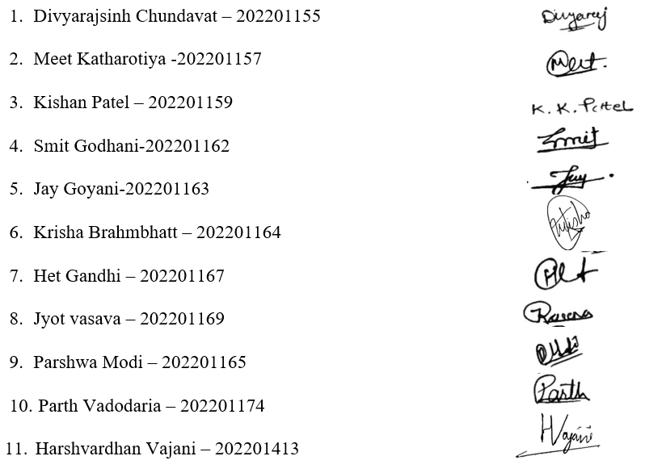
Honor Code
We declare that
The work that we are presenting is our own work.
We have not copied the work (the code, the results, etc.) that someone else has done.
Concepts, understanding and insights we will be describing are our own.
We make this pledge truthfully. We know that violation of this solemn pledge can
carry grave consequences.

Slide 3
Outline
Problem Statement
Objective
Introduction to convolution
Concept of encoding
Modulation and AWGN simulation
Demodulation
Concept of decoding
Simulation results
Observation from plots
Summary
References

Slide 4
Problem Statement
This project is about analyzing the effectiveness of convolutional codes in correcting errors in digital communication systems.
We will also analyze how well soft and hard decision decoding for convolution performs under different SNRs.
Plot the curves depicting the probability of detection errors for convolution codes with
i) rate=1/2 K=3
ii) rate=1/3 K=4
iii) rate=1/3 K=6
Observe the performance of both decoding techniques and compare these simulation results with their respective analysis results.
using both Viterbi hard and Viterbi soft decoding for varying values of SNR(in dB) from 0 to 10 in the steps of 0.5.

Slide 5
Objective
Our objective is to understand the channel coding through Convolution Codes in the digital communication. Here, the scope of the digital communication is limited to encoding, modulation, demodulation and decoding.
More Specifically:-
Encode the transmitted message for each of the above described rate and constraint length.
Modulation of the encoded bits using BPSK Modulator.
Addition of the noise when the message passes through the AWGN channel for simulation purpose. In reality, when the message passes from transmitter side to receiver side some noise is introduced in it.
Decoding the received message with two decoding techniques: viterbi hard and viterbi soft.
Plotting the graph for probability of detection errors which demonstrates the performance of both decoding techniques for different rates and constraint length.
Comparison of the simulation results of soft and hard decision decoding with their respective analysis results.

Slide 6
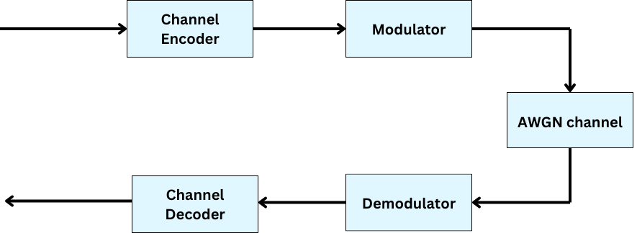
Introduction to Convolution Codes
Convolutional codes were invented by Elias in 1955.
Convolution codes coding method in digital communication involves the transmission of parity bits which are generated from message bits.
Message
Decoded Message

Slide 7
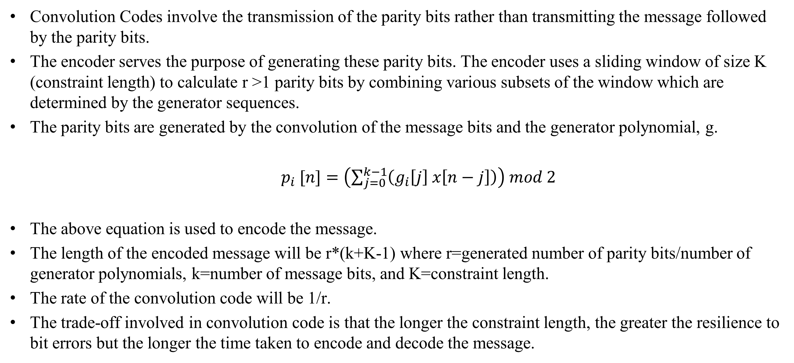
Concept Of Encoding
Convolution Codes involve the transmission of the parity bits rather than transmitting the message followed by the parity bits.
The encoder serves the purpose of generating these parity bits. The encoder uses a sliding window of size K (constraint length) to calculate r >1 parity bits by combining various subsets of the window which are determined by the generator sequences.
The parity bits are generated by the convolution of the message bits and the generator polynomial, g.
$p_{i} [n]=\left(\sum_{j=0}^{k−1}{\left(g_{i}\left[j\right] x\left[n−j\right]\right)}\right) mod 2$
The above equation is used to encode the message.
The length of the encoded message will be r*(k+K-1) where r=generated number of parity bits/number of generator polynomials, k=number of message bits, and K=constraint length.
The rate of the convolution code will be 1/r.
The trade-off involved in convolution code is that the longer the constraint length, the greater the resilience to bit errors but the longer the time taken to encode and decode the message.

Slide 8
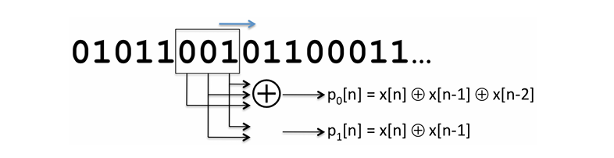
Encoder Concept
Fig-1: An example of a convolutional code with two parity bits per message bit (r =2) and constraint length K=3.
Views of Convolution encoder
Block Diagram
State Diagram
Trellis Diagram
* Figure taken from Lec-8 MIT

Slide 9
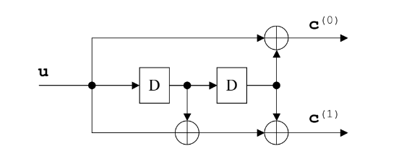
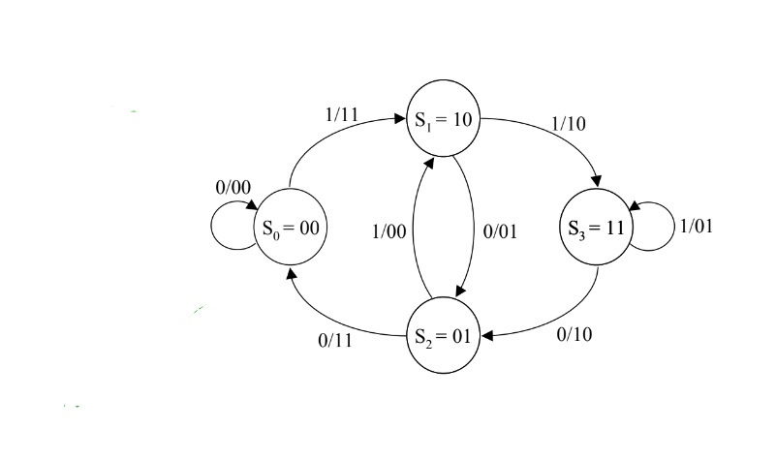
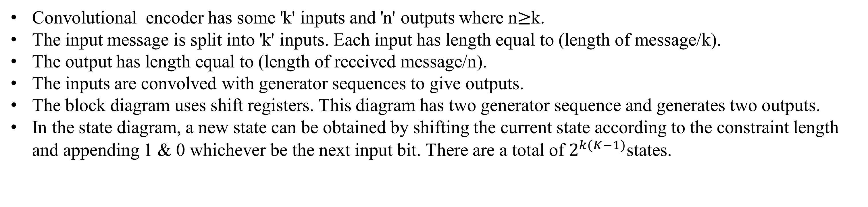
Encoder Concept
Convolutional encoder has some 'k' inputs and 'n' outputs where n$≥$k.
The input message is split into 'k' inputs. Each input has length equal to (length of message/k).
The output has length equal to (length of received message/n).
The inputs are convolved with generator sequences to give outputs.
The block diagram uses shift registers. This diagram has two generator sequence and generates two outputs.
In the state diagram, a new state can be obtained by shifting the current state according to the constraint length and appending 1 & 0 whichever be the next input bit. There are a total of $2^{k(K−1)}$states.
Fig-2: Block diagram view for K=3 rate=1/2
Fig-3: State diagram view for K=3 rate=1/2
* Figure taken from Lec Slide

Slide 10
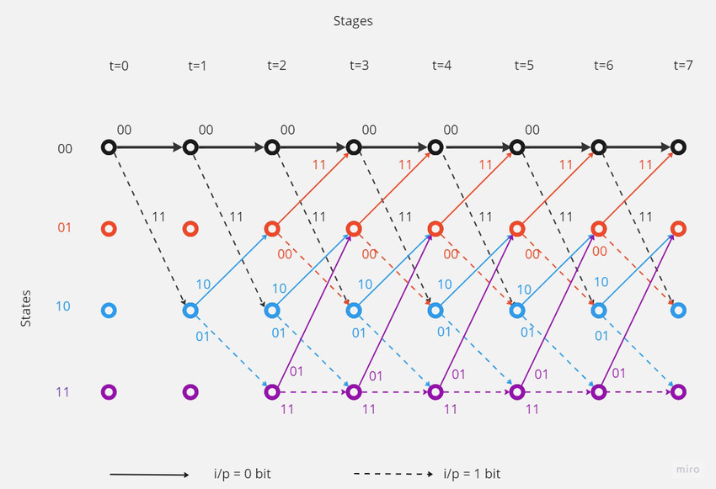
Encoder Concept
Fig-4: Trellis view for K=3 rate=1/2
The trellis diagram is a redrawing of the state diagram. it shows all possible state transitions at each time.
The trellis diagram can be used to decode the received parity bits which come as output of the encoding. In trellis diagram $2^{k}$branches enter each state and $2^{k}$branches leave each state.
* Image taken from research gate

Slide 11
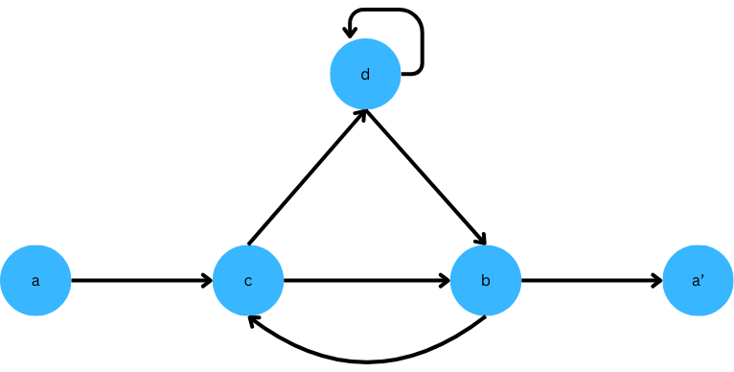
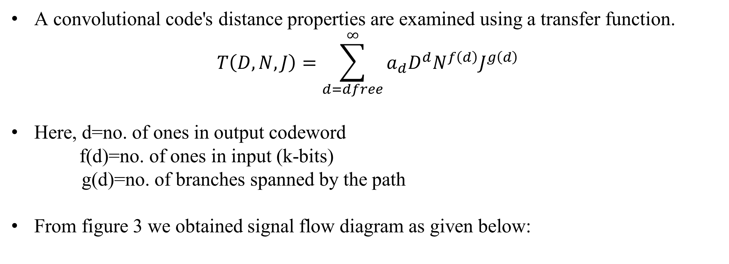

Transfer function
A convolutional code's distance properties are examined using a transfer function.
$$T\left(D,N,J\right)=\sum_{d=dfree}^{∞}{a_{d}D^{d}N^{f\left(d\right)}J^{g\left(d\right)}}$$
Here, d=no. of ones in output codeword
f(d)=no. of ones in input (k-bits)
g(d)=no. of branches spanned by the path
From figure 3 we obtained signal flow diagram as given below:
$$DNJ$$
$$DNJ$$
$$DJ$$
$$D^{2}J$$
$$DJ$$
$$D^{2}NJ$$
$$NJ$$

Slide 12

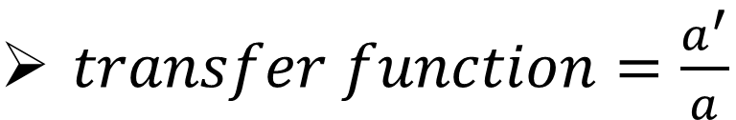
Transfer function
Provides the properties of all the paths.
Provides minimum Hamming Distance (smallest power of $D$ of transfer function).
$d=DNJc+DNJd − eqn 1$
$c=D^{2}NJa+NJb − eqn 2$
$${ a}^{′}=D^{2}Jb − eqn 3$$
$$b=DJd+DJc − eqn 4$$
$transfer function=\frac{a^{′}}{a}$
After solving Eqn-1,2,3 and 4 we get
$$\frac{a^{′}}{a}=\frac{D^{5}NJ^{3}}{1−DNJ−DNJ^{2}}$$
$$T\left(D,N,J\right)=D^{5}NJ^{3}+D^{6}N^{2}J^{4}+D^{6}N^{2}J^{5}+D^{7}N^{3}J^{5}……..$$

Slide 13
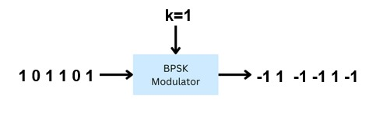
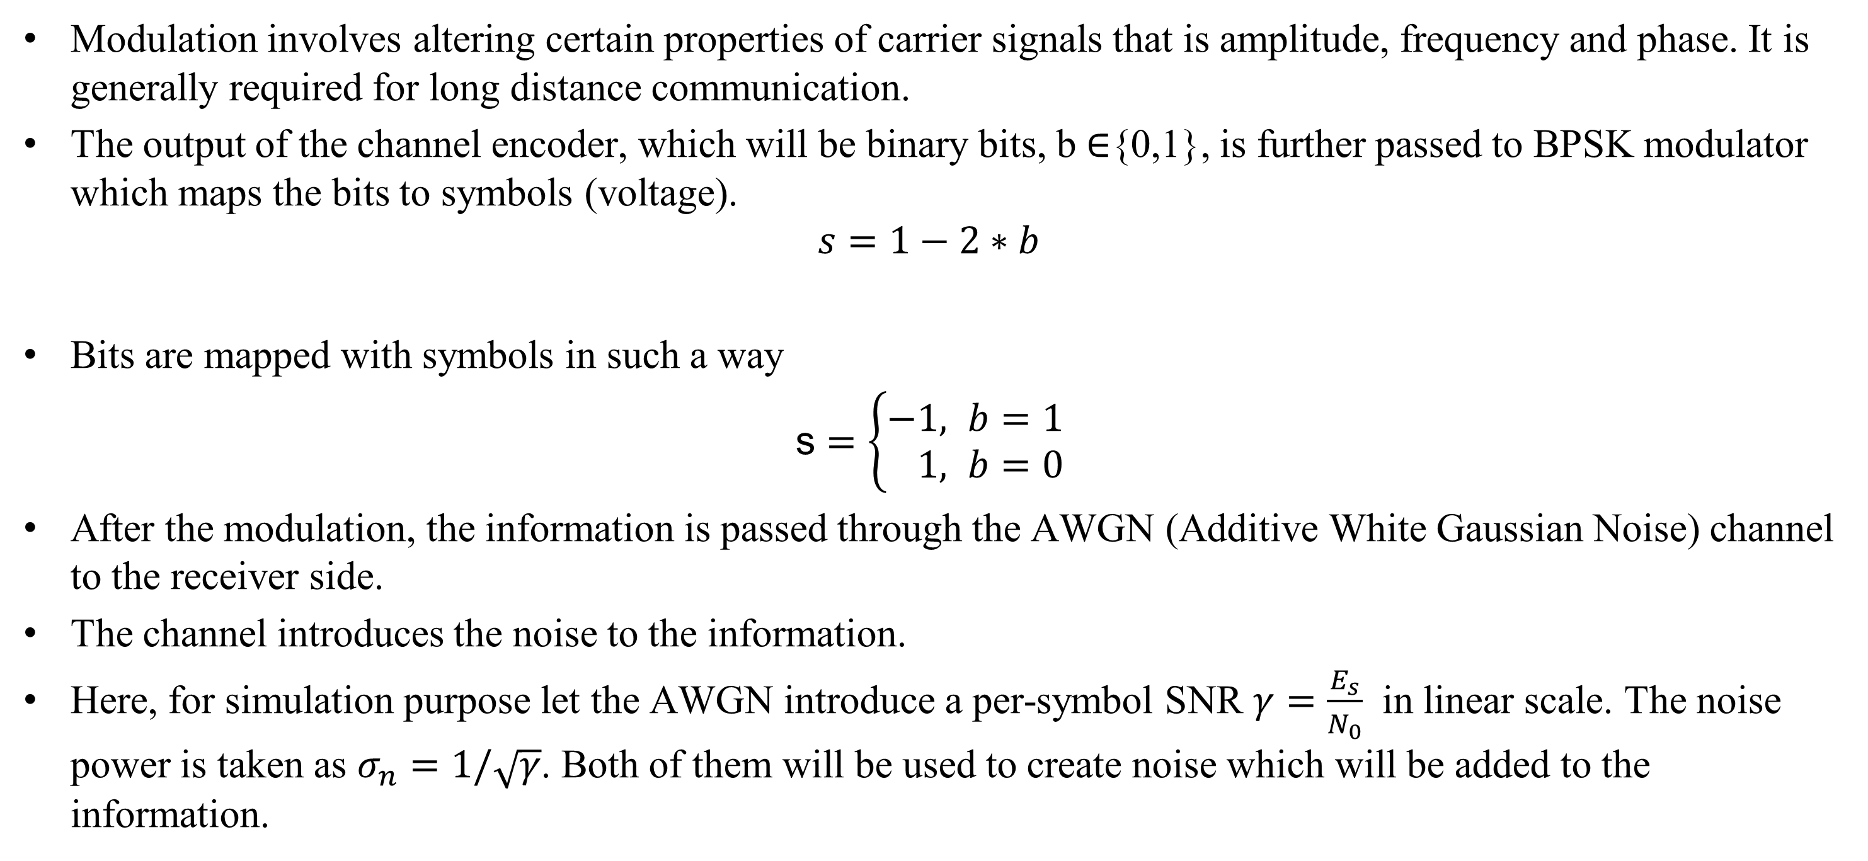
Modulation and AWGN Simulation
Modulation involves altering certain properties of carrier signals that is amplitude, frequency and phase. It is generally required for long distance communication.
The output of the channel encoder, which will be binary bits, b $∈${0,1}, is further passed to BPSK modulator which maps the bits to symbols (voltage).
$$s=1−2∗b$$
Bits are mapped with symbols in such a way
s $=\left\{\begin{aligned}−&1, b=1 \\ &1, b=0\end{aligned}\right.$
After the modulation, the information is passed through the AWGN (Additive White Gaussian Noise) channel to the receiver side.
The channel introduces the noise to the information.
Here, for simulation purpose let the AWGN introduce a per-symbol SNR $γ=\frac{E_{s}}{N_{0}}$ in linear scale. The noise power is taken as $σ_{n}=1/\sqrt{γ}$. Both of them will be used to create noise which will be added to the information.

Slide 14
BPSK and AWGN Simulation
BPSK Simulation
function s=create_symbols(encoded_msg)
s=1-2*encoded_msg;
end
AWGN Simulation
function noisy_msg=pass_msg(s,sigma_n)
[~,col_s]=size(s);
% Noise Creation
us= randn([1,col_s]);
noise=sigma_n * us;
% sigma_n=1/sqrt(rate*k*EbNo)
% Noise Addition
noisy_msg=s+noise;
end

Slide 15
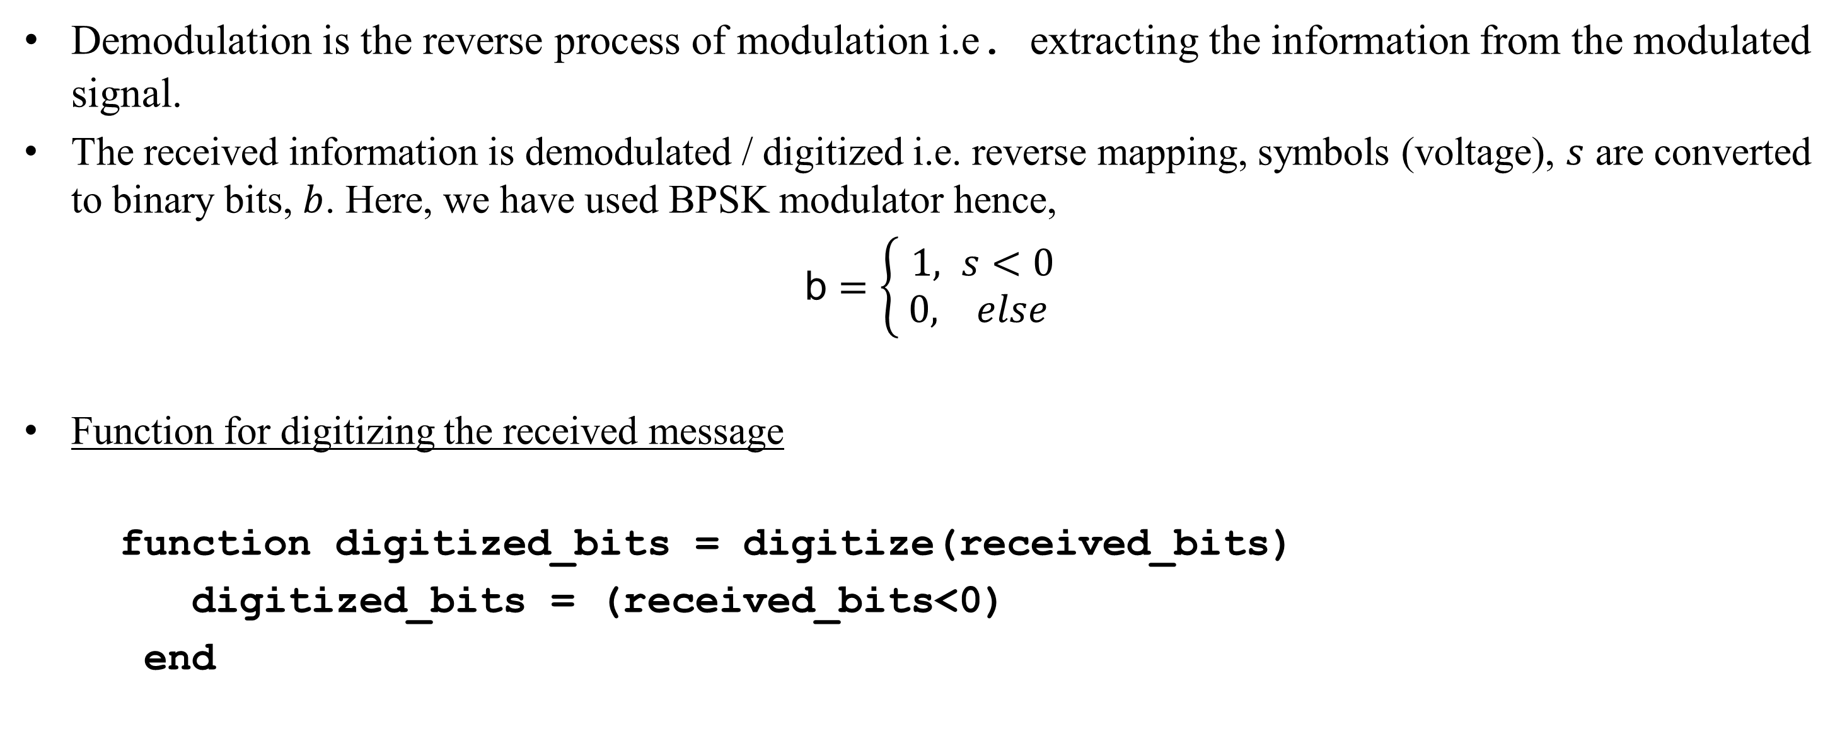
Demodulation
Demodulation is the reverse process of modulation i.e. extracting the information from the modulated signal.
The received information is demodulated / digitized i.e. reverse mapping, symbols (voltage), $s$ are converted to binary bits, $b$. Here, we have used BPSK modulator hence,
b $=\left\{ \begin{aligned}1, s<0 \\ &0, else \end{aligned}\right.$
Function for digitizing the received message
function digitized_bits = digitize(received_bits)
digitized_bits = (received_bits<0)
end

Slide 16
Concept of decoding
Decoding is the process of converting the received codeword into an expected transmitted message.
There are two commonly used decoding algorithms for convolution codes.
Fano algorithm
Viterbi algorithm
For this project, we mainly focus on the Viterbi algorithm.
The Viterbi algorithm is a Dynamic Programming Algorithm which was proposed by Andrew Viterbi in 1967 as a decoding algorithm for convolution code over noisy digital communication links.
We are using two types of decoding techniques viz, hard decision and soft decision decoding
For both hard and soft decision Viterbi decoding, we use two types of metrics: branch metric and path metric.
*history of Viterbi algorithm taken from Wikipedia

Slide 17
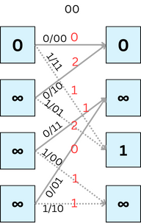
Hard Decision Decoding
For decoding purposes in convolution codes, the trellis provides a convenient way to understand the time evolution of the state machine.
Let us define two metrics which we discussed about in previous slide for hard decision decoding.
Branch Metric (BM): BM is the measure of the hamming distance between the received codeword and the expected parity bits (Hamming distance: No of places where corresponding bits are different)
Path Metric (PM): PM is the sum of the branch metric of the branches it traversed in the path.
PM[s, i + 1] = min(PM[α, i] + BM[α → s],PM[β, i] + BM[β → s])
(Where α , β are the states at time I and s is the state reachable from α and β at time i+1)
Time: i i+1
0 0
0 1
1 0
1 1
State

Slide 18
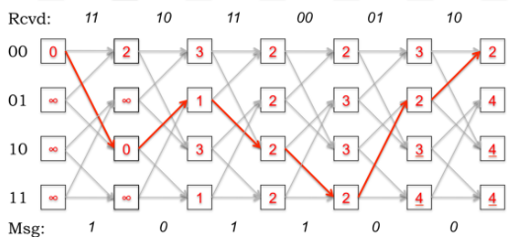
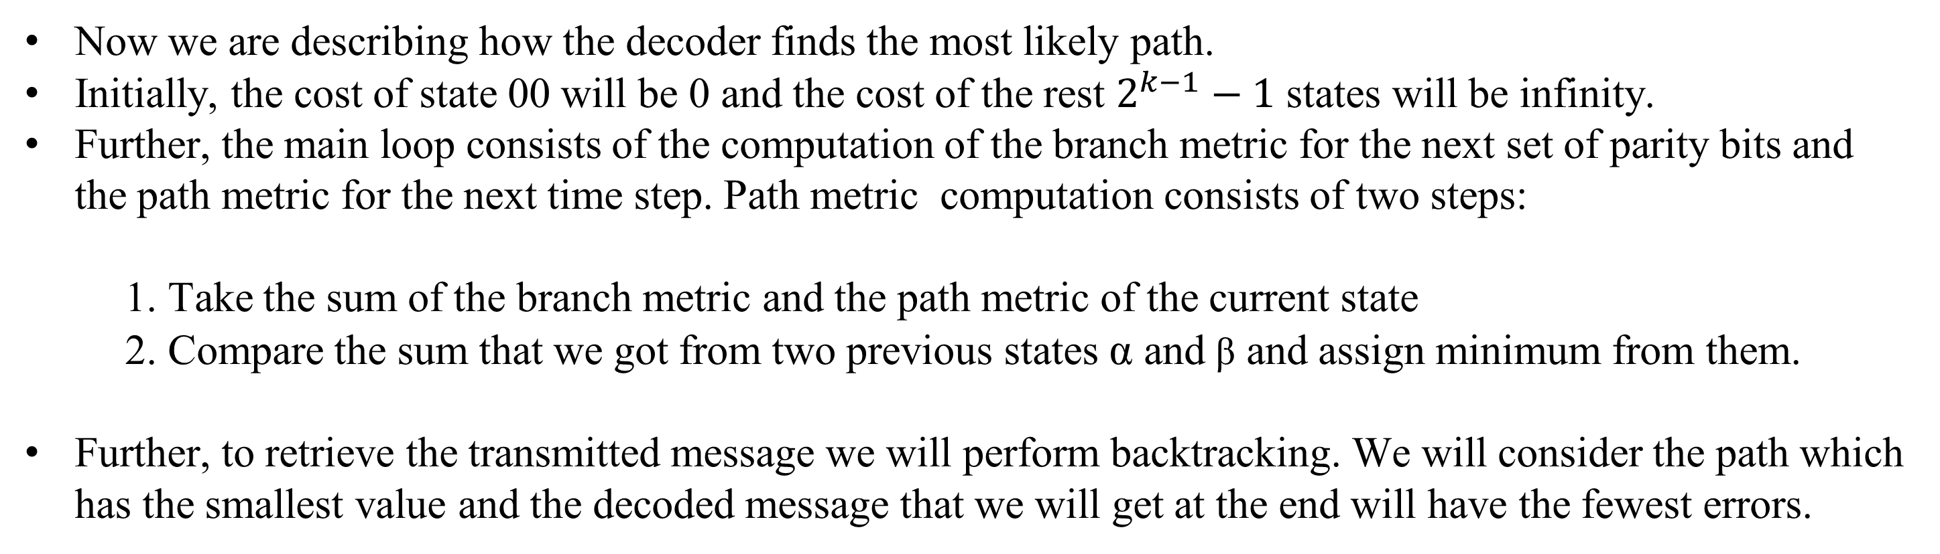
Hard Decision Decoding
Now we are describing how the decoder finds the most likely path.
Initially, the cost of state 00 will be 0 and the cost of the rest $2^{k−1}−1$ states will be infinity.
Further, the main loop consists of the computation of the branch metric for the next set of parity bits and the path metric for the next time step. Path metric computation consists of two steps:
1. Take the sum of the branch metric and the path metric of the current state
2. Compare the sum that we got from two previous states α and β and assign minimum from them.
Further, to retrieve the transmitted message we will perform backtracking. We will consider the path which has the smallest value and the decoded message that we will get at the end will have the fewest errors.
These bits represent the input(for the highlighted branches)
which we give to the current state to reach the next state. This is the decoded message.
* Figure taken from Lec-9 MIT

Slide 19
Pseudocode for Backtracking(hard)
function viterbi_decode(g, received_bit)
Set dp(1,1) = 0
Iterate over received bits:
for each time step i:
Extract a group of bits from received_bit
for each state st:
Compute Hamming distances for possible transitions
Update dp matrix with minimum path metric for each state
Backtrack to find decoded message:
Initialize next_st = 0
Iterate over time steps in reverse:
Determine previous states with minimum path metric
Compute Hamming distances for transitions
Choose the previous state with the minimum path metric
Update decoded message and next state
Return decoded message
end
(actual Matlab function for this we have uploaded in pdf file)

Slide 20
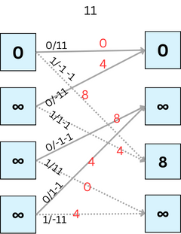
Soft Decision Decoding
In Soft decision decoding we do not demodulate received signal instead we take Euclidean distance with 1/-1.
For soft decision decoding in convolution codes the computation of the path matric and the Viterbi decoding algorithm will remain the same as hard decision decoding.
The only difference in soft and hard decision decoding is the computation of the branch metric.
Let us define the branch metric for soft decision decoding.
Branch Metric (BM): The branch metric for soft decision decoding is the Euclidean distance between the
received message and the expected message.
Time: i i+1
0 0
0 1
1 0
1 1
State
Let’s see visualization of computing trellis and backtracking for soft decision decoding.

Slide 21
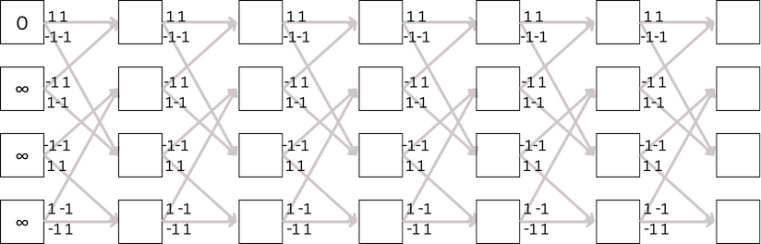
Soft Decision Decoding
Rcvd:
-1 -1
-1 1
-1 -1
1 1
1 -1
-1 1
0 0
0 1
1 0
1 1

Slide 22
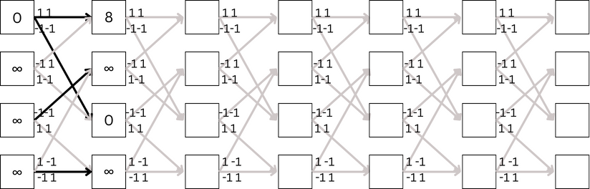
Soft Decision Decoding
Rcvd:
-1 -1
-1 1
-1 -1
1 1
1 -1
-1 1
0 0
0 1
1 0
1 1

Slide 23
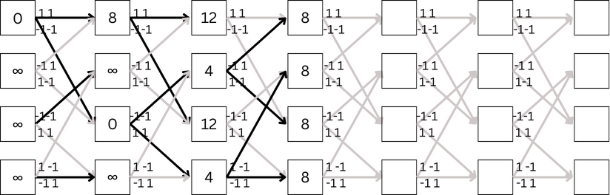
Soft Decision Decoding
Rcvd:
-1 -1
-1 1
-1 -1
1 1
1 -1
-1 1
0 0
0 1
1 0
1 1

Slide 24
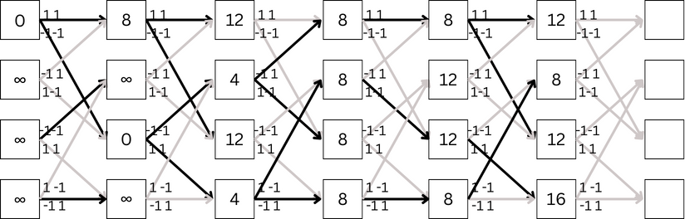
Soft Decision Decoding
Rcvd:
-1 -1
-1 1
-1 -1
1 1
1 -1
-1 1
0 0
0 1
1 0
1 1

Slide 25
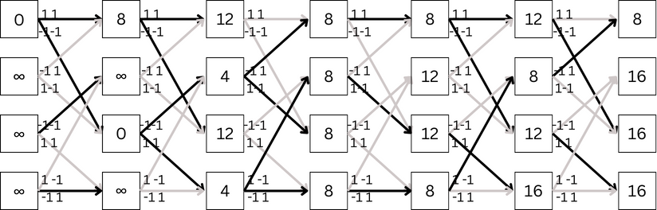
Soft Decision Decoding
Rcvd:
-1 -1
-1 1
-1 -1
1 1
1 -1
-1 1
0 0
0 1
1 0
1 1

Slide 26
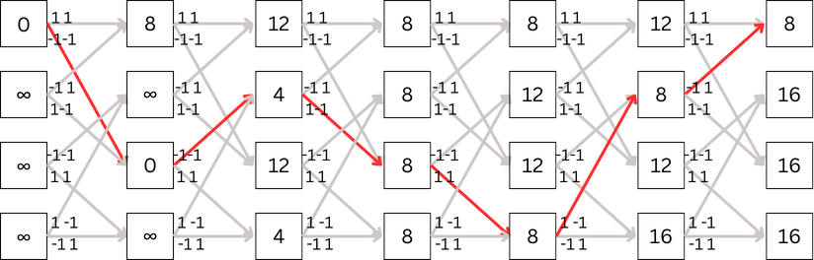
Soft Decision Decoding
Rcvd:
-1 -1
-1 1
-1 -1
1 1
1 -1
-1 1
0 0
0 1
1 0
1 1
Msg:
1
0
1
1
0
0

Slide 27
Pseudocode for Backtracking(soft)
function viterbi_decode(g, received_bit)
Set dp(1,1) = 0
Iterate over received bits:
for each time step i:
Extract a group of bits from received_bit
for each state st:
Compute Euclidean distances for possible transitions
Update dp matrix with minimum path metric for each state
Backtrack to find decoded message:
Initialize next_st = 0
Iterate over time steps in reverse:
Determine previous states with minimum path metric
Compute Euclidean distances for transitions
Choose the previous state with the minimum path metric
Update decoded message and next state
Return decoded message
end

Slide 28
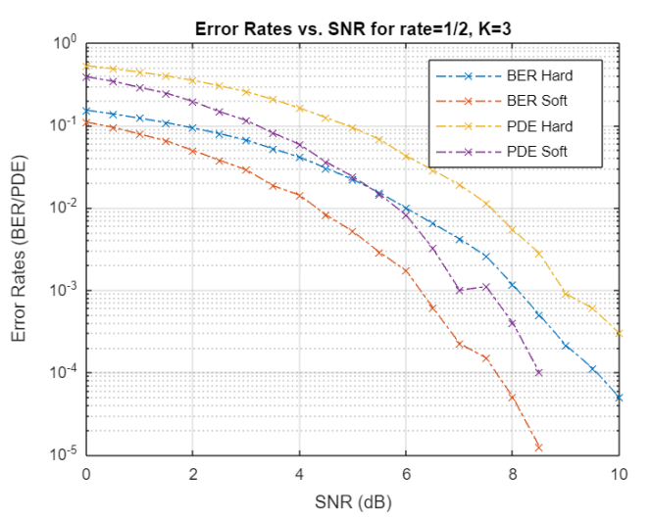
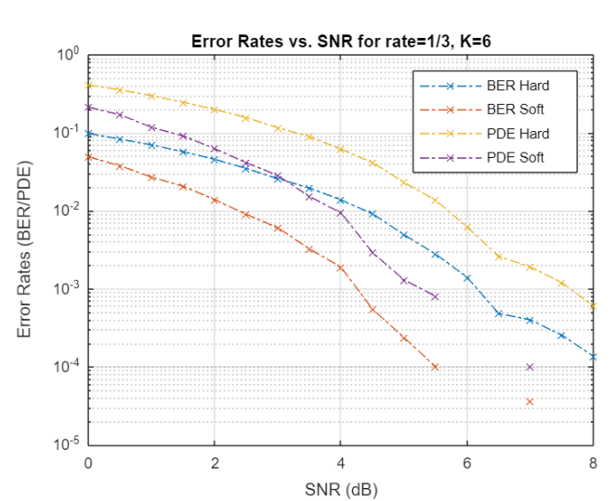
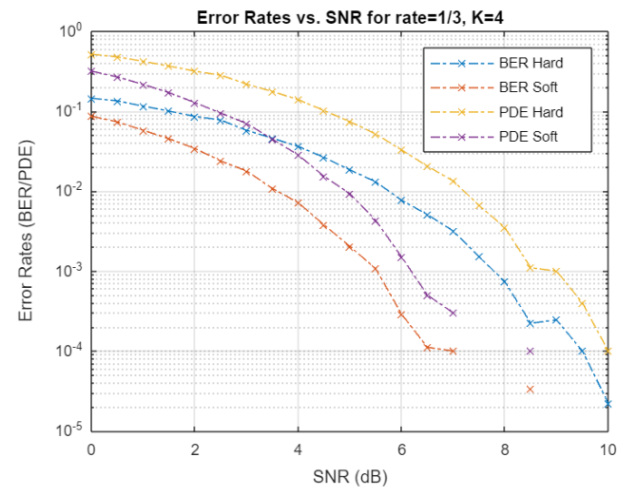
Simulation results
The plots depict the performance of the Viterbi hard and soft decoders for different rates and constraint lengths.

Slide 29
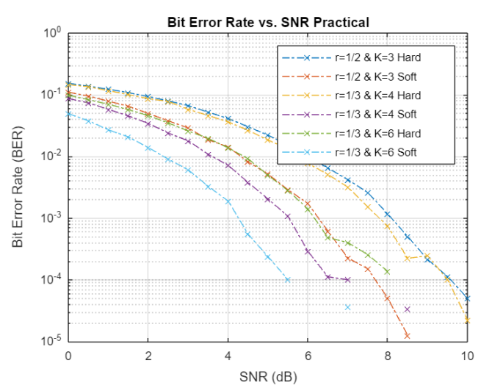
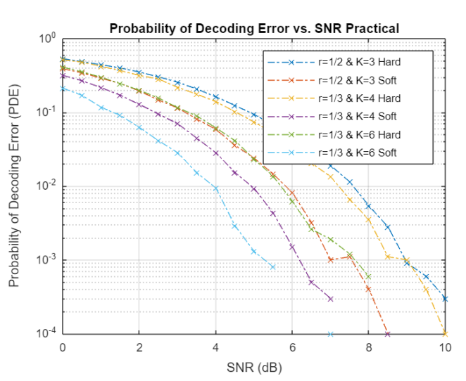
Observations from Plots
Performance of both Viterbi hard and soft for each case increases with the increase in SNR.
The BER and PDE is higher for lower SNR which suggests that Viterbi hard performs better for minimal noise.
The same goes for Viterbi-soft decision decoding but it performs better than Viterbi-hard.
Lower code rates enhance the performance of the decoders but it also introduces overhead.
Larger constraint length enhances error correction significantly but the cost is significant increase in time due to increase in computation complexity.
The overall performance of soft decision decoding is much better than the hard decision. The reasons can be:
>> In hard decision decoding, each of the received symbol is demodulated to bits considering a specific threshold. This leads to ambiguity because decoder may choose incorrect bits due to uncertainty.
>>Soft decision decodes using the received symbols rather than demodulating them to bits. Unlike viterbi hard, there is no room for ambiguity here.

Slide 30
Summary
Convolution code is a channel coding technique which transmits parity bits rather than message bits followed by parity bits.
Viterbi hard decision can be generalised to Viterbi soft decision just by changing the Branch Metric computation.
The overall performance of the Viterbi Soft Decoder is better than Viterbi Hard Decoder.
The trade off involved in convolution codes is that the errors in the decoded message decreases with the increase in constraint length but the decoding time increases significantly.
The performance of decoder improves as the rate decreases but it also leads to increase in the parity bits generated for message which increases the computation complexity or more appropriately the decoding time.
Convolutional codes can be used in wireless communication, satellite links, deep space communication, and digital television broadcasting.

Slide 31
Appendix
Soft Decision Decoding
Analysis

Slide 32
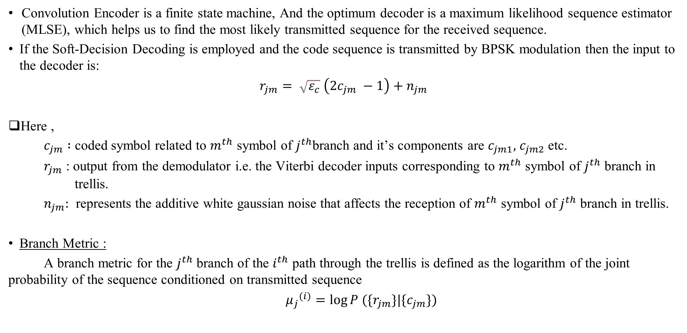
Appendix
Convolution Encoder is a finite state machine, And the optimum decoder is a maximum likelihood sequence estimator (MLSE), which helps us to find the most likely transmitted sequence for the received sequence.
If the Soft-Decision Decoding is employed and the code sequence is transmitted by BPSK modulation then the input to the decoder is:
$$r_{jm}= \sqrt{ε_{c}} \left(2c_{jm} −1\right)+n_{jm}$$
Here ,
$c_{jm} :$ coded symbol related to $m^{th}$ symbol of $j^{th}$branch and it’s components are $c_{jm1},$ $c_{jm2}$ etc.
$r_{jm}$ : output from the demodulator i.e. the Viterbi decoder inputs corresponding to $m^{th}$ symbol of $j^{th}$ branch in trellis.
$n_{jm}:$ represents the additive white gaussian noise that affects the reception of $m^{th}$ symbol of $j^{th}$ branch in trellis.
Branch Metric :
A branch metric for the $j^{th}$ branch of the $i^{th}$ path through the trellis is defined as the logarithm of the joint probability of the sequence conditioned on transmitted sequence
${μ_{j}}^{(i)}=\log{P (\{r_{jm}\}|\{c_{jm}\})}$
……… (8-2-9)
……… (8-2-10)

Slide 33
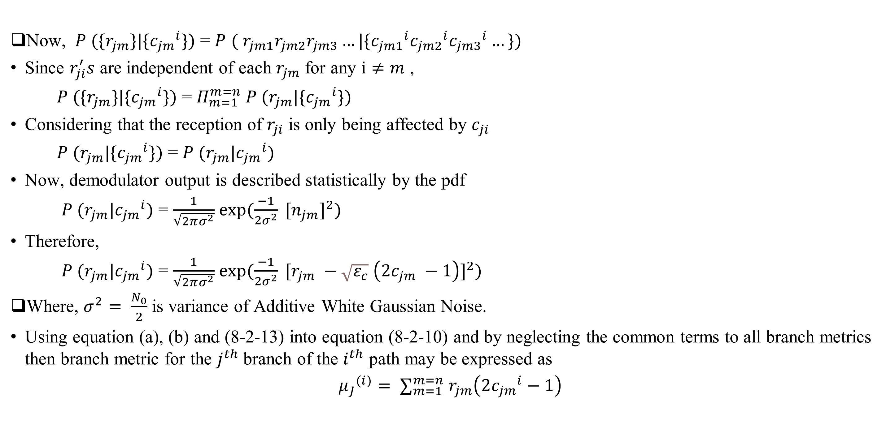
Appendix
Now, $P (\{r_{jm}\}|\{{c_{jm}}^{i}\})$ = $P$ $( r_{jm1}r_{jm2}r_{jm3}…|\{{c_{jm1}}^{i}{c_{jm2}}^{i}{c_{jm3}}^{i}…\})$
Since $r_{ji}^{′}s$ are independent of each $r_{jm}$ for any $i≠m$ ,
$P (\{r_{jm}\}|\{{c_{jm}}^{i}\})$ = $Π_{m=1}^{m=n} P (r_{jm}|\{{c_{jm}}^{i}\})$
Considering that the reception of $r_{ji}$ is only being affected by $c_{ji}$
$P (r_{jm}|\{{c_{jm}}^{i}\})$ = $P (r_{jm}|{c_{jm}}^{i})$
Now, demodulator output is described statistically by the pdf
$P (r_{jm}|{c_{jm}}^{i})$ = $\frac{1}{\sqrt{2πσ^{2}}}$ $\exp{(\frac{−1}{2σ^{2}} {[n_{jm}]}^{2})}$
Therefore,
$P (r_{jm}|{c_{jm}}^{i})$ = $\frac{1}{\sqrt{2πσ^{2}}}$ $\exp{(\frac{−1}{2σ^{2}} {[r_{jm} −\sqrt{ε_{c}} \left(2c_{jm} −1\right)]}^{2})}$
Where, $σ^{2}= \frac{N_{0}}{2}$ is variance of Additive White Gaussian Noise.
Using equation (a), (b) and (8-2-13) into equation (8-2-10) and by neglecting the common terms to all branch metrics then branch metric for the $j^{th}$ branch of the $i^{th}$ path may be expressed as
$${μ_{J}}^{(i)}= ∑_{m=1}^{m=n} r_{jm}\left(2{c_{jm}}^{i}−1\right)$$
……… (a)
……… (b)
……… (8-2-13)
……… (8-2-14)

Slide 34
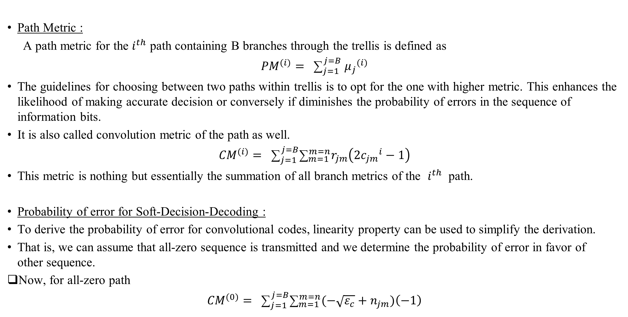
Appendix
Path Metric :
A path metric for the $i^{th}$ path containing B branches through the trellis is defined as
$${PM}^{(i)}= {\text{∑}}_{j=1}^{j=B} {μ_{j}}^{(i)}$$
The guidelines for choosing between two paths within trellis is to opt for the one with higher metric. This enhances the likelihood of making accurate decision or conversely if diminishes the probability of errors in the sequence of information bits.
It is also called convolution metric of the path as well.
$${CM}^{(i)}= {\text{∑}}_{j=1}^{j=B}{\text{∑}}_{m=1}^{m=n}r_{jm}\left(2{c_{jm}}^{i}−1\right)$$
This metric is nothing but essentially the summation of all branch metrics of the $i^{th}$ path.
Probability of error for Soft-Decision-Decoding :
To derive the probability of error for convolutional codes, linearity property can be used to simplify the derivation.
That is, we can assume that all-zero sequence is transmitted and we determine the probability of error in favor of other sequence.
Now, for all-zero path
$${CM}^{(0)}= {\text{∑}}_{j=1}^{j=B}{\text{∑}}_{m=1}^{m=n}(−\sqrt{ε_{c}}+n_{jm})\left(−1\right)$$
……… (c)
……… (8-2-16)

Slide 35
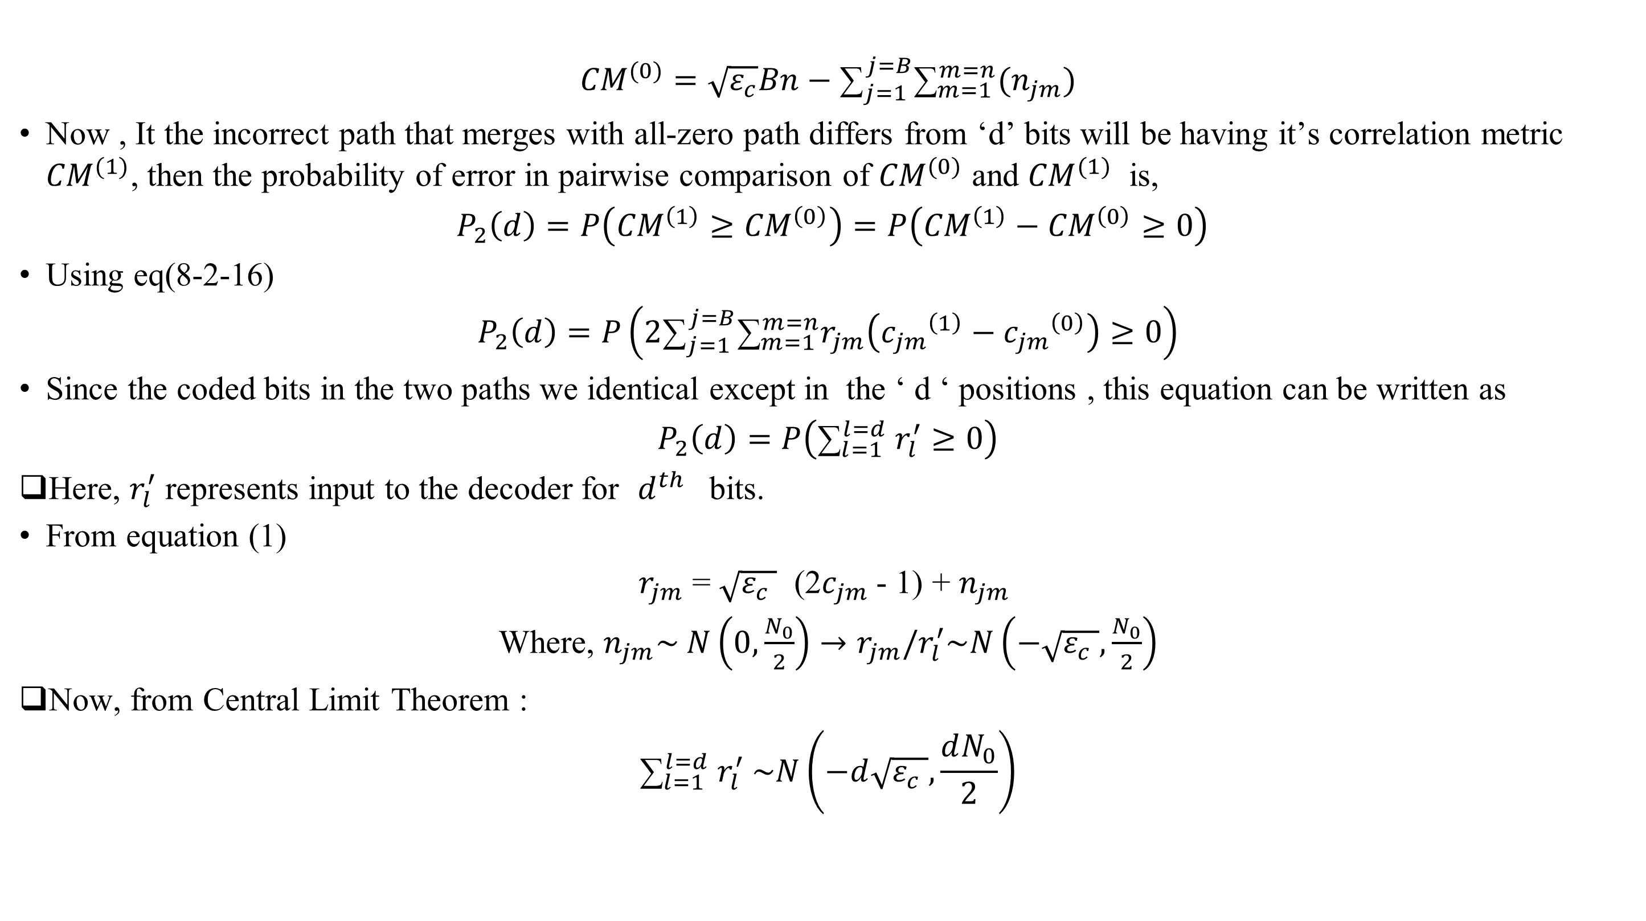
Appendix
$${CM}^{(0)}=\sqrt{ε_{c}}Bn−{\text{∑}}_{j=1}^{j=B}{\text{∑}}_{m=1}^{m=n}(n_{jm})$$
Now , It the incorrect path that merges with all-zero path differs from ‘d’ bits will be having it’s correlation metric ${CM}^{(1)}$, then the probability of error in pairwise comparison of ${CM}^{(0)}$ and ${CM}^{(1)}$ is,
$P_{2}\left(d\right)=P\left({CM}^{\left(1\right)}≥{CM}^{\left(0\right)}\right)=P\left({CM}^{\left(1\right)}−{CM}^{\left(0\right)}≥0\right)$
Using eq(8-2-16)
$$P_{2}\left(d\right)=P\left(2{\text{∑}}_{j=1}^{j=B}{\text{∑}}_{m=1}^{m=n}r_{jm}\left({c_{jm}}^{\left(1\right)}−{c_{jm}}^{\left(0\right)}\right)≥0\right)$$
Since the coded bits in the two paths we identical except in the ‘ d ‘ positions , this equation can be written as
$$P_{2}\left(d\right)=P\left({\text{∑}}_{l=1}^{l=d} r_{l}^{′}≥0\right)$$
Here, $r_{l}^{′}$ represents input to the decoder for $d^{th}$ bits.
From equation (1)
$r_{jm}$ = $\sqrt{ε_{c} }$ (2$c_{jm}$- 1) + $n_{jm}$
Where, $n_{jm}\sim N\left(0,\frac{N_{0}}{2}\right)→r_{jm}/r_{l}^{′}\sim N\left(−\sqrt{ε_{c} },\frac{N_{0}}{2}\right)$
Now, from Central Limit Theorem :
$${\text{∑}}_{l=1}^{l=d} r_{l}^{′} \sim N\left(−d\sqrt{ε_{c} },\frac{dN_{0}}{2}\right)$$
……… (8-2-17)
……… (8-2-18)
……… (8-2-19)

Slide 36
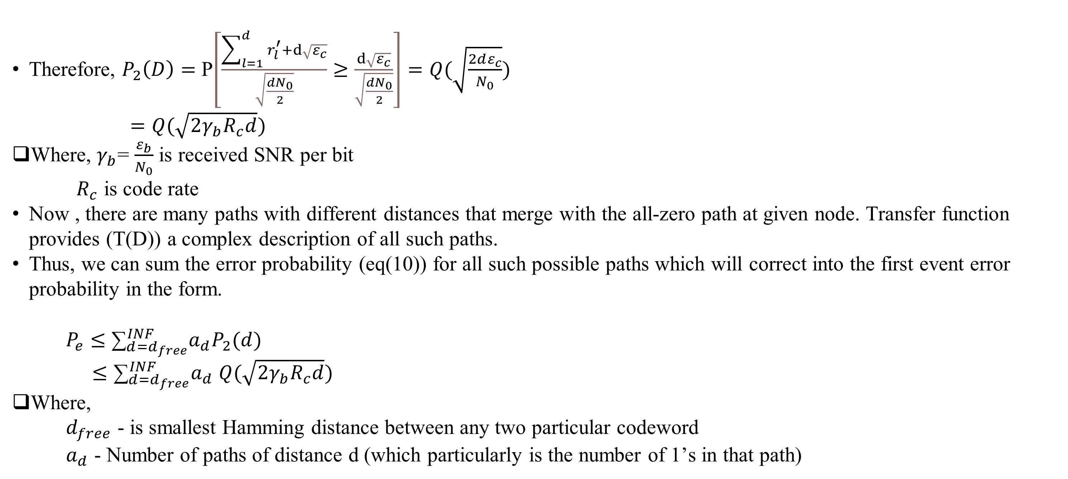
Appendix
Therefore, $P_{2}\left(D\right)=$ P$\left[\frac{\sum_{l=1}^{d}{r_{l}^{′}}+ⅆ\sqrt{ε_{c}}}{\sqrt{\frac{dN_{0}}{2}}}≥\frac{ⅆ\sqrt{ε_{c}}}{\sqrt{\frac{dN_{0}}{2}}}\right]=Q(\sqrt{\frac{2dε_{c}}{N_{0}}})$
$=Q(\sqrt{2γ_{b}R_{c}d})$
Where, $γ_{b}$= $\frac{ε_{b}}{N_{0}}$ is received SNR per bit
$R_{c}$ is code rate
Now , there are many paths with different distances that merge with the all-zero path at given node. Transfer function provides (T(D)) a complex description of all such paths.
Thus, we can sum the error probability (eq(10)) for all such possible paths which will correct into the first event error probability in the form.
$P_{e}≤$ ${\text{∑}}_{d=d_{free}}^{INF}a_{d}P_{2}(d)$
$≤{\text{∑}}_{d=d_{free}}^{INF}a_{d}$ $Q(\sqrt{2γ_{b}R_{c}d})$
Where,
$d_{free}$ - is smallest Hamming distance between any two particular codeword
$a_{d}$ - Number of paths of distance d (which particularly is the number of 1’s in that path)
……… (d)
……… (8-2-20)
……… (8-2-21)

Slide 37
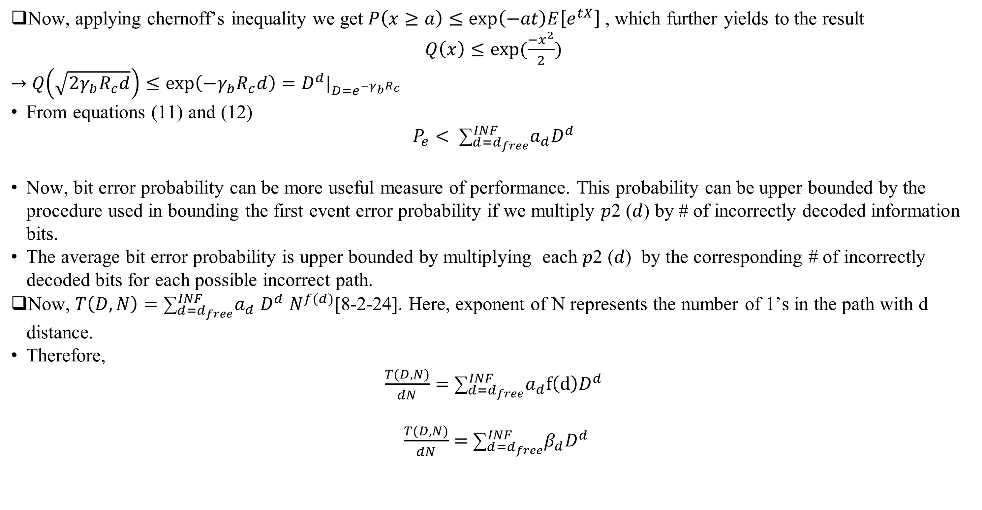
Appendix
Now, applying chernoff’s inequality we get $P\left(x≥a\right)≤\exp\left(−at\right)E\left[e^{tX}\right]$, which further yields to the result
$Q\left(x\right)≤exp⁡(\frac{−x^{2}}{2})$
$→$ $Q\left(\sqrt{2γ_{b}R_{c}d}\right)≤\exp\left(−γ_{b}R_{c}d\right)=D^{d}|_{D=e^{−γ_{b}R_{c}}}$
From equations (11) and (12)
$$P_{e}< {\text{∑}}_{d=d_{free}}^{INF}a_{d}D^{d}$$
Now, bit error probability can be more useful measure of performance. This probability can be upper bounded by the procedure used in bounding the first event error probability if we multiply 𝑝2 (𝑑) by # of incorrectly decoded information bits.
The average bit error probability is upper bounded by multiplying each 𝑝2 (𝑑) by the corresponding # of incorrectly decoded bits for each possible incorrect path.
Now, $T\left(D,N\right)={\text{∑}}_{d=d_{free}}^{INF}a_{d}$ $D^{d}$ $N^{f(d)}$[8-2-24]. Here, exponent of N represents the number of 1’s in the path with d distance.
Therefore,
$\frac{T(D,N)}{dN}=$ ${\text{∑}}_{d=d_{free}}^{INF}a_{d}f\left(d\right)D^{d}$
$\frac{T(D,N)}{dN}=$ ${\text{∑}}_{d=d_{free}}^{INF}β_{d}D^{d}$
……… (e)
……… (8-2-22)
……… (f)
……… (8-2-25)

Slide 38
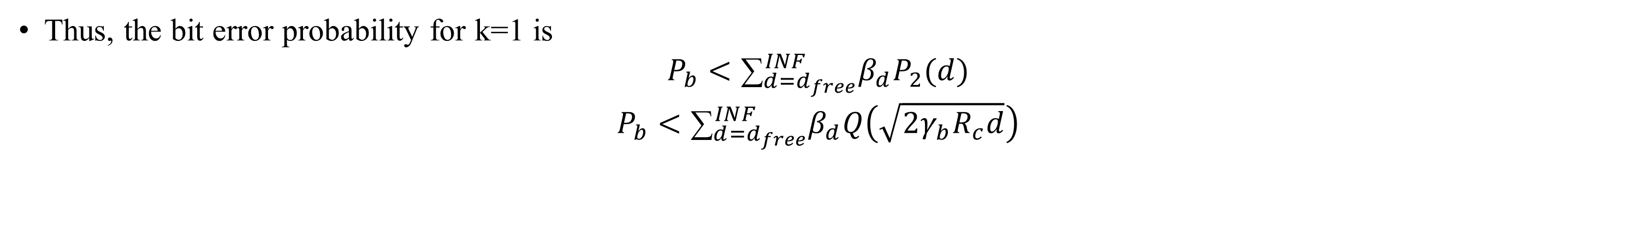
Appendix
Thus, the bit error probability for k=1 is
$$P_{b}<{\text{∑}}_{d=d_{free}}^{INF}β_{d}P_{2}(d)$$
$$P_{b}<{\text{∑}}_{d=d_{free}}^{INF}β_{d}Q\left(\sqrt{2γ_{b}R_{c}d}\right)$$
……… (8-2-26)

Slide 39
Appendix
Hard Decision Decoding
Analysis

Slide 40
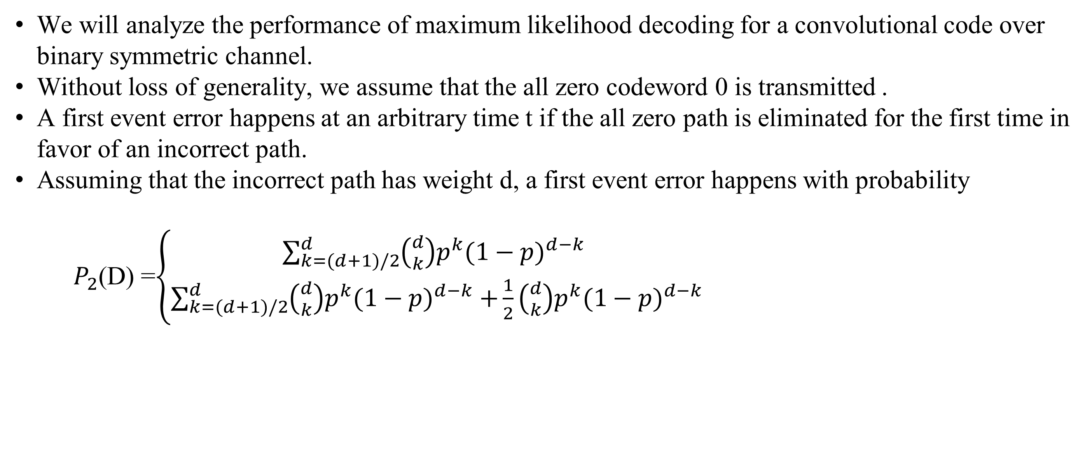
Appendix
We will analyze the performance of maximum likelihood decoding for a convolutional code over binary symmetric channel.
Without loss of generality, we assume that the all zero codeword 0 is transmitted .
A first event error happens at an arbitrary time t if the all zero path is eliminated for the first time in favor of an incorrect path.
Assuming that the incorrect path has weight d, a first event error happens with probability
$P_{2}$(D) =$\left\{\begin{aligned}\sum_{k=(d+1)/2}^{d}{\left({d \atop k}\right)p^{k}{(1−p)}^{d−k}} \\ \sum_{k=(d+1)/2}^{d}{\left({d \atop k}\right)p^{k}{(1−p)}^{d−k} +\frac{1}{2}\left({d \atop k}\right)p^{k}{(1−p)}^{d−k}} \end{aligned}\right.$
If d is odd
……… (8-2-28)
If d is even
……… (8-2-29)

Slide 41
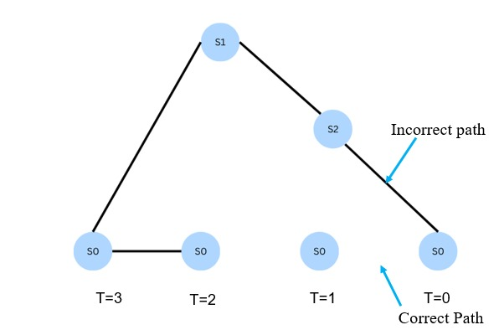
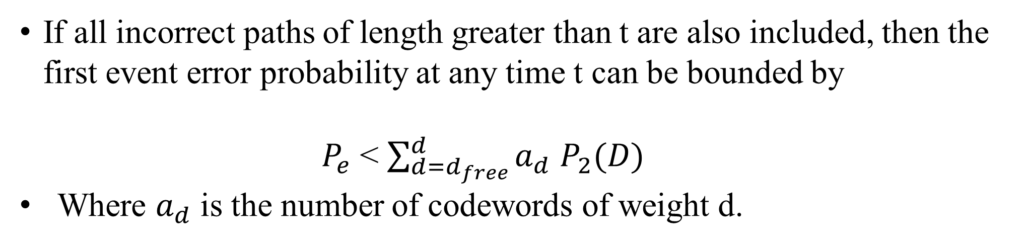
Appendix
All incorrect paths of length t branches or less can cause a first event error at time t.
Thus the first event error probability at time t can be bounded using union bound by the sum of the error probabilities of each of these paths.
If all incorrect paths of length greater than t are also included, then the first event error probability at any time t can be bounded by
$P_{e}$ < $\sum_{d=d_{free}}^{d}{a_{d}}$ $P_{2}(D)$
Where $a_{d}$ is the number of codewords of weight d.
……… (8-2-30)

Slide 42

Appendix
Instead of using the expressions for P2(d) given in (8-2-28) and (8-2-29), we can use the upper bound,
$P_{2}$(D) < ${[4p (1−p) ]}^{d/2}$
Use of this bound in (8-2-30) yields a looser upper bound on the first-event error probability, in the form,
$P_{e}$ < $\sum_{d=d_{free}}^{d}{a_{d}} {[4p (1−p) ]}^{d/2}$
< T(D)$|_{D=\sqrt{4p(1−p)}}$
……… (8-2-31)
……… (8-2-32)

Slide 43

Appendix
For odd d,
$$P_{2}\left(d\right)=∑_{e=\frac{d+1}{2}}^{d}\left(\begin{aligned}d \\ e\end{aligned}\right)p^{e}{(1−p)}^{d−e}$$
$≤∑_{e=\frac{d+1}{2}}^{d}$ $\left(\begin{aligned}d \\ e\end{aligned}\right)p^{d/2}{(1−p)}^{d/2}$
= $p^{d/2}{(1−p)}^{d/2}$ $∑_{e=\frac{d+1}{2}}^{d}$ $\left(\begin{aligned}d \\ e\end{aligned}\right)$
= $p^{d/2}{(1−p)}^{d/2}$ $∑_{e=0}^{d}$ $\left(\begin{aligned}d \\ e\end{aligned}\right)$
= $2^{d}p^{d/2}{(1−p)}^{d/2}$
$$P_{2}\left(d\right)=∑_{e=\frac{d}{2}+1}^{d}\left(\begin{aligned}d \\ e\end{aligned}\right)p^{e}{(1−p)}^{d−e}+\frac{1}{2}\left(\begin{aligned}d \\ e\end{aligned}\right)p^{d/2}{(1−p)}^{d/2}$$
$<$ $∑_{e=\frac{d}{2}}^{d}\left(\begin{aligned}d \\ e\end{aligned}\right)p^{e}{(1−p)}^{d−e}$
$<$ $∑_{e=\frac{d}{2}}^{d}\left(\begin{aligned}d \\ e\end{aligned}\right)p^{d/2}{(1−p)}^{d/2}$
= $p^{d/2}{(1−p)}^{d/2}$ $∑_{e=0}^{d}\left(\begin{aligned}d \\ e\end{aligned}\right)p^{d/2}$
= $2^{d}p^{d/2}{(1−p)}^{d/2}$
……… (a)
For even d,
……… (b)

Slide 44

Appendix
The bit error probability can be bounded by
$P_{b}$ < $\sum_{d=d_{free}}^{∞}{ β_{d}}$ $P_{2}(d)$
where $β_{d}$ is the total number of nonzero information bits on all weight-d paths, divided by the number of information bits k per unit time.
The ${\{β}_{d}\}$are the coefficients in the expansion of the derivative of T(D, N), evaluated at N = 1. For $P_{2}$(d), we may use either the expressions given in (8-2-28) and (8-2-29) or the upper bound in (8-2-31). If the latter is used, the upper bound on $P_{b}$, can be expressed as,
$P_{b}$ < $\frac{dT(D,N)}{dN}$ $|_{N=1,D=\sqrt{4p(1−p)}}$
When k >1, the results given in (8-2-33) and (8-2-34) for $P_{b}$, should be divided by k.
……… (8-2-33)
……… (8-2-34)

Slide 45
References
[1] CT216. Introduction to Communication Systems: Lecture 3 Channel Coding. DA-IICT, Winter 2024.
[2] J. G. Proakis. Digital Communications. McGraw-Hill, 4th edition, 1995.
[3] Matthew Valenti and Bibin Baby John. Introduction to Communication Systems: A Lecture on Convolution Coding and Viterbi Decoding. DA-IICT, Winter 2024.
[4] PERFORMANCE ANALYSIS OF M-QAM WITH VITERBI SOFT-DECISION DECODING by Rogerio Correa Manso
[5] MIT Lectures L8 and L9 (Convolution Codes and Viterbi Decoding)
[6] Performance Bounds for Convolutional Codes ( NPTEL Lecture )

Slide 46
Thank You !!!

