Slide 1
Unlocking Sales Potential
Analyzing Key Factors in Amazon’s Sales Strategy

Slide 2

Introduction
This project aims to analyze sales data from Amazon’s branches in Mandalay, Yangon, and Naypyitaw to uncover key insights for improving sales performance. By examining 1,000 transactions across various product lines and customer segments, this project seeks to answer critical business questions that impact sales, customer satisfaction, and overall profitability
By delving into product line performance, customer demographics, and temporal sales patterns, the project provides actionable insights that can enhance Amazon’s sales strategies and operational efficiency across its branches.

Slide 3
Contents of the Project
01
02
03
04
05
06
Introduction
Objectives and Constraints
Data Understanding
EDA
Insights and Recommendations
Conclusion

Slide 4
Aim &Goals
Our aim
The goal
To analyze sales data from Amazon’s branches in Mandalay, Yangon, and Naypyitaw to understand the key factors influencing sales performance.
To provide actionable insights that optimize sales strategies, improve customer targeting, and increase overall profitability across all branches.

Slide 5
Objectives
Product Analysis
Sales Analysis
Customer Analysis
Identify the top-performing product lines and those requiring improvement by analyzing sales data across all product categories.
Evaluate sales trends to measure the effectiveness of current sales strategies and identify opportunities for optimizing sales performance.
Segment customers based on purchase behavior to determine the most profitable groups and uncover trends that can inform targeted marketing efforts.

Slide 6
Data Understanding
Column | Description | Data Type
invoice_id | Invoice of the sales made | VARCHAR(30)
branch | Branch at which sales were made | VARCHAR(5)
city | The location of the branch | VARCHAR(30)
customer_type | The type of the customer | VARCHAR(30)
gender | Gender of the customer making purchase | VARCHAR(10)
product_line | Product line of the product sold | VARCHAR(100)
unit_price | The price of each product | DECIMAL(10, 2)
quantity | The amount of the product sold | INT
VAT | The amount of tax on the purchase | FLOAT(6, 4)
total | The total cost of the purchase | DECIMAL(10, 2)
date | The date on which the purchase was made | DATE
time | The time at which the purchase was made | TIMESTAMP
payment_method | The total amount paid | DECIMAL(10, 2)
cogs | Cost Of Goods sold | DECIMAL(10, 2)
gross_margin_percentage | Gross margin percentage | FLOAT(11, 9)
gross_income | Gross Income | DECIMAL(10, 2)
rating | Rating | FLOAT(2, 1)
The dataset used in this project consists of sales transactions from Amazon’s three branches located in Mandalay, Yangon, and Naypyitaw. It includes 17 columns and 1,000 rows, capturing various aspects of each transaction, such as product details, customer demographics, sales amounts, and payment methods
There are no NULL Values or empty rows.

Slide 7
Project roadmap
Building database
Creating a table and inserting the data.
EDA
Used SQL Queries to make analysis on customer, sales and Product
Conclusion
Handling Missing Values
Check for missing values and treat
Insights on Analysis
Feature Engineering
Columns Added: timeofday, dayname, monthname
Removed: Gross Income, Gross Margin Percentage
Recommendations

Slide 8
Constraints
Data Completeness
Although the dataset contains 1,000 rows, it may still lack some critical information, such as customer preferences (Reviews , popular products…) or detailed product attributes (Dimensions, Weights), or Order details (Returns, Cancellations), or Transaction details… limiting the depth of analysis.
Timeframe Coverage
The dataset represents a specific period, which might not capture seasonal trends or long-term shifts in customer behavior, only represents three-month data from Jan-Mar

Slide 9
More about the Data
Product Lines
Cities & Branches
Customer Type
Health and beauty
Electronic accessories
Home and lifestyle
Sports and travel
Food and beverages
Fashion accessories
Member or Normal
A → Yangon
B→ Naypyitaw
C→ Mandalay
Payment Methods
Gender
Timeofday
E-wallet , Cash and Credit Card
Male or Female
Morning , Afternoon, Evening

Slide 10
Product Analysis
Product line that generated the highest revenue
Food and beverages 53471.28000000006
Product line that generates highest sales
Food and beverages 56144.844000000005
Product line that incurred the highest Value Added Tax
Food and beverages 2673.5639999999994
Product line that is most frequently associated with each gender
Female : Fashion accessories
Male : Health and beauty

Slide 11
Product Analysis
Average rating for each product line
Categorised Product line
Health and beauty | 7.003289473684212
Electronic accessories | 6.92470588235294
Home and lifestyle | 6.8375
Sports and travel | 6.916265060240964
Food and beverages | 7.113218390804598
Fashion accessories | 7.029213483146067
Health and beauty | 46851.17999999998 | 51264.56333333333 | Bad
Electronic accessories | 51750.029999999984 | 51264.56333333333 | Good
Home and lifestyle | 51297.05999999998 | 51264.56333333333 | Good
Sports and travel | 52497.93000000002 | 51264.56333333333 | Good
Food and beverages | 53471.28000000006 | 51264.56333333333 | Good
Fashion accessories | 51719.89999999997 | 51264.56333333333 | Good

Slide 12

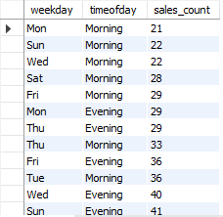


Sales Analysis
Monthly Revenue
Peak times and Cost of goods sold
The branch that exceeded the average number of products sold
Count the sales occurrences for each time of day on every weekday
Id

Slide 13




Sales Analysis
The customer type with the highest purchase frequency
The customer type contributing the highest revenue.
Payment Methods
City with the highest revenue recorded

Slide 14


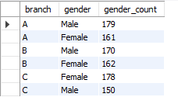

Customer Analysis
City with the highest VAT percentage
Customer type with the highest VAT payments
The predominant gender among customers
The customer type with the highest purchase frequency
Identify the customer type contributing the highest revenue.
The distribution of genders within each branch

Slide 15


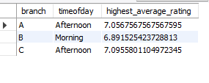

Ratings
The time of day when customers provide the most ratings
The time of day with the highest customer ratings for each branch
The day of the week with the highest average ratings
The day of the week with the highest average ratings for each branch.

Slide 16
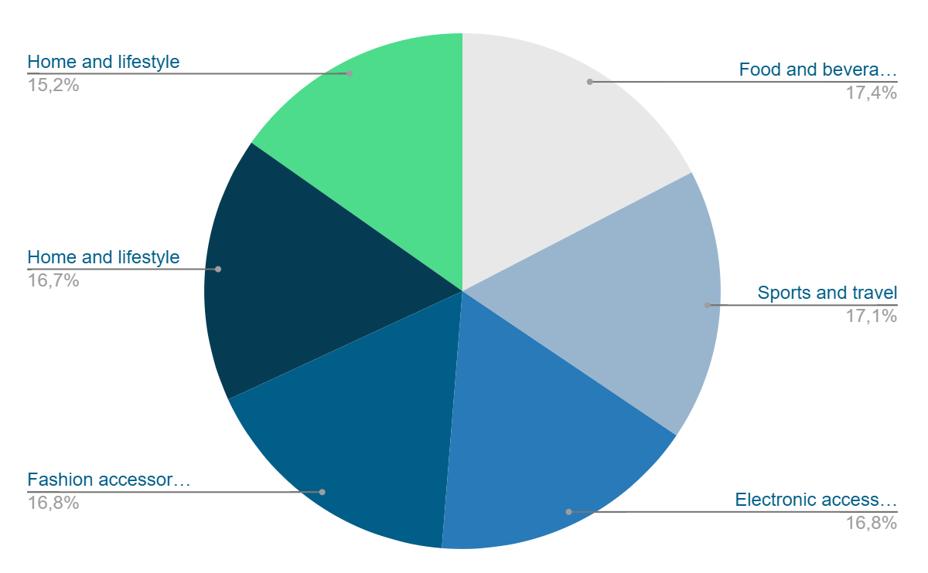
Sales Based on Product Line Chart
Food and beverages
Sports and travel
Electronic accessories
Fashion accessories
Home and lifestyle
Health and beauty

Slide 17
Insights
Product Analysis Insights
Food and Beverages is the product line with the highest sales meaning this product line has strong market performance and demand.
Food and Beverages incurred the highest VAT, high VAT indicates higher sales or pricing for this product line
Food and Beverages generated the highest revenue as this product line contributes significantly to the overall revenue.
Health and Beauty has below-average sales performance, so this product line is underperforming relative to others
Females frequently use Fashion Accessories, while Males use Health and Beauty. Different product lines appeal to different genders.
Sales Analysis Insights
Most revenue is generated during January, followed by March and February due to seasonal trends.
The cost of goods sold peaked in January. High costs in January is linked to increased sales or seasonal factors like new year and festivals..
Most sales occur in the afternoon, especially on Wednesdays and Saturdays probably due to break times or work end times.
Branch A (Yangon) exceeded the average number of products sold.
E-wallet is the most frequently used payment method.
Customer Analysis
Membership customers contribute the most revenue...
Branch A (Yangon) exceeded the average number of products sold.
Naypyitaw has the highest VAT percentage and highest sales.
Females make more purchases compared to males.
Highest number of males in Branch A and highest number of females in Branch B.

Slide 18
Recommendations
Consider increasing the inventory and promotional efforts for Food and Beverages. Promote Food and Beverages based on positive customer feedback and maintain high quality.
Evaluate customer preferences and adjust marketing strategies or product offerings for Health and Beauty.
Improve marketing and product positioning based on gender-specific preferences.
Plan marketing campaigns and inventory management or increase promotions around peak revenue months like January.
Analyze and evaluate successful strategies in Yangon and apply them to other branches to boost their sales.
Since most sales occur in the afternoon, especially on Wednesdays and Saturdays so adjust staffing and promotional efforts to align with peak sales times
Enhance payment options and promotions for digital payment methods.
Implement offers, rewards, discounts, and other loyalty programs for membership customers to retain and attract customers.
Encourage ratings and reviews during peak times to maximize feedback collection.
Analyze branch-specific factors affecting ratings and apply successful strategies to other branches

Slide 19
Conclusion
This study offers a thorough examination of client behavior, product lines, and sales across many outlets. We determined important trends and performance measures by looking at different product lines, customer kinds, payment methods, and cities. According to insights, certain product lines—such as "Food and Beverages"—sell well, and certain branches and clientele make major financial contributions. We also found trends in purchase frequencies, customer ratings, and the effect of VAT. These results provide practical suggestions for boosting client interaction, streamlining sales tactics, and boosting product line success. Resolving data constraints and emphasizing ongoing analysis can help businesses improve their plans and

