Slide 1
Smart Price
Leveraging Machine Learning to Predict Laptop Costs

Slide 2
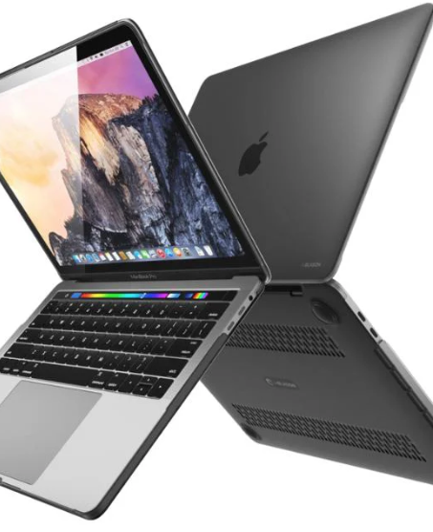
Introduction
In today's fast-changing tech world, predicting laptop prices accurately is crucial for both buyers and makers. Partnering with SmartTech Co., we aim to develop a machine-learning model to forecast laptop prices. This project will help consumers understand fair prices and help manufacturers better position their products and comprehend brand impact on pricing. Our model will offer real-time, easy-to-understand price predictions, aiding informed decisions in the dynamic laptop market.

Slide 3
Objectives
• Accurate Pricing
How can a model be developed to accurately predict laptop prices based on various features, helping our clients stay competitive in the market?
• Market Positioning:
In what ways do different features contribute to laptop pricing, and how can this understanding enable SmartTech Co. to strategically position its laptops in the market?
• Brand Influence
How does brand reputation impact laptop pricing, and what insights can this provide into brand perception and market demand?

Slide 4
Main Challenges:
• Varied Specifications
The dataset includes laptops with a broad spectrum of specifications, presenting a challenge to develop a model that effectively generalizes across diverse features.
• Real-time Forecasting
The model must be capable of predicting prices for newly launched laptops, mirroring the rapidly evolving tech industry.
• Interpretability
Ensuring the model is interpretable is essential so that SmartTech Co. can comprehend the reasoning behind the pricing predictions.

Slide 5
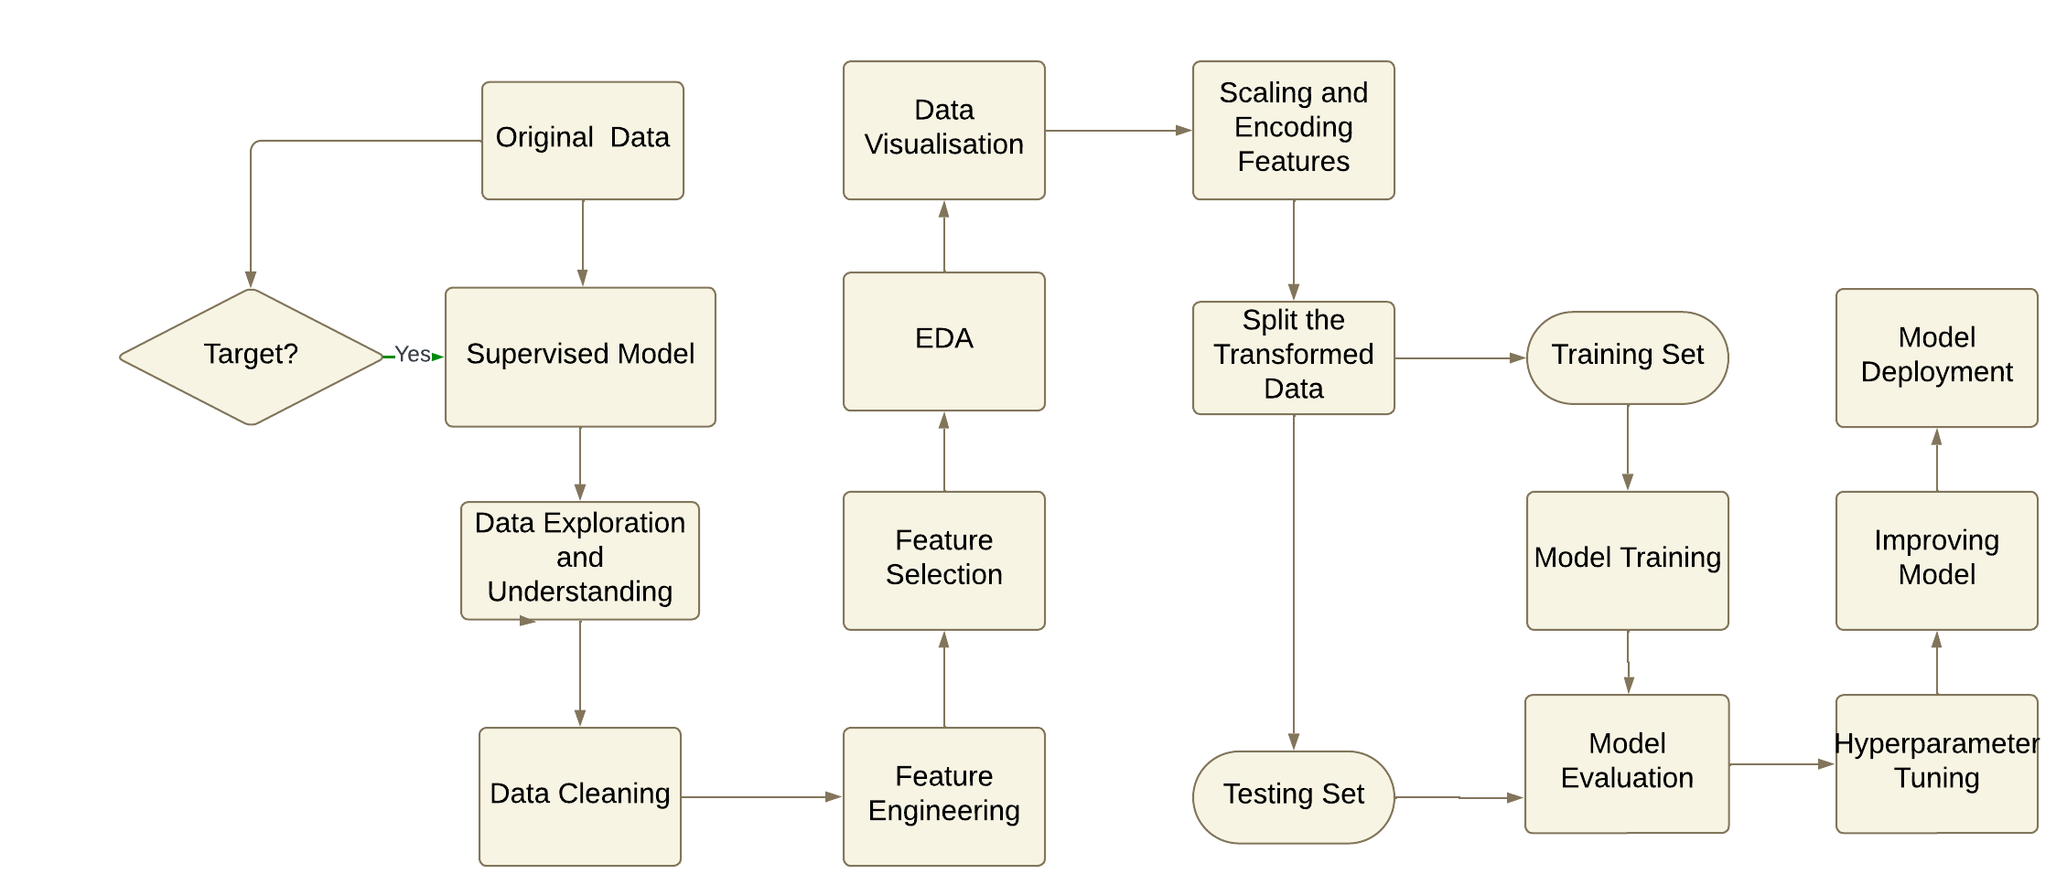

Slide 6
01
Data Understanding

Slide 7
—Data Information
Unnamed: 0.1: Typically, an extra index or placeholder column that might have been created during data export. It often contains redundant or duplicate index information.
Unnamed: 0: Similar to Unnamed: 0.1, this is usually an extra index or placeholder column created during data export, often serving the same purpose as Unnamed: 0.1.
Company: The brand or manufacturer of the laptop (e.g., Dell, Apple, HP).
TypeName: The type or category of the laptop (e.g., Ultrabook, Gaming, Notebook).
Inches: The size of the laptop screen measured diagonally in inches.
ScreenResolution: The resolution of the laptop screen (e.g., Full HD, 4K), specifying the number of pixels displayed on the screen.
Cpu: The model and specifications of the laptop's central processing unit (CPU).
Ram: The amount of Random Access Memory (RAM) installed in the laptop, typically measured in gigabytes (GB).
Memory: The storage capacity of the laptop, which could include HDD, SSD, or other types of storage, often specified in gigabytes (GB) or terabytes (TB).
Gpu: The model and specifications of the laptop's graphics processing unit (GPU), which handles rendering of images and videos.
OpSys: The operating system installed on the laptop (e.g., Windows 10, macOS, Linux).
Weight: The weight of the laptop, usually measured in kilograms (kg) or pounds (lb).
Price: The retail price of the laptop, typically in the local currency or USD.(Target Variable)

Slide 8
Data Cleaning

Slide 9
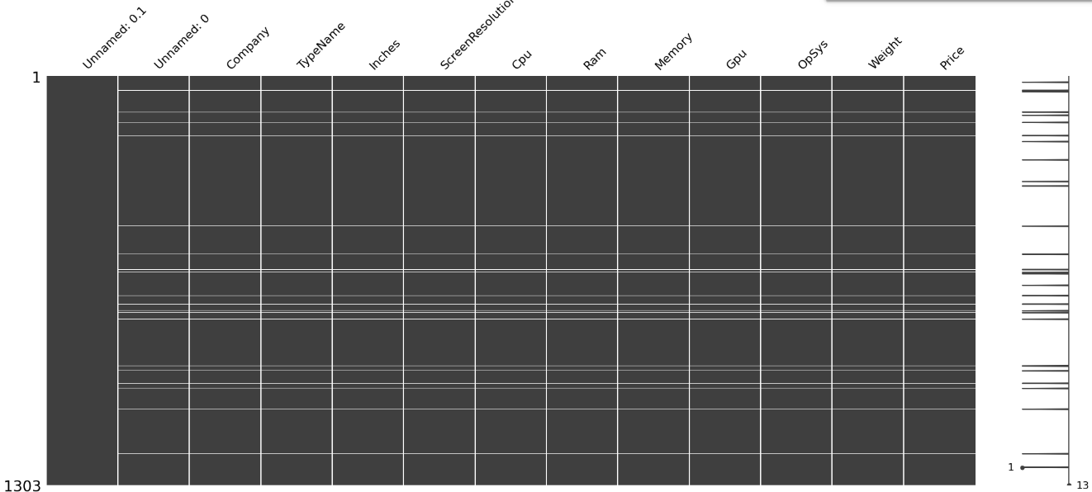
1
Removing Columns, Duplicates and Missing Rows
Unnecessary Columns : Unnamed: 0.1 , Unnamed: 0
Empty rows and Duplicates
Unrealistic Laptop sizes of 10 Inches and below or 17.3 Inches and above
2
Clipping Outliers
To preserve Data Set Size
To reduce the impact of outliers
on the model without completely
removing them
The presence of outliers may
impact the model
hold valuable information

Slide 10
Feature Engineering

Slide 11
Methodology
RAM , Weight → Removing UNITS GB , KG,GHZ
ScreenResolution → ResolutionType, IPS, Touchscreen, Width , Height
CPU→Cpu_Brand, Cpu_Series, Cpu_Clockspeed,
GPU→ Gpu_Brand, GPU_Series
Meomory→Primary and Secondary Storage
Splitting Columns
Making new Columns
PPI, Cpu_Series, Cpu_Clockspeed, ResolutionType, Touchscreen, Width , Height, Primary and Secondary Storage
Data
Changing Data types
Str → Float(Weight, Inches ,Cpu Clockspeed, Width and Height)
Str → Int(RAM)
Removed Original Columns after the split to avoid Data Redundancy and filled few rows containing ‘?’ With Data Imputation (Mean Mode).
Removing the extra columns and Gibberish

Slide 12
Data Visualization

Slide 13
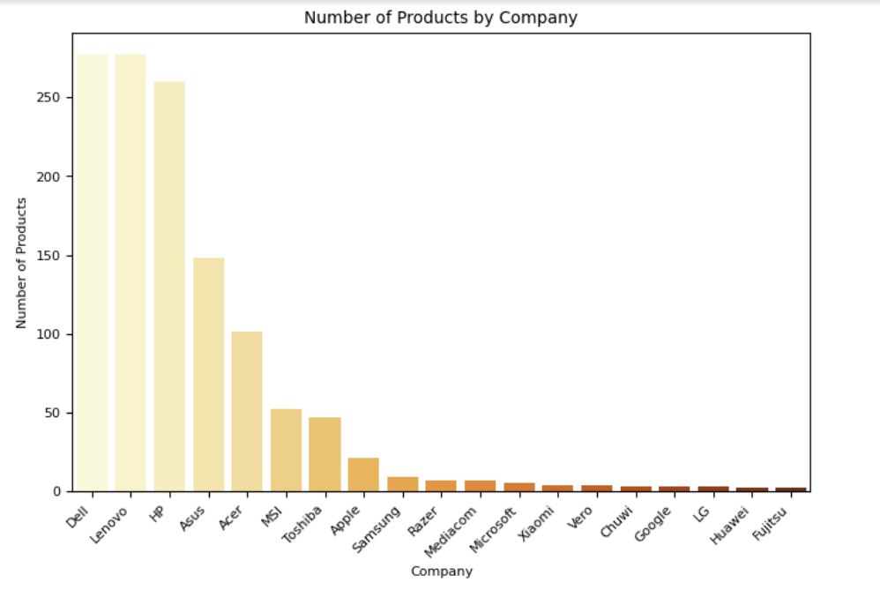

Slide 14
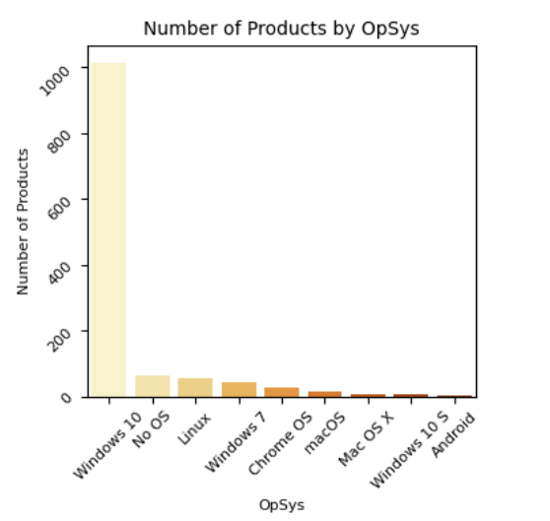

Slide 15
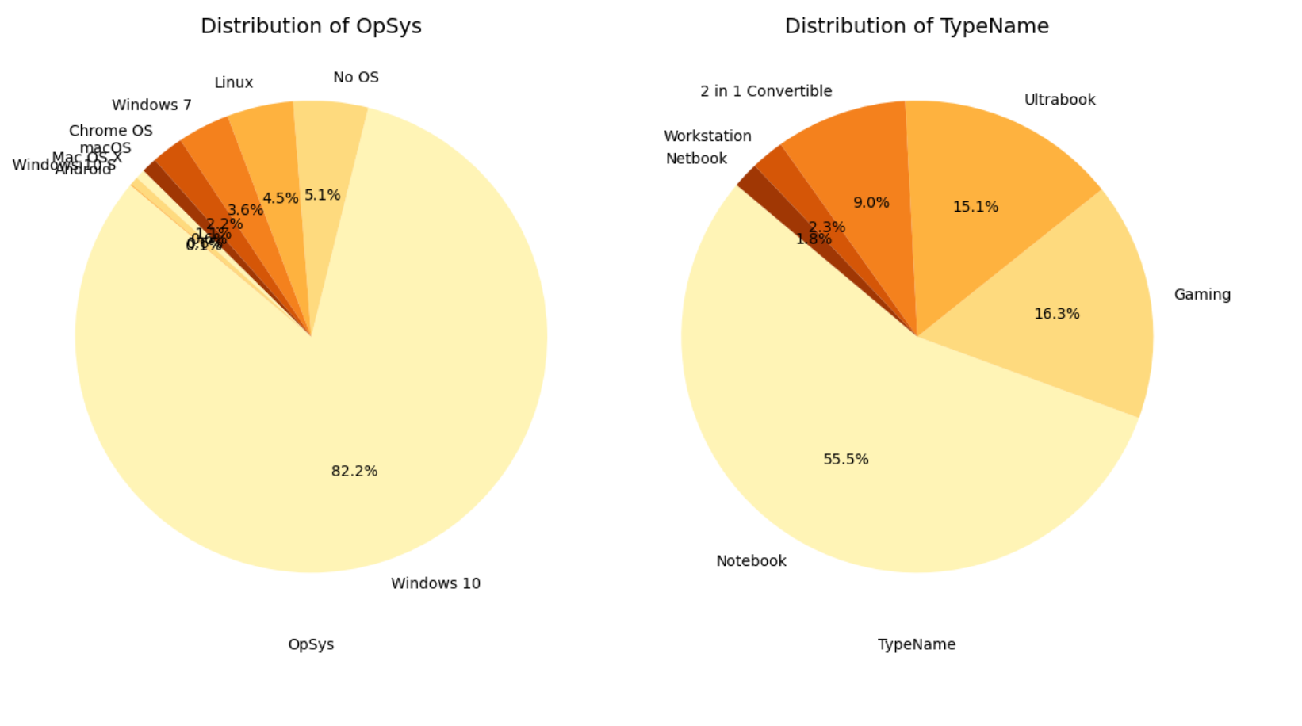

Slide 16
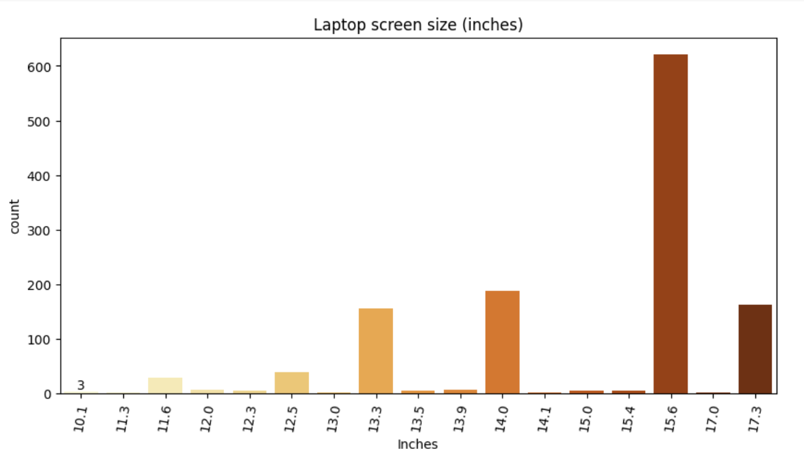

Slide 17
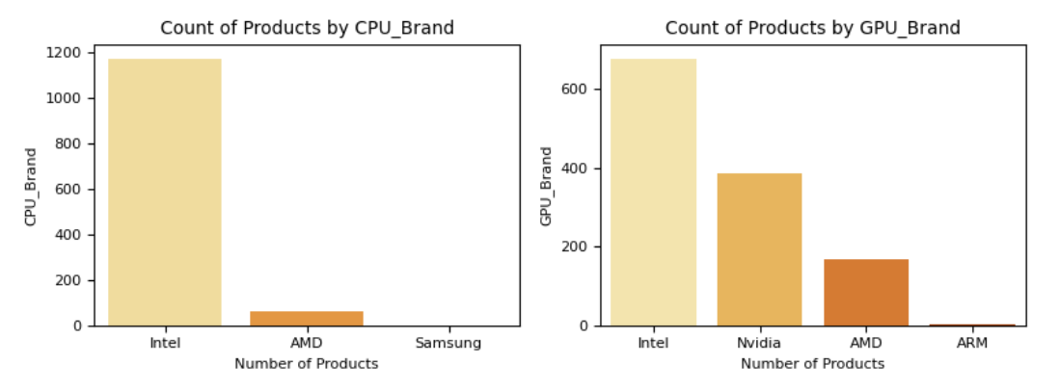

Slide 19
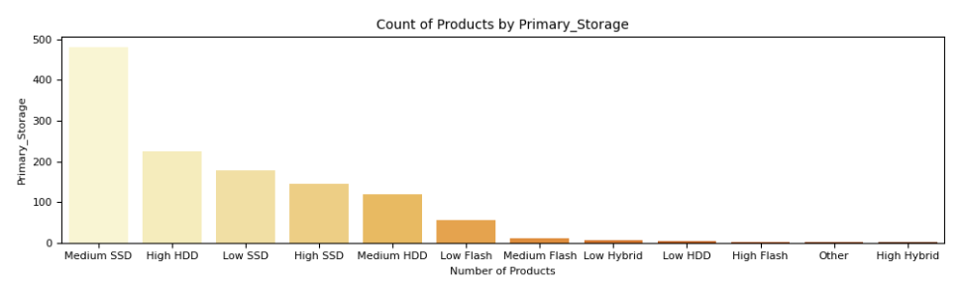
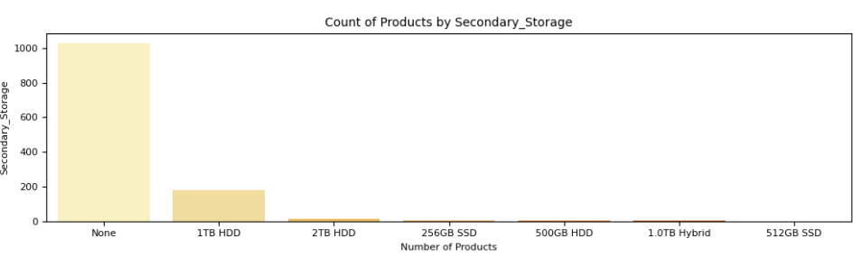

Slide 21
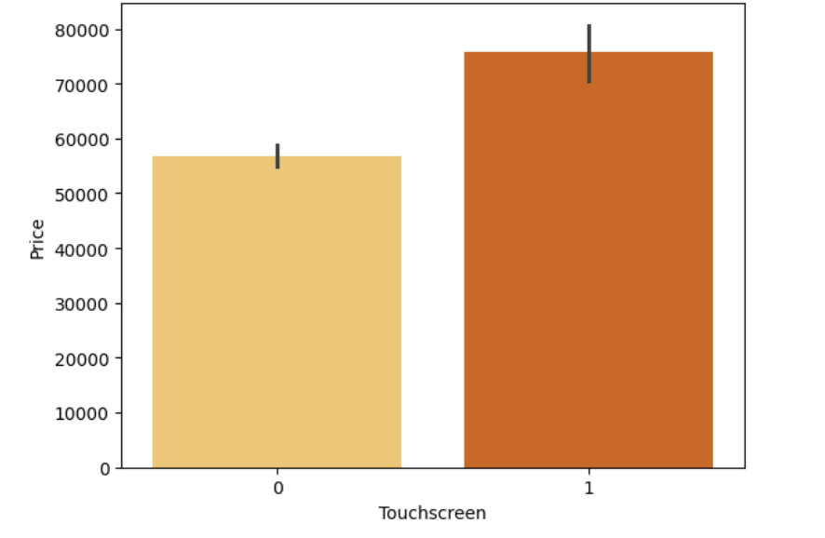
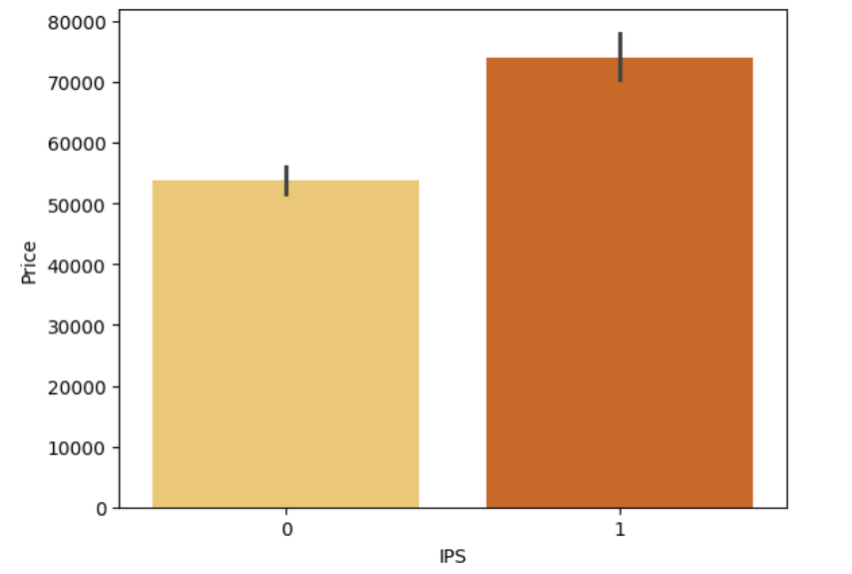

Slide 22
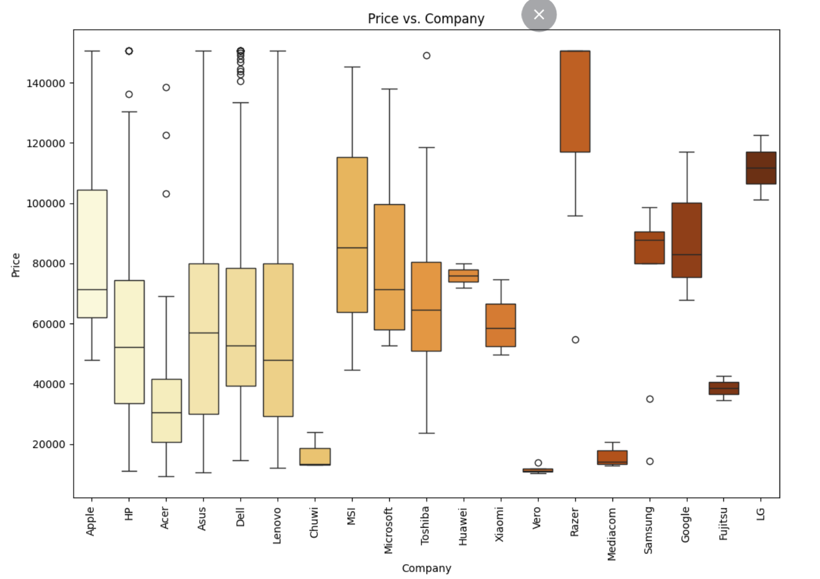

Slide 23
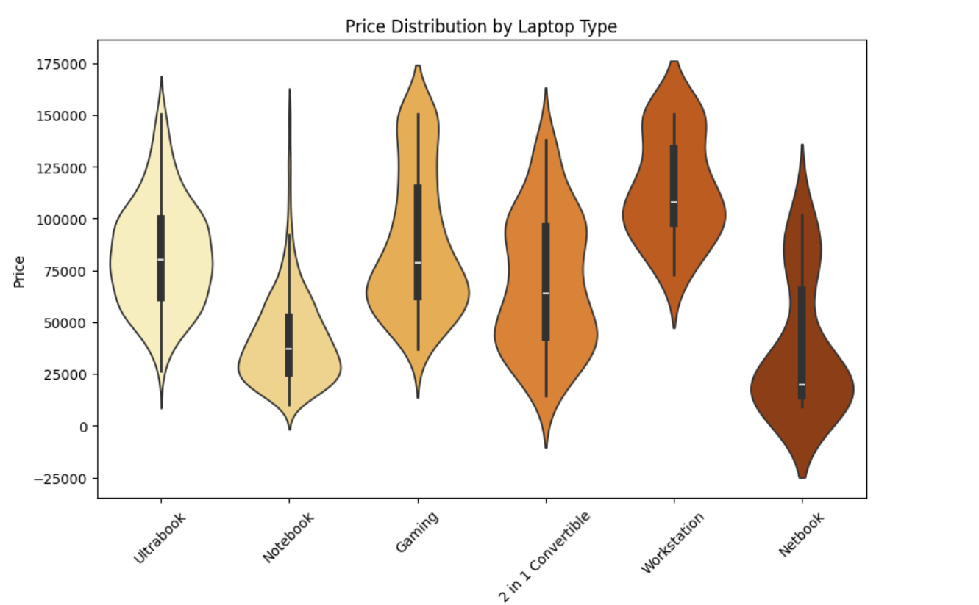

Slide 24
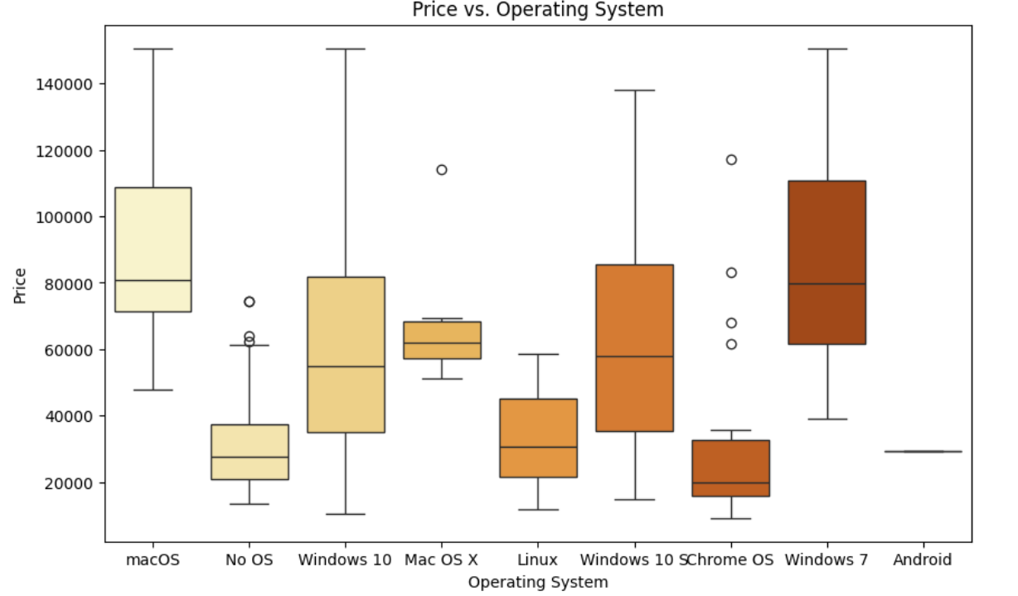

Slide 25
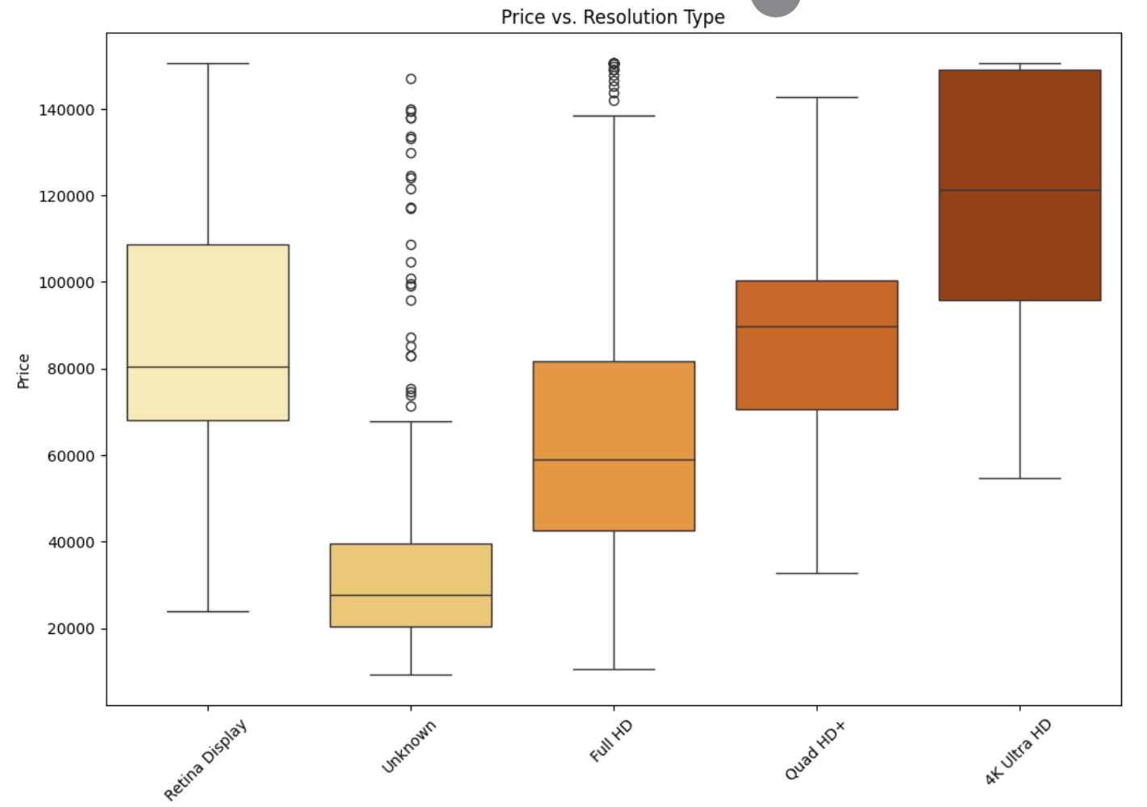

Slide 26
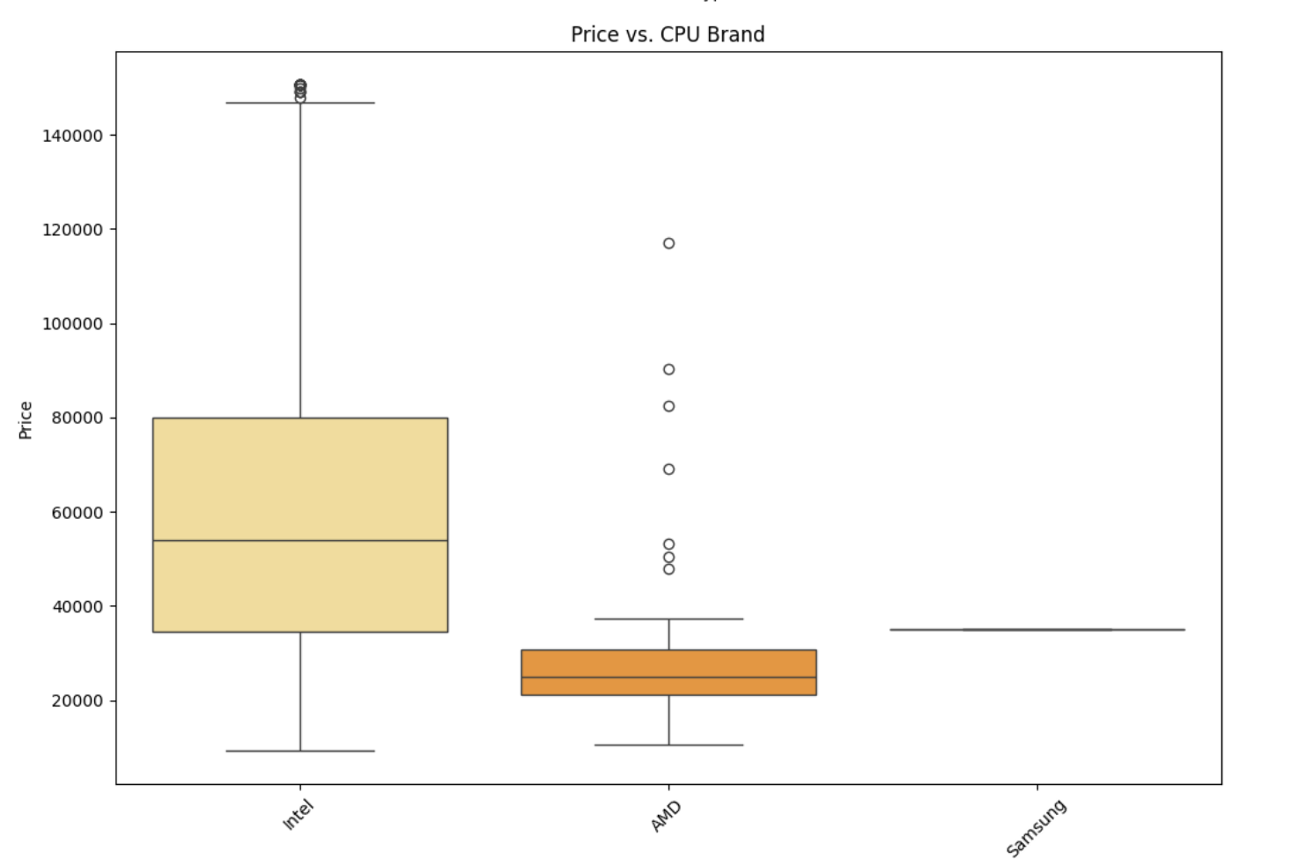
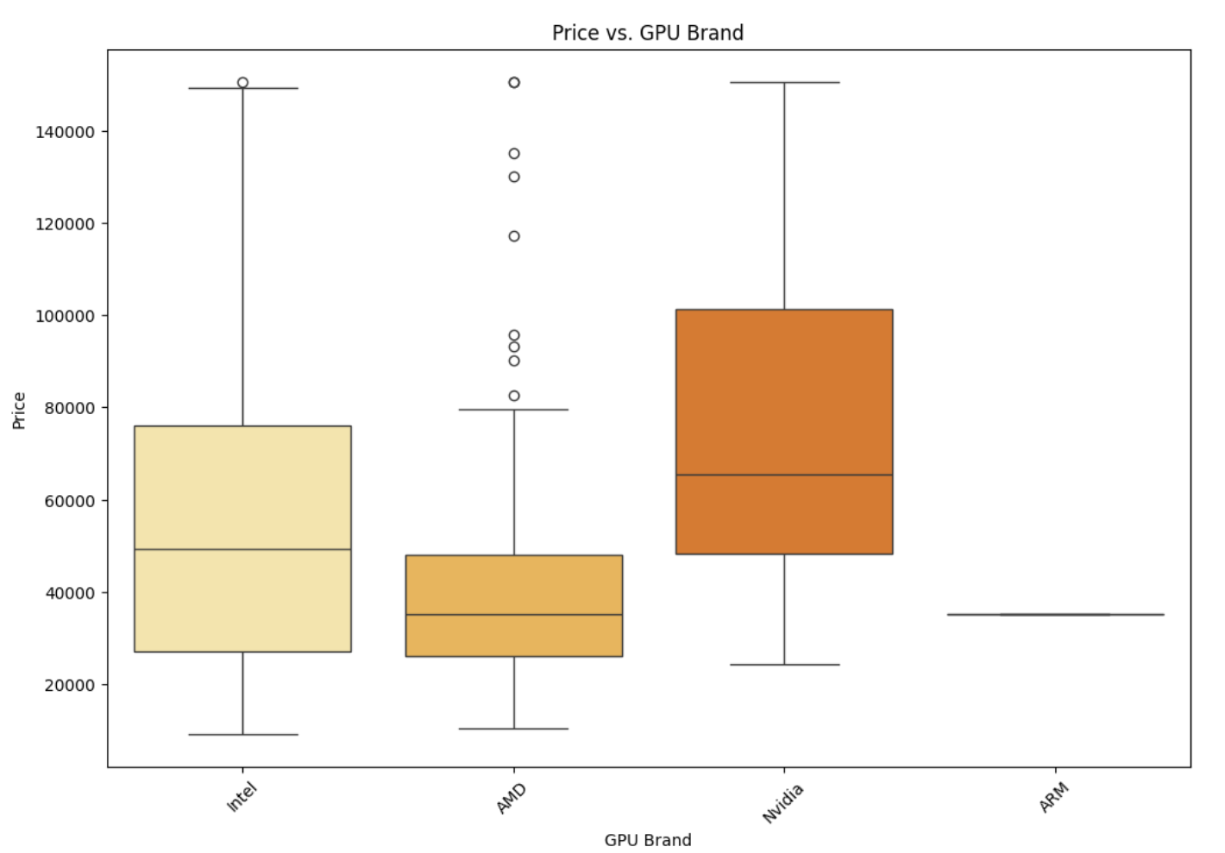

Slide 27
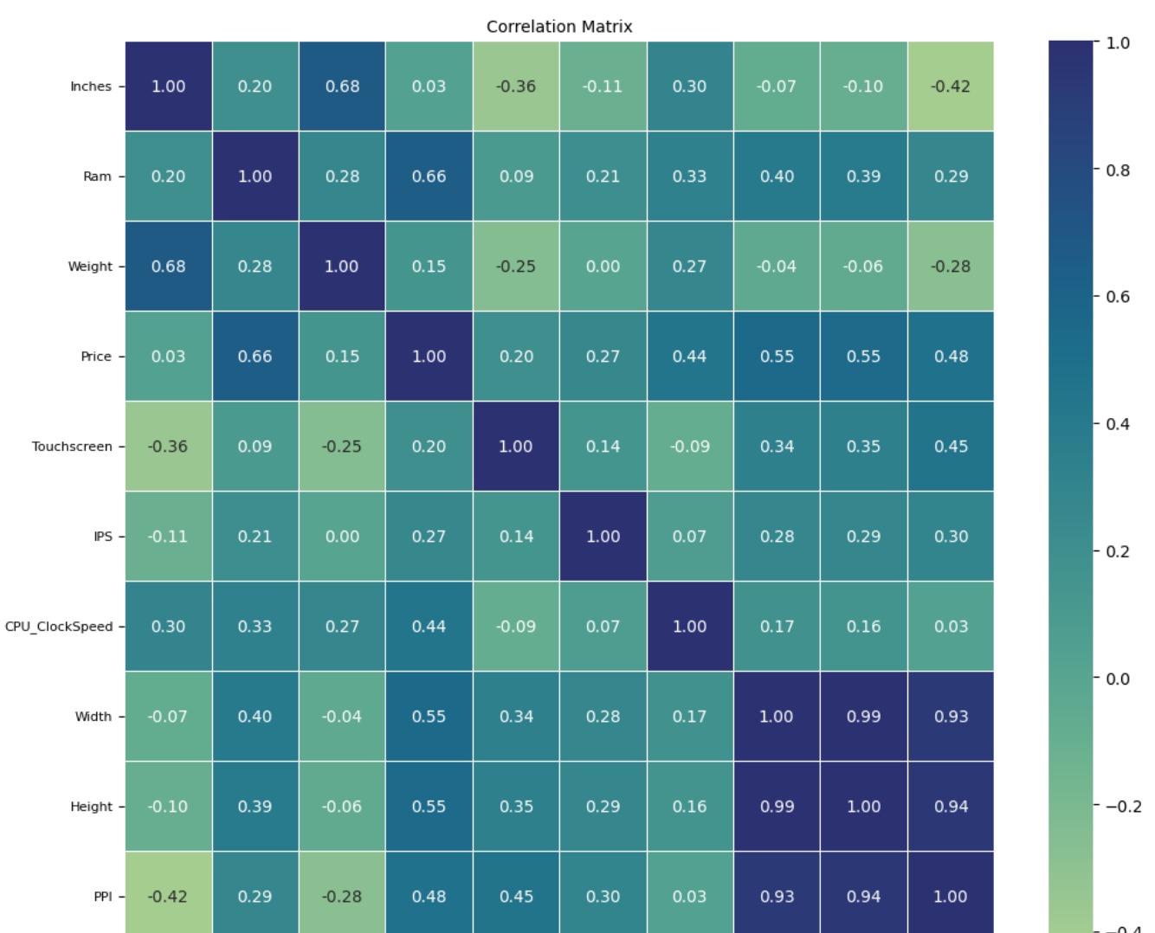

Slide 28
Data Encoding

Slide 29
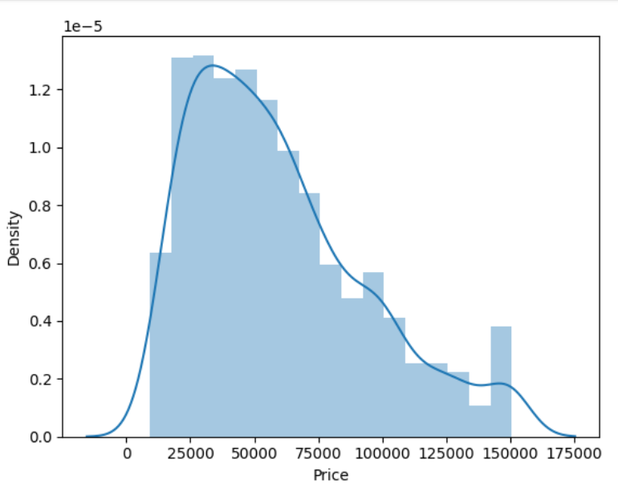
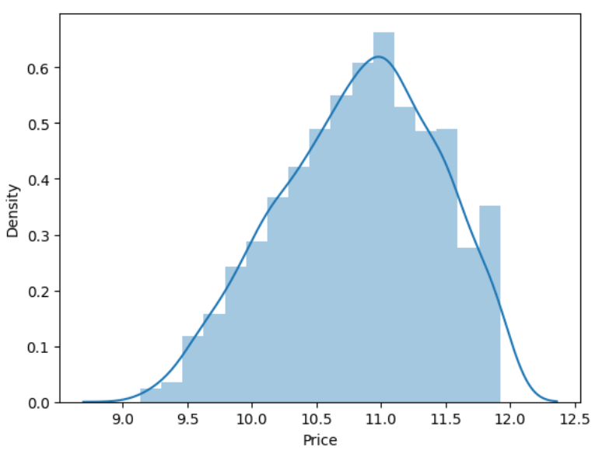
Theoretical framework
Target Variable
Categorical Columns
Nominal
Normalization
Used Log Transformation to fix the right skewed graph
One-Hot Encoder
Data Framework
Ordinal
Ordinal Encoding
Label Encoding
Numerical Columns
Scaling

Slide 30
Before Encoding
After Encoding
After Model Evaluation
Correlation to remove columns
Variance Threshold method to remove more columns 62→35 columns
Feature Importance to check which columns contribute more to Price Pred

Slide 31
Model Development

Slide 32
Regression Models
Linear Regression
Decision Tree
Random Forest
assumes a linear relationship between features and the target variablehighly sensitive to outliers
Effected by High Variance, easy to get overfit
Uses multiple decision tress but computationally expensive and slow
Gradient Boosting
SVR
XGBoost
computationally expensive and memory-intensive, particularly for large datasets
sensitive to noisy data and outliers sensitive to noisy data and outliers
built-in regularization which controls model complexity and prevents overfitting, improving generalization.

Slide 33
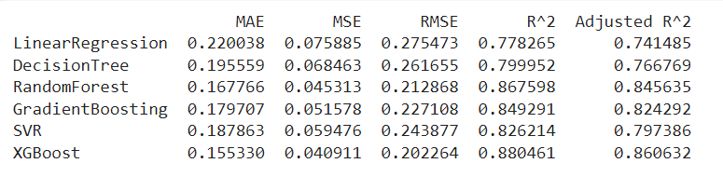
Model Evaluation
XGBOOST is the best model compared to others as it has lower error Metrics and Best Fit to Data about 88.25% of the variance in the target variable

Slide 34
Hyperparameter Tuning

Slide 35
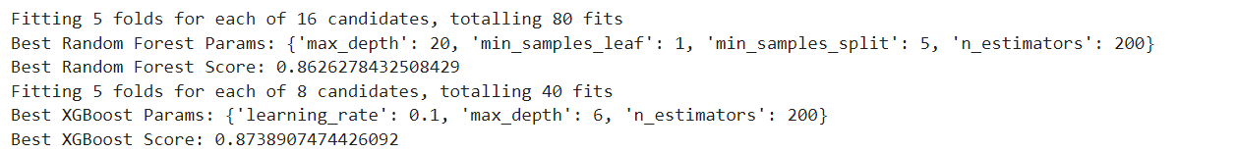
Best parameters for XGBoost and Random Forest after tuning the data using GridSearch

Slide 36
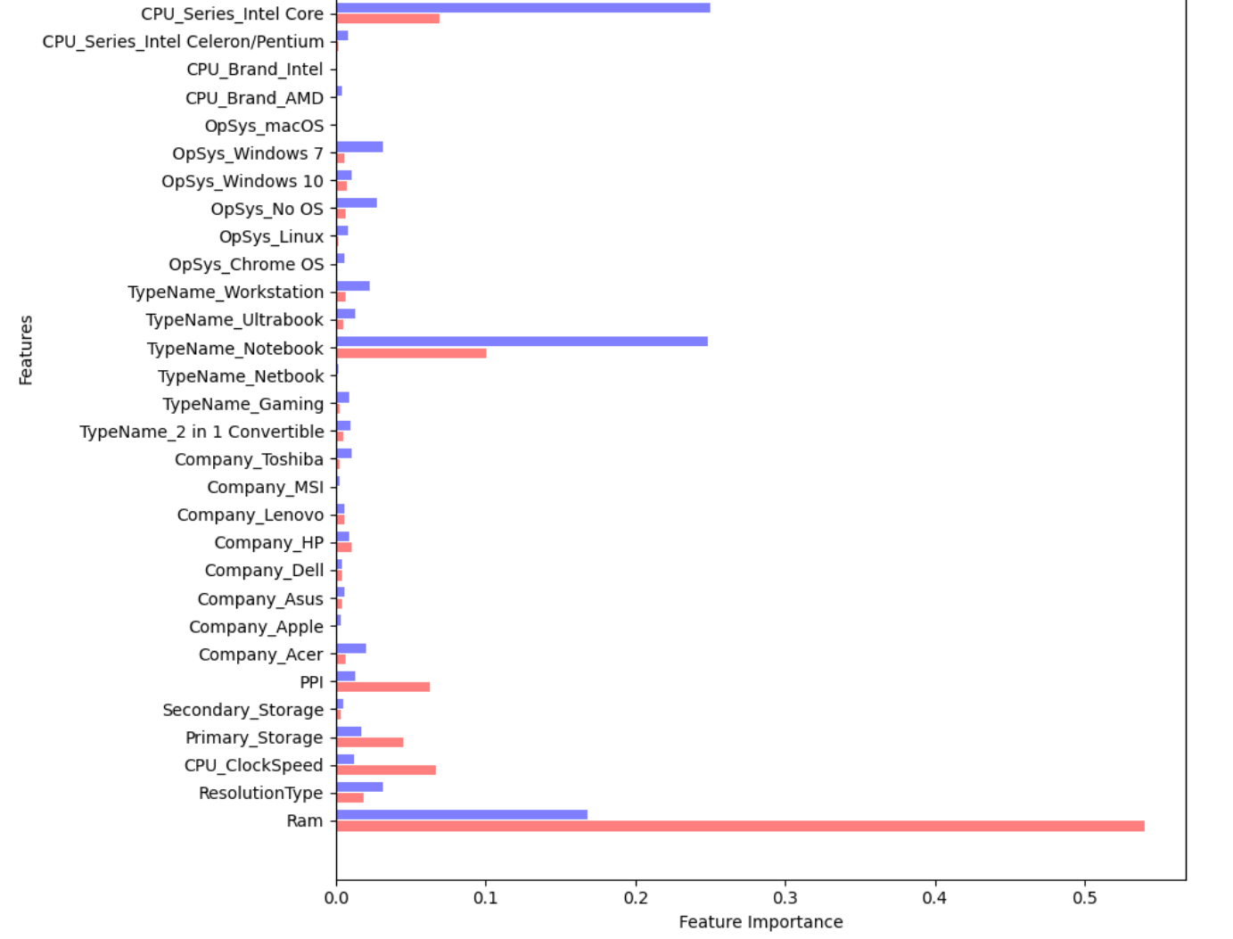
Significant Features
RAM: RAM has the highest feature importance, indicating it is the most significant predictor of laptop prices.
CPU Series (Intel Core): This is also a critical feature, particularly when identifying higher-end processors like Intel Core.
Primary Storage and PPI (Pixels Per Inch): Both features show considerable importance, they play a vital role in determining laptop prices.

Slide 37
Prediction of lesser-known brands
The low feature importance of brand-related features like Company_Toshiba and Company_MSI indicates that the model doesn't rely heavily on the brand to predict prices. However, predicting prices for lesser-known brands may still be difficult if the training data is biased towards popular brands.
Influence of Brand on Laptop price
The brand does seem to have some influence, as seen in the feature importance of different companies (e.g., Company_Apple, Company_Asus). However, compared to other technical specifications like RAM and CPU, the influence of the brand appears less significant.

Slide 38
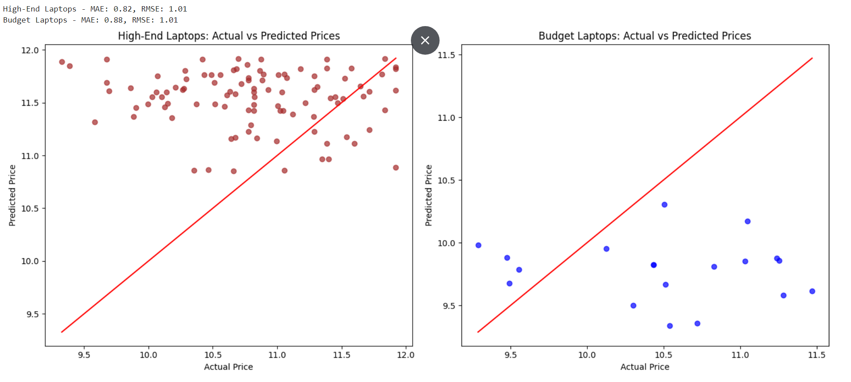

Slide 39
Model Performance on high-end specifications and Budget laptops
High-End Laptops: RAM >= 16GB, SSD storage, Intel Core i7 or higher.
Budget Laptops: RAM <= 4GB, HDD storage, Intel Celeron/Pentium or AMD equivalent.
The scatter plot shows that points for high-end laptops are more spread out from the red line, indicating the model struggles to predict prices accurately in this range. There is a tendency for the model to underestimate the prices of some high-end laptops
The budget laptop predictions show a noticeable spread around the ideal line, indicating prediction errors. They tend to slightly overestimate prices, even though there are fewer data points for budget laptops compared to high-end models.

Slide 40
Limitations
Feature Representation: not all features are equally important, which could lead to underfitting or overfitting if the model doesn't balance these effectively.
Brand Influence: Lesser-known brands are not be well-represented in the training data → poorer predictions
Market Dynamics: no account for recent price changes or market dynamics like demand and supply fluctuations, discounts, or promotions.
Specification Complexity: Laptops of similar specs but different brands or other subtle differences have price variations that are hard to capture.

