Slide 1
CRICKETAI
Daily project progress

Slide 2
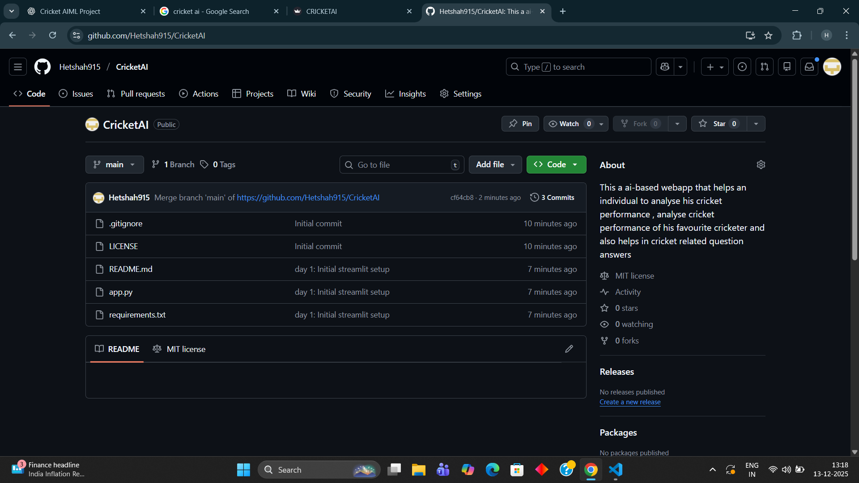
DAY 1
On day 1 : 13-12-2025
We learnt about streamlit and created github repo of cricketai and connect it with our local repo

Slide 3
DAY 2
On day 2 : 14-12-2025
We learnt about some streamlit syntax and built multi-pages website along with sidebar navigation with 4 pages : 1) home 2) ai-based assistant 3) players insights 4) video based analysis
We also understood how streamlit works with user inputs and how output is produced
We understood RULE-BASED-INTELLIGENCE and applied it to build basic chatbot that answers to user queries depending on the code we build

Slide 4
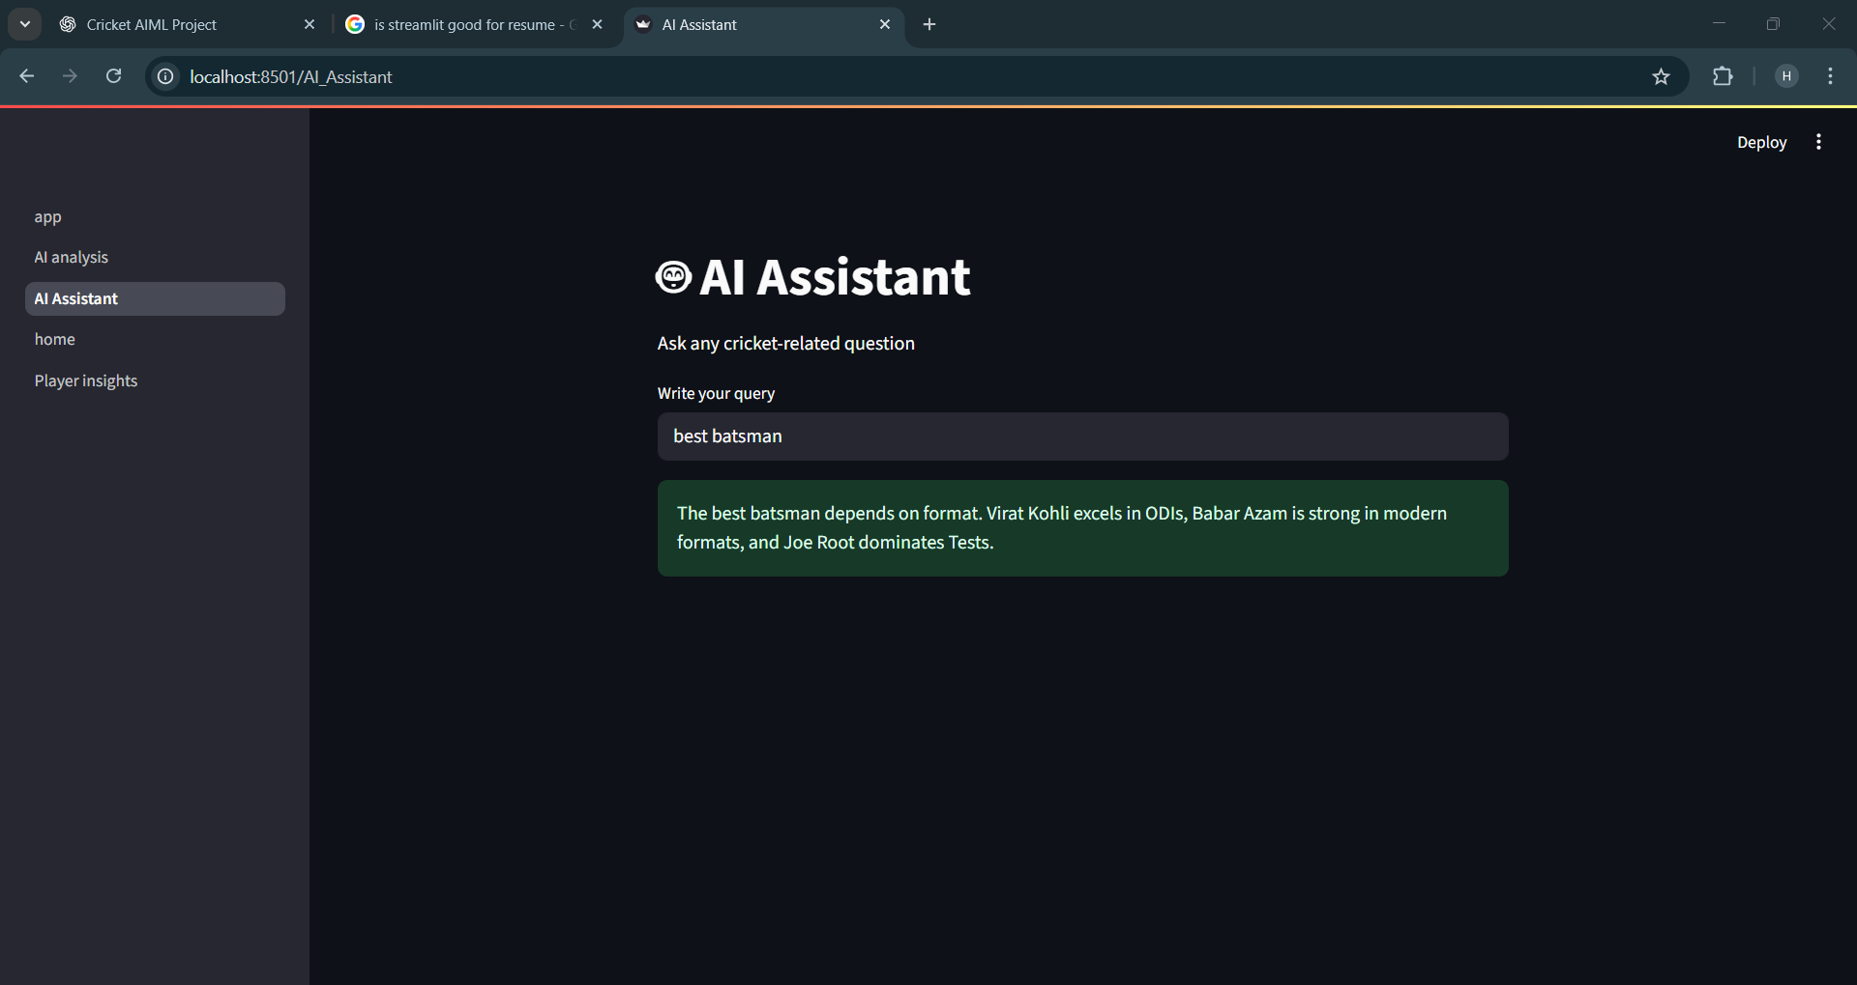
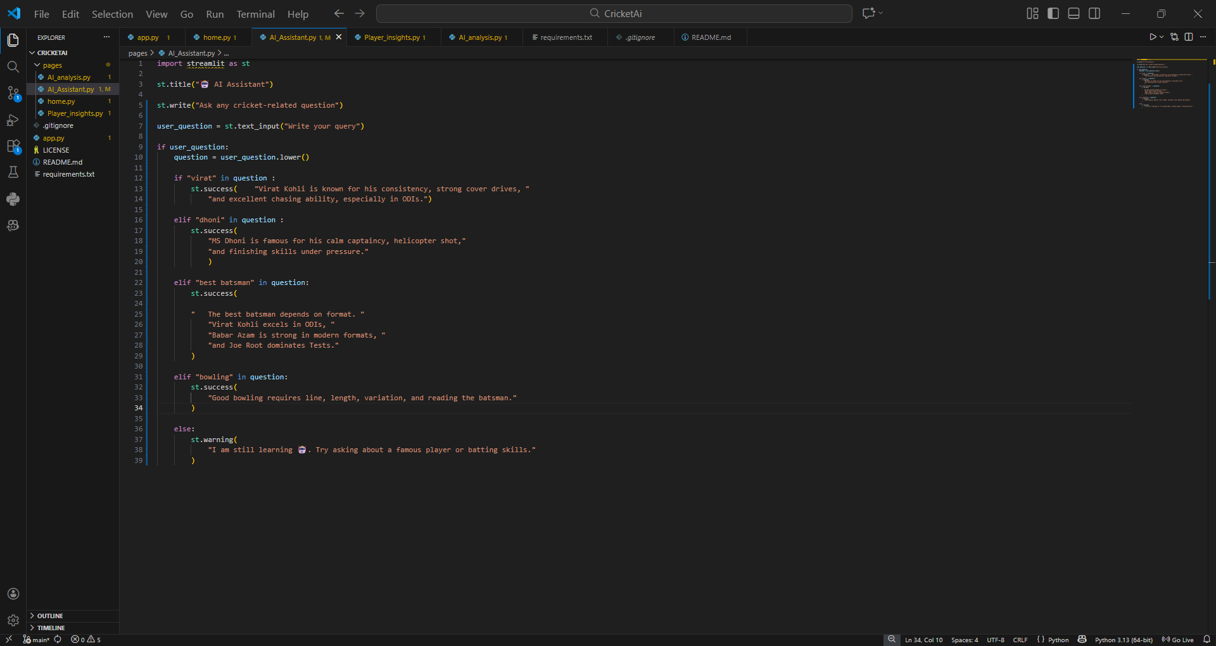
DAY 2 GLIMPSE :

