Slide 1
The Race to Fill the Gaps
Identifying gaps in Amsterdam’s hospitality sector

Slide 2
Introduction
Amsterdam is one of Europe’s most popular tourist destinations
Covid-19 has forced many establishments out of business
Vaccines on the way
Promising future
Rush among entrepreneurs

Slide 3
Data acquisition
Amsterdam-Centrum borough
9 neighbourhoods
Top venues for each neighbourhood retrieved from Foursquare API

Slide 4
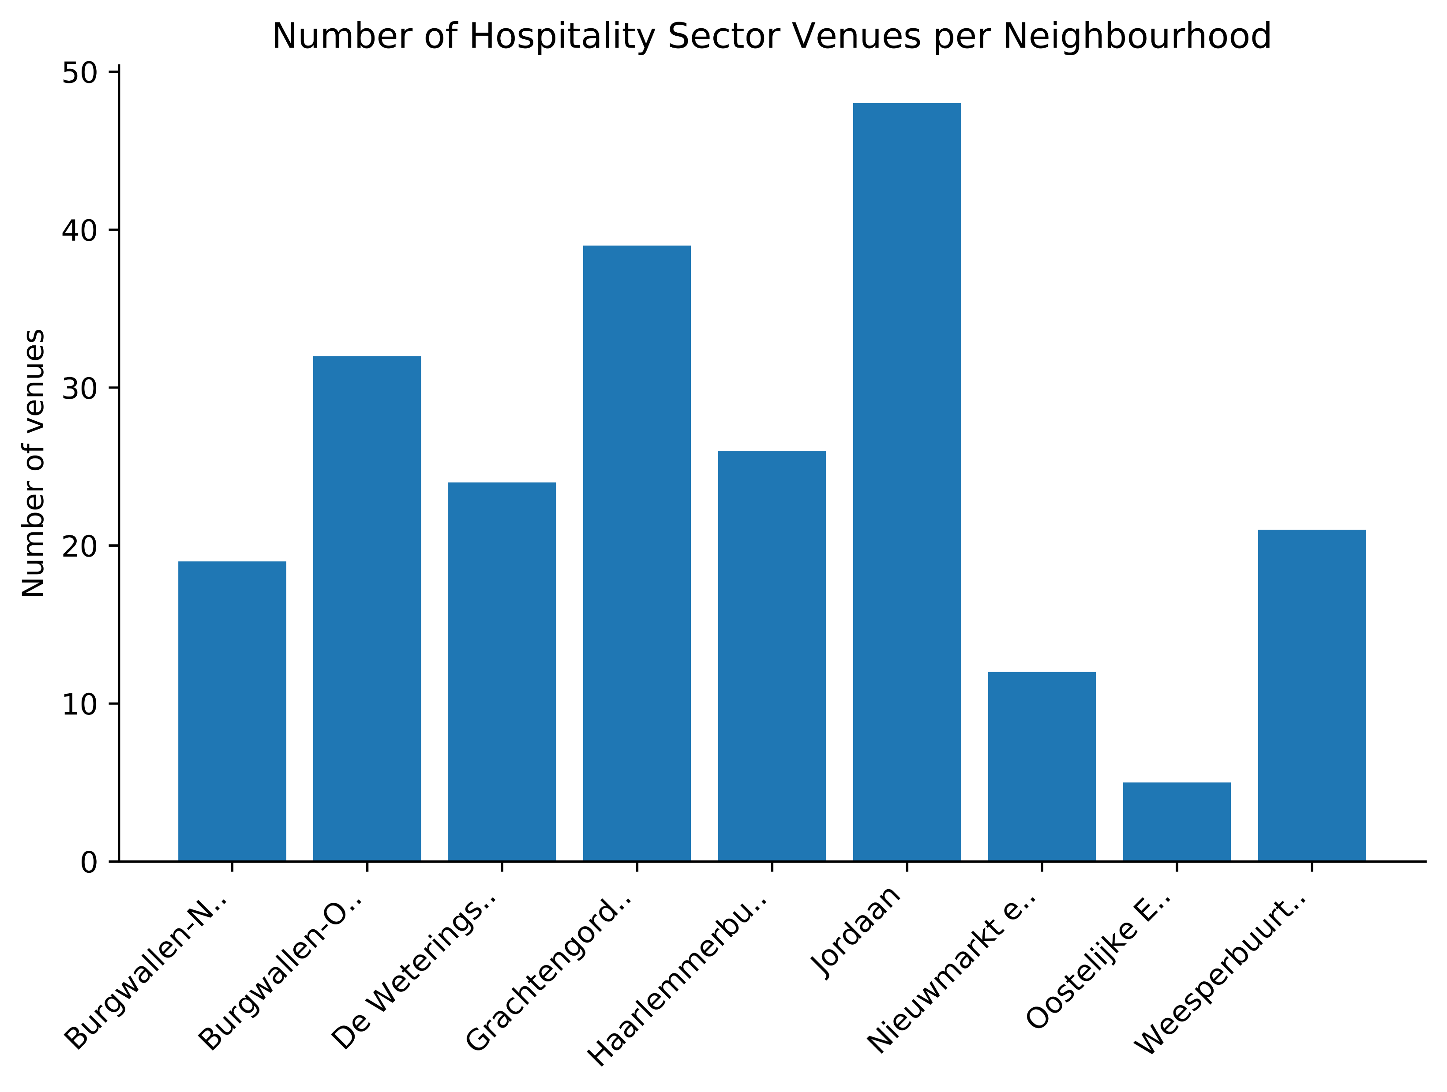
Methodology
Analyse and compare different types of venues present in each neighbourhood

Slide 5
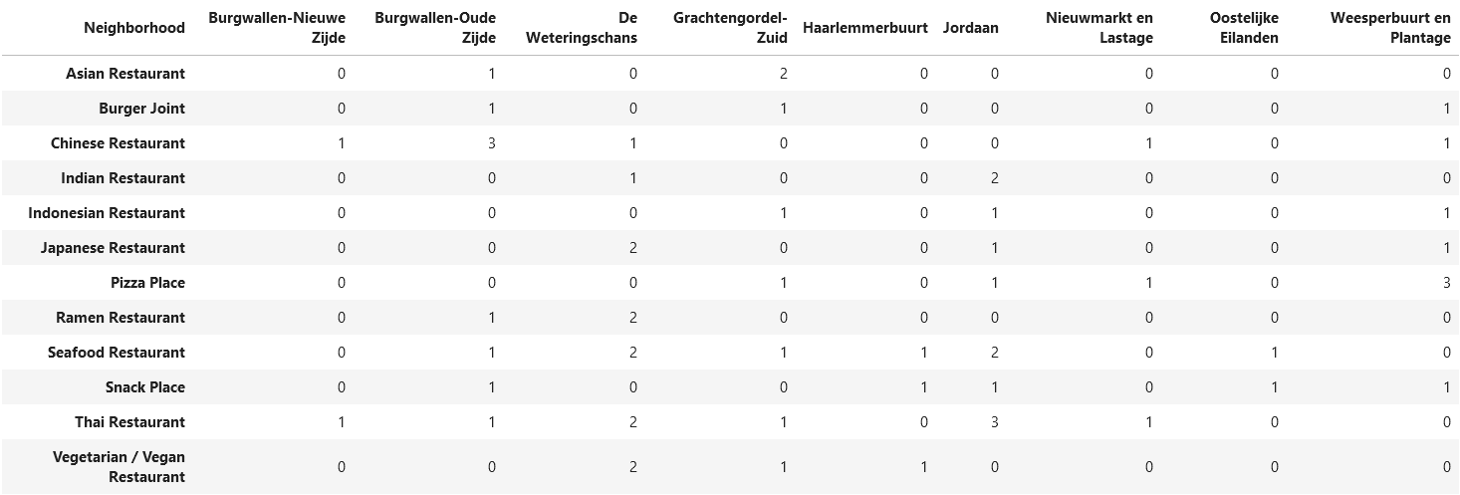
Results

Slide 6
Conclusions
Most popular venues: French, Italian, etc.
Not recommended
Niche restaurants
Not recommended
Recommendations:
Asian type restaurants in Burgwallen-Nieuwe Zijde & Haarlemmerbuurt
Vegetarian / vegan restaurant in Jordaan

