Slide 1


Bus Reservation System
Prepared By:-
Student 1 Name:____________________________
Batch:____________ Branch:__________________
Roll: ________

Slide 2
Project Outline:-
Purpose of the project
ER Diagram
Use case Diagram
Functionalities
Merits & Demerits

Slide 3
PURPOSE:-
The purpose of this Bus Reservation System project is to provide a comprehensivesolution for managing bus bookings efficiently.
It allows users to view available buses, book tickets, and cancel reservations, while also enabling the admin to manage bus details.
The system ensures a smooth, user-friendly experience with secure login mechanisms and integrates payment processing for seamless transactions.
This project highlights the use of SQL for database management and Java for application development, focusing on real-world applications in the transportation sector.

Slide 4
ER DIAGRAM
User_id
bus_name
bus_seats
User name
user
reserve
bus
User password
bus_id
bus_path

Slide 5
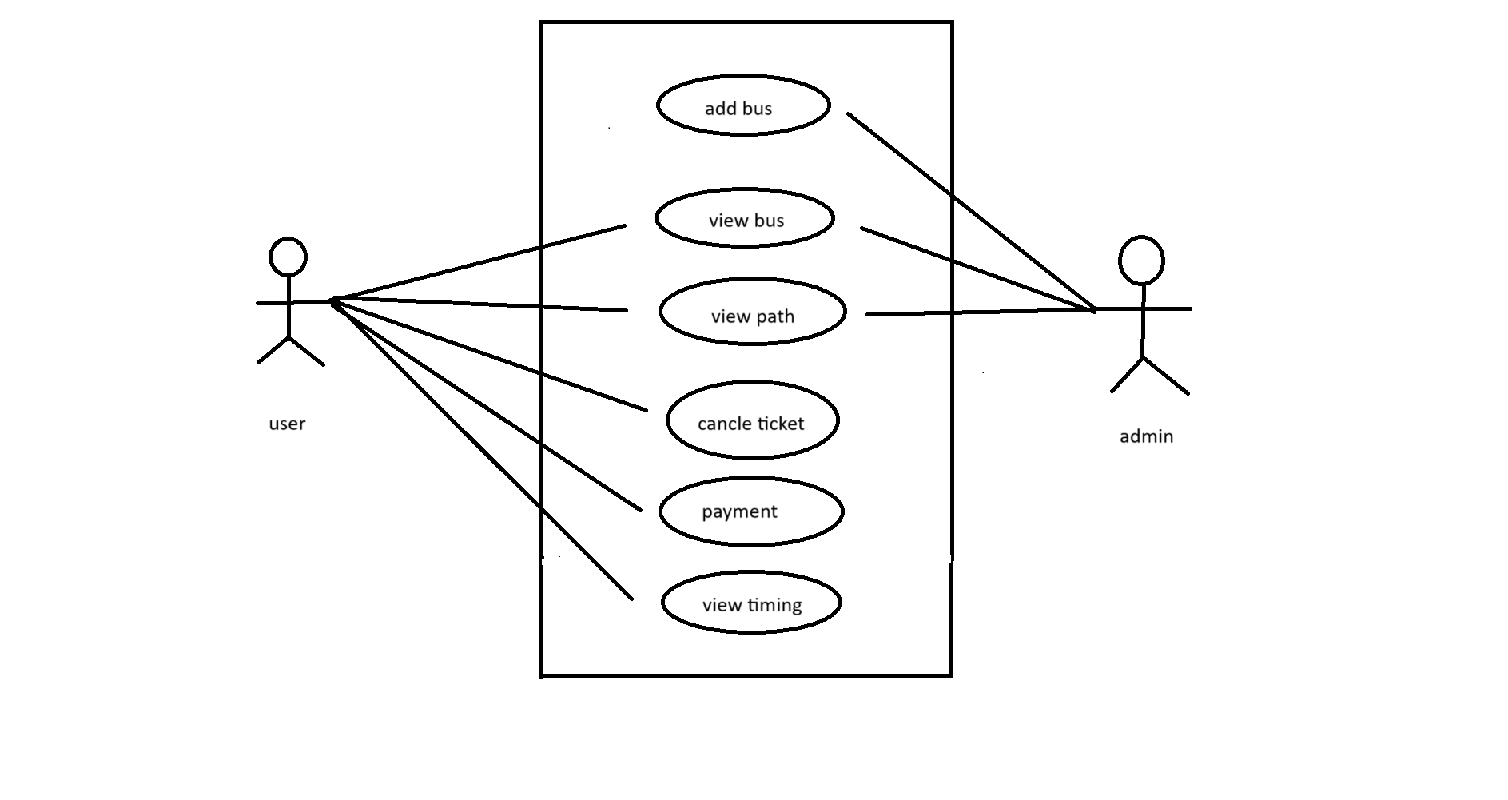
USE – CASE DIAGRAM

Slide 6
Functionalities of project Related with Particular Subject
DS | JAVA2 | DBMS
LinkedList: Data | JDBC: Database connection | SQL Queries: Data manipulation
Stack: LIFO operations | Prepared Statement: Query execution | Tables: Data storage
Queue: FIFO processing | Scanner: User input | Indexes: Efficient searching
Binary SearchTree: Fast search | Exceptions: Error handling | Constraints: Data integrity

Slide 7
MERITS - DEMERITS
merits
The system's modular design allows for easy scalability and customization, making it adaptable to different bus operators' needs and potential future enhancements.
It provides secure login and payment processing, enhancing the reliability and trustworthiness of the platform.
The integration of real-time seat availability checks ensures that users receive accurate and up-to-date information when making reservations, reducing the chances of booking conflicts.

Slide 8
MERITS - DEMERITS
Demerits
The system requires internet connectivity and a properly configured database, which may be a limitation in low-resource environments.
As the system grows, performance issues might arise due to the reliance on basic SQL operations without optimization for large-scale data handling.

Slide 9
THANK YOU….

