Slide 1
Presentation
How does the revenue of airline and air freight and logistics companies compare over time?
Below is the feed back for the analysis conducted

Slide 2
Summary statistics for airlines
The data shows the revenue acquired.AAL had a good revenue growth for 3years and by the 4th a drop in revenue. In there first year they made $24,855,000,000 ,in the second year $26,743,000,000, the third year $42,650,000,000, and the fourth year $40,990,000,000, making the 3rd year there best year. ALK on the other hand maintained a stable revenue growth in the first year making the sum of $4,657,000,000 , the second year$5,156,000,000, the third year $5,368,000,000 and the fourth year $5,368,000,000. alk made a steady growth with there best year being the fourth year.DAL had a stable growth until its 4th year. In the first year they made $37,773,000,000 , second year $40,362,000,000, third year $40,704,000,000,and fourth year $39,639,000,000.they had there worst year in the fourth year. LUV maintend a good revenue for all 4 years .In the first year LUV made $17,699,000,00, in the seconnd $18,605,000,000, in the third $19,820,000,000, and the fourth $20,425,000,000 . UAL had a good growth start until its 4th year were the revenue reduced. In the first year they made$37,152,000,000, the second $38,279,000,000, the third $38,901,000,000 and the fourth $37,864,000,000. LUV and ALK maintain a good growth rate with LUV making the higher revenue of the two companies . Below is the box and whisker chart for description
TICKER SYMBOL | YEAR 1 | YEAR 2 | YEAR3 3 | YEAR 4
AAL | $24,855,000,000 | $26,743,000,000 | $42,650,000,000 | $40,990,000,000
ALK | $4,657,000,000 | $5,156,000,000 | $5,368,000,000 | $5,598,000,000
DAL | $37,773,000,000 | $40,362,000,000 | $40,704,000,000 | $39,639,000,000
LUV | $17,699,000,000 | $18,605,000,000 | $19,820,000,000 | $20,425,000,000
UAL | $37,152,000,000 | $38,279,000,000 | $38,901,000,000 | $37,864,000,000
GRAND TOTAL | $122,136,000,000 | $129,145,000,000 | $147,443,000,000 | $144,516,000,000

Slide 3
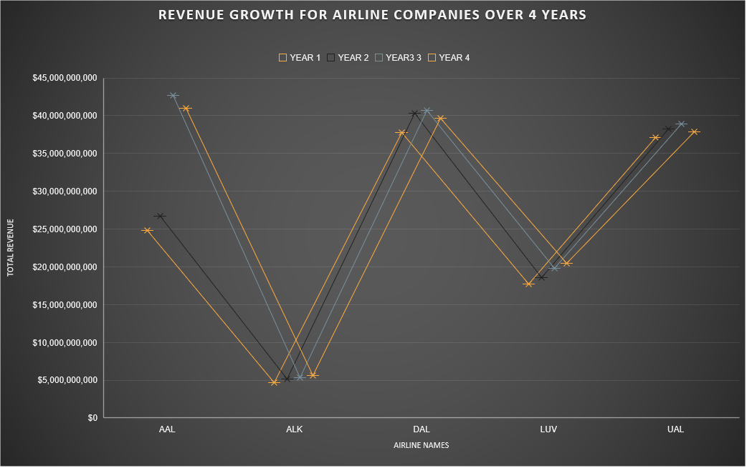

Slide 4
Summary statistics
The data shows the mean , median, range and standard deviation of all four years for each company in the airline industry. According to the mean DAL has the highest mean for all four years with $39,619,500,000, followed by UAL at $38,049,000,000 AAL at $31,416,000,000, LUV at $19,137,250,000 and ALK as the lowest $5,194,750,000.
The median data shows that DAL highest median for all four years with $40,000,500,000, followed by UAL at $38,071,500,000 AAL at $33,866,500,000 , LUV at $19,212,500,000 and ALK as the lowest $5,262,000,000. The data shows the range for all companies. According to the standard deviation AAL has the highest $9,306,494,381.17 for all four years with followed by DAL at $1,308,611,095.78 , LUV at $1,221,515,554.55 , UAL at $ 734,311,014.94 and ALK as the lowest $401,373,786.72 .
 |  | SUMMARY STATISTICS
 | MEAN | MEDIAN | RANGE | STANDARD DEVIATION
AAL | $31,416,000,000 | $33,866,500,000 | $16,135,000,000 | $ 9,306,494,381.17
ALK | $5,194,750,000 | $5,262,000,000 | $941,000,000 | $ 401,373,786.72
DAL | $39,619,500,000 | $40,000,500,000 | $2,931,000,000 | $ 1,308,611,095.78
LUV | $19,137,250,000 | $19,212,500,000 | $2,726,000,000 | $ 1,221,515,554.55
UAL | $38,049,000,000 | $38,071,500,000 | $1,749,000,000 | $ 734,311,014.94

Slide 5
The descriptive data

Slide 6
Summary statistics for Air Freight & Logistics
The data shows the revenue for air freight and logistics over the years CHRW maintained a slow revenue growth having $11,359,113,000 as its first years revenue,$12,752,076,000 for its second year $13,470,067,000 for its third and $13,476,084,000 for its fourth . EXPD maintained a slow revenue growth rate with its first year being $5,992,215,000, its second $6,080,257,000 third $6,564,721,000 and its fourth $6,616,632,000 . FDX can be consider to have a had a good growth rate with its first year as $44,287,000,000 its second year as $45,567,000,000 its third year as $47,453,000,000 and its fourth year as $50,365,000,000
UPS maintained a good revenue growth with its first year as $54,127,000,000 , its second year as $55,438,000,000,its third year as $58,232,000,000 and its fourth year as $58,363,000,000 . They all had there best year as the fourth year
 | Revenue year 1 | Revenue year2 | Revenue year3 | Revenue 4
CHRW | $11,359,113,000 | $12,752,076,000 | $13,470,067,000 | $13,476,084,000
EXPD | $5,992,215,000 | $6,080,257,000 | $6,564,721,000 | $6,616,632,000
FDX | $44,287,000,000 | $45,567,000,000 | $47,453,000,000 | $50,365,000,000
UPS | $54,127,000,000 | $55,438,000,000 | $58,232,000,000 | $58,363,000,000

Slide 8
Summary statistics
The data shows the mean , median and standard deviation of all four years for each company in the air freight and logistics industry. According to the mean UPS has the highest mean for all four years with $56,540,000,000 followed by FDX at $46,918,000,000 CHRW at $12,764,335,000
and EXPD as the lowest $6,313,456,250 .
The median data shows that UPS highest median for all four years with $56,835,000,000
followed by FDX at $46,510,000,000
CHRW at $13,111,071,500,
and EXPD as the lowest $6,322,489,000. According to the standard deviation FDX has the highest for all four years with $2,640,416,381.31
followed by UPS at $2,099,457,548.99, CHRW at $996,568,018.62 and EXPD as the lowest $322,814,36.4.04
.
 | Mean | median | standard deviation
CHRW | $12,764,335,000 | $13,111,071,500 | $996,568,018.62
EXPD | $6,313,456,250 | $6,322,489,000 | $322,814,364.04
FDX | $46,918,000,000 | $46,510,000,000 | $2,640,416,381.31
UPS | $56,540,000,000 | $56,835,000,000 | $2,099,457,548.99

Slide 9
DESCRIPTIVE DATA for air freight and logistics mean data, median and standard deviation

Slide 10
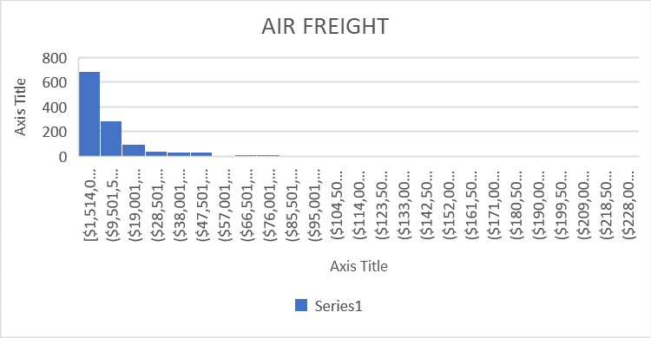
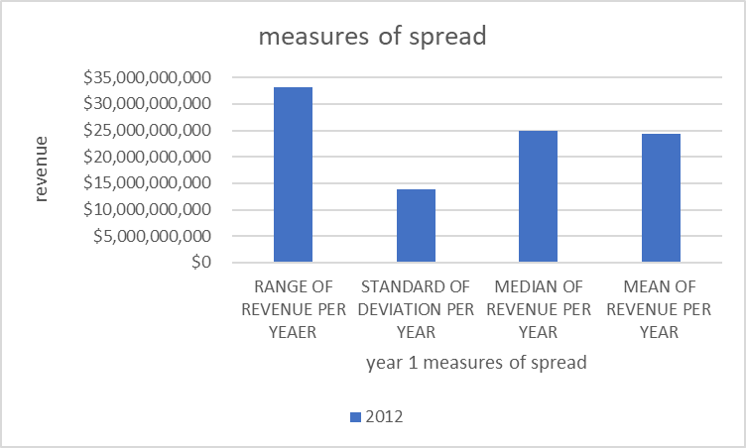
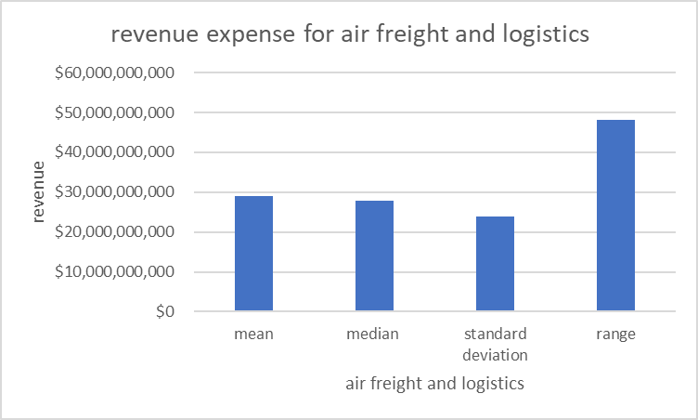
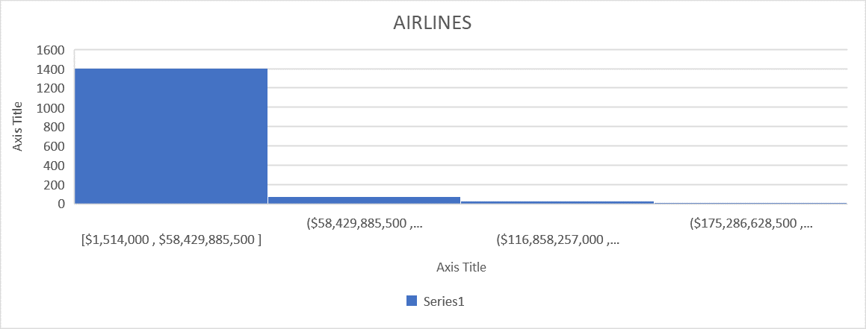
How does the revenue of airline and air freight and logistics companies compare in the 1st year?
Data shows the first year of each of both the airline and air freights sector. The histogram data shows that the data is right skewed that mean it is positively skewed that means the mean is greater than the median . The mean for air freight and logistics is $28,941,332,000 and the mean of Airlines $24,427,200,000 the mean for air freights and logistics is higher than airlines. The median for the air freight and logistic is $27,823,056,500 and that of Airlines $24,855,000,000. The standard deviation for air freight and logistics $23,843,963,561.85 and that of airlines as $13,931,469,850.67, that means the variability in the revenue for air freight and logistics and Airlines is higher. That directly says that the revenue for air freights is higher than air lines in the first year .

Slide 11
Conclusion
The data shows that air freights and logistics sector made more profit in the first year more than airline companies .

