Slide 1
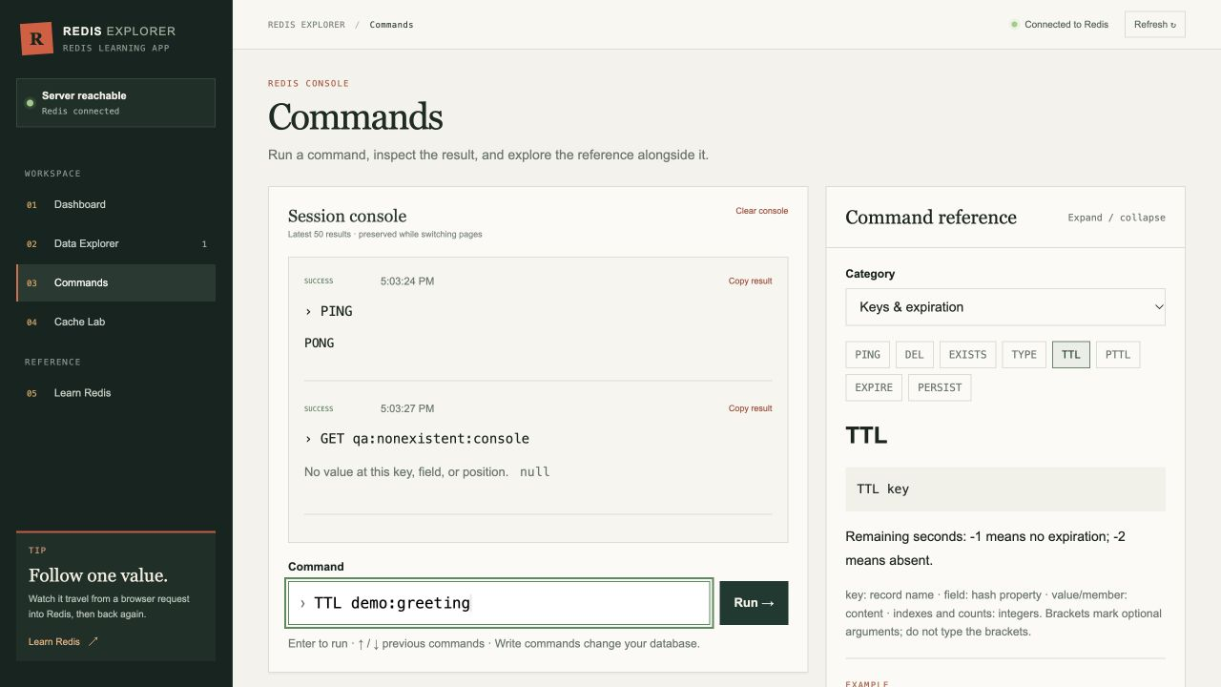
NOSQL DATABASE PROJECT
RedisExplorer
Learning Redis by seeing keys, commands, and cache behavior
[Name 1], [Name 2], [Name 3]
15-minute class presentation
01
Notes:
PRESENTER: Speaker 1
TARGET TIME: 0:30
TALK TRACK
Open with one sentence: RedisExplorer is a teaching app that lets students manipulate a real Redis database instead of only reading command definitions.
Introduce the three presenters and preview the order: Redis concepts, our implementation and demo, then caching and production tradeoffs.
SOURCES
https://github.com/Hetul803/RedisExplorer

Slide 2
1 REDIS BASICS
Where Redis fits in NoSQL
NoSQL databases organize data without requiring the relational table model. Redis focuses on direct key access and typed values.
Relational model
Redis model
Rows live inside tables
A schema defines columns and relationships
Joins combine related records
Every value has a unique key
The value has a data type
Commands act directly on that type
Best when relationships and complex queries lead the design
Best when fast access patterns and short-lived data lead the design
Redis often complements a relational database. It can also act as the primary store when its access model fits the application.
SPEAKER 1 1:10
02
Notes:
PRESENTER: Speaker 1
TARGET TIME: 1:10
TALK TRACK
Explain that NoSQL is a family, not one storage model. Document, wide-column, graph and key-value systems solve different problems.
Redis is commonly introduced as a key-value store, but data structure server is more accurate because the value type changes which commands are available.
Avoid saying Redis replaces SQL. The right question is whether the application's access patterns need joins and constraints or direct operations on known keys.
SOURCES
https://redis.io/docs/latest/develop/data-types/
https://redis.io/tutorials/what-is-redis/

Slide 3
1 REDIS BASICS
The Redis mental model
A command names a key, applies an operation allowed by the value type, and returns a response.
REDIS
CLIENT
student:42
RESPONSE
HGETALL student:42
hash
{ name: Ada,
major: CS }
name Ada
major CS
RAM holds the working dataset
Commands execute sequentially on the main event loop
RDB and AOF can persist data to disk
SPEAKER 1 1:15
03
Notes:
PRESENTER: Speaker 1
TARGET TIME: 1:15
TALK TRACK
Walk left to right. The client sends a command. Redis looks up the key, checks the type, runs the operation and returns a reply.
A single Redis command is atomic because command execution is sequential. Network I/O can use other threads, but the main command execution model remains sequential.
In-memory does not mean temporary by definition. Redis can write snapshots or an append-only log to disk.
SOURCES
https://redis.io/tutorials/what-is-redis/
https://redis.io/docs/latest/operate/oss_and_stack/management/persistence/

Slide 4
1 REDIS BASICS
Four Redis types implemented in our app
Redis supports more data types. We focused the learning experience on the four most approachable structures.
S
L
∪
H
String
List
Set
Hash
Text, counters, cached JSON
Ordered queues and timelines
Unique tags and membership
Editable field-value records
SET visits 41
RPUSH queue job1
SADD tags redis
HSET user:42 name Ada
Handoff: our implementation turns these commands into a visual learning workflow.
SPEAKER 1 1:50
04
Notes:
PRESENTER: Speaker 1
TARGET TIME: 1:50
TALK TRACK
Give one concrete use for each type. Spend the most time on the distinction between list ordering, set uniqueness and hash fields.
Explain that the type lives at the key. A string command on a list key causes a wrong-type error rather than converting the data.
Mention that Redis also provides sorted sets, streams, geospatial indexes, probabilistic structures, JSON, time series and vector sets.
End with the handoff to Speaker 2.
SOURCES
https://redis.io/docs/latest/develop/data-types/
https://github.com/Hetul803/RedisExplorer/blob/dev/README.md

Slide 5
2 OUR PROJECT
RedisExplorer architecture
The interface never connects to Redis directly. The API validates requests and owns the shared Redis connection.
BROWSER
HTTP API
DATABASE
React + Vite
Express
Redis 7
JSON request
Redis command
Pages, forms and shared state
Input validation
Command allowlist
JSON responses
Docker volume and append-only persistence
Local development
Vite proxies /api to Express. Docker Compose starts Redis and waits for its health check.
SPEAKER 2 1:20
05
Notes:
PRESENTER: Speaker 2
TARGET TIME: 1:20
TALK TRACK
Explain the separation of concerns. React owns interaction, Express owns security and validation, and Redis owns data.
The backend opens one shared Redis client. Feature routes call service functions for keys, commands, caching and metrics.
The Docker configuration uses redis:7-alpine, enables append-only persistence and stores data in a named volume.
SOURCES
https://github.com/Hetul803/RedisExplorer/blob/dev/README.md
https://github.com/Hetul803/RedisExplorer/blob/dev/backend/src/redis.js
https://github.com/Hetul803/RedisExplorer/blob/dev/docker-compose.yml

Slide 6
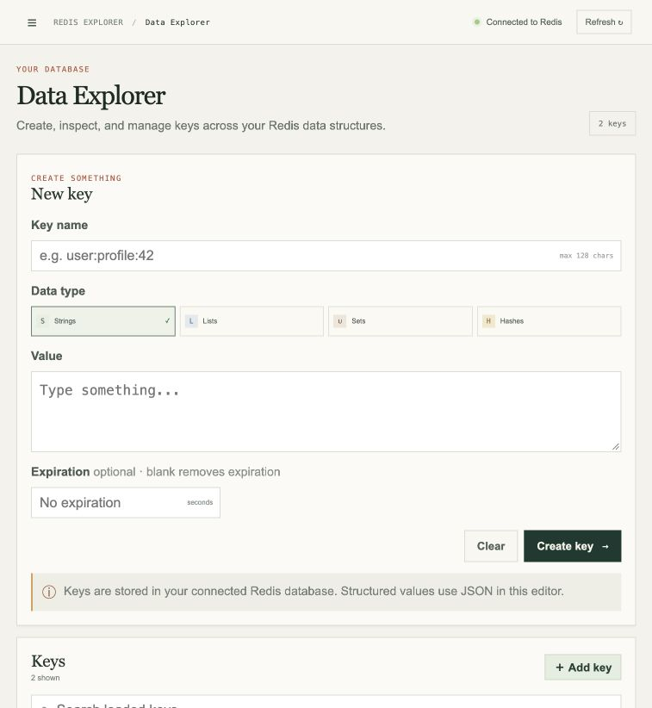
2 OUR PROJECT
Data Explorer
The visual editor exposes Redis structure without hiding the key, type, value or TTL.
1
Choose a key and type
String, list, set or hash
2
Enter a type-aware value
Arrays for lists and sets, fields for hashes
3
Add optional expiration
The backend applies EXPIRE after writing
Production-friendly detail
Key listing uses cursor-based SCAN instead of KEYS.
SPEAKER 2 1:00
06
Notes:
PRESENTER: Speaker 2
TARGET TIME: 1:00
TALK TRACK
Point out that the UI always keeps the key visible. This reinforces the Redis mental model.
The backend validates key names, value shapes and TTL ranges before sending commands.
Mention SCAN because KEYS can block on a large database. SCAN spreads the work across cursor calls and may return duplicates, so clients must treat iteration carefully.
SOURCES
https://github.com/Hetul803/RedisExplorer/blob/dev/backend/src/services/keys.js
https://redis.io/docs/latest/commands/scan/

Slide 7
2 OUR PROJECT
Command console and live demo
The console makes each request and response visible. The backend exposes a teaching allowlist and blocks administrative commands.
LIVE DEMO
> PING
> SET class:topic Redis EX 60
> GET class:topic
> TTL class:topic
> HSET class:student name Ada
> HGETALL class:student
Watch the reply after every command.
SPEAKER 2 2:40
07
Notes:
PRESENTER: Speaker 2
TARGET TIME: 2:40
TALK TRACK
Demo the commands in order. After SET, explain that EX attaches a 60-second lifetime. TTL should count down.
HSET and HGETALL show that a hash updates one field without replacing the entire record.
If the live site is unavailable, read the commands and point to the captured console screenshot. The deck still demonstrates the expected replies.
The backend parses quoted arguments and enforces an allowlist. It intentionally excludes administrative and scripting commands.
End with the handoff to Speaker 3: the most important applied lesson is caching and expiration.
SOURCES
https://github.com/Hetul803/RedisExplorer/blob/dev/backend/src/services/commands.js
https://github.com/Hetul803/RedisExplorer/blob/dev/frontend/src/constants/commandReference.js

Slide 8
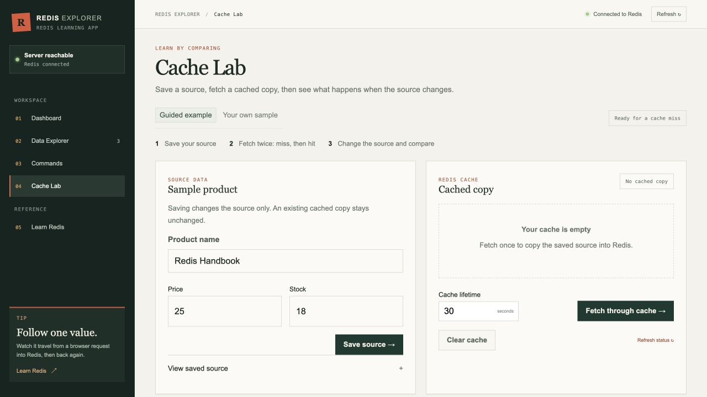
3 APPLIED REDIS
Cache-aside behavior in Cache Lab
A cache stores a copy. That copy can be fast and still be stale.
1
Check the cache key
GET returns null on a miss
2
Read the source
The slower path runs only after a miss
3
Store a copy with TTL
SET ... EX seconds limits its lifetime
4
Return hits immediately
Later requests reuse the cached copy
Source updates do not refresh the copy. Invalidate it or wait for TTL.
SPEAKER 3 1:35
08
Notes:
PRESENTER: Speaker 3
TARGET TIME: 1:35
TALK TRACK
Define cache-aside: the application checks Redis first, falls back to the source after a miss, then stores the result with a TTL.
A hit avoids the simulated source delay. A miss pays the source cost and repopulates the cache.
Changing the source does not automatically change the cached copy. That is the stale-data problem. Applications choose an invalidation strategy or accept bounded staleness through TTL.
SOURCES
https://github.com/Hetul803/RedisExplorer/blob/dev/backend/src/services/cache.js
https://github.com/Hetul803/RedisExplorer/blob/dev/README.md
https://redis.io/docs/latest/develop/using-commands/keyspace/

Slide 9
3 APPLIED REDIS
Why Redis feels fast
Redis reduces storage work and coordination overhead, but network round trips and expensive commands still matter.
1
2
3
In-memory working data
Sequential command execution
Fewer network waits
Reads and writes avoid a disk seek on the command path.
The main event loop avoids locks between ordinary commands.
Pipelining batches commands so one round trip carries more work.
Performance rule
Choose commands by complexity. Large collections, big keys and O(N) operations can block the event loop.
SPEAKER 3 1:15
09
Notes:
PRESENTER: Speaker 3
TARGET TIME: 1:15
TALK TRACK
Explain each factor without promising a universal latency number. Actual latency depends on hardware, network, payload size and command mix.
Pipelining improves throughput by reducing round trips. It does not make the commands a transaction.
The sequential execution model makes slow commands everyone's problem on that instance. Use command complexity, SLOWLOG, SCAN and sensible key sizes.
SOURCES
https://redis.io/tutorials/what-is-redis/
https://redis.io/docs/latest/develop/using-commands/pipelining/
https://redis.io/docs/latest/operate/oss_and_stack/management/optimization/latency/

Slide 10
3 APPLIED REDIS
Production Redis requires explicit choices
Redis provides building blocks. The team still chooses the durability, availability, scale and security policy.
Goal | Redis mechanism | Question to answer
Durability | RDB snapshots, AOF log, or both | How much recent data can we lose?
Availability | Primary-replica replication + Sentinel | How will failover happen?
Horizontal scale | Redis Cluster across 16,384 hash slots | Can related keys share a slot?
Memory control | TTL plus a maxmemory eviction policy | Which keys may Redis evict?
Security | Network isolation, ACLs and TLS | Who may run which commands?
Replication is asynchronous by default. Failover can still lose acknowledged writes depending on configuration.
SPEAKER 3 1:30
10
Notes:
PRESENTER: Speaker 3
TARGET TIME: 1:30
TALK TRACK
RDB is a point-in-time snapshot. AOF records write operations. Combining them balances backup speed and a smaller data-loss window.
Sentinel provides monitoring and failover for non-clustered Redis. Cluster adds sharding and failover across hash slots.
Expiration and eviction solve different problems. TTL expresses a data lifetime. Eviction responds to memory pressure after maxmemory is reached.
Security starts with network isolation. ACLs restrict commands and keys, and TLS protects traffic in transit.
Call out the warning below the table. WAIT reduces replication risk but does not turn Redis into a strongly consistent CP system.
SOURCES
https://redis.io/docs/latest/operate/oss_and_stack/management/persistence/
https://redis.io/docs/latest/operate/oss_and_stack/management/replication/
https://redis.io/docs/latest/operate/oss_and_stack/management/sentinel/
https://redis.io/docs/latest/management/scaling/
https://redis.io/docs/latest/develop/reference/eviction/
https://redis.io/docs/latest/operate/oss_and_stack/management/security/

Slide 11
3 APPLIED REDIS
Takeaways and project boundaries
What students should remember
Our project is designed for learning
1
A Redis key points to a typed value, and the type determines the useful commands.
It demonstrates
It still needs
CRUD across four types
A safe command console
Cache misses, hits and TTL
User authentication
Separate visitor data
Production monitoring
2
TTL makes temporary data automatic, but cache freshness remains an application decision.
3
Fast commands do not remove the need for persistence, scale and security choices.
Questions?
Live demo
https://redis-explorer-beta.vercel.app/
GitHub
SPEAKER 3 0:55
11
Notes:
PRESENTER: Speaker 3
TARGET TIME: 0:55
TALK TRACK
Close with the three ideas on the left.
Show critical thinking by stating the project's boundaries. The README explicitly says the learning deployment shares one database, has no authentication and allows a Delete all action.
Invite questions. Keep the separate private Q&A guide open for deeper answers.
SOURCES
https://github.com/Hetul803/RedisExplorer/blob/dev/README.md
https://redis-explorer-beta.vercel.app/

