Slide 1
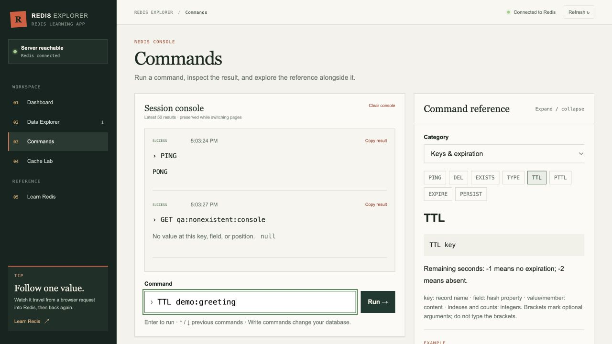
DATABASE SYSTEMS
RedisExplorer
Understanding Redis and NoSQL Databases
Presented by:
Hetul Patel
Abhishek Godse
Sri Rama Krishna
Database Systems — Graduate Student Project
01
Notes:
PRESENTER: Hetul Patel
TARGET TIME: 0:25
TALK TRACK
Good morning. We are Hetul Patel, Abhishek Godse and Sri Rama Krishna. RedisExplorer is our educational application connected to a real Redis database.
We will first build a simple mental model of Redis, then use our application to demonstrate keys, commands, expiration and caching behavior.
I will begin with why Redis exists and how it differs from the relational databases most of us already know.
SOURCES
https://github.com/Hetul803/RedisExplorer
https://github.com/Hetul803/RedisExplorer/blob/dev/presentation/Speaker_1_Script.md

Slide 2
1 REDIS BASICS
Why Was Redis Created?
Salvatore Sanfilippo created Redis in 2009 for LLOOGG, a real-time log analysis application.
2009
Redis means Remote Dictionary Server
Fast access to working data, with useful structures instead of only rows and tables.
TRADITIONAL DISK-BASED PATH
REDIS WORKING PATH
Application
→
storage engine
→
disk
Application
→
Redis
→
RAM
Working data may require storage I/O before the application receives a result.
Redis keeps its working data in memory and can persist it to disk when configured.
The design favors direct key access and native data structures such as strings, lists, sets and hashes.
SPEAKER 1 0:45
02
Notes:
PRESENTER: Hetul Patel
TARGET TIME: 0:45
TALK TRACK
Redis began with a real application problem. In 2009, Salvatore Sanfilippo was building LLOOGG, a real-time log analysis tool, and needed a simpler way to work with rapidly changing data.
A traditional database often follows a storage path that can involve disk. Redis keeps the working data in RAM, so the application can access a known key directly. I am not claiming a fixed speed difference because hardware, networks and commands all matter.
Redis stands for Remote Dictionary Server. Its design combines direct key access with useful structures such as lists, sets and hashes, plus optional persistence.
SOURCES
https://redis.io/blog/redis-then-and-now-adapting-with-developers-through-every-era/
https://github.com/redis/redis-doc/blob/master/docs/get-started/faq.md

Slide 3
1 REDIS BASICS
Why Do Developers Use Redis?
A product page can check Redis before asking the relational database for the same data again.
CACHE HIT
USER
→
APPLICATION
→
REDIS CACHE
→
Return cached product data
Product page
Look up product:42
GET product:42
CACHE MISS
↓
1 Query MySQL
→
2 Store result in Redis
→
3 Return product data
Other common uses
Login sessions
Counters
Game leaderboards
Temporary application state
Our Cache Lab demonstrates hits, misses, TTL and stale copies with separate Redis source and cache keys. MySQL appears here only as a familiar real-world source database.
SPEAKER 1 0:55
03
Notes:
PRESENTER: Hetul Patel
TARGET TIME: 0:55
TALK TRACK
Imagine an online store. A user opens product 42, the application checks Redis first, and a cache hit returns the saved product immediately.
On a miss, the application queries its main database, such as MySQL, stores a copy in Redis with an expiration, and returns the product. Later users can reuse that copy until it expires or the application invalidates it.
Redis also fits login sessions, counters, game leaderboards and temporary state because those values change often or have a natural lifetime.
Our Cache Lab demonstrates the same hit, miss, TTL and stale-copy behavior. It uses separate Redis keys as the teaching source and cache, so our application does not contain MySQL.
SOURCES
https://redis.io/docs/latest/develop/use-cases/
https://github.com/Hetul803/RedisExplorer/blob/dev/backend/src/routes/experiments.js

Slide 4
1 REDIS BASICS
Redis vs MySQL:
Understanding NoSQL
MySQL organizes related records. Redis gives direct access to typed values through keys and commands.
MySQL
Redis
Tables, rows and columns
SQL queries
Relationships and joins
Relational constraints
Key-value data model
Multiple native data types
Direct access using commands and keys
No conventional joins or foreign-key constraints
SELECT name FROM Students
WHERE id = 42;
HGETALL student:42
id | name | major
41 | Maya | Math
42 | Alex | CS
field | value
name | Alex
major | CS
MySQL and Redis often work together instead of replacing each other.
SPEAKER 1 0:55
04
Notes:
PRESENTER: Hetul Patel
TARGET TIME: 0:55
TALK TRACK
This is the bridge from what most students already know. MySQL stores rows in tables, supports SQL, joins related data and enforces constraints such as foreign keys.
Redis starts with a key. The key student:42 can point to a hash containing name Alex and major CS. HGETALL reads that record directly, without a WHERE clause or join.
NoSQL does not mean that every rule disappears. It means the database uses a different model, so the application chooses keys and data types around its access patterns.
MySQL and Redis often work together. MySQL remains the durable relational system of record, while Redis serves data needed quickly or temporarily.
SOURCES
https://redis.io/docs/latest/develop/data-types/
https://dev.mysql.com/doc/refman/8.4/en/innodb-introduction.html

Slide 5
1 REDIS BASICS
How Redis Works
A client sends a command. Redis finds the key, applies the operation to its data type and returns a response.
CLIENT
→
COMMAND
→
KEY
→
VALUE
→
RESPONSE
Application
HGETALL
student:42
hash
name: Alex
HSET student:42 name "Alex" major "CS"
HGETALL student:42
In-memory access
Expiration with TTL
Optional persistence
RAM holds the working dataset.
A key can disappear after its lifetime.
RDB snapshots or AOF can write data to disk.
SPEAKER 1 1:00
05
Notes:
PRESENTER: Hetul Patel
TARGET TIME: 1:00
TALK TRACK
Read the top row from left to right. The client sends a command, the command names a key, Redis applies the operation to the value's data type, and a response comes back.
Here HSET creates or updates fields in a hash. The key is student:42, the type is hash, and the fields are name and major. HGETALL returns every field and value in that hash.
Redis keeps the working dataset in memory. TTL can make a key expire automatically. In-memory does not mean that Redis can never save data because RDB snapshots and the append-only file provide optional disk persistence.
The important idea is simple: choose a key, choose a type, and use commands designed for that type.
SOURCES
https://redis.io/docs/latest/commands/hset/
https://redis.io/docs/latest/commands/hgetall/
https://redis.io/docs/latest/operate/oss_and_stack/management/persistence/

Slide 6
1 REDIS BASICS
Four Redis Data Types
RedisExplorer implements the four structures below. Redis also supports sorted sets, streams and other specialized types.
S
L
U
H
String
List
Set
Hash
Simple values and counters
Ordered collection; duplicates allowed
Unique members with no duplicates
Field-value pairs for a record
SET visits 41
LPUSH tasks "email"
SADD tags redis
HSET student:42 name Alex
Next: RedisExplorer turns these commands into a visual learning workflow.
SPEAKER 1 1:00
06
Notes:
PRESENTER: Hetul Patel
TARGET TIME: 1:00
TALK TRACK
A string stores one value and also supports atomic counters. A list keeps an order and allows duplicates, which can work for queues or timelines.
A set keeps unique members, so adding redis twice still leaves one redis member. A hash groups fields such as name and major under one key, which feels similar to a small record.
The type belongs to the key. If tasks is a list, Redis expects list commands for it and rejects an incompatible string command with a wrong-type error.
Redis also supports sorted sets and streams. Our application focuses on these four types so students can learn the core model clearly. Now Abhishek will show how the implementation exposes them.
SOURCES
https://redis.io/docs/latest/develop/data-types/
https://github.com/Hetul803/RedisExplorer/blob/dev/README.md

Slide 7
2 OUR PROJECT
RedisExplorer architecture
The interface never connects to Redis directly. The API validates requests and owns the shared Redis connection.
BROWSER
HTTP API
DATABASE
React and Vite
Express
Redis 7
JSON request
Redis command
Pages, forms and shared state
Input validation
Command allowlist
JSON responses
Docker volume and append-only persistence
Local development
Vite proxies /api to Express. Docker Compose starts Redis and waits for its health check.
SPEAKER 2 1:00
07
Notes:
PRESENTER: Abhishek Godse
TARGET TIME: 1:00
TALK TRACK
Explain the separation of concerns. React owns interaction, Express owns security and validation, and Redis owns data.
The backend opens one shared Redis client. Feature routes call service functions for keys, commands, caching and metrics.
The Docker configuration uses redis:7-alpine, enables append-only persistence and stores data in a named volume.
SOURCES
https://github.com/Hetul803/RedisExplorer/blob/dev/README.md
https://github.com/Hetul803/RedisExplorer/blob/dev/backend/src/redis.js
https://github.com/Hetul803/RedisExplorer/blob/dev/docker-compose.yml
https://github.com/Hetul803/RedisExplorer/blob/dev/presentation/Speaker_2_Script.md

Slide 8
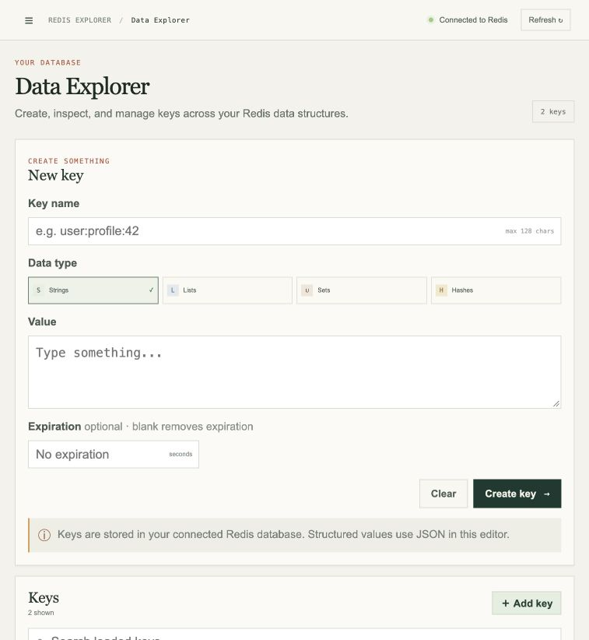
2 OUR PROJECT
Data Explorer
The visual editor exposes Redis structure without hiding the key, type, value or TTL.
1
Choose a key and type
String, list, set or hash
2
Enter a type-aware value
Arrays for lists and sets, fields for hashes
3
Add optional expiration
The backend applies EXPIRE after writing
Production-friendly detail
Key listing uses cursor-based SCAN instead of KEYS.
SPEAKER 2 0:50
08
Notes:
PRESENTER: Abhishek Godse
TARGET TIME: 0:50
TALK TRACK
Point out that the UI always keeps the key visible. This reinforces the Redis mental model.
The backend validates key names, value shapes and TTL ranges before sending commands.
Mention SCAN because KEYS can block on a large database. SCAN spreads the work across cursor calls and may return duplicates, so clients must treat iteration carefully.
SOURCES
https://github.com/Hetul803/RedisExplorer/blob/dev/backend/src/services/keys.js
https://redis.io/docs/latest/commands/scan/

Slide 9
2 OUR PROJECT
Command console and live demo
The console makes each request and response visible. The backend exposes a teaching allowlist and blocks administrative commands.
LIVE DEMO
> PING
> SET class:topic Redis EX 60
> GET class:topic
> TTL class:topic
> HSET class:student name Ada
> HGETALL class:student
Watch the reply after every command.
SPEAKER 2 2:30
09
Notes:
PRESENTER: Abhishek Godse
TARGET TIME: 2:30
TALK TRACK
Demo the commands in order. After SET, explain that EX attaches a 60-second lifetime. TTL should count down.
HSET and HGETALL show that a hash updates one field without replacing the entire record.
If the live site is unavailable, read the commands and point to the captured console screenshot. The deck still demonstrates the expected replies.
The backend parses quoted arguments and enforces an allowlist. It intentionally excludes administrative and scripting commands.
End with the handoff to Speaker 3: the most important applied lesson is caching and expiration.
SOURCES
https://github.com/Hetul803/RedisExplorer/blob/dev/backend/src/services/commands.js
https://github.com/Hetul803/RedisExplorer/blob/dev/frontend/src/constants/commandReference.js

Slide 10
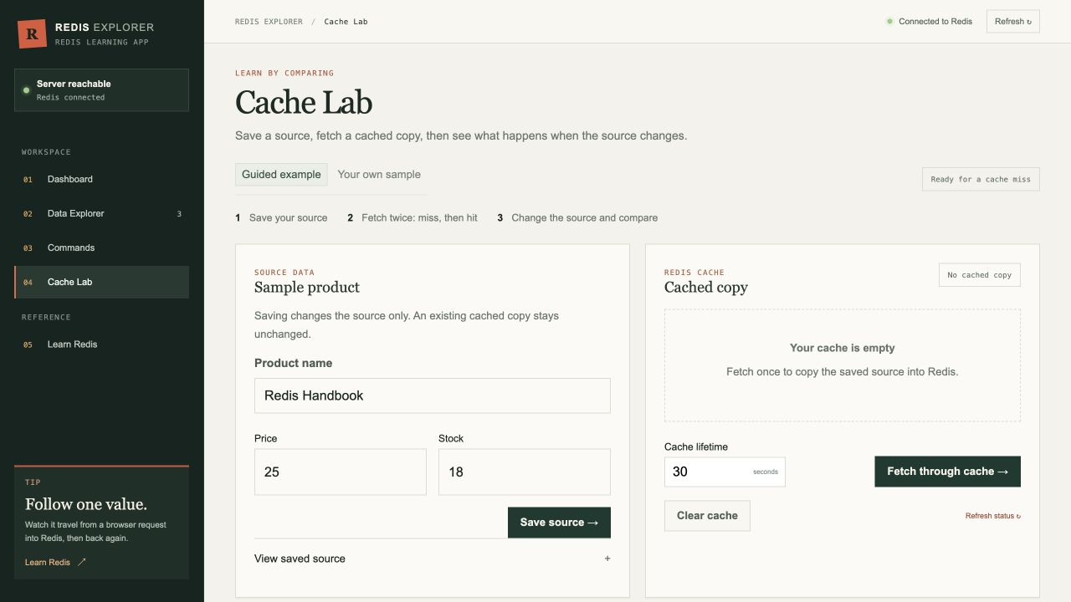
3 APPLIED REDIS
Cache-aside behavior in Cache Lab
A cache stores a copy. That copy can be fast and still be stale.
1
Check the cache key
GET returns null on a miss
2
Use the source value
A miss selects the saved source
3
Store a copy with TTL
SET ... EX seconds limits its lifetime
4
Return hits immediately
Later requests reuse the cached copy
Source updates do not refresh the copy. Invalidate it or wait for TTL.
SPEAKER 3 1:20
10
Notes:
PRESENTER: Sri Rama Krishna
TARGET TIME: 1:20
TALK TRACK
Define cache-aside: the application checks a cache key first. A hit returns that copy. A miss uses the source value, then writes a cached copy with a TTL.
In this teaching app, both the source and cached copy are separate Redis keys. The experiment demonstrates hit, miss, expiration and freshness behavior; it does not claim a measured MySQL-versus-Redis latency result.
Changing the source does not automatically change the cached copy. That is the stale-data problem. Applications choose an invalidation strategy or accept bounded staleness through TTL.
SOURCES
https://github.com/Hetul803/RedisExplorer/blob/dev/backend/src/routes/experiments.js
https://github.com/Hetul803/RedisExplorer/blob/dev/README.md
https://github.com/Hetul803/RedisExplorer/blob/dev/presentation/Speaker_3_Script.md
https://redis.io/docs/latest/develop/using-commands/keyspace/

Slide 11
3 APPLIED REDIS
Why Redis feels fast
Redis reduces storage work and coordination overhead, but network round trips and expensive commands still matter.
1
2
3
In-memory working data
Sequential command execution
Fewer network waits
Reads and writes avoid a disk seek on the command path.
The main event loop avoids locks between ordinary commands.
Pipelining batches commands so one round trip carries more work.
Performance rule
Choose commands by complexity. Large collections, big keys and O(N) operations can block the event loop.
SPEAKER 3 1:00
11
Notes:
PRESENTER: Sri Rama Krishna
TARGET TIME: 1:00
TALK TRACK
Explain each factor without promising a universal latency number. Actual latency depends on hardware, network, payload size and command mix.
Pipelining improves throughput by reducing round trips. It does not make the commands a transaction.
The sequential execution model makes slow commands everyone's problem on that instance. Use command complexity, SLOWLOG, SCAN and sensible key sizes.
SOURCES
https://redis.io/tutorials/what-is-redis/
https://redis.io/docs/latest/develop/using-commands/pipelining/
https://redis.io/docs/latest/operate/oss_and_stack/management/optimization/latency/

Slide 12
3 APPLIED REDIS
Production Redis requires explicit choices
Redis provides building blocks. The team still chooses the durability, availability, scale and security policy.
Goal | Redis mechanism | Question to answer
Durability | RDB snapshots, AOF log, or both | How much recent data can we lose?
Availability | Primary-replica replication with Sentinel | How will failover happen?
Horizontal scale | Redis Cluster across 16,384 hash slots | Can related keys share a slot?
Memory control | TTL plus a maxmemory eviction policy | Which keys may Redis evict?
Security | Network isolation, ACLs and TLS | Who may run which commands?
Replication is asynchronous by default. Failover can still lose acknowledged writes depending on configuration.
SPEAKER 3 1:25
12
Notes:
PRESENTER: Sri Rama Krishna
TARGET TIME: 1:25
TALK TRACK
RDB is a point-in-time snapshot. AOF records write operations. Combining them balances backup speed and a smaller data-loss window.
Sentinel provides monitoring and failover for non-clustered Redis. Cluster adds sharding and failover across hash slots.
Expiration and eviction solve different problems. TTL expresses a data lifetime. Eviction responds to memory pressure after maxmemory is reached.
Security starts with network isolation. ACLs restrict commands and keys, and TLS protects traffic in transit.
Call out the warning below the table. WAIT reduces replication risk but does not turn Redis into a strongly consistent CP system.
SOURCES
https://redis.io/docs/latest/operate/oss_and_stack/management/persistence/
https://redis.io/docs/latest/operate/oss_and_stack/management/replication/
https://redis.io/docs/latest/operate/oss_and_stack/management/sentinel/
https://redis.io/docs/latest/management/scaling/
https://redis.io/docs/latest/develop/reference/eviction/
https://redis.io/docs/latest/operate/oss_and_stack/management/security/

Slide 13
3 APPLIED REDIS
Takeaways and project boundaries
What students should remember
Our project is designed for learning
1
A Redis key points to a typed value, and the type determines the useful commands.
It demonstrates
It still needs
CRUD across four types
A safe command console
Cache misses, hits and TTL
User authentication
Separate visitor data
Production monitoring
2
TTL makes temporary data automatic, but cache freshness remains an application decision.
3
Fast commands do not remove the need for persistence, scale and security choices.
One final reference
Live demo
https://redis-explorer-beta.vercel.app/
The command cheat sheet follows.
GitHub
https://github.com/Hetul803/RedisExplorer
SPEAKER 3 0:45
13
Notes:
PRESENTER: Sri Rama Krishna
TARGET TIME: 0:45
TALK TRACK
Close with the three ideas on the left.
Show critical thinking by stating the project's boundaries. The README explicitly says the learning deployment shares one database, has no authentication and allows a Delete all action.
Move to the final command reference. After the class has a moment to scan it, invite questions and keep the separate Q&A guide open for deeper answers.
SOURCES
https://github.com/Hetul803/RedisExplorer/blob/dev/README.md
https://github.com/Hetul803/RedisExplorer/blob/dev/presentation/Redis_QA_Study_Guide.md
https://redis-explorer-beta.vercel.app/

Slide 14
4 QUICK REFERENCE
Commonly Used Redis Commands
A compact reference for the commands used throughout this presentation and RedisExplorer.
Category | Command syntax | Purpose and example
Strings | SET key value GET key | Write or read a value SET product:42 "Redis Handbook"
Strings | INCR key | Increase an integer counter INCR page:views
Hashes | HSET key field value HGETALL key | Update or read a record HSET student:42 name Alex
Lists | LPUSH key value LRANGE key 0 -1 | Push and read ordered items LPUSH jobs email:123
Sets | SADD key member SMEMBERS key | Add and read unique members SADD tags redis
Expiration | EXPIRE key 60 TTL key | Set or inspect lifetime EXPIRE session:abc 60
Inspection | TYPE key DEL key | Inspect a type or delete a key TYPE student:42
Redis: Fast access, flexible data structures, and practical real-time applications.
SPEAKER 3 0:25
14
Notes:
PRESENTER: Sri Rama Krishna
TARGET TIME: 0:25
TALK TRACK
Leave this slide visible for questions. Point out that the command name describes the operation and the key identifies the value.
The examples match the four types, expiration and inspection used in the application. Close by repeating that Redis combines fast access, flexible data structures and practical real-time use cases.
SOURCES
https://redis.io/docs/latest/commands/
https://redis.io/docs/latest/develop/data-types/

