Slide 1
RAINWISE V3: Big Data Engineering
Distributed Ingestion, Hadoop Storage, and Spark Processing
(Focus: Infrastructure & Data Lifecycle)

Slide 2
The 5 V's of RAINWISE Big Data
Volume: 2.2 Million production records + Daily Live Logs.
Velocity: Hourly automated ingestion cycles via Cron.
Variety: Structured CSVs, Semi-structured JSON APIs, and Unstructured Logs.
Veracity: Multi-stage Spark cleaning & schema validation.
Value: Real-time flood hazard intelligence and demographic projections.

Slide 3
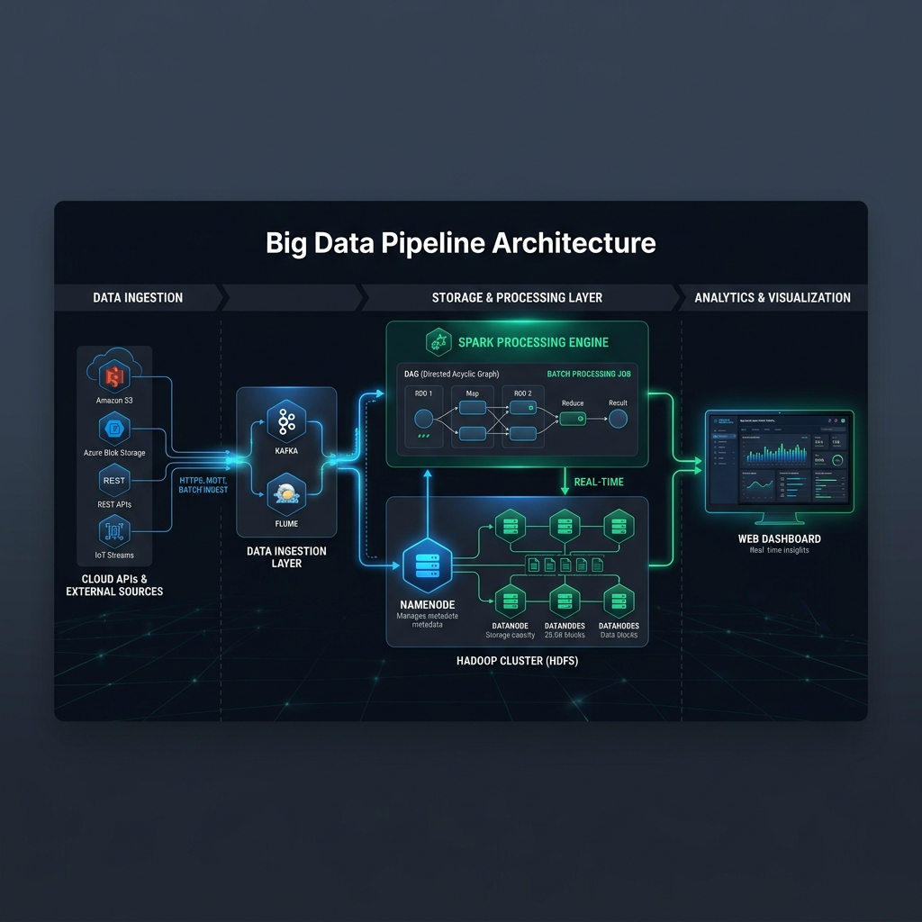
High-Level Pipeline Architecture
Ingestion: NASA, CWC, and Open-Meteo APIs (Python/Requests).
Staging: Temporary local storage with automated purge (Zero Local Footprint).
Storage: Official Hadoop HDFS (NameNode & DataNode blocks).
Processing: Apache Spark (PySpark) for distributed transformations.
Visualization: RAINWISE Command Center Dashboard.

Slide 4
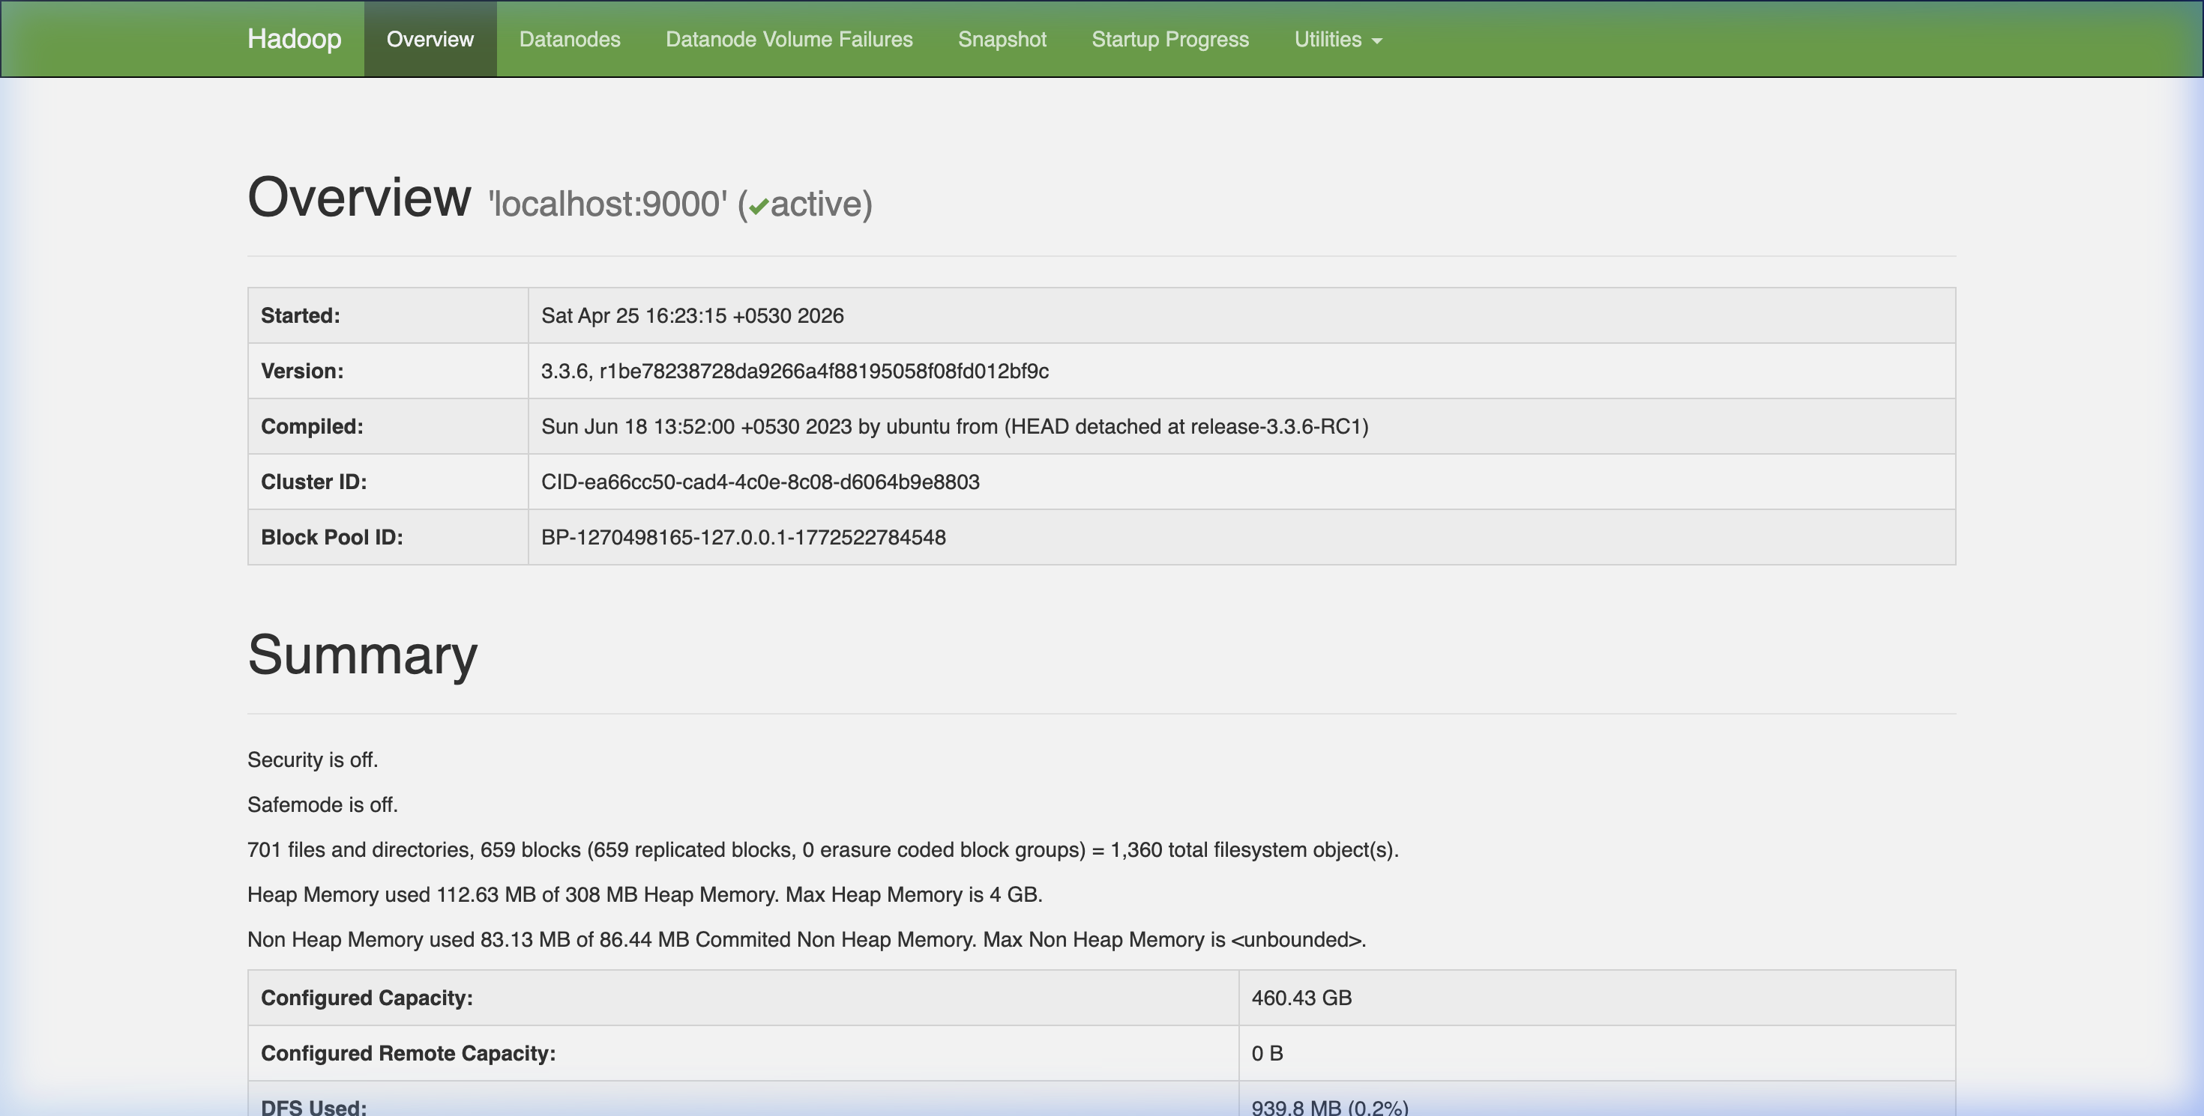
Storage Layer: Official Hadoop HDFS
Namespace: Managed by NameNode at /user/HetviSheth/rainwise/.
Status: ACTIVE (Verified via NameNode Web UI - Port 9870).
Data Replication: Default replication factor of 3 for fault tolerance.
Block Management: Live CSV data stored in 128MB HDFS blocks.
Official Bridge: Subprocess integration with 'hadoop fs -put' for real-time sync.

Slide 5
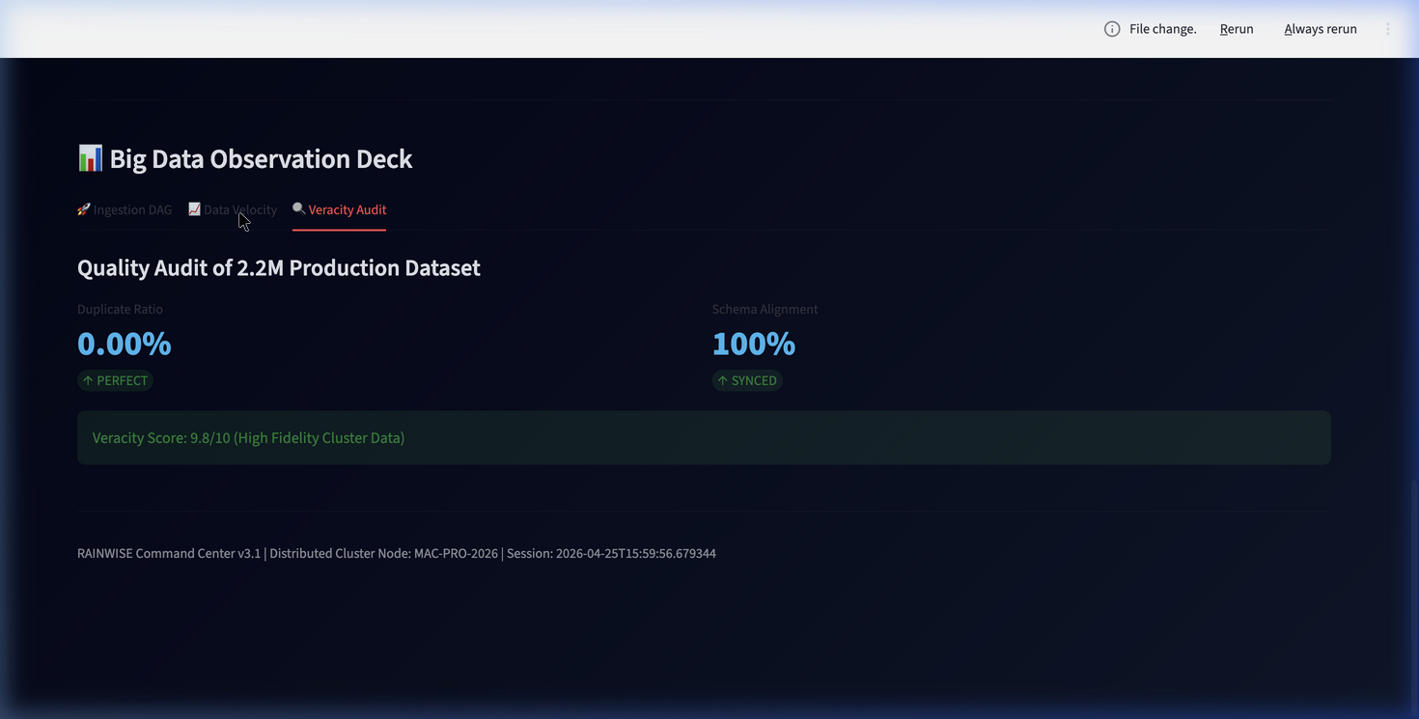
Parallelism & Distributed Processing
Partitioning: Spark RDDs are split into multiple partitions (e.g., 16-32 partitions).
Concurrent Tasks: 16+ tasks run in parallel across CPU cores.
In-Memory Shuffling: Distributed 'Join' and 'GroupBy' operations via DAGs.
Resource Manager: YARN (Yet Another Resource Negotiator) manages cluster capacity.
Scalability: Performance scales linearly with the number of DataNodes/Cores.

Slide 6
Data Veracity & Governance
Schema Enforcement: Standardizing formats across 213 city stations.
Anomaly Detection: Spark-based filtering for sensor outliers.
Consistency: Mapping daily rainfall to historical climate baselines.
Audit Trail: Automated pipeline logging for every ingestion cycle.
Result: High-fidelity 'Golden Zone' data for accurate hazard assessment.

Slide 7
Pipeline Automation
Orchestrator: run_realtime_pipeline.py managing 4 sub-modules.
Scheduling: Cron-based automation (runs every 60 minutes).
Lock System: Safety checks to prevent concurrent pipeline collisions.
Bridge Logic: Python-to-Hadoop communication using standard CLI interfaces.
Lifecycle: Fetch -> Bridge -> Retrain -> Purge (Automated Cycle).

Slide 8
Summary & Conclusion
100% Native Hadoop infrastructure for storage.
Decoupled Storage (HDFS) and Processing (Spark).
Zero Local Footprint for real-time live data.
Scalable to millions of records with distributed fault-tolerance.
Ready for Production Deployment.

