Slide 1
FINANCIAL FRAUD DETECTION
TEAM MEMBERS:
Srilatha Challa - U23CS123
Hetvi Shah - U23CS093
Himavarsha Kadivendi - U23CS128
Rushika Vaja - U23CS108
Eva Balabantaray - U23CS149

Slide 2
PROBLEM STATEMENT & MOTIVATION
Digital financial transactions are vulnerable to fraud.Machine learning techniques can identify unusual patterns and detect fraudulent activities in transaction data.
Objective: Detect fraudulent transactions and evaluate different detection approaches.
Financial fraud is a growing concern in today’s digital world, leading to significant financial losses and security risks. With the increasing number of online transactions, it becomes difficult to manually detect fraudulent activities. This project is motivated by the need for an automated and efficient system that can identify suspicious transactions in real time. By applying machine learning techniques, we aim to improve fraud detection accuracy and reduce the chances of financial loss.

Slide 3
DATA DESCRIPTION
DATA SOURCE: Credit Card Fraud Detection Dataset (Kaggle)
Features:
30 features: Time, Amount, V1–V28 (PCA transformed)
Target variable: Class (0 = Normal, 1 = Fraud)
Initial Analysis:
No missing values found
Dataset is highly imbalanced
Fraud cases are very rare (~0.17%)
Key Insight:
Requires careful handling using precision-recall metrics instead of accuracy text

Slide 4
DATA PREPROCESSING
DATA CLEANING & WHAT WE DID
Loaded dataset with 284,807 transactions and 31 features
Performed initial inspection (shape, info, null values)
Found no missing values (all columns complete)
Removed duplicate records to improve data quality
Checked data types → all features are numeric (float64), target is int64
Analysed outliers in the “Amount” column
Outliers were retained as they may represent fraud cases
Final dataset is clean, consistent, and ready for EDA

Slide 5
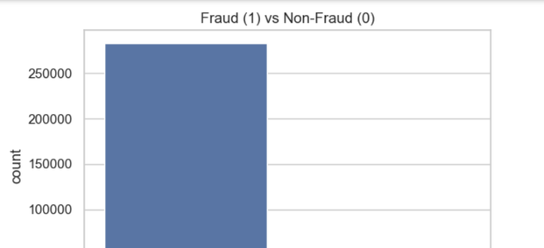
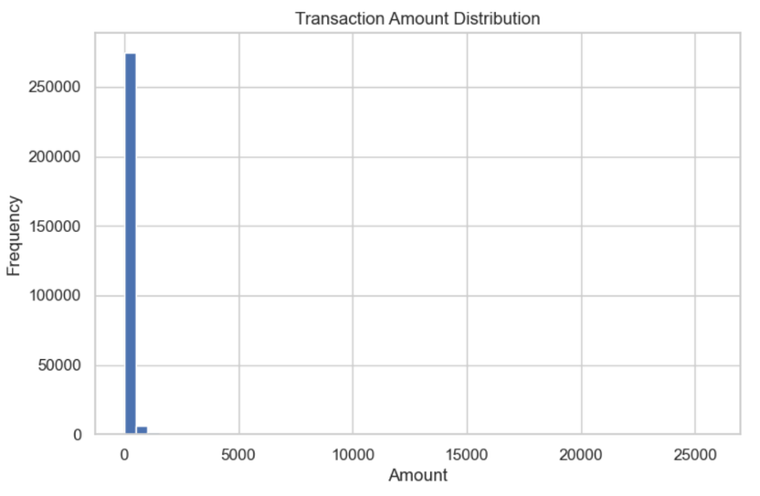
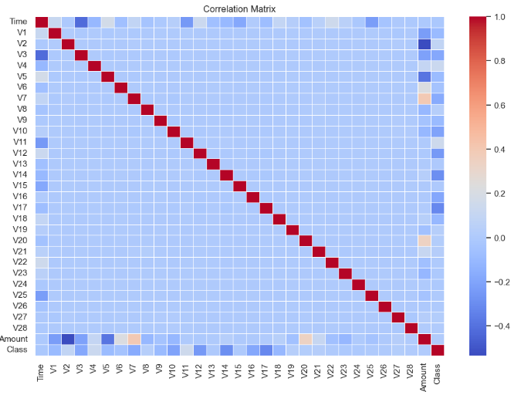
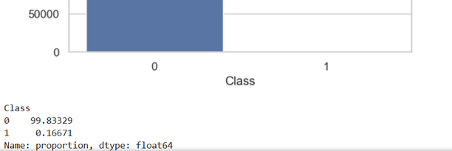
EDA OBSERVATIONS
Dataset is highly imbalanced:
Class 0 (Non-Fraud): ~284,315 (≈99.8%)
Class 1 (Fraud): ~492 (≈0.2%)
Transaction amount analysis:
Most transactions are low value (<100)
Few high-value outliers (~25,000) present
Feature insights:
V1–V28 are PCA-transformed features
Some features show different patterns for fraud vs normal
Correlation between features is mostly low

Slide 6
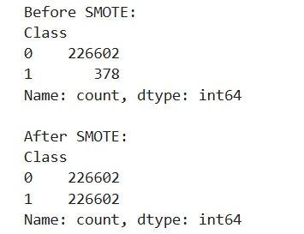
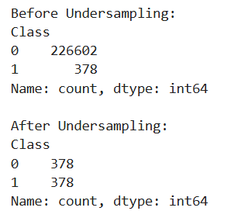
DATA IMBALANCE HANDLING
Problem: Dataset is highly imbalanced
Non-Fraud: ~99.8%
Fraud: ~0.2%
Leads to biased models (high accuracy, poor fraud detection)
Techniques Used
SMOTE (Oversampling)
Generates synthetic fraud samples
Balances dataset without data loss
Improves Recall & F1-score
Undersampling
Reduces majority class (non-fraud)
Faster but loses important data
Conclusion
SMOTE preferred for better fraud detection
Undersampling used for comparison

Slide 7
FEATURE SCALING
Problem
Features have different ranges
Amount: 0 → 25,000
Others (PCA): small values
Causes bias in model learning
Solution: StandardScaler
Converts data to:
Mean = 0
Std = 1
Applied on:
Amount
Time

Slide 8
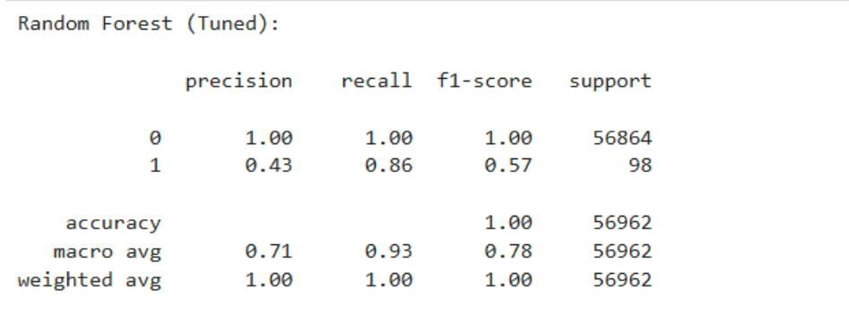
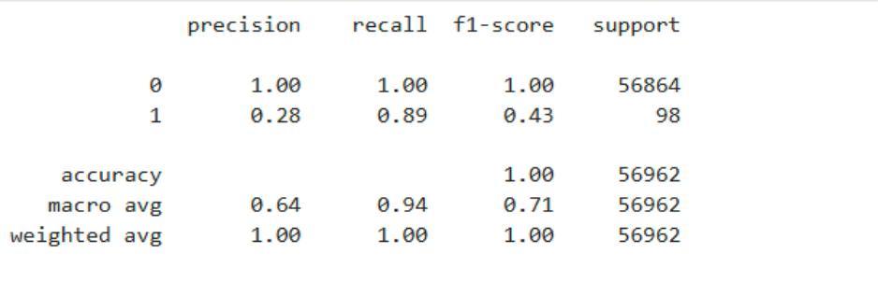
METHODOLOGY
Models Used
Logistic Regression (baseline)
Decision Tree (non-linear patterns)
Random Forest (final model)
Workflow
Data → Split → SMOTE → Scaling → Train Models → Tuning → Threshold (0.4) → Final Output
Why These Methods?
Dataset is highly imbalanced
Focus on Recall (fraud detection)
Random Forest:
Handles complex data well
Reduces overfitting

Slide 9


METHODOLOGY
Key Results
Random Forest (Tuned)
Recall: 0.86
Precision: 0.43
F1-score: 0.57
After Threshold Tuning (0.4)
Recall: 0.89 (Best)
Precision: 0.28
F1-score: 0.43
Model Improvement
Old RF Recall: 0.83
Tuned RF Recall: 0.86
Final Recall: 0.89
Conclusion
High recall → better fraud detection
Lower precision → acceptable trade-off
Final model = Random Forest + threshold tuning

Slide 10
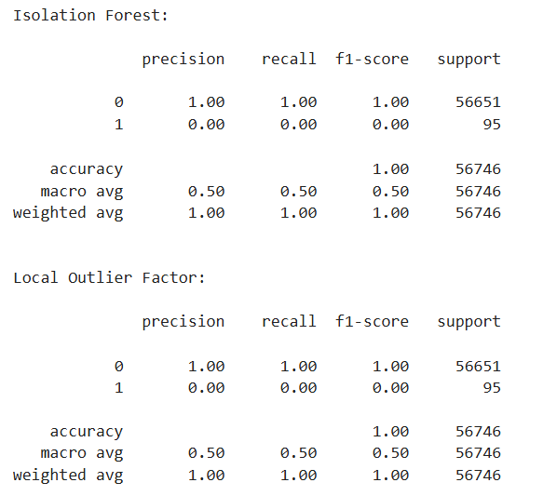
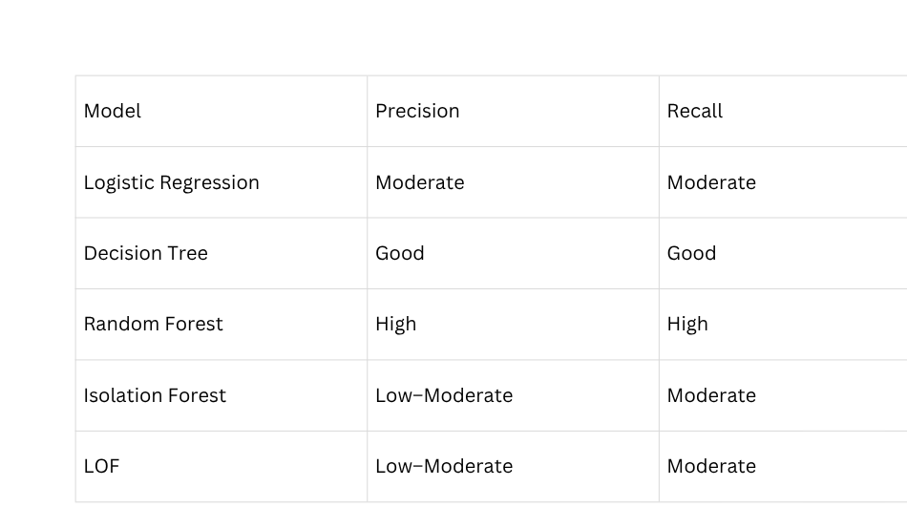
RESULTS AND EVALUATION
Evaluation Metrics Used
Precision → Measures correctness of fraud predictions
Recall → Measures ability to detect actual frauds
F1-score → Balance between precision and recall
ROC-AUC → Overall model performance
Focus was on Recall, due to imbalanced dataset
Key Observations
Supervised models performed better than anomaly detection models
Random Forest achieved the best balance of precision and recall
Anomaly detection models showed higher false positives
Precision-Recall curve confirmed better performance of Random Forest

Slide 11
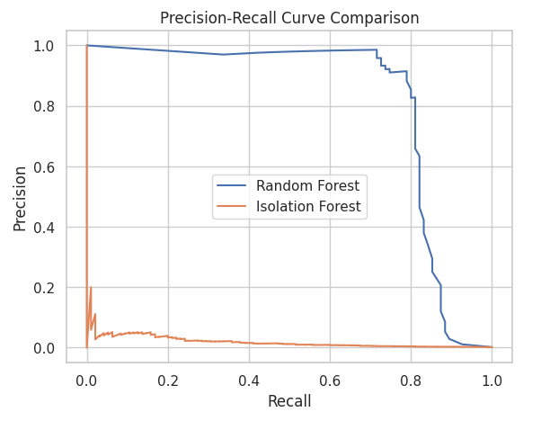
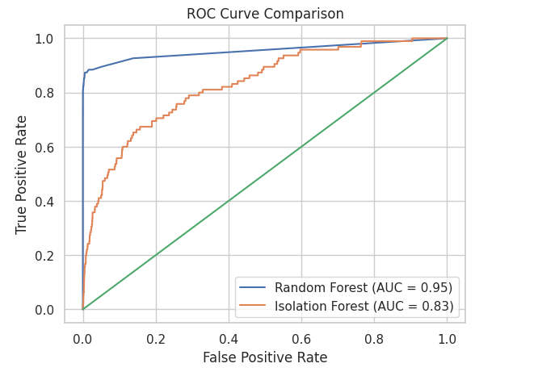
RESULTS AND EVALUATION
Best Result Obtained
Model: Random Forest (Tuned)
Performance:High Recall → Maximum fraud detection
Good Precision → Reduced false alarms
Conclusion: Best suited for fraud detection in this dataset

Slide 12
COMPARISON & FUTURE IMPROVEMENTS
Approach in Reference Papers
Use Machine Learning & Deep Learning models
Focus on:
Behavioral pattern analysis
Transaction history modeling
Address key challenges:
Class imbalance
Concept drift
Use:
Advanced models (CNN, LSTM, GAN)
Hybrid & ensemble techniques
Many studies show deep learning improves precision & recall
Our Approach
Used traditional ML models:
Logistic Regression
Random Forest
Isolation Forest
Handled imbalance using:
SMOTE (primary method)
Undersampling
Applied:
Feature scaling
Model evaluation (Precision, Recall, F1-score)
Future Improvements:
Real-time fraud detection system
Deep learning models

Slide 13
CONCLUSION & KEY FINDINGS
Best Model
Random Forest achieved highest performance
Recall improved to ~89% after tuning
Key Findings
Handling imbalanced data (SMOTE) improved detection
Threshold tuning increased fraud detection capability
Clear precision–recall trade-off observed
Model Comparison
Supervised models > Anomaly detection
Isolation Forest & LOF showed poor fraud detection
Final Takeaway
Recall is the most important metric in fraud detection
ML can effectively reduce financial fraud risk

Slide 14
THANK YOU
https://github.com/Hetvi4321/Financial-Fraud-Detection

