Slide 1
Chapter 15: Transactions
Notes:
‹#›

Slide 2
Chapter 15: Transactions
Transaction Concept
Transaction State
Concurrent Executions
Serializability
Recoverability
Implementation of Isolation
Transaction Definition in SQL
Testing for Serializability.

Slide 3
Transaction Concept
A transaction is a unit of program execution that accesses and possibly updates various data items.
A transaction must see a consistent database.
During transaction execution the database may be temporarily inconsistent.
When the transaction completes successfully (is committed), the database must be consistent.
After a transaction commits, the changes it has made to the database persist, even if there are system failures.
Multiple transactions can execute in parallel.
Two main issues to deal with:
Failures of various kinds, such as hardware failures and system crashes
Concurrent execution of multiple transactions

Slide 4
ACID Properties
A transaction is a unit of program execution that accesses and possibly updates various data items.To preserve the integrity of data the database system must ensure:
Atomicity. Either all operations of the transaction are properly reflected in the database or none are.
Consistency. Execution of a transaction in isolation preserves the consistency of the database.
Isolation. Although multiple transactions may execute concurrently, each transaction must be unaware of other concurrently executing transactions. Intermediate transaction results must be hidden from other concurrently executed transactions.
That is, for every pair of transactions T_{i} and T_{j}, it appears to T_{i} that either T_{j}, finished execution before T_{i} started, or T_{j} started execution after T_{i} finished.
Durability. After a transaction completes successfully, the changes it has made to the database persist, even if there are system failures.

Slide 5
Example of Fund Transfer
Transaction to transfer $50 from account A to account B:
1. read(A)
2. A := A – 50
3. write(A)
4. read(B)
5. B := B + 50
6. write(B)
Atomicity requirement — if the transaction fails after step 3 and before step 6, the system should ensure that its updates are not reflected in the database, else an inconsistency will result.
Consistency requirement – the sum of A and B is unchanged by the execution of the transaction.

Slide 6
Example of Fund Transfer (Cont.)
Isolation requirement — if between steps 3 and 6, another transaction is allowed to access the partially updated database, it will see an inconsistent database (the sum A + B will be less than it should be).
Isolation can be ensured trivially by running transactions serially, that is one after the other.
However, executing multiple transactions concurrently has significant benefits, as we will see later.
Durability requirement — once the user has been notified that the transaction has completed (i.e., the transfer of the $50 has taken place), the updates to the database by the transaction must persist despite failures.

Slide 7
Transaction State
Active – the initial state; the transaction stays in this state while it is executing
Partially committed – after the final statement has been executed.
Failed -- after the discovery that normal execution can no longer proceed.
Aborted – after the transaction has been rolled back and the database restored to its state prior to the start of the transaction. Two options after it has been aborted:
restart the transaction; can be done only if no internal logical error
kill the transaction
Committed – after successful completion.

Slide 8
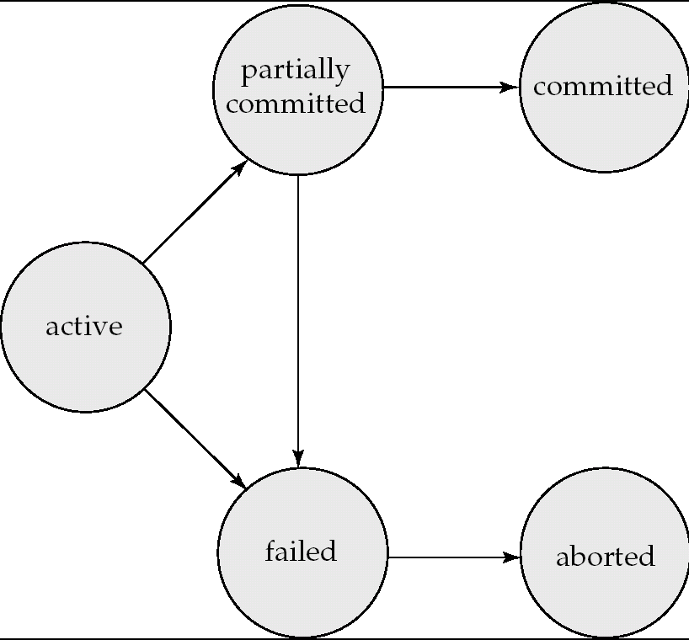
Transaction State (Cont.)

Slide 9
Implementation of Atomicity and Durability
The recovery-management component of a database system implements the support for atomicity and durability.
The shadow-database scheme:
assume that only one transaction is active at a time.
a pointer called db_pointer always points to the current consistent copy of the database.
all updates are made on a shadow copy of the database, and db_pointer is made to point to the updated shadow copy only after the transaction reaches partial commit and all updated pages have been flushed to disk.
in case transaction fails, old consistent copy pointed to by db_pointer can be used, and the shadow copy can be deleted.

Slide 10
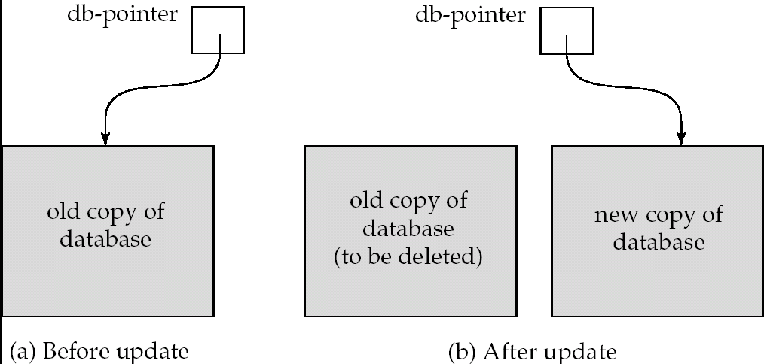
Implementation of Atomicity and Durability (Cont.)
The shadow-database scheme:
Assumes disks do not fail
Useful for text editors, but
extremely inefficient for large databases (why?)
Does not handle concurrent transactions
Will study better schemes in Chapter 17.

Slide 11
Concurrent Executions
Multiple transactions are allowed to run concurrently in the system. Advantages are:
increased processor and disk utilization, leading to better transaction throughput: one transaction can be using the CPU while another is reading from or writing to the disk
reduced average response time for transactions: short transactions need not wait behind long ones.
Concurrency control schemes – mechanisms to achieve isolation; that is, to control the interaction among the concurrent transactions in order to prevent them from destroying the consistency of the database
Will study in Chapter 16, after studying notion of correctness of concurrent executions.

Slide 12
Schedules
Schedule – a sequences of instructions that specify the chronological order in which instructions of concurrent transactions are executed
a schedule for a set of transactions must consist of all instructions of those transactions
must preserve the order in which the instructions appear in each individual transaction.
A transaction that successfully completes its execution will have a commit instructions as the last statement (will be omitted if it is obvious)
A transaction that fails to successfully complete its execution will have an abort instructions as the last statement (will be omitted if it is obvious)

Slide 13
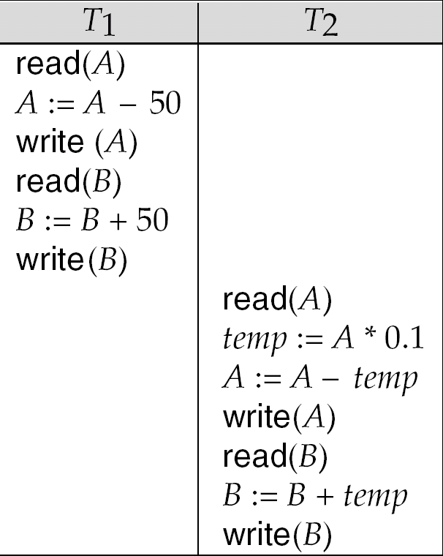
Schedule 1
Let T₁ transfer $50 from A to B, and T₂ transfer 10% of the balance from A to B.
A serial schedule in which T₁ is followed by T₂:

Slide 14
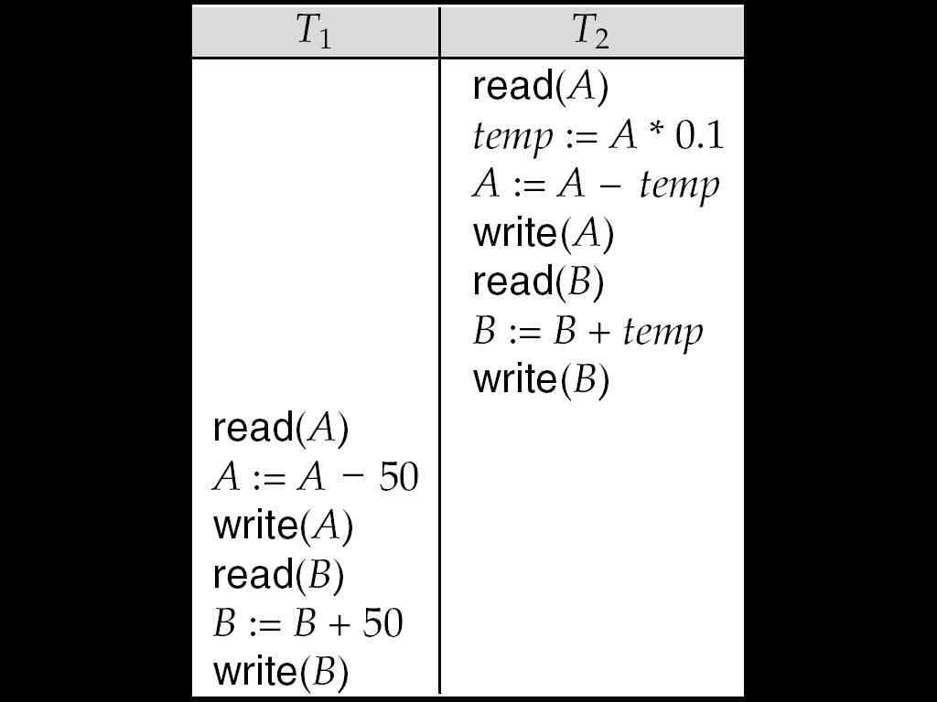
Schedule 2
A serial schedule where T₂ is followed by T₁

Slide 15
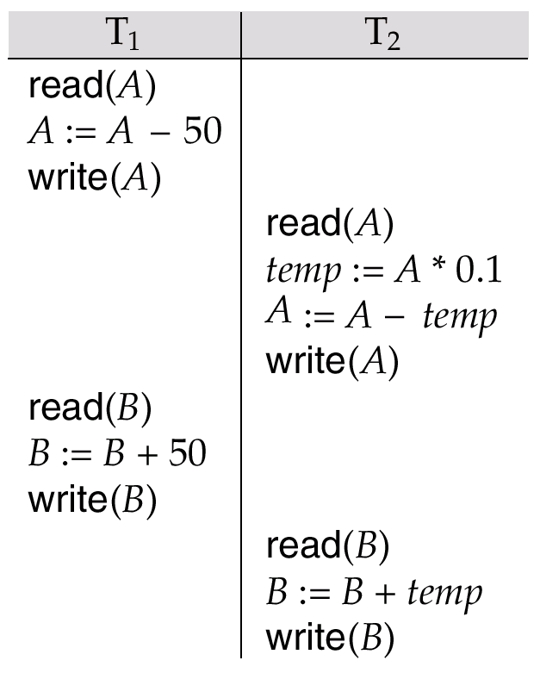
Schedule 3
Let T₁ and T₂ be the transactions defined previously. The following schedule is not a serial schedule, but it is equivalent to Schedule 1.
In Schedules 1, 2 and 3, the sum A + B is preserved.

Slide 16
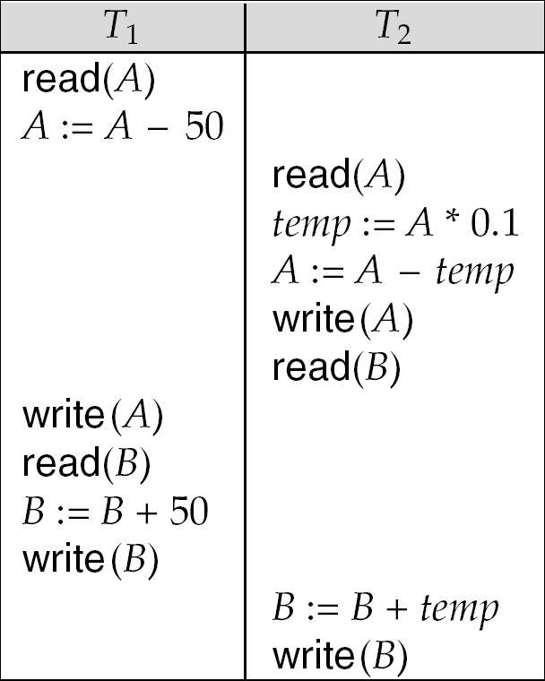
Schedule 4
The following concurrent schedule does not preserve the value of (A + B).

Slide 17
Serializability
Basic Assumption – Each transaction preserves database consistency.
Thus serial execution of a set of transactions preserves database consistency.
A (possibly concurrent) schedule is serializable if it is equivalent to a serial schedule. Different forms of schedule equivalence give rise to the notions of:
1. conflict serializability
2. view serializability
We ignore operations other than read and write instructions, and we assume that transactions may perform arbitrary computations on data in local buffers in between reads and writes. Our simplified schedules consist of only read and write instructions.

Slide 18
Conflicting Instructions
Instructions l_{i} and l_{j} of transactions T_{i} and T_{j} respectively, conflict if and only if there exists some item Q accessed by both l_{i} and l_{j}, and at least one of these instructions wrote Q.
1. l_{i} = read(Q), l_{j} = read(Q). l_{i} and l_{j} don’t conflict. 2. l_{i} = read(Q), l_{j} = write(Q). They conflict. 3. l_{i} = write(Q), l_{j} = read(Q). They conflict 4. l_{i} = write(Q), l_{j} = write(Q). They conflict
Intuitively, a conflict between l_{i} and l_{j} forces a (logical) temporal order between them.
If l_{i} and l_{j} are consecutive in a schedule and they do not conflict, their results would remain the same even if they had been interchanged in the schedule.

Slide 19
Conflict Serializability
If a schedule S can be transformed into a schedule S´ by a series of swaps of non-conflicting instructions, we say that S and S´ are conflict equivalent.
We say that a schedule S is conflict serializable if it is conflict equivalent to a serial schedule

Slide 20
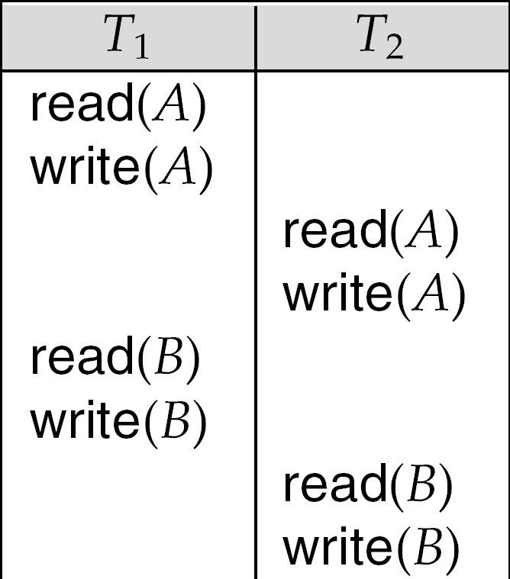
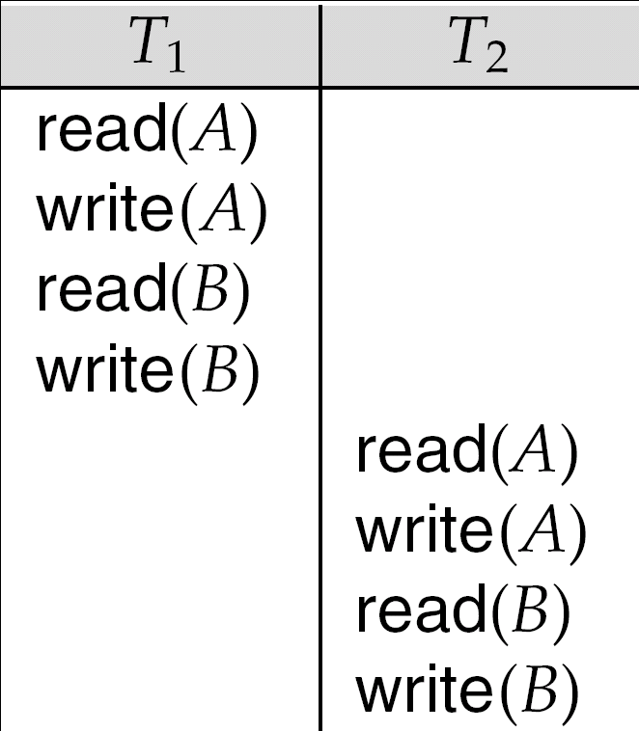
Conflict Serializability (Cont.)
Schedule 3 can be transformed into Schedule 6, a serial schedule where T₂ follows T₁, by series of swaps of non-conflicting instructions.
Therefore Schedule 3 is conflict serializable.
Schedule 3
Schedule 6

Slide 21
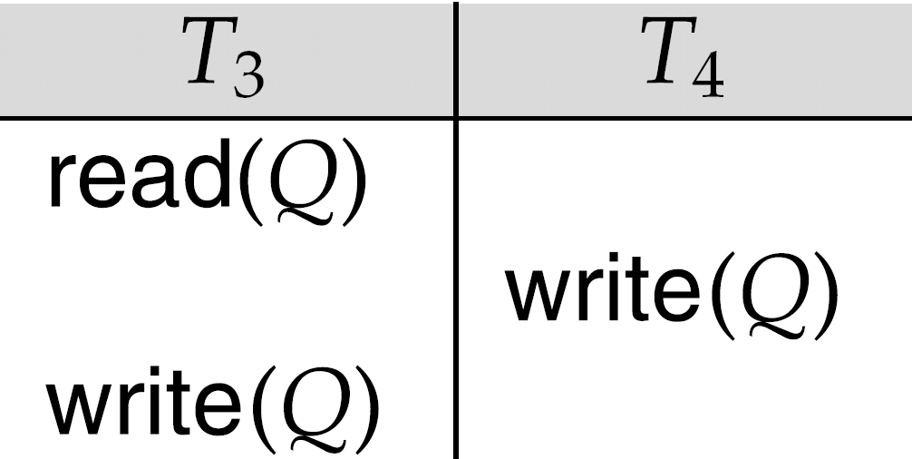
Conflict Serializability (Cont.)
Example of a schedule that is not conflict serializable:
We are unable to swap instructions in the above schedule to obtain either the serial schedule < T₃, T₄ >, or the serial schedule < T₄, T₃ >.

Slide 22
View Serializability
Let S and S´ be two schedules with the same set of transactions. S and S´ are view equivalent if the following three conditions are met:
1. For each data item Q, if transaction T_{i} reads the initial value of Q in schedule S, then transaction T_{i} must, in schedule S´, also read the initial value of Q.
2. For each data item Q if transaction T_{i} executes read(Q) in schedule S, and that value was produced by transaction T_{j} (if any), then transaction T_{i} must in schedule S´ also read the value of Q that was produced by transaction T_{j} .
3. For each data item Q, the transaction (if any) that performs the final write(Q) operation in schedule S must perform the final write(Q) operation in schedule S´.
As can be seen, view equivalence is also based purely on reads and writes alone.

Slide 23
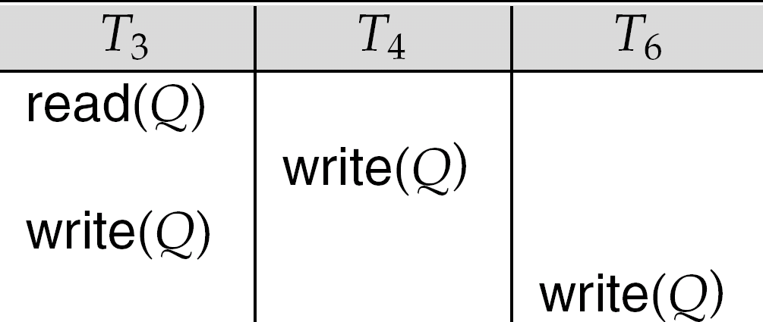
View Serializability (Cont.)
A schedule S is view serializable it is view equivalent to a serial schedule.
Every conflict serializable schedule is also view serializable.
Below is a schedule which is view-serializable but not conflict serializable.
What serial schedule is above equivalent to?
Every view serializable schedule that is not conflict serializable has blind writes.

Slide 24
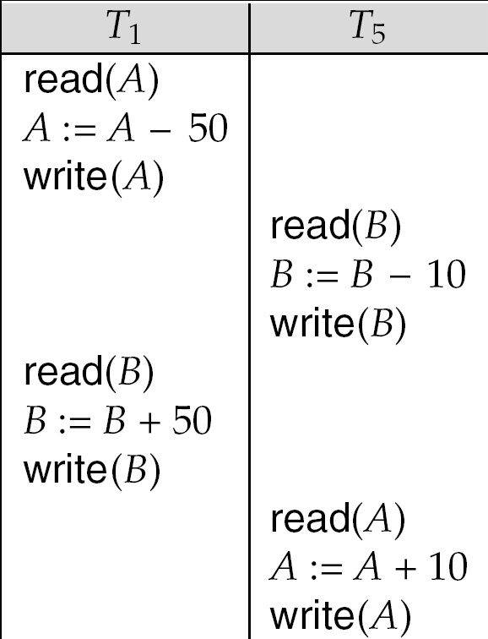
Other Notions of Serializability
The schedule below produces same outcome as the serial schedule < T₁, T₅ >, yet is not conflict equivalent or view equivalent to it.
Determining such equivalence requires analysis of operations other than read and write.

Slide 25
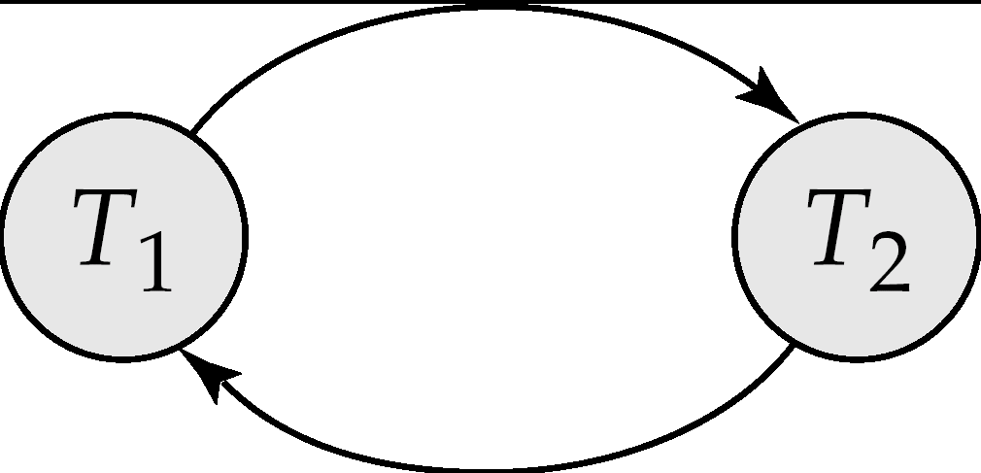
Testing for Serializability
Consider some schedule of a set of transactions T₁, T₂, ..., T_{n}
Precedence graph — a direct graph where the vertices are the transactions (names).
We draw an arc from T_{i} to T_{j} if the two transaction conflict, and T_{i} accessed the data item on which the conflict arose earlier.
We may label the arc by the item that was accessed.
Example 1
x
y

Slide 26
Example Schedule (Schedule A) + Precedence Graph
T₁ T₂ T₃ T₄ T₅ read(X) read(Y) read(Z) read(V) read(W) read(W) read(Y) write(Y) write(Z) read(U) read(Y) write(Y) read(Z) write(Z)
read(U) write(U)
T₁
T₂
T₄
T₃

Slide 27
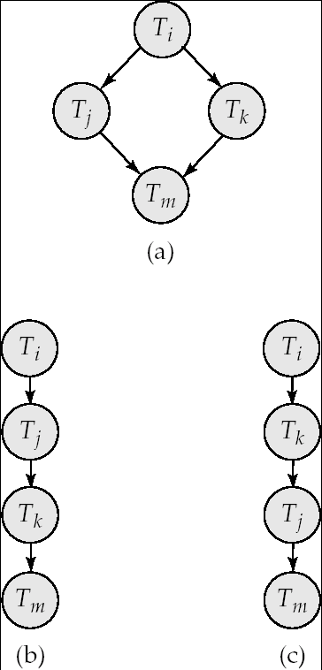
Test for Conflict Serializability
A schedule is conflict serializable if and only if its precedence graph is acyclic.
Cycle-detection algorithms exist which take order n² time, where n is the number of vertices in the graph.
(Better algorithms take order n + e where e is the number of edges.)
If precedence graph is acyclic, the serializability order can be obtained by a topological sorting of the graph.
This is a linear order consistent with the partial order of the graph.
For example, a serializability order for Schedule A would be T₅ → T₁ → T₃ → T₂ → T₄
Are there others?

Slide 28
Test for View Serializability
The precedence graph test for conflict serializability cannot be used directly to test for view serializability.
Extension to test for view serializability has cost exponential in the size of the precedence graph.
The problem of checking if a schedule is view serializable falls in the class of NP-complete problems.
Thus existence of an efficient algorithm is extremely unlikely.
However practical algorithms that just check some sufficient conditions for view serializability can still be used.

Slide 29
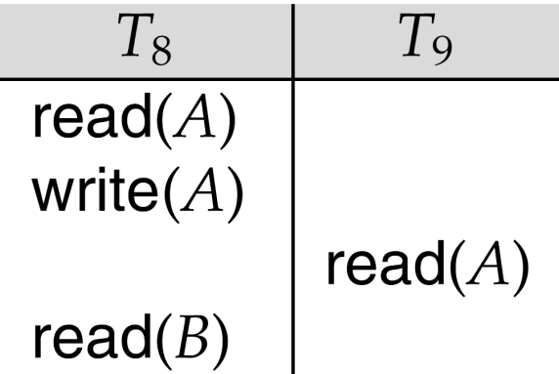
Recoverable Schedules
Need to address the effect of transaction failures on concurrently running transactions.
Recoverable schedule — if a transaction T_{j} reads a data item previously written by a transaction T_{i} , then the commit operation of T_{i} appears before the commit operation of T_{j}.
The following schedule (Schedule 11) is not recoverable if T₉ commits immediately after the read
If T₈ should abort, T₉ would have read (and possibly shown to the user) an inconsistent database state. Hence, database must ensure that schedules are recoverable.

Slide 30
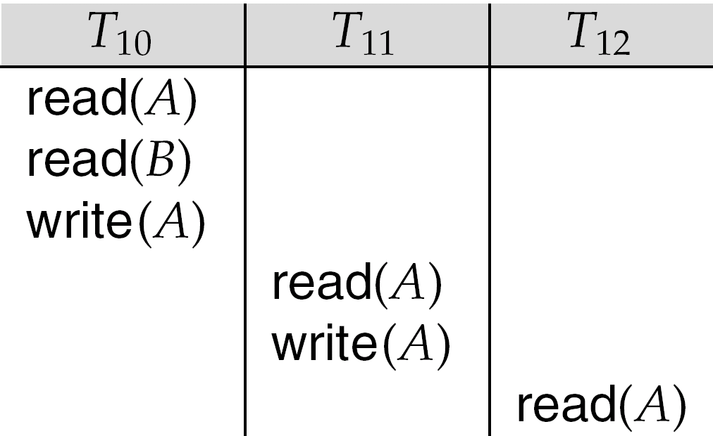
Cascading Rollbacks
Cascading rollback – a single transaction failure leads to a series of transaction rollbacks. Consider the following schedule where none of the transactions has yet committed (so the schedule is recoverable) If T₁₀ fails, T₁₁ and T₁₂ must also be rolled back.
Can lead to the undoing of a significant amount of work

Slide 31
Cascadeless Schedules
Cascadeless schedules — cascading rollbacks cannot occur; for each pair of transactions T_{i} and T_{j} such that T_{j} reads a data item previously written by T_{i}, the commit operation of T_{i} appears before the read operation of T_{j}.
Every cascadeless schedule is also recoverable
It is desirable to restrict the schedules to those that are cascadeless

Slide 32
Concurrency Control
A database must provide a mechanism that will ensure that all possible schedules are
either conflict or view serializable, and
are recoverable and preferably cascadeless
A policy in which only one transaction can execute at a time generates serial schedules, but provides a poor degree of concurrency
Are serial schedules recoverable/cascadeless?
Testing a schedule for serializability after it has executed is a little too late!
Goal – to develop concurrency control protocols that will assure serializability.

Slide 33
Concurrency Control vs. Serializability Tests
Concurrency-control protocols allow concurrent schedules, but ensure that the schedules are conflict/view serializable, and are recoverable and cascadeless.
Concurrency control protocols generally do not examine the precedence graph as it is being created
Instead a protocol imposes a discipline that avoids nonseralizable schedules.
We study such protocols in Chapter 16.
Different concurrency control protocols provide different tradeoffs between the amount of concurrency they allow and the amount of overhead that they incur.
Tests for serializability help us understand why a concurrency control protocol is correct.

Slide 34
Weak Levels of Consistency
Some applications are willing to live with weak levels of consistency, allowing schedules that are not serializable
E.g. a read-only transaction that wants to get an approximate total balance of all accounts
E.g. database statistics computed for query optimization can be approximate (why?)
Such transactions need not be serializable with respect to other transactions
Tradeoff accuracy for performance

Slide 35
Levels of Consistency in SQL-92
Serializable — default
Repeatable read — only committed records to be read, repeated reads of same record must return same value. However, a transaction may not be serializable – it may find some records inserted by a transaction but not find others.
Read committed — only committed records can be read, but successive reads of record may return different (but committed) values.
Read uncommitted — even uncommitted records may be read.
Lower degrees of consistency useful for gathering approximate information about the database

Slide 36
Transaction Definition in SQL
Data manipulation language must include a construct for specifying the set of actions that comprise a transaction.
In SQL, a transaction begins implicitly.
A transaction in SQL ends by:
Commit work commits current transaction and begins a new one.
Rollback work causes current transaction to abort.
Levels of consistency specified by SQL-92:
Serializable — default
Repeatable read
Read committed
Read uncommitted

Slide 37
End of Chapter

Slide 38


Slide 39
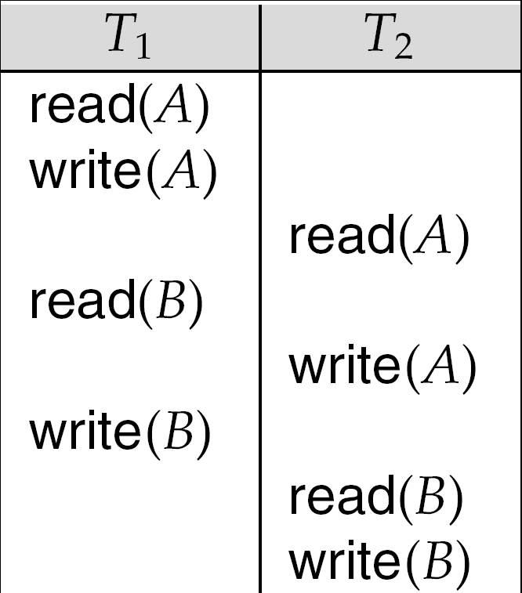

Slide 40
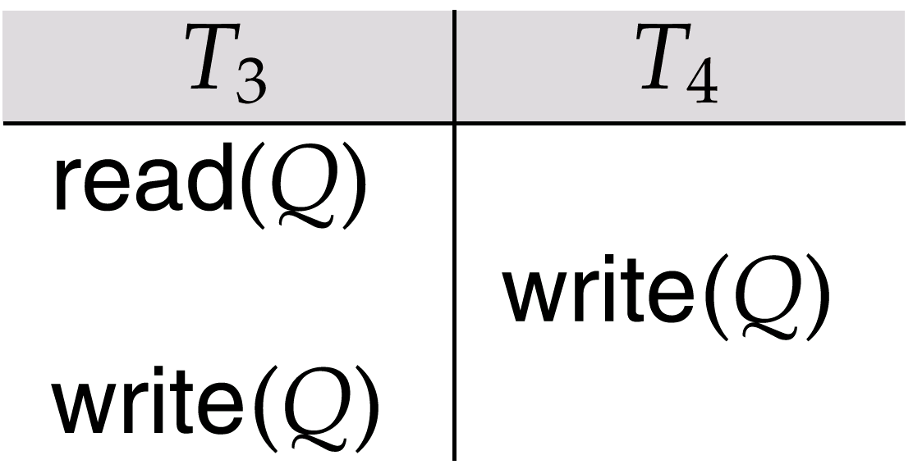
Schedule 7

Slide 41
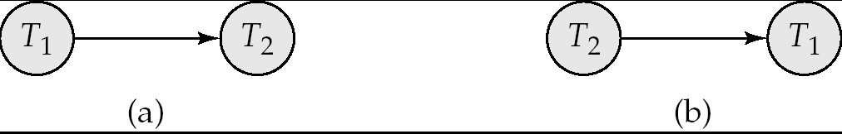
Precedence Graph for (a) Schedule 1 and (b) Schedule 2

Slide 42

Illustration of Topological Sorting

Slide 43
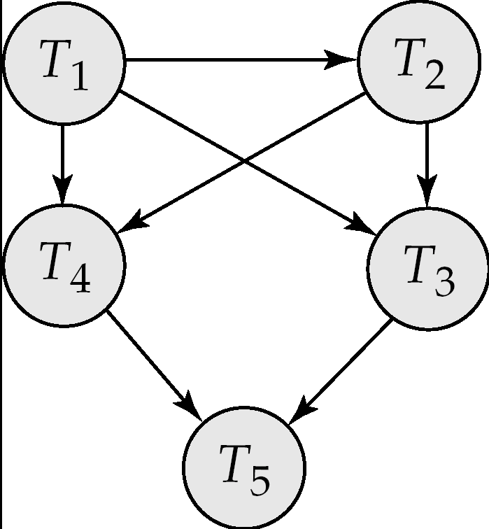
Precedence Graph

Slide 44
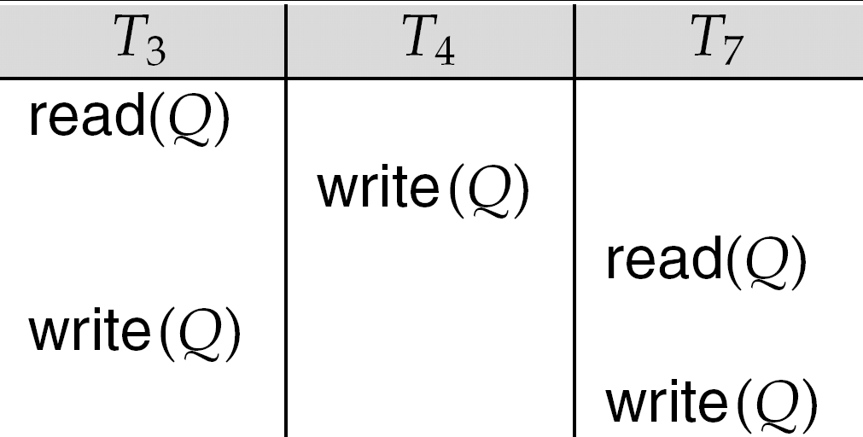
fig. 15.21

Slide 45
Implementation of Isolation
Schedules must be conflict or view serializable, and recoverable, for the sake of database consistency, and preferably cascadeless.
A policy in which only one transaction can execute at a time generates serial schedules, but provides a poor degree of concurrency.
Concurrency-control schemes tradeoff between the amount of concurrency they allow and the amount of overhead that they incur.
Some schemes allow only conflict-serializable schedules to be generated, while others allow view-serializable schedules that are not conflict-serializable.

Slide 46

Figure 15.6

Slide 47

Figure 15.12

