Slide 1
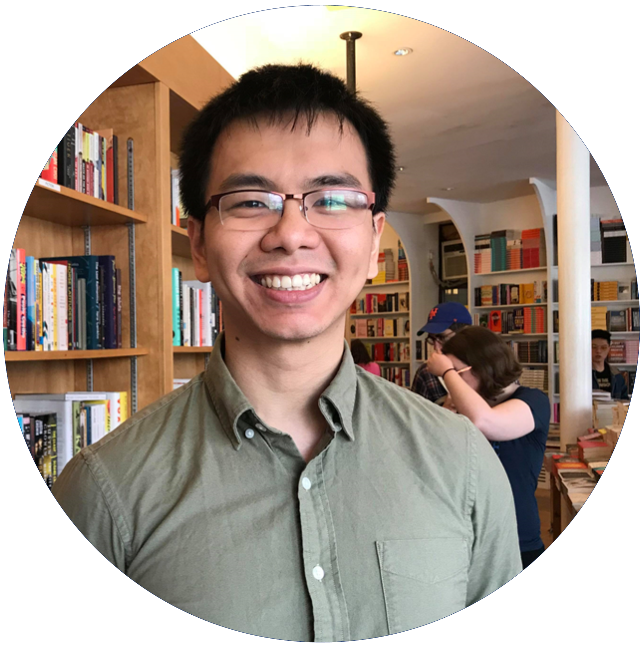
I’m Hieu and I have a passion for Web Development.
As a self taught web developer, it is a weakness but also one of my greatest strength.
My Work
Thanks for checking out!

Slide 2



I’m Hieu and I have a passion for Web Development.
As a self taught web developer, it is a weakness but also one of my greatest strength. As a self taught web developer, it is a weakness but also one of my greatest strength.
As a self taught web developer, it is a weakness but also one of my greatest strength.
My Work
Visit the site
Visit the site
Thanks for checking out!
Contact Me:

