Slide 1

MORE EXPLORATION TO COMPOSABLE INFRASTRUCTURE
THE APPLICATION AND ANALYSIS OF COMPOSABLE MEMORY
Ruan, Wo-Hao (Michael)

Slide 2
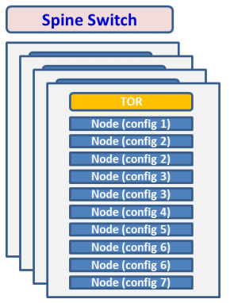
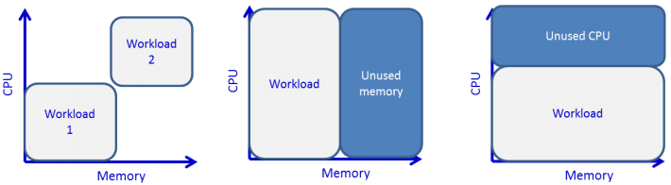

Retrospect - The Traditional Datacenter
Each of the nodes may have different CPU, memory, I/O and accelerator configurations.
Nodes in a rack are connected by a top-of-rack (TOR) switch
TORs are then connected by the spine switches.
The deployment is standalone, straightforward, and simple
However, that can lead to serious resource fragmentation.
In general, typical data centers’ memory utilization rate of is as low as 50%. [ACM, 2012]
The waste for the idles server in a datacenter would be huge [Intel, 2016] [Stanford University & Anthesis Group , 2015]
[FGCS,2017]
[FGCS,2017]

Slide 3
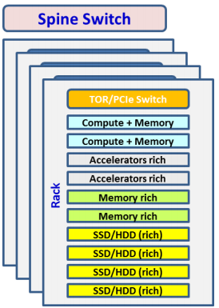
Today - The Rack Scale Design
Each node within the rack is specialized into in one type of resources (computing + memory, accelerator or storage)
Resources can be shared in a coarse-grained granularity
With the Rack, resource nodes can be accessed by compute nodes
Cross-node sharing is realized through ToR/PCIe switch
Key driver is the shrinking gap between the PCIe and Networking
PCIe4 16X (~250 Gb/s) V.S Ethernet (100/400 Gb/s)
[FGCS,2017]

Slide 4
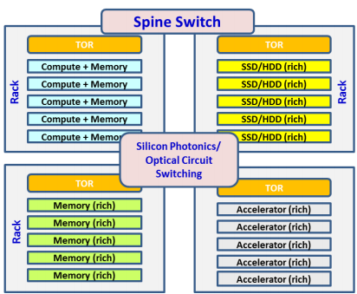
Future - The Composable Infrastructure
Each rack consists of nodes specialized into one type of resources (computing + memory, memory, accelerator or storage)
Resources can be shared in a fine-grained granularity
Resource nodes can be accessed by remote compute nodes
Cross-rack sharing is realized through silicon photonics/optical circuit switches
Key driver is the rapidly growing, memory-intensive workloads
Memory-intensive workload is increasing → need more memory for real time computing & BigData analytics. [MEMSYS, 2018]
Memory configuration growth substantially outpaced that of compute. → growth for memory demand has been approximately 2X of CPU demand. [Eurosys,2018]
Performance is a critical concern to ‘BigData‘, and in-memory computing will be the cure. [ISACA,2013] [SPIE,2013]
[FGCS,2017]

Slide 5
What Can Be The Problem?
 | Memory (DDR4) | GPU/NVMe (PCIe Gen3) | SSD | HDD
Latency | tens of ns | a few us | ~100 us | ~25 ms
Throughput | ~25GB/s | 15.8GB/s (x16) | ~100K OPS | ~ 75~200 OPS
Rack (~3m) | Silicon Photonics (+ ~15 ns)
PoD (~50m) | Optical Circuit Switch (+ ~250ns)
Datacenter (~200m) | Optical Circuit Switch (+ ~1 us)
Rocks on The Path
The speed of light – 300K km/s or 300M m/s; 3m distance (direct connect) will take 1/100M s or 10 ns
Cross-nodes memory sharing is a big challenge
The latency make it difficult to use CPU LOAD/STORE memory operations – the NUMA problems
Many application-level APIs/Libraries are designed to relief but they are complex.
So what can be the suitable use case of cross-nodes memory sharing considering the impacts from latency?

Slide 6
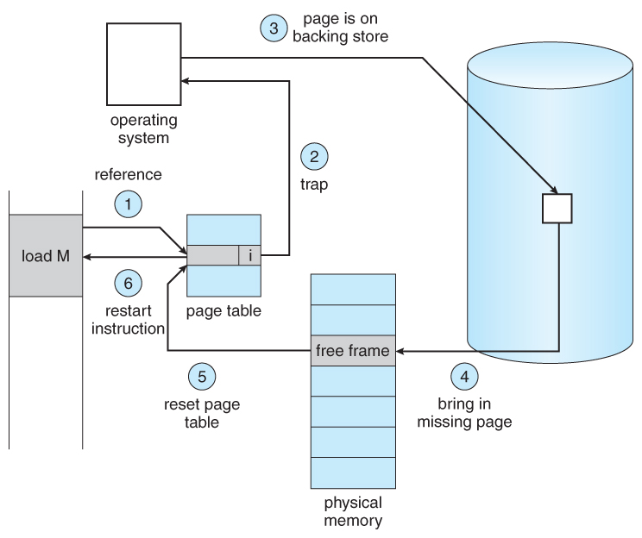
What Can Be The Opportunity?
Use cross-nodes memory sharing to SPEED UP virtual memory!
Modern OSes have paging system to extend the memory capacity physically attached
Paging is considered as the “last resort” because it relies on HDD with much higher (ns vs. ms or six-ordered) latency and operates extremely slow.
Consider the cross racks level latency:
Direct connect can be from ~250ns (Optical) to 5us (RoCE)
Switch latency from 30ns (Optical) – 2us (Ethernet) :
Still much faster than the device latency of SSD/HDD (100us ~ 25ms)
So, can we leverage these combinations as the paging system alternative?
Step3/4 are replaced by cross-nodes memory sharing
Virtual memory access latency can improve from ms to us or 3-ordered level
Lots of system design/behavior need re-visited/modeled/simulated

Slide 7
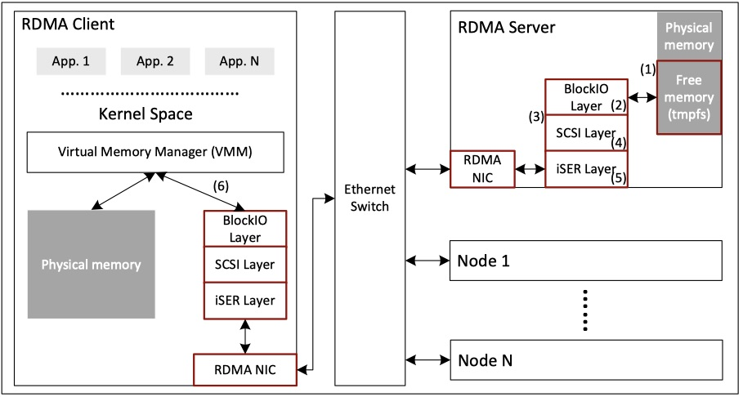
System Architecture Design
Use COTS H/W and mature system SW to construct a simplified PoC
Server constructs its unused memory as a block device
Client connects its VMM with the remote block device through SCSI/iSER and RDMA (verbs APIs, driver, and NIC)
Once the client requests more memory resources than locally attached, its VMM will swap memory pages to/from the memory pool on the remote server
No expensive proprietary H/W
No experimental system SW
No overhead introduced by Hypervisors
Good fits to Enterprise Container Applications

Slide 8
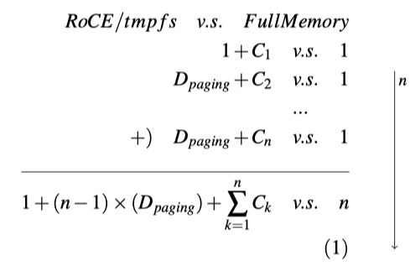
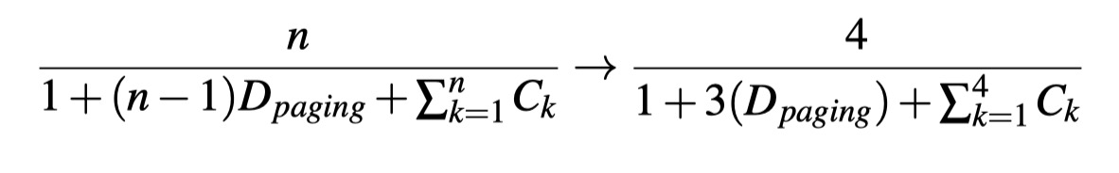
Generalized Performance Model
The performance between different memory access
What is the impact of using “local vs. remote” memory?
What if the workload requests n times of capacity compared with local memory?
Generalize the access time of 1 unit local memory as “1”
D_{paging} represents the multiples of 4KB page swap latency between local and remote memory, or Latency_{RoCE/tmpfs}/Latency_{LocalRAMDisk}
C_{k} represents the cost of OS VMM itself, which is assumed as a relatively small number and to be ignored before reaching the memory thrashing state.
Heuristically, it is a “low-bar” performance prediction model since we ignore all kinds of memory caching
If a client node runs a 256GB workload with only 64GB local memory (4 times); than its performance degradation is modeled by the ratio of two runtime durations:
Notes:
Heuristically, the “non-optimized” PoC can provide a “low-bar” performance result to understand its potential
It may guide us which parts are worth further optimization.
Assume:
a fixed access delay = 1 for 1 unit of local memory
a fixed access delay = Dpaging for 1 unit of remote memory
cost of VMM for each unit of remote memory
Workload consumes n units on a node with only 1 unit local memory
1 + (n-1)*Dpaging vs. n (ignore C)

Slide 9
Micro benchmark – LM_Bench & Intensive Write
Workload | LocalMemory | Ratio | Theoretical Degradation | Real Duration Slowdown (LocalMemory=WL Size/64GB) | Accuracy
128GB | 64GB | 2 | 0.4 | 0.44 | 91%
256GB | 64GB | 4 | 0.31 | 0.28 | 90%
512GB | 64GB | 8 | 0.28 | 0.25 | 88%
1TB | 64GB | 16 | 0.26 | 0.21 | 77%
Use lat_pagefault() of LM_Bench to get 4KB page access latency and count D_{paging}
local RAMDisk: 0.94us vs. remote RoCD/tmpfs: 3.8us
When n = 2; the formula tells the degradation should be: 2/1+(2-1)* D_{paging} -> 2/1+(3.8/0.94) ~= 0.4 (Ignore the C_{k})
Use home-made workload: intensive-write, and we get the total execution time of two LocalMemory size:
128GB: 55 sec vs. 64GB: 136 sec => 55/136 ~= 0.44
In general, the prediction works fine before Ratio < 8; we argue that C_{k} will play bigger under a higher multiple

Slide 10
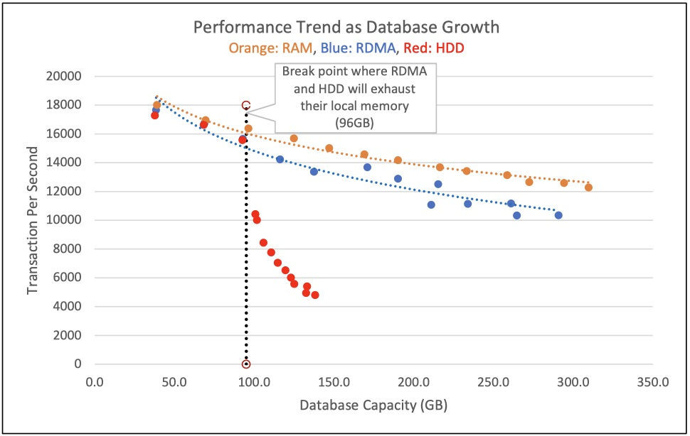
System benchmark – VoltDB/TPCC
A system benchmark can provide a better & closer to real-world picture about system performance
More complex compute & memory access patterns
Caching
VoltBD/TPC-C will simulate all activities of on-line transactions (add, delete, update, query, etc.) in its “in-memory” database
Report the “transactions/sec” as its performance indicator.
VoltDB/TPC-C can extend its capacity (database size) from 90GB to:
270GB (300%) with 11.7% throughput degradation
360GB (400%) with 17.6% throughput degradation

Slide 11
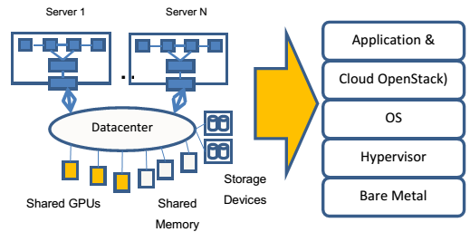
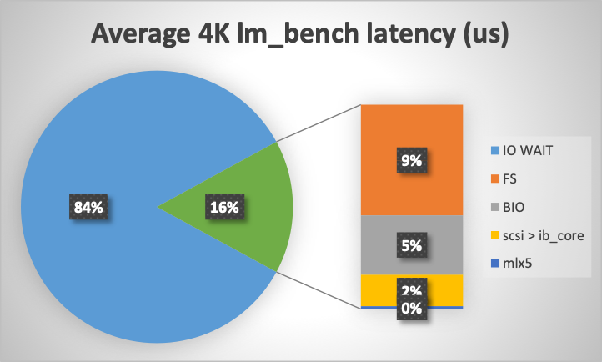
Conclusion & Future Work
[FGCS,2017]
The proposed system is worth more comprehensive studies
A new direction of deploying memory-intensive workloads on nodes without sufficient memory; which is too expensive or just impractical and never considered as an option before.
New research topics are emerging
The last piece of Software-Defined X: Composable Memory
Application-centric memory over-commit technique
Memory-driven computing infrastructure
Simulation & Modeling community play an important role in the era of memory-driven computing
Model the sensibility of degradation of different memory access patterns atop different System SW and memory technologies (e.g. local vs. remote; DDR4 vs. 3D XPoint vs. Memorist)
Simulate a specific memory access pattern atop different System SW and memory technologies, so we can develop the cost-performance matrix for a specific workload.

Slide 12
Takeaway
Market trends: the demand for BigData analytics is substantially increasing
[IDC, 2017] [IDC, 2017], [IDC,2016], [ISACA,2013] [SPIE,2013]
Challenge: memory vs. computing ratio is unbalanced & resources are wasted
[Eurosys,2018], [MEMSYS, 2018], [Network World, 2018], [Stanford University & Anthesis Group, 2015], [EcoCloud, 2014], [ACM, 2012]
Opportunity: the birth of “killer microseconds technologies” (e.g. GPU vs. Deep Learning)
[Attack, 2017]
Our work: develop/leverage better simulation/modeling technologies to improve heuristic designs for the next-gen system architecture
[HPC, 2019]

Slide 13
Quick References
[HPC, 2019] - More exploration to composable infrastructure - the application and analysis of composable memory
[Eurosys,2018] - Welcome to zombieland: Practical and Energy-efficient memory disaggregation in a datacenter
[MEMSYS, 2018] - A Comprehensive Memory Analysis of Data Intensive Workloads on Server Class Architecture
[Network World, 2018] - Facebook and Amazon are causing a memory shortage
[FGCS,2017] Composable architecture for rack scale big data computing [Synergy Research Group, 2017] - Hyperscale Data Center Count Approaches the 400 Mark; US Still Dominates
[IDC, 2017] - Top 10 data center predictions: IDC
[IDC,2016] - Worldwide Semiannual Big Data and Analytics Spending Guide
[Intel, 2016] - System Memory at a Fraction of the DRAM Cost
[Stanford University & Anthesis Group , 2015] - New data supports finding that 30 percent of servers are 'Comatose', indicating that nearly a third of capital in enterprise data centers is wasted
[EcoCloud, 2014] - Memory-Centric Server Architecture
[ISACA,2013] - In-memory Computing—Evolution, Opportunity and Risk
[SPIE,2013] - IN-MEMORY COMPUTING YIELDS REAL-TIME INSIGHTS FROM BIG DATA
[ACM,2012] - Heterogeneity and dynamicity of clouds at scale: Google trace analysis

Slide 14
Thank you
Ruan, Wo-Hao (Michael)
michael.ruan@hpe.com
d06922037@ntu.edu.tw
https://github.com/HewlettPackard/HPEVM

