Slide 1

HPE Reference Configuration
Deploying Kubernetes, Portworx PX-Enterprise on HPE Synergy
November 2017
Notes:
Today, we’re talking about the HPE Reference Configuration for deploying Aqua Container Security Platform with HPE Synergy. This reference architecture can help you secure container-based applications for production deployment.
Let’s take a look.

Slide 2
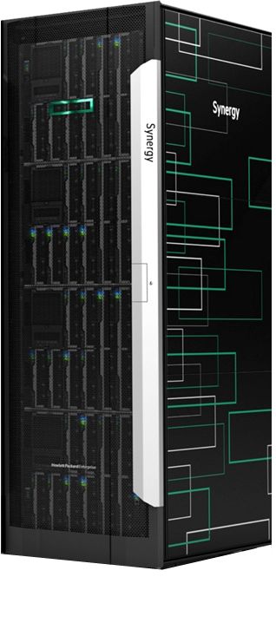
Deploying Docker Containers at Scale
HPE Synergy
Composable Infrastructure
Compute and Storage
Fabric
Rapid image-based deployment
Composer with embedded OneView
Image Streamer
Kubernetes
Portworx
Container Orchestration
Optimized container placement across a cluster of servers
Applications availability is managed
Built-in Services and Load Balancing
Services like IP addressing, DNS, and Load-balancing provided into apps
Self-healing
Containers replaced and rescheduled based on server and app-level checks
Elastic Container Storage
Increase number of stateful containers per server (example Cassandra rings)
Enables HA for any stateful application
Container Data Lifecycle Management
Volumes automatically get snapshots, encryption, and backup to object stores
Scheduler-complete Integration
Dynamic storage provisioning with automatic hyper-convergence
Notes:
Kubernetes is an open-source system for automating deployment, scaling, and management of containerized applications
Features:
Automatic binpacking,
Self-healing,
Horizontal scaling,
Service discovery and load balancing,
Automated rollouts and rollbacks,
Secret and configuration management
Storage orchestration
Batch execution

Slide 3
Kubernetes and Portworx setup configuration diagram on HPE Synergy

Slide 4
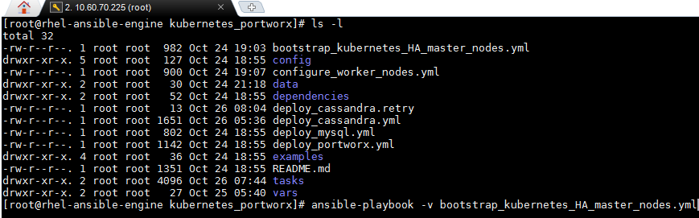
Bootstrapping the Deployment of Kubernetes HA Master Nodes on Virtual Machines
Script VM
API server
Automates master nodes deployment
compute
etcd
scheduler
compute
pod master
controller manager
data
apps
data
apps
Configures Docker and Kubernetes
kubelet
monit
Portworx + Kubernetes worker
(bare-metal on HPE Synergy 480 Gen10)
Kubernetes Master Node
(HA VMs on 480 Gen10)
Kubernetes HA Master Nodes
Ansible bootstraps master nodes, configures Docker and Kubernetes services. Configures load balancer and dashboard
Ansible bootstrap master nodes
Script VM
Bootstraps Kubernetes HA master nodes using Ansible playbooks

Slide 5
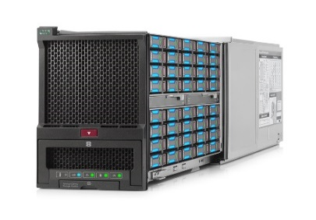
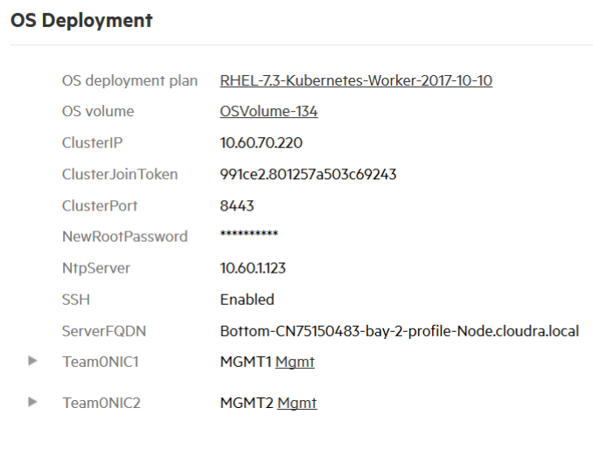
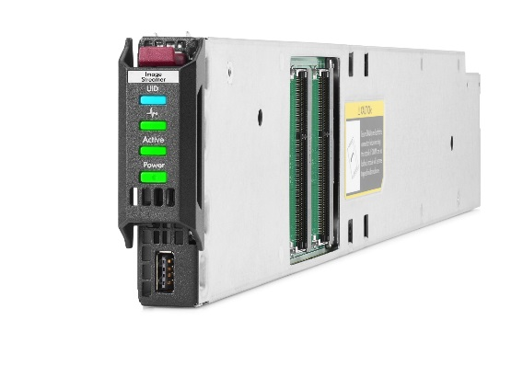
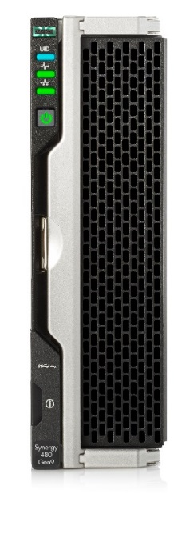
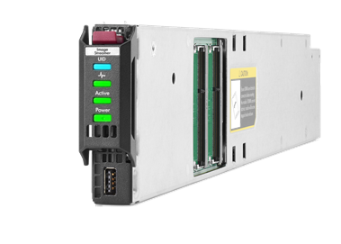
Bootstrapping the deployment of Kubernetes worker nodes on HPE Synergy
OS Image to Deploy
Block storage is presented to compute nodes. Portworx manages disks presented to nodes and provides container volume for running stateful apps
Initiates deployment plan
HPE Synergy D3940 Storage Module
Configures boot image
System configuration settings
Ansible
User triggers the ansible playbook
HPE Synergy Image Streamer
Creates bootable OS baked with Kubernetes services and Docker engine. Personalizes OS, Kubernetes and Docker per deployment plan
HPE Synergy Compute and Storage
Compute node boots directly into a running OS. Node joins automatically to Kubernetes and Portworx cluster
HPE OneView
Selects a deployment plan
Sets personalization parameters
Provisions physical infrastructure
Notes:
User triggers ansible playbook to provision worker nodes. Ansible talk to OneView to provision physical server with OS deployment.
OS deployment happens through Image Streamer

Slide 6
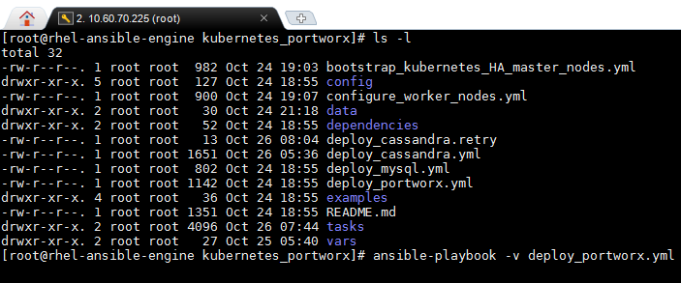
Automating the Deployment of Portworx on HPE Synergy
Script VM
HPE Synergy D3940 Storage Module
Automates installation of Portworx
Block storage is presented to computes nodes. Portworx manages disk presented to nodes and provides container volume for running stateful apps
Configures hardware for Portworx
Ansible installs Portworx
Kubernetes Worker Nodes
Nodes are assigned with disks from D3940.
Ansible bootstraps Portworx installation.
Portworx fingerprints the disks and creates the Portworx volume
Script VM
Bootstraps Portworx using Ansible playbooks

Slide 7
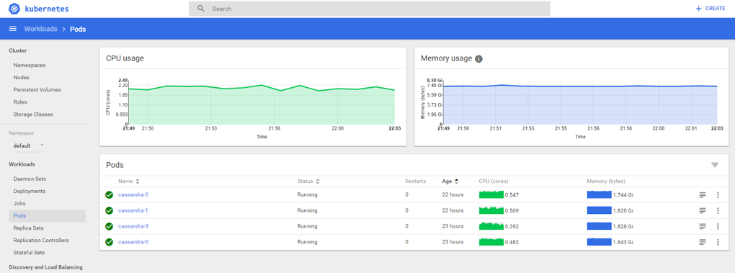
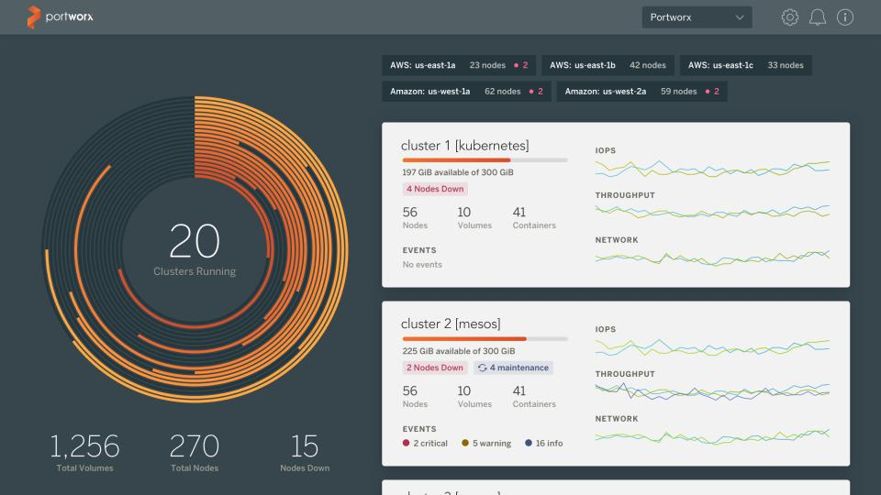
Deploying Cassandra with Kubernetes and Automating Persistent Volumes with Portworx
Cassandra deployed and managed as a StatefulSet and visible in the Kubernetes dashboard
Portworx volumes dynamically created with application deployments and visible from the management console
kublet
Docker
Cassandra-1
kublet
Docker
compute
Cassandra-1
Cassandra-1
kublet
Docker
compute
Cassandra-2
kube-proxy
compute
Cassandra-2
Kubernetes Worker Nodes
Every server is capable of running many Cassandra rings with compute containerization by Kubernetes and storage containerization by Portworx
kube-proxy
Cassandra-2
kube-proxy
Cassandra-3
PX-Enterprise
data
Cassandra-3
apps
PX-Enterprise
data
Cassandra-3
PX-Enterprise
data
apps
apps
Portworx + Kubernetes worker
(bare-metal on HPE Synergy 480 Gen10)
Portworx + Kubernetes worker
(bare-metal on HPE Synergy 480 Gen10)
Worker Nodes with Portworx + Kubernetes
(HPE Synergy 480 Gen10)

Slide 8
For more information:
HPE Reference Configuration for Kubernetes, Portworx PX-Enterprise on HPE Synergy
https://h20195.www2.hpe.com/V2/GetDocument.aspx?docname=a00039700enw
Kubernetes Persistent Storage on Portworx
https://portworx.com/use-case/kubernetes-storage/
Docker Storage on Portworx
https://portworx.com/use-case/docker-persistent-storage/
Persistent Storage for DC/OS on Portworx
https://portworx.com/use-case/persistent-storage-dcos/

