Slide 1
Demo: Kubernetes and Portworx on HPE Synergy
Oct-2017
Automated k8’s cluster deployment
With ansible

Slide 2
Infrastructure Setup Notes
All managements components like Kubernetes masters ( PX components ) , Etcd cluster will run on VM
VM infrastructure runs on 3 ESX nodes ( clustered )
VM Datastore created using local disks, managed using VSA
Optionally – you can use 3PAR if you are already using it your environment
RA setup will have 3 Synergy frames with 2 blades in each frame ( SY 480 G10 )
Blades will act as kubernetes worker nodes
Two frames will have Storage module D3940
PX should configure/present volumes to non storage compute nodes ( nodes in top frame )
Synergy composer and Image Streamer will provision physical server with OS
Golden image RHEL 7.3 will have Docker EE and Kubernetes components
Nodes will be provisioned and joined to kubernetes master automatically
End goal is to simplify the Kubernetes and PX cluster with click of a button
Scale the cluster on demand with click of a button
Provide persistent storage for statefull containers and apps
Please see the high level block diagram in the next slide

Slide 3
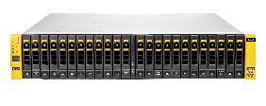
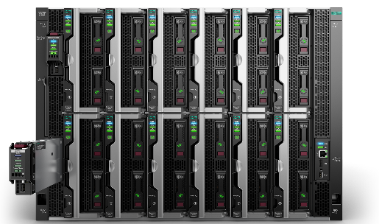

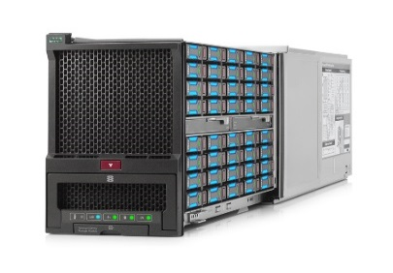
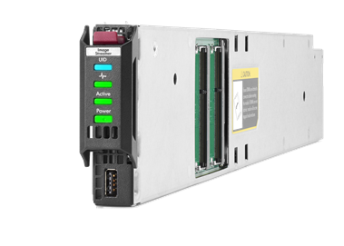
Kubernetes and Portworx setup configuration diagram on Synergy ( RA Target Env )
Optional
VMware vSphere® 6.0 HA Cluster
Management nodes Gen9
( VMs)
Other VMs
HPE 3PAR StoreServ 8200 All-Flash Array
Portworx engine
VM
Stateless Storage for Workers
3x HPE Synergy 12000
Kubernetes master node comp
VM
Docker Engine
VM
Top Frame
Stateless Bare-Metal Kubernetes Workers
SAS Volumes for
Docker Images
Temp files
Swap
iSCSI Boot Volume (OS + Docker EE + Kubernetes)
Kubernetes pods/Applications
Kubernetes Workers
(Bare-Metal RHEL 7.3 on HPE Synergy 480 Gen10 )
Middle Frame
…
HPE Synergy D3940 Storage Module
HPE Synergy
Image Streamer
Worker 1
Worker 2
Worker N
Bottom Frame
Notes:
Production-ready Docker Container-as-a-Service
Accelerate deployment and improve manageability by deploying Docker solutions with HPE Hyper Converged 380, HPE ITOM software, and HPE support—offering greater speed and ease of scalability.
Why Docker on HPE Hyper Converged 380?
Faster, simpler, more manageable, and affordable containers
Deployment confidence—Validated and tested on the HPE Hyper Converged 380 appliance, and supported by HPE and Docker
Simplified IT operations—Integrates multiple tools, automates complex tasks, and integrates lifecycle management; enables IT generalists to deploy and manage the infrastructure
Reduced CAPEX and OPEX—Includes HPE HC380 software-defined intelligence to reduce the cost of purchasing a Docker infrastructure
Highly available—Offers industry-leading performance and availability (up to five nines); leverages built-in data protection capabilities of HPE StoreVirtual
Rapid deployment—Quickly deploy the Docker engine to a virtual machine in a few clicks
Scalable—Enables you to expand your environment by adding capacity with no downtime

Slide 4
Software Versions
Synergy Composer v3.1
Synergy Image Streamer v3.1
Docker EE 17.06
Portworx PX 1.2.10
Kubernetes v1.7.4
RHEL 7.3

Slide 5
Demo: Automation with Ansible
Bootstrapping kubernetes master node cluster ( HA setup )
3 master nodes
External etcd cluster
Load balancer
Dashboard
Grow cluster: Provision synergy physical nodes and join kubernetes cluster
Create server profile with OS deployment
Extend the cluster by joining nodes automatically
Deploy Portworx
Deploy statefull pod ( mysql )
Note: We will have master playbook to orchestrate end-end

Slide 6
Pre-reqs
OneView and Image Streamer setup
Min one or more nodes
Template
RHEL 7.3 OS image with dependencies like docker engine and kubernetes components
ESXi and vCenter environment to deploy VMs
3 RHEL 7.3 VMs
Script VM ( for running ansible )
Internet access to nodes/vms

