Slide 1
Xtime-sst
John Moon
February 8, 2023

Slide 2
Schematic
Control/Demux (Data packet)
Control/Accum. (Result packet)
Control
Router
Demux
Accumulator
Router
Core/Demux (Data packet)
Core/Accum. (Result packet)
Router
Router
Router
Router
Core
Driver
aCAM
MMR
MEM
Adder
Demux (Data packet)
Accumulator (Result packet)
Core
Core
Core
Core

Slide 3


Flowchart
python
C++
readArg
noc.py
utils.py
readArg
readArg
readComponent
configureNoc
configureSST
SST
default.py
readModel
model.npy
genPacket
y_test.npy
x_test.npy
y_test.dat
x_test.dat
<component>.txt
result.txt

Slide 4
REadArg
readArg - Read the arguments from the command prompt - Send the arguments to ‘readComponent’ and ‘readModel’ functions
Parameters dataset: Name of dataset {churn, eye, forest, gas, gesture, telco, rossmann} task: Type of task {classification, regression} model: Type of model {catboost, xgboost, rf} numTree: Number of tree per class {202} numSample: Number of test samples {2000} numBatch: Batch size {1} config: Name of configuration file {default} noc: Type of NoC {tree, bus} verbose: Output verbosity {1, 0 ~ 5}
Return arg: Arguments
readArg
arg

Slide 5
ReadComponent
readComponent - Read the component parameters from the ‘config’ file - Send the component parameters to ‘configureNoc’ functions - List of components: {control, demux, driver, acam, mmr, memory, adder, accumulator}
Return componentConfig: Component configuration (NoC layout, component parameters)
readComponent
default.py
componentConfig
[default.py format]
noc = {
'tree' : {
'numPortControl' : 4, # Number of ports of control
'numPort' : 4, # Number of ports of demux/accumulator
'numLevel' : 5, # Number of levels of sub-tree
'mappingCore' : 'numTreePerCore’, # Compiling option for core {'continuous', 'numTreePerCore'}
'mappingNoc' : 'numCoreClass', # Compiling option for NoC {'continuous', 'numCoreBatch', 'numCoreClass'}
'numCoreClass' : 512, # Minimum number of cores per class (Active when 'mappingNoc' is 'numCoreClass')
'numCoreBatch' : 256, # Minimum number of cores per batch (Active when 'mappingNoc' is 'numCoreClass' or 'numCoreBatch')
'numTreePerCore' : 1, # Number of trees per core (Active when 'mappingCore' is 'numTreePerCore')
'sizeBus' : 32, # Size of bus (flit)},
'linkLatency' : {
# If latency is initialized as 0, it will be updated to latency depending on the data size from 'utils.configureNoC()’. Otherwise, it is fixed as given value in ns scale.
'Control-Demux' : 0, # Latency between control and demux
'Demux-Core' : 0, # Latency between demux and core
'Core-Accumulator' : 0, # Latency between core and accumulator
'Accumulator-Control' : 0, # Latency between accumulator and control
'Demux-Demux' : 0, # Latency between demuxs
'Accumulator-Accumulator' : 0, # Latency between accumulators
'Driver-Acam(EN)' : 1, # Latency between driver and acam (enable signal)
'Driver-Acam(DL)' : 1, # Latency between driver and acam (data signal)
'Acam-Mmr' : 1, # Latency between acam and mmr
'Mmr-Memory' : 1, # Latency between mmr and memory
'Memory-Adder' : 1, # Latency between memory and adder
'Acam-Acam' : 1, # Latency between acams},
}
control = {
'latency' : 1, # Number of cycles to process data
'freq' : '1GHz’, # Component frequency
}
acam = {
'latency' : 4, # Number of cycles to process data
'freq' : '1GHz’, # Component frequency
'acamQueue' : 1, # Number of queued acams in a core
'acamStack' : 1, # Number of stacked acams in a core
'acamCol' : 32, # Number of acam column
'acamRow' : 256, # Number of acam row
}

Slide 6
ReadModel
readModel - Read the model. - Send the model to 'configureNoC' function.
Parameters numFeature: Number of features numClass: Number of class numLeafPerClass: Number of leaves (branches) per class numTreePerClass: Number of tree per class.
Return modelConfig: Model configuration (Dataset parameters, Model threshold/logit map)
readModel
model.npy
modelConfig
Example branch - First tree of the second class, Dataset with 3 features - A list of conditions (Feature#0 < 0.5, 5.5 <= Feature#1 < 10.5), A leaf value (3.1)
[model.npy format]
Th_L (F#0), Th_H (F#0), Th_L (F#1), Th_H (F#1), Th_L (F#2), Th_H (F#2), Leaf value, Class ID, Tree ID [np.nan, 0.5, 5.5, 10.5, np.nan, np.nan, 3.1, 1, 0 ]

Slide 7
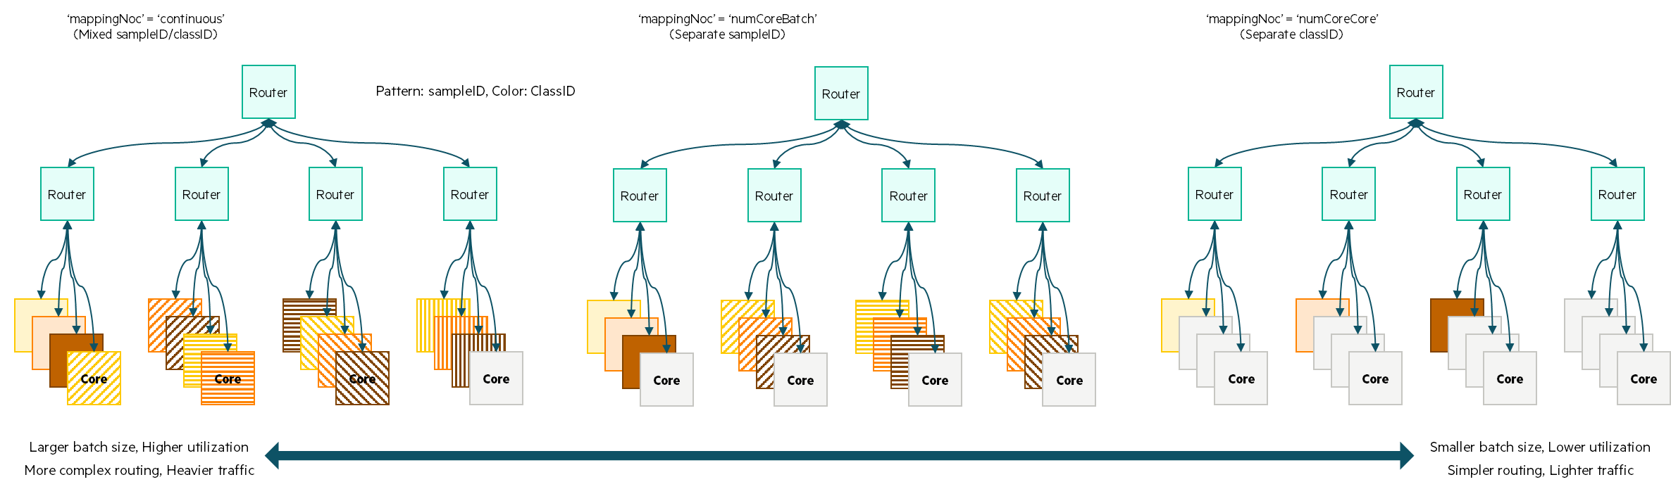
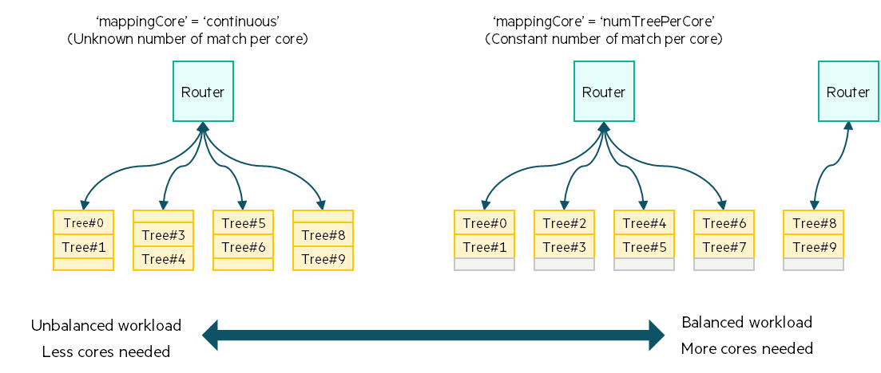
configNoc
configNoc - According to the compiling options, convert the model to the data for programming the components.
Parameters mappingCore: Compiling option for core {continuous, numTreePerCore} mappingNoc: Compiling option for NoC {continuous, numCorePerBatch, numCorePerClass}
Return nocConfig: NoC configuration (Data for programming the components) inputConfig: Input packet configuration
configureNoc
readModel
componentConfig
nocConfig
modelConfig
inputConfig

Slide 8
genPacket
inputConfig
genPacket - Generate input packet by adding sample ID, routing info to raw input data. - Write the input packets in data format(.dat).
readModel
genPacket
y_test.npy
x_test.npy
y_test.dat
x_test.dat

Slide 9
Control
Control - Send the data packets, receive the result packets, and predict the class label/regression result.
Parameters - task: Type of task - numPortControl: Number of ports - numFeature: Number of input features - numSample: Number of test samples - numLevel: Number of sub-tree levels - numClass: Number of classes - numTreePerClass: Number of trees per class - numBatch: Number of batches - numInputConfg: Number of input packets per batch - mode: Port configuration - xFile: Name of input data file - yFile: Name of truth file - outputDir: Path of output files
Input (Result packet) - Logit result (double), sampleID (int), classID (int), sumTree (int)
Output (Data packet) - Data (vector<double>), routing info (vector<int>), sampleID (int)
Control
numPortControl
numPortControl
Data (To level 0 demux)
Result (From level 0 acc.)

Slide 10
Demux
Data (From level i-1 demux or control)
Demux - Receive the data packet, and distribute its copies to the ports according to 'mode' and routing info in the packet.
Parameters - level: Level in tree NoC - numPort: Number of output ports - mode: Demux mode (e.g. [3, 1] = Port#0~#2 tied, Port#3 independent) - outputDir: Path of output files
Input (Data packet) - Data (vector<double>), routing info (vector<int>), sampleID (int)
Output (Data packet) - Data (vector<double>), routing info (vector<int>), sampleID (int)
Demux
Accumulator
numPort
Data (To level i+1 demux)

Slide 11
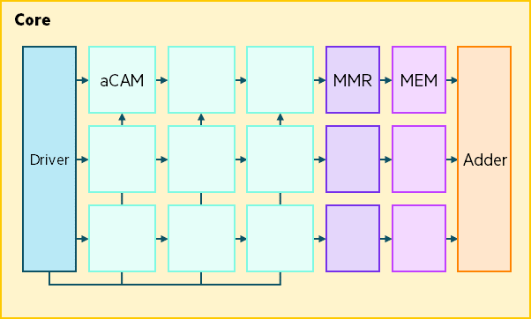
Driver
Data (From demux)
Driver - Receive the data packet, and apply data and enable signal to ‘acam’s.
Parameters - acamQueue: Number of queued acams - acamStack: Number of stacked acams - acamCol: Number of acam column - acamRow: Number of acam row
Input (Data packet) - Data (vector<double>), routing info (vector<int>), sampleID (int)
Output-DL (Data) - Data (vector<double>), sampleID (int)
Output-EN (Enable signal) - Enable (vector<int>), sampleID (int)
Driver
acamQueue*acamStack
acamStack
Data (To every acams in core)
Enable (To acams in the first column)

Slide 12
ACAM
Data (From driver)
Enable (From driver or previous acam)
Acam - Evaluate a list of conditions (acamThLow <= dl < acamThHigh) per row when the enable singal vector (en) is arrived. If every condition is true, the match result is also true.
Parameters - acamCol: Number of column in acam - acamRow: Number of row in acam - acamThLow: Low threshold - acamThHigh: High threshold - acamThXLow: Low ‘don’t care’ (1: ‘don’t care’) - acamThXHigh: High ‘don’t care’ (1: ‘don’t care’)
Input-DL (Data) - Data (vector<double>), sampleID (int)
Input-EN (Enable signal) - Enable (vector<int>), sampleID (int)
Output (Match result) - Match result (vector<int>), sampleID (int)
Acam
Match result (To next acam or mmr)

Slide 13
MMR
Match result (From acam)
Mmr - Receive data packet (match vector) from 'acam', convert the match vector to the address, and send data packet (address) to 'memory'.
Parameters -
Input (Match result) - Match result (vector<int>), sampleID (int)
Output (Address) - Address result (int), sampleID (int)
mmr
Address result (To memory)

Slide 14
Memory
Address result (From mmr)
Memory - Receive data packet (address) from 'mmr', and send result packet (logit) to 'adder'.
Parameters - logit: Data stored in the memory - classID: Class ID of the stored data
Input (Address) - Address result (int), sampleID (int)
Output (Result packet) - Logit result (double), sampleID (int), classID (int)
Memory
Logit result (To adder)

Slide 15
Adder
Logit result (From memory)
Adder - Accumulate the input results. - sumTree indicates how many tree contributes its result.
Parameters - numPort: Number of input ports
Input (Result packet) - Logit result (double), sampleID (int), classID (int)
Output (Result packet) - Logit result (double), sampleID (int), classID (int), sumTree (int)
Adder
numPort
Logit result (To accumulator)

Slide 16
Accumulator
Logit result (To level i-1 acc. or control)
Accumulator - Receive the result packets, and accumulate them, which have same sampleID and classID.
Parameters - numPort: Number of input ports - mode: Accumulator mode (0:accumulate, 1:bypass)
Input (Result packet) - Logit result (double), sampleID (int), classID (int), sumTree (int)
Output (Result packet) - Logit result (double), sampleID (int), classID (int), sumTree (int)
Demux
Accumulator
numPort
Logit result (From level i+1 acc. or adder)

