Slide 1
Performance Analysis of Interconnection Networks with Source-Code Attribution
Adarsh Yoga and Milind Chabbi
14 August 2017

Slide 2
Motivation
State-of-the-art developer tools for performance analysis measure in-node, CPU-only metrics
Interconnection networks are a significant fraction of execution time
Data movement cost exceeds cost of computing on the data
Network remains a black-box from a developer’s perspective

Slide 3
Challenge of Data Movement
Bottlenecks can occur in,
Local NIC
Switch hops
Destination NIC
Forward/return path
Intra/Inter job interference
Topology/routing algorithms
Hardware provisioning
Node
Node
NIC
NIC
Switch
Switch
Node
Node
NIC
NIC
.
.
.
.
.
.
Switch
Switch
Node
Node
NIC
NIC

Slide 4
Challenge of Data Movement
Bottlenecks can occur in,
Local NIC
Switch hops
Destination NIC
Forward/return path
Intra/Inter job interference
Topology/routing algorithms
Hardware provisioning
Node
Node
NIC
NIC
Switch
Switch
Node
Node
NIC
NIC
.
.
.
.
.
.
Switch
Switch
Node
Node
NIC
NIC

Slide 5
Need Detailed Insight
Detailed insight into the data movement and consequence on application source code
Need telemetry of,
Congested switches
Path traversed and its effect on latency
Delays associated with link-level credits
Delays introduced by destination node hardware/software
Node
Node
NIC
NIC
Switch
Switch
Node
Node
NIC
NIC
.
.
.
.
.
.
Switch
Switch
Node
Node
NIC
NIC

Slide 6
Refactor Software
Many performance problems can be fixed by simple refactor of application source code
For example, if lock release is frequently affected by network delays, then use higher priority VC for lock release
Node
Node
NIC
NIC
Switch
Switch
Node
Node
NIC
NIC
.
.
.
.
.
.
Switch
Switch
Node
Node
NIC
NIC

Slide 7
Our Work
Goal: Identify performance problems that occur in the network and co-relate to application source code.
Approach:
Track the movement of packets through the network
Collect performance metrics about the packets at every step
Attribute metrics to application source code
Aid application developer with rich visualization and automatic data ingestion

Slide 8
Overview
Input MPI program
Performance Stats Collection
Path Construction
Performance Visualization
Output graphs

Slide 9
Performance Stats Collection
Tracking all messages/packets is expensive
Use sampling to randomly/smartly select messages to monitor
A single bit (PM bit) in packet header used to track packets that are selected to be monitored (marked packet)
Advantages: Unsynchronized data collection in concurrent autonomous many-component systems
Hop-by-hop path synchronous metrics
Propose extensions to network components to enable efficient performance stats collection for every marked packet

Slide 10
Node-side Stats Collection
Software profiler selects a message at random and marks it to be tracked
Both source and destination nodes collect stats for a marked message
Stats: source node id, destination node id, message id, departure time/arrival time, application side calling context
Switch
Switch
Source Node
Dest Node
Switch
Switch
Node log
Node log

Slide 11
NIC and Network-side Stats
For a marked message, NIC hardware selects one among N packets and sets PM bit in header
Could select more than one packet
NIC and switch collect stats for the packet if PM bit set
Stats: output port, arrival time, departure time, buffer size, credits
Switch
Switch
Source Node
Dest Node
NIC
NIC
Switch
Switch
Nic log
Nic log
Switch log
Switch log

Slide 12
Hardware Extensions
Goal is to minimize time spent in logging performance stats at NIC and Switch
Log to a on-chip circular bounded buffer and a independent hardware component periodically drains logs from the buffer
NODE
SWITCH
SWITCH
NIC
DRAINER
DRAINER
DRAINER
Drainer periodically reads from buffer and write to a collection server (NFS mounted file)
NIC and switch add logs to the end of buffer

Slide 13
Implementation – SST/Macro
Simulator for large-scale interconnection networks
Emphasize coarse-grain approximations over accuracy
Pros:
Modular design; can be easily extended with additional network components
Perform analysis of varying network design parameters like machine models, packet flow models and topologies
Model realistic applications using Skeletons – MPI communication with limited computation
Notes:
It permits the coarse-grained study of distributed-memory applications.
For large, system-level experiments with thousands of network endpoints, high-accuracy cycle-accurate simulation is not possible, or at least not convenient. Simulation requires coarse-grained approximations to be practical.

Slide 14
SST/Macro for Stats Collection
Extended to Node module implementation to
randomly select messages to monitor
Log node side performance statistics
Implemented the Drainer as sub-component of the Node and Switch module and added buffers to hold the logs
Extended the Nic and the Switch module to collect performance statistics and write to the buffers
Collect machine configuration information that shows how nodes and switches are connected
Output: Set of log files containing performance statistics for monitored packets and machine configuration information
Notes:
It permits the coarse-grained study of distributed-memory applications.
For large, system-level experiments with thousands of network endpoints, high-accuracy cycle-accurate simulation is not possible, or at least not convenient. Simulation requires coarse-grained approximations to be practical.

Slide 15
Overview
Input MPI program
Performance Stats Collection
Path Construction
Performance Visualization
Output graphs

Slide 16
Path Construction
Post mortem pass to identify the path taken by each logged packet and compute delay (and other metrics) at each step
Read all the logs into memory in parallel
Use unordered maps to store per-component configuration information; indexed by port number
Use ordered maps to store per-component performance statistics information; indexed by the time the packet arrived at the component
Notes:
It permits the coarse-grained study of distributed-memory applications.
For large, system-level experiments with thousands of network endpoints, high-accuracy cycle-accurate simulation is not possible, or at least not convenient. Simulation requires coarse-grained approximations to be practical.

Slide 17
Path Construction Algorithm
Node log 0
Obtain next hop log using output port and config info
Switch log 0
Node log i
For each log entry of a packet originating for the same node
…
0,i, …,port,dep time
…
…
0, …,port,dep time
…
…..
……
Use departure time + delta to find a range of entries. Then use src id, dest id, message/packet id to find exact entry
…
…
Node log n
…
0,i, …,port,dep time
…
Repeat the same process for all n Nodes in parallel
……
Notes:
It permits the coarse-grained study of distributed-memory applications.
For large, system-level experiments with thousands of network endpoints, high-accuracy cycle-accurate simulation is not possible, or at least not convenient. Simulation requires coarse-grained approximations to be practical.

Slide 18
Overview
Input MPI program
Performance Stats Collection
Path Construction
Performance Visualization
Output graphs

Slide 19
Performance Visualization
Idea is to identify messages that took the most amount of time
Identify a pattern among the messages, e.g. all the slow messages happened in a small time window
Identify patterns for e.g. the slow messages were due to a bottleneck in a particular component
Notes:
It permits the coarse-grained study of distributed-memory applications.
For large, system-level experiments with thousands of network endpoints, high-accuracy cycle-accurate simulation is not possible, or at least not convenient. Simulation requires coarse-grained approximations to be practical.

Slide 20
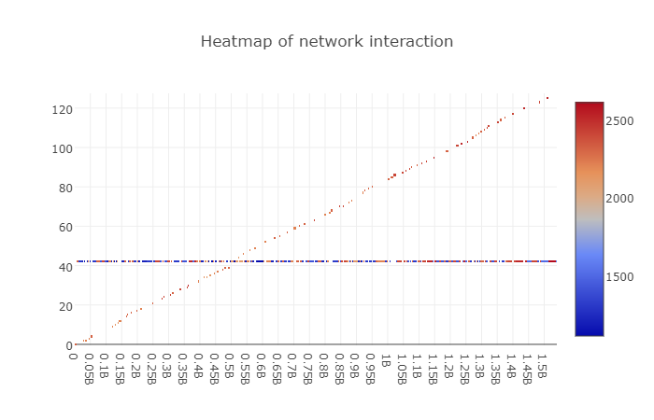
Heatmaps
Messages from node 80 and above appear darker; taken the most amount of time

Slide 21
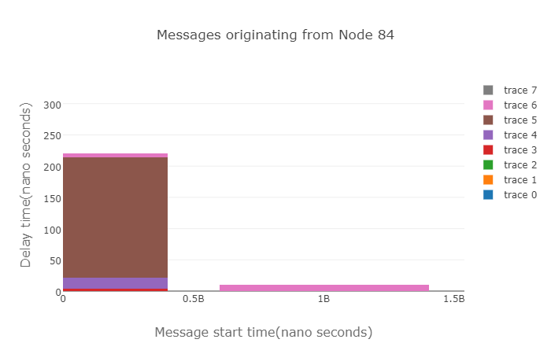
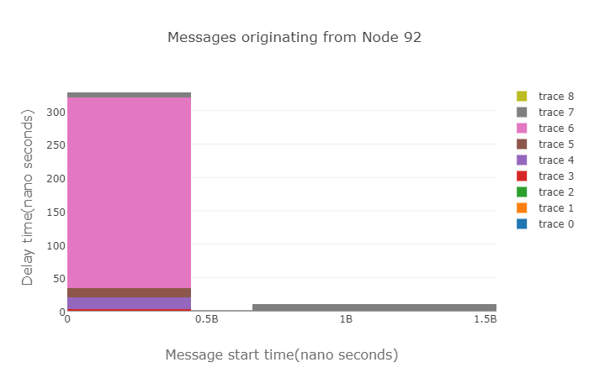
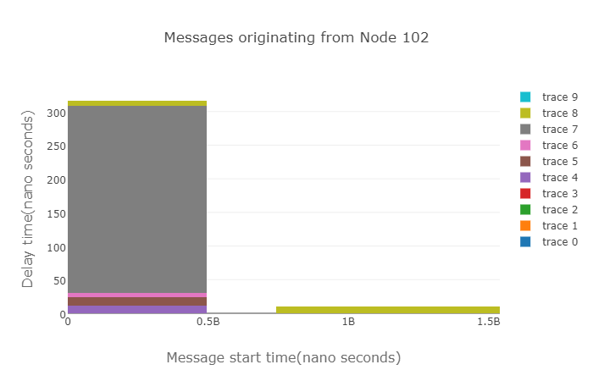
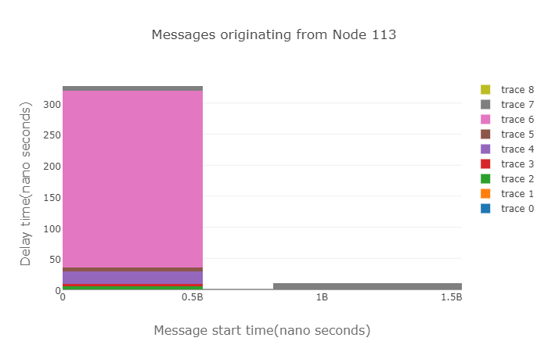
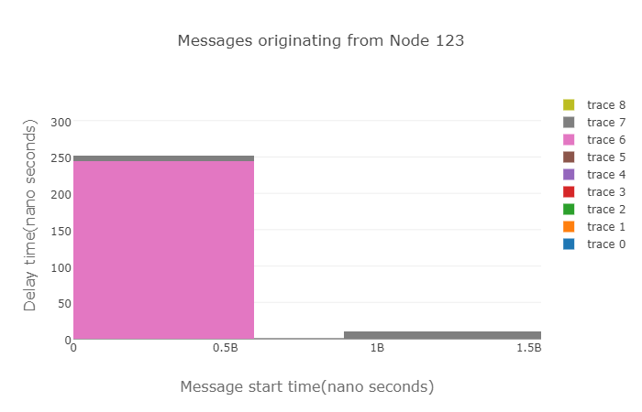
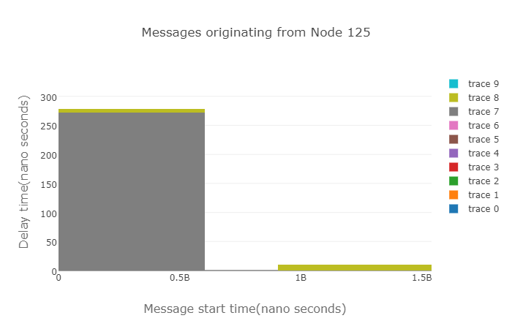
Per-component Bar Graphs
The most time is spent in Switch 21 for all graphs

Slide 22
Conclusion and Future Work
Light-weight network monitoring is essential to provide deeper insights in to performance problems
Solution: protocol extensions, hardware extensions and software solutions to provide deeper insights into performance problems
Designed and prototyped an extendable performance analysis framework with broad applicability
Todos:
Tie CPU-side calling context for source attribution
Collect detailed component level metrics (queue length, arbitration)
Evaluate on real-world large-scale applications
Incorporate into PathForward/GenZ switch and bridge ASICs

