Slide 1

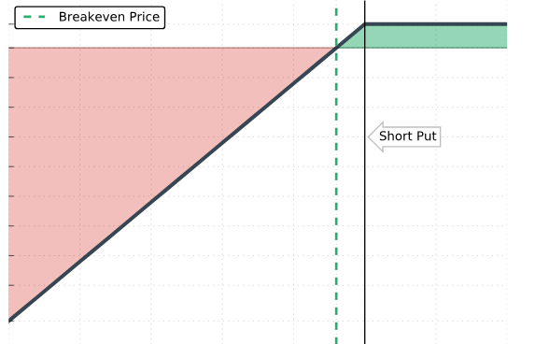
Put Trading Strategy
Hexin Liu, Kun Tang, Yuheng Wang, Mohamed El Hibouri

Slide 2

Background / Executive Summary / Overview / Analysis / Results
Project Background
Focus on ETF with large, liquid options market
Search for 2-year low closing price in ETF
Construct put strategy - Find deep out-of-money options to sell
Develop analytical recommendation application for put trading
Sources: Group analysis

Slide 3
Background / Executive Summary / Overview / Analysis / Results & Visualization
Executive Summary
Process
Collect & Clean Data: NASDAQ Test of Independent on Growth Rate: Autocorrelation Choose Simulation Method: Autocorrelation + Correlation Coefficient Risk & Reward: 5% VaR & Head Probability; Mean Expected Return Visualization: Web Recommendation APP and DIY Put Selling strategies !
Sources: Group analysis

Slide 4
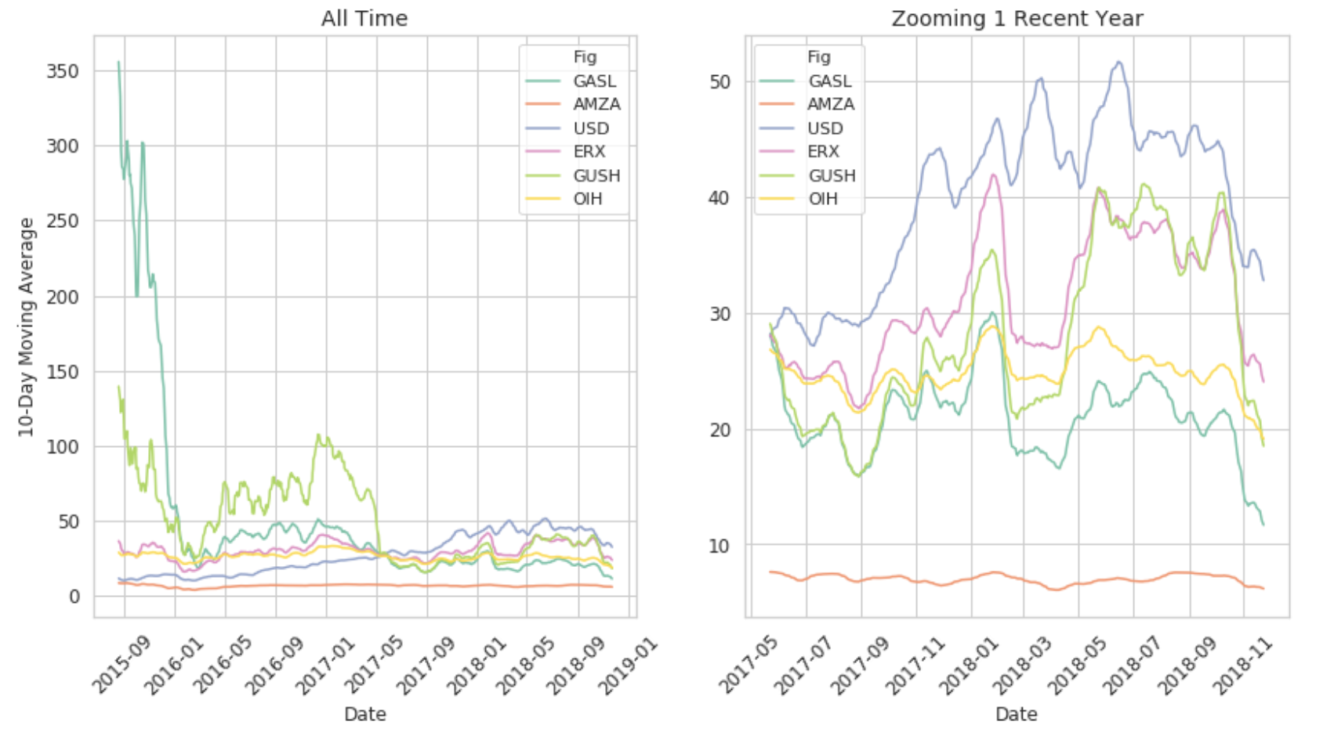
Background / Executive Summary / Overview / Analysis / Results & Visualization
Data Collection & Cleanse & Screening
Underlying Asset Data Source: NASDAQ
1. Large, Liquid ETFs with trading options (13)
2. The ETFs are at their 2-year low (AMZA, ERX, GASL, GUSH, OIH, USD)
Option Data Source: Yahoo Finance
Historical Daily quotes
Time Span: Nov 26, 2013 - Nov 26, 2018, (5 Years => 2.5 Years)
Sources: NASDAQ, YAHOO Finance

Slide 5
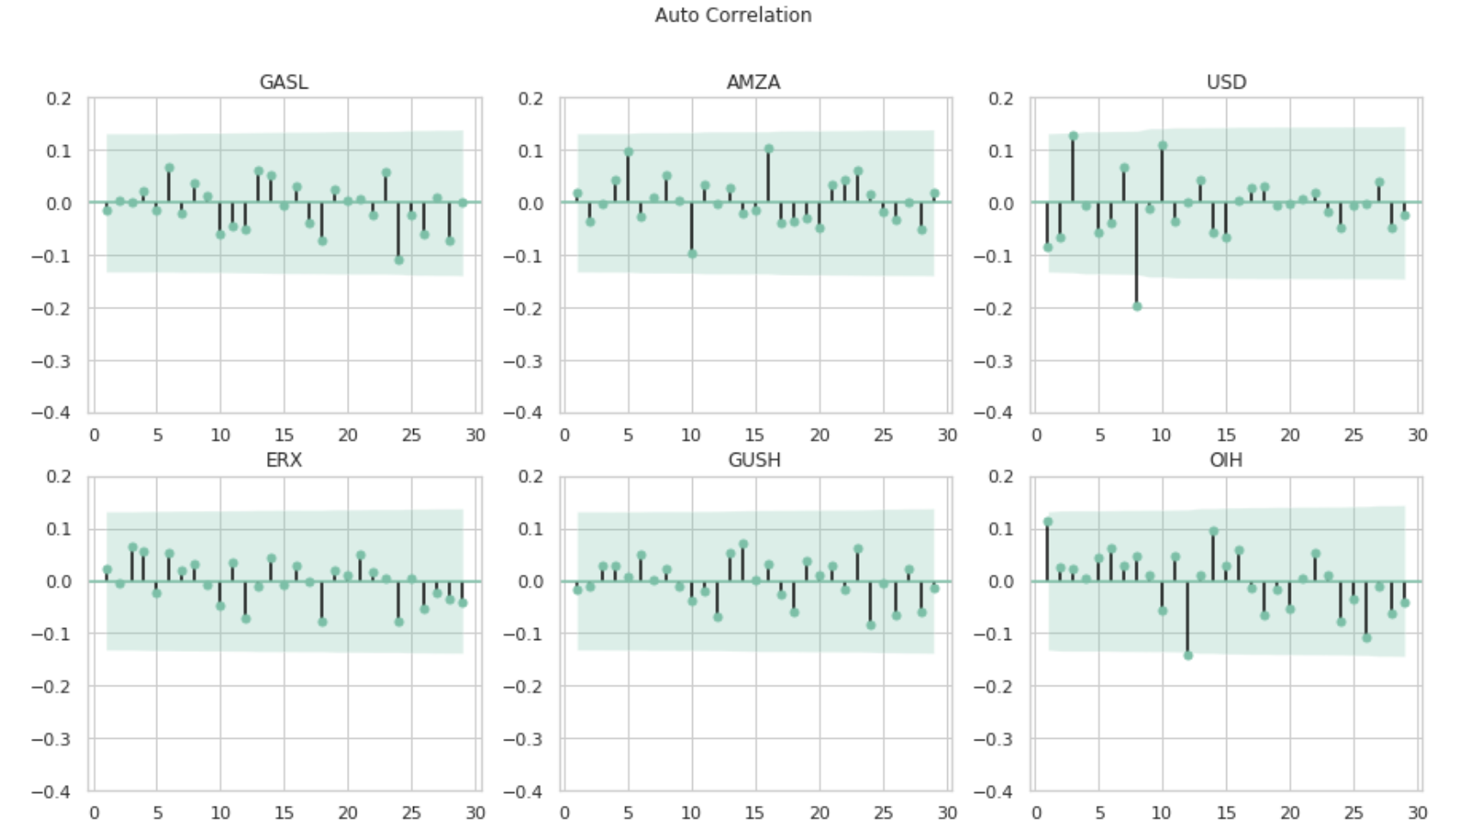
Background / Executive Summary / Overview / Analysis / Results & Visualization
Test of Independent on Growth Rate: Autocorrelation
The Underlying Returns are self-correlated: Nullifies GBM
Sources: Group analysis

Slide 6
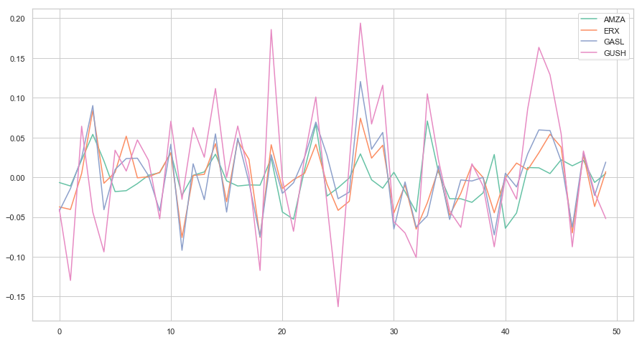
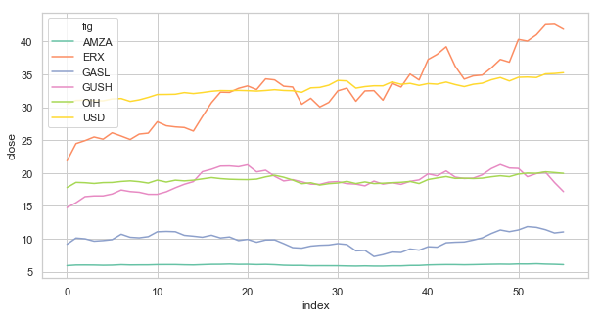
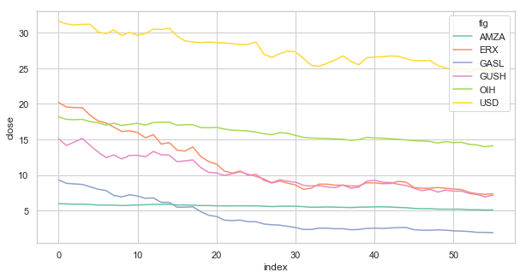
Background / Executive Summary / Overview / Analysis / Results & Visualization
Simulation: New Method
Combine Autocorrelation & Correlation Coefficient
Mean Square Error: 1.07 e-09
6 * 10,000 Sample Paths
Sources: Group analysis

Slide 7
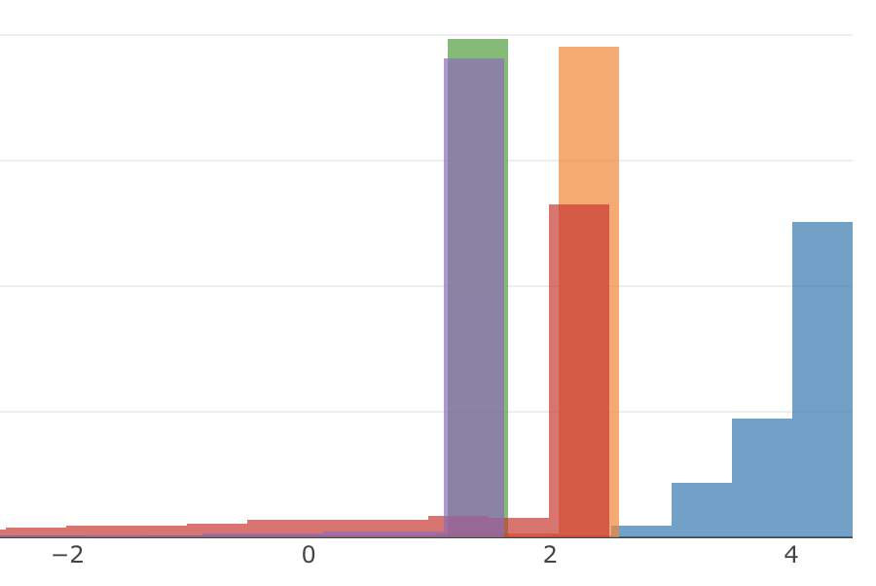
Background / Executive Summary / Overview / Analysis / Result & Visualization
Analytics: Policy and Visualization
Risk: 5% VaR & Head Probability
Reward: Mean Expected Return
Recommendation Dash
DIY Strategy
Sources: Group analysis

Slide 8
Q & A

