Slide 1

PHISHSHIELD: MACHINE LEARNING FOR PHISHING DETECTION
Under The Guidance
Prof. Chintal Gala
Group I34
Kartik Patel
PRATHAM BHADRA
ASHISH JHA

Slide 2
Introduction
PhishShield is Phishing detection Plugin Using ML (Random Forest Classification)
Give Real-Time Alerts if detected
Fast Speed because of Client-Side Developmen
High F1 Score of 88.6%

Slide 3

Problem Statement
Phishing is a serious cyber threat, and our presentation showcases a browser plugin that offers rapid, real-time protection against it. By focusing on client-side detection, we ensure user privacy and eliminate delays. Our solution leverages machine learning for effective and user-friendly phishing detection

Slide 4
Literature Review
Sr.No | Paper | Year | Author | Summery
1) | Intelligent phishing website detection using random forest classifier | 2017 | Abdulhamit Subasi Esraa Molah; Fatin Almkallawi | The passage discusses the use of data mining techniques to detect phishing attacks. An intelligent system was created to classify websites as legitimate or phishing. The Random Forest classifier outperformed other methods with a 97.36% accuracy, making it an effective and efficient choice for phishing detection.
2) | Phishing Detection using Random Forest, SVM and Neural Network with Backpropagation | 2020 | Sunil Parameshwar Patil; Arya Sreevalsan; Faiz Rahman | Phishing attacks, which mimic legitimate websites, are on the rise. This paper highlights three machine learning methods (Random Forest, SVM, and Neural Network with backpropagation) with high accuracies of around 97%.
3) | Phishing Attacks and Protection Against Them | 2022 | Vaishnavi Bhavsar, Aditya Kadlak, Shabnam Sharma | The paper focuses on the data security threat of phishing attacks, which aim to steal personal and financial information using various methods. It outlines types of phishing attacks and methods for detection and prevention.

Slide 5
LITERATURE REVIEW
Sr.No | Paper | Year | Author | Summery
3) | Phishing Detection and Prevention using Chrome Extension | 2022 | M. Amir Syafiq Rohmat Rose; Nurlida Basir; Nur Fatin Nabila Rafie Heng; Nurzi Juana Mohd Zaizi | The COVID-19 pandemic saw a surge in cyberattacks, including phishing. Existing anti-phishing solutions often lacked accuracy and adaptability. A new intelligent model based on URL characteristics was created, using machine learning. The result is a Chrome extension for phishing detection and prevention, aiming to reduce cybercrime and safeguard users from fraudulent websites.
4) | Machine Learning Based Phishing Attacks Detection Using Multiple Datasets | 2023 | Ashraf H. Aljammal, Salah taamneh, Ahmad Qawasmeh, Hani Bani Salameh | Phishing attacks are a rising threat. This paper uses three datasets to train and test machine learning classifiers. RandomForest performs best in the first stage, with an accuracy of 98% and 93.66% after feature selection for Dataset-1 and Dataset-2. ANN achieves the best accuracy of 88.92% for Dataset-3 due to its limited instances and features

Slide 6

Objective
Browser Plugin Development
Real-time URL Scanning
Server Less Design

Slide 7

Feature
Real-Time Analysis
Serverless Deployment
Browser Plugin
Cost Effective

Slide 8
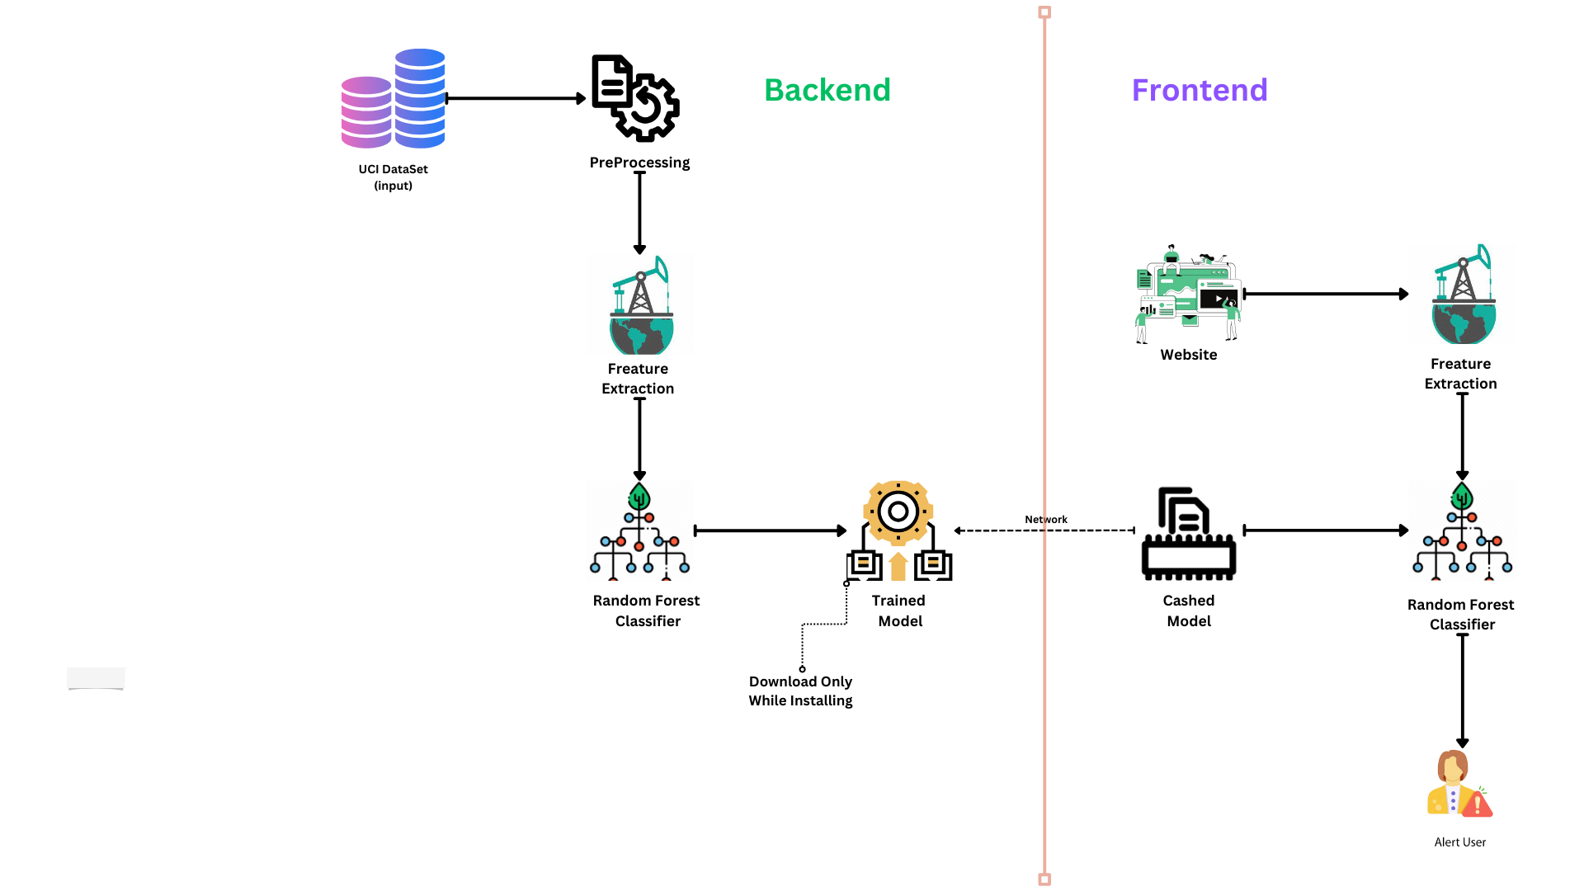
Architecture

Slide 9
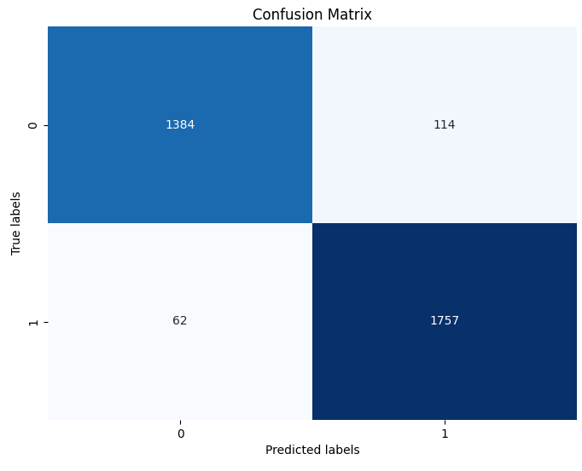
Confusion Matrix
TN
FP
FN
TP

Slide 10
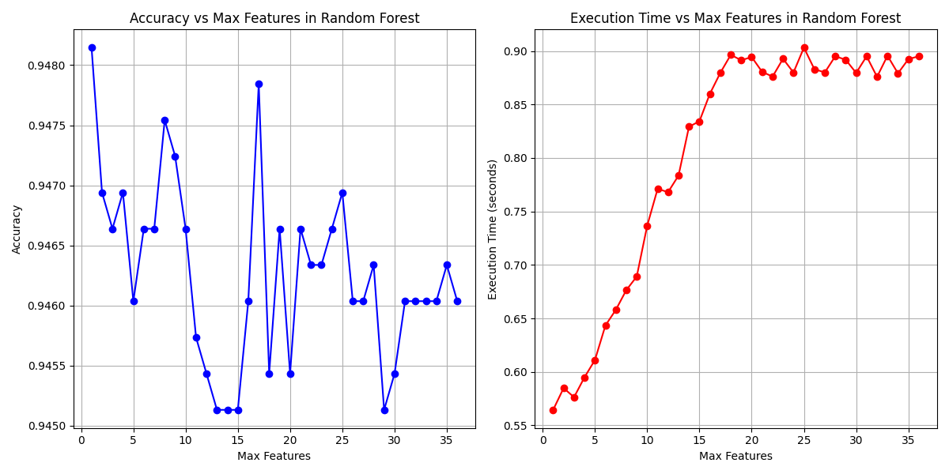
Feature Count Impact: Accuracy and Execution Time Analysis:

Slide 11

Technology Stack
Python
JavaScript
HTML
CSS
Algorithms Used
Random Forest Classification

Slide 12

Thankyou !
Do you have any Questions ?

