Slide 1
Fog Networks
Mung Chiang
Princeton University
2014

Slide 2

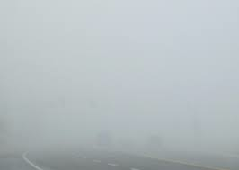
From Cloud to Fog
2000 – 2015
2015 – 2030 ?

Slide 3
What is “Fog Network”?
A network architecture that uses one or a collaborative multitude of end-user clients or near-user edge devices to carry out a substantial amount of storage (rather than stored primarily in cloud data centers), communication (rather than routed over backbone networks), and control, configuration, measurement and management (rather than controlled primarily by network gateways such as those in LTE core).

Slide 4
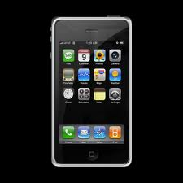
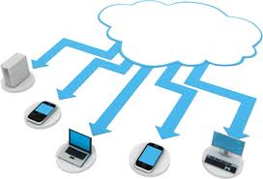
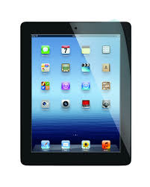
Rise of the Clients
Data center
Backbone network
LTE Core network

Slide 5
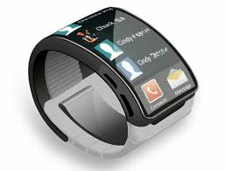
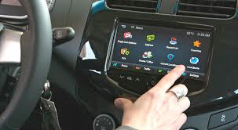
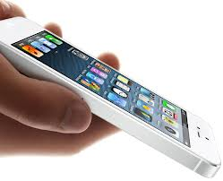
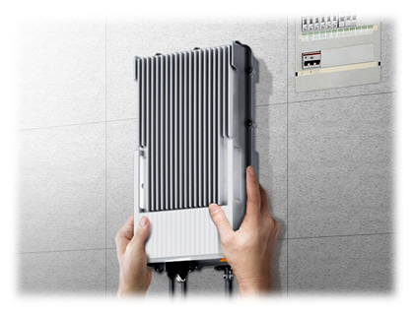
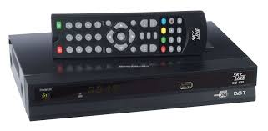
Many Types of Clients & Edge Devices

Slide 6
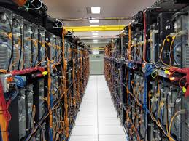
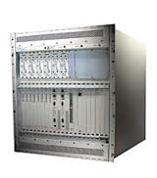
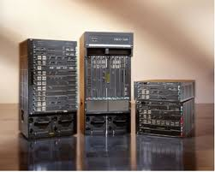
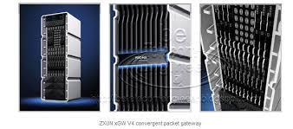
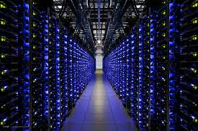
Contrast Them With…

Slide 7
Traditional View
use

Slide 8
Fog View
are (part of)

Slide 9
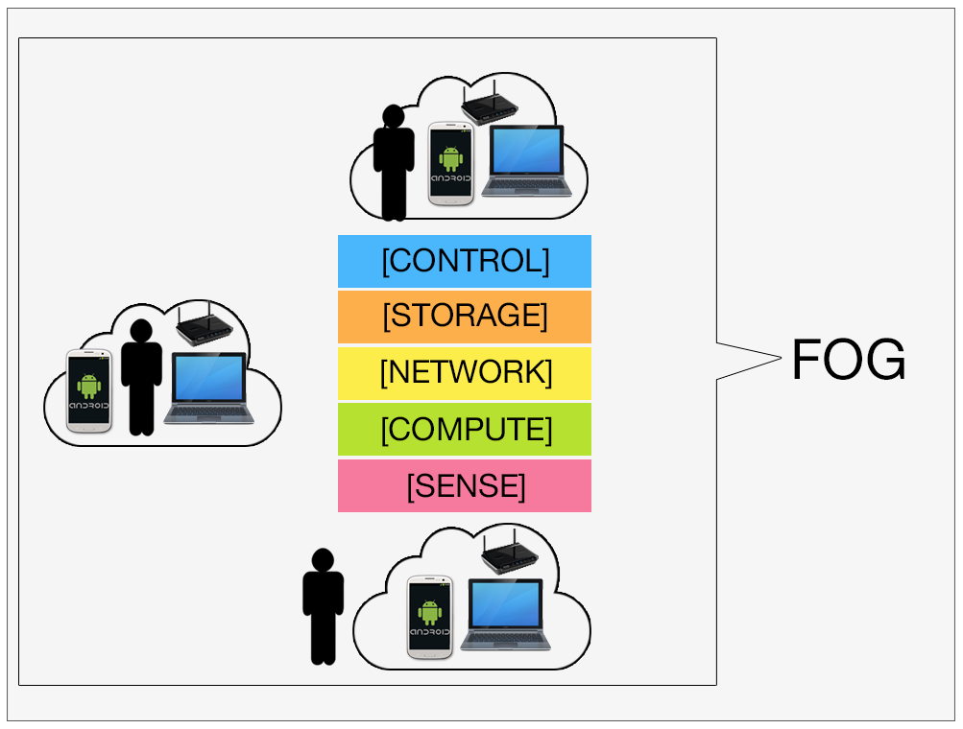
What If…
The set-top box in your living room replaces the DPI box?
The dashboard in your car is your cloud caching content?
Your phone (and other phones) become LTE PDN-GW & PCRF?
The “network edge” gives you the edge
The clients are the controllers

Slide 10
It has become both feasible and interesting to ask: “Can ‘this’ be done at clients/edge?”

Slide 11
Impact on Value Proposition along Ecosystem Food-chain
End user experience providers?
Network operators?
Equipment vendors?
Cloud service providers?
System integrators?
Edge device manufacturers?
Client/IoT device manufacturers/OS?
Chip suppliers?

Slide 12
Why Now?
Cognitive of end user application experience
Rise of encrypted traffic and use of multipath-TCP in core network
End to end principle, again
How 5G may look like
Each client/edge device in the past several years as become
Powerful (in sensing, storage, computing, control, comm.)
Still limited (in battery, storage, computing, information)
Maybe mobile
Crowds of clients/edge devices are
Dense
Distributed
Under-organized

Slide 13
Two Parts of Fog
EDD
Edge-Driven “Data-center”
EDC
Edge-Driven Control-plane
(less studied)

Slide 14
Examples
Prior work:
P2P
Sensor networks / MANET
Recent examples:
Edge caching/BW management at home gateway/small cell
Edge analytics and real-time stream-mining
IoT session management and signaling load optimization
Client-driven distributed beam-forming/content sharing
Clients’ idle computing/storage resource pooling
Cloudlets/Mobile CDN
FlashLinQ/LTE Direct/WiFi Direct/AirDrop
Over The Top (OTT) content management
4 more examples next

Slide 15
1. OTT Smart Data Pricing (SDP)
Clients can crowd-source network inference/measurement and overlay billing

Slide 16
2. Client-Side HetNets Control
Internet
Unlicensed
Licensed, Planned
Licensed, Unplanned
Core Network
HNS
(SeGW, HNB-GW, HomeNodeB)
Control Plane
Wi-Fi AP
RNS
(RNC, eNodeB)
Data Plane
Clients can autonomously manage/control their own configurations

Slide 17
3. Client-controlled Cloud Storage
Client/edge intelligence can commoditize cloud resources

Slide 18
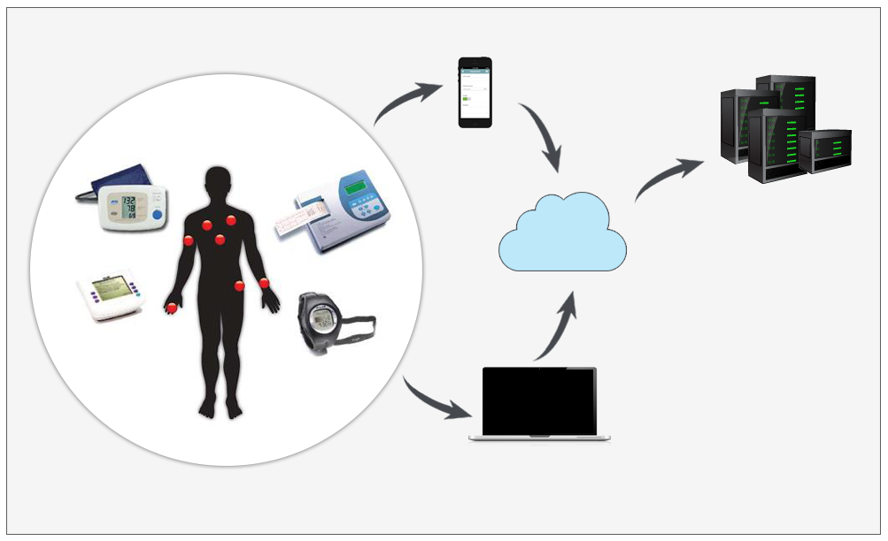
4. Consumer/Wearable IoT
We are still searching for an architecture for Glasses and Watches

Slide 19
Themes of Fog Applications
5 Key advantages offered by Fog:
Real-time processing
Rapid and affordable scaling
Client-centric objectives/privacy
Local content/resource pooling
Take care of encrypted traffic and multipath-TCP
But not to exclude cloud, which is still useful for:
Archival storage
Heavy duty computation
Global coordination
Where are the natural timescale/spatial-scale separation and interfaces between Cloud and Fog?

Slide 20
Networking Revisited
Objective:
End-user-experience-driven metrics
Questions on fairness, robustness, privacy, and efficiency in massively distributed systems
Resource:
Virtualized, pooled, and unpredictably shared
Architecture:
Role of clients/edge devices: store, measure, manage
Faster innovation cycle and “fail fast” mode

Slide 21
Research Challenges
Trustworthiness / verification of client/edge software & hardware
Incentivization of client participation
Interactions with OS and definition of network service APIs
Cloud-to-cloud and cloud-to-fog interfaces
Oscillation/divergence and global configuration consistency during the interactions of local actions
Tradeoff of Local vs. Global architecture

Slide 22
Inter-Disciplinary Solutions
Network Engineering
HCI &
App UI/UX
Data Science
Economics & Pricing
Device Hardware/OS

Slide 23
Industry-Academia Collaboration
chiangm@princeton.edu

