Slide 1
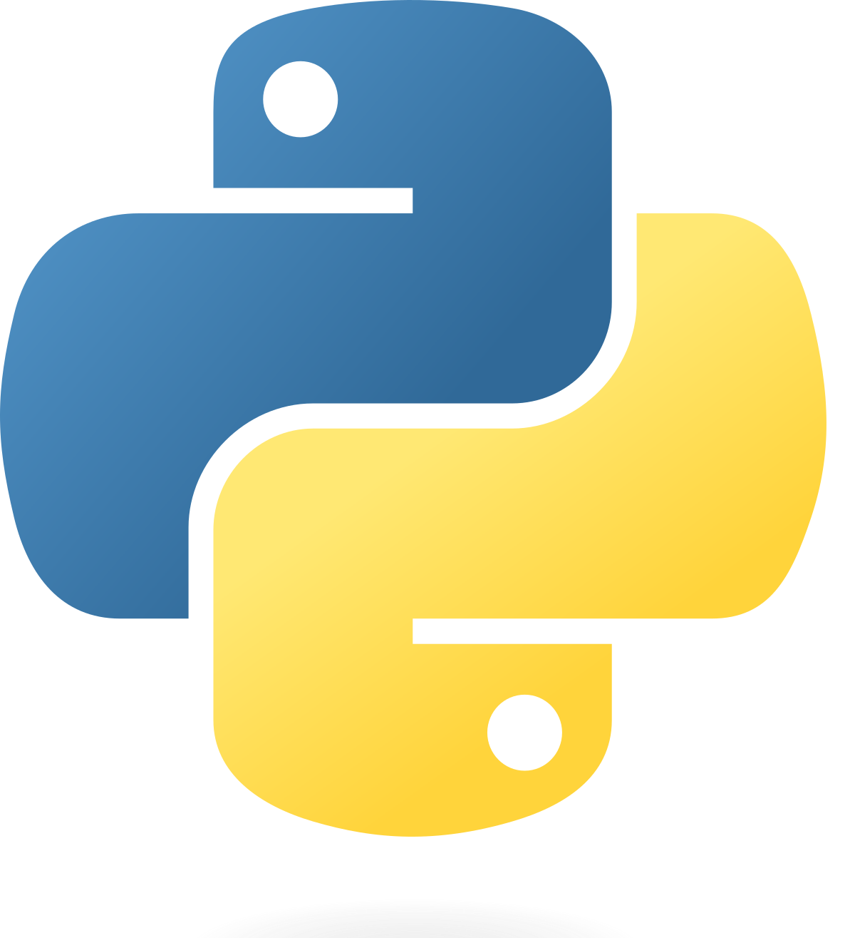
Python Fundamentals
Learn Python3
Ramesh Poudel, BCA 5th Semester
Dec 4, 2022
Github: @rigel-star

Slide 2
What is computer programming?
And, what are programming languages?

Slide 3
Programming
Programming is combination of art, science and engineering.
Programming as an art is figuring out what is it that you wanna do? Figuring out what the task is.
The science part is figuring out how to do it well. Such as, selection of algorithm and data structure.
The engineering part is that you have to work within constraints. You have limited time and resources to work with.
Such as computer memory, CPU’s processing power, project’s deadline etc.

Slide 4

Programming Languages
Computers are dumb. They are powerless to act on their own. So, to instruct them, programming languages were created. Just like the human body receives instructions from a variety of senses to initiate various activities.
Touch
Sound
Biological Brain
Action
Taste
Just like Human languages, programming language is a formal computer language that includes a controlled vocabulary and set of grammatical rules designed to instruct a computer how to perform specific tasks. Examples: Python, C, Java, Rust, Assembly etc.
Programming language = syntax + semantics
Where syntax = rules and regulations for writing any statement in programming language
And semantics = meaning associated with the statement in programming language

Slide 5
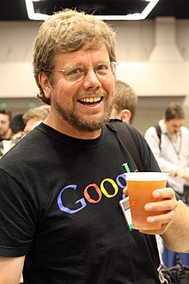
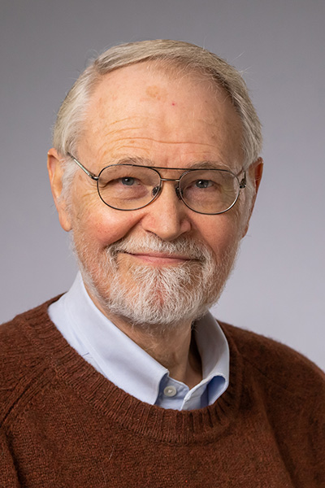
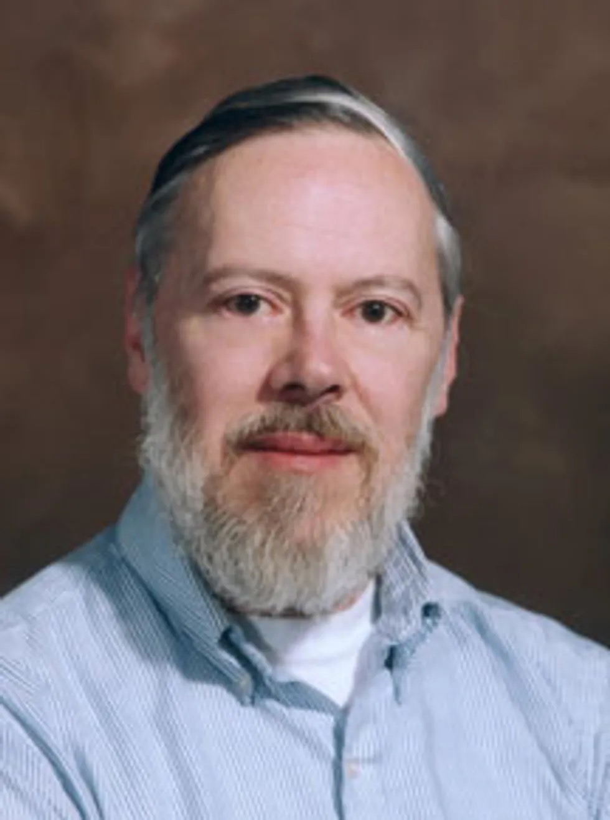
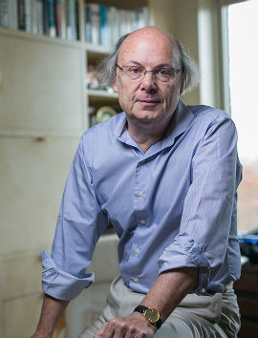
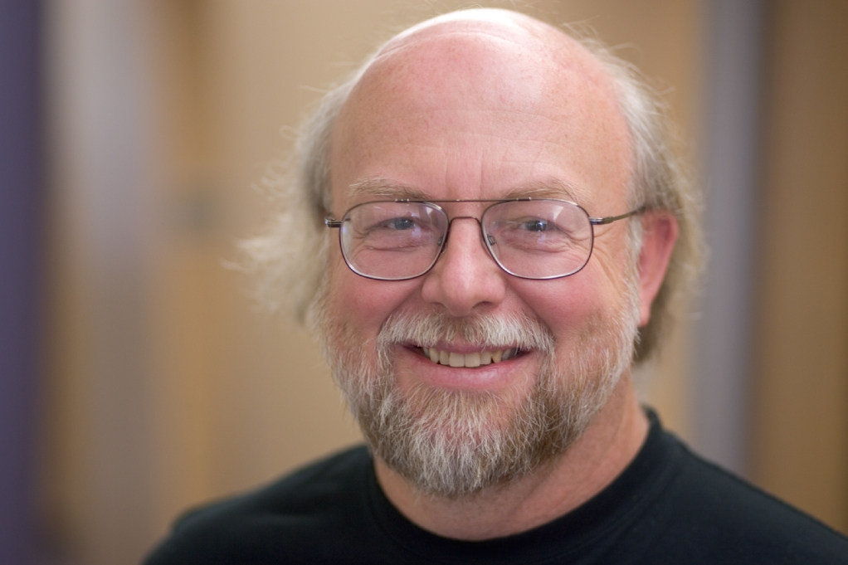
Pioneers of Programming Languages
We should be grateful that the many individuals who revolutionized the field of Computer Science are still alive
at the same time we do.
Guido Van Rossum
Creator of Python
Brian Kernighan
Co-creator of Unix
And co-author of
The C Programming
Language
Dennis Ritchie
Creator of C
And co-creator of Unix
Bjarne Stroustrup
Creator of C++
James Gosling
Creator of Java

Slide 6
Programming Languages
Mainly of two types:
— Interpreted
— Compiled

Slide 7
Interpreted Language
Source Code
Bytecode
Output
Compiler
Interpreter ( VM )
Output Consumer
Bytecode generation step is not
necessarily done by every interpreter

Slide 8
Interpreted Language
— Interpreted at runtime rather than being compiled

Slide 9
Interpreted Language
— Interpreted at runtime rather than being compiled
— DSL (Domain Specific Language)
Examples: bash for unix like systems
Powershell for Windows

Slide 10
Interpreted Language
— Interpreted at runtime rather than being compiled
— DSL (Domain Specific Language)
— Examples: bash for unix like systems
Powershell for Windows and Python
For building APIs and system tasks
— Some are compiled to byte code and executed by a virtual machine

Slide 11
Compiled Language
Machine independent
Intermediate Representation( IR )
CPU dependent
Machine Code
(eg.: x86, aarch64)
Source Code
Compiler backend
Compiler frontend
Executable file

Slide 12
Compiled Language
— Compiled to target CPU architecture’s instructions

Slide 13
Compiled Language
— Compiled to target CPU architecture’s instructions
— Executed directly by processor

Slide 14
Python3
Creator: Guido Van Rossum
Philosophy: Language for readable code
General purpose scripting Language
Dynamically-typed and garbage-collected
—> Automatic Memory Management ( no malloc() and no free() )
Supports procedural, object oriented and functional paradigms
Open sourced (CPython: https://github.com/python/cpython)
Different language than Python (Python2) and successor of ABC programming language
https://gvanrossum.github.io/

Slide 15
Interesting Features
No curly braces ( instead uses : for blocks )
No semicolon ( instead uses <Enter> to end a statement )
No variable declaration
No arrays ( yes, no arrays )
Simple elegant syntax:
—> a = input()
—> b = input()
—> c = a + b
—> print(c)
(Natural language like syntax)

Slide 16
What is Python used for?
Machine Learning and Data Analysis
Web Development (mainly using Django)
Mobile App development using Kivy
Automation or Scripting

Slide 17
Why is Python used?
Readable code ( eg.: if person is not Student: exit(2) )
Multiple Paradigms
Robust Standard Library
No manual compilation
Compatible with major platforms (linux installs python by default)
Many Open source frameworks, libraries and tools
—> pandas, kivy, numpy, django, flask, tensorflow, pyqt, torch etc.
Easy to learn

Slide 18
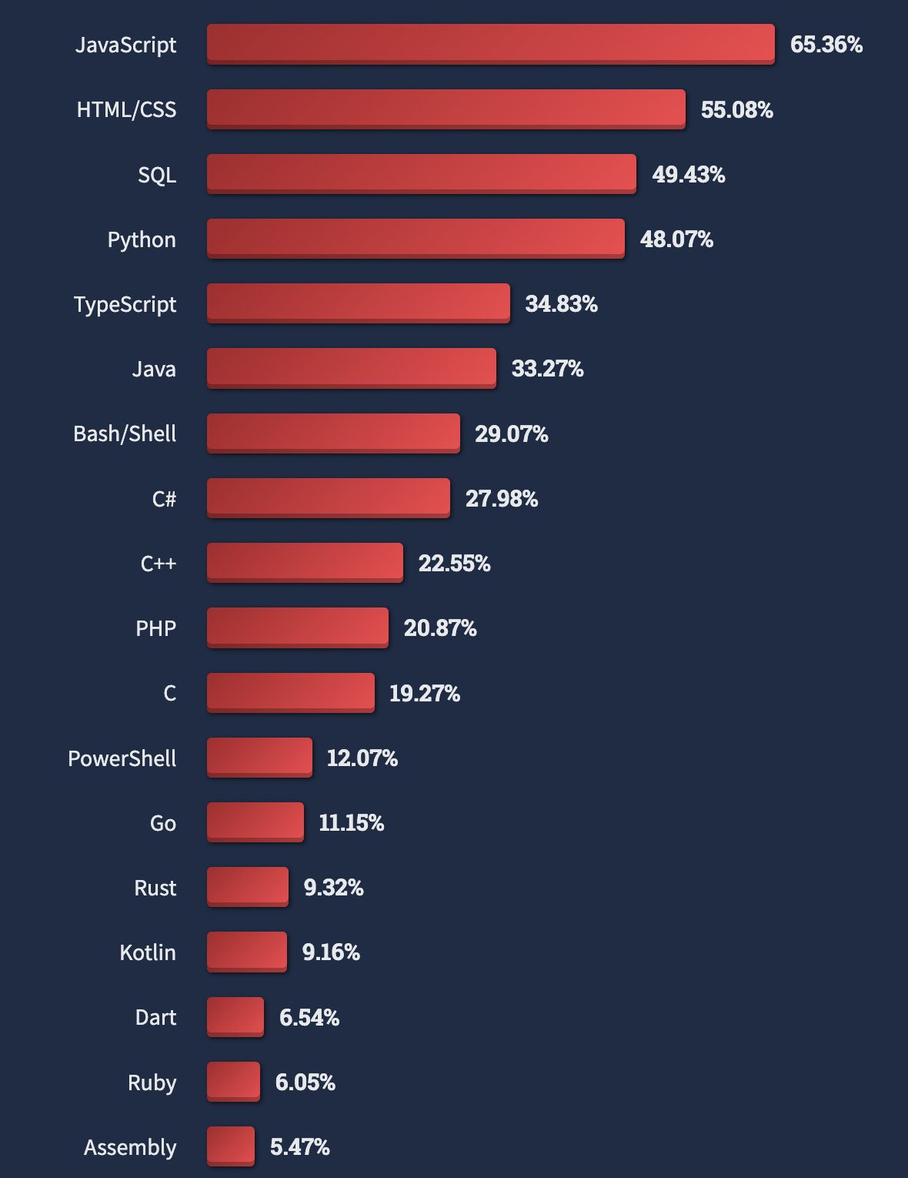
Who uses Python?
One of the most in demand programming language as of 2022.
Stackoverflow’s 2022 survey

Slide 19
What can I use Python for?
Machine Learning and Data Analysis ( eg.: Tensorflow and matplotlib )
GUI Programming (eg.: Kivy for Mobile and PyQT for Desktop)
Develop games (eg.: Pygame)
Plugin development (eg.: Blender plugin development using blenderpy)
Network Programming, Web Development and API development (eg.: Using Raw Sockets and Flask or Django)

Slide 20
Sample Python Program to Print 10 Numbers on Screen
Keywords used: for, in
Output:
1
2
3
4
5
6
7
8
9
10

Slide 22
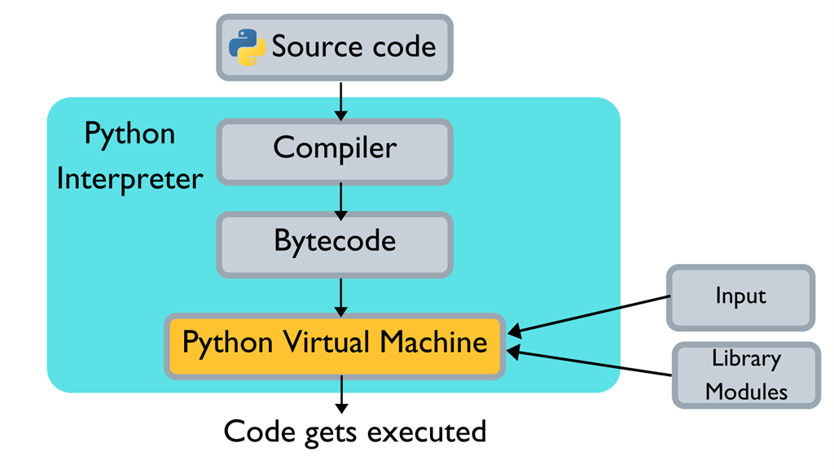
Architecture
Of Python Interpreter

Slide 23
Python REPL (Read Evaluate Print and Loop)

Slide 24
Python variables
—> Storing Information for later use

Slide 25
a = 56 # integer
name = “Scarlet” # string

