Slide 1
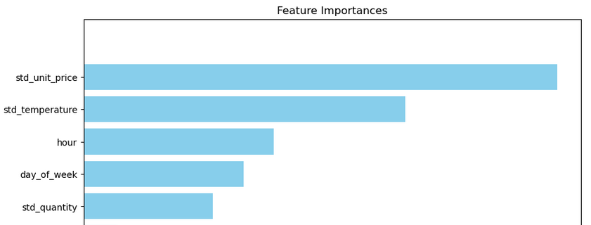
Results of modeling
Notebook with model
Good fitted model
Low percent of errors
High possibility to predict different data
Also I want to demonstrate the importance of columns, which I got
We can see, that price, temperature, hour, day of week and quantity are the most important for model. With their help such high precision was reached

