Slide 1
Convolutional Neural Networks (CNNs): Improving Performance
Further Explore the Potential of Invariant Information Clustering Using Video Datasets
Cai Shengqu
k1763920

Slide 2
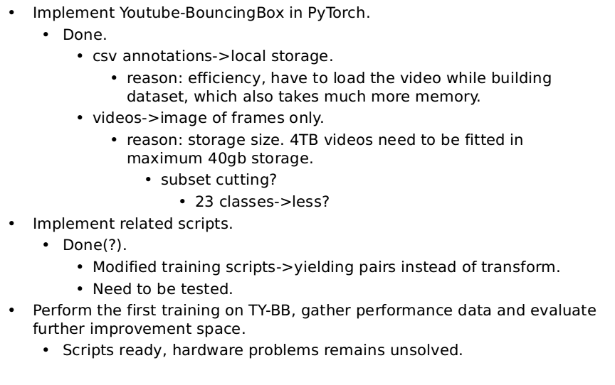
Progress since the last meeting

Slide 3
Current challenges and blocks
Hardware requirement
  disk space
    40gb home+20gb scratch for taught students on HPC.
  memory
    at least 22.9gb needed, 64gb available on HPC node with v100 gpu(?).
  gpu
    two nodes with v100 gpu available on HPC, others use k10 which is too old to compile with current Pytorch.
Code reading
  Un-explained parts.

Slide 4
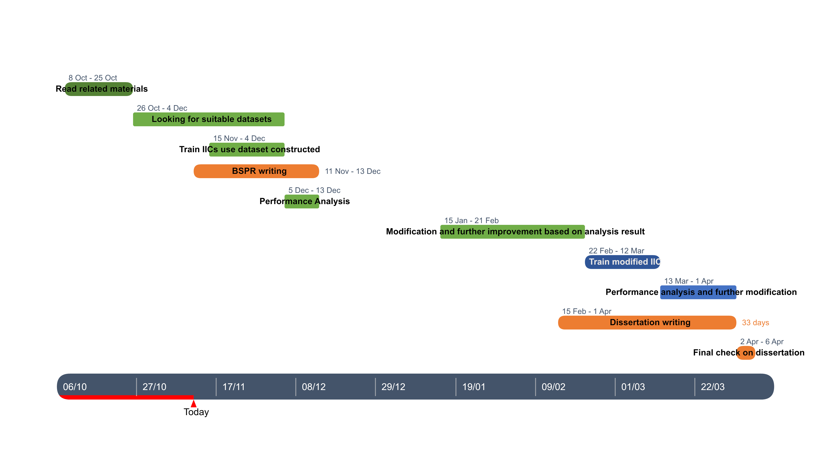
My next steps
Updated plan:
Next steps:
  BSPR writing.
  Hardware confirmation.
  Perform initial training.

Slide 5
Reference list
Xu Ji, Joao F Henriques, and Andrea Vedaldi. Invariant information distillation for unsupervised image segmentation and clustering. arXiv preprint arXiv:1807.06653, 2018.
E. Real, J. Shlens, S. Mazzocchi, X. Pan, and V. Vanhoucke. Youtube-boundingboxes: A large high-precision humanannotated data set for object detection in video. arXiv preprint arXiv:1702.00824, 2017.

