Slide 1
Convolutional Neural Networks (CNNs): Improving Performance
Further Explore the Potential of Invariant Information Clustering Using Video Datasets
Cai Shengqu
k1763920

Slide 2
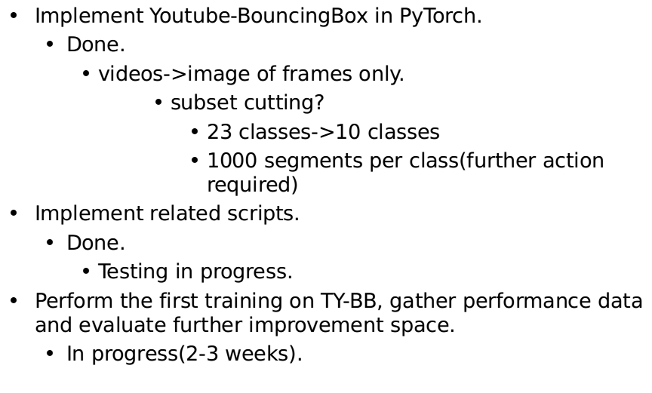
Progress since the last meeting

Slide 3
Current challenges and blocks
http error 429 too many requests
  youtube blacklists fingerprints.
  Possible solution: adding retry logic, download dataset from different clients.
  Worst case: 1000 segments per class---should be sufficient.
Yet to do:
  Cropping images by bounding box.
  Data comparison and conclusion.

Slide 4
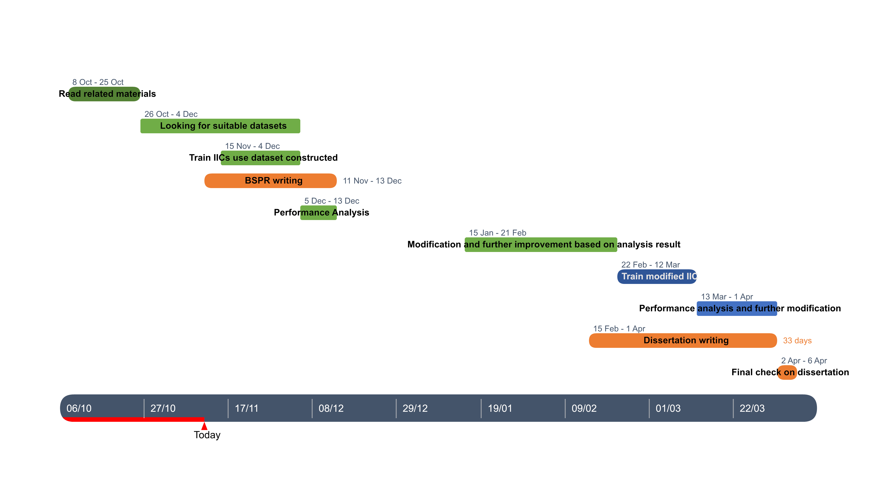
My next steps
Updated plan:
Next steps:
  Data gathering(in progress)
  Dissertation writing.

Slide 5
Reference list
Xu Ji, Joao F Henriques, and Andrea Vedaldi. Invariant information distillation for unsupervised image segmentation and clustering. arXiv preprint arXiv:1807.06653, 2018.
E. Real, J. Shlens, S. Mazzocchi, X. Pan, and V. Vanhoucke. Youtube-boundingboxes: A large high-precision humanannotated data set for object detection in video. arXiv preprint arXiv:1702.00824, 2017.

