Slide 1
Convolutional Neural Networks (CNNs): Improving Performance
Further Explore the Potential of Invariant Information Clustering Using Video Datasets
Cai Shengqu
k1763920

Slide 2
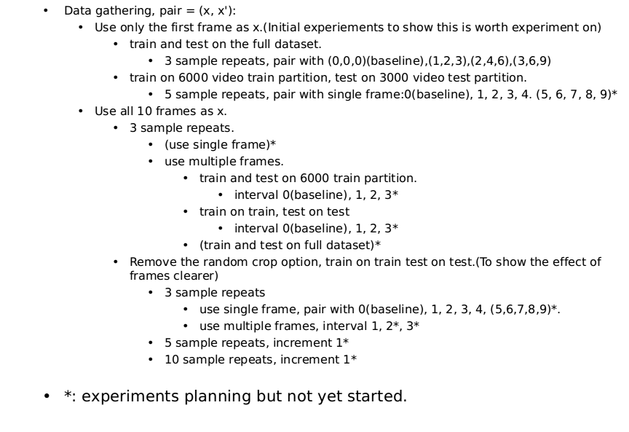
Progress since the last meeting

Slide 3
Current challenges and blocks
Report.
Design the best approach to represent data.
  single frame vs different single frame.
  single frame vs multi-frame.
  multi-frame vs multi-frame with different interval.
  train and test on the same data vs train and test on seperate partitions.
  results without random cropping.
  for each of which, average vs best

Slide 4
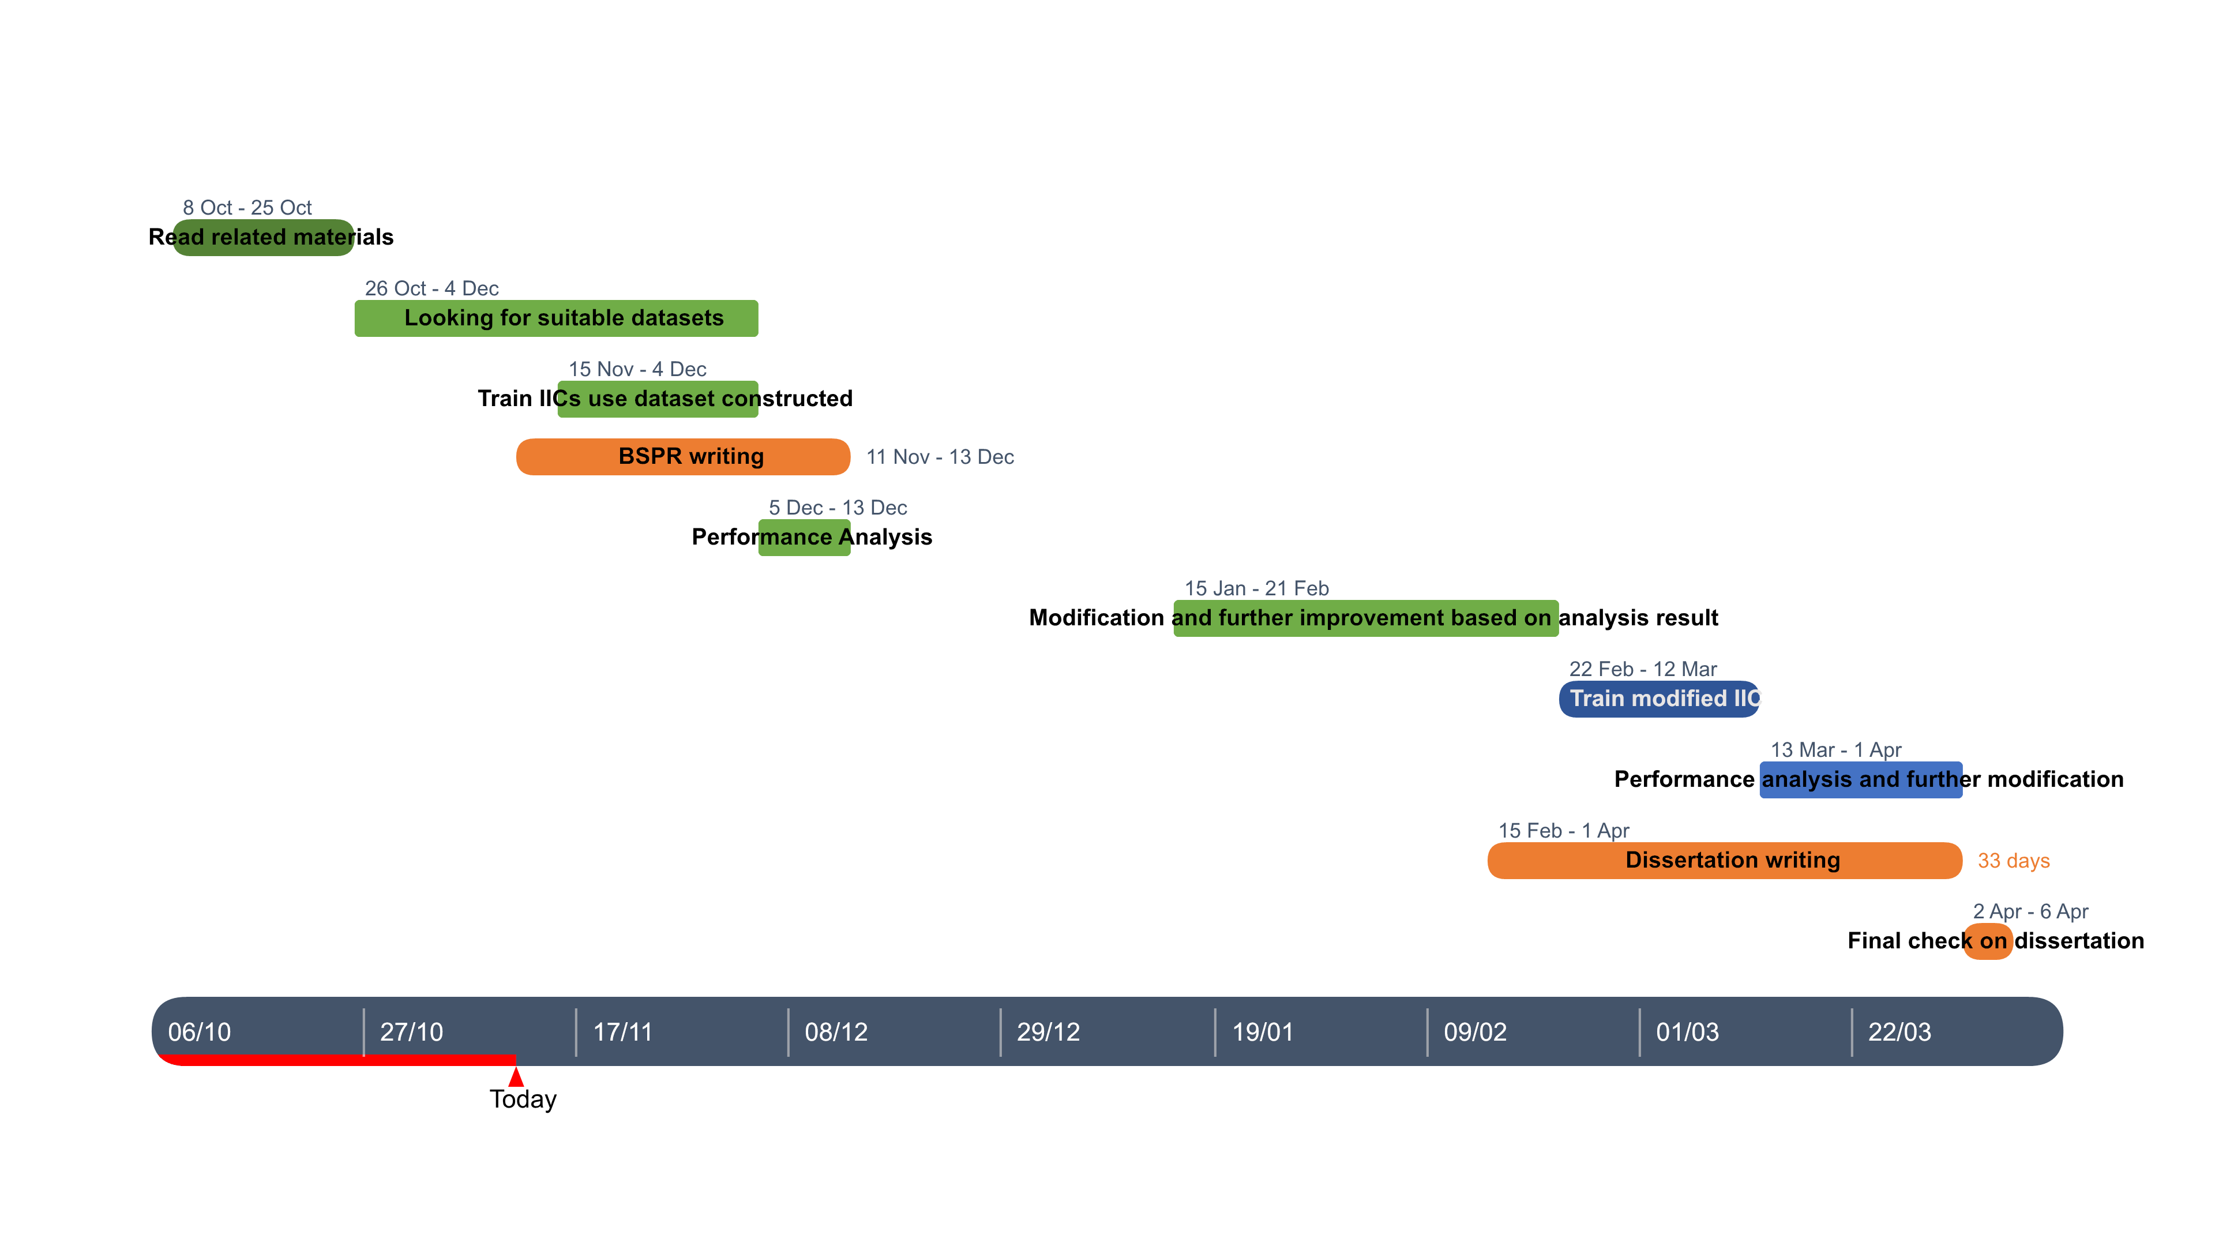
My next steps
Updated plan:
Next steps:
  Report.

Slide 5
Reference list
Xu Ji, Joao F Henriques, and Andrea Vedaldi. Invariant information distillation for unsupervised image segmentation and clustering. arXiv preprint arXiv:1807.06653, 2018.
E. Real, J. Shlens, S. Mazzocchi, X. Pan, and V. Vanhoucke. Youtube-boundingboxes: A large high-precision humanannotated data set for object detection in video. arXiv preprint arXiv:1702.00824, 2017.

