Slide 1
Convolutional Neural Networks (CNNs): Improving Performance
Further Explore the Potential of Invariant Information Clustering Using Video Datasets
Cai Shengqu
k1763920

Slide 2
Progress since the last meeting
Further reading.
  Done.
Collect a reasonable amount of video data which are sufficient to train for IIC for image clustering (on STL10?).
  Done:
    Best dataset found so far: YouTube-BoundingBoxes(Esteban Real et al.).
      23 classes, including all 10 classes of STL10.
      Uses a csv file to retract the frames:
        youtube_id - (string) the YouTube identifier of the video the segment was extracted from. One may view the selected video at http://youtu.be/${youtube_id}.
        timestamp_ms - (integer) the time in milliseconds of the classified frame in the video.
        class_id - (integer) a numeric identifier for the object class.
        class_name - (string) a human-readable name for the object class.
        object_presence - (string) whether or not the object is present in the frame ('present' or 'absent').
      Labeled, can be used for semi-supervised learning.
Perform the first image clustering test.
  Not done, challenge faced.

Slide 3
Current challenges and blocks
How to compare video-trained IICs with published image-trained IICs.
  Use video dataset with identical classes as existing image datasets, then compare with published results?
  Train existing image-trained models using video based dataset.
    For each video, take one frame, apply transformation as it is a still image.
    Compare the results with using frames yielding pairs completely without transformation.
    Compare the results with using both frames yielding pairs and transformations of each frame.xs
  However no matter what to do, it is hard to ensure the variables are controlled during the comparison process to make it valid.
How to train IICs with custom dataset.
  The original scripts used pyTorch build in dataset.
  In order to use cutom dataset, implementation of custom dataset class with the PyTorch interface is needed, together with relevant scripts.

Slide 4
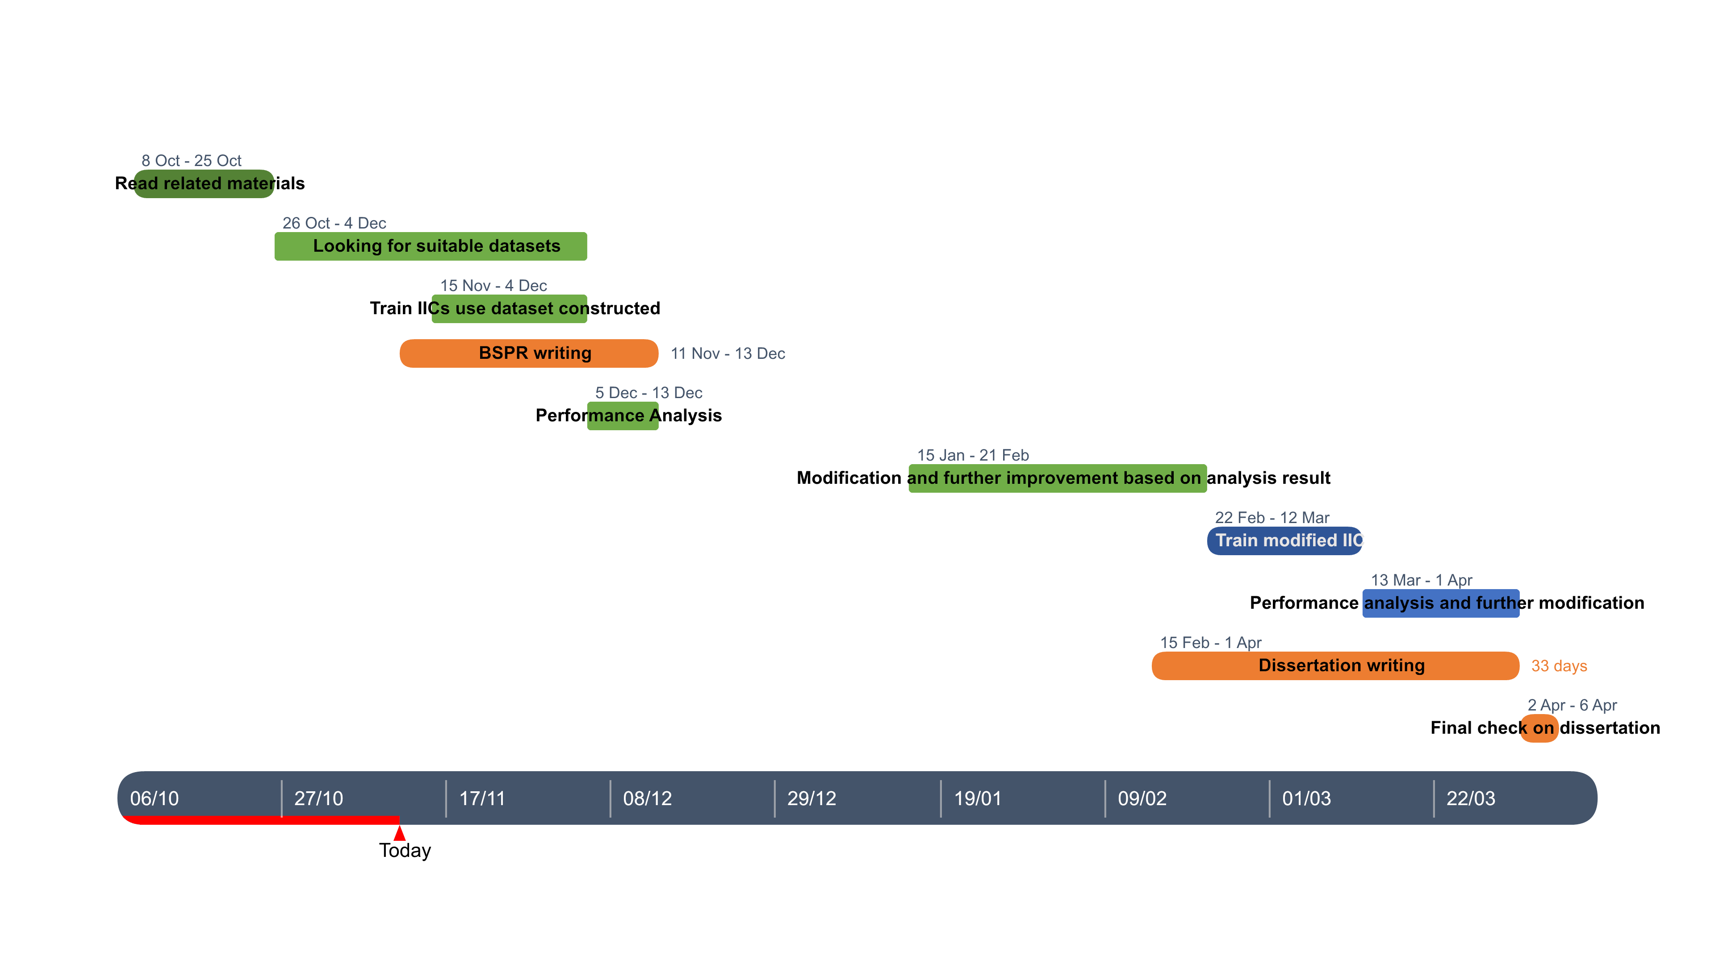
My next steps
Overall planning: provide a Gannt chart or similar with your rough plan for the rest of the project. Aim for tasks of roughly 2 weeks in length.
Next steps: what are your next steps until the next progress meeting going to be? how long will each step take? Aim for steps of only a few days in length to allow you to produce a useful plan.
  Further reading(By the end of week 5).
  Collect a reasonable amount of video data which are sufficient to train for IIC for image clustering on STL10(a week).
  Perform the first image clustering test on STL10 (a week).

Slide 5
Reference list
Xu Ji, Joao F Henriques, and Andrea Vedaldi. Invariant information distillation for unsupervised image segmentation and clustering. arXiv preprint arXiv:1807.06653, 2018.
E. Real, J. Shlens, S. Mazzocchi, X. Pan, and V. Vanhoucke. Youtube-boundingboxes: A large high-precision humanannotated data set for object detection in video. arXiv preprint arXiv:1702.00824, 2017.

