Slide 1
Convolutional Neural Networks (CNNs): Improving Performance
Further Explore the Potential of Invariant Information Clustering Using Video Datasets
Cai Shengqu
k1763920

Slide 2
Project motivation and scope
Context: what already exists that is relevant to understanding your project?
  The research is an extension of “Invariant Information Clustering for Unsupervised Image Classification and Segmentation”(Xu et al., 2018).
    With released PyTorch code implementation for image clustering and segmentation.
    Supplemental material including further experiment details.
Problem: what question / issue are you trying to answer / address?
  Whether IICs could be trained using video dataset and achieve a better performance.
Idea: what is the key idea of your approach?
  Using frames in a video yielding pairs of images to train the IIC model.
    Reasons: Videos may provide much more complete transformations which leads to potential better performance. Such process is also more similar to human observing.
  what kind of software will you build?
  Trained IIC networks using video dataset with better performance at object recognition.
  Potential improved version of IIC networks more suitable to be trained by video datasets.
    Reason of this possibility: IIC is designed to take pairs of still images, therefore there must be some improvement available when it need to take video data, in either performance or optimization, even both.
Beneficiaries: what would get better for who if this problem was addressed?
  IICs are not limited in computer vision, they have the potential to perform on any data that can be automatically formed into pairs where the elements share semantic content(Xu, 2019).
    Video is a kind of datastream. Even though it is still specific to vision, but the approach may have potential to be used in other tasks.

Slide 3
Current challenges
Learning: what do you need to learn about to successfully tackle this project?
  How are IICs trained and evaluated.
  How to compare video-trained IICs with published image-trained IICs.
    Possible solution: the video datasets used for training need to have identical classes with previous published trained models, so that video-trained IICs can be tested on the same image datasets: STL10(Coates et cl., 2011), CIFAR10(Krizhevsky & Hinton, 2009), etc. to ensure variables are controlled.
      Current challenge: Finding, or constructing sufficient and suitable video dataset.
  Basics deep neural network models and PyTorch implementation.
  where would guidance from your supervisor help you at this point?
  Evaluate if the basic approach and further planning are reasonable.
Reading: what have you already read about in preparing for this progress meeting?
  The original paper and supplemental material.
    Understood the basic mechanism of IIC.
    Successfully ran the code.
  what are you still planning on reading?
    Articles and tutorials helpful on further understanding the key terms.
    Referenced papers containing vital details including implementation, training and evaluation, including:
      “Adam: A method for stochastic optimization”(Kingma and Ba, 2014).
      “The hungarian method for the assignment problem”(Kuhn, 2010).
      etc.
    Papers cite the original paper.
      Many of which propose new models which outperform IIC in some scenarios--could also be used as baselines.
    Other unsupervised/self-supervised papers/models.
  where would you like recommendations for reading from your supervisor?
    Suggested: object tracking video dataset, consider whether the data need to be pre-processed(very likely).

Slide 4
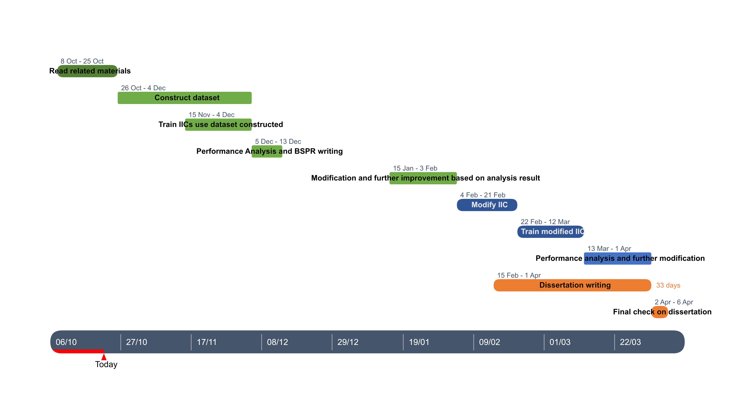
Future planning
Overall planning: provide a Gannt chart or similar with your rough plan for the rest of the project. Aim for tasks of roughly 2 weeks in length.
Next steps: what are your next steps until the next progress meeting going to be? how long will each step take? Aim for steps of only a few days in length to allow you to produce a useful plan.
  Further reading(By the end of week 5).
  Collect a reasonable amount of video data which are sufficient to train for IIC for image clustering on STL10(a week).
  Perform the first image clustering test on STL10 (a week).

Slide 5
Reference list
Xu Ji, Joao F Henriques, and Andrea Vedaldi. Invariant information distillation for unsupervised image
segmentation and clustering. arXiv preprint arXiv:1807.06653, 2018.
Adam Coates, Andrew Ng, and Honglak Lee. An analysis of single-layer networks in unsupervised feature learning. In Proceedings of the fourteenth international conference on artificial intelligence and statistics, pages 215–223, 2011.
Alex Krizhevsky and Geoffrey Hinton. Learning multiple layers of features from tiny images. Technical report, Citeseer, 2009.
Diederik P Kingma and Jimmy Ba. Adam: A method for stochastic optimization. arXiv preprint arXiv:1412.6980,
2014.
Harold W Kuhn. The hungarian method for the assignment problem. In 50 Years of Integer Programming 1958-2008, pages 29–47. Springer, 2010.

