Slide 1
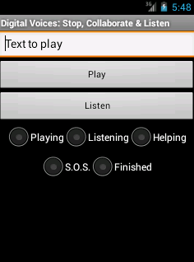
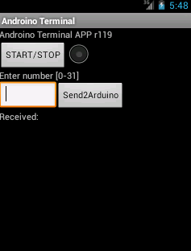
Week summary
Familiar with original documents.
Find some relative code and documents about this project.
3. Use smartphone to test the correctness of code
Frequency shift keying (FSK) is a frequency modulation scheme in which digital information is transmitted through discrete frequency changes of a carrier wave. Normally, the transmitted audio alternates between two tones: one , the "mark", represents a binary one, the other, the "space", represents a binary zero.
ASK version
FSK version

Slide 2
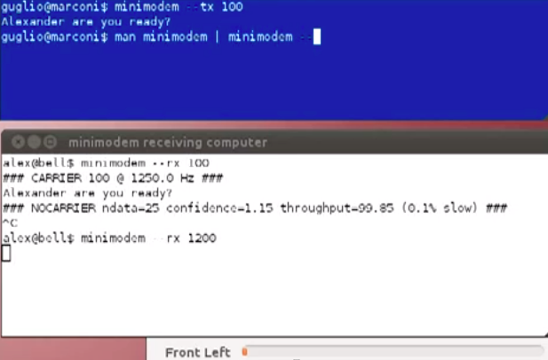
Understand and study the detail information of FSK
Using minimodem to test further on smartphone.
We will integrate this software with server
Minimodem

Slide 3
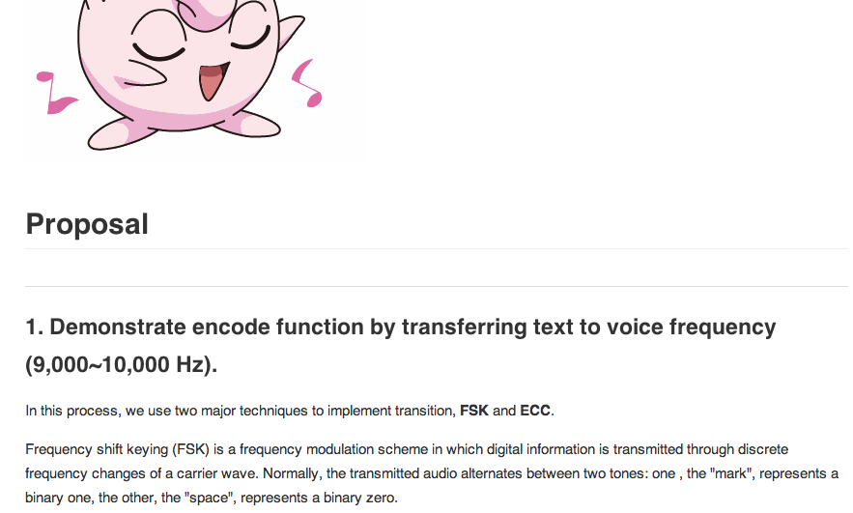
Define the project proposal

