Slide 1
IMPLEMENTING ALGORITHM FOR SMALLEST ENCLOSING BALL PROBLEM
DONE BY:
Marco Fischer & Dexter Lyman
01

Slide 2
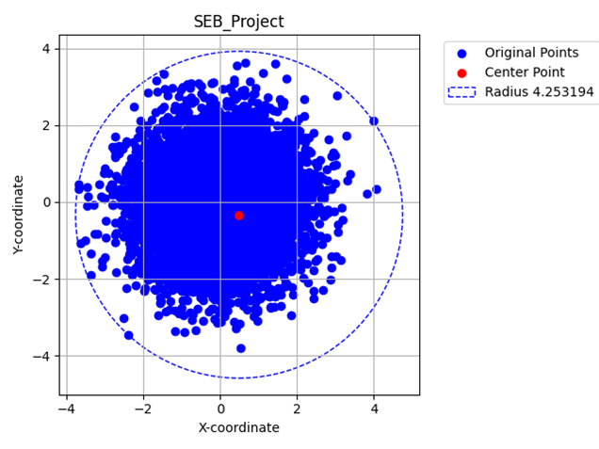
Introduction
Smallest Enclosing Ball Problem (SEB)
Given a number of generated points, enclose them all in the smallest possible circle/sphere with all of them in it.
02

Slide 3

The main goal is to:
The Goal
01
Implement the SEB algorithm
02
Compare the runtime of our code implementation (SEB) and the code based on Fischer et al. written by Jan Bradley
1
2
1- Fischer, K., Gärtner, B., & Kutz, M. (2003). Fast Smallest-Enclosing-Ball Computation in High Dimensions. In G. Di Battista & U. Zwick (Eds.), Algorithms—ESA 2003 (Vol. 2832, pp. 630–641). Springer Berlin Heidelberg. https://doi.org/10.1007/978-3-540-39658-1_57
2- https://github.com/hbf/miniball
03
Notes:
*Add an image

Slide 4
3 data types were used:
Datasets Used
01
Normal Distribution
02
Uniform distribution
03
Unit-circle (spherical) with uniform distribution disturbance
Datasets were generated onto a text file via a separate python code
04

Slide 5

Hardware
Hardware Used:
01
Lenovo Laptop
02
12th Gen i7-12700H
03
2.3 GHz, with 32GB RAM, 64 bit OS, x64 based processor
05

Slide 6
Testing Conditions:
01
Both algorithms are running on Dexter’s machine
Testing
02
The same dataset is used to test both algorithms
03
Both ours and Fischer’s algorithm are executed using Ubuntu (WSL)
Testing Procedures:
01
Dataset is generated.
02
SEB algorithm is executed using Ubuntu (WSL).
03
Fischer algorithm is executed using Ubuntu (WSL).
04
Time in milliseconds is recorded for both.
06

Slide 7

Normal Distribution
Goal: To generate normally distributed points
07

Slide 8
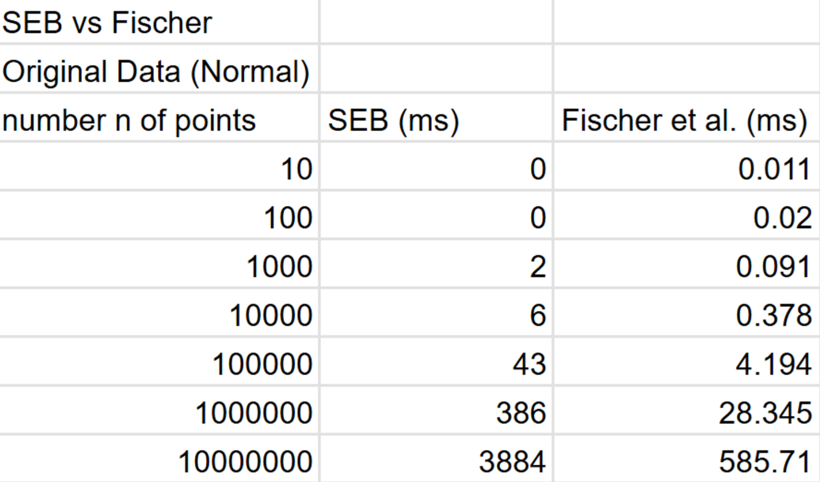
SEB vs. Fischer
Normal Distribution
08

Slide 9
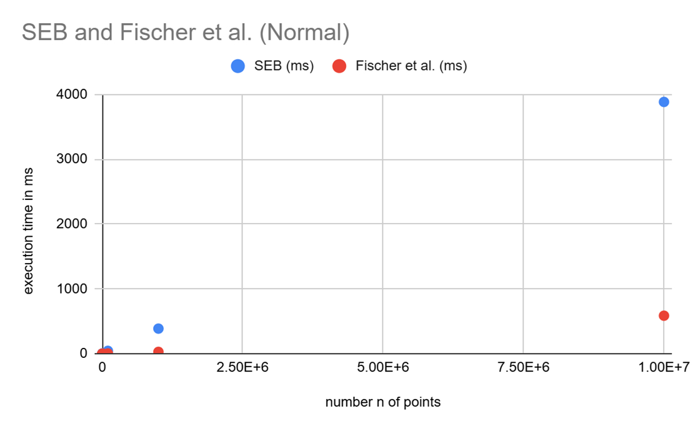
SEB and Fischer et al. (Normal)
Normal Distribution
09

Slide 10
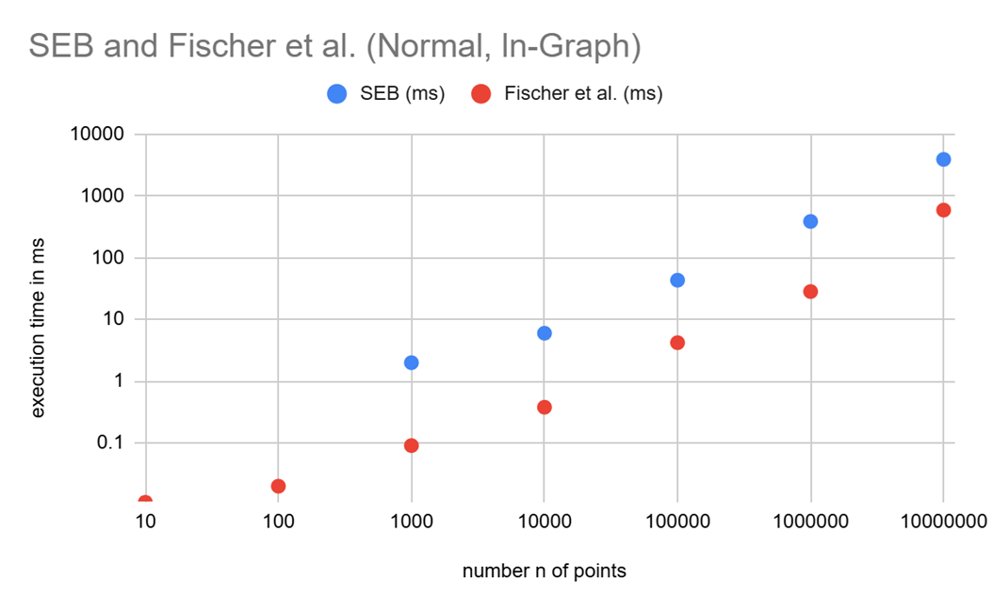
SEB and Fischer et al. (Normal, In Graph)
Normal Distribution
10

Slide 11
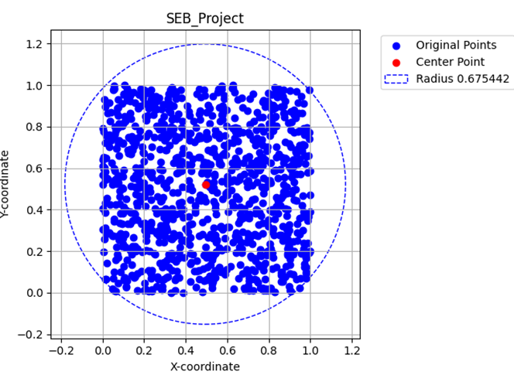
Uniform Distribution
Goal: Generate uniformly distributed points
011

Slide 12
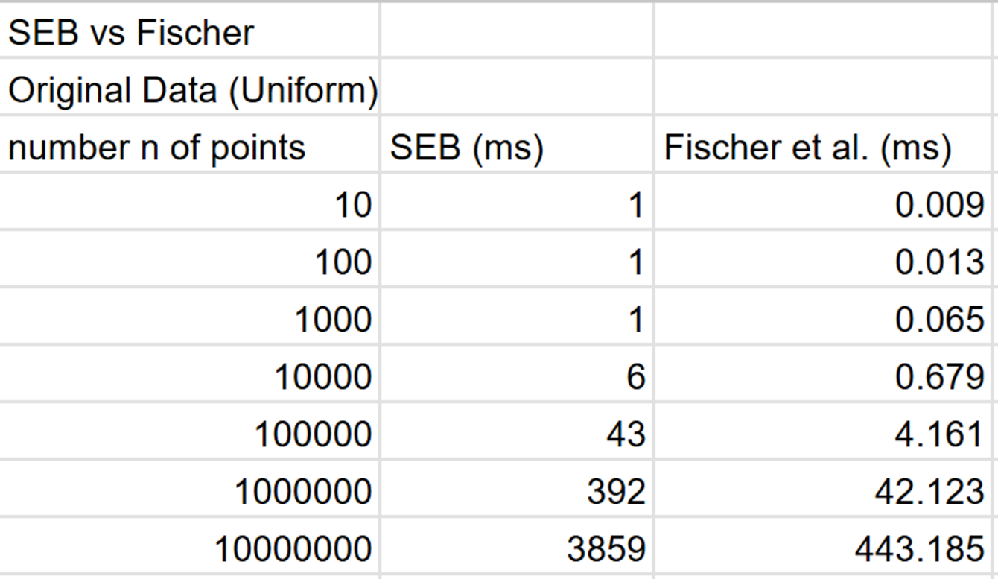
SEB vs. Fischer
Uniform Distribution
12

Slide 13
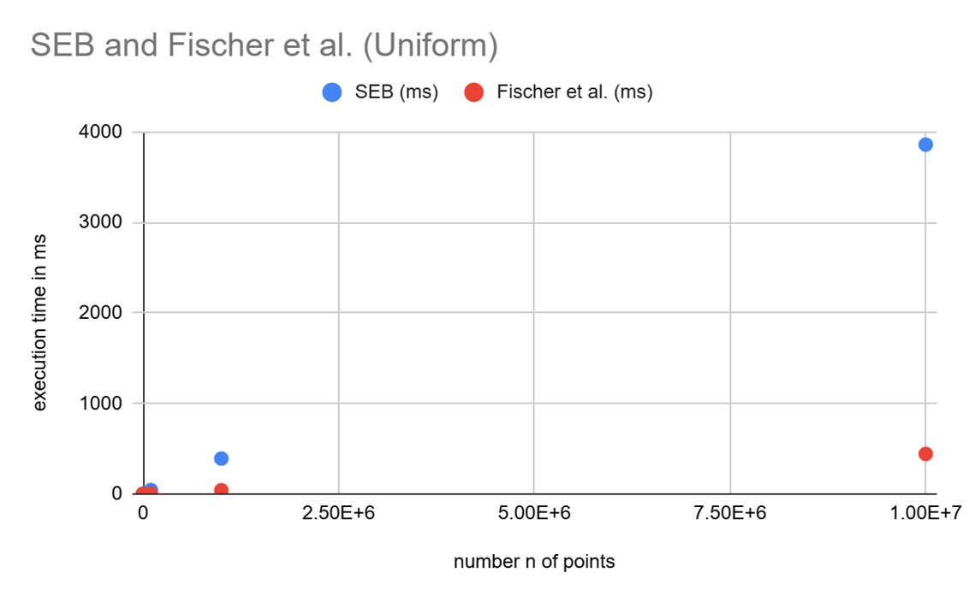
SEB and Fischer et al. (Uniform)
Uniform Distribution
13

Slide 14
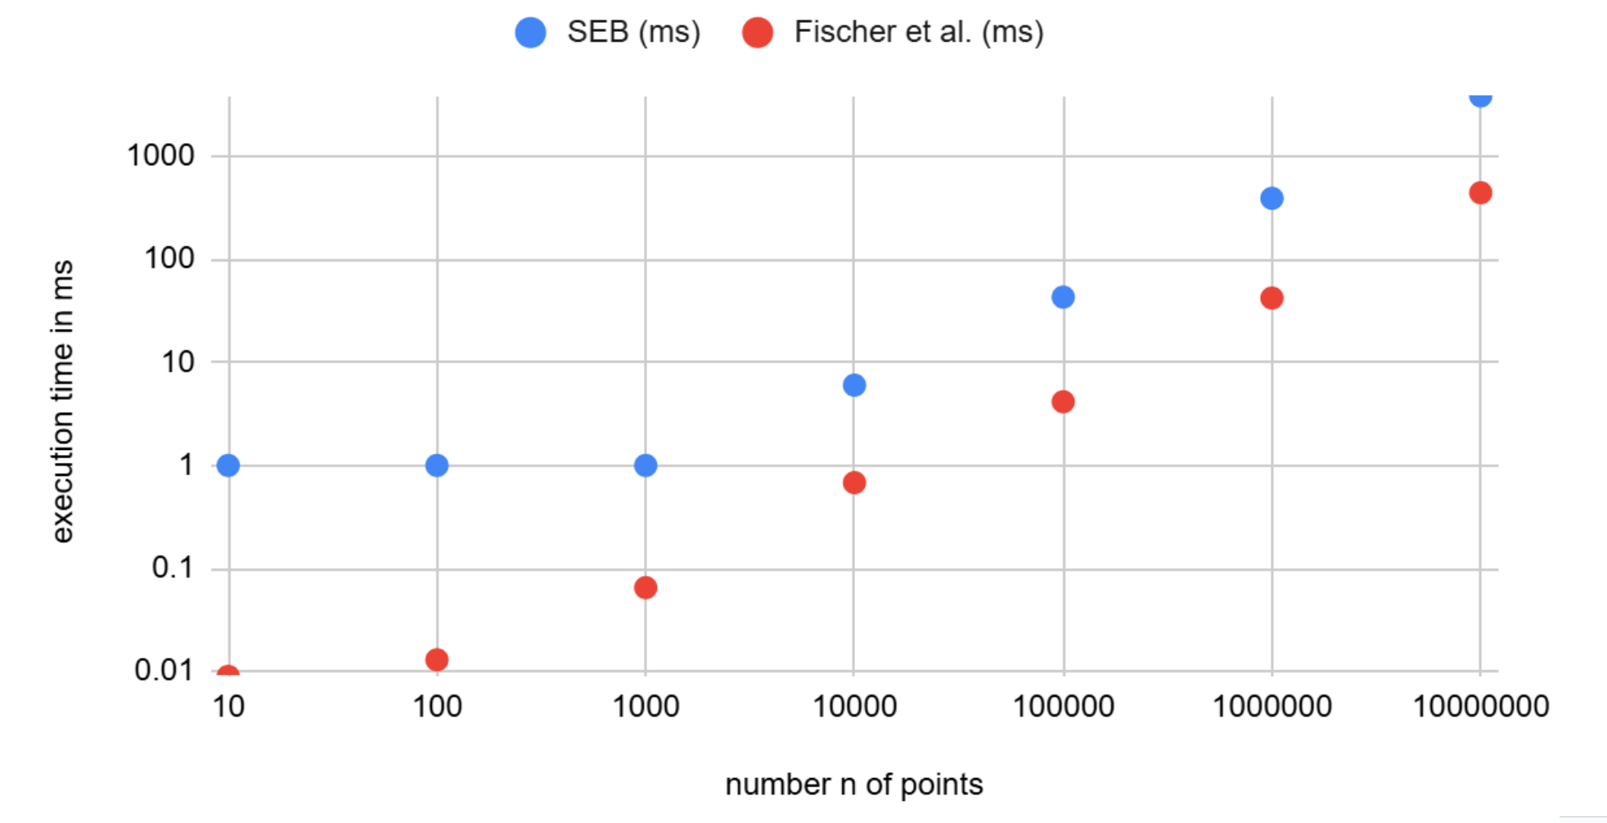
SEB and Fischer et al. (ln-Uniform)
Uniform Distribution
14

Slide 15
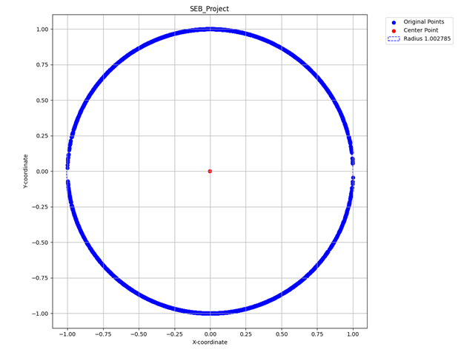

Goal: Generate points uniformly distributed on the surface of a unit circle (radius r=1)
Unit Circle
Point Perturbation:
01
02
15

Slide 16
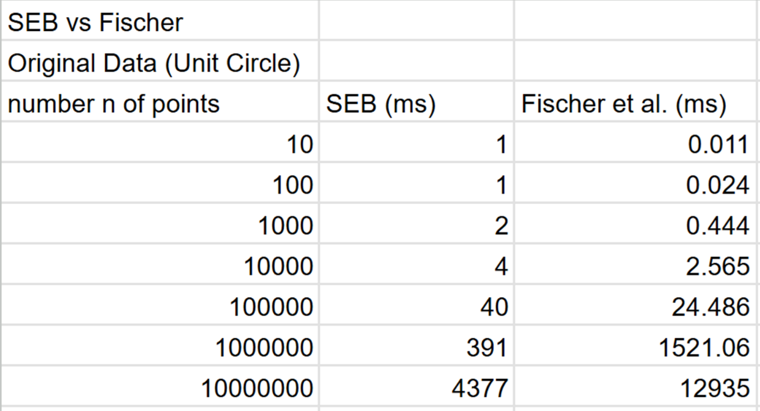
SEB vs. Fischer
Unit Circle
16

Slide 17
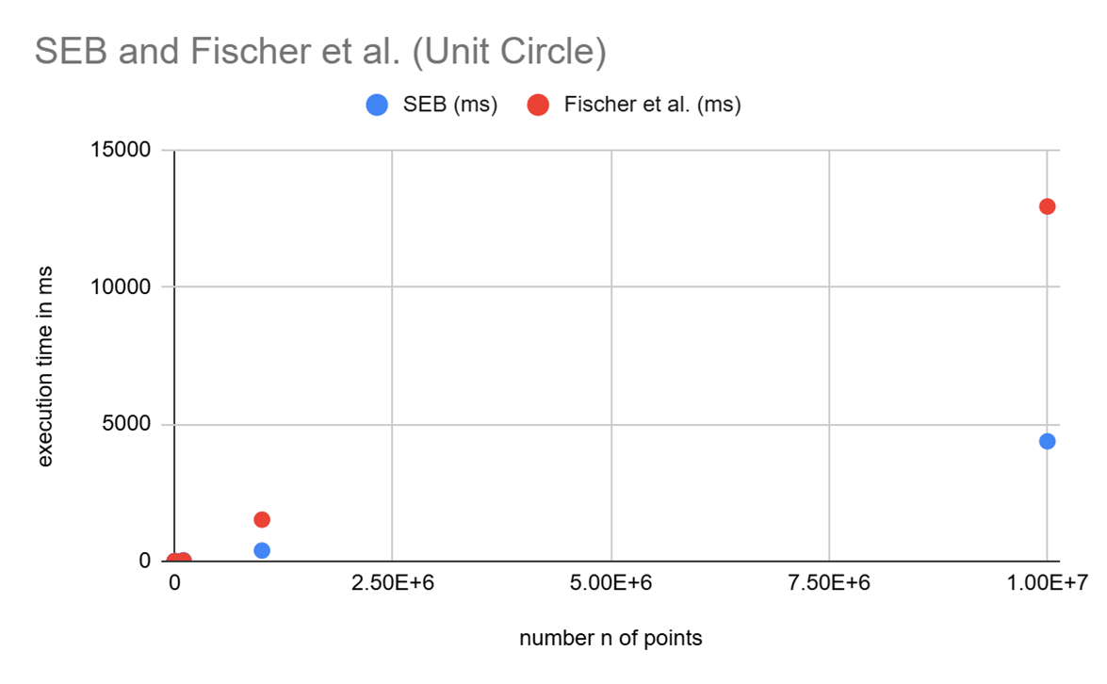
SEB and Fischer et al. (Unit Circle)
Unit Circle
17

Slide 18
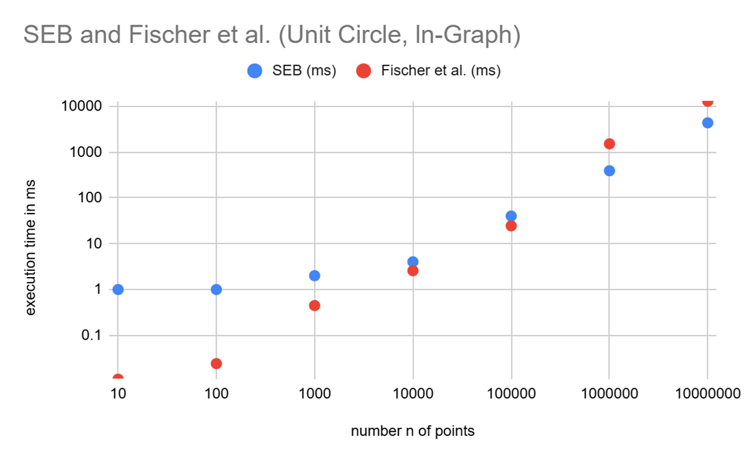
SEB and Fischer et al. (Unit Circle, In-Graph)
Unit Circle
18

Slide 19
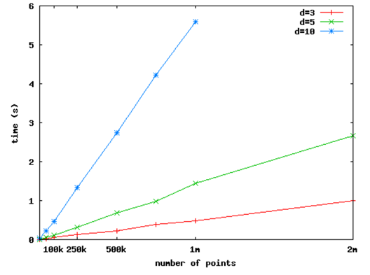

Findings on Time Complexity:
Findings
01
3
Fischer’s algorithm has a runtime of O(n)
02
Our algorithm (SEB) also has a runtime of O(n)
3. Test results from https://github.com/hbf/miniball
19

Slide 20
Improvements to our Runtime
Results
01
The built-in function “sort” [O(n log n)] -> bucket-sort [O(n)]
02
Using linear sorting has made our program achieve near-competitive speed with Fischer’s algorithm.
20

Slide 21
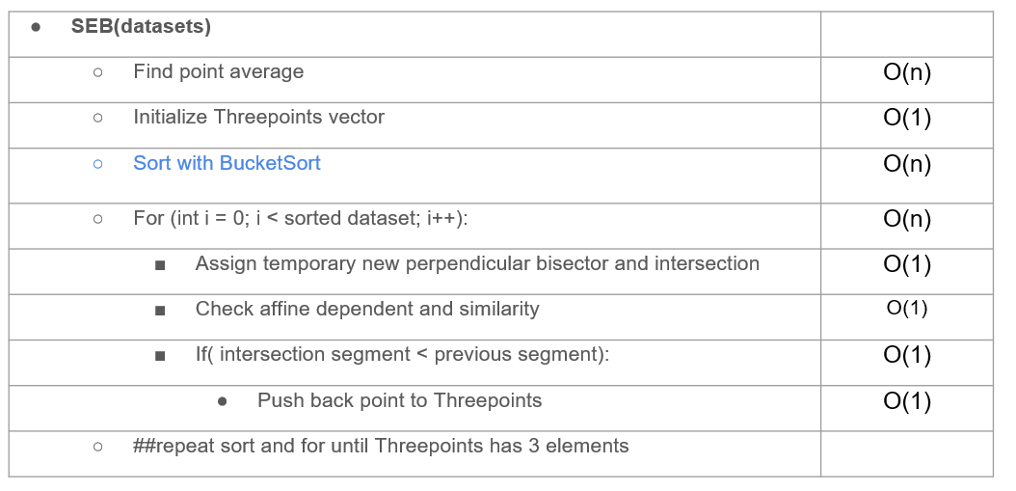
Time Complexity Analysis:
Code
21

Slide 22
Findings on different datasets
Findings
01
Uniform datasets are the least resource-demanding to compute
02
Normal and Unit-Circle datasets are very resource-demanding to compute
03
Our code (SEB) computes the Unit-Circle faster than Fischer’s.
22

Slide 23
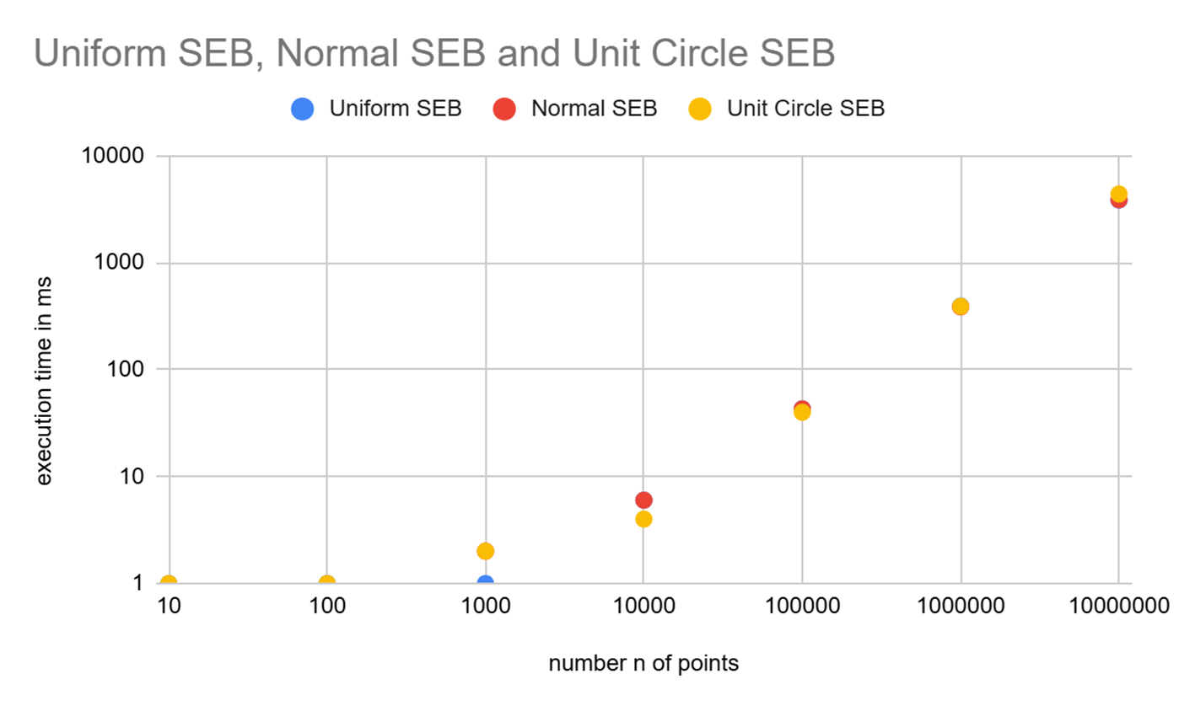
Uniform SEB, Normal SEB and Unit Circle SEB
SEB Comparison
23

Slide 24
Issues we faced:
Limitations
Hardware Limitations:
01
Limits our maximum number of computable Points (10 million)
Slower Performance due to:
01
Our algorithm (SEB) uses bisector approach (geometry)
02
Fischer’s algorithm uses dot-product approach
03
SEB requires more for-loops in the algorithm, hence it is not as fast as Fischer’s
24

Slide 25
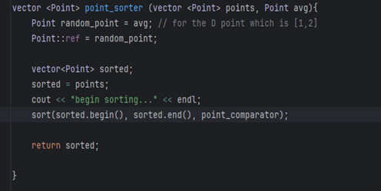
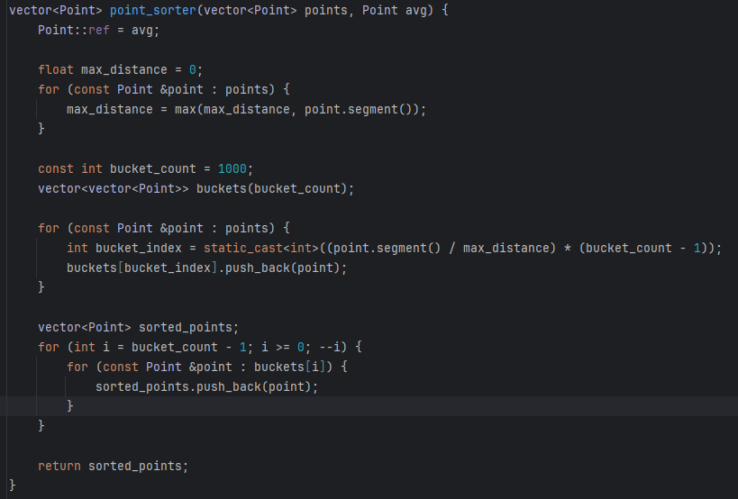
Improved Sort Function
Improvements
01
Switched from a O(nlogn) Sort algorithm to Bucket sort approach O(n)
25

Slide 26
Bibliography
1- Fischer, K., Gärtner, B., & Kutz, M. (2003).
Fast Smallest-Enclosing-Ball Computation in High Dimensions. In G. Di Battista & U. Zwick (Eds.),
Algorithms—ESA 2003 (Vol. 2832, pp. 630–641). Springer Berlin Heidelberg.
https://doi.org/10.1007/978-3-540-39658-1_57
2,3- https://github.com/hbf/miniball
Bibliography
26

