Slide 1
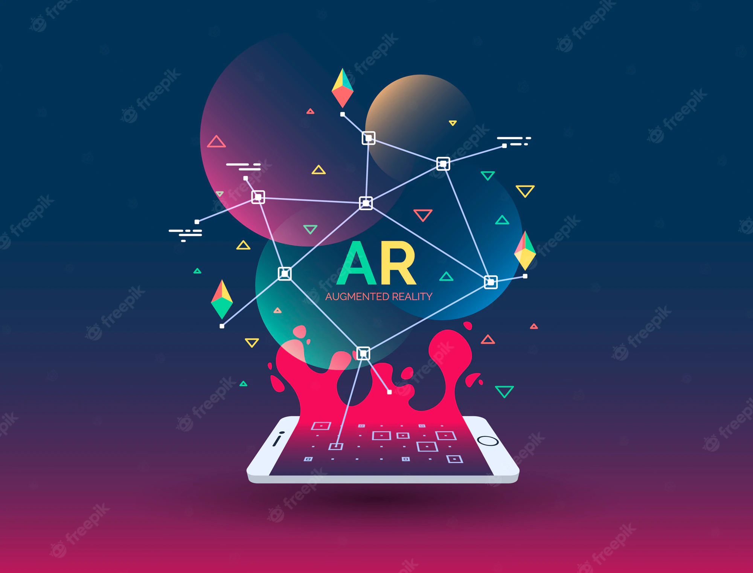
Augmented Reality
By K.Likhitha Rukmini
208R1A6234
CSE-Cyber security

Slide 2
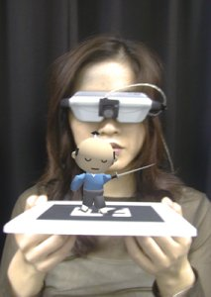
What Is Augmented Reality (AR)?
A combination of
  a real scene viewed by a user and
  a virtual scene generated by a computer that augments the scene with additional information.
  ARToolkit demo movie
  T-immersion 2004 video

Slide 3
Augmented Reality vs. Virtual Reality
Augmented Reality
System augments the real world scene
User maintains a sense of presence in real world
Needs a mechanism to combine virtual and real worlds
Hard to register real and virtual
Virtual Reality
Totally immersive environment
Senses are under control of system
Need a mechanism to feed virtual world to user
Hard to make VR world interesting
Notes:
Computer generated virtual objects must be accurately registers with the real
in all dimensions.
Errors in registration prevent the real and virtual images from being seen as fused.
Registration must be maintained while the user moves around in the virtual
environment.
Changes in registration can be distracting or physically disturbing.

Slide 4
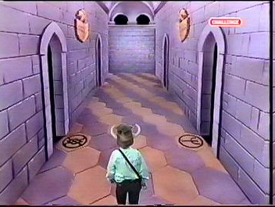
Milgram’s Reality-Virtuality Continuum
Mixed Reality (MR)
Real Environment
Augmented Reality (AR)
Augmented Virtuality (AV)
Virtual Environment
Milgram coined the term “Augmented Virtuality” to identify systems which are mostly synthetic with some real world imagery added such as texture mapping video onto virtual objects.
Notes:
Augmented reality is closest to the real world because mainly a user is perceiving
the real world with just a little computer generated data.
This distinction will probably fade as technology improves.

Slide 5
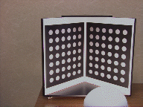
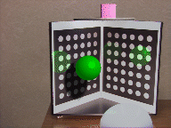
Combining the Real and Virtual Worlds (cont)
Register models of all 3D objects of interest with their counterparts in the scene
Track the objects over time when the user moves and interacts with the scene
Notes:
1st picture - real world
2nd picture - real world with virtual objects and inter-reflections and virtual
shading

Slide 6
Display Technologies
Monitor Based
  Laptops
  Cell phones
  Projectors (more Ubiquitous Computing)
Head Mounted Displays:
  Video see-through
  Optical see-through

Slide 7
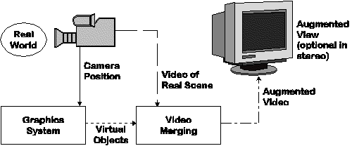
Monitor Based Augmented Reality
Simplest available
Treat laptop/PDA/cell phone as a window through which you can see AR world.
Sunglasses demo
Notes:
Sometimes referred to as “Windows on the World” or “Fish Tank VR”
Other display technologies are used to increase the sense of presence.

Slide 8
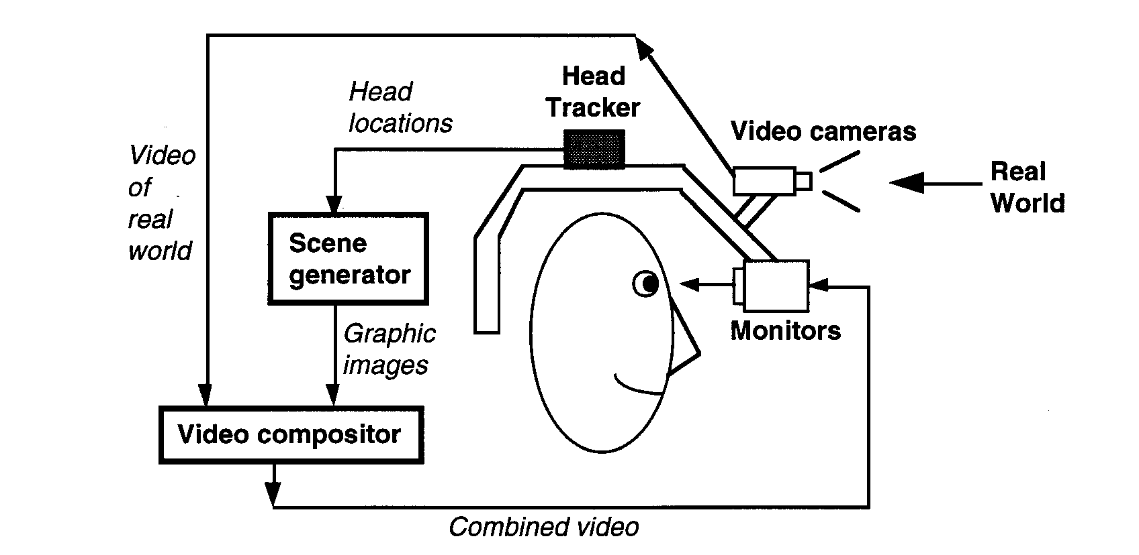
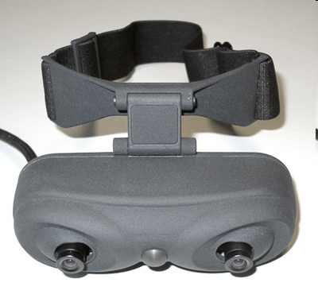
Video see-through HMD
Notes:
Works by combining a closed-view HMD with one or two head-mounted video
cameras
Video cameras provide the user’s view of the real world.
Video from cameras is combined with graphics images by the scene generator to
blend the two worlds.
Result is sent to the monitors in from on the user’s eyes in the closed-view HMD.
User has no direct view of the real world.
If power is off, the user is “blind.”

Slide 9
Advantages of
Video see-through HMD
Flexibility in composition strategies
Real and virtual view delays can be matched
Notes:
Flexibility in composition strategies
Basic Problem with optical is the virtual objects do not completely obscure real- world objects because
combiners allow light from both the virtual and real sources.
Virtual objects appear ghost-like and semi-transparent, damaging the illusion of reality because
occlusion is a strong depth cue.
Video see-through is much more flexible about how it merges real and virtual - they are both in
digitized form so compositors can do a pixel-by-pixel comparison.
Produces more compelling environments.
Wide Field of View
Distortions in optical systems are a function of the radial distance away from the optical axis - the
further you look away from the center of the view, the more distorted it gets.
A digitized image taken through a distorted optical system can be undistorted by applying image
processing techniques to unwarp the image.
This requires significant amounts of computation - but this constraint will lessen as computers
become faster.
It is harder to build wide FOV displays with optical see-through constraints.
Distortions of the user’s view of the real world could be corrected optically, but complex optics are
expensive and make the HMD heavier.
Real and Virtual delays can be matched
Delay the video of the real world to match the delay in the virtual image stream. (can’t be done in
optical because it gives the user a direct view of the real world.)
Disadvantage: eliminating dynamic error comes at the cost of delaying both the real and virtual
scenes - user sees everything lagging behind.

Slide 10
Advantages of
Optical see-through HMD
Simplicity
Resolution
No eye offset
Notes:
Simplicity
Optical has only 1 stream of video to worry about (the graphics images), while
Video has separate streams for real and virtual images.
Optical - real world is seen directly through combiners with a time delay of a few
nanoseconds while both delays in video are in 10s of milliseconds.
Optical HMDs with narrow field of view combiners offer views of the real world
that are basically undistorted, while Video has distortion that must
be compensated for.
Resolution
Video limits the resolution of what the user sees (both real and virtual) to the
resolution of the display devices.
Optical limits the virtual resolution to the resolution of the display devices but not
the user’s view of the real world.
No Eye Offset
Video - user’s view of real world is provided by video cameras that are not
necessarily located at exact positions of user’s eye - creating an
offset between cameras and real eyes.
Video problem can be avoided using mirrors to create a set of optical paths that
mimic the direct path to the user’s eyes, however this adds
complexity to the HMD design.
Offset is not generally a problem for optical.

Slide 11
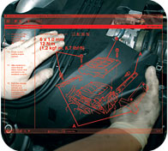
Advantage of Monitor Displays
Consumer-level equipment
Most practical
A lot of current research aimed here
Other current active area is a flip-down optical display.

Slide 12
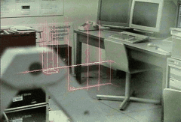
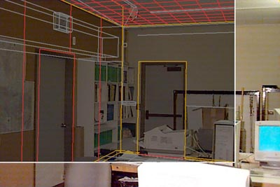

Early Application
Later – “architectural anatomy” - movie
Tourguide - movie

Slide 13
Thank You☺

