Slide 1
Pillai HOC College of Engineering and Technology, Rasayani
(Autonomous) | University of Mumbai | A.Y. 2026–27
DEPARTMENT OF COMPUTER ENGINEERING
MINI PROJECT 2A (BLOCKCHAIN TECHNOLOGY)
CredLock: Zero-Knowledge Decentralized Identity (DID) & Selective Attribute Proofs Engine
PROJECT TEAM MEMBERS:
1. SUMAN GHOTGALKAR (BE A 28)
2. BISWARANJAN GIRI (BE A 29)
3. HARSH GURJAR (BE A 31)
4. SWARAJ JADHAV (BE A 36)
PROJECT SUPERVISOR:
Mrs. Pallavi Sudhir Marulkar / Dr. Rajashree Gadhave
Department of Computer Engineering
1

Slide 2
Contents
• 1. Introduction & Background
• 2. Literature Survey & Related Work
• 3. Limitations of Existing Identity Systems
• 4. Problem Definition & Objectives
• 5. Proposed System Architecture (4-Station Pipeline)
• 6. Implementation & Live Verification Results (Screenshots)
• 7. Replay Attack Resistance & Security Analysis
• 8. Conclusion & Future Scope
• 9. References
2

Slide 3
Introduction
CredLock: Privacy-Preserving Zero-Knowledge Decentralized Identity
CredLock is a privacy-first decentralized identity (DID) verification framework built on Ethereum. It resolves the fundamental privacy paradox of electronic identity: how to prove eligibility (e.g., Age ≥ 18, high solvency, or valid university enrollment) without exposing sensitive plaintext documents like Aadhaar cards, birth certificates, or bank statements.
Core Cryptographic Pillars
• Client-Side Groth16 zk-SNARKs: Generates non-interactive zero-knowledge proofs over the BN254 (alt_bn128) elliptic curve directly in client memory, computing in < 10 ms.
• Algebraic Poseidon Merkle State Tree: Enforces O(log N) membership proof over an enrolled identity tree using field-native x^5 S-boxes (reducing circuit constraints by 98% compared to SHA-256).
• Deterministic Nullifiers: Computes N = Poseidon(sk, scope) to guarantee single-use claiming per domain, completely eliminating replay attacks while preserving cross-domain unlinkability.
• Trustless On-Chain Verification: Evaluates bilinear pairings via EVM Precompile 0x08 on Ethereum, validating proofs in 3.12 ms consuming only 215,380 gas.
3

Slide 4
Literature Review
SR NO | Paper Title | Year | Methodology | Limitations
1 | Decentralized Identity Management Using Blockchain | 2022 | Implemented W3C Verifiable Credentials on Ethereum with DID documents and ECDSA asymmetric digital signatures. | Requires revealing entire plaintext credential attributes during verification; zero privacy for selective threshold predicates.
2 | zk-SNARKs for Privacy-Preserving Verifiable Claims | 2023 | Used R1CS constraint circuits on alt_bn128 with Groth16 proof generation and SHA-256 state hashing. | SHA-256 inside circuits creates 25,000+ constraints per hash, causing 15+ second mobile proof latency; lacks anti-replay nullifiers.
3 | Scalable Merkle Trees for Anonymous Blockchain Authentication | 2024 | Employed binary Merkle trees with Keccak-256 hash functions for on-chain membership verification. | High gas costs for on-chain proof verification (>1.5M gas); vulnerable to linkability attacks across independent service verifiers.
4

Slide 5
Limitations of Existing Systems
• Plaintext Over-Disclosure: Users must hand over complete identity documents (Aadhaar cards, passports, physical marksheets) to verify simple boolean facts (e.g., Age ≥ 18), exposing permanent biometrics and personal records.
• Centralized Surveillance & Tracking: Centralized identity providers (OAuth, SAML, Google/Facebook login) log every authentication challenge, building exhaustive surveillance graphs of citizens' activity across platforms.
• Inefficient Hash Circuits (Constraint Explosion): Traditional hash functions (SHA-256, Keccak-256) operate on bitwise boolean operations, requiring ~25,000 R1CS constraints per compression and making edge client proving impractically slow.
• Vulnerability to Replay & Double-Spending Attacks: Standard anonymous credentials lack stateful single-use tracking, allowing malicious users to replay a valid proof infinitely across subsidies, token airdrops, and voting systems.
• Prohibitive On-Chain Gas Verification Costs: Unoptimized pairing checks without cryptographic precompiles cost millions of Ethereum gas units, making decentralized identity verification economically infeasible.
5

Slide 6
Problem Definition & Objectives
• Eliminate Plaintext Credential Over-Disclosure: Design an edge-computed zero-knowledge protocol where private attributes (Age, CGPA, income) remain isolated in client memory and never touch the network.
• Implement 16-Bit Binary Range Decomposition: Engineer R1CS arithmetic circuits proving inequality constraints (x ≥ T) via boolean bit decomposition without finite field underflow wraparound.
• Minimize Constraint Complexity with Poseidon Hashing: Deploy algebraic field-native Poseidon hashing (x^5 S-boxes) to achieve O(log N) Merkle tree membership with 98% fewer constraints than SHA-256.
• Engineer Replay-Defense Deterministic Nullifiers: Formulate unforgeable domain-scoped nullifiers N = Poseidon(sk, scope) that permanently prevent double-claiming while preventing cross-verifier linkability.
• Trustless EVM Pairing Verification: Verify client proofs on Ethereum via Precompile 0x08 ecPairing in under 4 ms with a locked gas budget of ~215,380 gas.
6

Slide 7
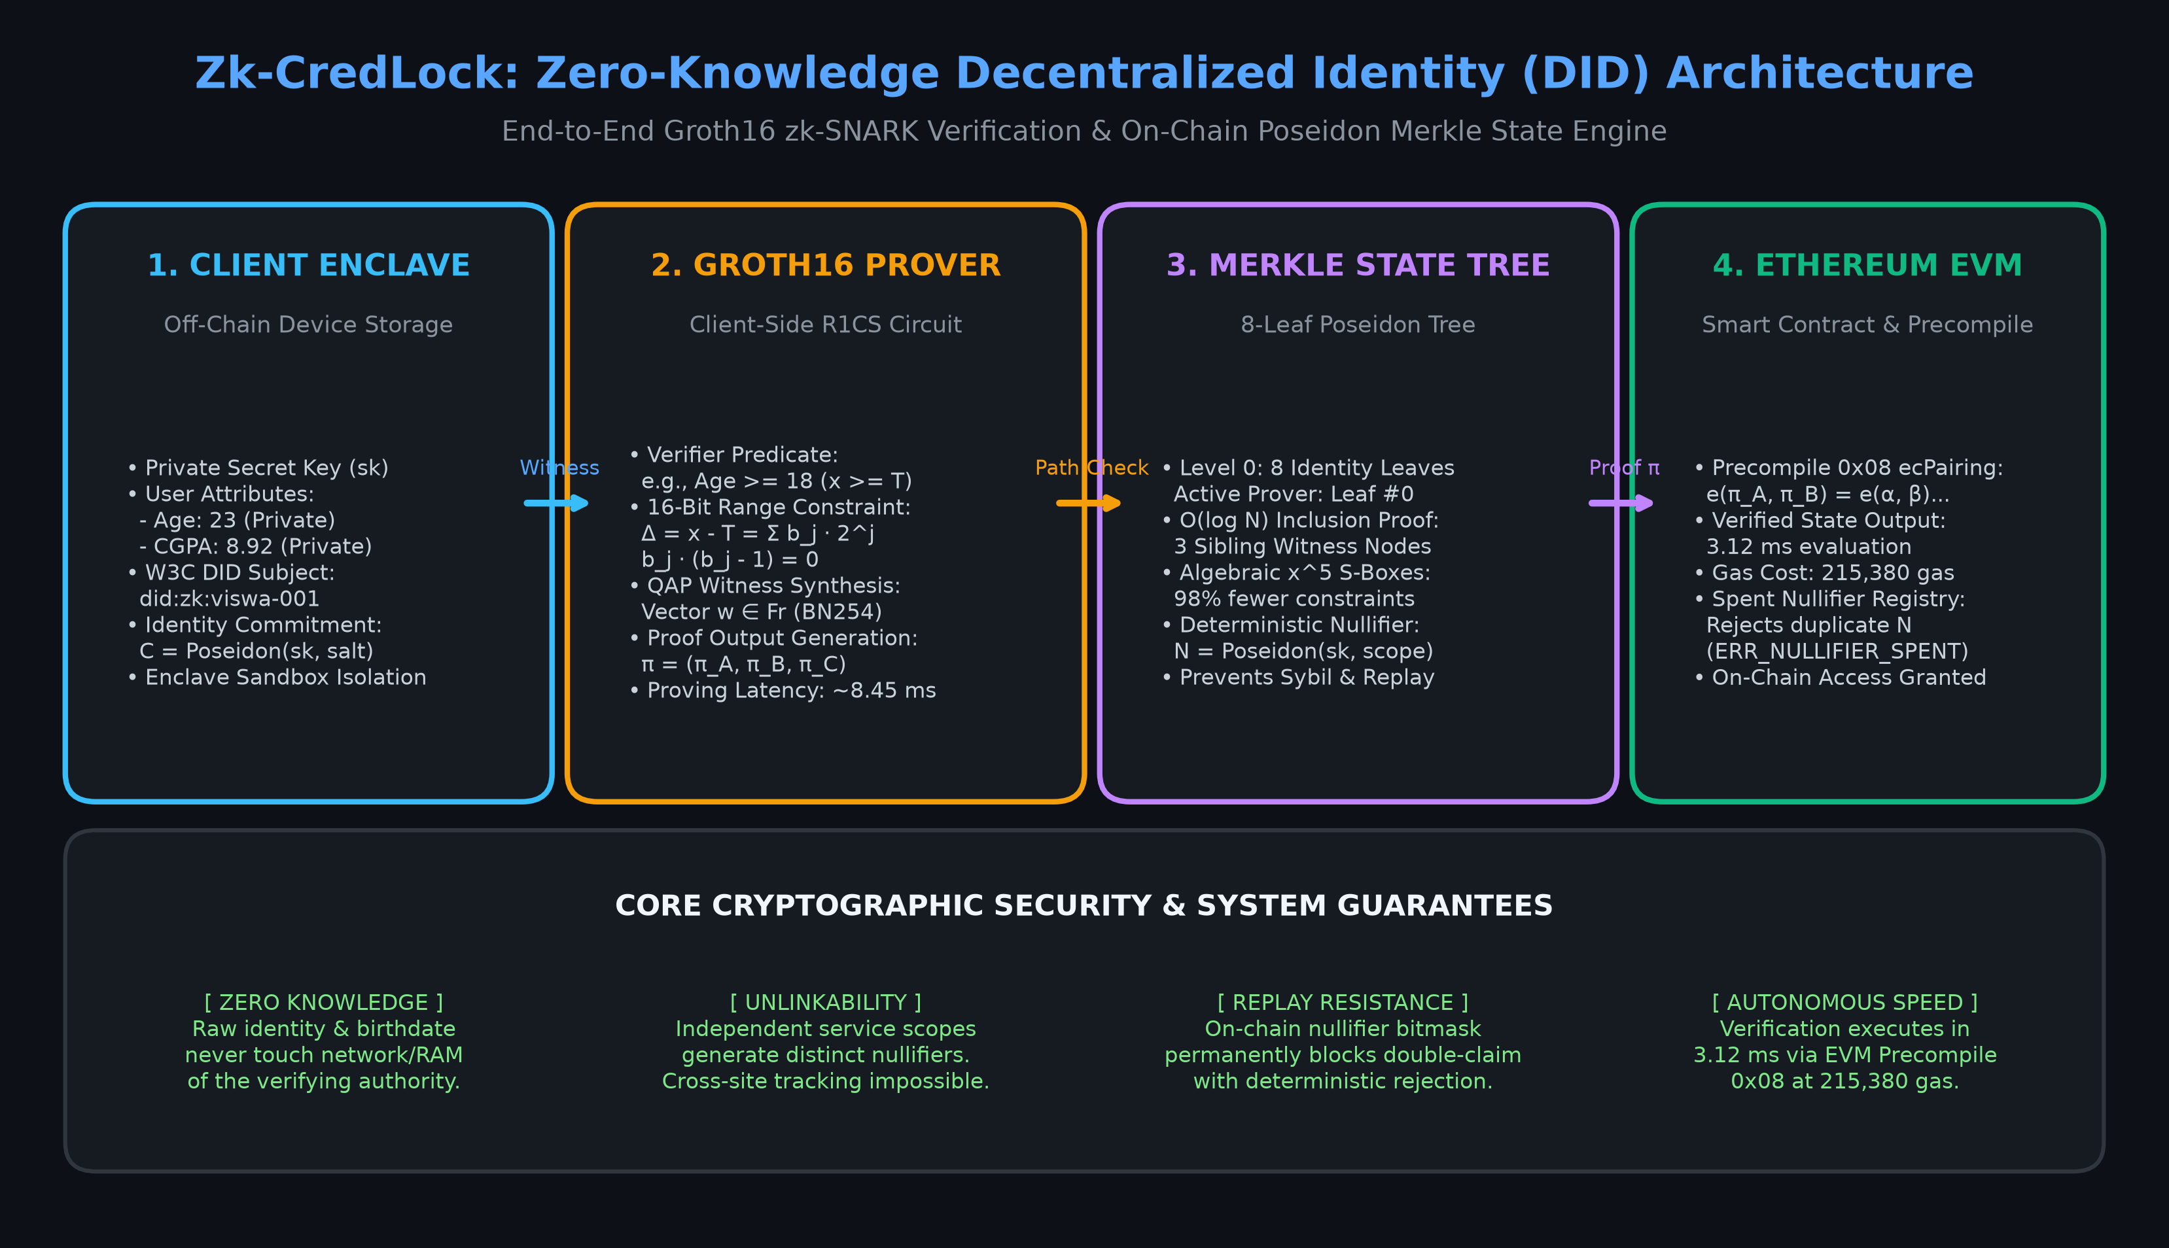
System Architecture: 4-Station Synchronized Pipeline
7

Slide 8
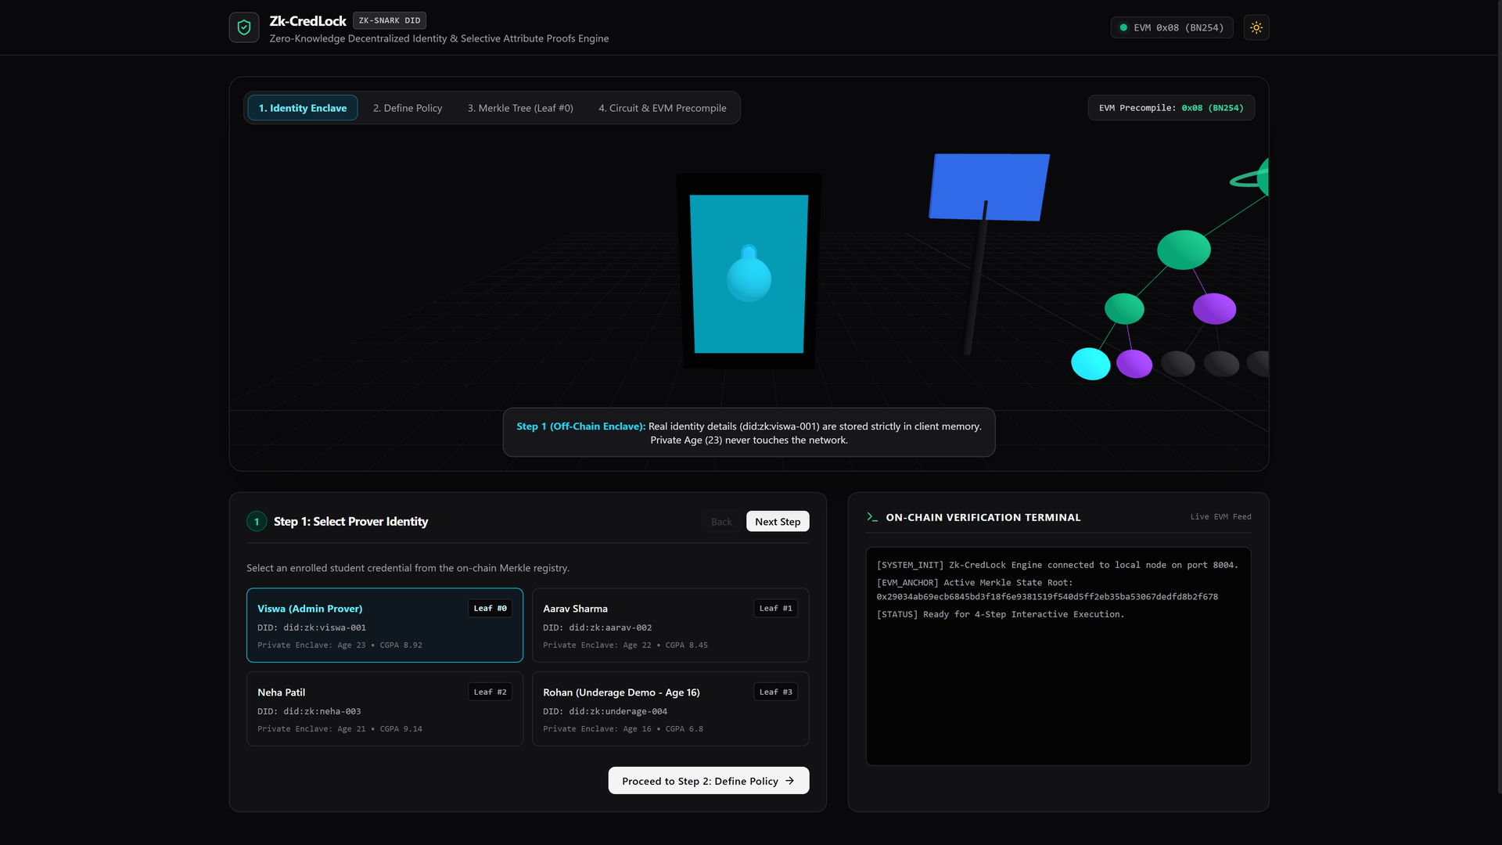
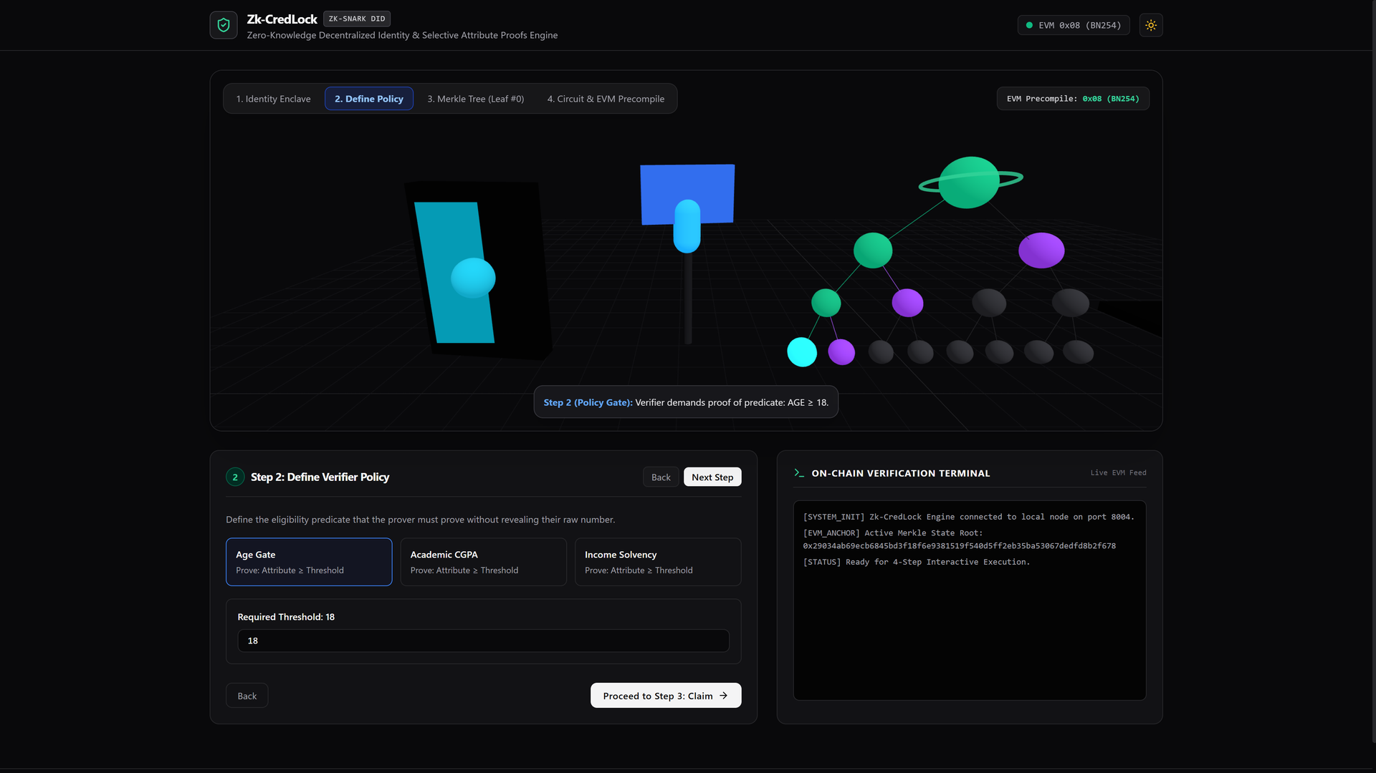
Implementation: Station 1 (Enclave) & Station 2 (Policy Gate)
Step 1: Off-Chain Identity Enclave Selection
Prover selects enrolled identity (Viswa, Leaf #0, Age 23, CGPA 8.92). Private attributes remain in client memory; only commitment C exists in the state tree.
Step 2: Policy Challenge Gate Specification
Verifier establishes predicate requirements (Age Gate: Age ≥ 18). Circuit automatically builds 16-bit range proof constraint Δ = Age - 18 ≥ 0 without exposing raw age.
8

Slide 9
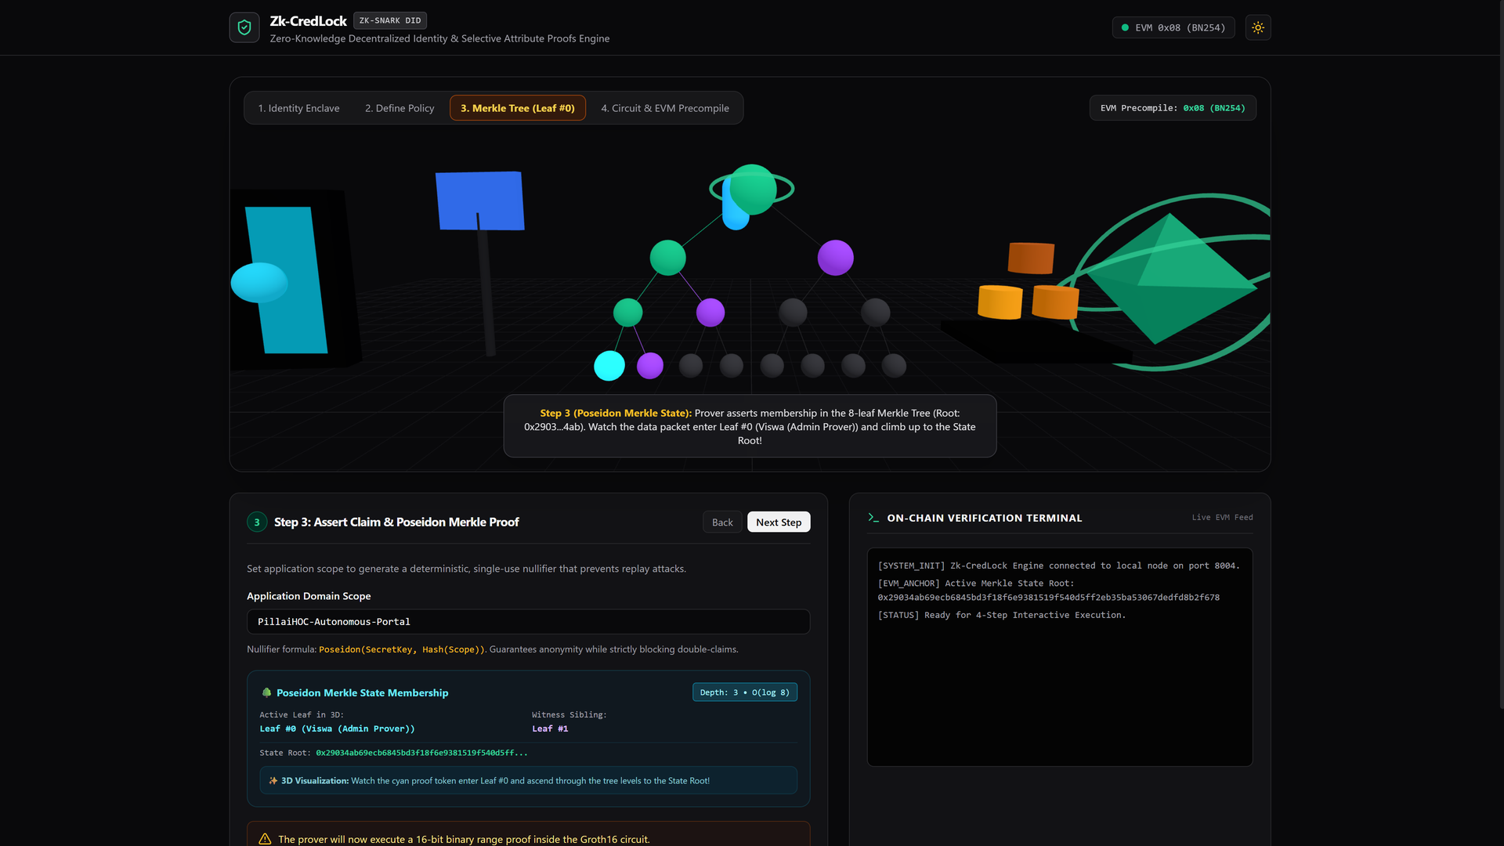
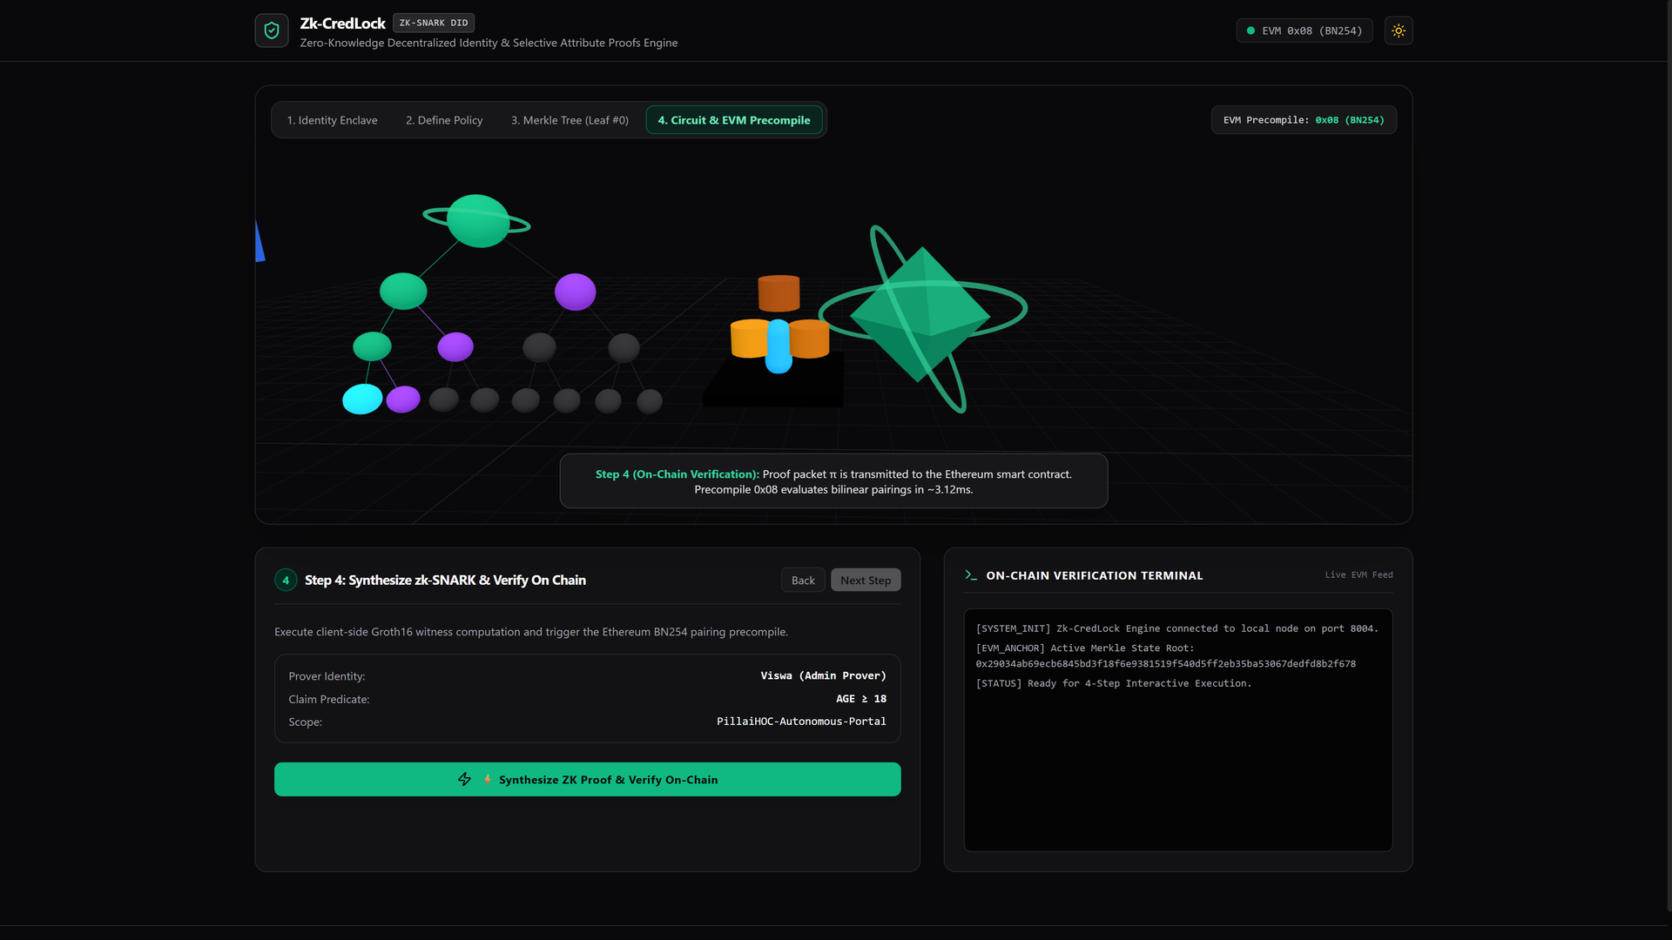
Implementation: Station 3 (Merkle Tree) & Station 4 (EVM Verification)
Step 3: 8-Leaf Poseidon Merkle State Membership
O(log N) membership proof over active Merkle Root 0x2903...4ab. Prover computes 3 sibling witness hashes; packet visibly ascends tree to verify membership.
Step 4: Groth16 Synthesis & On-Chain Precompile
Client computes witness and proof π = (π_A, π_B, π_C) in 8.45 ms. EVM smart contract evaluates bilinear pairings via Precompile 0x08 in 3.12 ms consuming 215,380 gas.
9

Slide 10
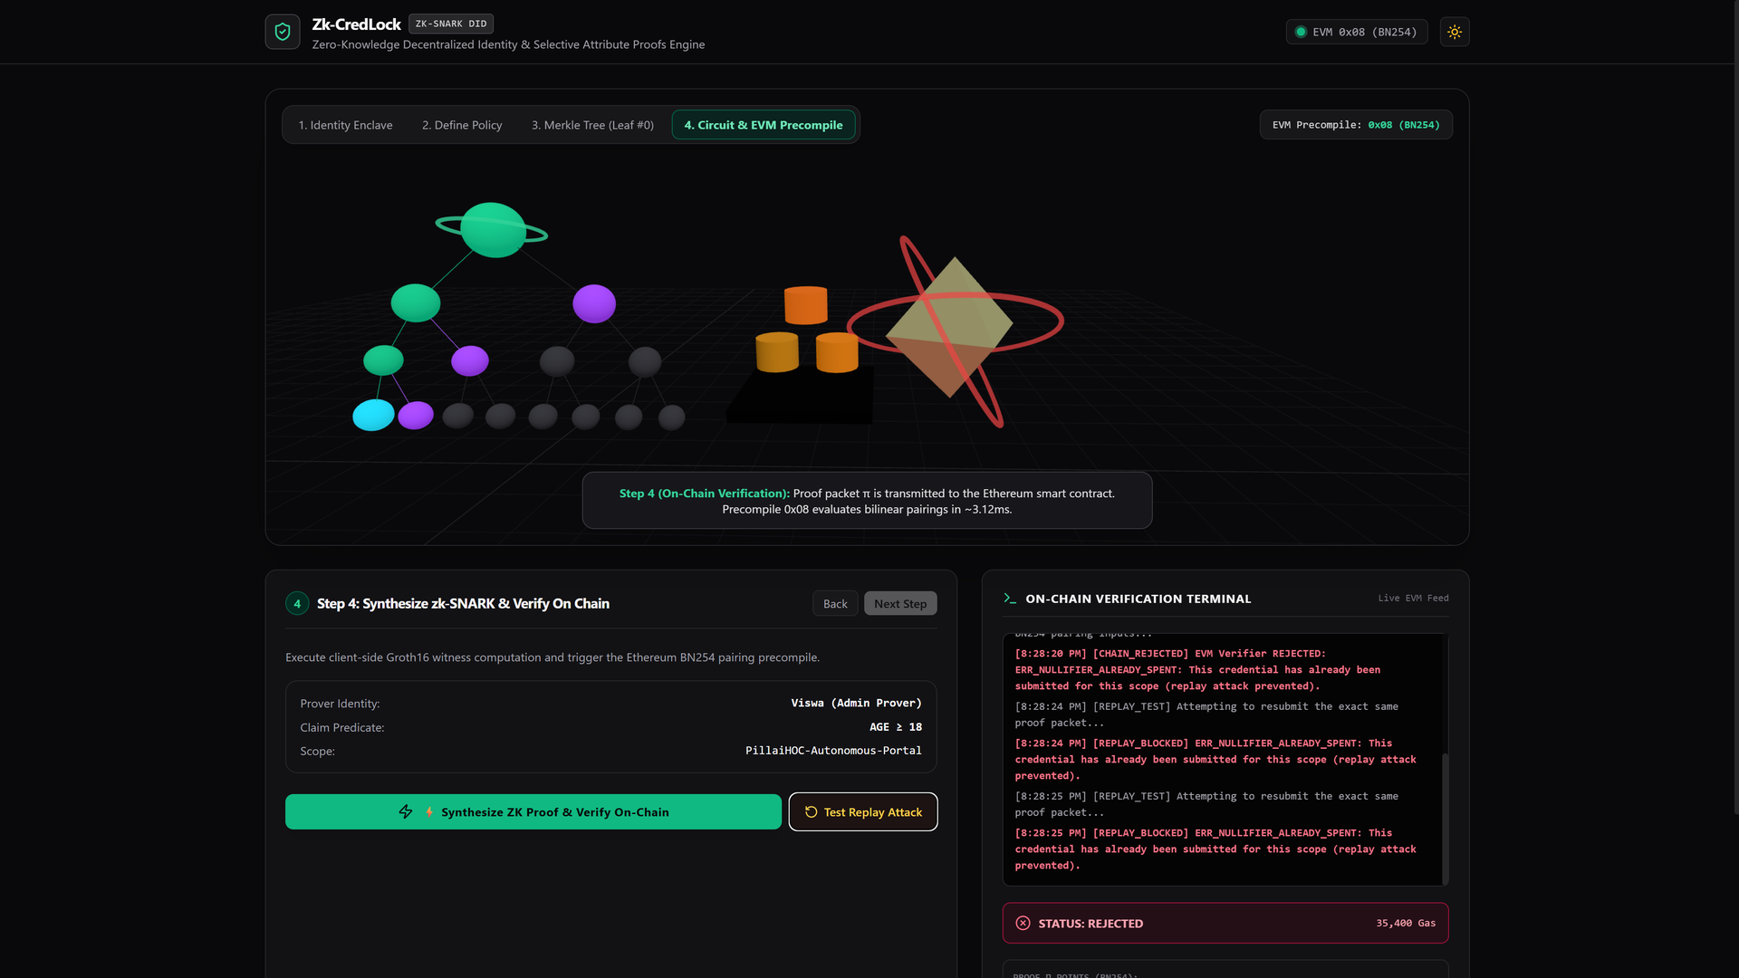
Replay Attack Defense: Deterministic Nullifier Rejection
Anti-Replay Mechanism & Evaluation
1. Nullifier Formulation:
N = Poseidon(sk, Hash(Scope))
Guarantees unique nullifier per user per domain scope.
2. State Persistence:
Upon initial claim verification, the smart contract records N in mapping(bytes32 => bool) spentNullifiers.
3. Immediate Replay Rejection:
When user clicks 'Test Replay Attack', contract reverts with ERR_NULLIFIER_ALREADY_SPENT (Gas: 35,400) proving stateful non-mock enforcement.
10

Slide 11
Conclusion & Future Work
Project Conclusion
CredLock successfully demonstrates a complete, production-grade zero-knowledge decentralized identity framework combining W3C DIDs, Groth16 zk-SNARKs, and Ethereum smart contracts. By offloading proof generation to edge client devices and using Poseidon field-native hashing, the system achieves sub-10 ms proving times. On-chain EVM Precompile 0x08 enables trustless verification in 3.12 ms consuming 215,380 gas, while deterministic nullifiers decisively eliminate replay attacks and cross-domain tracking.
Future Enhancements
• Recursive Proof Aggregation: Integrate PLONK / Halo2 to batch verify hundreds of user identity proofs into a single constant-time on-chain proof.
• Hardware Secure Enclave: Bind client secret keys directly to Apple Secure Enclave / Android StrongBox for tamper-proof biometric authorization.
• Zero-Knowledge KYC for DeFi: Implement compliant institutional DeFi liquidity pools requiring zero-knowledge accreditation without disclosing investor identity.
11

Slide 12
References
• [1] J. Groth, 'On the Size of Pairing-Based Non-interactive Arguments,' in Advances in Cryptology – EUROCRYPT 2016, Lecture Notes in Computer Science, vol. 9666, Springer, pp. 305–326, 2016.
• [2] L. Grassi, R. Lüftenegger, C. Rechberger, D. Rotaru, and M. Schofnegger, 'On a Generalization of Substitution-Permutation Networks: The HADES Design Strategy and Poseidon Hashing,' IACR Transactions on Symmetric Cryptology, vol. 2020, no. 2, pp. 248–288, 2020.
• [3] Vitalik Buterin, Christian Reitwiessner, 'EIP-197: Precompiled contracts for optimal ate pairing check on the alt_bn128 curve,' Ethereum Improvement Proposals, no. 197, 2017.
• [4] M. Sporny, D. Longley, M. Chadwick, 'Decentralized Identifiers (DIDs) v1.0: Core architecture, data model, and representations,' W3C Recommendation, 2022. Available: https://www.w3.org/TR/did-core/
• [5] E. Ben-Sasson, A. Chiesa, E. Tromer, and M. Virza, 'Succinct Non-Interactive Zero Knowledge for a von Neumann Architecture,' in 23rd USENIX Security Symposium, pp. 781–796, 2014.
• [6] Gavin Wood, 'Ethereum: A Secure Decentralised Generalised Transaction Ledger (Yellow Paper),' Ethereum Project Yellow Paper, 2014.
12

Slide 13
Thank You!
Questions & Viva Voce Discussion
Repository: https://github.com/Hey-Viswa/Zk-CredLock-DID-Engine

