Slide 1


IKEA – Customer Retention & Experience Analysis
Prepared by Aadesh Dhikale

Slide 2

The Retention Crisis: 58% Never Return
Abandonment
Competitive Threat
Urban first-time buyers abandon IKEA within 12 months of purchase
Pepperfry and Urban Ladder are actively converting these lost customers
Support Surge
Post-purchase support tickets up 24% YoY — signaling deeper experience gaps

Slide 3

Why Customers Leave
"Too Far, Too Overwhelming, Too Effortful"
Exit surveys reveal consistent pain points — yet never formally analyzed
Digital and store teams operate in silos; no shared retention metric exists
Fragmented data prevents a unified understanding of the customer journey

Slide 4
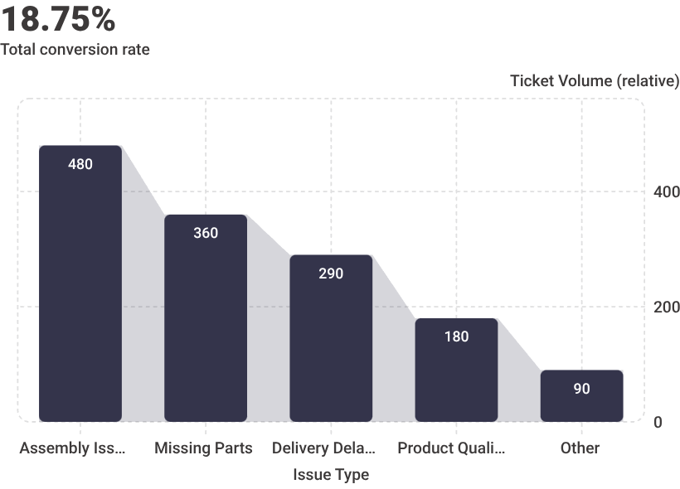
The Support Ticket Surge: 24% YoY Increase
Root Causes
Assembly issues, missing parts, and delivery delays dominate the complaint pipeline — yet the current model remains entirely reactive.
Reactive support drains resources without addressing root causes. Mining FAQs from tickets can surface the top recurring issues and drive proactive fixes.

Slide 5

CHAPTER
Strategic Opportunity Areas
Five actionable initiatives to reverse the retention crisis and rebuild customer loyalty.

Slide 6
Post-Purchase Engagement: Capture Insights, Drive Loyalty
Structured Follow-Ups
Feedback Assessment
Retention Campaigns
Implement follow-up calls and after-sales surveys within 30 days of purchase
Measure product performance, pain points, and overall purchase experience
Design targeted re-engagement campaigns grounded in real customer feedback

Slide 7

Support Optimization: Self-Help at Scale
Develop video tutorials and self-help guides for assembly and common issues
Reduce ticket volume and improve first-contact resolution rates
Lower operational costs while measurably improving customer satisfaction
Shifting to a self-service model can deflect up to 40% of inbound support volume, freeing agents for complex cases.

Slide 8
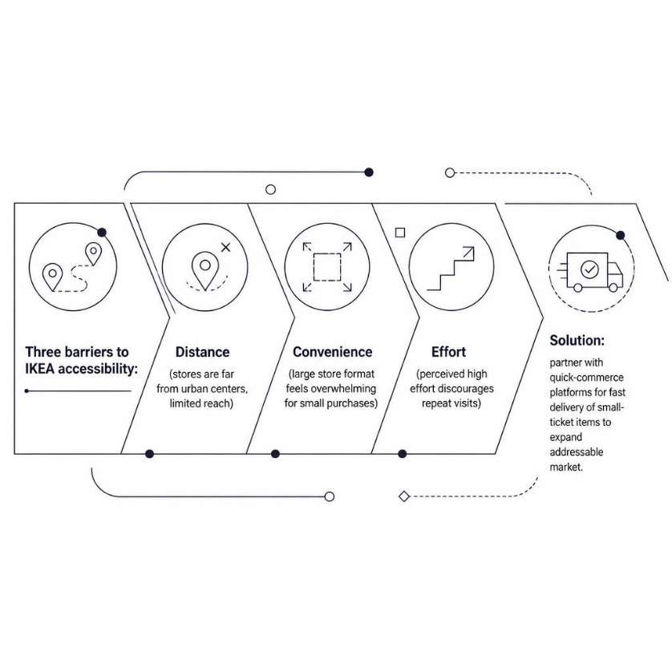
Accessibility & Quick-Commerce Expansion
Reducing Friction, Expanding Reach
Survey store reach and identify convenience barriers across urban markets
Partner with quick-commerce platforms for small-ticket, fast-delivery items
Reduce perceived effort and expand the addressable customer base

Slide 9
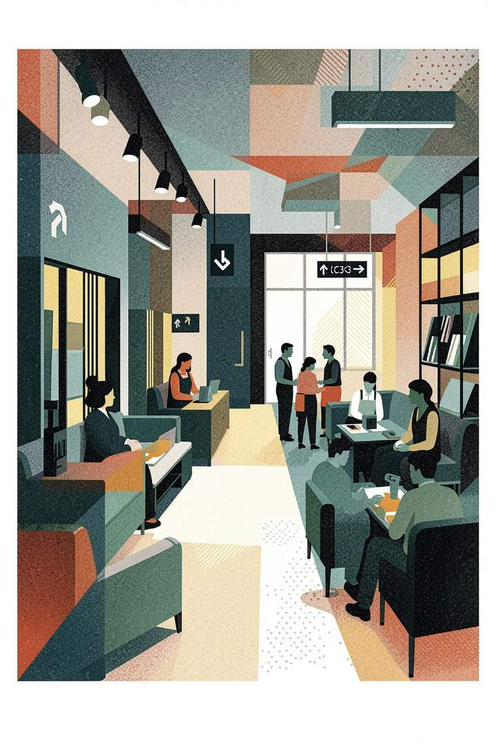
In-Store Experience Audit: Comfort Drives Conversion
Exit Survey Deep-Dive
Formally analyze existing exit survey data to identify and rank top in-store pain points
Amenity Evaluation
Assess staff guidance, water stations, seating, washrooms, and baby-care facilities
Operational Improvements
Recommend targeted fixes for navigation clarity and physical comfort to boost dwell time and conversion

Slide 10

Pricing & Marketing: Reinforce Value, Attract New Buyers
Launch "Best Price Everyday" campaigns to attract price-conscious first-time customers
Reinforce value perception and sharpen competitive positioning against Pepperfry and Urban Ladder
Align messaging consistently across digital and in-store channels
Consistent value messaging across touchpoints is critical to rebuilding trust and driving the first repeat purchase.

