Slide 1
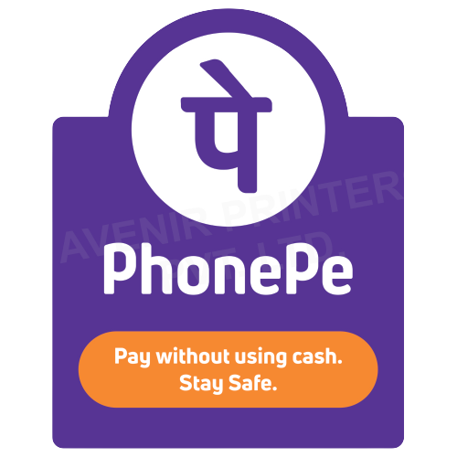
PHONEPE · CASE STUDY
“As a user, I want to split bills so that it is easier.”
REJECTED
A real user story, submitted for a live feature. Here's everything wrong with it.
SWIPE TO SEE WHY →
PHONEPE CASE STUDY | AADESH DHIKALE

Slide 2
PHONEPE · CASE STUDY
Three teams walked in with three different features.
🧩
⚠
No one had framed the problem
Compliance flagged unresolved UPI limits
📏
✍
Engineering wanted scope locked pre-sprint
A junior PM already wrote user stories
There was energy and intent. What was missing was alignment.
PHONEPE CASE STUDY | AADESH DHIKALE

Slide 3
PHONEPE · CASE STUDY
The real problem wasn't ‘no bill-splitting feature.’
TEDIOUS · UNTRACKABLE · NO REMINDERS
JOB TO BE DONE
“When I split an expense with my group, I want to track who's paid, so I don't have to chase anyone.”
Especially for 18–35-year-olds splitting rent, trips, and dining with the same group, again and again.
PHONEPE CASE STUDY | AADESH DHIKALE

Slide 4
PHONEPE · CASE STUDY
A good user story sits between ‘too vague’ and ‘too much.’
TOO VAGUE
READY FOR DEV
“As a user, I want to split bills so that it is easier.”
“As a user, I want a bill-split feature in the app so I can divide expenses easily and accurately within a group.”
No persona
No clear outcome
Not testable
ACCEPTANCE CRITERIA
Given a bill ≤ ₹50,000
When >1 person is included
Then it splits accurately
PHONEPE CASE STUDY | AADESH DHIKALE

Slide 5
PHONEPE · CASE STUDY
Alignment before requirements. Requirements before code.
Partial payments, deep UPI sync, and AI-based suggestions all got pushed to later releases — not because they're bad ideas, but because they weren't the problem in front of us.
What's the worst user story you've ever had to rewrite?
PHONEPE CASE STUDY | AADESH DHIKALE

